Slide 1
CS4101 嵌入式系統概論 DAC and PWM
Prof. Chung-Ta King
Department of Computer Science
National Tsing Hua University, Taiwan

Slide 2
Outline
Introduction to digital-to-analog converter (DAC)
Pulse-width modulation (PWM)
Introduction to stepper motor

Slide 3
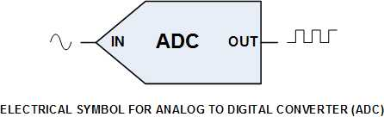
ADC
We have learned that we can quantify a nature value by ADC.
We can also transform digital value into analog signals, e.g. control motors, generate sounds, ...
Analog signal
Digital signal
Analog signal
DAC
Binary input
IN
OUT

Slide 4
Digital-to-Analog Converter (DAC)
DAC converts digital values into analog signals by producing different proportions of voltage according to the binary input.
Voltage can be generated by modifying different resistors
V_{ref}
V₁
R
V₂
2R
I
Rf
V₃
4R
-
V_{out}
+
V_{n}
2^{n-1}R
MSB
LSB
(D. Hinckley, L. Huynh, D. Kim)
Notes:
inverting summer Op Amp circuit

Slide 5


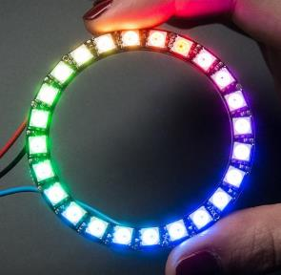
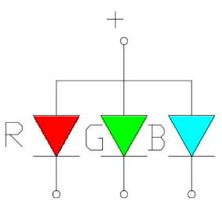
DAC Example – RGB LED
If we give LED more power, it will be brighter. So we can use this feature to intensify Red, Blue and Green diode through a DAC.

Slide 6
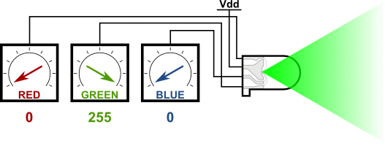
RGB LED Animation
Reference : Matthew Beckler's Home Page (https://www.mbeckler.org/microcontrollers/rgb_led/)

Slide 7
Outline
Introduction to digital-to-analog converter (DAC)
Pulse-width modulation (PWM)
Introduction to stepper motor

Slide 8
Pulse-width Modulation (PWM)
We can use DAC to control the output voltage, but this usually requires an additional chip.
Pulse-width modulation (PWM) provides the ability to simulate varying levels of outputs. Thus, we can use PWM to convert digital signals into analog intensities without DAC.

Slide 9
Pulse-width Modulation
A PWM signal:
Different duty cycles imply different average power.
Duty Cycle = (PW/T) * 100%, where PW is pulse width time and T is total period of a signal.
Ex.: A 90% duty cycle means the signal is high 90% of the time and low 10% of the time.

Slide 10
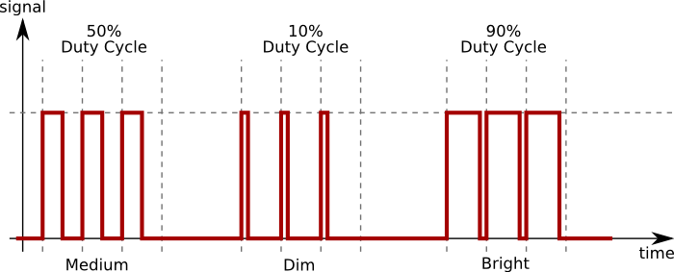
Example of Duty Cycle
If high voltage = 5 V and duty cycle = 10%, then the average output voltage = 0.5 V

Slide 11
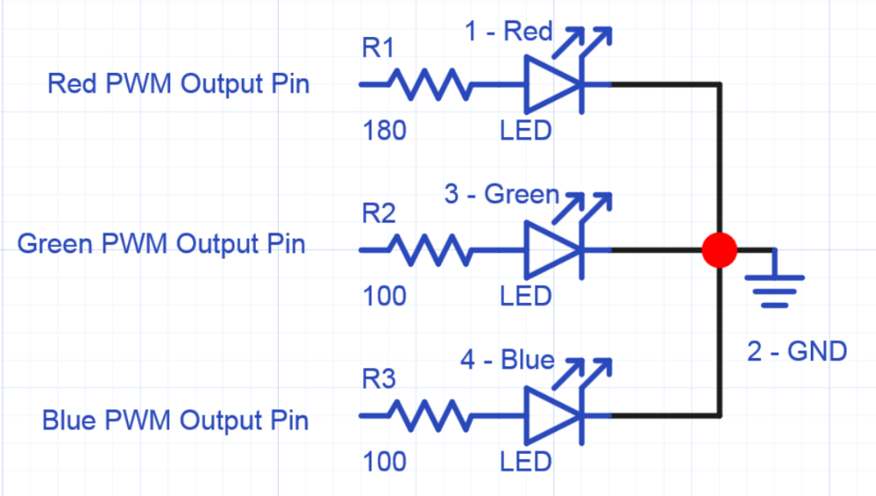
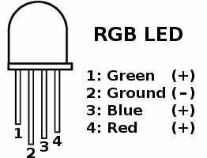
PWM for Driving RGB LED
(https://developer.mbed.org/users/4180_1/notebook/rgb-leds/)
(https://www.pjrc.com/teensy/rgb_led.gif)

Slide 12
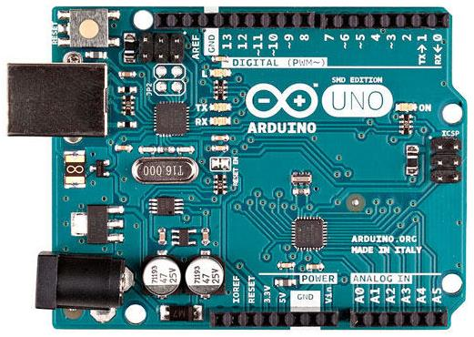
PWM in Arduino
6 pins, 3, 5, 6, 9, 10, 11, marked by ~ can produce PWM output via analogWrite(pinNumber, dutyCycle)

Slide 13
PWM in Arduino - analogWrite()
analogWrite(pin, value)
Writes an analog value (PWM wave) to a pin.
Value specifies the duty cycle between 0 (always off) and 255 (always on).
Pin will generate a steady square wave of the specified duty cycle until the next call to analogWrite().
The frequency of the PWM signal on most pins is approximately 490 Hz.
On Arduino UNO, pins 5 and 6 have a frequency of approximately 980 Hz.
Notes:
http://garretlab.web.fc2.com/en/arduino/inside/arduino/wiring_analog.c/analogWrite.html

Slide 14
Outline
Introduction to digital-to-analog converter (DAC)
Pulse-width modulation (PWM)
Introduction to stepper motor

Slide 15
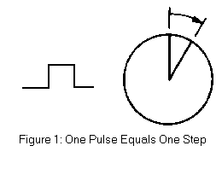

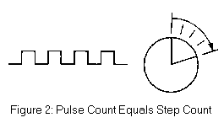
Stepper Motor
An electromagnetic device that
Converts digital pulses into mechanical shaft rotation
Ex. analog clock
Precision
Determined primarily by the number of steps per revolution
(coecsl.ece.illinois.edu/ge423/sensorprojects/StepMotor.ppt)

Slide 16
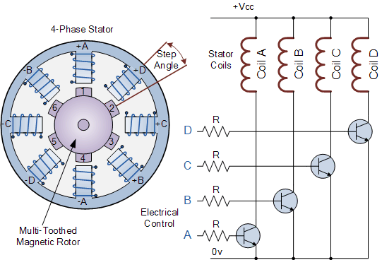
Stepper Motor
Controlled by a series of electromagnetic coils
The coils are alternately given current.
The creating magnetic fields will repulse or attract the magnets on the shaft, causing the motor to rotate.
(http://www.electronics-tutorials.ws/io/io_7.html)

Slide 17
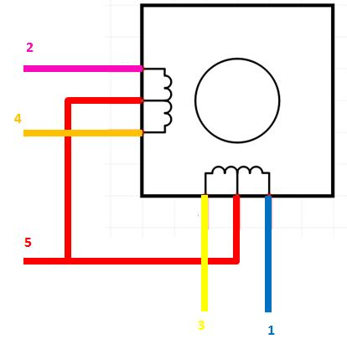
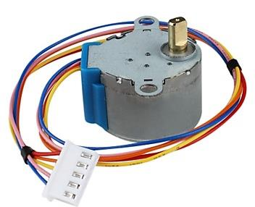
Example Stepper Motor: 28BYJ-48
Number of phases: 4
Step angle:
8-step sequence: 5.625° (64 steps per revolution)
4-step sequence: 11.25° (32 steps per revolution)
Gear reduction ratio: 1/64
32*64 = 2048 steps per revolution in 4-step sequence

Slide 18
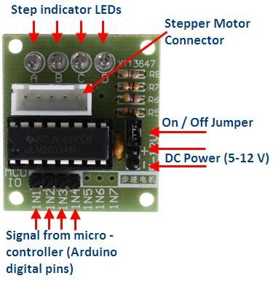
Stepper Motor Driver
The output voltage provided by Arduino UNO cannot drive 28BYJ-48.
So we need to use an amplifier, ULN2003, to raise the output voltage.
4 LEDs indicate which coil is currently powered

Slide 19
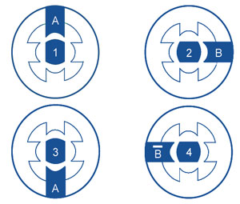
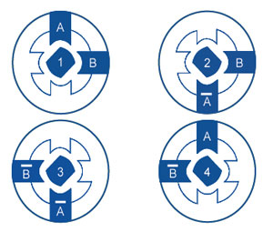
Drive Methods
Different drive methods for stepper motors.
Different methods cause different shakiness, power consumption and accuracy.
1-phase excitation
2-phase excitation

Slide 20
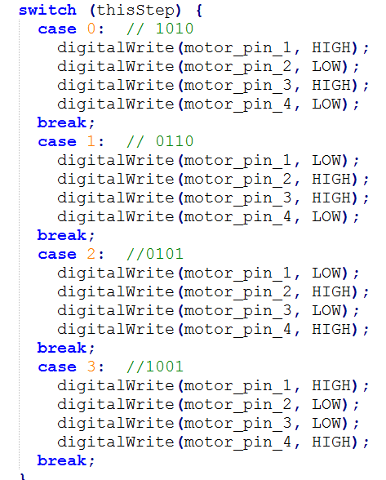
Stepper.c
Arduino stepper library uses 2-phase excitation to rotate the motor.

Slide 21
Sample Code for Stepper Motor
#include <Stepper.h>
// change this to the number of steps on your motor
#define STEPS 100
// create an instance of the stepper class, specifying # of steps of the motor and the pins it is attached to
Stepper stepper(STEPS, 8, 9, 10, 11);
// the previous reading from the analog input
int previous = 0;
void setup() {
stepper.setSpeed(30); // set the speed to 30 RPMs
}

Slide 22
Sample Code for Stepper Motor
void loop() {
// get the sensor value from analog input A0
int val = analogRead(A0);
// move a number of steps equal to the change in the
// sensor reading
stepper.step(val - previous);
// remember the previous value of the sensor
previous = val;
}

