Slide 1
CS4101 嵌入式系統概論
Arduino UNO
Prof. Chung-Ta King
Department of Computer Science
National Tsing Hua University, Taiwan

Slide 2
Outline
Introduction to Arduino UNO
Programming environment setup
GPIO
Interrupt and timers

Slide 3
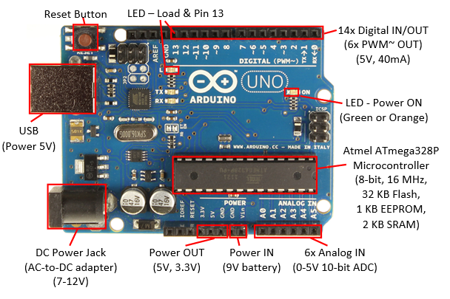
Arduino UNO
https://www.ntu.edu.sg/home/ehchua/programming/arduino/Arduino.html

Slide 4
Arduino UNO Board
Atmel ATmega328P 8-bit Microcontroller
  32KB of Flash memory for application programs, 2KB of SRAM, and 1KB of EEPROM for non-volatile data
  Clock speed is 16MHz
USB Port
  Communication to the computer and power supply
Power IN
  Can be from USB (5V), DC power jack (7-12V via AC-to-DC adapter), or VIN/Ground PIN (7-12V via 9V battery)
Power OUT
  Board output regulated 5V and 3.3V (50mA) for powering external components

Slide 5
Arduino UNO Board
14x digital I/O pins (numbered from 0 to 13):
  pinMode(pinNumber, INPUT|OUTPUT) to configure the pin for input or output
  digitalRead(pinNumber) or digitalWrite(pinNumber, value) to read or write
  Pin 13: connected to a built-in LED
  PWM output: 6 pins 3, 5, 6, 9, 10, 11, marked by ~ can produce PWM (Pulse Width Modulated) output via analogWrite(pinNumber, dutyCycle)
6x analog input pins (A0 to A5):
  Each pin can measure between 0 to 5V with 10-bit of resolution
Notes:
Each pin operates at 5V and can provide or receive a maximum of 40mA.
PWM: With duty cycle between 0 (off) to 255 (on) and frequency of 980 Hz on pins 5 and 6 and 490 Hz for other pins
The PWM square wave at various duty cycles can be used to simulate "analog" output (e.g., to control the brightness of LED or speed of motor).
ADC: The upper range can be changed using the AREF pin and analogReference() function

Slide 6
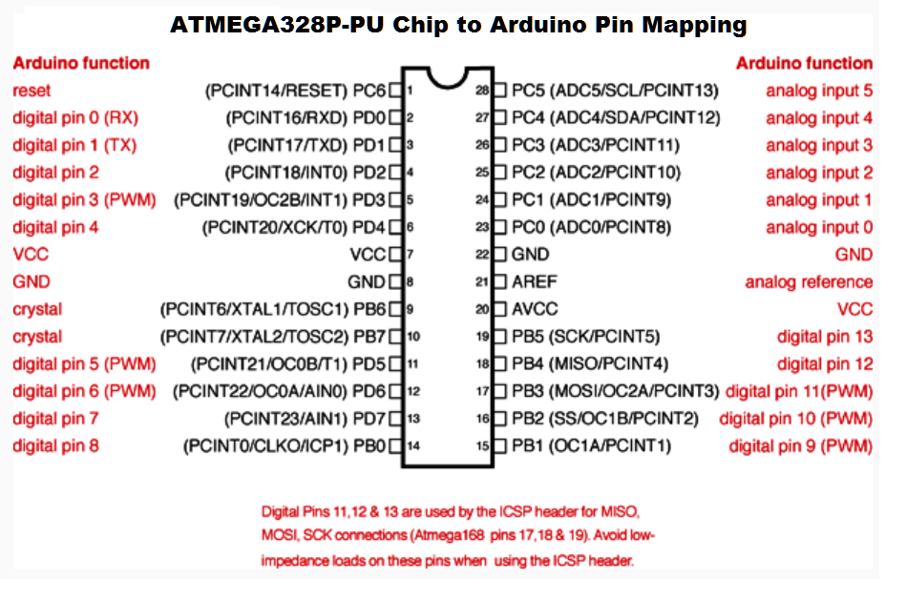
Atmel ARV Atmega 328P
http://www.instructables.com/file/F2SFHSDH3Z3V3P4/

Slide 7
Atmel ARV Atmega 328P
(ATmega328/P Datasheet Summary)

Slide 8
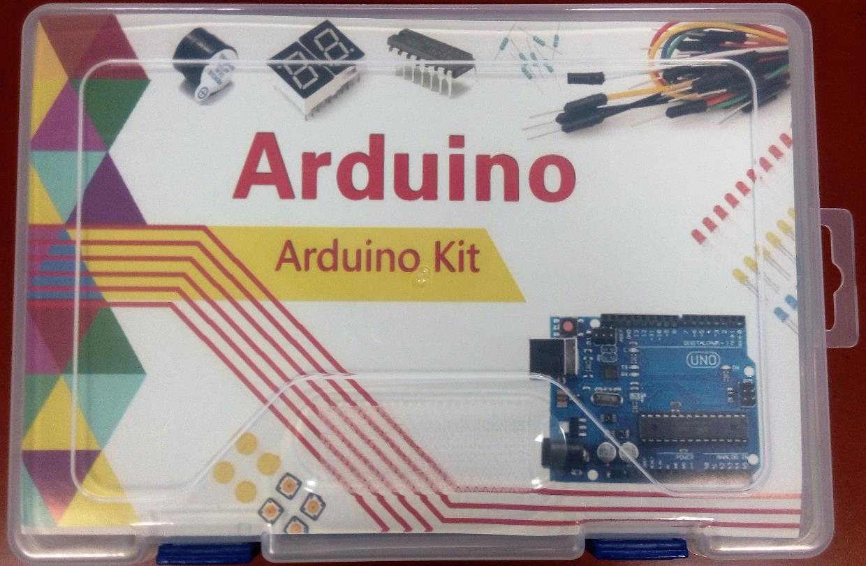
Arduino Kit

Slide 9
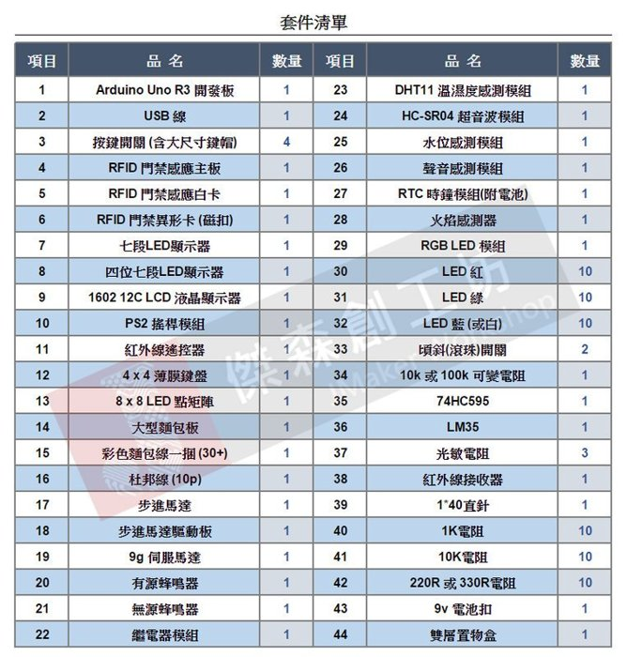
Arduino Kit

Slide 10
Outline
Introduction to Arduino UNO
Programming environment setup
GPIO
Interrupt and timers

Slide 11
Getting Started
Check out: http://arduino.cc/en/Guide/HomePage
  Download and install the Arduino environment (IDE)
  Connect the board to your computer via the UBS cable
  Install the drivers
  Reboot
  Launch the Arduino IDE
  Select your board
  Select your serial port
  Develop your program
  Upload the program

Slide 12
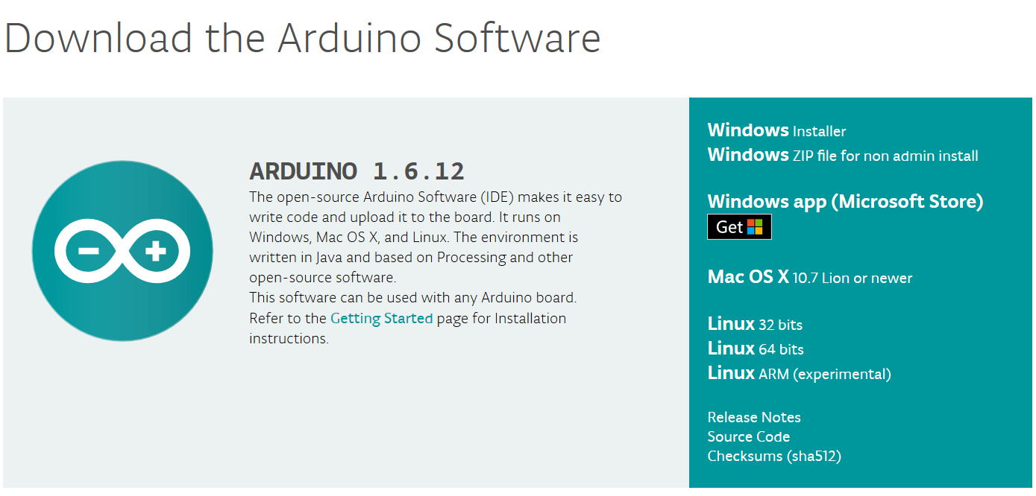
Download Arduino IDE
Download at
  https://www.arduino.cc/en/Main/Software
No need to install after decompressing
按此下載

Slide 13
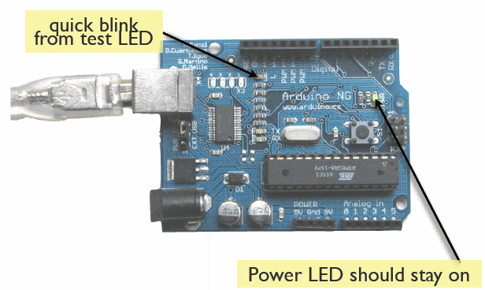
Connect the USB Cable
(todbot.com/blog/bionicarduino)

Slide 14
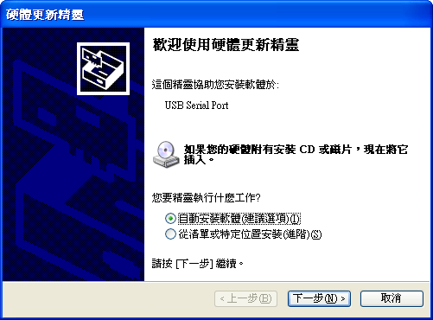
Install the Drivers
After connecting the Arduino to your computer

Slide 15
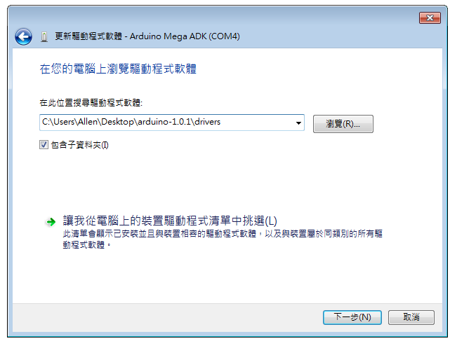
Install the Drivers

Slide 16
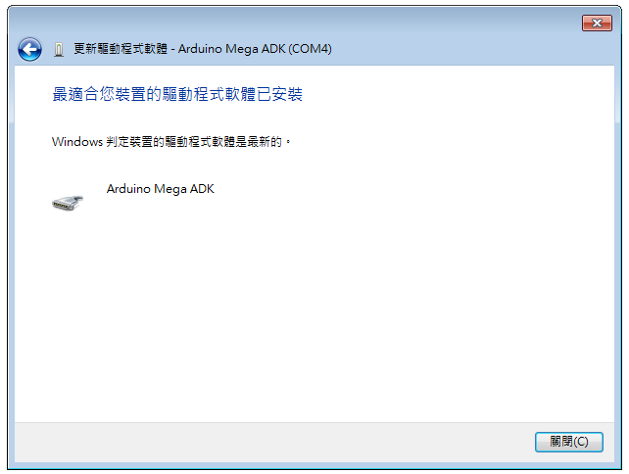
Install the Drivers

Slide 17
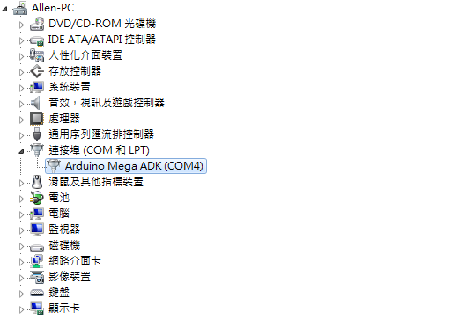
Install the Drivers
到裝置管理員(我的電腦右鍵選擇管理)確認驅動程式已安裝完成

Slide 18
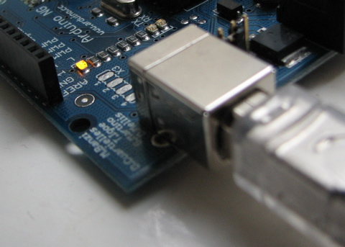
Reboot
Unplug the USB wire and then plug back in
Make sure the LED on Arduino is on again

Slide 19
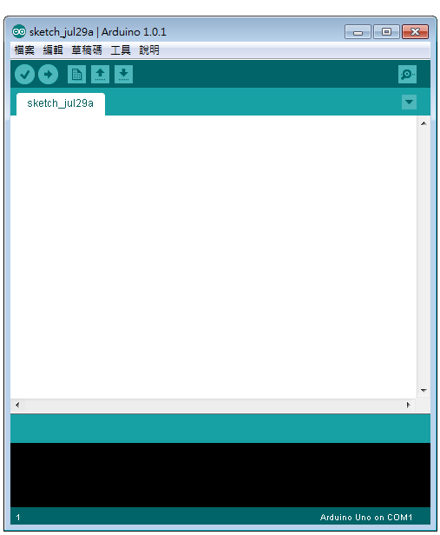
Arduino IDE
 | New (new a file) Open a blank page to write the code
 | Open (open an exiting file) Open the project file (.pde)
 | Save (save file)
 | Verify/Compile
 | Upload to I/O Board Load the compiled program into the Arduino board
 | Serial Monitor Monitor the input/output data

Slide 20
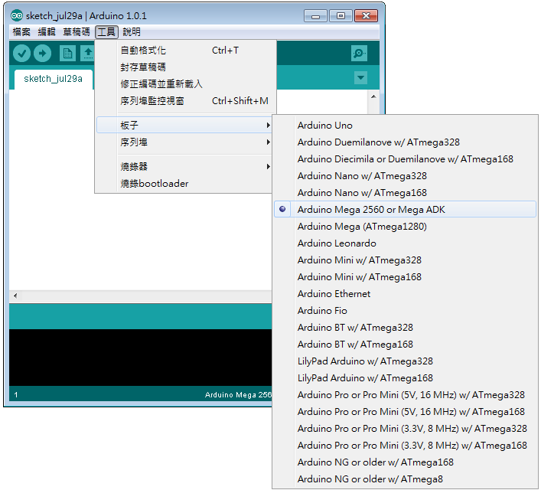
Arduino IDE
Click Tools>Board> to choose board (Arduino UNO)

Slide 21
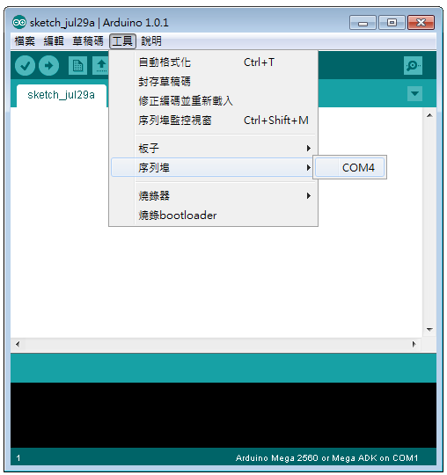
Arduino IDE
Click Tools > Serial Port to select the correct COM port

Slide 22
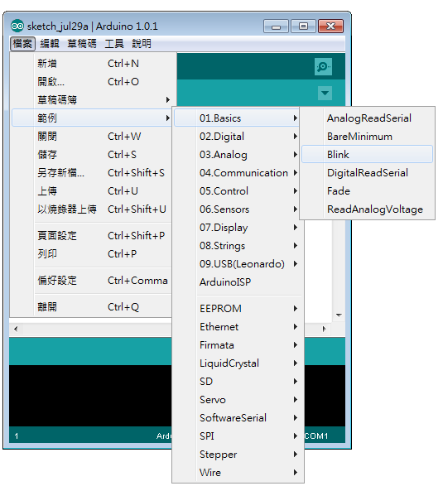
Arduino IDE
Sample code:
File>Examples

Slide 23
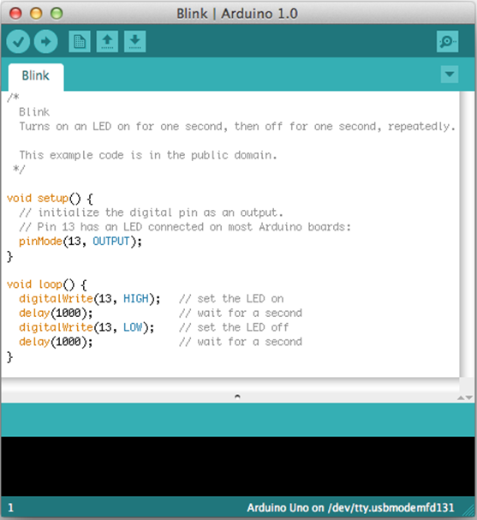
Sample Code: Blink
Click "Verify" (or "Sketch" menu ⇒ "Verify/Compile"; or Ctrl-R) to compile code
Click "Upload" button (or "File" menu ⇒ "Upload"; or Ctrl-U) to upload code onto Arduino board
  Should see a small light beside Pin 13 blinking (in orange)

Slide 24
Arduino C Programs
Arduino calls these “sketches”
  Basically C with libraries
Program structure
  Header: declarations, includes, etc.
  setup(): initialization; executes once when program starts
  loop(): continuously re-executed when the end is reached

Slide 25
Outline
Introduction to Arduino UNO
Programming environment setup
GPIO
Interrupt and timers

Slide 26
GPIO
Output
Digital(on/off, HIGH/LOW, 0,1)
Light
LED
Sound
Piezo
Movement
Standard Servo Motor
Continuous Rotation Servo Motor
Wind
Fan
Analog(0-255)
Light
LED-Light Intensity
RGB LED

Slide 27
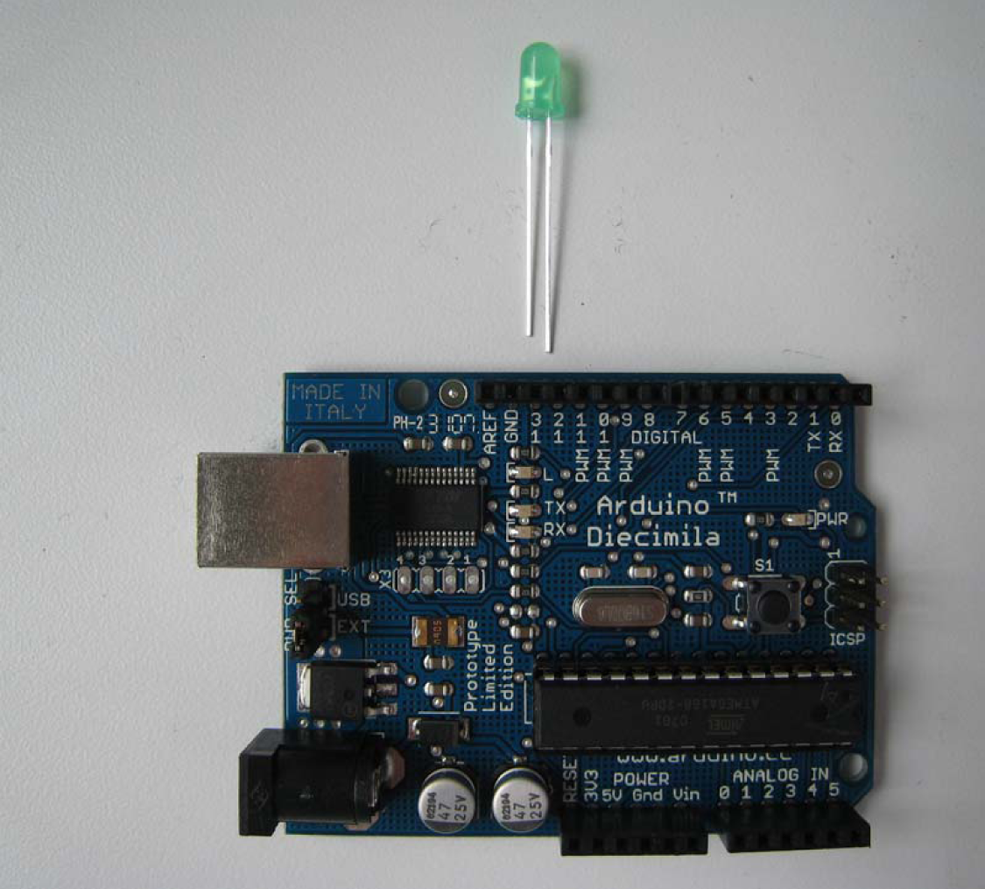
Arduino Digital I/O
Digital pins:
  Each pin operates at 5V and can provide or receive a maximum of 40 mA
  Writing HIGH to an input pin installs a 20KΩ pullup

Slide 28
Useful Digital I/O Functions
pinMode(pin, mode)
  Sets pin to either INPUT or OUTPUT
digitalRead(pin)
  Reads HIGH or LOW from a pin
digitalWrite(pin, value)
  Writes HIGH or LOW to a pin
  Code in /arduino/cores/arduino/wiring_digital.c
Notes:
27

Slide 29
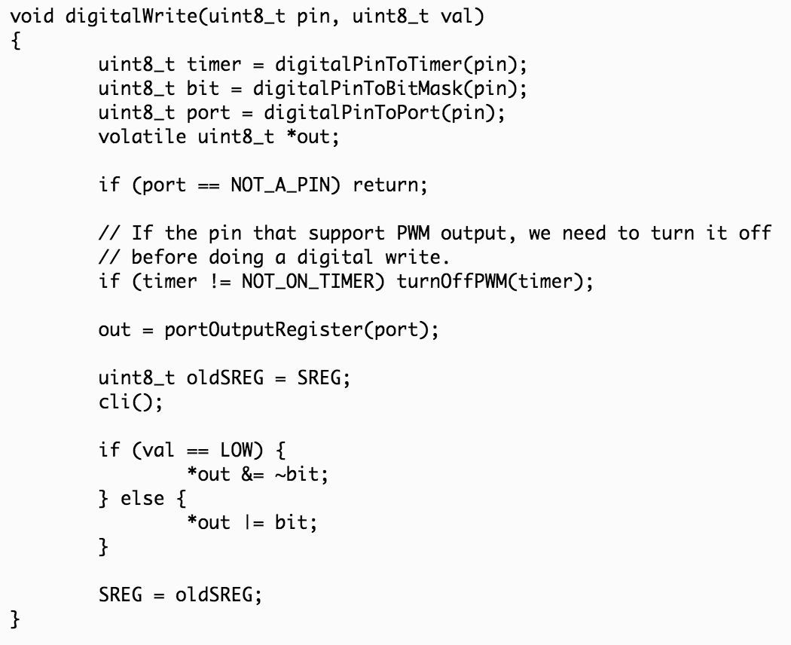
digitalWrite(pin, value)
Notes:
http://garretlab.web.fc2.com/en/arduino/inside/arduino/wiring_digital.c/digitalWrite.html

Slide 30
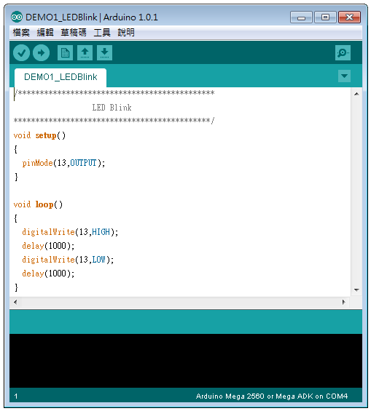
Program Template
This function is executed only once after the program is started
Generally used in initializaing parameters
This function performs the main operations of the program
Never stop until the power is turned off or reset is pressed

Slide 31
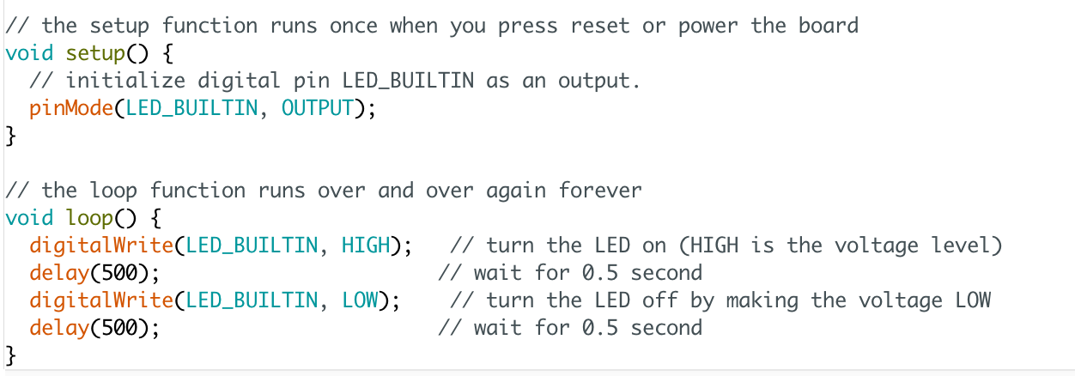
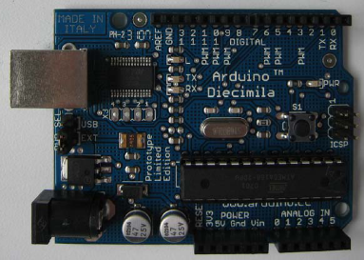
Sample Code 1 for LED
Flash the on-board LED at 1Hz

Slide 32
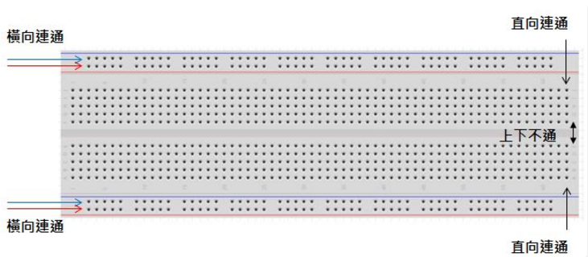
Breadboard

Slide 33
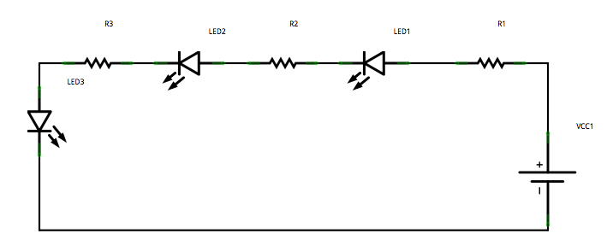
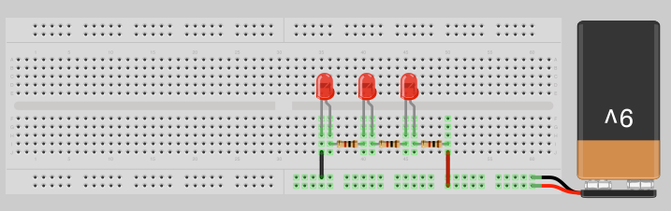
Serial LED Connection

Slide 34
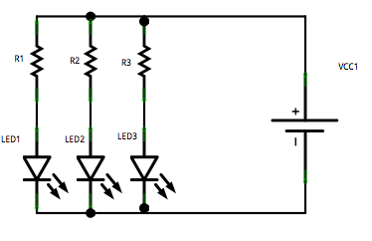
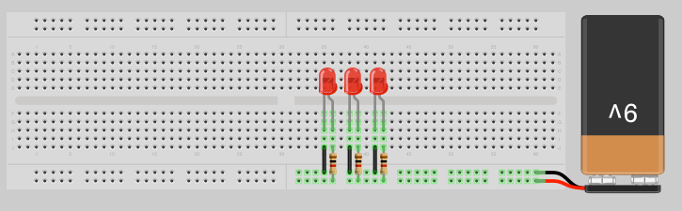
Parallel LED Connection

Slide 35
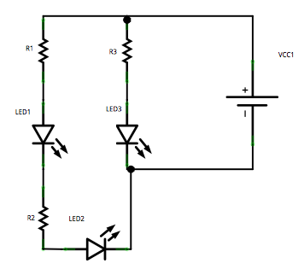
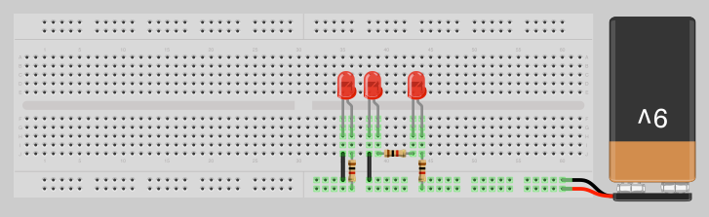
Parallel and Series LED Connection
Notes:
Find a good explanation or modify the circuit to be more visual.

Slide 36
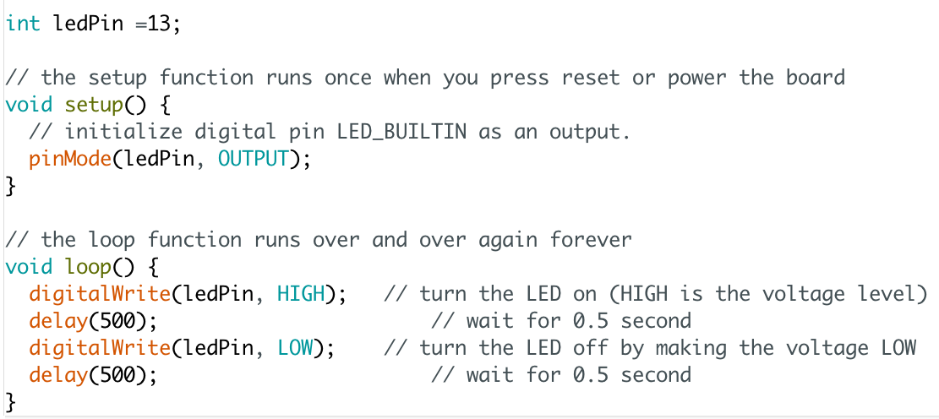
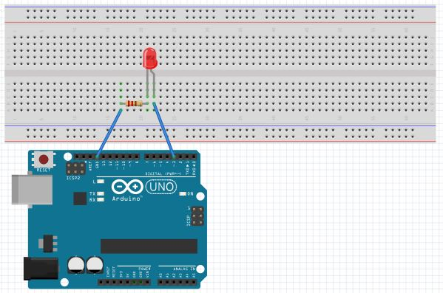
Sample Code 2 for LED
Flash the LED connected to digital pin 13 at 1 Hz
Notes:
圖連接到的是pin3 這可以在程式裡改 把output pin改成3即可

Slide 37
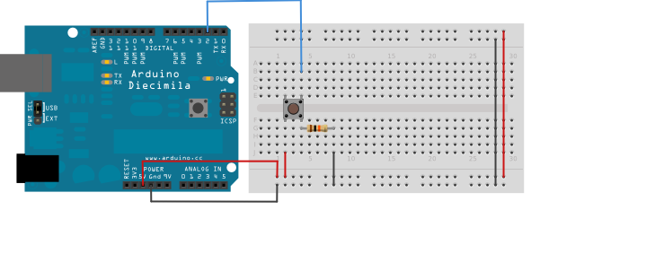
Sample Code 3 for Button and LED
int button_pin = 2; // pin to read the button
int led_pin = 13;
void setup() {
pinMode(button_pin, INPUT);
pinMode(led_pin, OUTPUT);
}
void loop() {
int button;
button = digitalRead(button_pin);
if (button == HIGH) {
digitWrite(led_pin, HIGH);
} else {
digitWrite(led_pin, LOW);
}
}
Notes:
Turn on the LED when Button pressed

Slide 38
Outline
Introduction to Arduino UNO
Programming environment setup
GPIO
Interrupt and timers

Slide 39
Sources of Interrupts
Interrupts can be generated from several sources:
  Timer interrupts from one of the Arduino timers, which interrupt us once per several milliseconds
  External interrupts from a change in state of one of the external interrupt pins
  Pin-change interrupts from a change in state of any one of a group of pins
Interrupt programming:
  ISR(vector): interrupt routine definition
  reti(): return from interrupt, automatically generated for ISR

Slide 40
ATmega328 Interrupts

Slide 41
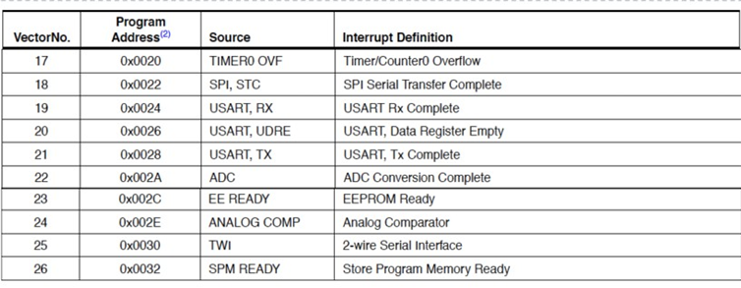
ATmega328 Interrupts (cont.)

Slide 42
ISRs
#define INT0_vect _VECTOR(1) /* External Interrupt Request 0 */
#define INT1_vect _VECTOR(2) /* External Interrupt Request 1 */
#define PCINT0_vect _VECTOR(3) /* Pin Change Interrupt Request 0 */
#define PCINT1_vect _VECTOR(4) /* Pin Change Interrupt Request 0 */
#define PCINT2_vect _VECTOR(5) /* Pin Change Interrupt Request 1 */
#define WDT_vect _VECTOR(6) /* Watchdog Time-out Interrupt */
#define TIMER2_COMPA_vect _VECTOR(7) /* Timer/Counter2 Compare Match A */
#define TIMER2_COMPB_vect _VECTOR(8) /* Timer/Counter2 Compare Match A */
#define TIMER2_OVF_vect _VECTOR(9) /* Timer/Counter2 Overflow */
#define TIMER1_CAPT_vect _VECTOR(10) /* Timer/Counter1 Capture Event */
#define TIMER1_COMPA_vect _VECTOR(11) /* Timer/Counter1 Compare Match A */
#define TIMER1_COMPB_vect _VECTOR(12) /* Timer/Counter1 Compare Match B */
#define TIMER1_OVF_vect _VECTOR(13) /* Timer/Counter1 Overflow */
#define TIMER0_COMPA_vect _VECTOR(14) /* TimerCounter0 Compare Match A */
#define TIMER0_COMPB_vect _VECTOR(15) /* TimerCounter0 Compare Match B */
... ...

Slide 43
Arduino Timers and Timer Interrupts
Arduino Uno has 3 timers that count at some frequency derived from the 16MHz system clock:
Timer0: An 8 bit timer used by Arduino functions delay(), millis() and micros()
Timer1: A 16 bit timer used by the Servo() library
Timer2: An 8 bit timer used by the Tone() library
Clock divisor: configured to alter the frequency and various different counting modes
Timers can be configured to generate interrupts when they overflow or reach a specific count

Slide 44
Timer0
8-bit timer using a clock divisor of 64 by default to give an interrupt rate of 976.5625 Hz (close to 1 KHz)
Arduino timers have a number of configuration registers, which can be read or written to using special symbols defined in the Arduino IDE
  Ex.: use a comparison register OCR0A
  On every tick, the timer counter is compared with the comparison register and when they are equal an interrupt will be generated

Slide 45
Timer Functions
Blocking: delay(ms)
  Wait for ms milliseconds before continuing
  Ex: delay(1000);
Non-Blocking: unsigned long millis()
  Returns the number of milliseconds since the current program started
  Ex: time = millis();
Blocking functions prevent a program from doing anything else until that task has completed
  Using delay() will make your program slow

Slide 46
Timer0 Registers
TCNT0 – Timer/Counter Register (8-bit)
OCR0A – Output Compare Register A
OCR0B – Output Compare Register B
TCCR0A/B – Timer/Counter Control Registers
  Prescale the timer frequency
  Select the clock source
  Set timer mode: normal, CTC, etc.
TIMSK0 – Timer/Counter Interrupt Mask Register
  Timer overflow interrupt; compare A&B interrupts
TIFR0 – Timer/Counter Interrupt Flag Register
  Timer overflow interrupt; compare A&B interrupts
Notes:
We can change the Timer behavior through the timer register
TCNT: 儲存要 count 的 value

Slide 47
Timer/Counter Control Registers
TCCR0A: Timer/Counter Control Register A
TCCR0B: Timer/Counter Control Register B
TIFR0: Timer/Counter Interrupt Flags
  TOV0: Timer Overflow flag
  OCF0A/B: Compare A/B interrupt flag

Slide 48
Clock Source Select (CS0[2:0])
TCCR0B |= (1<<CS01) | (1<<CS00); // 64 prescaler

Slide 49
Normal Mode (0)
Timer increments
Wraps around at TOP = 0xFF
Starts again at 0
TOV0 interrupt flag set when TCNT0 reset to 0
Useful for generating interrupts every N time units
Useful for generating an interrupt in N time units
Set TCNT0 to an initial value (255 – N)

Slide 50
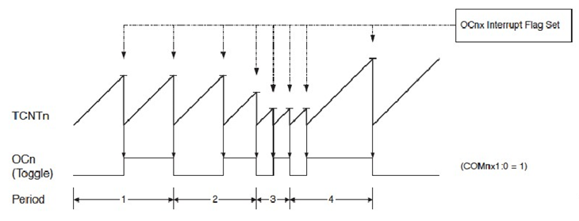
CTC (Clear Timer on Compare) Mode (2)
Timer increments and wraps around at OCR0A
  OCR0A defines top value of counter
Starts again at 0
OCF0A interrupt flag set when TCNT0 reset to 0
  Pin OC0A can be made to toggle when counter resets
  Can generate output waveform

Slide 51
Mode Summary
TCCR0A |= (1 << WGM01); // set CTC mode for timer0

Slide 52
Sample Code 4 for Timer1
Flash the LED connected to pin 13 at 1 Hz using CTC mode by polling timer interrupt flag
void setup() {
pinMode(13, OUTPUT);
// initialize timer1
noInterrupts(); // disable all interrupts
TCCR1A = 0; TCCR1B = 0; TCNT1 = 0;
OCR1A = 7812; // target for counting
TCCR1B |= (1 << WGM12); // turn on CTC
TCCR1B |= (1<<CS12) | (1<<CS10); // 1024 prescaler
interrupts(); // enable all interrupts
}
void loop() {
if (TIFR1 & (1<<OCF1A)) { // wait for time up
digitalWrite(13, digitalRead(13) ^ 1);
TIFR1 &= ~(1 << OCF1A); } // clear overflow flag
}

Slide 53
Input Capture
Event on input causes:
  Counter value (TCNT1) written to ICR1 → time-stamp
  Interrupt flag ICF1 to be set, causing an interrupt

Slide 54
Arduino External Interrupts
Two digital pins can be used for external interrupts
  INT0 is mapped to Pin2
  INT1 is mapped to Pin3
  Other pins can be monitored by pin change interrupts
Functions for external interrupts:
  attachInterrupt(interrupt, function, mode)
    interrupt: 0 or 1 for INT0 or INT1
    function: interrupt function to call
    mode: LOW, CHANGE, RISING, FALLING
  detachInterrupt(interrupt)
  interrupts( ): enable interrupts: sei( )
  noInterrupts( ): disable interrupts: cli( )

Slide 55
Mode in attachInterrupt()
LOW:
  Trigger the interrupt whenever the pin is low
CHANGE:
  Trigger the interrupt whenever the pin changes value
RISING:
  Trigger when the pin goes from low to high
FALLING:
  Trigger when the pin goes from high to low

Slide 56
Sample Code 5 for Interrupt
Flash the LED connected to pin 13 at 1 Hz using CTC mode by interrupt routine
int toggle;
void setup() {
pinMode(13, OUTPUT);
cli(); // stop interrupts
// initialize timer1
TCCR1A = 0; TCCR1B = 0; TCNT1 = 0;
OCR1A = 7812; // target for counting
TCCR1B |= (1 << WGM12); // turn on CTC
TCCR1B |= (1<<CS12) | (1<<CS10); // 1024 prescaler
TIMSK1 |= (1<<OCIE1A); // enable timer compare int.
sei(); // enable all interrupts
}
Check page 45 for timer registers

Slide 57
Sample Code 5 for Interrupt
ISR(TIMER1_COMPA_vect) { // Timer1 ISR
if (toggle) {
digitalWrite(13, HIGH);
toggle = 0 ;
} else {
digitalWrite(13, LOW);
toggle = 1;
}
}
void loop() {
...
}
Check page 41 for interrupt vectors

Slide 58
Sample Code 6 for Interrupt
Button click switches LED; button connected to pin 2
int led_pin = 13;
int button_int = 0; // INT0 is on pin 2
int toggle_on = false; // Button click switches LED
void setup() {
attachInterrupt(button_int, handle_click, RISING);
// Register handler
}
void loop() {
if (toggle_on) {
digitWrite(led_pin, HIGH);
} else {
digitWrite(led_pin, LOW);
}
}

Slide 59
Sample Code 6 for Interrupt
void handle_click() { // debouncing and toggle
static unsigned long last_int_time = 0;
unsigned long int_time = millis(); // Read the clock
if (int_time - last_int_time > 200 ) {
// Ignore when < 200 msec
toggle_on = !toggle_on; // switch LED
}
last_int_time = int_time;
}

