Slide 1
CS4101 嵌入式系統概論
Low-Power Optimization
Prof. Chung-Ta King
Department of Computer Science
National Tsing Hua University, Taiwan
(Materials from MSP430 Microcontroller Basics, John H. Davies, Newnes, 2008)

Slide 2
Introduction
Why low power?
  Portable and mobile devices are getting popular, but they have limited power sources, e.g., battery
  Energy conservation for our planet
  Power generates heat → low carbon
Power optimization becomes a new dimension in system design, besides performance and cost
MSP430 provides many features for low-power operations, which will be discussed later

Slide 3
Outline
Introduction to low-power optimizations
Low-power design in MSP430

Slide 4

Energy and Power
Energy: ability to do work
  Most important in battery-powered systems
Power: energy per unit time
  Important even in wall-plug systems---power becomes heat
Power increases
with…
  Vcc
  Clock speed
  Temperature

Slide 5
Efforts for Low Power
Device/transistor level
  Development of low power devices
  Reducing power supply voltage
  Reducing threshold voltage
Circuit level
  Clock gating, frequency reduction, circuit turned off
  Asynchronous circuits
System level
  Compiler optimization for energy
  OS-directed power management and resource scheduling
Application level
Notes:
4

Slide 6
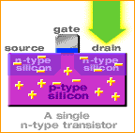
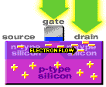
Power Consumption: Transistor Level
Switching consumes power → dynamic power
  Switching slower, consume less power
  Smaller sizes reduce power to operate
Leakage → static power

Slide 7
Power Consumption: Circuit Level
Power consumption of CMOS
circuits (ignoring leakage):
Delay for CMOS circuits:
Decreasing V_{dd} reduces P quadratically, while the execution time of circuits is only linearly increased
Notes:
6

Slide 8
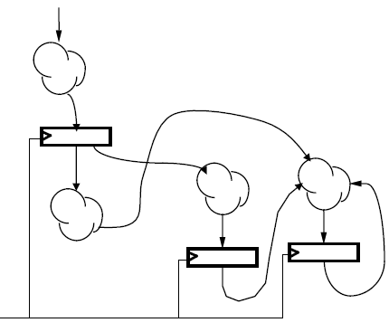
Power Consumption: Circuit Level
Clock gating for synchronous sequential logic:
  Disable the clock so that flip-flops will hold their states forever and the whole circuit will not switch
  → no dynamic power consumed
Still need static power to hold the states
clock

Slide 9
System Level: Compiler
Energy-aware code scheduling
Energy-aware instruction selection
Operator strength reduction: e.g. replace * by + and <<
Standard optimizations with energy as a cost function
R2 = a[0];
for (i = 1; i < 10; i++) {
R1 = a[i];
C = 2 * R1 + R2;
R2 = R1; }
e.g.: register pipelining:
for (i = 1; i < 10; i++)
C = 2 * a[i] + a[i-1];
Notes:
8

Slide 10
System Level: Compiler
First-order optimization:
  high performance = low energy (some exceptions)
Eliminate pipeline stalls (e.g., software pipeline)
Use registers efficiently
Identify and eliminate cache conflicts
Optimize memory access patterns
Moderate loop unrolling eliminates some loop overhead instructions
Inlining procedures may help: reduces linkage, but may increase cache thrashing

Slide 11
System Level: OS
Idle base
  After idle for a period, switch system to sleep mode
Power-aware memory management
  e.g. OS can determine points during execution of an application where memory banks would remain idle, so they can be transitioned to low power modes
Power-aware buffer cache
  Collect disk operations in a cache until the hard drive is running or has enough data

Slide 12
System Level: Cooperative I/O
Time
Idle
Idle
Idle
Idle
Idle
Standby
Idle
Time
Standby
Idle
Standby
Reduces power consumption by batching requests

Slide 13
Outline
Introduction to low-power optimizations
Low-power design in MSP430

Slide 14
General Strategies
Put the system in low-power modes and/or use low-power modules as much as possible
How?
  Provide clocks of different frequencies → frequency scaling
  Turn off clocks when no work to do → clock gating
  Use interrupts to wake up the CPU, return to sleep when done (another reason to use interrupts)
  Switch on peripherals only when needed
  Use low-power integrated peripheral modules in place of software, e.g., move data between modules

Slide 15
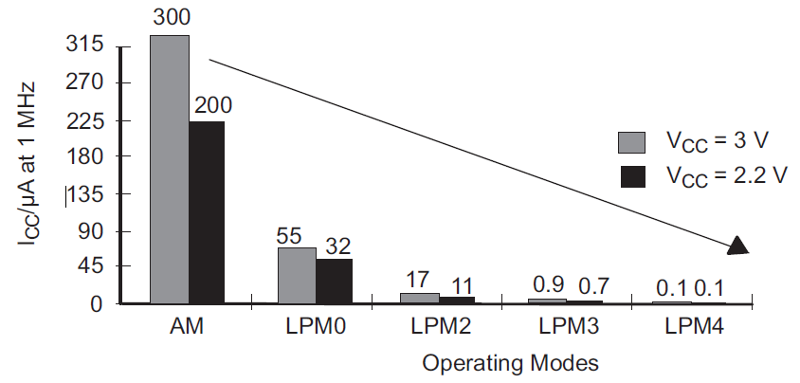
MSP430 Low-Power Modes
Mode | CPU and Clocks
Active | CPU active; all enabled clocks active
LPM0 | CPU, MCLK disabled; SMCLK, ACLK active
LPM1 | CPU, MCLK disabled; DCO disabled if not for SMCLK; ACLK active
LPM2 | CPU, MCLK, SMCLK, DCO disabled; ACLK active
LPM3 | CPU, MCLK, SMCLK, DCO disabled; ACLK active
LPM4 | CPU and all clocks disabled

Slide 16
MSP430 Low Power Modes
Active mode:
  MSP430 starts up in this mode, which must be used when the CPU is required, i.e., to run code
  An interrupt automatically switches MSP430 to active
  Current can be reduced by running at the lowest supply voltage consistent with the frequency of MCLK, e.g. V_{CC} to 1.8V for f_{DCO} = 1MHz
LPM0:
  CPU and MCLK are disabled
  Used when CPU is not required but some modules require a fast clock from SMCLK and DCO
Notes:
Low-power mode 2 or 3 is selected if bits CPUOff and SCG1 in the status register are set. Immediately after the bits are set, CPU, MCLK, and SMCLK operations halt and all internal bus activities stop until an interrupt request or reset occurs.
Peripherals that operate with the MCLK or SMCLK signal are inactive because the clock signals are inactive. Peripherals that operate with the ACLK signal are active or inactive according with the individual control registers and the module enable bits in the SFRs. All I/O port pins and the RAM/registers are unchanged. Wake up is possible byenabled interrupts coming from active peripherals or RST/NMI.

Slide 17
MSP430 Low Power Modes
LPM3:
  Only ACLK remains active
  Standard low-power mode when MSP430 must wake itself at regular intervals and needs a (slow) clock
  Also required if MSP430 must maintain a real-time clock
LPM4:
  CPU and all clocks are disabled
  MSP430 can be wakened only by an external signal, e.g., RST/NMI, also called RAM retention mode

Slide 18
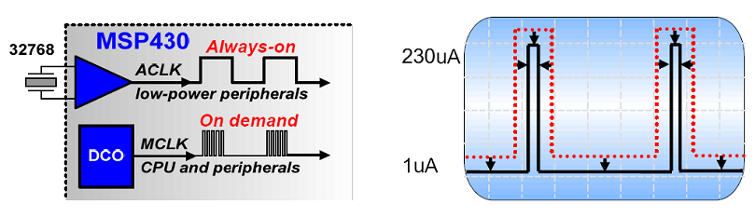
Power Saving in MSP430
The most important factor for reducing power consumption is using the MSP430 clock system to maximize the time in LPM3
“Instant on” clock

Slide 19
Controlling Low Power Modes
Through four bits in Status Register (SR) in CPU
  SCG0 (System clock generator 0): when set, turns off DCO, if DCOCLK is not used for MCLK or SMCLK
  SCG1 (System clock generator 1): when set, turns off the SMCLK
  OSCOFF (Oscillator off): when set, turns off LFXT1 crystal oscillator, when LFXT1CLK is not use for MCLK or SMCLK
  CPUOFF (CPU off): when set, turns off the CPU
  All are clear in active mode

Slide 20
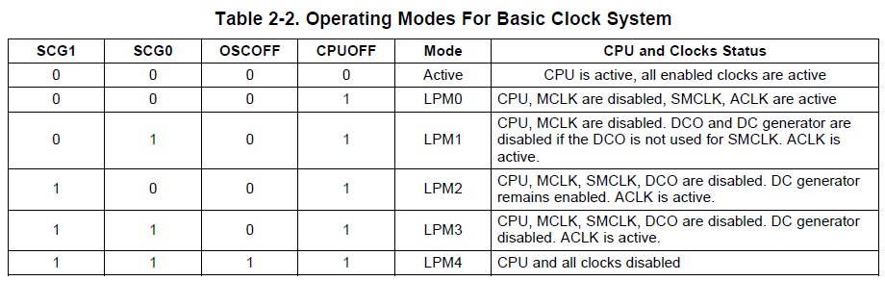
Controlling Low Power Modes
Status bits and low-power modes

Slide 21
Entering/Exiting Low-Power Modes
Interrupt wakes MSP430 from low-power modes:
Enter ISR:
  PC and SR are stored on the stack
  CPUOFF, SCG1, OSCOFF bits are automatically reset
  → entering active mode
  MCLK must be started so CPU can handle interrupt
Options for returning from ISR:
  Original SR is popped from the stack, restoring the previous operating mode
  SR bits stored on stack can be modified within ISR to return to a different mode when RETI is executed

Slide 22
Sample Code 1 for Low Power
void main(void) { //Toggle P1.0 every 50000 cycles WDTCTL = WDTPW + WDTHOLD; // Stop WDT P1DIR |= 0x01; // P1.0 output TA0CCTL0 = CCIE; // CCR0 interrupt enabled TA0CCR0 = 50000-1; TA0CTL = TASSEL_2 + MC_1; // SMCLK, up mode _BIS_SR(LPM0_bits + GIE); // LPM0 w/ interrupt } #pragma vector=TIMERA0_VECTOR __interrupt void Timer0_A (void) { P1OUT ^= 0x01; // Toggle P1.0 }
Use _BIC_SR_IRQ(LPM0_bits)
to exit LPM0

Slide 23
Sample Code 2 for Low Power
Repetitive single conversion:
  Repetitively perform single samples on A1 (pin P1.1) with reference to Vcc
  If A1 > 0.5*Vcc, P1.0 set, else reset.
  Set ADC10SC to start sample and conversion
    But ADC10SC is automatically cleared at end of conversion
  CPU goes to sleep while waiting for the ADC10 conversion and is waken up when ADC10 conversion is done.
  Use ADC10 internal oscillator to time the sample and conversion

Slide 24
Sample Code 2 for Low Power
#include "msp430.h" void main(void) { WDTCTL = WDTPW + WDTHOLD; // Stop WDT // H&S time 16x, interrupt enabled ADC10CTL0 = ADC10SHT_2 + ADC10ON + ADC10IE; ADC10CTL1 = INCH_1; // Input A1 ADC10AE0 |= 0x02; // Enable pin A1 for analog in P1DIR |= 0x01; // Set P1.0 to output for (;;) { ADC10CTL0 |= ENC + ADC10SC; // Start sampling __bis_SR_register(CPUOFF + GIE); // Sleep if (ADC10MEM < 0x1FF) // 0x1FF = 511 P1OUT &= ~0x01; // Clear P1.0 LED off else P1OUT |= 0x01; // Set P1.0 LED on } }
Notes:
23
Why not read ADC10MEM right after setting ADC10CTL0? While wait for interrupt?
Any one of the pins of Port 1 can be set to be an analog input. Thus up to 8 channels are available for separate ADC inputs.
Analog Enable control register ADC10AE0 will be use for enabling the corresponding input channels.
The settling time for the internal reference is < 30µs. A value of 5 cycles would be 40µs.
We should allow thirteen ADC10CLK cycles before we read the conversion result.
Thirteen cycles of the 5MHz ADC10CLK is 2.6µs. Even a single cycle of the DCO/8 would be longer than that. We will leave the LED on and use the same delay so that we can see it with our eyes.
When the conversion is complete, the encoder and reference need to be turned off.
Pulse-width modulation (PWM): The load is switched on and off periodically so that the average voltage has the desired value. The fraction of the time while the load is active is called the duty cycle D.
23

Slide 25
Sample Code 2 for Low Power
// ADC10 interrupt service routine #pragma vector=ADC10_VECTOR __interrupt void ADC10_ISR(void) { __bic_SR_register_on_exit(CPUOFF); // Clear CPUOFF bit from 0(SR) }
Notes:
24
24

Slide 26
Sample Code 3 for Low Power
Continuous sampling driven by Timer0_A3
  A1 is sampled 16/second with reference to 1.5V, where ACLK runs at 32 KHz driven by an external crystal (2048 ACLK cycles give 1/16 second (ACLK/2048))
  If A1 > 0.5Vcc, P1.0 is set, else reset.
  Timer0_A3 is run in up mode with CCR0 defining the sampling period (2048 cycles)
  Use CCR1 to automatically trigger ADC10 conversion

Slide 27
Sample Code 3 for Low Power
#include "msp430.h" void main(void) { WDTCTL = WDTPW + WDTHOLD; // Stop WDT // TA1 trigger sample start ADC10CTL1 = SHS_1 + CONSEQ_2 + INCH_1; ADC10CTL0 = SREF_1 + ADC10SHT_2 + REFON + ADC10ON + ADC10IE; __enable_interrupt(); // Enable interrupts TA0CCR0 = 30; // Delay for Volt Ref to settle TA0CCTL0 |= CCIE; // Compare-mode interrupt TA0CTL = TASSEL_2 + MC_1; // SMCLK, Up mode LPM0; // Wait for settle TA0CCTL0 &= ~CCIE; // Disable timer Interrupt __disable_interrupt();
Notes:
26
Pulse-width modulation (PWM): The load is switched on and off periodically so that the average voltage has the desired value. The fraction of the time while the load is active is called the duty cycle D.
26

Slide 28
Sample Code 3 for Low Power
ADC10CTL0 |= ENC; // ADC10 Enable ADC10AE0 |= 0x02; // P1.1 ADC10 option select P1DIR |= 0x01; // Set P1.0 output TA0CCR0 = 2048-1; // Sampling period TA0CCTL1 = OUTMOD_3; // TACCR1 set/reset TA0CCR1 = 2046; // TACCR1 OUT1 on time TA0CTL = TASSEL_1 + MC_1; // ACLK, up mode // Enter LPM3 w/ interrupts __bis_SR_register(LPM3_bits + GIE); }
Timer_A CCR1 out mode 3: The output (OUT1) is set when the timer counts to the TACCR1 value and is reset when the timer counts to the TACCR0 value.
Notes:
27
27

Slide 29
Sample Code 3 for Low Power
// ADC10 interrupt service routine #pragma vector=ADC10_VECTOR __interrupt void ADC10_ISR(void){ if (ADC10MEM < 0x1FF) // ADC10MEM = A1 > 0.5V? P1OUT &= ~0x01; // Clear P1.0 LED off else P1OUT |= 0x01; // Set P1.0 LED on } #pragma vector=TIMERA0_VECTOR __interrupt void ta0_isr(void){ TA0CTL = 0; LPM0_EXIT; // Exit LPM0 on return }
Notes:
28
28

Slide 30
Summary
Power and energy
Efforts for low power operations
Low-power modes of MSP430
  Active, LPM0, LPM3
Controlling low power modes
Which saves more energy?
  Use a higher frequency to run a program faster so as to sleep longer
  Use a lower frequency to run a program to save power, but system may be active longer

