Slide 1
CS4101 嵌入式系統概論
Analog-to-Digital Converter
Prof. Chung-Ta King
Department of Computer Science
National Tsing Hua University, Taiwan
Materials from MSP430 Microcontroller Basics, John H. Davies, Newnes, 2008

Slide 2
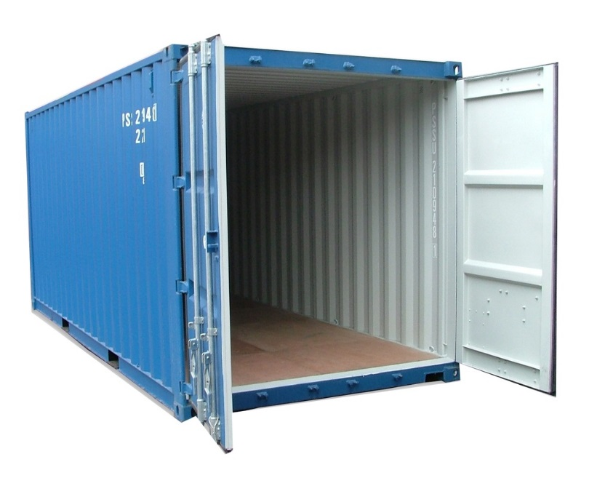

Recall the Container Thermometer
Container thermometer: monitor the temperature of the interior of a container
  Monitor the temperature
  every 5 minutes
  Flash LED alarm at 1 Hz
  If the temperature rises above
  a threshold, flash the LED alarm
  at 3 Hz and notify backend server
  If the temperature drops below
  a threshold, return the LED alarm
  to normal and notify the server
Need to know the temperature!

Slide 3
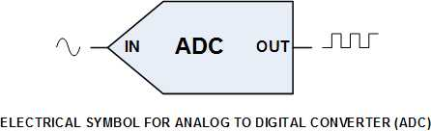
Digitizing Temperature
Temperature is a nature phenomena, whose value varies continuously
To make it feasible for computer to handle, we need to convert it into a digital number
To transform an analog signal into a digital number, the analog-to-digital converter (ADC) samples the input at fixed interval and do the conversion
Analog signal
Digital signal
Notes:
2

Slide 4
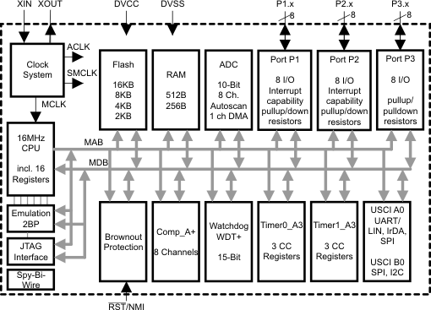
So Far, We Have Learned …
ADC
Clock System
IO
Timer System

Slide 5
Outline
Introduction to analog-to-digital conversion
ADC of MSP430
Sample code of using ADC10 in MSP430

Slide 6
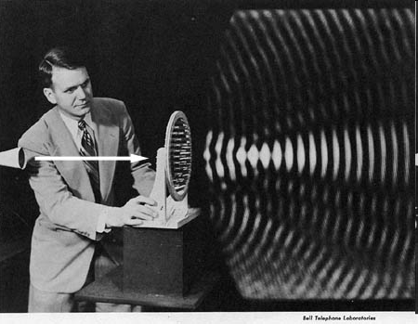
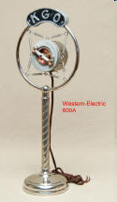
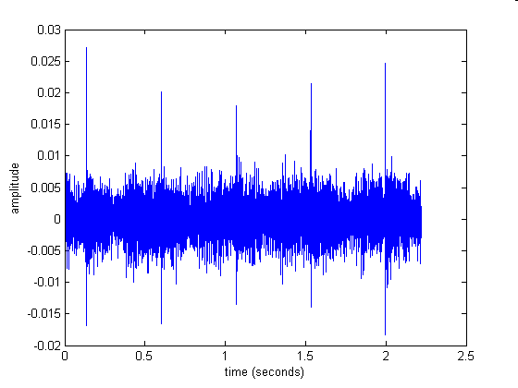
Analog Signals
A signal representing continuous things, e.g.
  Fluctuations in air pressure (i.e. sound) strike the diaphragm of a microphone, which causes corresponding fluctuations in the voltage or current in an electric circuit
  The voltage or current signal is an "analog" of the sound
strength
voltage
time
time
Notes:
Analog signals normally imply continuous signals (in time and value)

Slide 7
Analog-to-Digital Conversion (ADC)
ADC: convert an analog signal, e.g., a voltage V, into a binary value that the processor can handle
  The input V(t) is a continuous function, i.e., V can take any value within a permitted range and can change in any way as a function of time t
  The output V[n] is a sequence of binary values, each has a fixed number of bits and can represent only a finite number of values
  Typically input is sampled regularly at intervals of T, so the continuous nature of time has also been lost
Of course, we also have DAC
(digital-to-analog converter)!

Slide 8
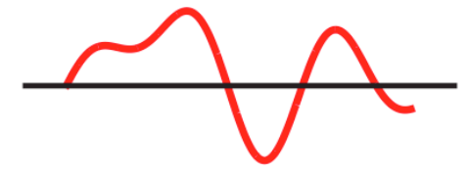
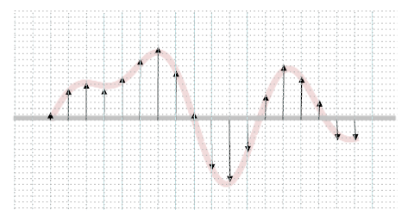
Analog-to-Digital Conversion
Digital representation of an analog signal
Continuous time
Continuous values
Discrete time
Discrete values

Slide 9
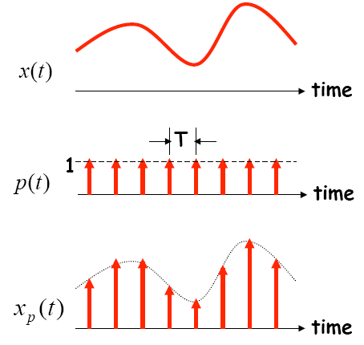
Sampling in Time
The value of the analog signal is measured at certain intervals in time. Each measurement is referred to as a sample
A series of “snapshots”

Slide 10
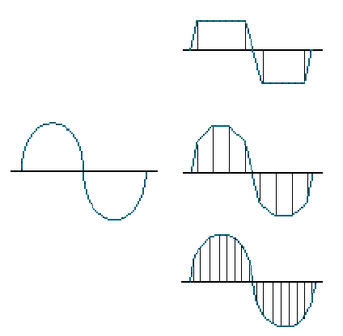
Terminologies in Sampling
Sampling rate:
  How often analog signal is measured (samples per second, Hz), e.g. 44,100 Hz?
Sampling resolution:
  Number of bits to represent each sample (“sample word length,” “bit depth”), e.g. 16 bit
Analog Input
4 samples/cycle
8 samples/cycle
16 samples/cycle

Slide 11
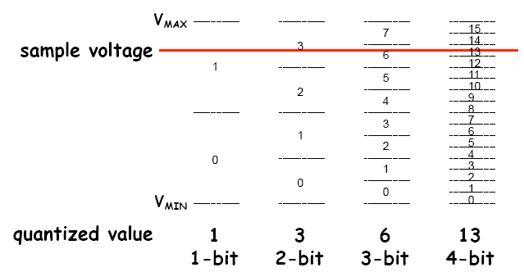
Encoding of Discrete Signals
If we use N bits to encode the magnitude of one of the discrete-time samples, we can capture 2^{N} possible values

Slide 12
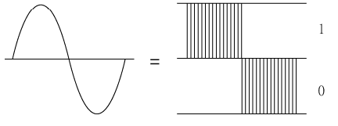
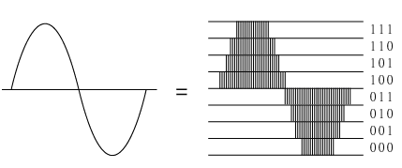
Sampling Rate and Encoding Bits
1-bit
3-bit

Slide 13
Outline
Introduction to analog-to-digital conversion
ADC of MSP430
Sample code of using ADC10 in MSP430

Slide 14
Requirements of MSP430 for ADC
Provide continuous sampling of multiple analog inputs and store sampled data
ADC10AE0
INCH in
ADC10CTL1

Slide 15
Requirements of MSP430 for ADC
Provide continuous sampling of multiple analog inputs and store sampled data
SHS, ADC10SSEL,
CONSEQ in
ADC10CTL1

Slide 16
Requirements of MSP430 for ADC
Provide continuous sampling of multiple analog inputs and store sampled data
Interrupt CPU on every word sampled from ADC
Use software (ISR run by the CPU) to move data from ADC (ADC10MEM) to memory

Slide 17
Requirements of MSP430 for ADC
Provide continuous sampling of multiple analog inputs and store sampled data
Use hardware (Data
Transfer Controller, DTC) to move data from ADC to memory
→ DMA
Interrupt CPU when block transfer is
completed

Slide 18
ADC in MSP430
MSP430 may contain one or more converters:
Comparator:
  Compare the voltages on its two input terminals and return 0 or 1, e.g., Comparator_A+
Successive-approximation ADC:
  Use binary search to determine the closest digital representation of the input signal, e.g., ADC10 and ADC12 to give 10 and 12 bits of output
Sigma-delta ADC:
  A more complicated ADC that gives higher resolution (more bits) but at a slower speed, e.g., SD16 and SD16_A, both of which give a 16-bit output

Slide 19
Simplified Block Diagram of ADC10
Voltage reference
Clock sources
Conversion trigger

Slide 20
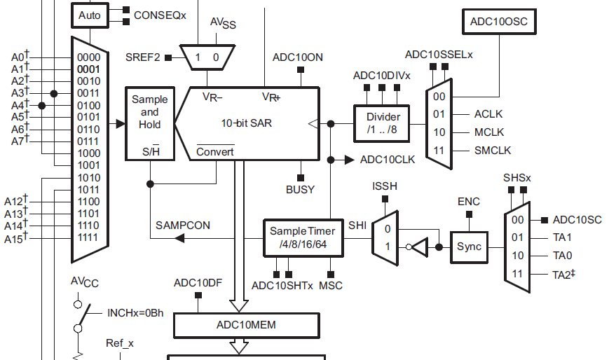
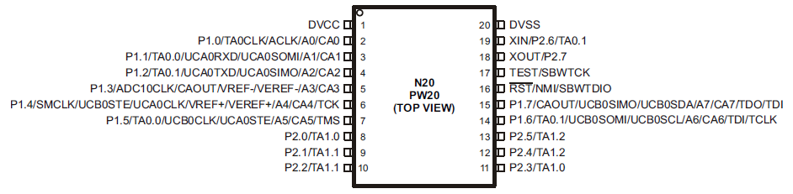
Main Components of ADC10
Analog inputs:
  Some are from internal,
  e.g. temperature, and
  some are from external,
  e.g. A0, A1, …, A7

Slide 21
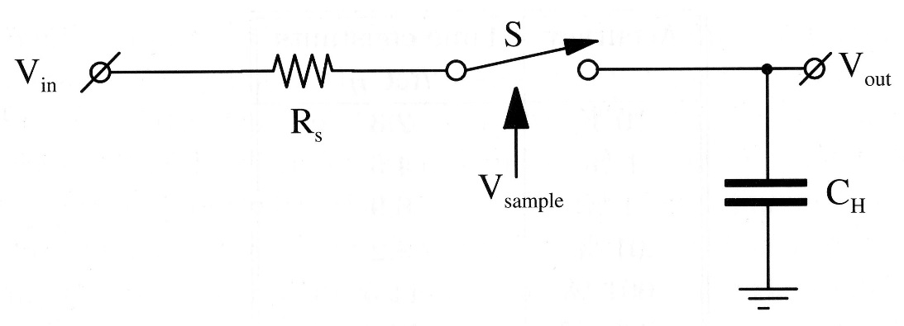
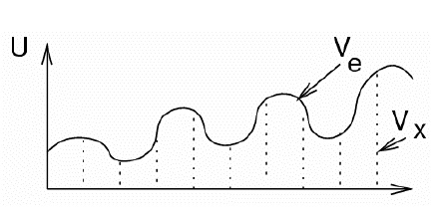
Main Components of ADC10
Sample-and-Hold circuit:
  V_{out} = V_{in} when V_{sample} = 1
SAR (Successive-Approximation Register):
  10-bit
  Result written to ADC10MEM and raising ADC10IFG
V_{in}
V_{out}

Slide 22
Successive-Approximation ADC
Generate internal analog signal V_{D/A} by DAC
Compare V_{D/A} with input signal V_{in}
Modify V_{D/A} by D₀D₁D₂…D_{N-1} until closest possible value to V_{in} is reached
Dr.-Ing. Frank Sill, Department of Electrical Engineering, Federal University of Minas Gerais, Brazil

Slide 23
Successive-Approximation ADC
P. Fischer, VLSI-Design - ADC und DAC, Uni Mannheim, 2005

Slide 24
Main Components of ADC10
Built-in voltage reference:
  Setting REFON in ADC10CTL0 register to 1 enables the internal reference
    Two selectable voltage levels: 2.5 V and 1.5 V
  Setting REF2_5V in ADC10CTL0 to 1 selects 2.5 V as the internal reference, otherwise 1.5 V
  After voltage reference is turned on, we must wait about 30µs for it to settle
Notes:
The input signal is between 0 V to 1.5 (2.5) V. If input signal is 1.5 V, then ADC10MEM will contain 0x3FF (10-bit output).

Slide 25
Main Components of ADC10
Reference voltage: 1.5V or 2.5V
ADC10MEM: 10-bit output of ADC conversion
  0x3FF for 1.5V or 2.5V

Slide 26
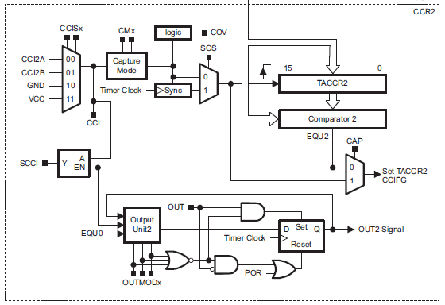
Main Components of ADC10
Triggering of sample-and-hold circuit:
  By ADC10SC bit in ADC10CTL0 register, which can be set (and is thus triggered) by software, or
  OUTx from
  Timer0_A: for
  periodic
  sampling
Capture/Compare Block 2
of Timer0_A

Slide 27
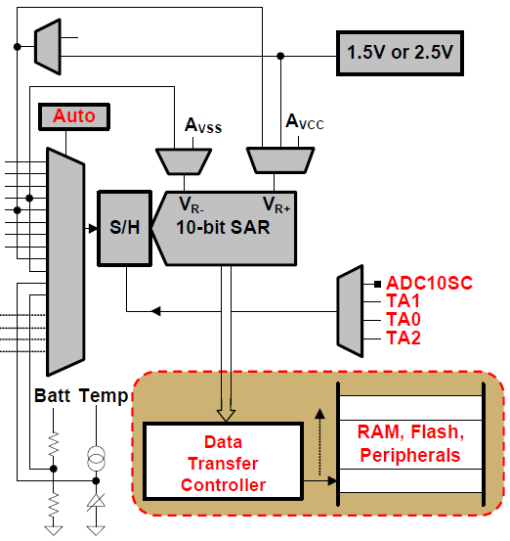
Data Transfer Controller (DTC)
Transfer conversion
results from
ADC10MEM to
other on-chip
memory locations
  Each load of
  ADC10MEM
  triggers a data
  transfer until a set
  amount
  During each DTC
  transfer, CPU is
  halted
1.5V or 2.5V or Reference
Input channel
ADC10MEM
Notes:
@ userguide 22.2.1 10-Bit ADC Core ,Page 542
The eight external and four internal analog signals are selected as the channel for conversion by the analog input multiplexer.
The ADC core converts an analog input to its 10-bit digital representation and stores the result in the ADC10MEM register. The core uses two programmable/selectable voltage levels (VR+ and VR-) to define the upper and lower limits of the conversion. The digital output (NADC) is full scale (03FFh) when the input signal is equal to or higher than VR+, and zero when the input signal is equal to or lower than VR-. The input channel and the reference voltage levels (VR+ and VR-) are defined in the conversion-control memory. Conversion results may be in straight binary format or 2s-complement format.
The ADC10 core is configured by two control registers, ADC10CTL0 and ADC10CTL1. The core is enabled with the ADC10ON bit. With few exceptions the ADC10 control bits can only be modified when ENC = 0. ENC must be set to 1 before any conversion can take place.
SAR: successive approximation register
26

Slide 28
ADC10 Interrupts
One interrupt and one interrupt vector
  When DTC is not used (ADC10DTC1 = 0), ADC10IFG is set when conversion results are loaded into ADC10MEM
  When DTC is used (ADC10DTC1 > 0), ADC10IFG is set when a block transfer completes
If both ADC10IE and GIE bits are set, then ADC10IFG generates an interrupt request
  ADC10IFG is automatically reset when interrupt request is serviced, or it may be reset by software

Slide 29
Enabling Sampling and Conversion

Slide 30
Steps for Single Conversion
(1) Configure ADC10, including the ADC10ON bit to enable the module.
  The ENC bit must be clear so that most bits in ADC10CTL0 and ADC10CTL1 can be changed.
(2) Set the ENC bit to enable a conversion.
  This cannot be done if the module is being configured in (1).
(3) Trigger the conversion.
This is done either by setting the ADC10SC bit or by an edge from Timer_A.
ADC10ON, ENC, ADC10SC are all in control register ADC10CTL0

Slide 31
ADC10 Registers
Register | Short Form | Register Type | Addr. | Initial State
ADC10 input enable register 0 | ADC10AE0 | Read/write | 04Ah | Reset with POR
ADC10 input enable register 1 | ADC10AE1 | Read/write | 04Bh | Reset with POR
ADC10 control register 0 | ADC10CTL0 | Read/write | 01B0h | Reset with POR
ADC10 control register 1 | ADC10CTL1 | Read/write | 01B2h | Reset with POR
ADC10 memory | ADC10MEM | Read | 01B4h | Unchanged
ADC10 data transfer control register 0 | ADC10DTC0 | Read/write | 048h | Reset with POR
ADC10 data transfer control register 1 | ADC10DTC1 | Read/write | 049h | Reset with POR
ADC10 data transfer start address | ADC10SA | Read/write | 01BCh | 0200h with POR
Where the converted 10-bit digital value is saved
Notes:
power-on reset (PoR)
30

Slide 32
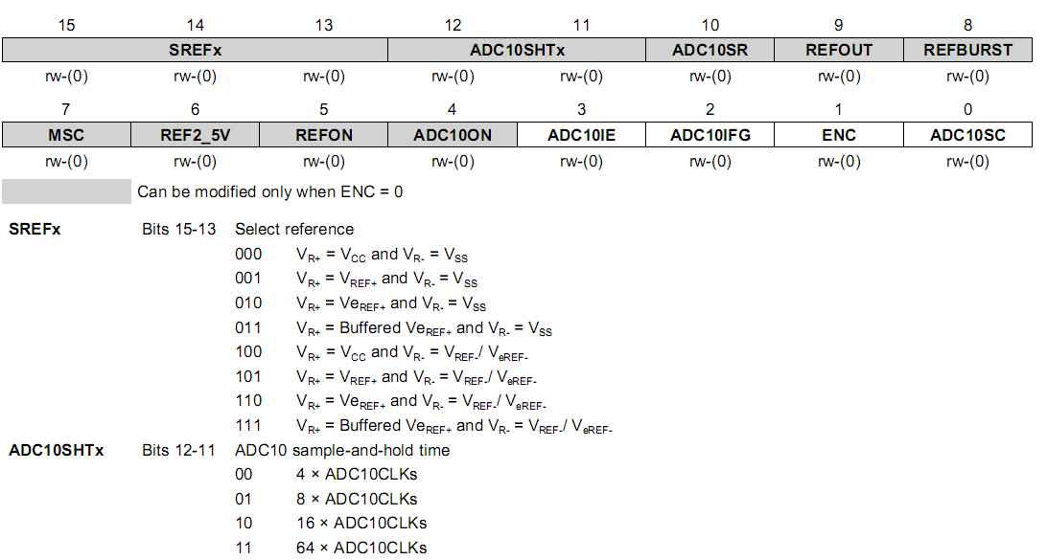
ADC10CTL0
ideal for the temperature sensor
ideal for the temperature sensor
Notes:
31

Slide 33
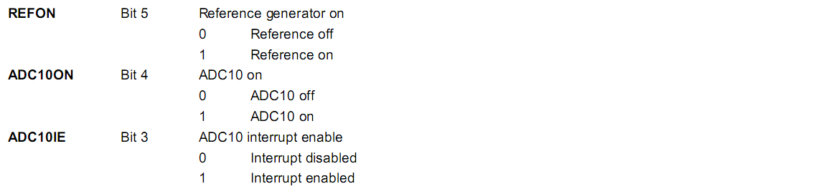
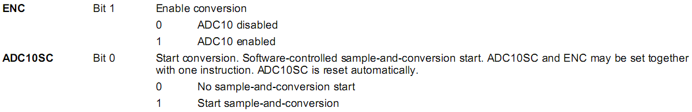
ADC10CTL0 cont’d
ADC10CTL0 = SREF_2 + ADC10SHT_1; // Reference range & SH time
Notes:
32

Slide 34
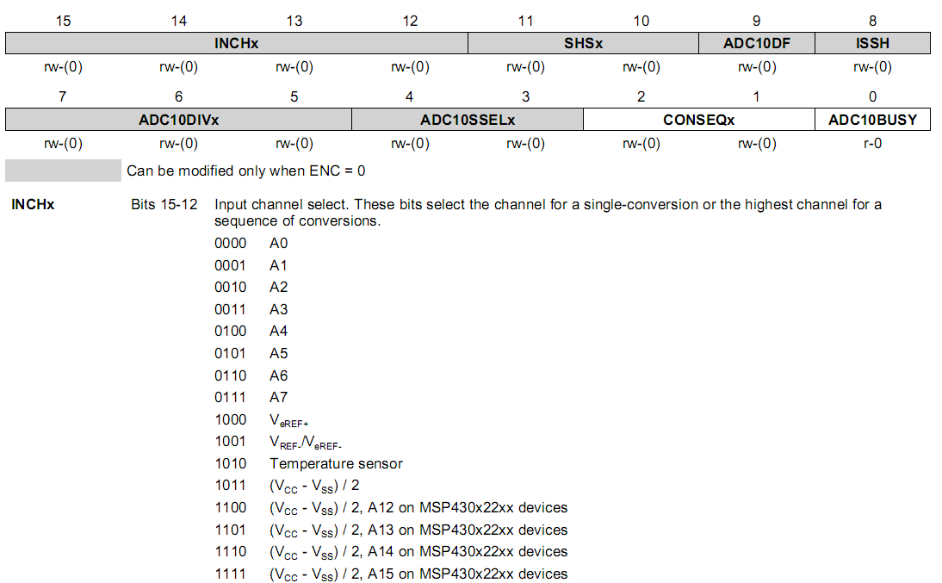
ADC10CTL1
Notes:
33

Slide 35
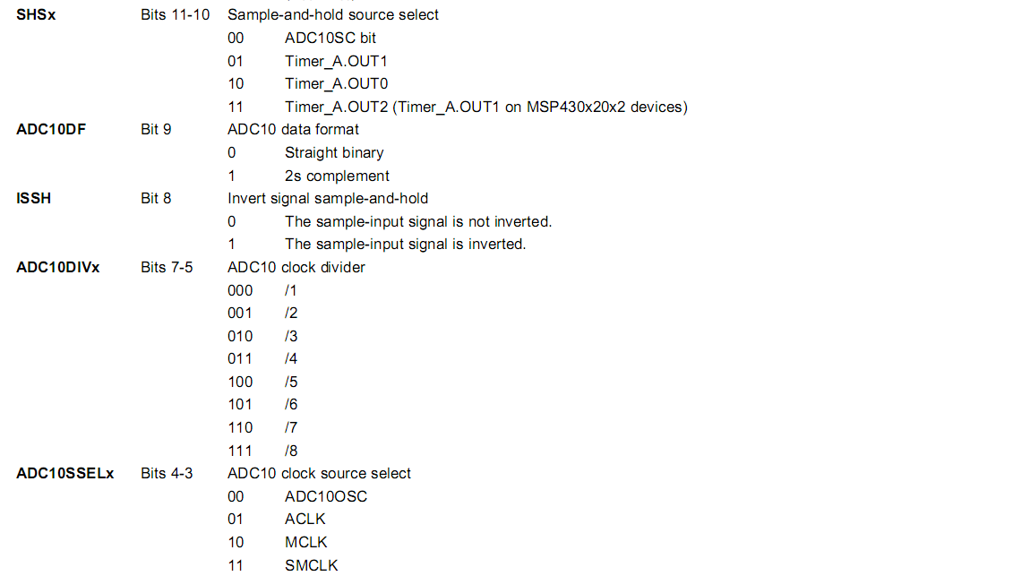
ADC10CTL1 cont’d
ADC10CTL1 = INCH_10 + ADC10DIV_0; // Temp Sensor ADC10CLK
Notes:
34

Slide 36
Outline
Introduction to analog-to-digital conversion
ADC of MSP430
Sample code of using ADC10 in MSP430

Slide 37
Sample Code 1 for ADC10
Repetitive single conversion:
  Repetitively perform single samples on A1 (pin P1.1) with reference to Vcc
  If A1 > 0.5*Vcc, P1.0 set, else reset.
  Set ADC10SC to start sample and conversion
    But ADC10SC automatically cleared at end of conversion.
  Enable the next conversion in ISR of ADC10 and iterate

Slide 38
Sample Code 1 for ADC10
void main(void) { WDTCTL = WDTPW + WDTHOLD; // Stop WDT // H&S time 16x, interrupt enabled ADC10CTL0 = ADC10SHT_2 + ADC10ON + ADC10IE; ADC10CTL1 = INCH_1; // Input from A1 ADC10AE0 |= 0x02; // Enable pin A1 for analog in P1DIR |= 0x01; // Set P1.0 to output ADC10CTL0 |= ENC + ADC10SC; // Start sampling for (;;) { } } #pragma vector=ADC10_VECTOR __interrupt void ADC10_ISR(void) { if (ADC10MEM < 0x1FF) P1OUT &= ~0x01; else P1OUT |= 0x01; ADC10CTL0 |= ENC + ADC10SC; // enable sampling }
Notes:
37
Why not read ADC10MEM right after setting ADC10CTL0? While wait for interrupt? What is the time to go through one iteration?
Any one of the pins of Port 1 can be set to be an analog input. Thus up to 8 channels are available for separate ADC inputs.
Analog Enable control register ADC10AE0 will be use for enabling the corresponding input channels.
37

Slide 39
Sample Code 2 for ADC10
Continuous sampling driven by Timer0_A3
  A1 is sampled 16/second with reference to 1.5V, where ACLK runs at 32 KHz driven by an external crystal (2048 ACLK cycles give 1/16 second (ACLK/2048))
  If A1 > 0.5V, P1.0 is set, else reset.
  Timer0_A3 is run in up mode with CCR0 defining the sampling period (2048 cycles)
  Use CCR1 to automatically trigger ADC10 conversion

Slide 40
Sample Code 2 for ADC10
#include “msp430.h” int i=1; void main(void) { WDTCTL = WDTPW + WDTHOLD; // Stop WDT // TA1 trigger sample start ADC10CTL1 = SHS_1 + CONSEQ_2 + INCH_1; ADC10CTL0 = SREF_1 + ADC10SHT_2 + REFON + ADC10ON + ADC10IE; __enable_interrupt(); // Enable interrupts TA0CCR0 = 30; // Delay for Volt Ref to settle TA0CCTL0 |= CCIE; // Compare-mode interrupt TA0CTL = TASSEL_2 + MC_1; // SMCLK, Up mode while(i); // Wait for settle TA0CCTL0 &= ~CCIE; // Disable timer Interrupt __disable_interrupt();
How to break?
Notes:
39
SHS_1: S&H triggering source → OUT1
CONSEQ_2: Conversion sequence mode select (Repeat-single-channel)
SREF_1: Select reference (VR+ = VREF+ and VR- = VSS)
ADC10SHT_2: Sample-and-hold time (6 × ADC10CLKs)
REFON: internal reference generator on
The settling time for the internal reference is < 30µs. If DCOCLK is 1 MHz, then 1 cycle takes 6µs and 30 cycles gives long enough delay for the internal reference voltage to settle down.
39

Slide 41
Sample Code 2 for ADC10
ADC10CTL0 |= ENC; // ADC10 Enable ADC10AE0 |= 0x02; // P1.1 ADC10 option select P1DIR |= 0x01; // Set P1.0 output TA0CCR0 = 2048-1; // Sampling period TA0CCTL1 = OUTMOD_3; // TACCR1 set/reset TA0CCR1 = 2046; // TACCR1 OUT1 on time TA0CTL = TASSEL_1 + MC_1; // ACLK, up mode while(1); }
Timer0_A CCR1 out mode 3: The output (OUT1) is set when the timer counts to the TA0CCR1 value and is reset when the timer counts to the TA0CCR0 value.
Notes:
40
40

Slide 42
Sample Code 2 for ADC10
// ADC10 interrupt service routine #pragma vector=ADC10_VECTOR __interrupt void ADC10_ISR(void){ if (ADC10MEM < 0x155) // ADC10MEM = A1 > 0.5V? P1OUT &= ~0x01; // Clear P1.0 LED off else P1OUT |= 0x01; // Set P1.0 LED on } #pragma vector=TIMERA0_VECTOR __interrupt void ta0_isr(void){ TA0CTL = 0; i = 0; }
Break the while loop in main() that waits for the internal voltage reference to settle
Notes:
41
Where do these two ISRs return to?
0x155 is 1/3 of 0x3FFF, which gives 0.5 V out of 1.5 V
41

Slide 43
Summary
ADC: analog-to-digital conversion
DAC: digital-to-analog conversion
  Conversions will necessarily introduce errors. Important to understand constraints and limitations
ADC10 in MSP430
  Convert an analog signal into 10-bit digitals
  Registers associated with ADC10
Sample program of ADC10
  Single conversion
  Continuous conversion driven by Timer_A

