Slide 1
CS4101 嵌入式系統概論 General Purpose IO
Prof. Chung-Ta King
Department of Computer Science
National Tsing Hua University, Taiwan
Materials from MSP430 Microcontroller Basics, John H. Davies, Newnes, 2008

Slide 2
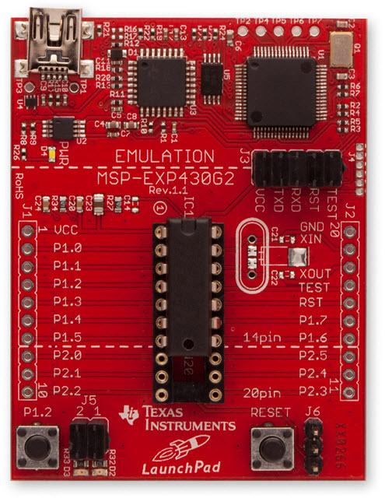
LaunchPad Development Board
USB Emulator Connection
Embedded Emulation
6-pin eZ430 Connector
Crystal Pads
Chip Pinouts
Part and Socket
P1.3 Button
Power Connector
LEDs P1.0 & P1.6
Reset Button

Slide 3
Recall: Sample Code for Output
#include <msp430.h> void main(void) { WDTCTL = WDTPW + WDTHOLD; // Stop watchdog P1DIR |= 0x41; // set P1.0 & 6 to outputs for(;;) { volatile unsigned int i; P1OUT ^= 0x41; // Toggle P1.0 & P1.6 i = 50000; // Delay do (i--); while (i != 0); } }

Slide 4
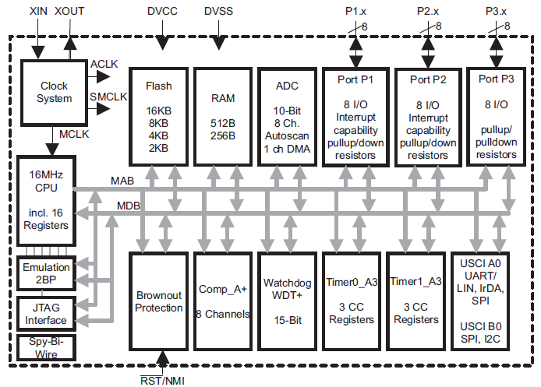
Recall: Memory-Mapped I/O
LED
P1OUT
X
No P3 for 20-pin devices
P1IN
…
P1REN
MOV.W #0x80,P1OUT
Notes:
Go through all the components once and explain their meanings

Slide 5
Configuring the I/O Ports
Registers (Mem Addr) | Functions | Descriptions
P1IN (0x0020) | Port 1 input | This is a read-only register that reflects the current state of the port's pins.
P1OUT (0x0021) | Port 1 output | The values written to this read/write register are driven out to corresponding pins when they are configured to output.
P1DIR (0x0022) | Port 1 data direction | Bits written as 1 (0) configure the corresponding pins for output (input).
P1SEL (0x0026) | Port 1 function select | Bits written as 1 (0) configure corresponding pins for use by the specialized peripheral (for general-purpose I/O).
P1REN (0x0027) | Port 1 resistor enable | Bits set in this register enable pull-up/down resistors on the corresponding I/O pins.

Slide 6
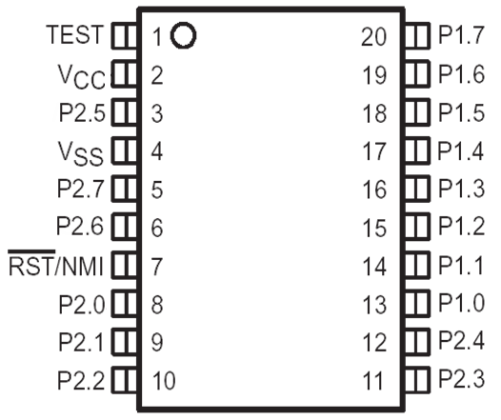
MSP430 GPIO
GPIO = General Purpose Bit Input/Output
8-bit I/O ports
Each pin is individually controllable
Controlled by memory-mapped registers R1IN, R1OUT, …
 | P1.7 | P1.6 | P1.5 | P1.4 | P1.3 | P1.2 | P1.1 | P1.0
I/O Port 1 | Bit 7 | Bit 6 | Bit 5 | Bit 4 | Bit 3 | Bit 2 | Bit 1 | Bit 0

Slide 7
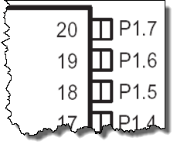
PxDIR (Pin Direction): Input or Output
PxDIR.y: 0 = input 1 = output
Register example: P1DIR &= 0x81;
P1IN.7
P1OUT.7
P1DIR.7
“1”
 | 7 | 6 | 5 | 4 | 3 | 2 | 1 | 0
P1IN
P1OUT
P1DIR | 1 |  |  |  |  |  |  | 1

Slide 8
GPIO Output
PxOUT.y: 0 = low 1 = high
Register example: P1OUT &= 0x80;
P1IN.7
P1OUT.7
P1DIR.7
“1”
“1”
“1”
 | 7 | 6 | 5 | 4 | 3 | 2 | 1 | 0
P1IN | X
P1OUT | 1
P1DIR | 1

Slide 9
GPIO Input
Problem occurs if P1.7 is connected to a button!
P1IN.7
P1OUT.7
P1DIR.7
“1”
“1”
“0”
 | 7 | 6 | 5 | 4 | 3 | 2 | 1 | 0
P1IN | 1
P1OUT | X
P1DIR | 0

Slide 10
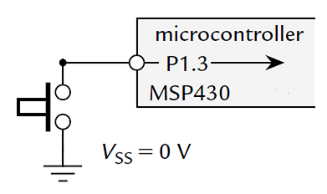
Problem with Input from a Button
When the button is pressed down (closed), MSP430 will detect a 0 from the pin
When the button is up (open), what will MSP430 detect?
Ans.: random value
→ Floating

Slide 11
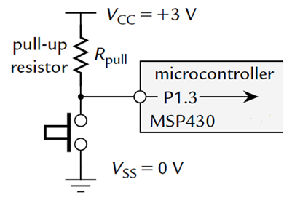
Typical Way of Connecting a Button
The pull-up resistor R_{pull} holds input at logic 1 (voltage V_{CC}) while button is up and logic 0 or V_{SS} when button is down → active low
A wasted current flows through R_{pull} to ground when button is down
This is reduced by making R_{pull} large enough, typically 33 kΩ

Slide 12
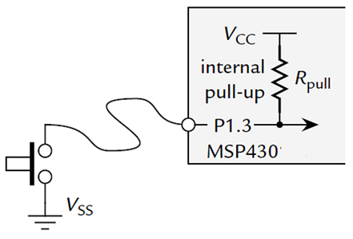
Typical Way of Connecting a Button
MSP430 offers internal pull-up/down resistor
PxREN register selects whether this resistor is used (1 to enable, 0 to disable)
When enabled, the corresponding bit of PxOUT register selects whether the resistor pulls the input up to V_{CC} (1) or down to V_{SS} (0)

Slide 13
GPIO Input
P1IN.7
P1OUT.7
P1DIR.7
P1REN.7
up/down
Enable resistor
Input pins are held in high-impedance (Hi-Z) state, so they can react to 0 or 1
When not driven, Hi-Z inputs may float up/down …
Prevent this with pull-up/pull-down resistors
PxREN enables pull-up/pull-down resistors PxOUT selects pull-up (1) or -down (0)
Lower cost devices may not provide up/down resistors for all ports
 | 7 | 6 | 5 | 4 | 3 | 2 | 1 | 0
P1IN | x
P1OUT | 1
P1DIR | 0
P1REN | 1

Slide 14
Sample Code for Input
#include <msp430.h> #define LED1 BIT0 //P1.0 to red LED #define B1 BIT3 //P1.3 to button void main(void){ WDTCTL = WDTPW + WDTHOLD; //Stop watchdog timer P1OUT |= LED1 + B1; P1DIR = LED1; //Set pin with LED1 to output P1REN = B1; //Set pin to use pull-up resistor for(;;){ //Loop forever if((P1IN & B1) ==0){ //Is button down? P1OUT &= ~LED1; // Yes, turn LED1 off } else{ P1OUT |= LED1; // No, turn LED1 on } } }
Notes:
Whenever button is down, turn LED off. Whenever button is up, turn LED on.
P1OUT is not initialized and must be written before configuring the pin for output.
Assume button is active low (0 → pressed; 1 → depressed)

Slide 15
Sample Code 2 for Input
#include <msp430.h> #define LED1 BIT6 // P1.0 to green LED #define B1 BIT3 // P1.3 to button volatile unsigned int i, j; void main(void){ WDTCTL = WDTPW + WDTHOLD; // Stop watchdog timer P1OUT |= LED1 + B1; P1DIR = LED1; // Set pin with LED1 to output P1REN = B1; // Set pin to use pull-up resistor for(;;){ while((P1IN & B1) != 0){ // Loop on button up i = P1IN; j = P1OUT; } P1OUT &= ~LED1; // Turn LED1 off while((P1IN & B1) == 0){ // Loop on button down i = P1IN; j = P1OUT; } P1OUT |= LED1; // Turn LED1 on } }
Notes:
On button down, turn LED off. On button up, turn LED on.

