Slide 1
CS4101 嵌入式系統概論 Introduction to LaunchPad
Prof. Chung-Ta King
Department of Computer Science
National Tsing Hua University, Taiwan
Materials from MSP430 Microcontroller Basics, John H. Davies, Newnes, 2008

Slide 2
Outline
MSP430 LaunchPad
MSP430 Microcontroller
Processor
Memory
I/O
LaunchPad and First Program
C
Assembly
LaunchPad Development Environment

Slide 3
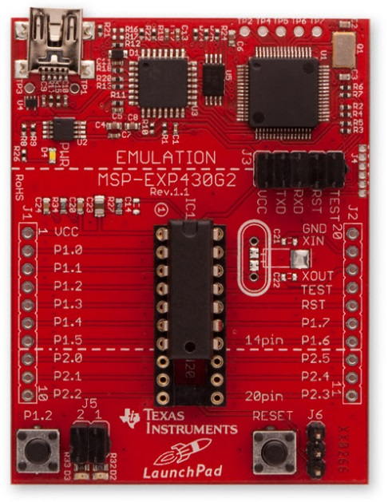
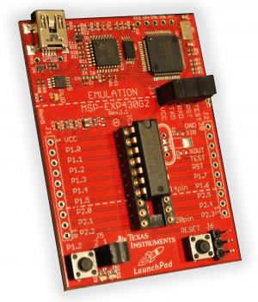
MSP430 LaunchPad Development Kit
LaunchPad development board
Mini-USB cable, 10-pin PCB connectors
2 MSP430 MCUs: MSP430G2553, MSP430G2452
Micro Crystal 32.768kHz Oscillator
Notes:
開發板: many peripherals, pins are linked to outside for easy connections
How to read the pin id of a chip?

Slide 4
MSP430 Microcontroller
LaunchPad development board uses microcontroller such as MSP430G2553 and MSP430G2452
Microcontroller (MCU):
A small computer on a single IC containing a processor core, memory, programmable I/O peripherals
MSP430 microcontroller:
Incorporates a 16-bit RISC CPU, peripherals, and a flexible clock system that are interconnected using a von-Neumann common memory address bus (MAB) and memory data bus (MDB)
Notes:
比較前一頁的開發板, 上面的電路很簡單, 幾乎沒有其他元件

Slide 5
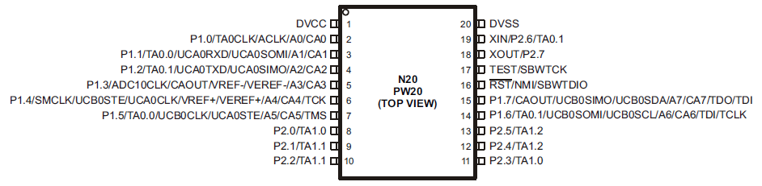
MSP430 Microcontroller
MSP430G2553 outside view (pin-out):
20-pin version
VCC , VSS : supply voltage and ground
P1.0~P1.7, P2.0~P2.7 are for digital input and output, grouped into ports P1 and P2
TA0CLK, TA0.0, and TA0.1 are associated with Timer0_A

Slide 6
MSP430 Microcontroller
MSP430G2553 outside view: (cont’d)
A0~A7 inputs to the analog-to-digital (ADC) converter
VREF is the reference voltage for the ADC converter
ACLK and SMCLK are outputs for the microcontroller’s clock signals
UCA0RXD and UCA0TXD are used for the universal serial interface
XIN and XOUT are the connections for a crystal
RST is an active low reset signal
NMI is the non-maskable interrupt input

Slide 7
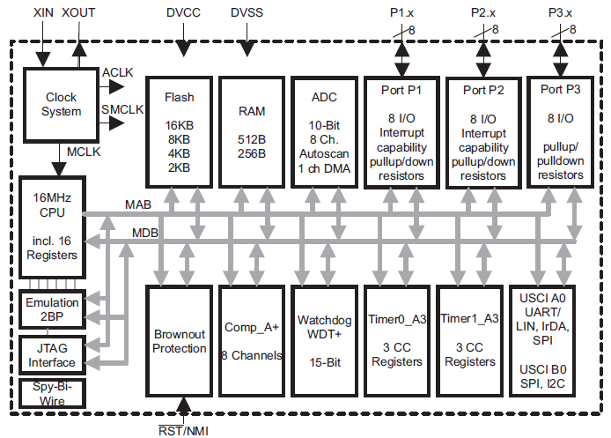
MSP430G2553 Inside View
LED
P1OUT
X
No P3 for 20-pin devices
P1IN
…
P1REN
MOV.W #0x40,P1OUT
Memory-mapped I/O
Notes:
Go through all the components once and explain their meanings

Slide 8
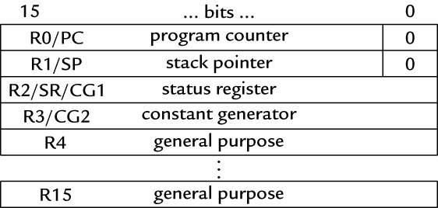
MSP430 CPU Registers
Sixteen 16-bit registers
R0, R1, R2, and R3: program counter, status registers, stack pointer, constant generator (provides six most used immediate values and reduces code size)
R4 to R15 are working registers for general use
Notes:
Ask the meanings of the special registers

Slide 9
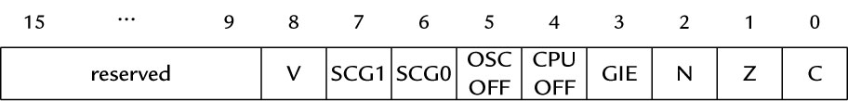
Status Register: SR (R2)
C: SR(0)
Z: SR(1)
N: SR(2)
V: SR(8)
GIE (Global interrupt enable): SR(3)
CPUOff: SR(4)
OSCOff: SR(5)
SCG1, SCG0: SR(7), SR(6)
result of last arithmetic/logical operation
put MCU into one of low-power modes
Notes:
Alex Milenkovich
8

Slide 10
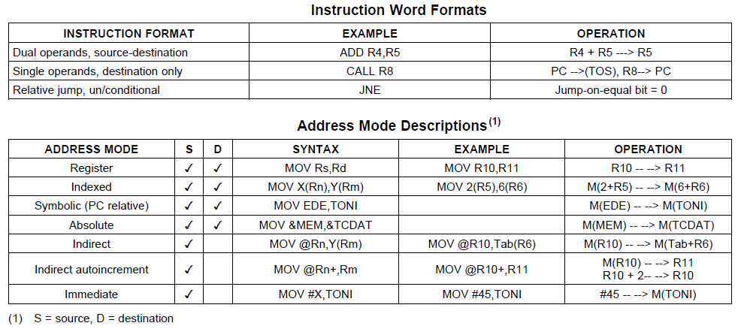
MSP430 Instruction Set
Instruction set architecture:
RISC with 51 instructions, 3 formats, and 7 addressing modes
Notes:
Sample some of the entries

Slide 11
Addressing Modes
Addressing modes: the ways in which operands can be specified
Four basic modes for the source and two for the destination in instructions with two operands
The combination of the basic addressing modes and the registers gives seven modes
All 16 registers treated on an equal basis, including special-purpose registers PC, SP, SR/CG1, and CG2
An instruction fits into a single word of 16 bits, although it may be followed by further words to provide addresses or an immediate value

Slide 12
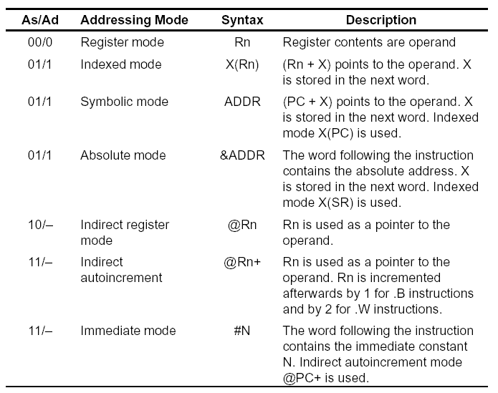
Notes:
Alex Milenkovich
11

Slide 13
MSP430 Memory Organization
Memory:
Word and byte addressing and instruction formats
16-bit memory address bus (MAB) allows direct access and branching throughout entire memory range
16-bit memory data bus (MDB) allows direct manipulation of word-wide arguments
Direct memory-to-memory transfers without intermediate register holding

Slide 14
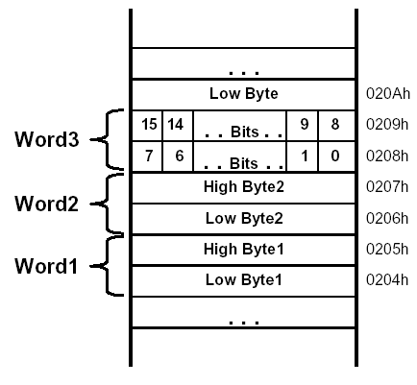
MSP430 Memory Organization
16-bit addresses, addressing to bytes
Aligned words:
The address of a word is the address of the byte with the lower address, which must be even
Little-endian ordering: The low-order byte is stored at the lower address and high-order byte at higher address

Slide 15
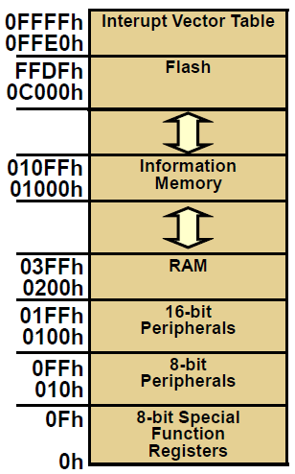
MSP430G2553 Memory Map
Flash/ROM
(16 KB)
Information memory: A 256B block of flash memory that is intended for storage of nonvolatile data, including serial numbers to identify the equipment
Flash/ROM
(256 bytes)
RAM
(512 bytes)
?
Notes:
14
Refer back to page 6 to see the blocks; Ask where the peripherals go?

Slide 16
MSP430 Input/Output
Simple digital input and output of MSP430 (GPIO) takes place through sets of pins on the package of the IC called ports
20-pin MSP430G2553 has two ports: P1 (8 bits: P1.0~P1.7), P2 (8 bits: P2.0~P2.7)
Typical pins can be configured for either input or output and some inputs may generate interrupts when the voltage on the pin changes
The ports appear to the CPU as registers (memory-mapped I/O ), where each bit corresponds to a pin and a port may be associated to many registers for different purposes (next page)

Slide 17
Registers Associated with Port 1
Reg. | Addr. | Func. | Description
P1IN | 020h | Input from port 1 | The 8 bits of data from port P1
P1OUT | 021h | Output to port 1 | Outputs 8 bits of data to port P1
P1DIR | 022h | Direction of port 1 data transfer | Bits written as 1 (0) configure corresponding pin for output (input)
P1SEL | 026h | Select function for port 1 | Bits written as 1 configure the corresponding pin for use by the specialized peripheral; 0 configure general-purpose I/O
Notes:
16

Slide 18
Outline
MSP430 LaunchPad
MSP430 Microcontroller
Processor
Memory
I/O
LaunchPad and First Program
C
Assembly
LaunchPad Development Environment

Slide 19

LaunchPad Development Board
USB Emulator Connection
Embedded Emulation
6-pin eZ430 Connector
Crystal Pads
Chip Pinouts
Part and Socket
P1.3 Button
Power Connector
LEDs and Jumpers
P1.0 & P1.6
Reset Button
Notes:
Purpose of emulation

Slide 20
LaunchPad Pinouts
On-board features of LaunchPad are pinned in the following fashion:
LED1 (red) = P1.0
LED2 (green) = P1.6
Switch1 = P1.3
Switch2 = Reset
Timer UART Transmit = P1.1
Timer UART Receive = P1.2
In order to blink the Red and Green LEDs, we have to set Ports 1.0 and 1.6 as outputs, and toggle them

Slide 21
Sample Code
#include <msp430.h> void main(void) { WDTCTL = WDTPW + WDTHOLD; // Stop watchdog timer P1DIR |= 0x41; // set P1.0 & P1.6 to outputs //(red & green LEDs) for(;;) { volatile unsigned int i; P1OUT ^= 0x41; // Toggle P1.0 & P1.6 with XOR i = 50000; // Delay do (i--); while (i != 0); } }
Notes:
20

Slide 22
Sample Code (cont’d)
Configure the LED connected to the GPIO line
The green and red LED are located on Port 1 Bit 0 and Bit 6 → make these pins to be output → P1DIR set to 0x41 = 0100 0001
To turn on/off LED, set bit in register to 1/0
Use XOR to toggle P1OUT
WDTCTL = WDTPW + WDTHOLD; // Stop watchdog timer P1DIR |= 0x41; // P1.0 & 6 outputs
0100 0001
P1OUT ^= 0x41; // toggle P1.0 & 6 on/off
Notes:
21

Slide 23
Characteristics of Sample Code
No printf(), no GUI operations
Do not end
Do I/O mainly
More on control of peripherals through their special registers → details of individual bits, bytes, words are important → manipulations of bits, bytes, words
Complete ownership of CPU
Device hangs if program goes wrong
Watchdog timer
No OS

Slide 24
Notes of Sample Code
volatile variable:
volatile unsigned int i;
The variable may appear to change “spontaneously,” with no direct action by the user’s program → may be due to memory-mapped I/O devices
Compiler must be careful in optimizing it
Ex.: should not keep a copy of the variable in a register for efficiency; should not assume the variable remains constant when optimizing the structure of the program, e.g., rearranging loops
The peripheral registers associated with the input ports should be declared as volatile

Slide 25
Notes of Sample Code
Example from wikipedia:
Optimizing compiler will think that foo is never changed and will optimize the code into
static int foo; void bar(void) { foo = 0; while (foo != 255) ; }
static int foo; void bar(void) { foo = 0; while (true) ; }
The volatile keyword in declaration of foo prevents this optimization

Slide 26
Notes of Sample Code
Bit manipulation:
Important instruction set architecture (ISA) feature for embedded processors
Bit mask: set a bit P1OUT = P1OUT | BIT3 clear a bit P1OUT &= ~BIT3 toggle a bit P1OUT ˆ= BIT3
Bit field: struct { unsigned short TAIFG:1; unsigned short TAIE:2; unsigned short TACLR:5; } TACTL_bit;
Set with TACTL_bit.TAIFG = 1

Slide 27
Other Aspects of Embedded C
Programs for small embedded systems tend not to contain a lot of complicated manipulation of complex data objects
Much code is usually devoted to the control of peripherals through their special registers
Details of individual bits, bytes, words are important
Important operations
Shifting and rotating bits
Bit-level Boolean logic (A && B) and bitwise operator (A & B)
Bit mask for testing and modifying individual bits

Slide 28
Other Aspects of Embedded C
Union for manipulating individual bits or the whole byte/word as a unit
union {
unsigned short TACTL; // Timer_A Control
struct {
unsigned short TAIFG : 1; // Timer_A counter interrupt flag
unsigned short TAIE : 1; // Timer_A counter interrupt enable
unsigned short TACLR : 1; // Timer_A counter clear
unsigned short : 1;
unsigned short TAMC : 2; // Timer_A mode control
unsigned short TAID : 2; // Timer_A clock input divider
unsigned short TASSEL : 2; // Timer_A clock source select
unsigned short : 6;
} TACTL_bit;
} TimerA;
bit 0

Slide 29
Sample C Code: Blinking Only Red LED
#include <msp430.h> int main(void) { WDTCTL = WDTPW | WDTHOLD; // Stop watchdog timer P1DIR |= 0x01; // Set P1.0 as output for(;;) { volatile unsigned int i; // prevent optimization P1OUT ^= 0x01; // Toggle P1.0 using XOR i = 10000; // SW Delay do i--; while(i != 0); } return 0; }

Slide 30
Machine Code: Blinking Only Red LED
23 int main(void) { c05e: 8321 DECD.W SP WDTCTL = WDTPW | WDTHOLD; c060: 40B2 5A80 0120 MOV.W #0x5a80,&Watchdog_Timer_WDTCTL P1DIR |= 0x01; c066: D3D2 0022 BIS.B #1,&Port_1_2_P1DIR 31 P1OUT ^= 0x01; $C$L1: c06a: E3D2 0021 XOR.B #1,&Port_1_2_P1OUT i = 10000; c06e: 40B1 2710 0000 MOV.W #0x2710,0x0000(SP) 34 do i--; $C$L2: c074: 8391 0000 DEC.W 0x0000(SP) 36 } c078: 9381 0000 TST.W 0x0000(SP) c07c: 27F6 JEQ ($C$L1) ......
Notes:
BIS(.B) src,dst: Set bits in destination src .or. dst → dst

Slide 31
Assembly for Using volatile
23 int main(void) { c05e: 8321 DECD.W SP WDTCTL = WDTPW | WDTHOLD; c060: 40B2 5A80 0120 MOV.W #0x5a80,&Watchdog_Timer_WDTCTL P1DIR |= 0x01; c066: D3D2 0022 BIS.B #1,&Port_1_2_P1DIR 31 P1OUT ^= 0x01; $C$L1: c06a: E3D2 0021 XOR.B #1,&Port_1_2_P1OUT i = 10000; c06e: 40B1 2710 0000 MOV.W #0x2710,0x0000(SP) 34 do i--; $C$L2: c074: 8391 0000 DEC.W 0x0000(SP) 36 } c078: 9381 0000 TST.W 0x0000(SP) c07c: 27F6 JEQ ($C$L1) c07e: 3FFA JMP ($C$L2)
Notes:
“i” is allocated to top of stack → DECD.W SP

Slide 32
Assembly for Not Using volatile
WDTCTL = WDTPW | WDTHOLD; main(): c078: 40B2 5A80 0120 MOV.W #0x5a80,&Watchdog_Timer_WDTCTL P1DIR |= 0x01; c07e: D3D2 0022 BIS.B #1,&Port_1_2_P1DIR 31 P1OUT ^= 0x01; $C$L1: c082: E3D2 0021 XOR.B #1,&Port_1_2_P1OUT 34 do i--; c086: 3FFD JMP ($C$L1) 65 func_epilog_7: POP r4 __mspabi_func_epilog(), __mspabi_func_epilog_7(): c088: 4134 POP.W R4 66 func_epilog_6: POP r5 __mspabi_func_epilog_6(): c08a: 4135 POP.W R5
Notes:
“i” is removed and not allocated at all!

Slide 33
Outline
MSP430 LaunchPad
MSP430 Microcontroller
Processor
Memory
I/O
LaunchPad and First Program
C
Assembly
LaunchPad Development Environment

Slide 34
Hardware Setup
Please check the version of the MSP430 microcontroller and use the right header files in your programs
MSP430G2553

Slide 35
Code Composer Studio (CCS)
An Integrated Development Environment (IDE) based on Eclipse
Integrated “Debugger” and “Editor” – IDE
Edit and Debug have own “perspectives” (menus, windows)
Contains all development tools: compilers, TI-RTOS kernel, and includes one target: the Simulator
Other development tools also available:
Energia
CCS Cloud
(http://www.ti.com/ww/en/launchpad/software.html)

Slide 36
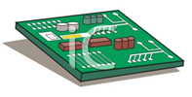
Code Composer Studio (CCS)
Compiler
Standard Runtime Libraries
TI-RTOS
Libraries
Target Cfg File
.asm
.c
.lib
.ccxml
Launch Pad
Edit
.asm
Asm
.obj
Link
.out
Debug
EVM
TI-RTOS
Config
(.cfg)
User.cmd
.map
Stand Alone Emulator (MSP430 FET)
Bios.cmd

Slide 37
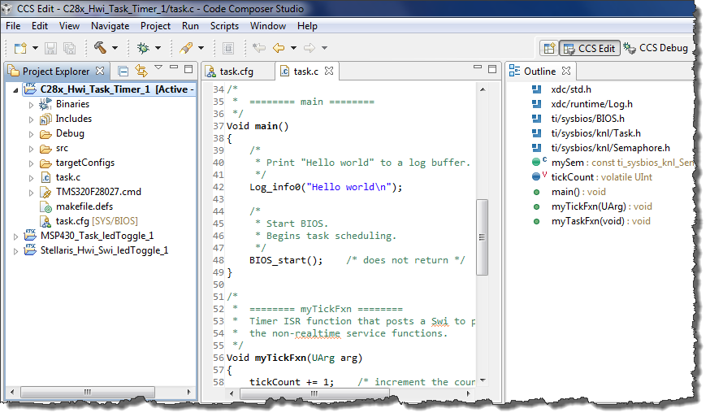
CCS GUI – EDIT Perspective
Menus & Buttons
Specific actions related to EDIT’ing
Perspectives
EDIT and DEBUG
Project Explorer
Project(s)
Source Files
Source EDIT’ing
Tabbed windows
Color-coded text
Outline View
Declarations and functions

Slide 38
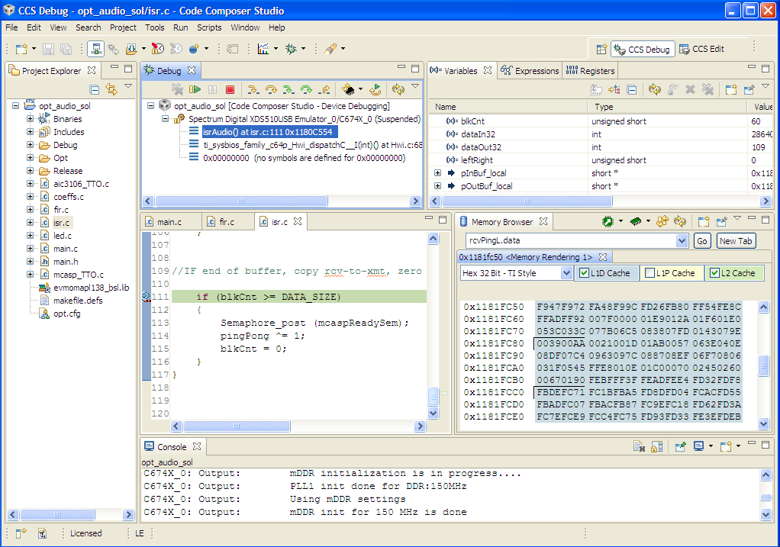
CCS GUI – DEBUG Perspective
Connection Type
Specified in Target Cfg file
What options do users have when connecting to a target?
This window also provides a “call” stack
Menus & Buttons
Related to DEBUG’ing
Play, pause, terminate
DEBUG Windows
Watch variables
Memory browser
PC execution point
Console window

Slide 39
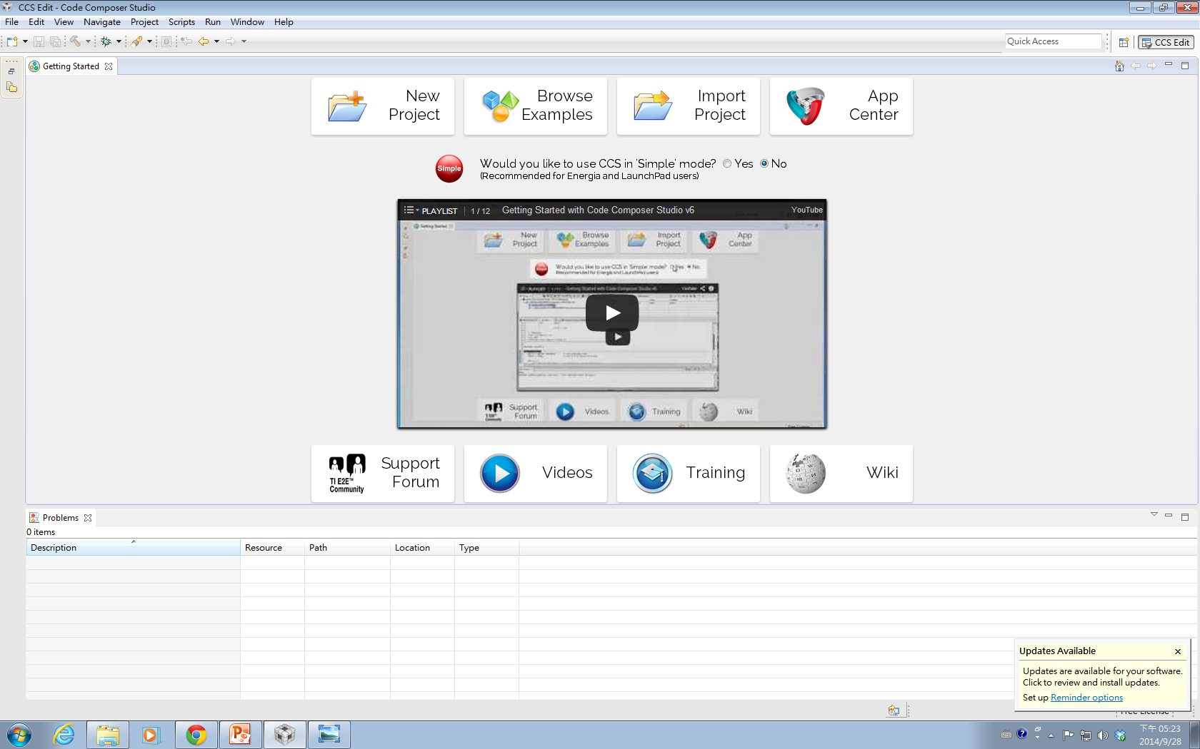
Create a New CCS Project
1

Slide 40
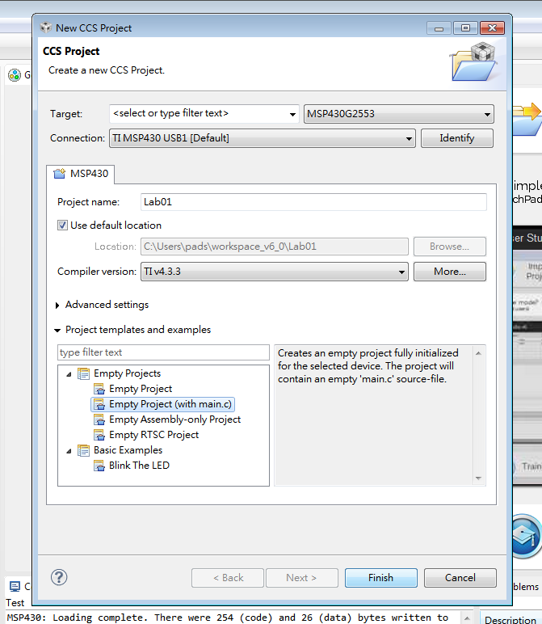
Create a New CCS Project
Type 2553 to find MSP430G2553
2
3
Type the project name
4
5

Slide 41
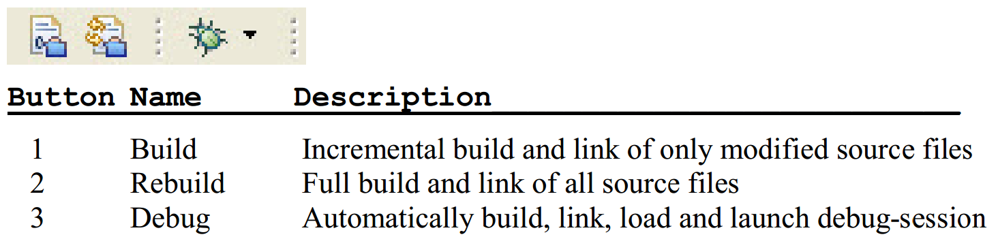
Build and Load the Project
Three buttons on the horizontal toolbar control code generation. You can move your mouse over each button to read their descriptions.
Click the “Build” button and watch the tools run in the Console window. Check for any errors in the Problems window.

Slide 42
Build and Load the Project
CCS can automatically save modified source files, build the program, open the debug perspective view for debugging, download the program to the target, and run the program at the beginning of the main() function
Click on the “Debug” button (green bug) or
Click Target → Debug Active Project

Slide 43
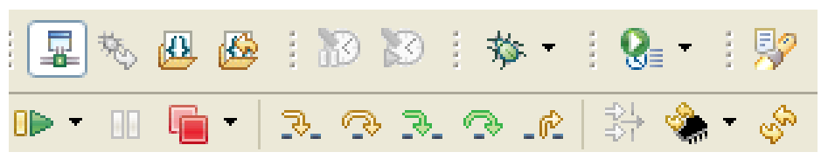
Debug Environment
The basic buttons that control the debug environment are located in the top of CCS:
At this point you should still be at the beginning of main(). Click the Run button to run the code.
Notice that the LEDs are toggling, as expected.
RUN

Slide 44
End Debug Session and Close Project
The Terminate All button will terminate the active debug session, close the debugger and return CCS to the “C/C++ Perspective” view
Click Target → Terminate All or use the Terminate All button
Next, close the project by right-clicking on project-name in the C/C++ Projects window and select Close Project.

Slide 45
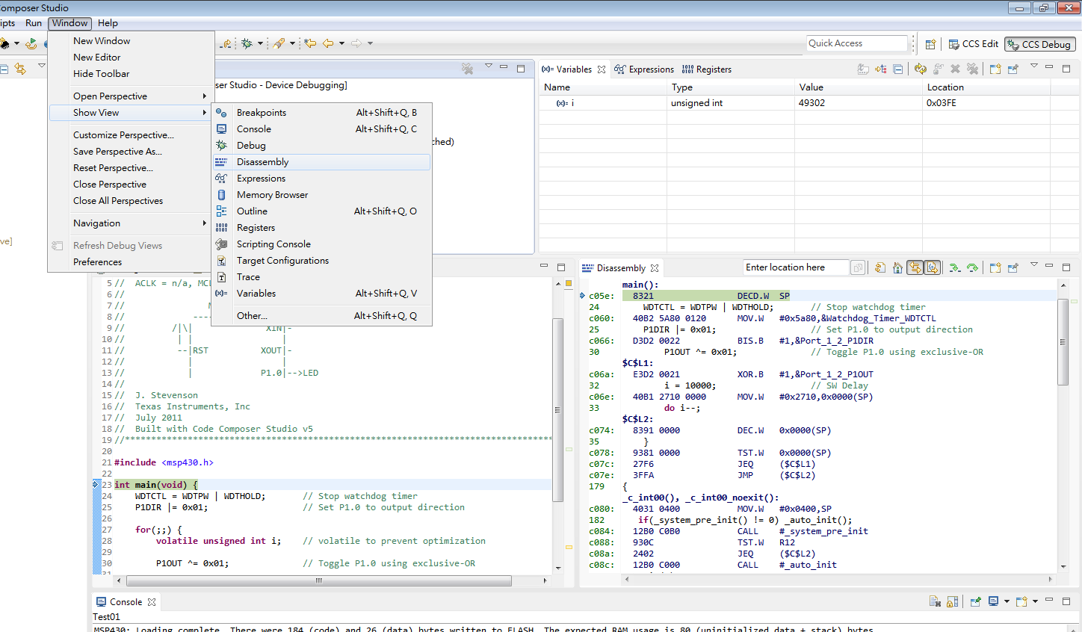
Use Disassembly Window in Debug Mode

Slide 46
Summary
Basic structure of MSP430 LaunchPad:
MSP430 CPU and memory
MSP430 I/O ports and LaunchPad I/O connections
First MSP430 program
C and assembly
Importance of bit/byte manipulation
Management and allocation of memory
Development environment

