Slide 1
CS4101 Introduction to Embedded Systems Design and Implementation
Prof. Chung-Ta King
Department of Computer Science
National Tsing Hua University, Taiwan
Materials from Computers as Components: Principles of Embedded Computing System Design, Wayne Wolf, Morgan Kaufman; An Embedded Software Primer, David E. Simon, Addison Wesley

Slide 2
Recap
More and more physical things will be augmented or embedded with computing
Things become “smarter”
Computing becomes ubiquitous
An embedded system is a system that is embedded with programmable computers for specific applications of that system
Why embedded systems?
Faster, more flexible development at lower cost
More complex functionalities

Slide 3
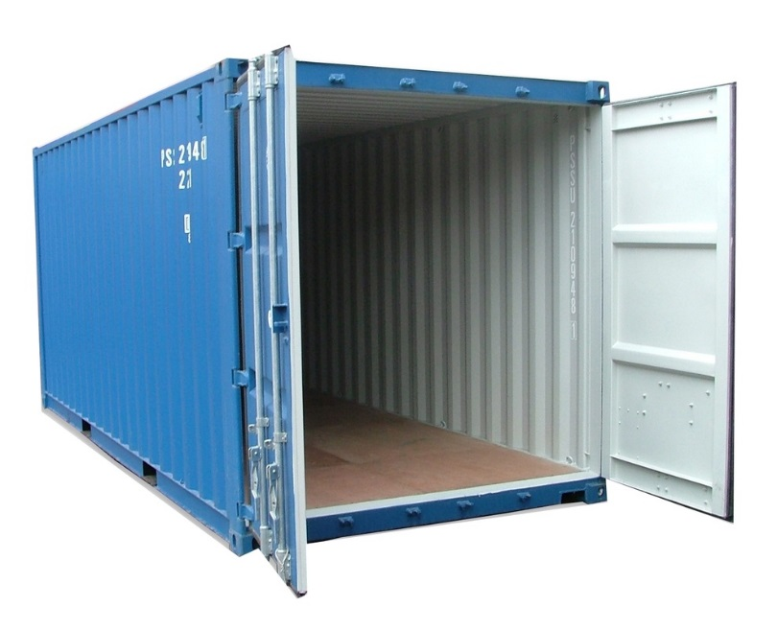
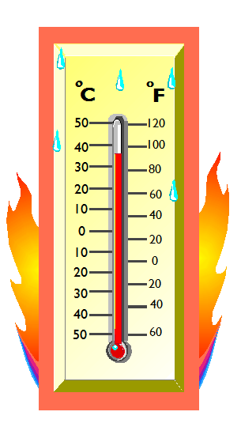
Suppose You Have a Need
To monitor the temperature of the interior of a cargo container
Monitor the temperature continuously
If the temperature rises above a threshold, immediately sound an alarm and notify the headquarter
How to start from here?

Slide 4
Typical Design Flow
requirements
Top-down
design
specification
architecture
Bottom-up
design
Real design often iterative
component
development
system
integration

Slide 5
Requirements
requirements
specification
From needs to product/service ideas and requirements
Plain language description of what the user wants and expects to get
A step of problem definition
May be developed in several ways:
Talking directly to customers
Talking to marketing representatives
Providing prototypes to users for comment
architecture
component
development
outputs
f
inputs
system
integration
Describe “WHAT”, not “HOW”
Notes:
定題, 而不是解題 → 分辨敘述中何者為題目, 何者為解題方法, e.g.
Apple as an example, go pro

Slide 6
Requirements
requirements
specification
Exploit different solution strategies and tradeoff for the best product/service idea
e.g. to develop a thermometer with communication capability that monitors the temperature of containers and issues alarms
May involve iterative refinements between problem and solutions
Focus on the chosen product/service idea and work out further details
Describe how the end product is used by the user, i.e. describe the system from the perspective of the user
architecture
component
development
system
integration

Slide 7
Requirements
Functional requirements: Internals as a black box and describe only the outputs as a function of inputs
Sound an alarm when temperature rises above a threshold
Notify backend server when temperature rises above a threshold and drops below the threshold
Buttons to reset the device
Non-functional requirements:
Performance, reliability, etc.
Size, weight, etc.
Power consumption
Cost
outputs
inputs
f
Notes:
Most embedded systems are responsive → respond to external stimulus

Slide 8
Requirements Form
Name | Container thermometer
Purpose | Monitor temperature of containers
Inputs | Reset
Outputs | LED alarm, serial port
Performance | Response time < 1 sec
Manufacturing cost | $20
Power | 100 mW
Physical size/weight | < 2” x 2”, 4 g

Slide 9
Specification
requirements
More precise, usually quantitative description of the system:
Should not imply a particular architecture
List assumptions
e.g., normal temp. monitoring: every 5 min above threshold: every 5 sec
May include functional and non-functional elements
May be executable or may be in mathematical form for proofs
e.g. UML (Unified Modeling Language)
specification
architecture
component
development
system
integration
Notes:
Quantitative to facilitate checking of conformance of the end product
Taiwan’s ability to give spec (??) → easy for components but hard for systems

Slide 10
Architecture Design
requirements
What major components satisfy the spec.?
Need to know what are available
Hardware/software partition
Hardware components:
CPUs, peripherals, etc.
e.g. MSP430 CPU, thermometer
Software components:
Major programs and their operations
e.g. no OS, thermometer driver, PC driver
Must take into account functional and non-functional specifications
specification
architecture
component
development
system
integration

Slide 11
Design Considerations
Environment which the embedded system is in
External and internal stimulus sources that interact with the embedded system ← inputs and outputs
Actions and events caused by stimulus
Elements of the embedded system that could be affected by the stimulus
Desired system responses to the stimulus, which reflects one or more system requirements ← algorithm/workflow
How can the system responses be measures, evaluated, validated?
Notes:
Structure and operation flow

Slide 12
Component Development
requirements
Actual implementation of individual hardware and software components
Must spend time architecting the system before you start coding
Some components are ready-made, some can be modified from existing designs, others are to be designed from scratch
e.g. MSP430 CPU, thermometer
Good surveys help
specification
architecture
component
development
system
integration
Notes:
Interface is important, team work

Slide 13
System Integration
requirements
Put together the components
Many bugs appear only at this stage
Require good interface definition from the start
Have a plan for integrating components to uncover bugs quickly, test as much functionality as early as possible → test and verification
specification
architecture
component
development
system
integration

Slide 14

System Development
Now you have a better idea of the requirements, specifications, and architecture of the container thermometer
How to proceed to develop the components and integrate the system?
Real hardware? Programming environment?
requirements
specification
architecture
component
development
system
integration

Slide 15
Development Environment
Host: a computer running programming tools for development of the programs
Target: the HW on which code will run
After program is written, compiled, assembled and linked, it is transferred to the target
X86
MSP430
Host system
Target system

Slide 16
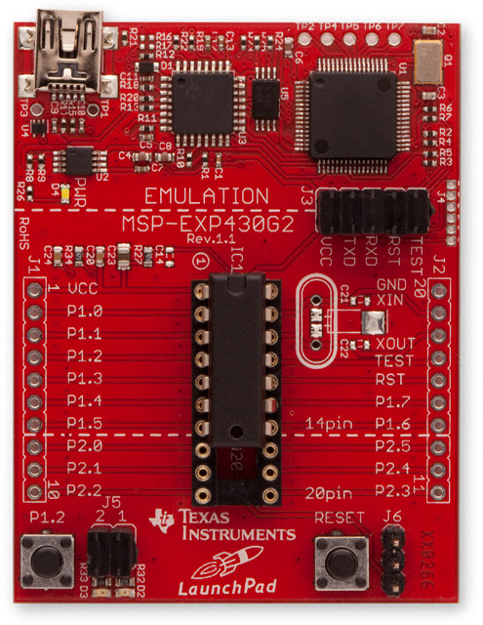
What If Real HW Not Available?
Development board:
Before real hardware is built, software can be developed and tested using development boards
Development boards usually have the same CPU as the end product and provide many IO peripherals for the developed software to use as if it were running on the real end product
Tools for program development
Integrated Development Environment (IDE): cross compiler, linker, loader, …
OS and related libraries and packages

Slide 17
Cross Compiler
Runs on host but generates code for target
Target usually have different architecture from host. Hence compiler on host has to produce binary instructions that will be understood by target

Slide 18
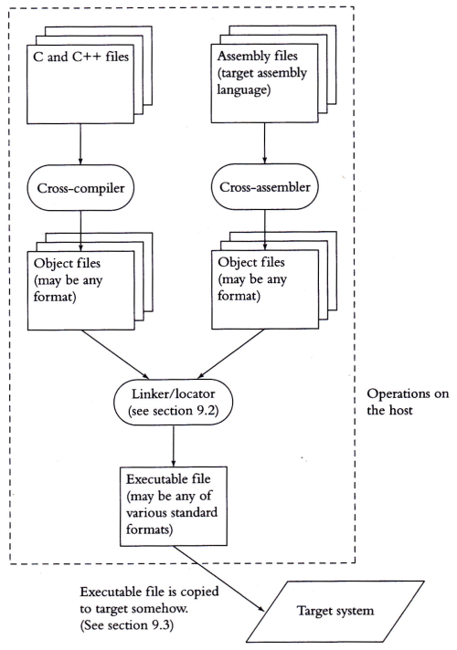
Development Process
Process for creating executables that are built on host but meant for the target
Tools are compatible with each other → a toolchain
Binutils: as, ld
Glibc：C runtime Lib
GCC：C/C++ compiler

Slide 19
Linker/Locators
For computers:
Linker: creates an image file to be run on host
Loader: loads image file into memory during run-time
For embedded systems:
Locater: creates a file, containing binary image or other format, that will be copied onto target, which run on its own (not through loader)
It needs exact addresses beforehand
Certain parts of program in ROM and some in RAM
Normally done by dividing program in segments
Locator needs to be told where in memory to place segments

Slide 20
Summary
Development of a system usually involves:
Requirement, specification, architecture design, component development, system integration, test and validation
Development environment of an embedded system often includes
Development host with toolchain: cross compiler, linker/loader, library, emulator
Development board

