Slide 1
CS4101 Introduction to Embedded Systems Lab 11: FreeRTOS
Prof. Chung-Ta King
Department of Computer Science
National Tsing Hua University, Taiwan
(Materials are from http://www.freertos.org/RTOS.html)

Slide 2
Introduction
In this lab , we will learn
How to manage tasks and timers in FreeRTOS?
How to port FreeRTOS onto NuMaker TRIO?

Slide 3
Real Time Systems
Real time/embedded systems are designed to provide a timely response to real world events
Events occurring in the real world can have deadlines before which the real time/embedded system must respond
The RTOS scheduling policy must ensure these deadlines are met
It is thus important to decide how time is measured and tracked

Slide 4
Time in FreeRTOS
FreeRTOS measures time using a tick count variable
A timer interrupt (the RTOS tick interrupt) increments the tick count with strict temporal accuracy
This allows FreeRTOS to measure time to a resolution of the chosen timer interrupt frequency, configured by the configTICK_RATE_HZ constant in FreeRTOSConfig.h
FreeRTOS API calls always specify time in tick interrupts (or ‘ticks’)
The portTICK_RATE_MS constant is provided to allow time delays to be converted from the number of tick interrupts into milliseconds

Slide 5
Task Scheduling in FreeRTOS
FreeRTOS scheduling:
Each time the tick count is incremented, FreeRTOS checks to see if it is now time to unblock or wake a task
If the task woken or unblocked during the tick ISR has a priority higher than that of the interrupted task, the newly woken/unblocked task is scheduled to run
Such a context switch is said to be preemptive ➔ fixed priority preemptive scheduling

Slide 6
Timers in FreeRTOS
FreeRTOS uses software timer
Specify a function, called the timer’s callback function, to be executed at a set time in the future
Timer must be explicitly created before it can be used
It is essential that timer callback functions never attempt to block, e.g., must not call vTaskDelay(), vTaskDelayUntil()
Timer functionality provided by a timer service task
A set of timer related APIs are provided that use a standard FreeRTOS queue to send commands to the timer service task

Slide 7
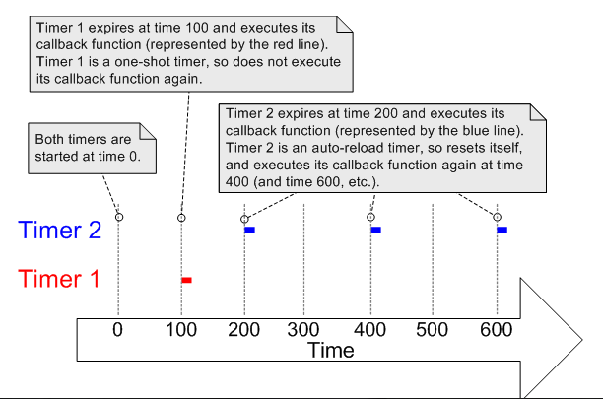
Timers in FreeRTOS
One-shot timer
Execute callback function only once and can be manually re-started
Auto-reload timer
Automatically restart itself after each execution of its callback function, resulting in periodic callback executions

Slide 8
Timers Configuration (FreeRTOSConfig.h)
/* Software timer definitions. */
/* Set to 1 to include timer functionality. */
#define configUSE_TIMERS 1
/* Sets the priority of the timer service task. */
#define configTIMER_TASK_PRIORITY ( 2 )
/* This sets the maximum number of unprocessed commands that the timer command queue can hold at any one time. */
#define configTIMER_QUEUE_LENGTH 5
/* Sets the size of the stack allocated to the timer service task. */
#define configTIMER_TASK_STACK_DEPTH ( 80 )

Slide 9
Example: Create a Timer
int main(void) {
TimerHandle_t xTimer = NULL;
unsigned long ulTimer = 1UL;
xTimer = xTimerCreate(
"Timer", /* A text name to help debugging */
1000/portTICK_RATE_MS, /* Timer period, i.e. 1 s */
pdTRUE, /* Timer type, auto-reload or one-shot*/
(void *) pvTimerID, /* Identifier of created timer */
TimerCallbackFunc /* Callback function */
);
if( xTimer != NULL ) {
xTimerStart(xTimer, 0);
}
}
Notes:
ulTimer = (unsigned long) 1

Slide 10
Example: Create a Timer
void TimerCallbackFunc(TimerHandle_t xTimer) {
unsigned long index;
/* Identify which timer calls this function */
index = (unsigned long) pvTimerGetTimerID(xTimer);
/* Toggle the LED */
GPIO_TOGGLE(PB15);
}

Slide 11
Port FreeRTOS onto NuMaker TRIO
Download FreeRTOS source code
http://sourceforge.net/projects/freertos/files/latest/download?source=files
Use smpl_Debug project of NuMaker as an example below
Add head file path into NuMaker project
<FreeRTOS>\Source\include
<FreeRTOS>\Source\portable\RVDS\ARM_CM0
<FreeRTOS>\Demo\CORTEX_M0_STM32F0518_IAR

Slide 12
Port FreeRTOS onto NuMaker TRIO
1. Click here to call out Options window
2. Click here to add head file path

Slide 13
Port FreeRTOS onto NuMaker TRIO
1. Add new path
2. Find the path

Slide 14
Port FreeRTOS onto NuMaker TRIO

Slide 15
Port FreeRTOS into NuMaker TRIO
Add a new Group in the project
Add source file into project
<FreeRTOS>\Source\<all>
<FreeRTOS>\Source\portable\MemMang\heap1.c
<FreeRTOS>\Source\portable\RVDS\AMR_M0\port.c

Slide 16
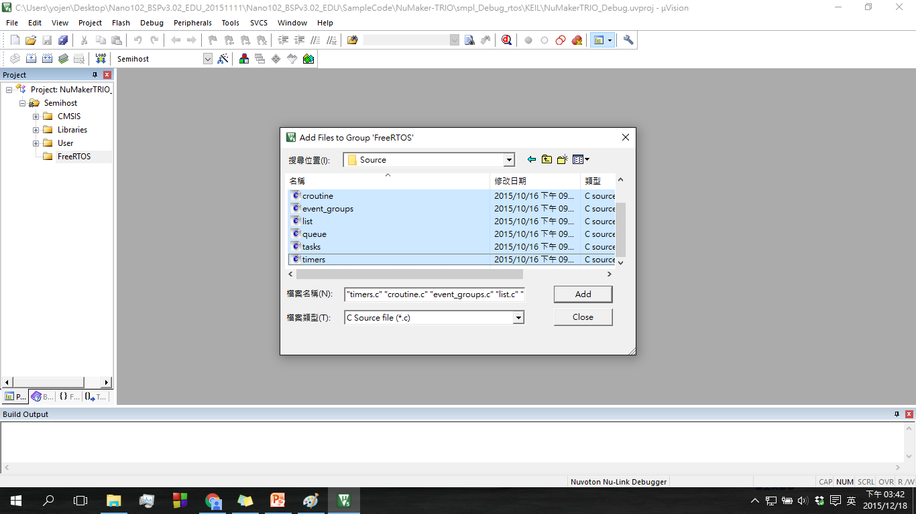
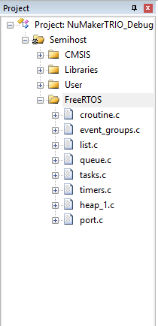
Port FreeRTOS onto NuMaker TRIO
1. Right click to add new Group
2. Double click to add source code

Slide 17
Port FreeRTOS onto NuMaker TRIO
Modify <FreeRTOS>/Demo/CORTEX_M0_STM32F0518_IAR /FreeRTOSConfig.h
Add #include "Nano1X2Series.h "
modify configMINIMAL_STACK_SIZE from 60 to 128
modify configTOTAL_HEAP_SIZE from 6500 to 5*1024
Modify configCHECK_FOR_STACK_OVERFLOW from 2 to 0
Modify <FreeRTOS>/Source/portable/RVDS/ARM_CM0/port.c
Add #include "Nano1X2Series.h"

Slide 18
Sample Code
int main(void){
SYS_Init();
GPIOInit(); // Initial GPIO
// Create myTask1() with priority 2
// Priorities: Higher numbers are higher priority
xTaskCreate(myTask1, "LED1", configMINIMAL_STACK_SIZE,
NULL, 2, NULL);
//Create myTask2()
xTaskCreate(myTask2, "LED2", configMINIMAL_STACK_SIZE,
NULL, 2, NULL);
vTaskStartScheduler(); // Start Scheduling
/* Will only get here if there was insufficient memory
to create the idle task. */
while(1);
}

Slide 19
Sample Code
void myTask1(){ // Task 1
portTickType xLastWakeTime = xTaskGetTickCount();
while(1){
GPIO_TOGGLE(PA14); // Toggle LED
vTaskDelayUntil(&xLastWakeTime,
(1000/portTICK_RATE_MS)); // Delay 1000 ms
}
}
void myTask2(){ // Task 2
portTickType xLastWakeTime = xTaskGetTickCount();
while(1){
GPIO_TOGGLE(PB15); // Toggle LED
vTaskDelayUntil(&xLastWakeTime,
(500/portTICK_RATE_MS)); // Delay 500 ms
}
}

Slide 20
Lab: Basic 1
Port FreeRTOS onto your NuMaker TRIO
Run the sample code successfully
Modify the sample code to use two timers instead of two tasks
FreeRTOS API
http://www.freertos.org/modules.html#API_reference

Slide 21
Lab: Basic 2
Create three tasks
Task 1: run every second to do a dumb loop 1000 times and print 0, 1, …, 9 in round robin on the display
Task 2: run every 2 seconds to do a dumb loop 500 times and print a, b, …, z in round robin on the display
Task 3: run every 0.5 second to detect if light is blocked; if so, print “Dark” on the display, else print “Bright”
Remember to clear the display before you print
Observe what happen if all three tasks have the same priority.
Set the priority of task 3 higher and observe whether the system responds to light changes better.

Slide 22
Lab: Bonus
Use FreeRTOS to complete Basic 2 of Lab 8
The traffic light will change to the green light when there is an ambulance passing.
Let the blue LED represent the yellow traffic light, and the buzzer indicates the passing of an ambulance.
Normally the red LED is on for 3 sec, then the blue LED is on for 2 sec, then the green LED is on for 4 sec, and repeat.
The buzzer will be turned on for 4 sec in 2 Hz. The on time is set randomly between 6 and 15 sec. When the buzzer is on, the traffic light will be turned to the green LED. After the buzzer is turned off, the traffic light turns to normal.

