Slide 1
CS4101 Introduction to Embedded Systems Lab 11: Sensors
Prof. Chung-Ta King
Department of Computer Science
National Tsing Hua University, Taiwan

Slide 2
Introduction
In this lab , we will learn
To use accelerometer of NuMarker to detect gestures
To use gyroscope of NuMarker to detect tilts

Slide 3
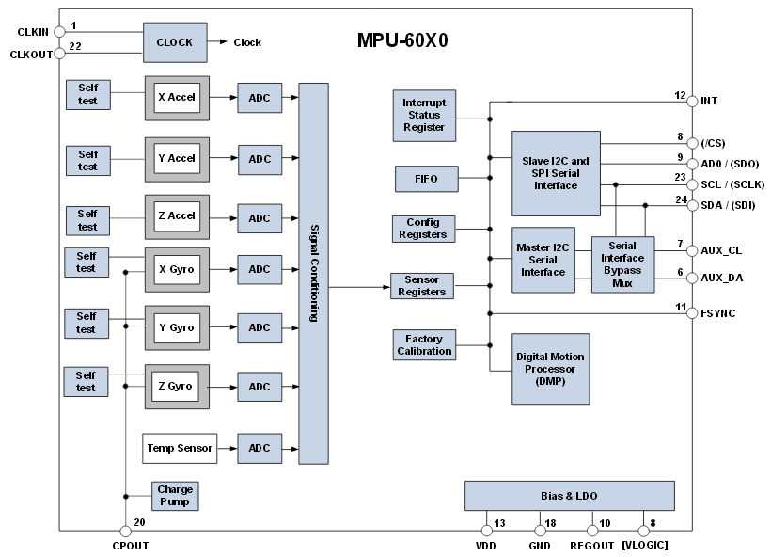
MPU-6050
3-axis accelerometer
3-axis gyroscope

Slide 4
MPU-6050: Accelerometer
Two bytes (high and low) to present each axis
Read_MPU6050_AccY(void):
LowByte =MPU6050_ReadByte(MPU6050_ACCEL_YOUT_L);
HighByte =MPU6050_ReadByte(MPU6050_ACCEL_YOUT_H);
AccY = (HighByte<<8) | LowByte ;

Slide 5
MPU6050 - Gyroscope
Similar to the accelerometer
Read_MPU6050_GyroX(void):
LowByte = MPU6050_ReadByte(MPU6050_GYRO_XOUT_L);
HighByte = MPU6050_ReadByte(MPU6050_GYRO_XOUT_H);
GyroX = (HighByte<<8) | LowByte ;

Slide 6
MPU6050.h/.c (Library/NuMakerLib/Include,Source)
#define MPU6050_I2C_SLA 0xD0
#define MPU6050_I2C_PORT I2C1
void MPU6050_WriteByte(uint8_t MPU6050_reg,
uint8_t MPU6050_data) {
uint8_t data[1];
data[0]=MPU6050_data;
I2C_writeBytes(MPU6050_I2C_PORT, MPU6050_I2C_SLA,
MPU6050_reg, 1, data);
}
uint8_t MPU6050_ReadByte(uint8_t MPU6050_reg){
uint8_t data[1];
I2C_readBytes(MPU6050_I2C_PORT, MPU6050_I2C_SLA,
MPU6050_reg, 1, data);
return(data[0]);
}

Slide 7
smpl_I2C_MPU6050 (SampleCode/NuMaker-TRIO)
int32_t main(){
int16_t accX, accY, accZ;
int16_t gyroX, gyroY, gyroZ;
SYS_Init(); Init_MPU6050();
I2C_Open(I2C1, I2C1_CLOCK_FREQUENCY);
while(1) {
accX = Read_MPU6050_AccX();
accY = Read_MPU6050_AccY();
accZ = Read_MPU6050_AccZ();
printf("Acc: %6d, %6d, %6d, ", accX,accY,accZ);
gyroX = Read_MPU6050_GyroX();
gyroY = Read_MPU6050_GyroY();
gyroZ = Read_MPU6050_GyroZ();
printf("Gyro: %6d, %6d, %6d", gyroX,gyroY,gyroZ);
}
}

Slide 8
Lab: Basic 1
Use your NuMaker to cast lots (搖籤)
Shake your NuMarker left and right very hard for preparation.
Then, make a sudden up-down move to cast the lots.
Print the cast lot on the display, which is a word from “Bad”, “Good”, and “Great”, depending on the intensity of the left-right shake:
If the intensity is low, print ‘Bad’.
If the intensity is medium, print ‘Good’.
If the intensity is high, print ‘Great’.

Slide 9
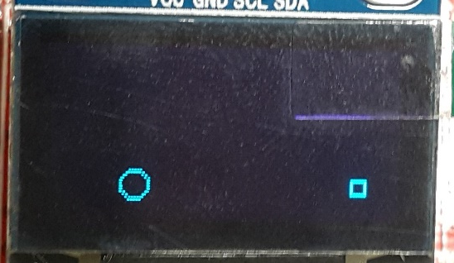
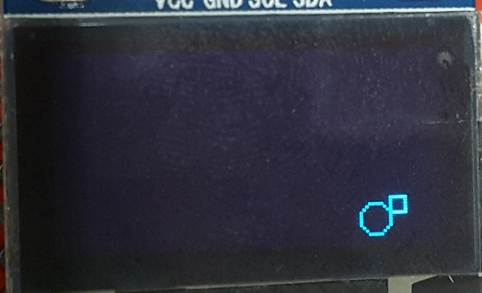
Lab: Basic 2
Game of ball rolling
There is a ball and a destination flag on the display.
The player has to control the ball by tilting the device (right, left, up, down) to move close to the flag.
If the ball touches the destination flag, the game is won. A new game is then started with the ball and the flag at new random locations.
You have to protect the ball from going through the screen boundaries by setting proper conditions.
Sample

Slide 10
Lab: Bonus
Enhance Basic 2 to add obstacles. You have to make sure that there is at least one path from the starting position of the ball to the destination flag.

