Slide 1
CS4101 Introduction to Embedded Systems Lab 9: NuMaker ADC and LCD
Prof. Chung-Ta King
Department of Computer Science
National Tsing Hua University, Taiwan

Slide 2
Introduction
In this lab, we will learn
Using ADC of NuMaker to measure temperature
Displaying with LCD through I²C

Slide 3
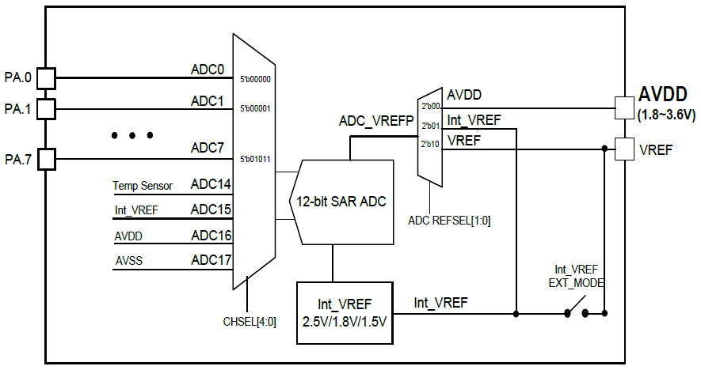
ADC Block Diagram

Slide 4
Three Operation Modes
Single mode:
A/D conversion is performed one time on a specified channel
Single-cycle scan mode:
A/D conversion is performed one cycle on all specified channels with the sequence from the lowest numbered channel to the highest numbered channel
Continuous scan mode:
A/D converter continuously performs single-cycle scan mode until software stops it

Slide 5
Functions in adc.h (Library/StdDriver/inc)
//Get the latest ADC conversion data
ADC_GET_CONVERSION_DATA(adc, u32ChNum)
// adc: Base address of ADC module
// u32ChNum: Channel number
//Set ADC input channel.
// Enabled channel will be converted while ADC starts
ADC_SET_INPUT_CHANNEL(adc, u32Mask)
// adc: Base address of ADC module
// u32Mask: Channel enable bit, one for an input channel
// Configure HW trigger condition and enable HW trigger
ADC_SetExtraSampleTime(ADC_T *adc, uint32_t u32ChNum, uint32_t u32SampleTime)

Slide 6
smpl_ADC4_GL5516 (SampleCode/NuMaker-TRIO)
// Define Clock source
#define MCU_CLOCK_SOURCE
#define MCU_CLOCK_SOURCE_HIRC // HXT, LXT, HIRC, LIRC
#define MCU_CLOCK_SOURCE_LXT
#define MCU_CLOCK_FREQUENCY 32000000 //Hz
// Define MCU Interfaces
#define MCU_INTERFACE_ADC
#define ADC_CLOCK_SOURCE_HIRC // HXT,LXT,PLL,HIRC,HCLK
#define ADC_CLOCK_DIVIDER 1
#define PIN_ADC_4 // To Photoresistor or IR Diode
#define ADC_INPUT_MODE ADC_INPUT_MODE_SINGLE_END
// SINGLE_END, DIFFERENTIAL
#define ADC_OPERATION_MODE ADC_OPERATION_MODE_CONTINUOUS
// SINGLE, SINGLE_CYCLE, CONTINUOUS

Slide 7
smpl_ADC4_GL5516 (SampleCode/NuMaker-TRIO)
#include <stdio.h>
#include "Nano1X2Series.h"
#include "MCU_init.h"
#include "SYS_init.h“
void Init_ADC(void) { // Initialize ADC
ADC_Open(ADC, ADC_INPUT_MODE,
ADC_OPERATION_MODE, ADC_CHANNEL_MASK);
ADC_POWER_ON(ADC);
// Enable ADC interrupt
ADC_EnableInt(ADC, ADC_ADF_INT);
// Enable ADC interrupt
NVIC_EnableIRQ(ADC_IRQn);
//ADC conversion start
ADC_START_CONV(ADC);
}

Slide 8
smpl_ADC4_GL5516 (SampleCode/NuMaker-TRIO)
void ADC_IRQHandler(void) {
uint32_t u32Flag;
uint32_t u32ADCvalue;
// Get ADC conversion finish interrupt flag
u32Flag = ADC_GET_INT_FLAG(ADC, ADC_ADF_INT);
if(u32Flag & ADC_ADF_INT) {
u32ADCvalue = ADC_GET_CONVERSION_DATA(ADC, 4);
printf("GL5516 = %d\n",u32ADCvalue);
}
ADC_CLR_INT_FLAG(ADC, u32Flag);
}
int32_t main() {
SYS_Init(); Init_ADC();
while(1) { }
}

Slide 9
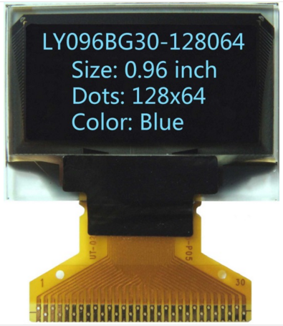
Outline
Using ADC of NuMaker to measure temperature
Displaying with LCD through I²C
0.96 inch, 128x64, OLED/PLED, with driver: SSD1306 (single-chip CMOS OLED/PLED driver)

Slide 10
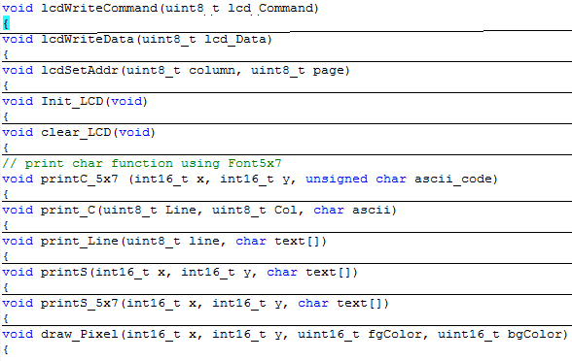
I2C_SSD1306.c (Library/NuMakerLIb/Source)

Slide 11
I2C_SSD1306.c (Library/NuMakerLIb/Source)
void print_C(uint8_t Line, uint8_t Col, char ascii) {
uint8_t j, i, tmp;
for (j=0;j<2;j++) {
lcdSetAddr(Col*8, Line*2+j);
for (i=0;i<8;i++) {
tmp=Font8x16[(ascii-0x20)*16+j*8+i];
lcdWriteData(tmp); } }
}
void print_Line(uint8_t line, char text[]) {
uint8_t Col;
for (Col=0; Col<strlen(text); Col++)
print_C(line, Col, text[Col]);
}
void lcdWriteData(uint8_t lcd_Data){
uint8_t data[1]; data[0]=lcd_Data;
I2C_writeBytes(LCD_I2C_PORT,LCD_I2C_SLA,0x40,1,data);
}

Slide 12
I2C_SSD1306.c (Library/NuMakerLIb/Source)
void draw_LCD(unsigned char *buffer){
uint8_t x,y;
for (x=0; x<LCD_Xmax; x++) {
for (y=0; y<(LCD_Ymax/8); y++) {
lcdSetAddr(x ,y);
lcdWriteData(buffer[x+y*LCD_Xmax]); }
}
}
void clear_LCD(void){
int16_t x, Y;
for (Y=0;Y<LCD_Ymax/8;Y++) {
lcdSetAddr(0, Y);
for (x=0;x<LCD_Xmax;x++) lcdWriteData(0x00); }
}

Slide 13
I2C_SSD1306.c (Library/NuMakerLIb/Source)
void draw_Bmp8x8(int16_t x, int16_t y,
uint16_t fgColor, uint16_t bgColor,
unsigned char bitmap[]) {
uint8_t t,i,k, kx,ky;
if (x<(LCD_Xmax-7) && y<(LCD_Ymax-7))
for (i=0;i<8;i++){
kx=x+i; t=bitmap[i];
for (k=0; k<8; k++) {
ky=y+k;
if (t&(0x01<<k))
draw_Pixel(kx,ky,fgColor,bgColor); }
}
}
// Many other sizes to draw, e.g. draw_Bmp32x8

Slide 14
smpl_I2C_LCD (SampleCode/NuMaker-TRIO)
MCU_init.h
//Define Clock source
#define MCU_CLOCK_SOURCE
#define MCU_CLOCK_SOURCE_HIRC // HXT, LXT, HIRC, LIRC
#define MCU_CLOCK_SOURCE_LXT
#define MCU_CLOCK_FREQUENCY 32000000 //Hz
//Define MCU Interfaces
#define MCU_INTERFACE_I2C1
#define I2C1_CLOCK_FREQUENCY 400000 //Hz
#define PIN_I2C1_SCL_PC10
#define PIN_I2C1_SDA_PC11

Slide 15
smpl_I2C_LCD (SampleCode/NuMaker-TRIO)
main.c
#include <stdio.h>
#include "Nano1X2Series.h"
#include "MCU_init.h"
#include "SYS_init.h"
#include "I2C_SSD1306Z.h“
int32_t main(){
SYS_Init();
I2C_Open(I2C1, I2C1_CLOCK_FREQUENCY);
Init_LCD();
clear_LCD();
print_Line(0, "NuMaker TRIO");
print_Line(1, "Cortex-M0 @32MHz");
}

Slide 16
Lab 9
Basic 1:
Modify Basic 2 of Lab 8 so that whenever the ambulance passes through the traffic light, the temperature is measured at 2 Hz.
After the ambulance passed, the average temperature in Celsius is displayed on the LCD.
Hint: Vtemp (mV) = -1.73 (mV/℃) x Temperature (℃) + 1498.6 (mV).

Slide 17
Lab 9
Basic 2:
Print the text “Hi, NTHU!” to the LCD and make a marquee (跑馬燈) effect by scrolling from left to right.

