Slide 1
CS4101 Introduction to Embedded Systems Lab 6: Low-Power Optimization
Prof. Chung-Ta King
Department of Computer Science
National Tsing Hua University, Taiwan

Slide 2
Introduction
In this lab, we will learn power optimization of MSP430 LanuchPad
Configuring the low-power modes of MSP430

Slide 3
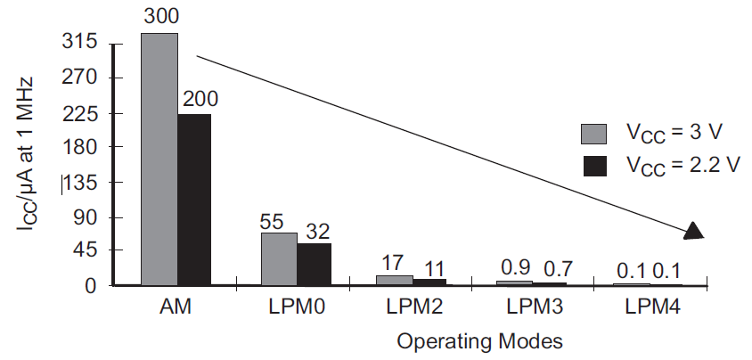
MSP430 Low-Power Modes
Mode | CPU and Clocks
Active | CPU active; all enabled clocks active
LPM0 | CPU, MCLK disabled; SMCLK, ACLK active
LPM1 | CPU, MCLK disabled; DCO disabled if not for SMCLK; ACLK active
LPM2 | CPU, MCLK, SMCLK, DCO disabled; ACLK active
LPM3 | CPU, MCLK, SMCLK, DCO disabled; ACLK active
LPM4 | CPU and all clocks disabled

Slide 4
Controlling Low Power Modes
Through four bits in Status Register (SR) in CPU
SCG0 (System clock generator 0): when set, turns off DCO, if DCOCLK is not used for MCLK or SMCLK
SCG1 (System clock generator 1): when set, turns off the SMCLK
OSCOFF (Oscillator off): when set, turns off LFXT1 crystal oscillator, when LFXT1CLK is not use for MCLK or SMCLK
CPUOFF (CPU off): when set, turns off the CPU
All are clear in active mode

Slide 5
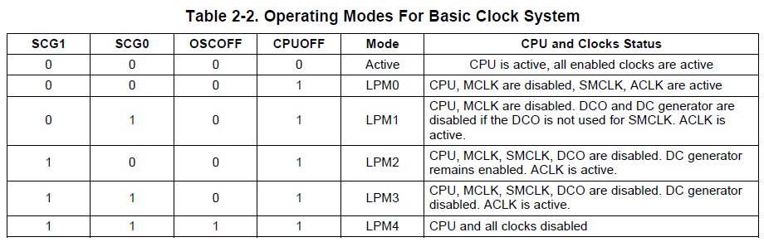
Controlling Low Power Modes
Status bits and low-power modes

Slide 6
Sample Code 1 for ADC10
Repetitive single conversion:
A single sample is made on A1 with reference to Vcc
If A1 > 0.5*Vcc, P1.0 set, else reset.
Software sets ADC10SC to start sample and conversion. ADC10SC automatically cleared at end of conversion.
Use ADC10 internal oscillator to time the sample and conversion.

Slide 7
Sample Code 1 for ADC10
#include "msp430.h" void main(void) { WDTCTL = WDTPW + WDTHOLD; // Stop WDT // H&S time 16x, interrupt enabled ADC10CTL0 = ADC10SHT_2 + ADC10ON + ADC10IE; ADC10CTL1 = INCH_1; // Input A1 ADC10AE0 |= 0x02; // Enable pin A1 for analog in P1DIR |= 0x01; // Set P1.0 to output for (;;) { ADC10CTL0 |= ENC + ADC10SC; // Start sampling __bis_SR_register(CPUOFF + GIE); // Sleep if (ADC10MEM < 0x1FF) // 0x1FF = 511 P1OUT &= ~0x01; // Clear P1.0 LED off else P1OUT |= 0x01; // Set P1.0 LED on } }
Notes:
6
Pulse-width modulation (PWM): The load is switched on and off periodically so that the average voltage has the desired value. The fraction of the time while the load is active is called the duty cycle D.
6

Slide 8
Sample Code 1 for ADC10
// ADC10 interrupt service routine #pragma vector=ADC10_VECTOR __interrupt void ADC10_ISR(void) { __bic_SR_register_on_exit(CPUOFF); // Clear CPUOFF bit from 0(SR) }
Notes:
7
7

Slide 9
Sample Code 2 for ADC10
Continuous sampling driven by Timer0_A
A1 is sampled 16/second (ACLK/2048) with reference to 1.5V, where ACLK runs at 32 KHz driven by an external crystal.
If A1 > 0.5Vcc, P1.0 is set, else reset.
Timer0_A is run in up mode and its CCR1 is used to automatically trigger ADC10 conversion, while CCR0 defines the sampling period.
Use internal oscillator times sample (16x) and conversion (13x).

Slide 10
Sample Code 2 for ADC10
#include "msp430.h" void main(void) { WDTCTL = WDTPW + WDTHOLD; // Stop WDT // TA1 trigger sample start ADC10CTL1 = SHS_1 + CONSEQ_2 + INCH_1; ADC10CTL0 = SREF_1 + ADC10SHT_2 + REFON + ADC10ON + ADC10IE; __enable_interrupt(); // Enable interrupts. TA0CCR0 = 30; // Delay for Volt Ref to settle TA0CCTL0 |= CCIE; // Compare-mode interrupt. TA0CTL = TASSEL_2 + MC_1; // SMCLK, Up mode. LPM0; // Wait for settle. TA0CCTL0 &= ~CCIE; // Disable timer Interrupt __disable_interrupt();
Notes:
9
Pulse-width modulation (PWM): The load is switched on and off periodically so that the average voltage has the desired value. The fraction of the time while the load is active is called the duty cycle D.
9

Slide 11
Sample Code 2 for ADC10
ADC10CTL0 |= ENC; // ADC10 Enable ADC10AE0 |= 0x02; // P1.1 ADC10 option select P1DIR |= 0x01; // Set P1.0 output TA0CCR0 = 2048-1; // Sampling period TA0CCTL1 = OUTMOD_3; // TACCR1 set/reset TA0CCR1 = 2046; // TACCR1 OUT1 on time TA0CTL = TASSEL_1 + MC_1; // ACLK, up mode // Enter LPM3 w/ interrupts __bis_SR_register(LPM3_bits + GIE); }
Timer_A CCR1 out mode 3: The output (OUT1) is set when the timer counts to the TACCR1 value. It is reset when the timer counts to the TACCR0 value.
Notes:
10
10

Slide 12
Sample Code 2 for ADC10
// ADC10 interrupt service routine #pragma vector=ADC10_VECTOR __interrupt void ADC10_ISR(void){ if (ADC10MEM < 0x1FF) // ADC10MEM = A1 > 0.5V? P1OUT &= ~0x01; // Clear P1.0 LED off else P1OUT |= 0x01; // Set P1.0 LED on } #pragma vector=TIMERA0_VECTOR __interrupt void ta0_isr(void){ TA0CTL = 0; LPM0_EXIT; // Exit LPM0 on return }
Notes:
11
11

Slide 13
Lab 6
Basic 1:
Flash the green LED at 1 Hz in LPM3 using Timer0_A and measure the temperature using ADC10 at 1 Hz driven by Timer0_A. Calculate the average temperature of last 2 sec.
If the average temperature is higher than 30ºC, enter LPM0, measure temperature and flash the red LED at 2 Hz, and calculate the average temperature of the past 2 sec.
If the average temperature is higher than 35ºC, enter active mode, measure temperature and flash both LEDs at 5 Hz, and calculate the average temperature of last 2 sec.

Slide 14
Lab 6
Basic 1: (cont’d)
Go back to the initial state when the average temperature drops below 30ºC.
Draw a finite-state machine to show the logic of your code.
Try to minimize the time spent in the ISR.

Slide 15
Lab 6
Bonus: (Game of Memory)
Put LaunchPad to LPM4 and wait for button input to start the game.
Once the button is pressed, enter LPM0 and turn on the red LED for a random period. After the red LED is turned off, immediately press the button for the duration that the red LED is on.
Calculate the difference between the on-time of the red LED and the button.
If the difference is larger than 0.5 second, then you lose. Flash the green LED at 2 Hz for 3 seconds and return to the waiting state.

Slide 16
Lab 6
Bonus: (cont’d)
At the n^{th} round, turn on the red LED for a random period for n times, with a random interval between two on-time. Ignore button activities during this period of time.
After the n^{th} on-time, immediately press the button for the duration of the sum of the n on-time.
Calculate the difference between the on-time of the red LED and the button.
If the difference is larger than 0.5 second, then you lose. Flash the green LED at 2 Hz for 3 seconds and return to the waiting state. Otherwise, you can enter the next round.

