Slide 1
CS4101 Introduction to Embedded Systems Lab 5: Analog-to-Digital Converter
Prof. Chung-Ta King
Department of Computer Science
National Tsing Hua University, Taiwan

Slide 2
Introduction
In this lab, we will learn ADC of MSP430
Configuration of ADC10
Use of ADC10 to measure the temperature of LauchPad

Slide 3
Simplified Block Diagram of ADC10
Voltage reference
Clock sources
Conversion trigger

Slide 4
ADC10 Registers
Register | Short Form | Register Type | Addr. | Initial State
ADC10 input enable register 0 | ADC10AE0 | Read/write | 04Ah | Reset with POR
ADC10 input enable register 1 | ADC10AE1 | Read/write | 04Bh | Reset with POR
ADC10 control register 0 | ADC10CTL0 | Read/write | 01B0h | Reset with POR
ADC10 control register 1 | ADC10CTL1 | Read/write | 01B2h | Reset with POR
ADC10 memory | ADC10MEM | Read | 01B4h | Unchanged
ADC10 data transfer control register 0 | ADC10DTC0 | Read/write | 048h | Reset with POR
ADC10 data transfer control register 1 | ADC10DTC1 | Read/write | 049h | Reset with POR
ADC10 data transfer start address | ADC10SA | Read/write | 01BCh | 0200h with POR
Where the data is saved
Notes:
power-on reset (PoR)
3

Slide 5
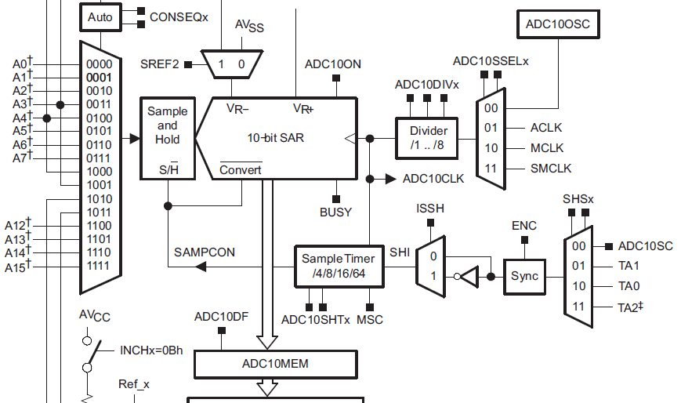
Enabling Sampling and Conversion

Slide 6
Steps for Single Conversion
(1) Configure ADC10, including the ADC10ON bit to enable the module.
The ENC bit must be clear so that most bits in ADC10CTL0 and ADC10CTL1 can be changed.
(2) Set the ENC bit to enable a conversion.
This cannot be done if the module is being configured in (1).
(3) Trigger the conversion.
This is done either by setting the ADC10SC bit or by an edge from Timer_A.
ADC10ON, ENC, ADC10SC are all in control register ADC10CTL0

Slide 7
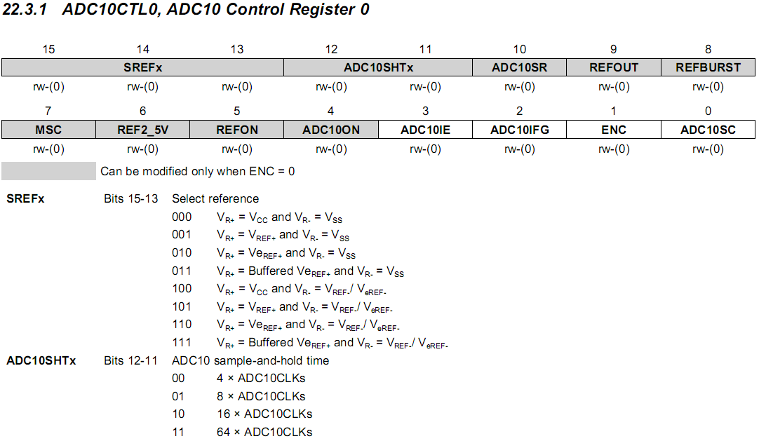
ADC10CTL0
ideal for the temperature sensor
ideal for the temperature sensor
Notes:
6

Slide 8
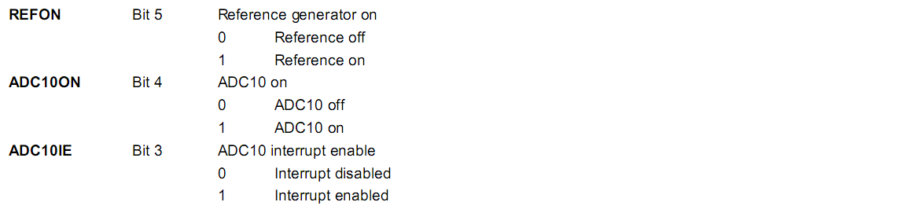
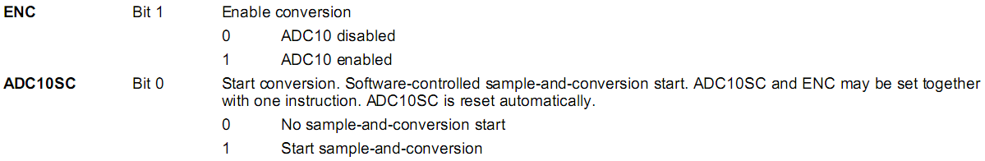
ADC10CTL0 cont’d
ADC10CTL0 = SREF_2 + ADC10SHT_1; // Reference range & SH time
Notes:
The settling time for the internal reference is < 30µs. A value of 5 cycles would be 40µs.
We should allow thirteen ADC10CLK cycles before we read the conversion result. Thirteen cycles of the 5MHz ADC10CLK is 2.6µs. Even a single cycle of the DCO/8 would be longer than that. When the conversion is complete, the encoder and reference need to be turned off.
7

Slide 9
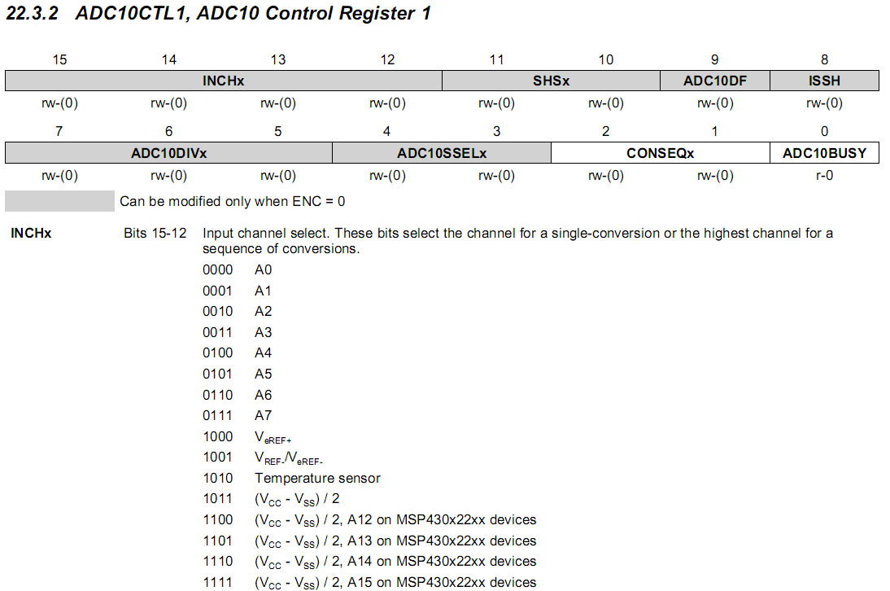
ADC10CTL1
Notes:
8

Slide 10
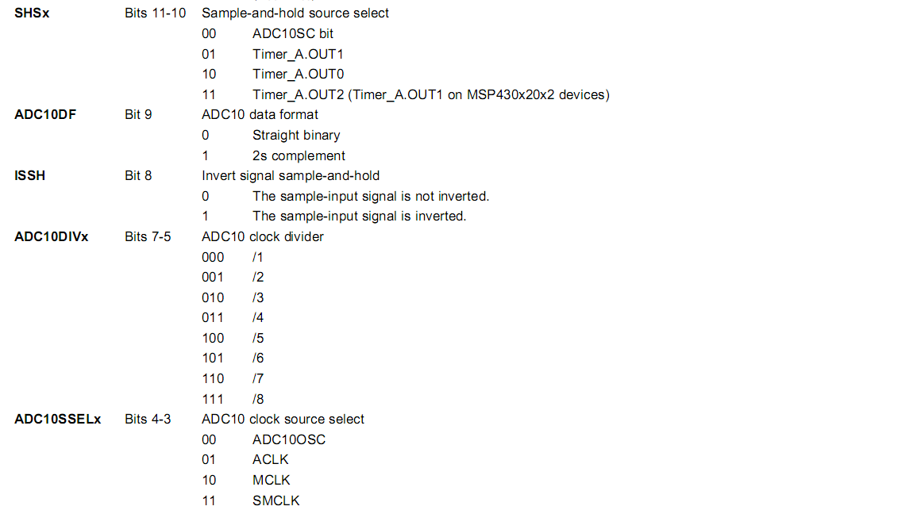
ADC10CTL1 cont’d
ADC10CTL1 = INCH_10 + ADC10DIV_0; // Temp Sensor ADC10CLK
Notes:
9

Slide 11
Sample Code 1 for ADC10
Repetitive single conversion:
A single sample is made on A1 (pin P1.1) with reference to Vcc
If A1 > 0.5*Vcc, P1.0 set, else reset.
Software sets ADC10SC to start sample and conversion. ADC10SC automatically cleared at end of conversion.
Use ADC10 internal oscillator to time the sample and conversion.

Slide 12
Sample Code 1 for ADC10
#include "msp430.h" void main(void) { WDTCTL = WDTPW + WDTHOLD; // Stop WDT // H&S time 16x, interrupt enabled ADC10CTL0 = ADC10SHT_2 + ADC10ON + ADC10IE; ADC10CTL1 = INCH_1; // Input from A1 ADC10AE0 |= 0x02; // Enable pin A1 for analog in P1DIR |= 0x01; // Set P1.0 to output ADC10CTL0 |= ENC + ADC10SC; // Start sampling for (;;) { } } #pragma vector=ADC10_VECTOR __interrupt void ADC10_ISR(void) { if (ADC10MEM < 0x1FF) P1OUT &= ~0x01; else P1OUT |= 0x01; ADC10CTL0 |= ENC + ADC10SC; // enable sampling }
Notes:
11
Pulse-width modulation (PWM): The load is switched on and off periodically so that the average voltage has the desired value. The fraction of the time while the load is active is called the duty cycle D.
11

Slide 13
Sample Code 2 for ADC10
Continuous sampling driven by Timer0_A
A1 is sampled 16/second (ACLK/2048) with reference to 1.5V, where ACLK runs at 32 KHz driven by an external crystal.
If A1 > 0.5Vcc, P1.0 is set, else reset.
Timer0_A is run in up mode and its CCR1 is used to automatically trigger ADC10 conversion, while CCR0 defines the sampling period
Use internal oscillator times sample (16x) and conversion (13x).

Slide 14
Sample Code 2 for ADC10
#include "msp430.h“ int i=1; void main(void) { WDTCTL = WDTPW + WDTHOLD; // Stop WDT // TA1 trigger sample start ADC10CTL1 = SHS_1 + CONSEQ_2 + INCH_1; ADC10CTL0 = SREF_1 + ADC10SHT_2 + REFON + ADC10ON + ADC10IE; __enable_interrupt(); // Enable interrupts TA0CCR0 = 30; // Delay for Volt Ref to settle TA0CCTL0 |= CCIE; // Compare-mode interrupt TA0CTL = TASSEL_2 + MC_1; // SMCLK, Up mode while(i); // Wait for settle TA0CCTL0 &= ~CCIE; // Disable timer Interrupt __disable_interrupt();
Notes:
13
SHS_1: S&H triggering source → OUT1
CONSEQ_2: Conversion sequence mode select (Repeat-single-channel)
SREF_1: Select reference (VR+ = VREF+ and VR- = VSS)
ADC10SHT_2: Sample-and-hold time (6 × ADC10CLKs)
REFON: reference generator on
13

Slide 15
Sample Code 2 for ADC10
ADC10CTL0 |= ENC; // ADC10 Enable ADC10AE0 |= 0x02; // P1.1 ADC10 option select P1DIR |= 0x01; // Set P1.0 output TA0CCR0 = 2048-1; // Sampling period TA0CCTL1 = OUTMOD_3; // TACCR1 set/reset TA0CCR1 = 2046; // TACCR1 OUT1 on time TA0CTL = TASSEL_1 + MC_1; // ACLK, up mode while(1); }
Timer0_A CCR1 out mode 3: The output (OUT1) is set when the timer counts to the TA0CCR1 value. It is reset when the timer counts to the TA0CCR0 value.
Notes:
14
14

Slide 16
Sample Code 2 for ADC10
// ADC10 interrupt service routine #pragma vector=ADC10_VECTOR __interrupt void ADC10_ISR(void){ if (ADC10MEM < 0x155) // ADC10MEM = A1 > 0.5V? P1OUT &= ~0x01; // Clear P1.0 LED off else P1OUT |= 0x01; // Set P1.0 LED on } #pragma vector=TIMERA0_VECTOR __interrupt void ta0_isr(void){ TA0CTL = 0; i = 0 }
Notes:
15
15

Slide 17
Lab 5
Basic 1:
Flash red and green LED at 1 Hz based on the interrupt from TA1R of Timer1_A driven by ACLK sourced by VLO.
The red LED should be on for 0.4 sec and off for 0.6 sec based on the interrupt from TA1CCR0.
The green LED should be on for 0.2 sec and off for 0.8 sec, based on the interrupt from TA1CCR1.
Enable button interrupt. Every time the button is pushed, measure the temperature, convert it to Celsius scale, and assign it into a variable. Show the value of the variable in the debug mode of CCS.
Lab 4
Basic 1

Slide 18
Lab 5
Basic 1: (cont’d)
Use 1.5V voltage reference. Choose single-channel-single-conversion as the conversion sequence mode and ADC10SC as the triggering source.
Hint: V = 0.00355 * C + 0.986, where V is Voltage and C is Celsius

Slide 19
Lab 5
Basic 2:
Measure the temperature of MSP430 every 0.5 second. Flash both LEDs at 1 Hz if the average temperature of the last 2 seconds remains unchanged between two consecutive measurements. Flash the red LED at 2 Hz if the average temperature rises and the green LED at 1 Hz if it drops.
Choose repeat-single-conversion as the conversion sequence mode
The sampling of ADC10 must be triggered continuously by Timer0_A.

Slide 20
Lab 5
Bonus:
Repeat Basic 2 but handle all the events (timer up, DAC done, …) with interrupts.

