Slide 1
CS4101 Introduction to Embedded Systems Lab 4: Interrupt
Prof. Chung-Ta King
Department of Computer Science
National Tsing Hua University, Taiwan

Slide 2
Introduction
In this lab, we will learn interrupts of MSP430
Handling interrupts in MSP430
Handling interrupts of Timer_A in MSP430
Handling interrupts of port P1 in MSP430
Writing an interrupt service routine

Slide 3
Three Types of Interrupts in MSP430
System reset:
Power-up, external reset, Watchdog Timer, flash key violation, PC out-of-range, etc.
Always take
(Non)-maskable interrupt (NMI):
RST/NMI pin, oscillator fault, flash access violation
Cannot be masked; but still need bits to be set in special peripheral registers
Maskable interrupt
Enable the interrupt
Prepare the interrupt service routine (ISR) and link it to the interrupt

Slide 4
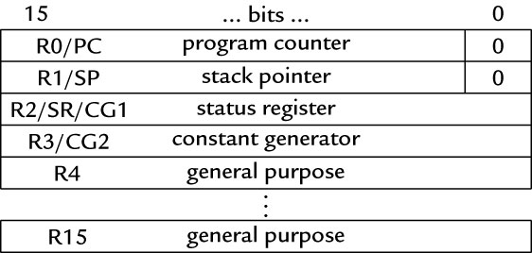
Enable an Interrupt
On MSP430, an interrupt will be detected and serviced if
The global interrupt-enable (GIE) bit in Status Register (SR) in CPU is set
A peripheral device enables interrupt → For Timer_A: TAIE bit in TACTL register, CCIE bit in TACCTLx register
The peripheral signals an interrupt → For Timer_A: TAIFG, CCIFG

Slide 5
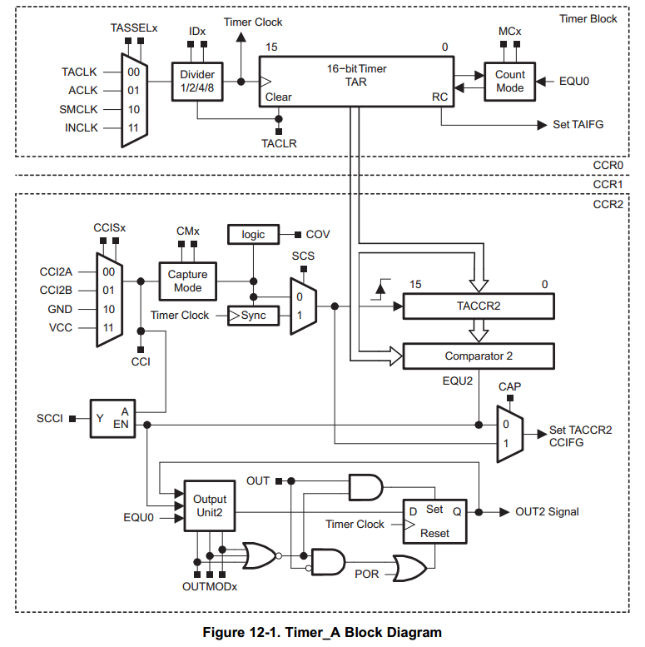
Ex: Timer_A Interrupt Enabling
TACTL
TACCTL

Slide 6
When an Interrupt Is Requested
Any currently executing instruction is completed. MCLK is started if the CPU was off.
The PC, which points to the next instruction, is pushed onto the stack.
The SR is pushed onto the stack.
The interrupt with the highest priority is selected.
The interrupt request flag is cleared automatically for interrupts that have a single source.
The SR is cleared, and other maskable interrupts are disabled.
The “starting address” of ISR is loaded into the PC and the CPU starts to execute the ISR at that address.
These operations take about 6 cycles

Slide 7
After an Interrupt Is Serviced
An interrupt service routine must always finish with the return from interrupt instruction reti:
The SR pops from the stack. All previous settings of GIE and the mode control bits are now in effect. → enable other maskable interrupts and restores the previous low-power mode if there was one.
The PC pops from the stack and execution resumes at the point where it was interrupted. Alternatively, the CPU stops and the device reverts to its low-power mode before the interrupt.
The original program runs as if there were no interrupt.

Slide 8
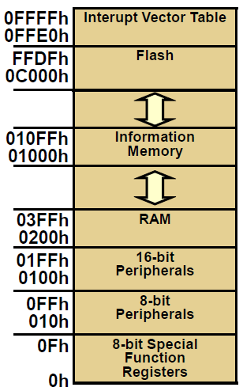
Where to Find ISRs?
MSP430 uses vectored interrupts
Each ISR has its own vector (starting address), which is stored at a predefined address in a vector table at the end of the program memory (addresses 0xFFE0 ~ 0xFFFF).
The vector table is at a fixed location, but the ISRs themselves can be located anywhere in memory.

Slide 9
Interrupt Source | Interrupt Flag | System Interrupt | Word Address | Priority
Power-up/external reset/Watchdog Timer+/flash key viol./PC out-of-range | PORIFG RSTIFG WDTIFG KEYV | Reset | 0FFFEh | 31 (highest)
NMI/Oscillator Fault/ Flash access viol. | NMIIFG/OFIFG/ ACCVIFG | Non-maskable | 0FFFCh | 30
Timer1_A3 | TA1CCR0 CCFIG | maskable | 0FFFAh | 29
Timer1_A3 | TA1CCR1/2 CCFIG, TAIFG | maskable | 0FFF8h | 28
Comparator_A+ | CAIFG | maskable | 0FFF6h | 27
Watchdog Timer+ | WDTIFG | maskable | 0FFF4h | 26
Timer0_A3 | TA0CCR0 CCIFG | maskable | 0FFF2h | 25
Timer0_A3 | TA0CCR1/2 CCIFG, TAIFG | maskable | 0FFF0h | 24
 |  |  | 0FFEEh | 23
 |  |  | 0FFECh | 22
ADC10 | ADC10IFG | maskable | 0FFEAh | 21
 |  |  | 0FFE8h | 20
I/O Port P2 (8) | P2IFG.0 to P2IFG.7 | maskable | 0FFE6h | 19
I/O Port P1 (8) | P1IFG.0 to P1IFG.7 | maskable | 0FFE4h | 18
 |  |  | 0FFE2h | 17
 |  |  | 0FFE0h | 16
Unused |  |  | 0FFDEh 0FFCDh | 15 - 0
Notes:
The MSP430 uses vectored interrupts, which means that the address of each ISR—its vector—is stored in a vector table at a deﬁned address in memory. In most cases each vector is associated with a unique interrupt but some sources share a vector. The ISR itself must locate the source of interrupts that share vectors. For example, TAIFG shares a vector with the capture/compare interrupts for all channels of Timer_A other than 0. Channel 0 has its own interrupt ﬂag TACCR0 CCIFG and separate vector.
8

Slide 10
Outline
Handling interrupts in MSP430
Handling interrupts of Timer_A in MSP430
Handling interrupts of port P1 in MSP430
Writing an interrupt service routine

Slide 11
Interrupts from Timer_A
Interrupts can be generated by the timer itself (flag TAIFG) and each capture/compare block (flag TACCRx CCIFG)
TAIFG
CCIFG
TACTL
TACCTL

Slide 12
Two Interrupt Vectors for Timer_A
For TACCR0 CCIFG (high priority):
CCIFG0 flag is cleared automatically when serviced
For all other CCIFG flags and TAIFG
In compare mode, any CCIFG flag is set if TAR counts to the associated TACCRx value
Flags are not cleared automatically, because need to determine who made the interrupt request
Can use software (ISR) to poll the flags → slow
Use hardware: Timer_A interrupt vector register (TAIV)

Slide 13
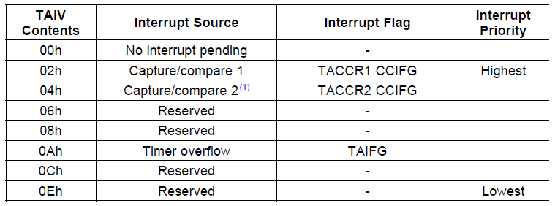
TAIV
On an interrupt, TAIV contains a number indicating highest priority enabled interrupt
Any access of TAIV resets the highest pending interrupt flag. If another interrupt flag is set, another interrupt is immediately generated

Slide 14
Sample Code for Timer_A Interrupt
Toggle LEDs using interrupts from Timer_A in up mode
#include <io430x11x1.h> // Specific device #include <intrinsics.h> // Intrinsic functions #define LED1 BIT0 void main(void) { WDTCTL = WDTPW|WDTHOLD; // Stop watchdog timer P1OUT = ˜LED1; P1DIR = LED1; TA0CCR0 = 49999; // Upper limit of count for TAR TA0CCTL0 = CCIE; // Enable interrupts TA0CTL = MC_1|ID_3|TASSEL_2|TACLR; // Up mode, divide clock by 8, clock from SMCLK, clear __enable_interrupt(); // Enable interrupts (intrinsic) for (;;) { } // Loop forever doing nothing } // Interrupt service routine for Timer0_A #pragma vector = TIMER0_A0_VECTOR __interrupt void TA0_ISR (void){ P1OUT ˆ= LED1; // Toggle LED }

Slide 15
Sample Code Explained
#pragma line associates the function with a particular interrupt vector
__interrupt keyword names the function
Compiler will generate code to store address of the function in the vector and to use reti rather than ret at the end of the function
An intrinsic function, __enable_interrupt() sets the GIE bit and turn on interrupts
It is declared in intrinsics.h

Slide 16
Outline
Handling interrupts in MSP430
Handling interrupts of Timer_A in MSP430
Handling interrupts of port P1 in MSP430
Writing an interrupt service routine

Slide 17
Interrupts on Port 1
Ports P1 and P2 can request an interrupt when the value on an input pin changes
Registers of P1 for interrupt:
Port P1 interrupt enable, P1IE: enables interrupts when the value on an input pin changes, by setting appropriate bits of P1IE to 1; off (0) by default
Port P1 interrupt edge select, P1IES: can generate interrupts either on a positive edge (0), when the input goes from low to high, or on a negative edge (1)
Port P1 interrupt flag, P1IFG: a bit is set when the selected transition has been detected on the input, and an interrupt is requested if it has been enabled.

Slide 18
Interrupts on Port 1
A single interrupt vector for the whole port
An interrupt will be requested whenever one or more interrupt-enabled pins on the port detect the signal transitions
The ISR must check P1IFG to determine the bit that caused the interrupt
This bit must be cleared explicitly

Slide 19
Sample Code for P1
A hi/low transition on P1.4 triggers P1_ISR to toggles P1.0
void main(void) { WDTCTL = WDTPW + WDTHOLD; // Stop watchdog timer P1DIR = 0x01; // P1.0 output, else input P1OUT = 0x10; // P1.4 set, else reset P1REN |= 0x10; // P1.4 pullup P1IE |= 0x10; // P1.4 interrupt enabled P1IES |= 0x10; // P1.4 Hi/lo edge P1IFG &= ~0x10; // P1.4 IFG cleared _BIS_SR(GIE); // Enter interrupt while(1); // Loop forever } #pragma vector=PORT1_VECTOR __interrupt void Port_1(void) { P1OUT ^= 0x01; // P1.0 = toggle P1IFG &= ~0x10; // P1.4 IFG cleared }

Slide 20
Lab 4
Basic 1:
Flash red and green LED at 1 Hz 1 based on the interrupt from TA0R of Timer0_A driven by ACLK sourced by VLO.
The red LED should be on for 0.4 sec and off for 0.6 sec based on the interrupt from TA0CCR0.
The green LED should be on for 0.2 sec and off for 0.8 sec, based on the interrupt from TA0CCR1.
Hint: For different devices, the names of the Interrupt Vectors may be different. Please check the header file for the correct name.

Slide 21
Lab 4 Hint
The name of the interrupt vector for TA0CCR1, TA0CCR2, and TA0R is TIMER0_A1_VECTOR. All three interrupts will cause the CPU to run the same ISR at TIMER0_A1_VECTOR.
To detect whether it is TA0CCR1, TA0CCR2, or TA0R that causes the interrupt, please check the register TA0IV. Note that TA0IV will be reset automatically when you read it. Thus, you need to read TA0IV into a local variable first before you check its bits.

Slide 22
Lab 4
Basic 2:
Write an ISR for the button that would switch the behavior of the two LEDs in Basic 1.
The ISR is requested whenever the button is released.
Hint: PORT1_VECTOR as interrupt type, P1IFG as interrupt flag
List the assembly code and point out the location of ISR.

Slide 23
Lab 4
Bonus: measure the duration of button down
Write the button ISR so that it detects button down as well as up in an alternative fashion.
Hint: You may need to use a variable to track the state of the button.
When button is down, start a timer with Timer0_A. When the button is released, stop the timer and report the amount of time (in seconds) that the button is pressed on the expression window of CCS.
Timer0_A may overflows several times during this period. You need to use interrupts to track the number of times that the timer overflows.

