Slide 1
CS4101 Introduction to Embedded Systems Lab 3: Timer and Clock
Prof. Chung-Ta King
Department of Computer Science
National Tsing Hua University, Taiwan

Slide 2
Introduction
In this lab, we will learn more advanced timer operations and clocking of MSP430 LanuchPad
Capture/compare block of the timer
Characteristics of different clock sources and their settings
Clock
Timer
Notes:
A timer is really no more than a counter and has no direct concept of time. It is the programmer’s job to establish a relation
between the value in the counter and real time. This depends essentially on the frequency of the clock for the timer.

Slide 3
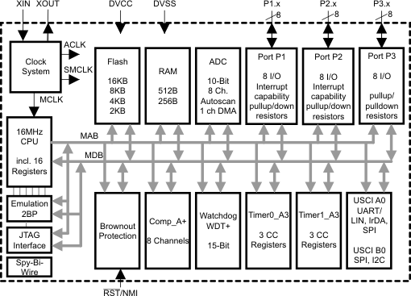
Interior of MSP430G2553
Clock system
IO
X
Not available on 20-pin device
Timer system

Slide 4
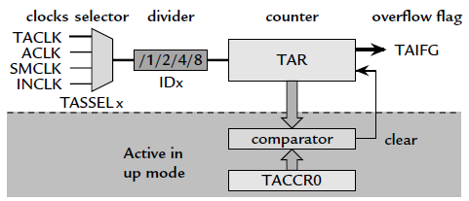
Recall: MSP430 Timer_A
TAR (0170h): the counter itself
TACTL (0160h): register to control TAR settings
TACCR0 (0172h): target for counting
Others: clock source selection, flags

Slide 5
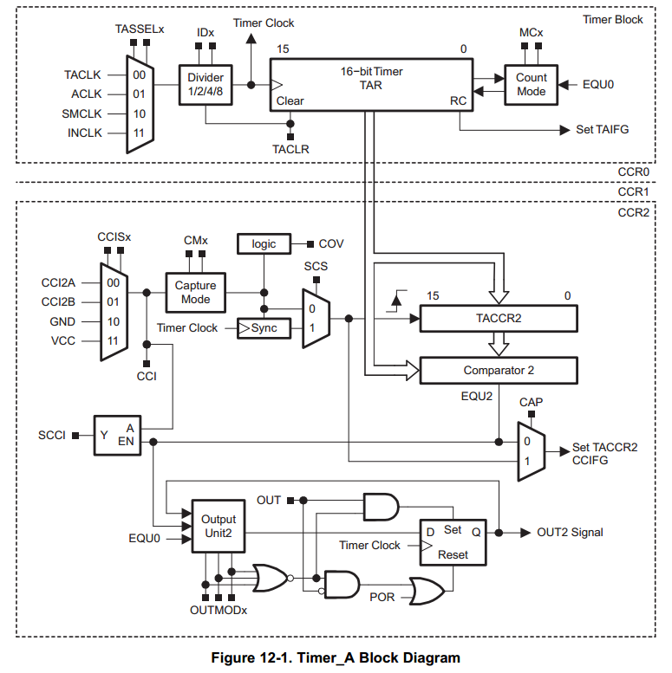
Timer_A Capture/Compare Block
Timer Block
May contain several Capture/Compare Blocks
Each C/C block is controlled by a control register, TACCTLx
Inside each C/C block, the Capture/Compare Register, TACCRx, holds the count to configure timer
But, all C/C blocks within Timer_A share the same timer block: TAR
TACTL
Capture/Compare Block
TACCTL2
Notes:
Two or three identical capture/compare blocks, TACCRx, are present in Timer_A
Capture/compare channel 0 is special in two ways. Its register TACCR0 is taken over for the modulus value in Up and Up/Down
modes, so that it is no longer available for its usual functions. It also has its own interrupt vector with a higher priority than the other interrupts from Timer_A, which all share a common vector. Therefore channel 0 should be chosen for the most urgent tasks if it
is free.

Slide 6
Modes of Capture/Compare Block
Compare mode:
Compare the value of TAR with the value stored in TACCRx and update an output when they match
Capture mode: used to record time events
Records the “time” (value in TAR) at which the input changes into TACCRx
The input, usually CCIxA and CCIxB, can be either external or internal from another peripheral or software, depending on board connections
Notes:
The capture mode is selected when CAP = 1.
If a capture occurs:
• The timer value is copied into the TACCRx register
• The interrupt flag CCIFG is set
The compare mode is selected when CAP = 0.
The compare mode is used to generate PWM output signals or interrupts at specific time intervals. When TAR counts to the value in a TACCRx:
• Interrupt flag CCIFG is set
• Internal signal EQUx = 1
• EQUx affects the output according to the output mode
• The input signal CCI is latched into SCCI

Slide 7
Capture Basics
15 |  |  |  |  |  |  |  |  |  |  |  |  |  |  | 0
TAR
Counter
Register (TAR)
Counter Overflow Action
Interrupt (TAIFG)
Clock Input
Clock
GPIO Pin (TACLK)
Capture Input signal triggers transfer: Counter → Capture
Capture Actions
Interrupt (CCIFGx)
Signal peripheral
Modify pin (TAx.n)
Capture Input
CCInA
CCInB
Software
Capture/Compare Register (TACCR_{x})
Capture time (i.e. count value) when Capture Input signal occurs
When capture is triggered, count value is placed in CCR and an interrupt is generated

Slide 8
Compare Basics
15 |  |  |  |  |  |  |  |  |  |  |  |  |  |  | 0
TAR
Counter
Register (TAR)
Counter Overflow Action
Interrupt (TAIFG)
Clock Input
Clock
GPIO Pin (TACLK)
when Counter = Compare
Compare Actions can occur
Compare Actions
Interrupt (CCIFGx)
Signal peripheral
Modify pin (TAx.n)
Capture/Compare Register (TACCR_{x})

Slide 9
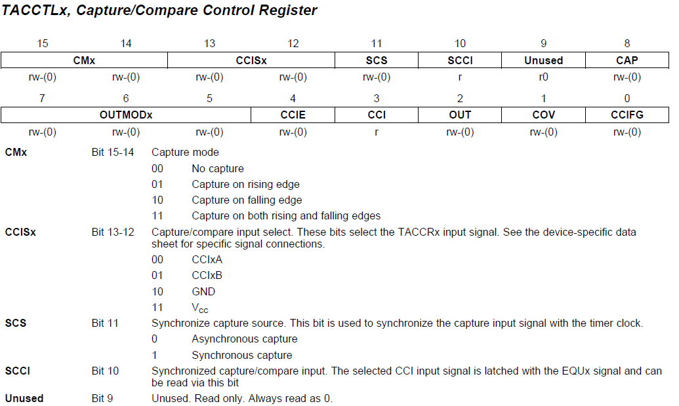
TACCTLx

Slide 10
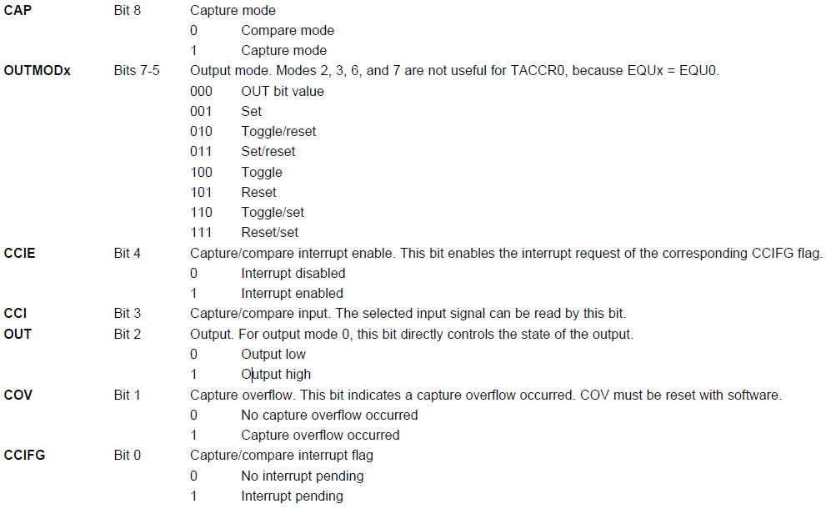
TACCTL cont’d

Slide 11
Example of Compare Mode
Exact behavior of a Capture/Compare Block depends on setting of the corresponding control register, e.g.
TAR counts to TACCR0 and resets (i.e., TACCR0 determines frequency (along with TAR input frequency))
At Output Mode 3, EQU1 is set when TAR>TACCR1 (i.e., TACCR1 determines pulse width)

Slide 12
MSP430 Clock System
Clock system

Slide 13
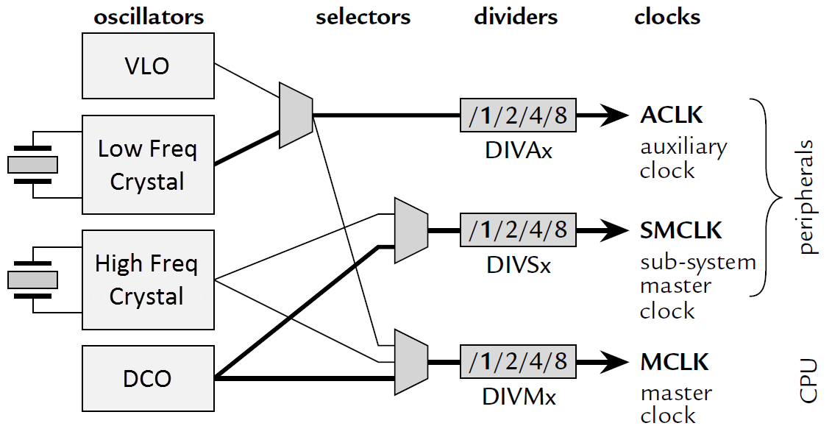
Clock System of MSP430
Variety of oscillator sources: on-chip (cheap, reliable) and off-chip (accurate)
Rich selection of oscillator sources routed to internal clocks

Slide 14
Clocks in MSP430
Master clock (MCLK): for CPU and some peripherals, normally driven by digitally controlled oscillator (DCO)
Subsystem master clock (SMCLK): distributed to peripherals, normally driven by DCO
Auxiliary clock (ACLK): distributed to peripherals, normally for real-time clocking and driven by a low-frequency crystal oscillator, typically at 32 KHz
Name | Description | Used-by | Typical Speed
MCLK | Master Clock | CPU | Fast
SMCLK | Sub-Master Clock | Peripherals | Fast
ACLK | Auxiliary Clock | Peripherals | Slow
Notes:
Typically SMCLK runs at the same frequency as MCLK, both in the megahertz range.
ACLK is often derived from a watch crystal and therefore runs at a much lower frequency.
Most peripherals can select their clock from either SMCLK or ACLK

Slide 15
Clock Sources
Low- or high-frequency crystal oscillator, LFXT1:
External; used with a low- or high frequency crystal; an external clock signal can also be used; connected to MSP430 through XIN and XOUT pins
High-frequency crystal oscillator, XT2:
External; similar to LFXT1 but at high frequencies
Very low-power, low-frequency oscillator, VLO:
Internal at 12 KHz; alternative to LFXT1 when accuracy of a crystal is not needed; may not available in all devices
Digitally controlled oscillator, DCO:
Internal; a highly controllable RC oscillator that starts fast
Notes:
14
To support the lowest power consumption and performance on-demand, the enhanced basic clock system (BCS+) on the MSP430F2xx (like all other MSP430 clock systems) typically provides two clocks. A low frequency auxiliary clock (ACLK) is typically sourced directly from a common 32 kHz watch crystal and is used for always-on low power peripherals. A high-speed clock is generated on-chip from an instant-on digitally controlled oscillator (DCO) used by the CPU and other peripherals. To save power, an application’s interrupt events steer the usage of the DCO only when required. The majority of the application’s life is spent in standby mode with high-performance available on-demand and only when required.
Reduced standby power consumption also known as real-time clock (RTC) or LPM3 mode current has been reduced to less than 1 micro amp. This power consumption can be achieved using an external 32kHz crystal or the VLO.
The F20xx introduces a new very-low power oscillator (VLO) as an alternative to the typical 32kHz ACLK. The VLO provide a 12kHz on-chip oscillator with no external components that is perfect for ultra-low power applications that need a wake-up function, but the precision of a 32kHz crystal.
The F2xx crystal oscillator is improved providing programmable integrated crystal load capacitors allows the use of a wider range of crystals and elimination of external components used typically to stabilize oscillation. Failsafe crystal oscillator can trigger a non-maskable interrupt and start the on-chip oscillator for failsafe operation. This feature is always available with no additional power consumption in both high-frequency and low frequency modes. Crystal min-pulse input de-glitch filters reduce the possibility of externally introduced high frequency system noise and improves reliability.
Improved on-chip digitally controlled oscillator (DCO) offers a sub 1 micro second start with +2.5% accuracies and 16MHz operation over temperature and voltage.

Slide 16
Controlling Clocks
In MSP430, the Basic Clock Module is also an IO peripheral and can be controlled by registers, DCOCTL and BCSCTL1–3
DCOCTL (056h): configure DCO
BCSCTL1 (basic clock system control 1, 057h): configure ACLK
BCSCTL2 (basic clock system control 2, 058h): configure MCLK, SMCLK
BCSCTL3 (basic clock system control 3, 053h): control LFXT1/VLO

Slide 17
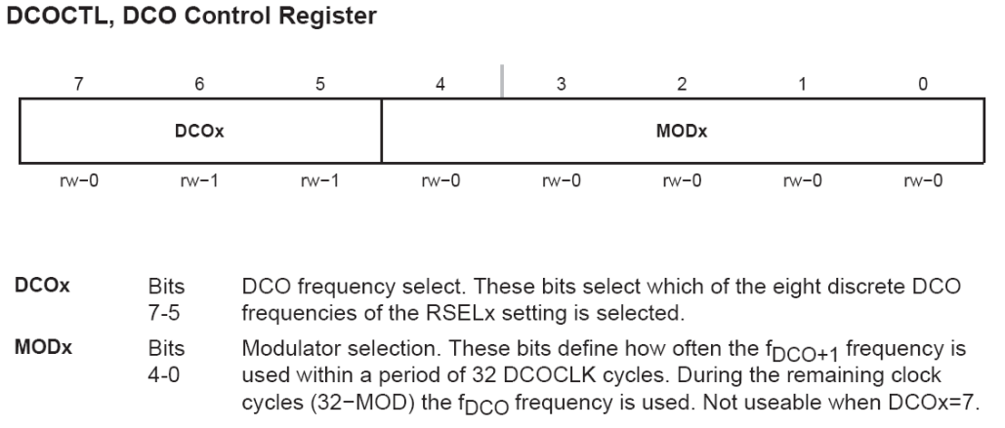
DCOCTL (at Memory Address 056h)
Tag-Length-Value
DCOCTL = CALDCO_1MHZ; // Set DCO step + modulation
Notes:
The frequency can be controlled through sets of bits in the module’s registers at three levels. The numbers are taken from the data sheet for the F2013. The first two levels set the DCO to a constant frequency:
RSELx: Selects one of 16 coarse ranges of frequency. The frequencies in each range are larger than those in the one below by a factor of 1.3–1.4. The overall range is about 0.09–20 MHz.
DCOx: Selects one of eight steps within each range. Each step increases the frequency by about 8%, giving a factor of 1.7 from bottom to top of the range. Thus the ranges overlap slightly.
Finer control of the average frequency is obtained by modulating the frequency of the oscillator between the selected value of DCO and the next step up (DCO+1).
16

Slide 18
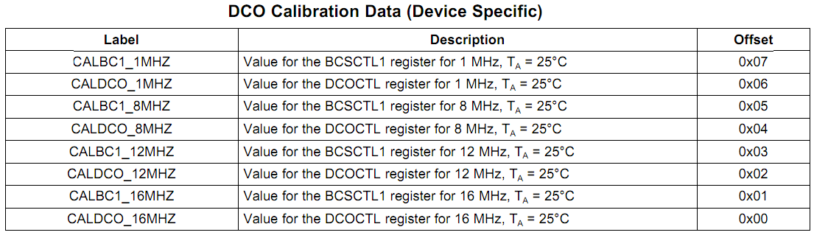
Tag-Length-Value
Tag-Length-Value (TLV) stores device-specific information in the flash memory to set DCOCTL and BCSCTL1 for DCO frequency
BCSCTL1 = CALBC1_1MHZ; // Set range DCOCTL = CALDCO_1MHZ;
Notes:
The Tag-Length-Value (TLV) structure is used in selected MSP430x2xx devices to provide device-specific information in the device’s flash memory SegmentA, such as calibration data. For the device-dependent Implementation, see the device-specific data sheet. (@ chapter 24, userguide, page 587)
For DCO calibration, the BCS+ registers (BCSCTL1 and DCOCTL) are used. The values stored in the flash information memory SegmentA are written to the BCS+ registers
17

Slide 19
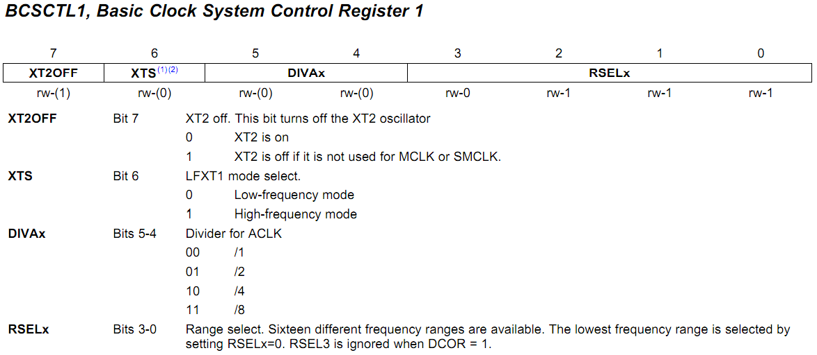
BCSCTL1
BCSCTL1 = CALBC1_1MHZ; // Set range
Notes:
(1) XTS = 1 is not supported in MSP430x20xx devices.
(2) This bit is reserved in the MSP430AFE2xx devices
18

Slide 20
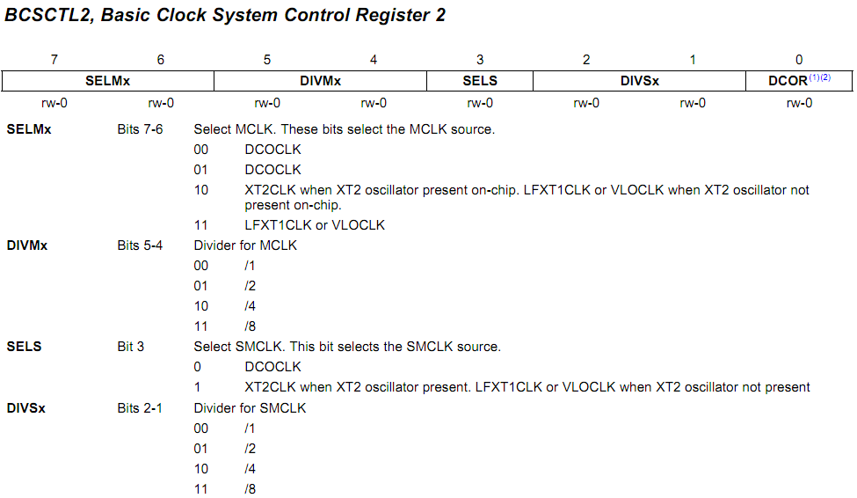
BCSCTL2
MCLK
SMCLK
BCSCTL2 |= SELM_3 + DIVM_3; // MCLK = VLO/8
Notes:
(1) Does not apply to MSP430x20xx or MSP430x21xx devices.
(2) This bit is reserved in the MSP430AFE2xx devices
19

Slide 21
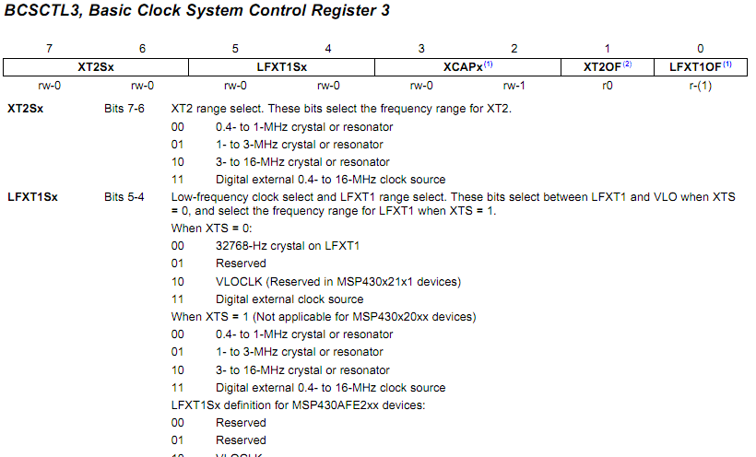
BCSCTL3
In MSP430G2231
BCSCTL3 |= LFXT1S_2; // Enable VLO as MCLK/ACLK src
Notes:
MSP430x22xx, MSP430x23x0: XT2 is not present
(1) This bit is reserved in the MSP430AFE2xx devices.
(2) Does not apply to MSP430x2xx, MSP430x21xx, or MSP430x22xx devices.
20

Slide 22
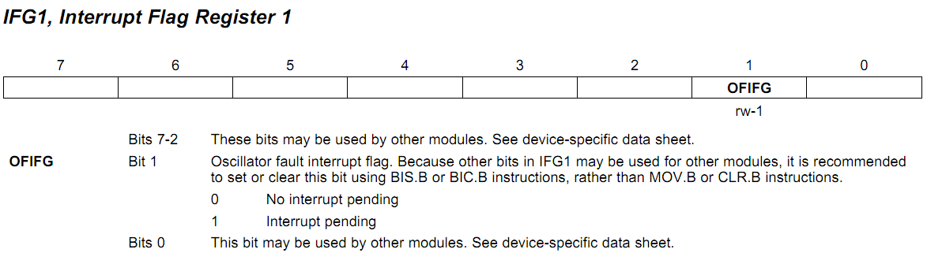
Interrupt Flag Register 1 (IFG1)
OFIFG oscillator-fault flag is set when an oscillator fault (LFXT1OF) is detected.
IFG1 &= ~OFIFG; // Clear OSCFault flag
Notes:
* The clock system will force the MCLK to use the DCO as its source in the presence of a clock fault (see the User’s Guide section 5.2.7).
5.2.7 @userguide. Page 280
The OFIFG oscillator-fault flag is set and latched at POR or when an oscillator fault (LFXT1OF, or XT2OF) is detected. When OFIFG is set, MCLK is sourced from the DCO, and if OFIE is set, the OFIFG requests an NMI interrupt. When the interrupt is granted, the OFIE is reset automatically. The OFIFG flag must be cleared by software. The source of the fault can be identified by checking the individual fault bits.
21

Slide 23
Sample Code for Timer_A
Flash red LED at 1 Hz using SMCLK at 800 KHz
#include <msp430g2553.h> #define LED1 BIT0 void main (void) { WDTCTL = WDTPW|WDTHOLD; // Stop watchdog timer P1OUT = ~LED1; P1DIR = LED1; TACCR0 = 49999; TACTL = MC_1|ID_3|TASSEL_2|TACLR; //Setup Timer_A //up mode, divide clk by 8, use SMCLK, clr timer for (;;) { // Loop forever while (!(TACTL&TAIFG)) { // Wait time up } // doing nothing TACTL &= ~TAIFG; // Clear overflow flag P1OUT ^= LED1; // Toggle LEDs } // Back around infinite loop }

Slide 24
Lab 3
Basic 1:
Flash both red and green LEDs at 1 Hz. The green LED should be on for 0.7 sec and off for 0.3 sec, which is controlled by polling Timer0_A driven by ACLK sourced by VLO. The red LED should be on for 0.2 sec and off for 0.8 sec, which is controlled by polling Timer1_A driven by SMCLK sourced by DCO.
Basic 2:
Repeat Basic 1 by using Timer0_A only. Use TA0R to keep a cycle time of 1 sec. Use TA0CCR1 to control the green LED and TA0CCR2 to control the red LED.

Slide 25
Lab 3
Bonus:
Flash the green LED at 1 Hz by polling Timer0_A, on for 0.5 sec and off for 0.5 sec.
When the button is pressed, keep the green LED at the same state, and turn on the red LED with a proportion of time according to the time the button is pressed
e.g., when the button is pressed for less than 1 sec, then turn on the red LED for 0.1 sec and off for 0.9 sec; when the button is pressed for more than 1 sec but less than 2 sec, then turn on the red LED for 0.2 sec and off for 0.8 sec, etc.
Hint: use the timer for green LED to track button timing
If the button is pressed for more than 5 sec, then turn off the red LED.

