Slide 1
CS4101 Introduction to Embedded Systems Lab 2: Basic IO and Timer
Prof. Chung-Ta King
Department of Computer Science
National Tsing Hua University, Taiwan

Slide 2
Introduction
In this lab, we will learn the basic IO and timer of MSP430 LanuchPad
Configure the I/O port of LanuchPad for input
Set the timer
Run the debugger for basic debugging

Slide 3
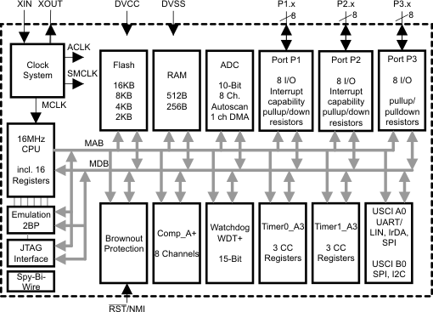
Interior of MSP430G2553
X
Not available on 20-pin device

Slide 4
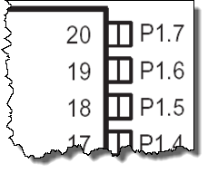
PxDIR (Pin Direction): Input or Output
PxDIR.y: 0 = input 1 = output
Register example: P1DIR &= 0x81;
P1IN.7
P1OUT.7
P1DIR.7
“1”
 | 7 | 6 | 5 | 4 | 3 | 2 | 1 | 0
P1IN
P1OUT
P1DIR | 1 |  |  |  |  |  |  | 1

Slide 5
GPIO Output
PxOUT.y: 0 = low 1 = high
Register example: P1OUT &= 0x80;
P1IN.7
P1OUT.7
P1DIR.7
“1”
“1”
“1”
 | 7 | 6 | 5 | 4 | 3 | 2 | 1 | 0
P1IN | X
P1OUT | 1
P1DIR | 1

Slide 6
GPIO Input
P1IN.7
P1OUT.7
P1DIR.7
P1REN.7
up/down
Enable resistor
 | 7 | 6 | 5 | 4 | 3 | 2 | 1 | 0
P1IN | x
P1OUT | 1
P1DIR | 0
P1REN | 1
PxREN enables resistors PxOUT selects pull-up (1) or pull-down (0) resistor

Slide 7
Sample Code 1 for Input
#include <msp430.h> #define LED1 BIT0 // P1.0 to red LED #define B1 BIT3 // P1.3 to button void main(void){ WDTCTL = WDTPW + WDTHOLD; // Stop watchdog timer P1OUT |= LED1 + B1; P1DIR = LED1; // Set pin with LED1 to output P1REN = B1; // Set pin to use pull-up resistor for(;;){ //Loop forever if((P1IN & B1) == 0){ // Is button down? P1OUT &= ~LED1; } // Turn LED1 off else{ // Button is up P1OUT |= LED1; } // Turn LED1 on } }
Notes:
Whenever button is down, turn LED off. Whenever button is up, turn LED on.

Slide 8
Sample Code 2 for Input
#include <msp430.h> #define LED1 BIT6 // P1.0 to green LED #define B1 BIT3 // P1.3 to button volatile unsigned int i, j; void main(void){ WDTCTL = WDTPW + WDTHOLD; // Stop watchdog timer P1OUT |= LED1 + B1; P1DIR = LED1; // Set pin with LED1 to output P1REN = B1; // Set pin to use pull-up resistor for(;;){ while((P1IN & B1) != 0){ // Loop on button up i = P1IN; j = P1OUT; } P1OUT &= ~LED1; // Turn LED1 off while((P1IN & B1) == 0){ // Loop on button down i = P1IN; j = P1OUT; } P1OUT |= LED1; // Turn LED1 on } }
Notes:
On button down, turn LED off. On button up, turn LED on.

Slide 9
Lab 2
Basic 1:
Upload and run sample code 1 and 2 on the MSP430 LaunchPad respectively. Do they behave differently? Why?
Basic 2:
Modify to flash only the red LED when the button is down and flash only the green LED when the button is released.
Run the debugger to show the values of P1IN after each while() statement

Slide 10
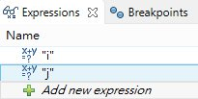
How to Debug?
In the code line containing:
i = P1IN;
j = P1OUT;
Add new expression from Expressions window
Right-click on the appropriate line of code and set the Breakpoint
When the code runs, it will hit the breakpoint and stop
You can now observe the value

Slide 11
Debugger Output
1111 1110
01001000
00000110
00001000
No need to care about other bits!

Slide 12
Interior of MSP430G2553
X
Not available on 20-pin device

Slide 13
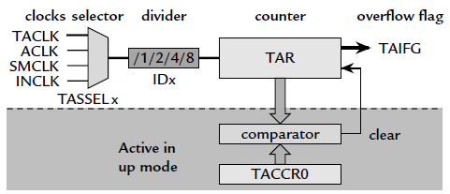
MSP430 Timer0_A3: Registers
TA0R (0170h): the counter itself
TA0CCR0 (0172h): target for counting
TA0CTL (0160h): control settings
Others: clock source selection, flags

Slide 14
Inside Timer0_A3
Timer_A Control Register: TA0CTL

Slide 15
Timer0_A3 Control Register (TA0CTL)
TASSELx: Timer0_A3 clock source select (x is 0, 1, 2, or 3)
IDx: input divider
MCx: mode control
TACLR: Timer0_A3 clear
TAIE: Timer0_A3 interrupt enable
TAIFG: Timer0_A3 interrupt flag

Slide 16
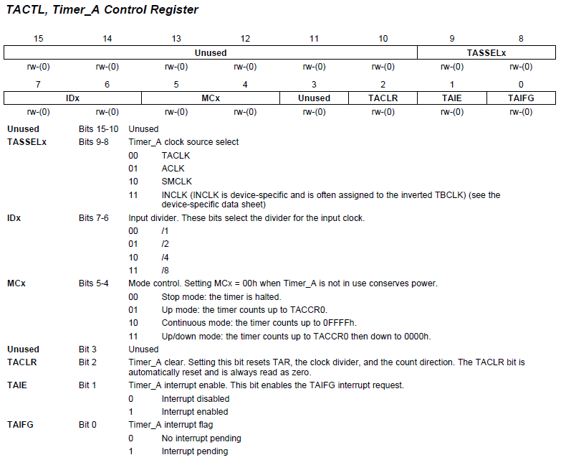
TACTL (TA0CTL/TA1CTL)
TA0CTL = TASSEL_2 + MC_1; // src from SMCLK, up mode

Slide 17
Timer Mode
MCx=00: Stop mode
The timer is halted
MCx=01: Up mode
The timer repeatedly counts from 0 to TACCR0
MCx=10: Continuous mode
The timer repeatedly counts from 0 to 0FFFFh
MCx=11: Up/down mode
The timer repeatedly counts from 0 to TACCR0 and back down to 0

Slide 18
Sample Code 1 for Timer_A
Goal: simplest way to flash an LED at 1 Hz
Need an event to trigger the flashing → counter (TA0R) overflow
Need a way to detect the event → CPU polling
How to make TA0R overflow at 1 Hz?
Use SMCLK clock (discussed later) at 800 KHz
When TAR (16 bits) overflows, it has counted 2¹⁶, equivalent to a period of 2¹⁶/800KHz ≈ 0.08 sec
Divide the frequency of the clock by 8 to give a period of about 0.64 sec → close enough!
Continuously count up; on overflow return to 0

Slide 19
Sample Code 1 for Timer_A
#include <msp430g2553.h> #define LED1 BIT0 void main(void) { WDTCTL = WDTPW | WDTHOLD; P1DIR = LED1; P1OUT = ~LED1; TA0CTL = MC_2 | ID_3 | TASSEL_2 |TACLR; for(;;) { while(!(TA0CTL & TAIFG)){} TA0CTL &= ~TAIFG; // Clear overflow flag P1OUT ^=LED1; } }
Notes:
18
18

Slide 20
Sample Code 2 for Timer0_A3
Can have more accurate time if we can control the amount to count
The maximum desired value of the count is programmed into TA0CCR0
TAR starts from 0 and counts up to the value in TA0CCR0, after which it returns to 0 and sets TAIFG
Thus the period is TA0CCR0+1 counts
With SMCLK (800KHz) divided down to 100 KHz, we need 50,000 counts for a delay of 0.5 sec → store 49,999 in TA0CCR0

Slide 21
Lab 2
Basic 3:
Flash the red LED at 1 Hz by polling Timer0_A3. After the button is pressed for more than 3 seconds, flash the green LED at 4 Hz. When the button is released for more than 3 seconds, flash red LED at 1 Hz. If button activity is shorter than 3 seconds, then do nothing.
Note two events to monitor: timer up and button down.
Bonus:
Flash the red LED according to the time you press the button. For example, press the button for 1 second, flash at 1Hz; press for 2 seconds, flash every two seconds (0.5Hz), etc. When press the button for 5 seconds, turn off LED.

