Slide 1
CS4101 Introduction to Embedded Systems
Lab 1: MSP430 LaunchPad IDE
Prof. Chung-Ta King
Department of Computer Science
National Tsing Hua University, Taiwan

Slide 2
Introduction
In this lab, we will learn the IDE for MSP430 LanuchPad, Code Composer Studio (CCS)
  Learn how to set up the LaunchPad development board
  Learn how to create a new project on CCS
  Learn how to upload a program to the board
  Debug a program
  Run a program
  Use disassembly window

Slide 3
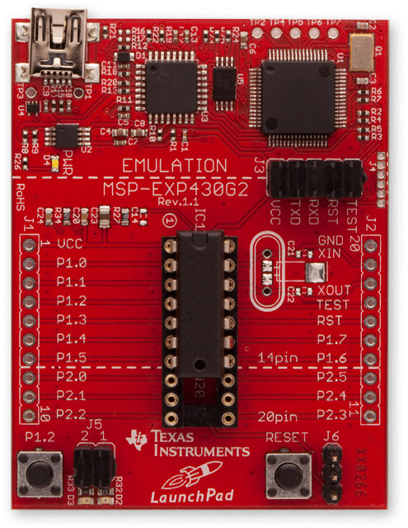
Hardware Setup
Please check the version of the MSP430 microcontroller and use the right header files in your programs
MSP430G2553

Slide 4
Code Composer Studio (CCS)
An Integrated Development Environment (IDE) based on Eclipse
Integrated “Debugger” and “Editor” – IDE
  Edit and Debug have the own “perspectives” (menus, windows)
Contains all development tools – compilers, TI-RTOS kernel and includes one target – the Simulator

Slide 5
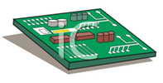
Code Composer Studio (CCS)
Compiler
Standard Runtime Libraries
TI-RTOS
Libraries
Target
Cfg File
.asm
.c
.lib
.ccxml
Launch Pad
Edit
.asm
Asm
.obj
Link
.out
Debug
EVM
TI-RTOS
Config
(.cfg)
User.cmd
.map
Stand Alone Emulator (MSP430 FET)
Bios.cmd

Slide 6
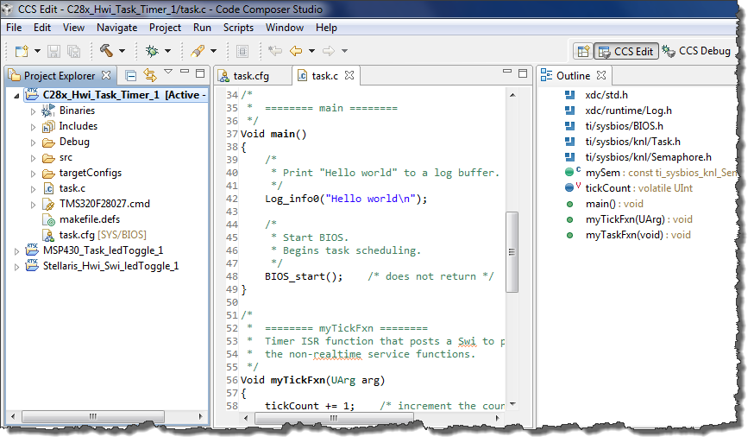
CCS GUI – EDIT Perspective
Menus & Buttons
Specific actions related to EDIT’ing
Perspectives
EDIT and DEBUG
Project Explorer
Project(s)
Source Files
Source EDIT’ing
Tabbed windows
Color-coded text
Outline View
Declarations and functions

Slide 7
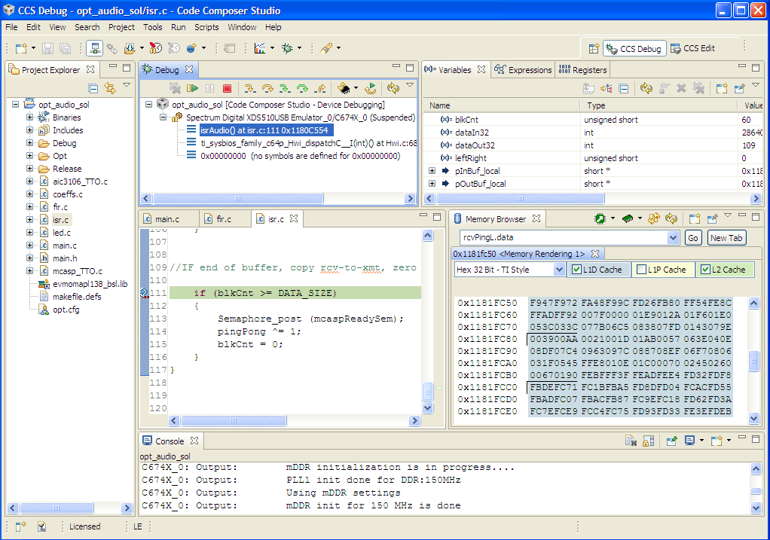
CCS GUI – DEBUG Perspective
Connection Type
Specified in Target Cfg file
What options do users have when connecting to a target?
This window also provides a “call” stack
Menus & Buttons
Related to DEBUG’ing
Play, Pause, Terminate
DEBUG Windows
Watch Variables
Memory Browser
PC execution point
Console Window

Slide 8
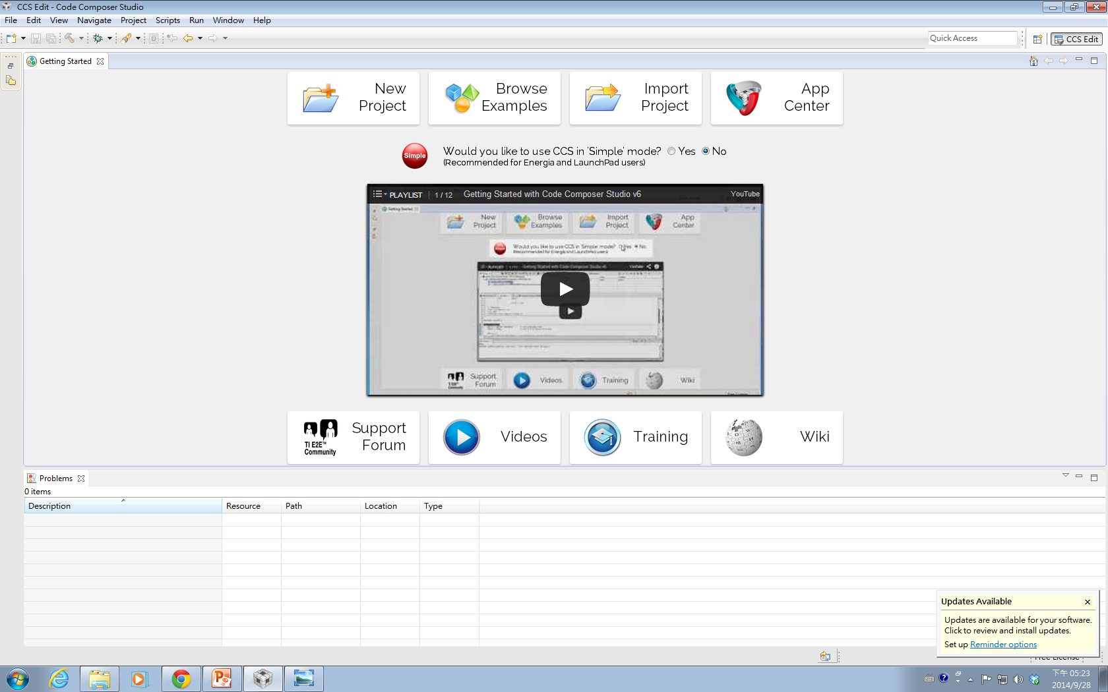
Create a New CCS Project
1

Slide 9
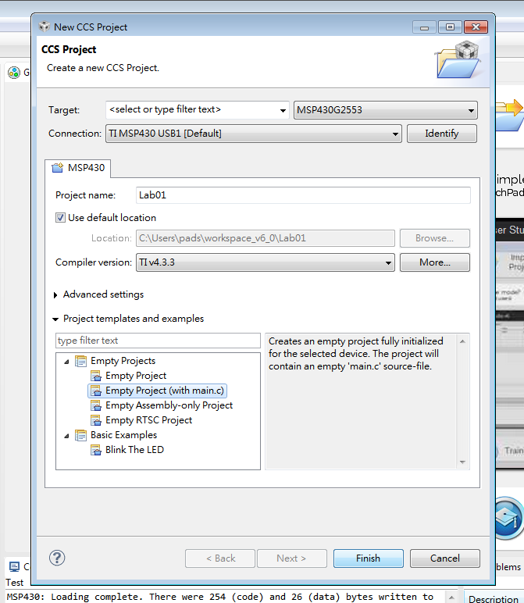
Create a New CCS Project
Type 2553 to find MSP430G2553
2
3
Type the project name
4
5

Slide 10
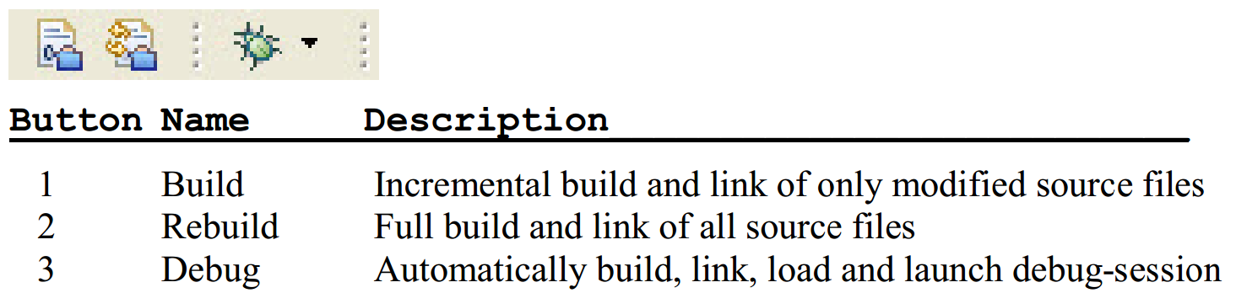
Build and Load the Project
Three buttons on the horizontal toolbar control code generation. You can move your mouse over each button to read their descriptions.
Click the “Build” button and watch the tools run in the Console window. Check for any errors in the Problems window.

Slide 11
Build and Load the Project
CCS can automatically save modified source files, build the program, open the debug perspective view for debugging, download the program to the target, and run the program at the beginning of the main() function
  Click on the “Debug” button (green bug) or
  Click Target → Debug Active Project

Slide 12
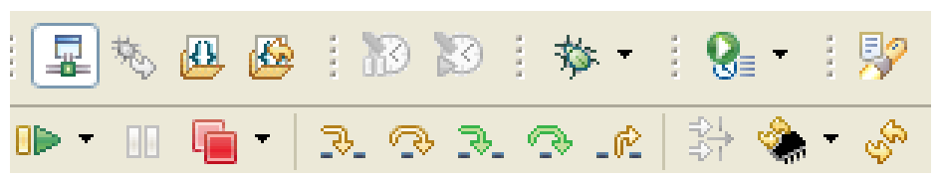
Debug Environment
The basic buttons that control the debug environment are located in the top of CCS:
At this point you should still be at the beginning of main(). Click the Run button to run the code.
  Notice that the LEDs are toggling, as expected.
RUN

Slide 13
End Debug Session and Close Project
The Terminate All button will terminate the active debug session, close the debugger and return CCS to the “C/C++ Perspective” view
  Click Target → Terminate All or use the Terminate All button
Next, close the project by right-clicking on project-name in the C/C++ Projects window and select Close Project.

Slide 14
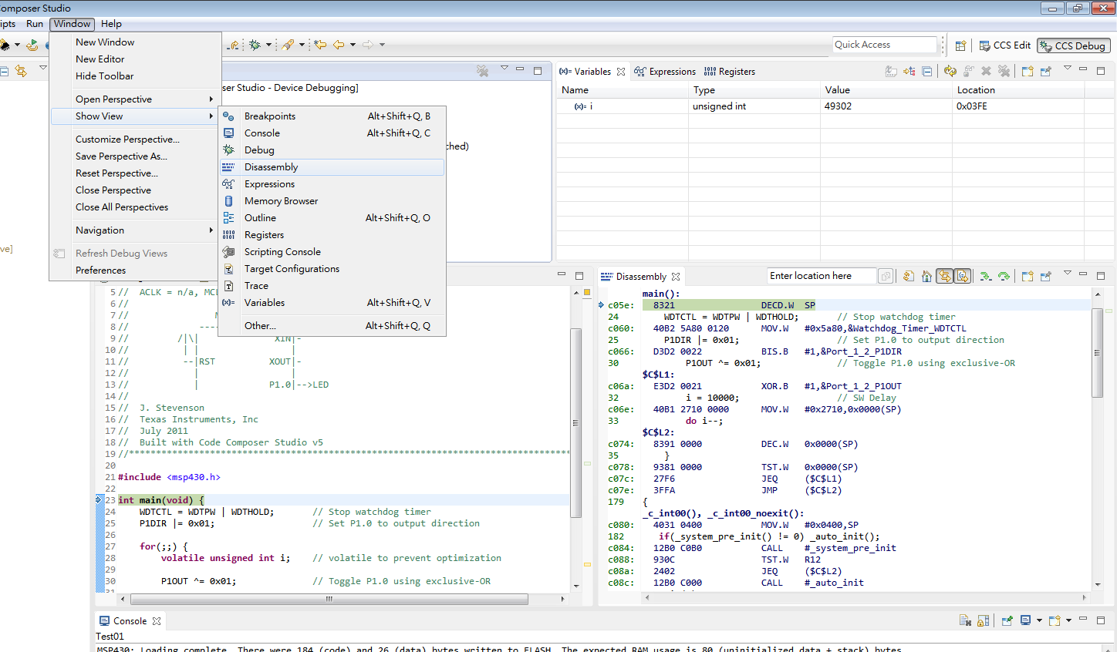
Use Disassembly Window in Debug

Slide 15
Sample Code: Blinking the Red LED
#include <msp430x2553.h> int main(void) { WDTCTL = WDTPW | WDTHOLD; // Stop watchdog timer P1DIR |= 0x01; // Set P1.0 as output for(;;) { volatile unsigned int i; // prevent optimization P1OUT ^= 0x01; // Toggle P1.0 using XOR i = 10000; // SW Delay do i--; while(i != 0); } return 0; }

Slide 16
Lab 1
Upload sample code to the board and run it. The red LED should blink.
Basic 1: Modify the code to blink the green and red LED, which are located at Port 1 Bit 0 and Bit 6.
    If we want to turn on green LED, we should assign P1OUT to 0x40, which is 01000000 in binary.
WDTCTL = WDTPW + WDTHOLD; // Stop watchdog timer P1DIR = 0x41; // P1.0 & 6 outputs (red & green LEDs)
0100 0001
0100 0000
while(1) { P1OUT = 0x40; // P1.6 on (green LED) _delay_cycles(100); P1OUT = 0; // green LED off _delay_cycles(5000); }

Slide 17
Lab 1
Basic 2: Modify the code to blink the green and red LED alternatively.
Basic 3:
  Modify the sample code to remove the volatile keyword in declaring the variable i. Observe how the LaunchPad behaves.
  To explain the behavior of LaunchPad, let us study the assembly code of the two programs.
    Use the disassembly window to obtain the assembly code of the original sample code and the modified sample code
    Observe the differences of these two assembly programs and explain the behavior of LaunchPad.

Slide 18
Assembly for Not Using volatile
WDTCTL = WDTPW | WDTHOLD; main(): c078: 40B2 5A80 0120 MOV.W #0x5a80,&Watchdog_Timer_WDTCTL P1DIR |= 0x01; c07e: D3D2 0022 BIS.B #1,&Port_1_2_P1DIR 31 P1OUT ^= 0x01; $C$L1: c082: E3D2 0021 XOR.B #1,&Port_1_2_P1OUT 34 do i--; c086: 3FFD JMP ($C$L1) 65 func_epilog_7: POP r4 __mspabi_func_epilog(), __mspabi_func_epilog_7(): c088: 4134 POP.W R4 66 func_epilog_6: POP r5 __mspabi_func_epilog_6(): c08a: 4135 POP.W R5

Slide 19
Assembly for Using volatile
23 int main(void) { main(): c05e: 8321 DECD.W SP WDTCTL = WDTPW | WDTHOLD; c060: 40B2 5A80 0120 MOV.W #0x5a80,&Watchdog_Timer_WDTCTL P1DIR |= 0x01; c066: D3D2 0022 BIS.B #1,&Port_1_2_P1DIR 31 P1OUT ^= 0x01; $C$L1: c06a: E3D2 0021 XOR.B #1,&Port_1_2_P1OUT i = 10000; c06e: 40B1 2710 0000 MOV.W #0x2710,0x0000(SP) 34 do i--; $C$L2: c074: 8391 0000 DEC.W 0x0000(SP) 36 } c078: 9381 0000 TST.W 0x0000(SP) c07c: 27F6 JEQ ($C$L1) c07e: 3FFA JMP ($C$L2)

Slide 20
Assembly for Using volatile
179 { _c_int00(), _c_int00_noexit(): c080: 4031 0400 MOV.W #0x0400,SP 182 if(_system_pre_init() != 0) _auto_init(); c084: 12B0 C0B0 CALL #_system_pre_init c088: 930C TST.W R12 c08a: 2402 JEQ ($C$L2) c08c: 12B0 C000 CALL #_auto_init 183 main(0); $C$L2: c090: 430C CLR.W R12 c092: 12B0 C05E CALL #main 184 abort(); c096: 12B0 C0B4 CALL #abort 65 func_epilog_7: POP r4 __mspabi_func_epilog(), __mspabi_func_epilog_7(): c09a: 4134 POP.W R4 66 func_epilog_6: POP r5 __mspabi_func_epilog_6():

Slide 21
Grading Policies
DEMO in the lab --------------------------------------100%
DEMO within a week (before lab starts) ---------80%
DEMO after a week (before lab starts) -----------60%
After two weeks (after lab starts)------------------- 0%
TA office hour:
  Wed 10:00 – 12:00
  Thr 13:00 – 15:00

