Slide 1
CS4101 嵌入式系統概論 Task Synchronization
Prof. Chung-Ta King
Department of Computer Science
National Tsing Hua University, Taiwan
(Materials from http://www.freertos.org/FreeRTOS-quick-start-guide.html, MQX User Guide, Using the FreeRTOS Real Time Kernel, Study of an Operating System: FreeRTOS)

Slide 2
Outline
Introduction to task synchronization
Queues of FreeRTOS
Semaphores and mutexs of FreeRTOS

Slide 3
Why Synchronization?
Synchronization may be used to solve:
Mutual exclusion
Control flow
Data flow
Synchronization mechanisms include:
Message queues
Semaphores
Mutexs
Events
Correct synchronization mechanism depends on the synchronization issue being addressed
EF
M

Slide 4
Mutual Exclusion
Problem: multiple tasks may “simultaneously” need to access the same resource
Resource may be code, data, peripheral, etc.
Need to allow the shared resource exclusively accessible to only one task at a time
How to do?
Allowing only one task to lock the resource and the rest have to wait for the resource to be unlocked
Common mechanisms: lock/unlock, mutex, semaphore

Slide 5
Control Flow Synchronization
Problem: a task or ISR may need to resume the execution of one or more other tasks, so that tasks execute in an application-controlled order
Mutual exclusion is used to prevent another task from running, while control flow is used to allow another task to run, often specific tasks
How to do?
Common mechanisms: post/wait, signal, event

Slide 6
Data Flow Synchronization
Problem: a task or ISR may need to pass some data to one or more other specific tasks, so that data may be processed in an application-specified order
How to do?
May be accomplished indirectly through control flow synchronization
Common mechanisms: queues, signal, post/wait

Slide 7
Outline
Introduction to task synchronization
Queues of FreeRTOS
Semaphores and mutexs of FreeRTOS

Slide 8
FreeRTOS Queues
Queues are the primary form of inter-task communications in FreeRTOS
Can be used to send messages between tasks, and between interrupts and tasks
In most cases, used as thread safe FIFO (First In First Out) buffers with new data being sent to the back of the queue, although data can also be sent to the front.

Slide 9
FreeRTOS Queues
Queues store a finite number of fixed-size data
May be read and written by different tasks, but do not belong to any task
# of items and item size determined at queue create time
Sending/receiving items are by copy not reference
Queue functions
Create queues: xQueueCreate(), vQueueDelete()
Send/receive data to/from queues: xQueueSend(), xQueueSendToBack(), xQueueReceive(), xQueueReceiveFromISR()
Queue management/number of items in a queue
Blocking on a queue/effect of priority

Slide 10
Blocking on Queues
Queue APIs permit a block time to be specified
When read from an empty queue,
Task will be placed into the Blocked state
Until data is available on the queue or block time expires
When write to a full queue,
Task will be placed into the Blocked state
Until space is available in the queue, or block time expires
If more than one task block on the same queue, then the task with the highest priority will be the task that is unblocked first

Slide 11
Queue Creation
QueueHandle_t xQueueCreate(
UBaseType_t uxQueueLength,
UBaseType_t uxItemSize);
Creates a new queue instance
Allocates queue storage and returns a handle
uxQueueLength: maximum number of items that the queue can contain
uxItemSize: number of bytes that each item in the queue will require
Items are queued by copy, not by reference, so this is the number of bytes that will be copied for each posted item
Each item on the queue must be the same size

Slide 12
Send Data through Queues
BaseType_t xQueueSend(QueueHandle_t xQueue,
const void * pvItemToQueue,
TickType_t xTicksToWait);
Post an item on a queue
The item is queued by copy, not by reference
Must not be called from an interrupt service routine
xQueue: queue handle to which the item is to be posted
pvItemToQueue: pointer to item to be placed on queue
xTicksToWait: max. time (in ticks) that task should block waiting for space to become available, should it is full
If INCLUDE_vTaskSuspend is set to '1‘, then specifying the block time as portMAX_DELAY will block task indefinitely

Slide 13
Receive Data through Queues
BaseType_t xQueueReceive(
QueueHandle_t xQueue, void *pvBuffer,
TickType_t xTicksToWait);
Receive an item from a queue
The item is received by copy so a buffer of adequate size must be provided
Must not be used in an interrupt service routine
xQueue: queue handle from which to receive item
pvBuffer: pointer to the buffer into which the received item will be copied.
xTicksToWait: max. amount of time the task should block waiting for an item should the queue be empty

Slide 14
Example of Queues (1/2)
xQueueHandle Global_Queue_Handle = 0; //Global Handler void sender_task(void *p){ int i=0; while(1){ printf("Send %i to receiver task\n", i); if(!xQueueSend(Global_Queue_Handle, &i, 1000)) printf("Failed to send to queue\n"); i++; vTaskDelay(3000); } } void receiver_task(void *p){ int rx_int = 0; while(1){ if(xQueueReceive(Global_Queue_Handle,&rx_int,1000)) printf("Received %i\n", rx_int); else puts("Failed to receive data from queue"); } }
Notes:
13
13

Slide 15
Example of Queues (2/2)
int main(void){ Global_Queue_Handle = xQueueCreate(3, sizeof(int)); /*Create tasks with priority 1 for both users*/ xTaskCreate(sender_task, (signed char*)) “sx", 1024, NULL, 1, NULL); xTaskCreate(receiver_task, (signed char*)) “rx", 1024, NULL, 1, NULL); vTaskStartScheduler(); return 0; }
Notes:
14
14

Slide 16
Outline
Introduction to task synchronization
Queues of FreeRTOS
Semaphores and mutexs of FreeRTOS
Binary semaphores
Counting semaphores
Mutex

Slide 17
Semaphores
Semaphores are used to:
Control access to a shared resource (mutual exclusion)
Signal the occurrence of an event
Allow two tasks to synchronize their activities
Basic idea
A semaphore contains a number of tokens. The code needs to acquire one in order to continue execution
If all the tokens of the semaphore are used, the requesting task is suspended until some tokens are released by their current owners

Slide 18
How Semaphores Work?
A semaphore has:
Counter: maximum number of concurrent accesses
Queue: for tasks that wait for access
If a task requests (waits for) a semaphore
if counter > 0, then (1) the counter is decremented by 1, and (2) task gets the semaphore and proceed to do work
Else task is blocked and put in the queue
If a task releases (posts) a semaphore
if there are tasks in the semaphore queue, then appropriate task is readied, according to queuing policy
Else counter is incremented by 1
Notes:
17
This should be a quick review from the basic RTOS section earlier
Mutex is special case where the count =1 so only one task can hold it at a time

Slide 19
Binary Semaphores
Semaphores with counter = 1, used for mutual exclusion and synchronization
For synchronization purpose, a binary semaphore can be think of as a queue that can only hold one item
The queue can only be empty or full (hence binary)
Tasks using the queue don't care what the queue holds, only want to know if the queue is empty or full
If more than one task blocks on the same semaphore, then the task with the highest priority will be the task that is unblocked the next time the semaphore becomes available

Slide 20
Binary Semaphores and Interrupts
The best way to handle complex events triggered by interrupts is to not do the code in the ISR
Create a task that is blocking on a binary semaphore
When the interrupt happens, the ISR just sets (gives) the semaphore and exits
Task can now be scheduled like any other
No need to worry about nesting interrupts and interrupt priority
This is called Deferred Interrupt Processing

Slide 21
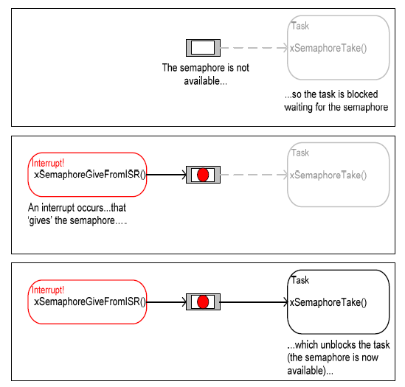
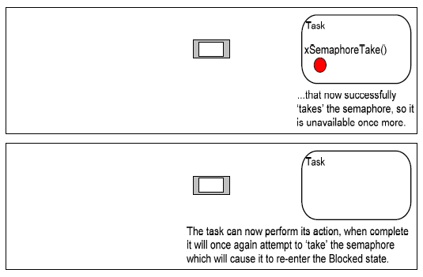
Binary Semaphores and Interrupts
Figure from Using the FreeRTOS Real Time Kernel (a pdf book), fair use claimed.

Slide 22
Create a Binary Semaphore
SemaphoreHandle_t xSemaphoreCreateBinary(void);
Function to create a binary semaphore
The semaphore is created in the 'empty' state
A binary semaphore need not be given back once obtained, so task synchronization can be implemented by one task/interrupt continuously 'giving' the semaphore while another continuously 'takes' the semaphore
Binary semaphores are assigned to variables of type SemaphoreHandle_t and can be used in any API function that takes a parameter of this type

Slide 23
Set a Binary Semaphore
xSemaphoreGiveFromISR(
SemaphoreHandle_t xSemaphore,
signed BaseType_t *pxHigherPriorityTaskWoken)
Set (give) a semaphore
Can be used from an ISR
xSemaphore: handle to the semaphore being released
pxHigherPriorityTaskWoken: set to pdTRUE if giving the semaphore caused a task of a higher priority to unblock, causing a context switch

Slide 24
Reset a Binary Semaphore
xSemaphoreTake( xSemaphoreHandle xSemaphore,
portTickType xBlockTime)
Reset (take) a semaphore
xSemaphore: handle to the semaphore being taken
xBlockTime: time in ticks to wait for the semaphore to become available
A block time of zero can be used to poll the semaphore

Slide 25
Example of Binary Semaphores
vSemaphoreHandle binary_sem; //Global handler void one_sec_isr(void){ // an ISR xSemaphoreGiveFromISR(binary_sem, NULL); } void sem_task(void *p){ while(1) if(xSemaphoreTake(binary_sem,999999)) puts("Tick!"); } int main(void){ vSemaphoreCreateBinary(binary_sem); xTaskCreate(sem_task, (signed char*)) "t1", 2048, NULL, 1, NULL); vTaskStartScheduler(); return 0; }
Notes:
24
24

Slide 26
Counting Semaphores
Typically used for two things:
Counting events:
An event handler will 'give' a semaphore each time an event occurs, and a handler task will 'take' a semaphore each time it processes an event
Resource management:
The count value indicates number of available resources
To get a resource, a task must obtain (take) a semaphore
When a task finishes with the resource, it 'gives' the semaphore back
SemaphoreHandle_t xSemaphoreCreateCounting( UBaseType_t uxMaxCount, UBaseType_t uxInitialCount)

Slide 27
Mutex
Mutexes are used for mutual exclusion, so that only one task at a time uses a shared resource, e.g., file, data, device, ...
To access the shared resource, a task locks the mutex associated with the resource
The task owns the mutex, until it unlocks the utex

Slide 28
Mutex
Mutex acts like a token used to guard a resource
When a task wishes to access the resource, it must first obtain ('take') the token
When the task has finished with the resource it must 'give' the token back - allowing other tasks the opportunity to access the same resource
Mutexes are binary semaphores that include a priority inheritance mechanism
If a high priority task blocks while attempting to obtain a mutex (token) that is currently held by a lower priority task, then the priority of the task holding the token is temporarily raised to that of the blocking task

Slide 29
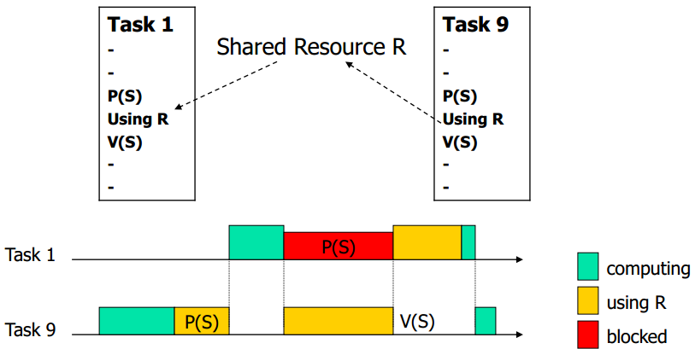
Priority Inversion
Assume priority of T₁ > priority of T₉
If T₉ has exclusive access, T₁ has to wait until T₉ releases resource → inverting priority → can raise priority of T₉
T₁ has higher priority and preempts T₉
Critical section
(critical section)

Slide 30
Example of Mutex (1/3)
xSemaphoreHandle gatekeeper = 0; //Global handler void user_1(void *p){ while(1){ if(xSemaphoreTake(gatekeeper, 1000)){ puts("User 1 got access"); access_precious_resource(); // critical section xSemaphoreGive(gatekeeper); } else{ puts("User 1 failed to get access within 1000ms"); } vTaskDelay(1000); /*Without delay, user 1 will get key immediately after releasing the key */ } }
Notes:
29
29

Slide 31
Example of Mutex (2/3)
void user_2(void *p){ while(1){ if(xSemaphoreTake(gatekeeper, 1000)){ puts("User 2 got access"); access_precious_resource(); // critical section xSemaphoreGive(gatekeeper); } else{ puts("User 2 failed to get access within 1000ms"); } vTaskDelay(1000); /*Without delay, user 2 will get key immediately after releasing the key */ } }
Notes:
30
30

Slide 32
Example of Mutex (3/3)
int main(void){ gatekeeper = xSemaphoreCreateMutex(); /*Create tasks with priority 1 for both users*/ xTaskCreate(user_1, (signed char*)) "t1", 1024, NULL, 1, NULL); xTaskCreate(user_2, (signed char*)) "t2", 1024, NULL, 1, NULL); vTaskStartScheduler(); return 0; }
Notes:
31
31

