Slide 1
CS4101 嵌入式系統概論
Sensors
Prof. Chung-Ta King
Department of Computer Science
National Tsing Hua University, Taiwan

Slide 2
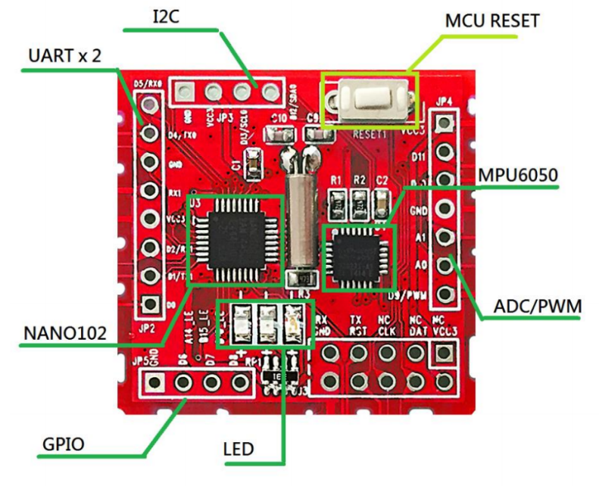
Outline
Introduction to sensors
  Accelerometer
  Gyroscope
NuMaker TRIO sensor
controller MPU-6050

Slide 3
What Are Sensors?
A sensor is a device that detects either an absolute value or a change in a physical or electrical quantity, and converts that change into a useful input signal (often analog signals) for a decision making center
Data Processing,
Control, Connectivity
Actuator
or
Output
Sensor
Input
Notes:
What is a Sensor?
A Sensor is a device that detects a physical or electrical quantity and converts this characteristic into a value for a decision making center such as an MCU. From this the MCU can decide on events, and trigger an additional output.
Some examples of physical quantities that our sensors measure include:
Temperature
Pressure
Flow rate
Acceleration
Vibration
Tilt
Touch

Slide 4
Sensors
For capturing physical data
Sensors can be designed for virtually every physical and chemical stimulus
  Heat, light, sound, weight, velocity, acceleration, electrical current, voltage, pressure, …
  chemical compounds
Many physical effects can be used for constructing sensors
  Law of induction (generation of voltages in an electric field), light-electric effects. …

Slide 5
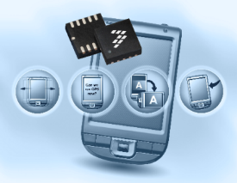

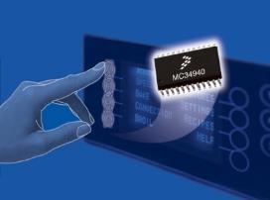

Sensor Applications
Acceleration
Gesture detection
Tilt to control
Tap detection
Position detection
Orientation
Gyroscopic
Magnetic
Ambient light sensing
Temperature/humidity
Motion detection
Pressure
Medical
Barometer/altimeter
Engine control/tire pressure
HVAC applications
Water level
Multiple sensors working together for next generation applications…
Touch
Touch detection
Appliance control panels
Touch panels
Notes:
Accelerometers include measurements of Gesture detection, Tilt, Tap and Orientation.
Pressure sensors measure Automotive engine control parameters, medical health monitoring, and have lots of industrial applications.
Touch sensors can be utilized in button replacement and be designed for custom applications.

Slide 6
Accelerometers
Devices that are used to measure acceleration
Common accelerometer types
  Resistive: strain gauge, piezoresistive, thin-film
  Capacitive: fiber optic, servo or force balance, vibrating quartz, piezoelectric
MEMS accelerometers:
  MEMS (Micro ElectroMechanical Systems): small silicon devices that perform the same function as larger mechanical systems
There is always 1 g downward due to gravity

Slide 7
Accelerometer Types
Capacitive: utilizes frequency modulation technique through varying capacitor bridge
Power
Ground
Signal
Fixed Capacitors
~
Built-In Electronics
Insulator
Sensing Capacitor #1
Flexure
Mass
Sensing Capacitor #2
Insulator

Slide 8
Accelerometer Types
Signal/Power
Ground
F
Piezoelectric Material
+
+
+
+
+
+
+
-
-
-
-
-
-
Voltage or Charge Amplifier
-
Preload Ring
Mass
Piezoelectric Crystal
F
Base
7
Piezoelectric:
  Force on self-generating crystal provides charge output proportional to acceleration
Notes:
壓電材料

Slide 9
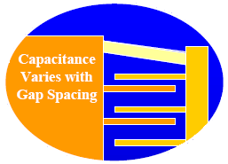
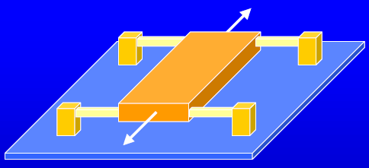
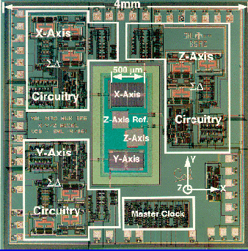
MEMS Accelerometer
Suspension arms
Proof mass
Substrate with circuitry
Axis of response
8

Slide 10
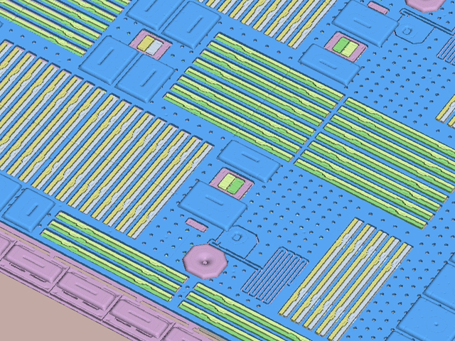
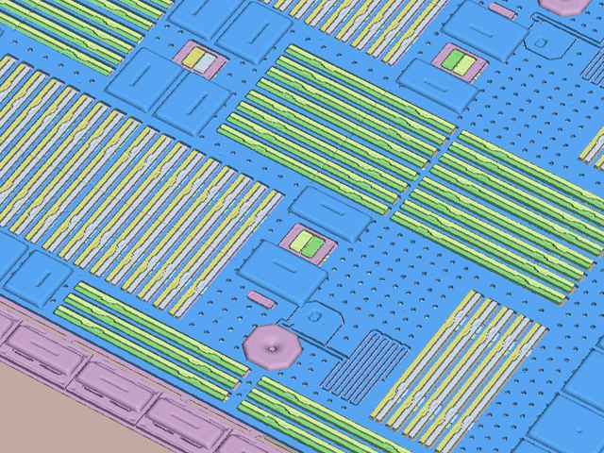
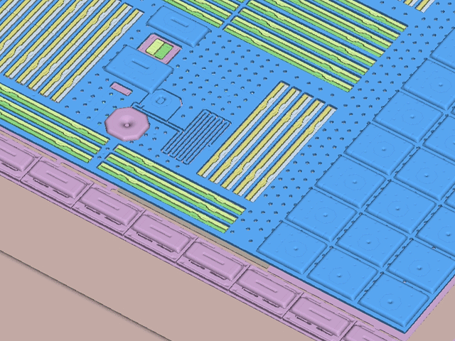
Accelerometer at Work: X, Y, Z Movement
X-axis
Y-axis
Z-axis
Notes:
Notice how the g-cell moves in X, Y and Z axes. The change in the distance between the plates or fingers determines the capacitance. This relates to the acceleration in each axis. Silicon has no fatigue, so can repetitively move back and forth for extended periods. Bump stops are used to control maximum movement.

Slide 11


Accelerometer Application: Pedometer
Pedometer or Step Counter: count number of steps
  When the person starts moving, x-axis value will increase and y-axis value will tell the relative change in the height
  Can recognize behaviors (rises from the ground or touches the ground) according to this trend value
y-axis
x-axis
z-axis

Slide 12
Gyroscopes
Devices that are used to determine orientation and measure angular velocity
Common gyroscope types
  Mechanical gyroscopes
  Fiber optic gyroscope(FOG): precise rotational rate information
MEMS gyroscopes
  Principle of operation is instead based on the vibration

Slide 13
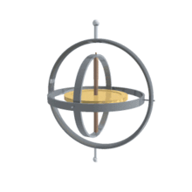
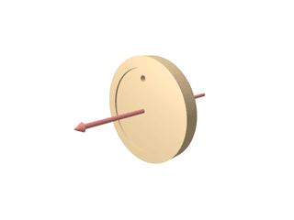
Mechanical Gyroscopes
A gyroscope is a spinning wheel. When rotating, the orientation of the axis is unaffected according to the conservation of angular momentum, and thus it can measure or maintain orientation.
Notes:
想像一個陀螺在一本書上旋轉，書雖然轉動, 但陀螺總是保持一個固定方向

Slide 14
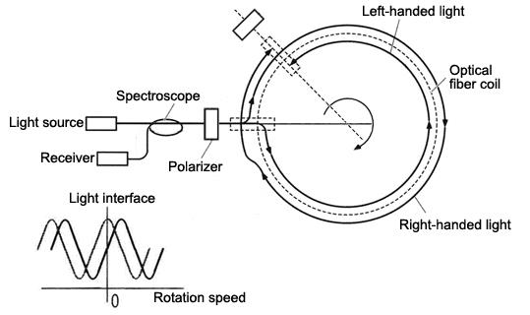
Fiber Optic Gyroscopes
(http://www.neubrex.com/htm/applications/gyro-principle.htm)
Two beams injected into same fiber in opposite directions. The beam travelling against the rotation runs a shorter path, resulting in differential phase shift
Notes:
Its principle of operation is based on the interference of light, which has passed through a coil of optical fiber which can be as long as 5 km.

Slide 15
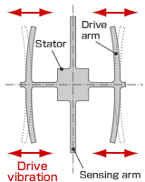
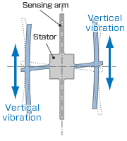
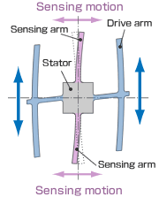
MEMS Gyroscopes
MEMS gyroscopes use the Coriolis effect, e.g.,
A drive arm vibrates in a certain direction
When the gyro is rotated, the Coriolis force produces vertical vibration
Stationary part bends due to vertical drive arm vibration, producing a sensing motion in sensing arms
(http://www5.epsondevice.com/en/information/technical_info/gyro/)

Slide 16
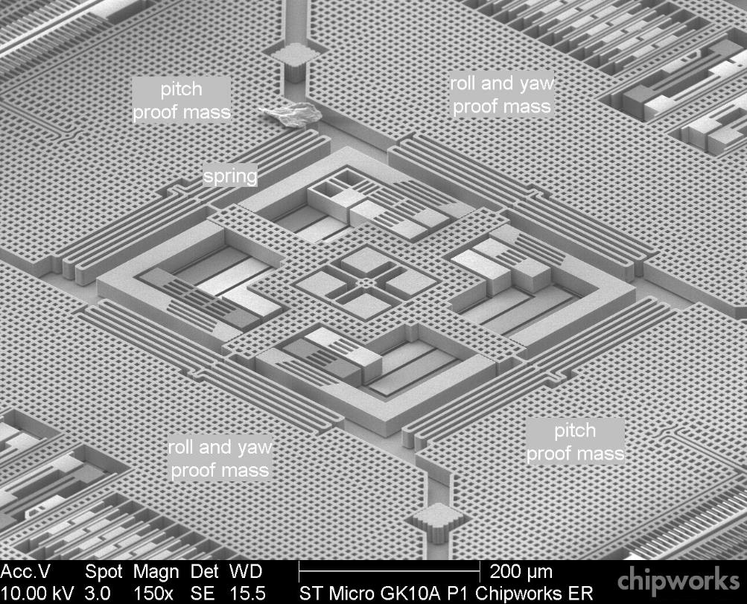
3-axis MEMS Gyroscope

Slide 17
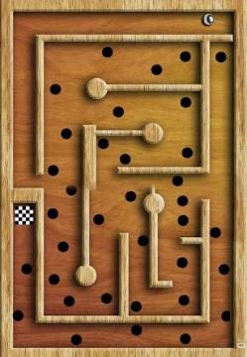
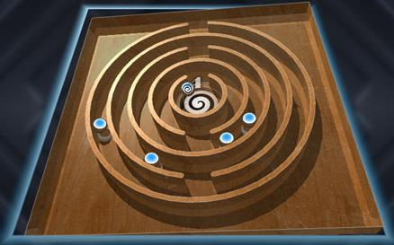

Gyroscope Applications
Smartphone can rotate the view of screen automatically when the user rotate the device
A smartphone game (balance ball) in which the user need to rotate the device to make the ball arrive at the destination area

Slide 18
Accelerometers versus Gyroscopes
An accelerometer has the ability to measure the orientation of a stationary platform relative to the earth’s surface.
A gyroscope has the capability of measuring the rate of rotation around a particular axis.
In other words, an accelerometer gets the direction of motion of an object and a gyroscope gets the degree of rotation.

Slide 19
Outline
Introduction to Sensors
  Accelerometer
  Gyroscope
NuMaker TRIO sensor controller MPU-6050

Slide 20

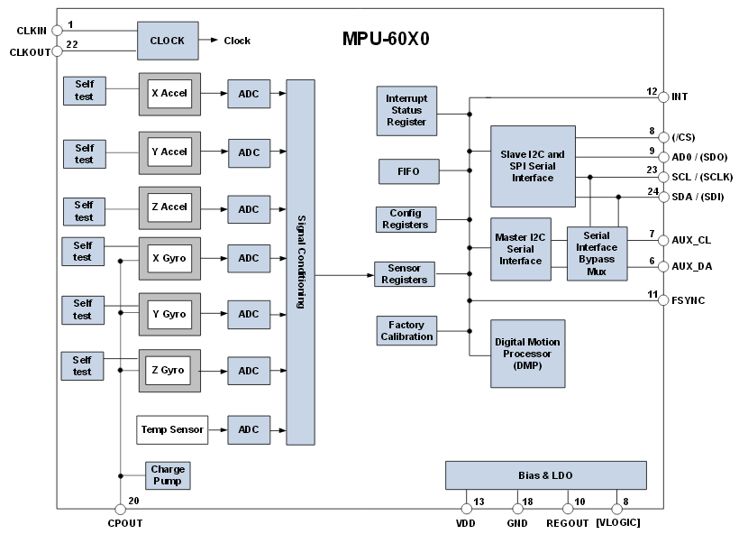
MPU-6050

Slide 21
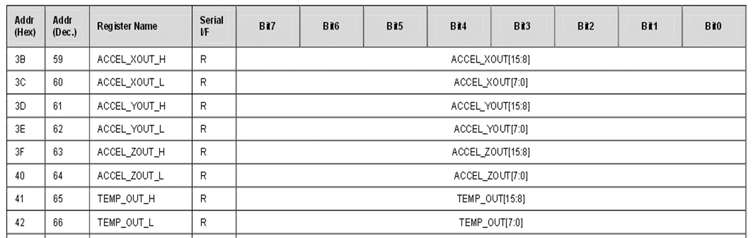
MPU-6050: Accelerometer
Two bytes (high and low) to present each axis
Read_MPU6050_AccY(void):
  LowByte =MPU6050_ReadByte(MPU6050_ACCEL_YOUT_L);
  HighByte =MPU6050_ReadByte(MPU6050_ACCEL_YOUT_H);
  AccY = (HighByte<<8) | LowByte ;

Slide 22
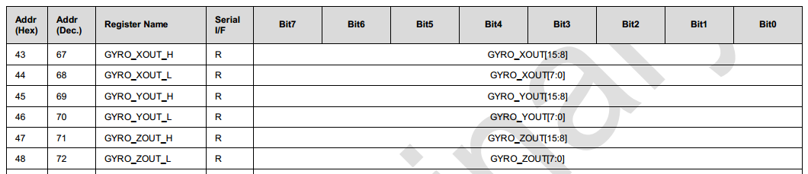
MPU6050 - Gyroscope
Similar to the accelerometer
Read_MPU6050_GyroX(void):
  LowByte = MPU6050_ReadByte(MPU6050_GYRO_XOUT_L);
  HighByte = MPU6050_ReadByte(MPU6050_GYRO_XOUT_H);
  GyroX = (HighByte<<8) | LowByte ;

Slide 23
MPU6050.h/.c (Library/NuMakerLib/Include,Source)
#define MPU6050_I2C_SLA 0xD0
#define MPU6050_I2C_PORT I2C1
void MPU6050_WriteByte(uint8_t MPU6050_reg,
uint8_t MPU6050_data) {
uint8_t data[1];
data[0]=MPU6050_data;
I2C_writeBytes(MPU6050_I2C_PORT, MPU6050_I2C_SLA,
MPU6050_reg, 1, data);
}
uint8_t MPU6050_ReadByte(uint8_t MPU6050_reg){
uint8_t data[1];
I2C_readBytes(MPU6050_I2C_PORT, MPU6050_I2C_SLA,
MPU6050_reg, 1, data);
return(data[0]);
}

Slide 24
smpl_I2C_MPU6050 (SampleCode/NuMaker-TRIO)
int32_t main(){
int16_t accX, accY, accZ;
int16_t gyroX, gyroY, gyroZ;
SYS_Init();
I2C_Open(I2C1, I2C1_CLOCK_FREQUENCY);
Init_MPU6050();
while(1) {
accX = Read_MPU6050_AccX();
accY = Read_MPU6050_AccY();
accZ = Read_MPU6050_AccZ();
printf("Acc: %6d, %6d, %6d, ", accX,accY,accZ);
gyroX = Read_MPU6050_GyroX();
gyroY = Read_MPU6050_GyroY();
gyroZ = Read_MPU6050_GyroZ();
printf("Gyro: %6d, %6d, %6d", gyroX,gyroY,gyroZ);
}
}

Slide 25
smpl_I2C_MPU6050_Tilt (SampleCode/NuMaker-TRIO)
while(1) {
accX = Read_MPU6050_AccX();
accY = Read_MPU6050_AccY();
accZ = Read_MPU6050_AccZ();
printf("Acc: %6d, %6d, %6d, ", accX, accY, accZ);
// calculate tilt (degree = radians *180 / PI)
theta=atan(accX/sqrt(pow(accY,2)+pow(accZ,2)))*180/PI;
psi=atan(accY/sqrt(pow(accX,2)+pow(accZ,2)))*180/PI;
phi=atan(sqrt(pow(accX,2)+pow(accY,2))/accZ)*180/PI;
printf("theta=%d, psi=%d, phi=%d\n",
(int) theta, (int) psi, (int) phi);
}

