Slide 1
CS4101 嵌入式系統概論 NuMaker TRIO: ADC, I2C, LCD
Prof. Chung-Ta King
Department of Computer Science
National Tsing Hua University, Taiwan

Slide 2
Outline
Analog to digital conversion (ADC) of NuMaker TRIO
I2C and LCD of NuMaker TRIO

Slide 3
ADC of NuMaker TRIO
12-bit successive approximation
8 external input channels and 4 internal channels
ADC can be started by software, external STADC (PA.11) pin, timer event and PWM trigger
SAR
End-Of-Conversion
Clock
N-bit
Vref
DAC
Comparator
-
+
Vin
Sample
& Hold

Slide 4
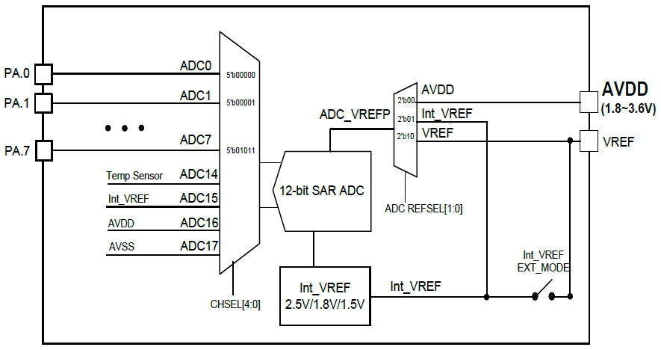
ADC Block Diagram

Slide 5
Three Operation Modes
Single mode:
A/D conversion is performed one time on a specified channel
Single-cycle scan mode:
A/D conversion is performed one cycle on all specified channels with the sequence from the lowest numbered channel to the highest numbered channel
Continuous scan mode:
A/D converter continuously performs single-cycle scan mode until software stops it

Slide 6
smpl_ADC4_GL5516 (SampleCode/NuMaker-TRIO)
// Define Clock source
#define MCU_CLOCK_SOURCE
#define MCU_CLOCK_SOURCE_HIRC // HXT, LXT, HIRC, LIRC
#define MCU_CLOCK_SOURCE_LXT
#define MCU_CLOCK_FREQUENCY 32000000 //Hz
// Define MCU Interfaces
#define MCU_INTERFACE_ADC
#define ADC_CLOCK_SOURCE_HIRC // HXT,LXT,PLL,HIRC,HCLK
#define ADC_CLOCK_DIVIDER 1
#define PIN_ADC_4 // To Photoresistor or IR Diode
#define ADC_INPUT_MODE ADC_INPUT_MODE_SINGLE_END
// SINGLE_END, DIFFERENTIAL
#define ADC_OPERATION_MODE ADC_OPERATION_MODE_CONTINUOUS
// SINGLE, SINGLE_CYCLE, CONTINUOUS
Notes:
A differential ADC will measure the voltage difference between two pins (the plus and minus input). A single-ended ("regular") ADC will measure the voltage difference between one pin and ground.

Slide 7
smpl_ADC4_GL5516 (SampleCode/NuMaker-TRIO)
void Init_ADC(void) // Initialize ADC
{
ADC_Open(ADC, ADC_INPUT_MODE,
ADC_OPERATION_MODE, ADC_CHANNEL_MASK);
ADC_POWER_ON(ADC);
// Enable ADC interrupt
ADC_EnableInt(ADC, ADC_ADF_INT);
// Enable ADC interrupt
NVIC_EnableIRQ(ADC_IRQn);
//ADC conversion start
ADC_START_CONV(ADC);
}

Slide 8
SYS_init.h (Library/NuMakerLib/Include)
#ifdef PIN_ADC_4
#define ADC_CHANNEL_MASK_4 ADC_CH_4_MASK
#else
#define ADC_CHANNEL_MASK_4 0
#endif
...
#define ADC_CHANNEL_MASK (ADC_CHANNEL_MASK_0 | ADC_CHANNEL_MASK_1 | ADC_CHANNEL_MASK_2 | ADC_CHANNEL_MASK_3 | ADC_CHANNEL_MASK_4 | ADC_CHANNEL_MASK_5 | ADC_CHANNEL_MASK_6 | ADC_CHANNEL_MASK_7)

Slide 9
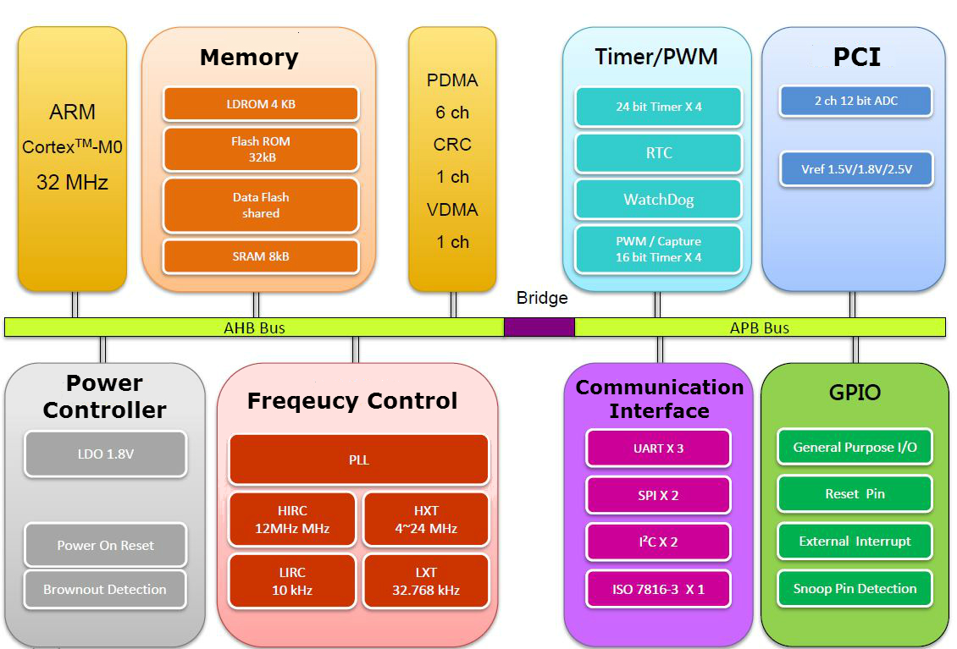
Outline
Analog to digital conversion (ADC) of NuMaker TRIO
I2C and LCD of NuMaker TRIO
On NuMaker TRIO, CPU communicates with LCD display via the I²C bus

Slide 10
I²C Serial Communication
I²C: Inter Integrated Circuit Bus
Two-wire serial multimaster-slave bus protocol by Philips in the 1980s
Enables peripheral ICs to communicate using simple communication hardware
7-bit or 10-bit address space
Data transfer rate: 100 kbits/s (standard mode), 400 kbits/s (fast mode), 3.4M bits/s (high speed mode)
Common devices capable of interfacing to I²C bus:
EPROMS, Flash, and some RAM memory, real-time clocks, watchdog timers, and microcontrollers

Slide 11
I²C (Inter Integrated Circuit)
I²C is a two-wire, bi-directional synchronous serial bus supporting multiple masters with collision detection and arbitration
Serial 8-bit bi-directional data transfers up to 1 Mbps between a Master and a Slave according to SCL on the SDA line
Vdd
SDA (Serial Data Line)
SCL (Serial Clock Line)
SCLKN1 out
DATA1 out
SCLK in
DATA in

Slide 12
I²C Bus Structure
2 signal lines: SCL (serial clock), SDA (serial data)
Every device connected to the I²C bus has a unique address and can act as a receiver or a transmitter
I²C is a multi master bus.
Bus master is established at the time of communication

Slide 13
I²C Protocol
Transfers are byte oriented, MSB first
Quiescent state for SCL, SDA is HIGH
Start: Master sends SDA low while keeps SCL high
Master sends address of slave (7-bits) on next 7 clocks
Master sends read/write request bit
0 (write to slave), 1 (read from slave)
Slave ACKs by pulling SDA low on next clock

Slide 14
I²C Protocol
Master transfers one-byte of data to slave on next 8 clock pulses
Clock is controlled by master
Data receipt is ACKed by slave on 9th pulse by pulling SDA low
When slave releases, SDA master can send next byte
At the end of transmission, Master sets a Stop condition by making a low to high transition on SDA with SCL is high

Slide 15
Timing Diagram of I²C Protocol
Data transfer initiated with a START bit (S) signaled by SDA being pulled low while SCL stays high.
SDA sets 1st data bit level, keeping SCL low (blue)
Data is sampled (received) when SCL rises (green)
This process repeats: SDA transitioning while SCL is low, and data being read while SCL is high
A STOP bit (P) is signaled when SDA is pulled high while SCL is high
(wikipedia)

Slide 16
I²C Transaction
Transmitter/receiver differs from master/slave
Master initiates transactions
Slave responds
Transmitter sets data on SDA line, slave acks
For a read, slave is transmitter and master acks
For a write, master is transmitter, and slave acks

Slide 17
Arbitration
Two transmitters may start transmission at about the same time → need arbitration
If one transmitter sets SDA to 1 (not driving a signal) and a second transmitter sets it to 0 (pull to ground), the result is that the line is low.
The first transmitter observes that the level of the line is different from that expected. It concludes that another node is transmitting and it loses arbitration
In the meantime, the other node has not noticed any difference between the expected and actual levels on SDA, and therefore continues transmission

Slide 19
I²C Protocol
Four parts in a standard communication:
START or Repeated START signal generation
Slave address transfer
Data transfer
STOP signal generation
Notes:
When the bus is free/idle, meaning no master device is engaging the bus (both SCL and SDA
lines are high), a master can initiate a transfer by sending a START signal. A START signal,
usually referred as the S-bit, is defined as a HIGH to LOW transition on the SDA line while SCL
is HIGH. The START signal denotes the beginning of a new data transfer.

Slide 20
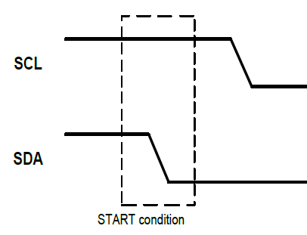
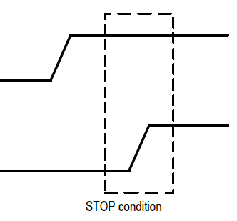
I²C Protocol: Start and Stop
Bus is free/idle when both SCL and SDA are high
A master initiates a transfer by sending START signal
A HIGH to LOW transition on SDA while SCL is HIGH
A STOP signal to terminate the communication
a LOW to HIGH transition on SDA while SCL is HIGH
Notes:
When the bus is free/idle, meaning no master device is engaging the bus (both SCL and SDA
lines are high), a master can initiate a transfer by sending a START signal. A START signal,
usually referred as the S-bit, is defined as a HIGH to LOW transition on the SDA line while SCL
is HIGH. The START signal denotes the beginning of a new data transfer.

Slide 21
I²C Protocol: Bit Transfer
Each bit is sampled during the high period of SCL
SDA may be changed only during the low period of SCL and must be held stable during the high period of SCL
A transition on the SDA line while SCL is high is interpreted as a command (START or STOP)

Slide 22
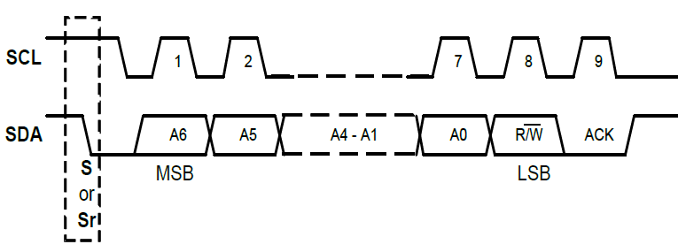
I²C Protocol: Slave Address Transfer
The 1st byte transferred by Master after START signal
A 7-bits calling address followed by the R/W bit to indicate the data transfer direction
The matching slave responds by returning an acknowledge bit by pulling SDA low at the 9th SCL clock cycle

Slide 23
I²C Protocol: Data Transfer
Each transferred byte is followed by an acknowledge bit on the 9th SCL clock cycle
If the slave signals a NACK, the master can generate a STOP signal to abort the data transfer or generate a Repeated START signal and start a new transfer cycle
If the master, as the receiving device, send NACK to the slave, the slave releases the SDA line for the master to generate a STOP or Repeated START signal

Slide 24
smpl_I2C_LCD (SampleCode/NuMaker-TRIO)
MCU_init.h
//Define Clock source
#define MCU_CLOCK_SOURCE
#define MCU_CLOCK_SOURCE_HIRC // HXT, LXT, HIRC, LIRC
#define MCU_CLOCK_SOURCE_LXT
#define MCU_CLOCK_FREQUENCY 32000000 //Hz
//Define MCU Interfaces
#define MCU_INTERFACE_I2C1
#define I2C1_CLOCK_FREQUENCY 400000 //Hz
#define PIN_I2C1_SCL_PC10
#define PIN_I2C1_SDA_PC11

Slide 25
smpl_I2C_LCD (SampleCode/NuMaker-TRIO)
main.c
#include <stdio.h>
#include "Nano1X2Series.h"
#include "MCU_init.h"
#include "SYS_init.h"
#include "I2C_SSD1306Z.h“
int32_t main(){
SYS_Init();
I2C_Open(I2C1, I2C1_CLOCK_FREQUENCY);
Init_LCD();
clear_LCD();
print_Line(0, "NuMaker TRIO");
print_Line(1, "Cortex-M0 @32MHz");
}

Slide 26
I2C_SSD1306.c (Library/NuMakerLIb/Source)
void print_C(uint8_t Line, uint8_t Col, char ascii) {
uint8_t j, i, tmp;
for (j=0;j<2;j++) {
lcdSetAddr(Col*8, Line*2+j);
for (i=0;i<8;i++) {
tmp=Font8x16[(ascii-0x20)*16+j*8+i];
lcdWriteData(tmp); } }
}
void print_Line(uint8_t line, char text[]) {
uint8_t Col;
for (Col=0; Col<strlen(text); Col++)
print_C(line, Col, text[Col]);
}
void lcdWriteData(uint8_t lcd_Data){
uint8_t data[1]; data[0]=lcd_Data;
I2C_writeBytes(LCD_I2C_PORT,LCD_I2C_SLA,0x40,1,data);
}

