Slide 1
CS4101 嵌入式系統概論 NuMaker TRIO
Prof. Chung-Ta King
Department of Computer Science
National Tsing Hua University, Taiwan

Slide 2
Outline
Introduction to NuMaker TRIO
Programming environment setup
Clock controller
GPIO

Slide 3
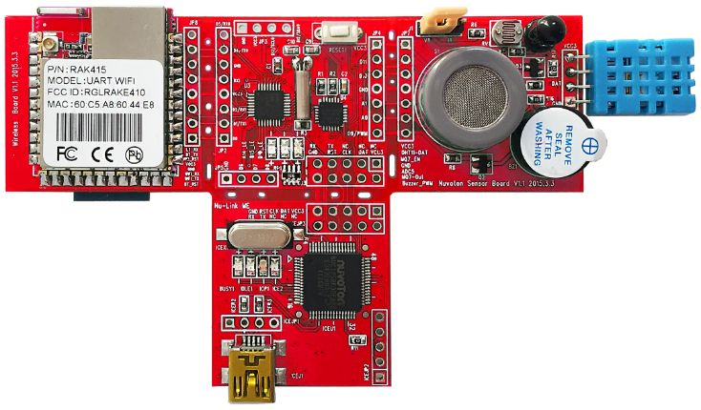
Introduction to NuMaker TRIO
An IoT development board
Based on Nuvoton Cortex®-M0 NANO102 MCU
Cortex-M0: 32-bit ARMv6 RISC processor
Run up to 32Mhz, 32KB Flash ROM, 8KB SRAM, Real-Time Clock (RTC)
Support SPI, I²C, UART, ADC, PWM, GPIO interfaces

Slide 4
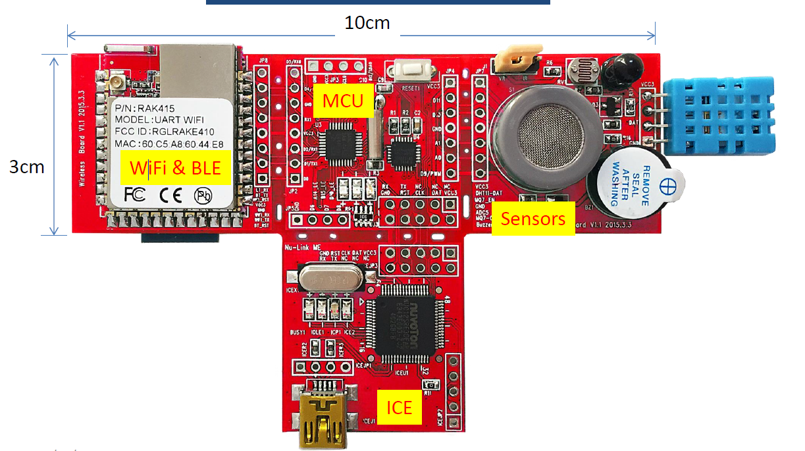
NuMaker TRIO Board Overview
Composed of four sections

Slide 5
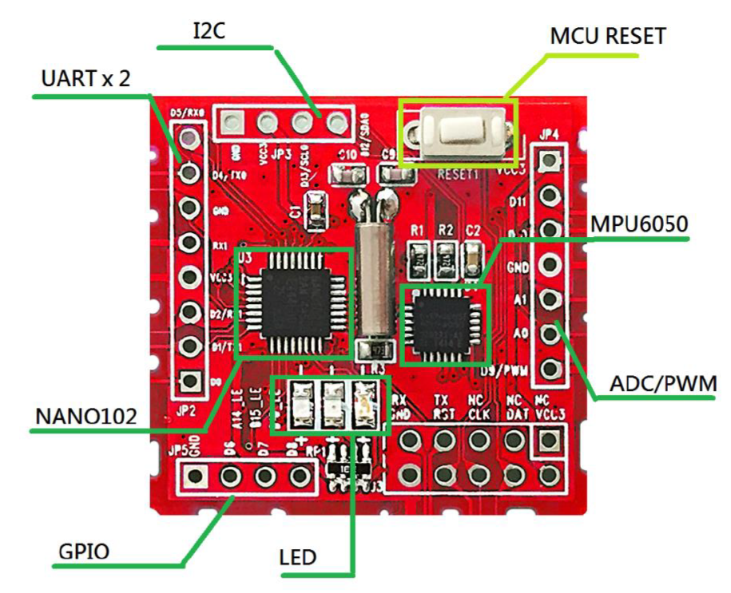
MCU Board
MCU: Nano102ZC2AN QFN33
Motion : MPU6050 (3-axis accelerometer and 3-axis gyroscope)
Real time clock : 32768Hz crystal
LEDs and reset button

Slide 6
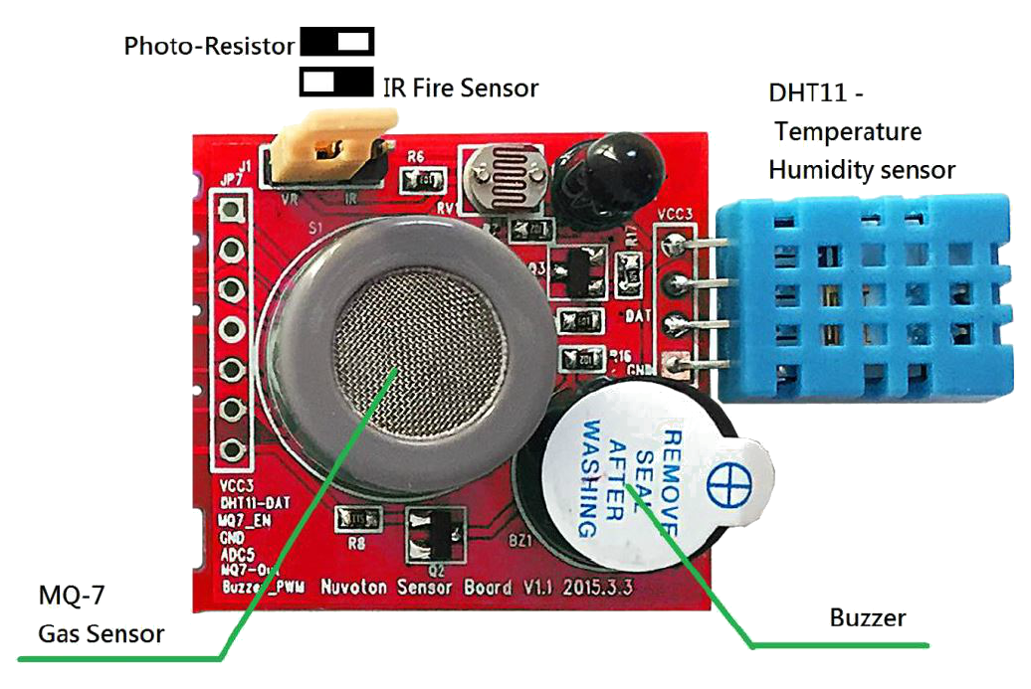
Sensor Board
Gas/CO detection: MQ-7
Luminance: GL5516 (photo-resistor)
Flame detection: IR diode
Humidity and temperature: DHT11
Buzzer

Slide 7
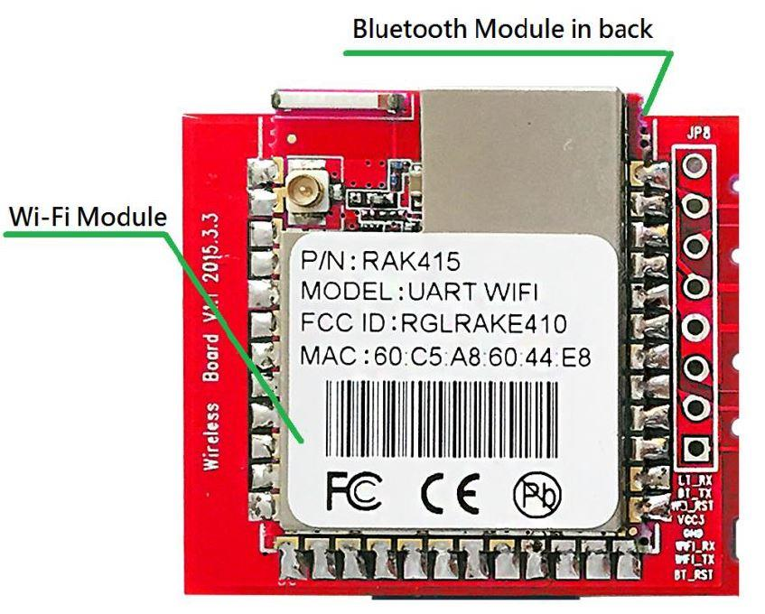
Wireless Board
WiFi: RAK415 (802.11n)
BT3.0+BLE: ITON BB2710

Slide 8
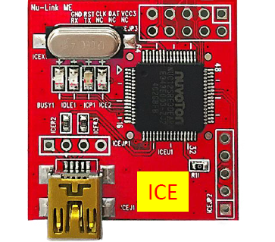
Nu-Link Adapter
Support ICP (In-Circuit Programming) based on SWD (Serial Wire Debug) interface
Support Nuvoton NuMicro ICP Programming Tool
Support other development toolkits, such as Keil RVMDK, IAR EWARM, CooCox CoIDE
Notes:
In-circuit emulator (ICE) used to debug the software of an embedded system. The programmer uses the emulator to load programs into the embedded system, run them, step through them slowly, and view and change data used by the system's software. It operates by using a processor with the additional ability to support debugging operations, as well as to carry out the main function of the system. It was historically in the form of bond-out processor which has many internal signals brought out for the purpose of debugging. These signals provide information about the state of the processor.
Joint Test Action Group (JTAG) based hardware debuggers provide equivalent access using on-chip debugging hardware with standard production chips.

Slide 9
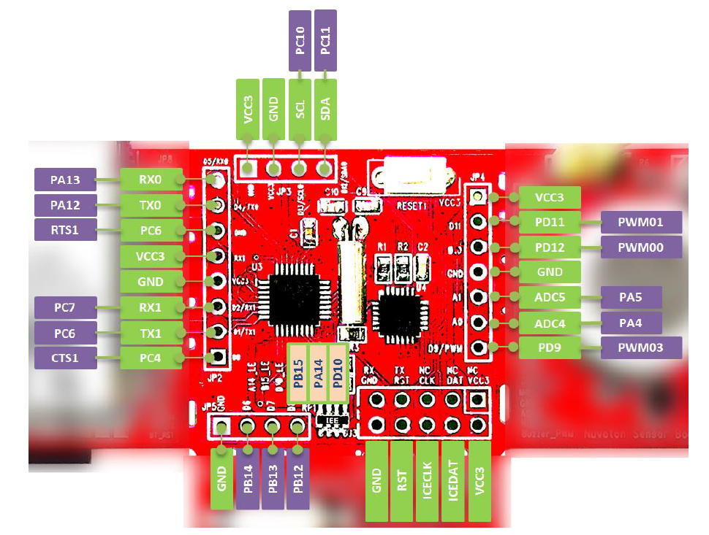
NuMaker TRIO MCU connectors

Slide 10
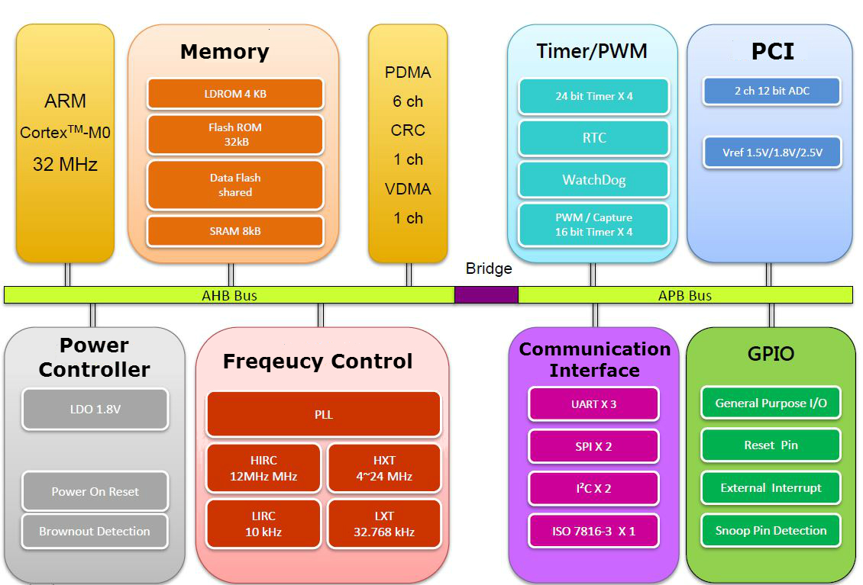
NANO102 MCU

Slide 11
Outline
Introduction to NuMaker TRIO
Programming environment setup
Clock controller
GPIO

Slide 12
Software Development Kit (SDK)
ARM Keil Microcontroller Development Kit (MDK)
IDE, C/C++ compiler, debugger for ARM Cortex-M
https://www.keil.com/demo/eval/arm.htm
Register and download MDK517.exe
NuLink Driver
Nu-Link_Keil_Driver_V1.30.6491.zip
Driver to link PC to NuMaker TRIO board through USB
Board Support Package (BSP): MCU device driver and sample code
Nano102_BSPv3.02_EDU

Slide 13
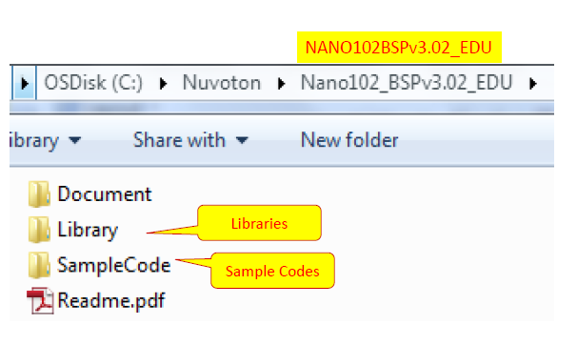
NANO102 BSP

Slide 14
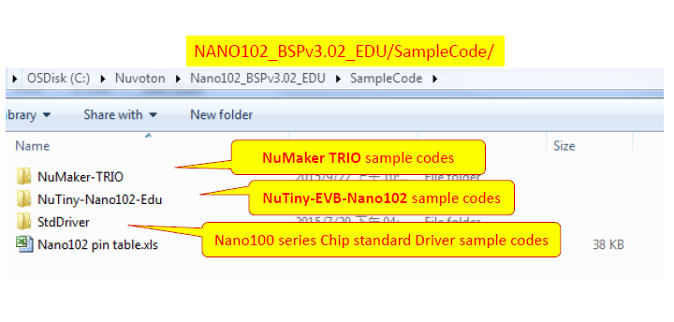
SampleCode Folder

Slide 15
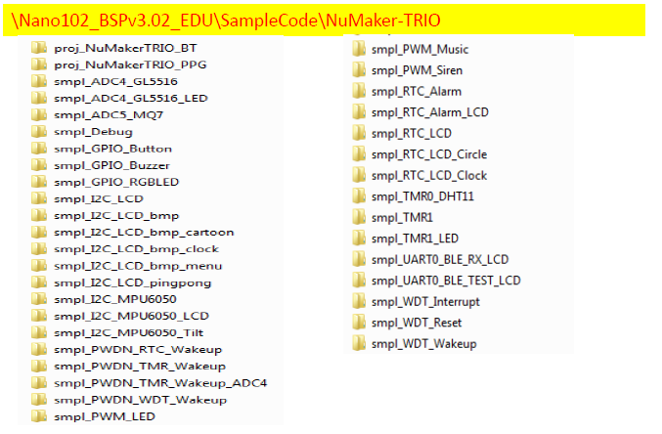
NuMaker TRIO Folder

Slide 16
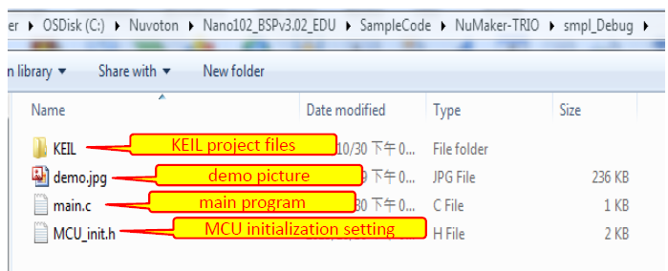
Smpl_Debug Folder

Slide 17
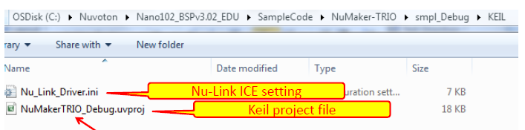
Keil Folder
Double click on .uvproj file to open a Keil project

Slide 18
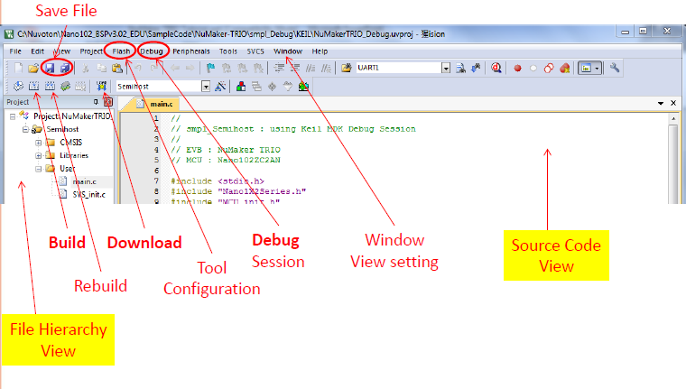
Keil MCU Development Environment

Slide 19
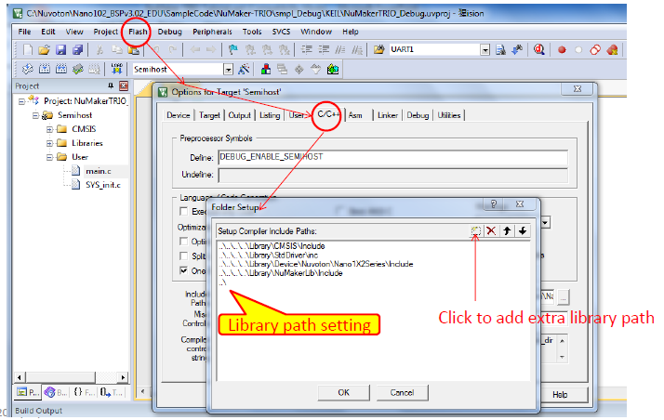
Keil MDK Configuration

Slide 20
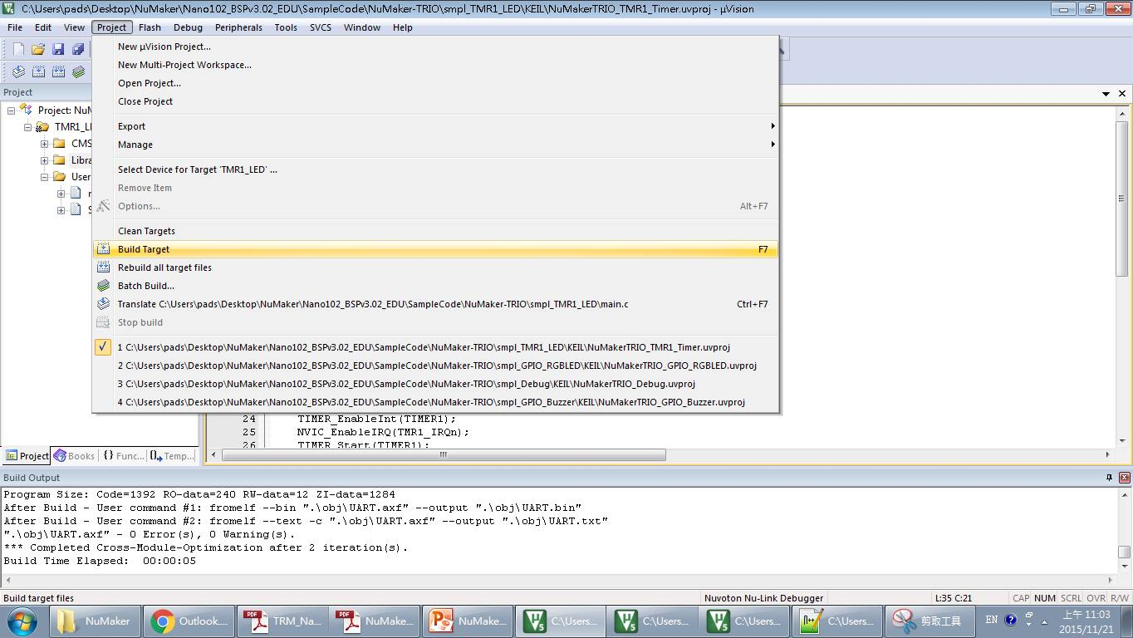
Build and Execute
1. Build your project

Slide 21
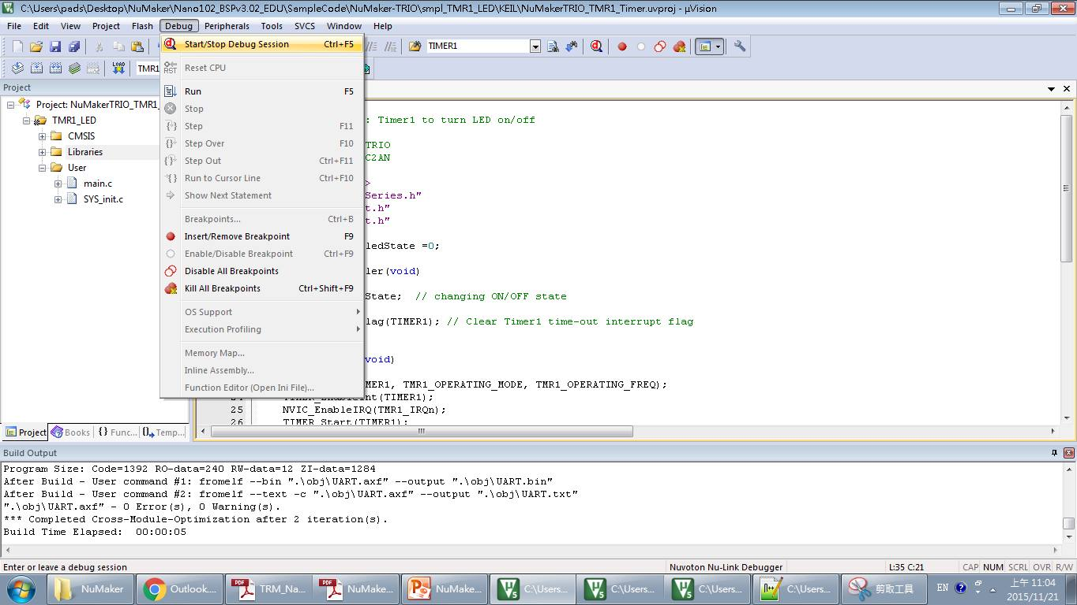
Build and Execute
2. Change to debug mode
3. Run your project

Slide 22
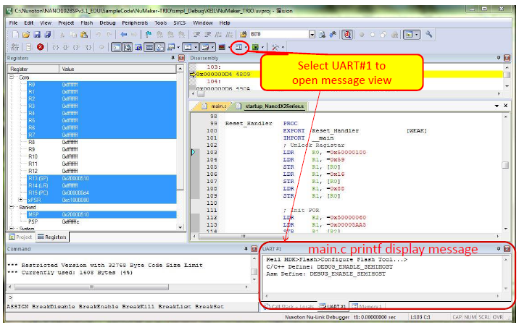
Debug Session

Slide 23
Outline
Introduction to NuMaker TRIO
Programming environment setup
Clock controller
GPIO

Slide 24
Clock Controller
Generates clocks for the whole chip, including system clocks (CPU clock, HCLKx, and PCLKx) and all peripheral module clocks
HCLKx: AHB bus clock for peripherals on AHB bus
AHB bus: high performance system bus for devices, such as processors, DMA controller, SRAM controller…
PCLKx: APB bus clock for peripherals on APB bus
APB bus: low-power peripheral bus for UART, smart card, etc.
Each peripheral module clock can be turned on/off

Slide 25
Recall NANO102 MCU

Slide 26
Sources for Clock Controller
32768Hz external low-speed crystal oscillator (LXT)
4~ 24 MHz external high-speed crystal oscillator (HXT)
12/16 MHz internal high-speed RC oscillator (HIRC)
10 kHz internal low-speed RC oscillator (LIRC)
Programmable PLL FOUT (PLL source can be selected from HXT or HIRC)

Slide 27
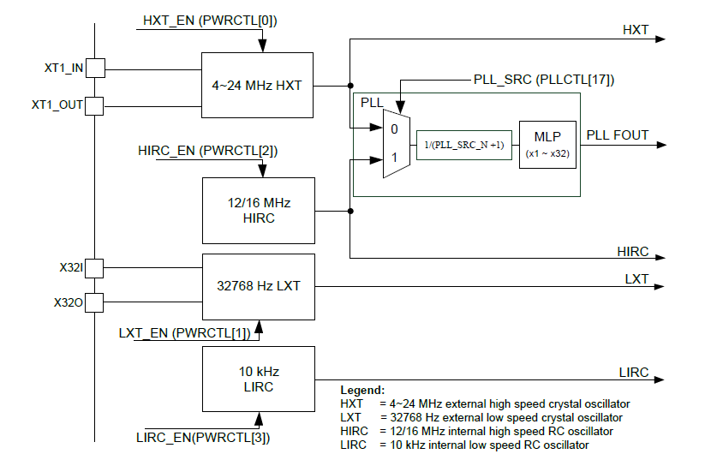
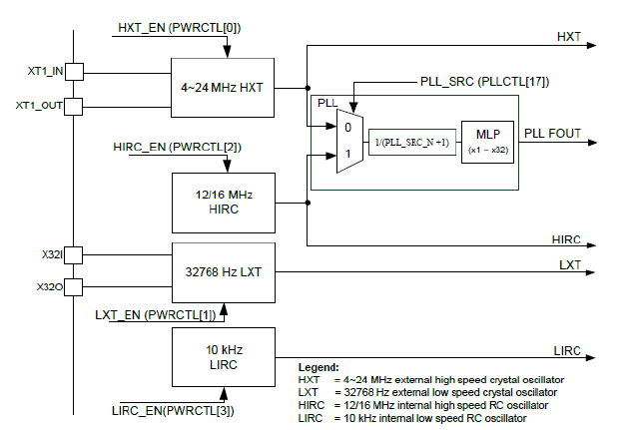
Clock Controller Block Diagram

Slide 28
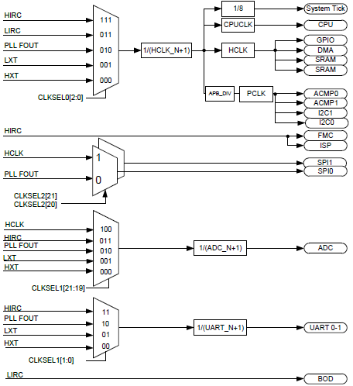
Host Clock Selection

Slide 29
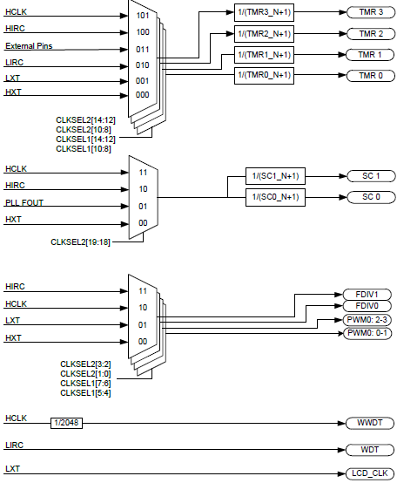
Host Clock Selection

Slide 30
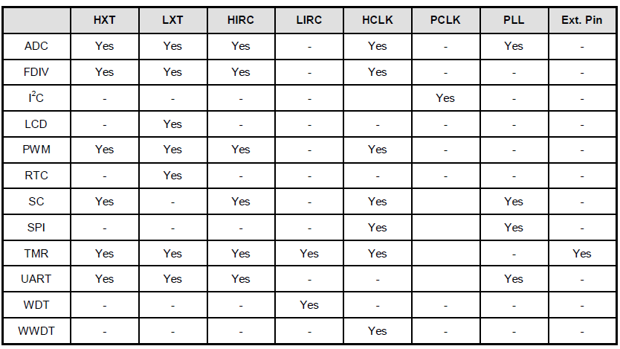
Peripheral Clock Selection

Slide 31
MCU_init.h
//Define Clock source #define MCU_CLOCK_SOURCE #define MCU_CLOCK_SOURCE_HIRC // HXT, LXT, HIRC, LIRC #define MCU_CLOCK_SOURCE_LXT #define MCU_CLOCK_FREQUENCY 32000000 //Hz range 16MHZ~32MHZ

Slide 32
Outline
Introduction to NuMaker TRIO
Programming environment setup
Clock controller
GPIO

Slide 33
General Purpose I/O (GPIO)
Up to 80 General Purpose I/O pins, arranged in 6 ports GPIOA, GPIOB, GPIOC, GPIOD, GPIOE, GPIOF
Three I/O modes:
Push-pull output
Open-drain output
Schmitt trigger Input-only with high impendence
I/O pin can be configured as interrupt source with edge/level setting
Enabling the pin interrupt function will also enable the pin wake-up function
Notes:
An open-drain or open-collector output pin is driven by a single transistor, which pulls the pin to only one voltage (generally, to ground). When the output device is off, the pin is left floating (open, or hi-z). When the transistor is off, the signal can be driven by another device or it can be pulled up or down by a resistor. The resistor prevents an undefined, floating state.
- A logical LOW will cause the pin to force a voltage of 0V ("ground") on whatever is connected to it, just like in normal mode.
A logical HIGH will cause the pin to not force anything on whatever is connected to it, as if it were physically disconnected.
The most common use is that some electronic components require a 0V / 5V signal rather than 0V / 3.3V. An external resistance will pull the voltage to 5V. Another use is when connecting several components' output pins to a single point, called a "bus". Since we never want any two pins to try to force different voltage levels on a single net, thus damaging each other, we use them all in open-drain mode, and use a single pull-up resistor to either 3.3V or 5V. When one (or more) of the pins on the bus "pulls low" by forcing 0V, the bus voltage will be 0V and all pins listening on that bus can detect it. When all of the pins are HIGH, i.e. virtually disconnected, the bus voltage gets "pulled up" by the resistor to whatever voltage it is connected to.

Slide 34
GPIO Set Mode
Library/StdDriver/src/gpio.c
GPIO set mode: GPIO_SetMode(PA, BIT12, GPIO_PMD_OUTPUT);
I/O groups:
NANO102 = PA, PB, PC, PD, PE, PF
port no = BIT0~15
I/O modes
GPIO_PMD_INPUT: input only mode
GPIO_PMD_OUTPUT: push-pull output mode
GPIO_PMD_OPEN_DRAIN: open-drain output mode
GPIO_PMD_QUASI: quai bi-direction mode
Output value: PA12 = 0;
Read Input: if (PA12 !=0) { }

Slide 35
Sample Code
#include <stdio.h> #include "Nano1X2Series.h" #include "MCU_init.h" #include "SYS_init.h" void Init_RGBLED(void) { GPIO_SetMode(PB, BIT15, GPIO_PMD_OUTPUT); GPIO_SetMode(PA, BIT14, GPIO_PMD_OUTPUT); GPIO_SetMode(PD, BIT10, GPIO_PMD_OUTPUT); PB15=1; PA14=1; PD10=1; }

Slide 36
Sample Code
int32_t main() { SYS_Init(); Init_RGBLED(); while(1) { PB15=0; // Red LED on CLK_SysTickDelay(200000); PB15=1; // Red LED off CLK_SysTickDelay(200000); PA14=0; // Green LED on CLK_SysTickDelay(200000); PA14=1; // Grene LED off CLK_SysTickDelay(200000); PD10=0; // Blue LED on CLK_SysTickDelay(200000); PD10=1; // Blue LED off CLK_SysTickDelay(200000); } }

