Slide 1
CS4101 嵌入式系統概論
Serial Communication
Prof. Chung-Ta King
Department of Computer Science
National Tsing Hua University, Taiwan
Materials from MSP430 Microcontroller Basics, John H. Davies, Newnes, 2008

Slide 2
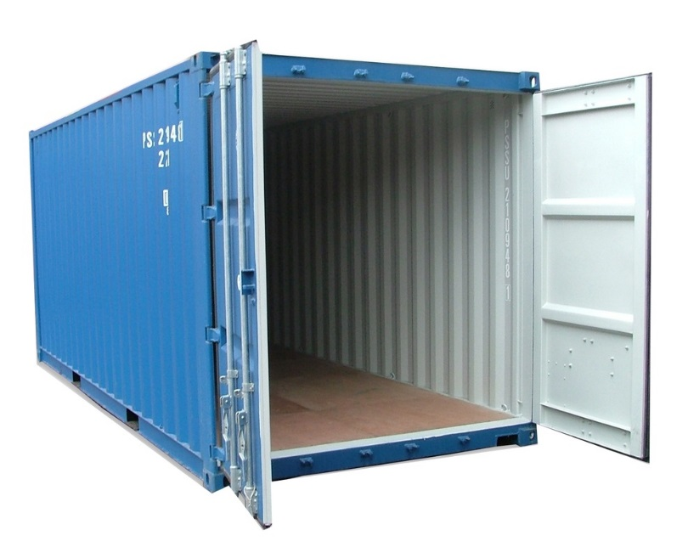

Recall the Container Thermometer
Container thermometer: monitor the temperature of the interior of a container
  Monitor the temperature
  every 5 minutes
  Flash LED alarm at 1 Hz
  If the temperature rises above
  a threshold, flash the LED alarm
  at 3 Hz and notify backend server
  If the temperature drops below
  a threshold, return the LED alarm
  to normal and notify the server
Need to communicate with the server!

Slide 3
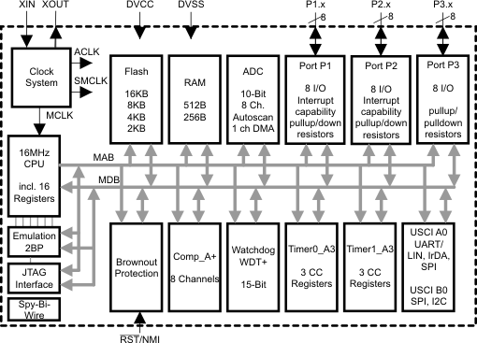
We Have Learned …
ADC
Clock System
IO
Comm
Timer System

Slide 4
Outline
Asynchronous serial communication
Asynchronous serial communication in MSP430 using software and Timer_A

Slide 5
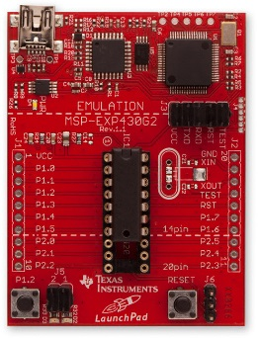
Communication Interfaces
Communication interfaces:
  For exchanging information with external devices, e.g., USB, RS-232, Ethernet ...
Serial communication:
  A single bit is transferred at a time
  Synchronous: a clock signal is sent along with data;
  the device that generates the clock is called the
  master and other devices are slaves
  Asynchronous: no clock transmitted, fewer wires
Parallel communication:
  Multiple bits are transferred at a time

Slide 6
Asynchronous Serial Communication
Serial communication without carrying clock signal
  Can be managed in hardware by a peripheral called a universal asynchronous receiver/transmitter (UART), which is built into many microcontrollers
  Even if UART is not available, it can be emulated easily with a timer assisted by software
Features:
  Usually require only a single wire for each transmission direction plus a common ground wire
  Most general-purpose connections are full duplex, i.e. data can be sent simultaneously in both directions
  Often connect two end devices (not a bus)

Slide 7
Asynchronous Serial Communication
How to synchronize the transmissions of the two ends which run on independent clocks?
  Use absolute (real) time, or
  Transmit short data (e.g. one byte) at a time, assuming the two clocks run at same rate during that period of time

Slide 8
Data Format for Asyn Transmission
Data are sent in short frames, each of which typically contains a single byte
Example: the line idles high and each frame contains:
  one low start bit (ST)
  eight data bits, usually LSB first
  one high stop bit (SP)
8-N-1 format: 8-bit data, no parity bit, 1 stop bit

Slide 9
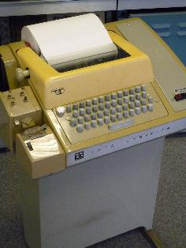

RS-232
A standard for asynchronous serial communication
  Originally for connecting equipment such as teletype (data terminal equipment, DTE) to modem (data communication equipment, DCE)
  Old version, RS-232-C, in 1969
  Current version, ANSI/TIA/EIA-232-F,
  maintained by EIA
Main features:
  Connection must be less than 50 feet
  Voltage level: 1 (-3~-15V), 0 (+3~+15V)
    Region between ±3 V does not correspond to valid data
    MSP430’s voltage is less than 3V → use transceiver
Falling edge
means 0 → 1

Slide 10
Transmission Speed
Baud rate:
  # of signal changes per second, e.g., 9600 baud
    In RS-232, each signal change represents one bit, so baud rate and bits per second are equal
  Since each 8 bits of data are accompanied by a start and a stop bit, maximum data rate is only 8/10 of baud rate
How close must the two ends run their clocks?
  The final sample is taken 9.5 bit periods after the initial falling edge and must lie within the stop bit
  The permissible error is therefore about ±0.5 bit period in 9.5 periods or ±5%
  There may be errors in both receiver and transmitter, so each should be accurate to within about ±2%

Slide 11
Serial Transmission Using UARTs
UART: Universal Asynchronous Receiver Transmitter
  Takes parallel data
  and transmits serially
  Receives serial data
  and converts to parallel
embedded device
1
0
1
0
1
0
1
1
1
0
0
1
1
0
1
1
1
0
0
1
1
0
1
1
Sending UART
Receiving UART
start bit
end bit
data

Slide 12
Outline
Asynchronous serial communication
Asynchronous serial communication in MSP430 using software and Timer_A

Slide 13
Communication Peripherals in MSP430
Universal Serial Interface (USI):
  A lightweight module handles only synchronous communication: SPI and I²C
Universal Serial Communication Interface (USCI):
  Handle almost all aspects of the communication
  Asynchronous channel, USCI_A: act as a universal asynchronous receiver/transmitter (UART) to support the usual RS-232 communication
  Synchronous channel, USCI_B: handle both SPI and I²C as either master or slave
  Included in MSP430G2553

Slide 14
Software UART Using Timer_A
Software UART on MSP430 using Timer_A without relying on special UART hardware
  Assume data are received and transmitted through two GPIO pins, e.g. P1.1 (TXD) and P1.2 (RXD), respectively
  Use software to control Timer_A to handle serial IO directly and process the sampled input or set up the next bit for output in an ISR
ADC
Clock System
IO
Comm
Timer System

Slide 15
How to Do?
General procedure for receive (RX)
  Hardware detect falling edge on serial input (e.g., P1.2), which indicates a start bit; start timer for 0.5 bit period
  On timer interrupt, sample the serial input to confirm whether a valid start bit is received; if so, set timer for 1 bit period
  On timer interrupt, sample the input to read the first bit (LSB); set timer for another bit period
  Repeat this until all 8 bits have been received
  Wait a further bit period and check that the input is high for the stop bit. A framing error occurs if this bit is low.
Transmission (TX) similar!

Slide 16
How to Leverage Timer_A?
For receive:
  Use capture mode of a capture/compare block: When an event occurs on an input to the block, the register TACCRx will store the “time”, i.e., the value in TAR, of that event
  The input
  value will be
  latched in
  SCCI bit
RXD pin
(e.g., P1.2)

Slide 17
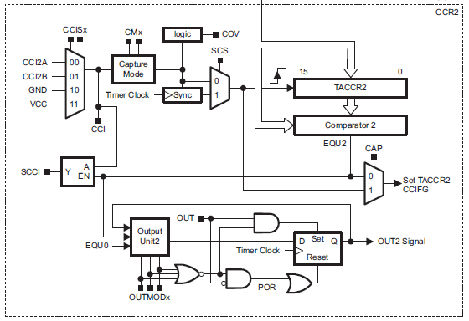
How to Leverage Timer_A?
For transmission:
  Use output circuit of Timer_A
  e.g., if OUTMOD=0, output of the block is controlled directly by
  OUT bit in
  TACCTLx, as
  if the pin is
  used for
  normal, digital
  output but
  operated via
  Timer_A
TXD pin
(e.g., P1.1)

Slide 18
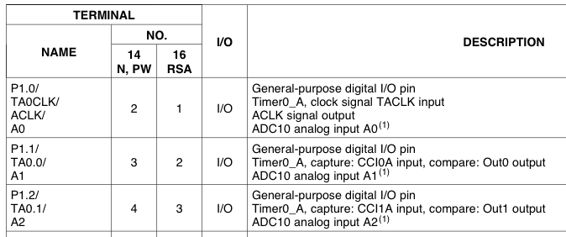
Pin Connections
Use TA0CCR0
TXD
Use TA0CCR1
RXD
#define TXD 0x02 // TXD on P1.1 (Timer0_A.OUT0) #define RXD 0x04 // RXD on P1.2 (Timer0_A.CCI1A) P1SEL |= TXD + RXD; // Enable TXD/RXD pins P1DIR = 0xFF & ~RXD; // Set pins to output P1OUT = 0x00; // Initialize all GPIO

Slide 19
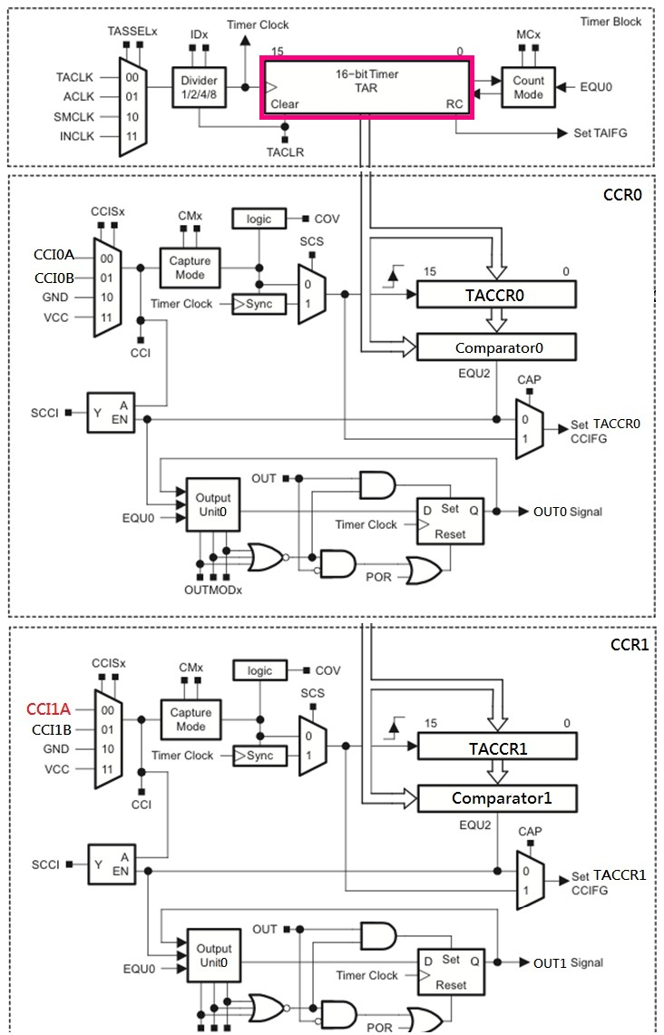
For
Transmission
TXD pin
For
Receive
Latch allows sampling
at precise time,
regardless of ISR latency
RXD pin

Slide 20
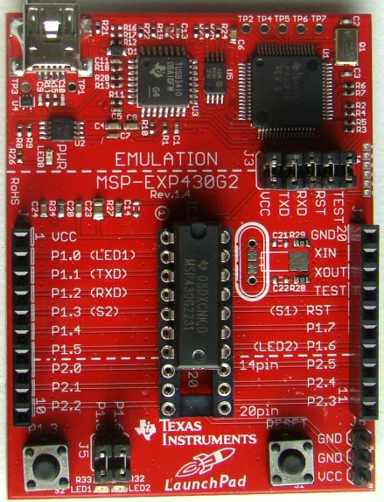
For
LaunchPad
LaunchPad thinks that
it has physical RS232
links with PC, while
PC also thinks it has
physical COM port
(RS232) to LaunchPad

Slide 21
Receive Procedure by Timer_A
Between transmissions, CCR1 waits in Capture mode for a falling edge on its input.
When a falling edge is detected, TACCR1 captures the count in TAR and raises an interrupt. CCR1 is switched to Compare mode and TACCR1 is set to fire an interrupt after 1.5 of the bit period from now.
The next interrupt occurs and SCCI contains the value of LSB. ISR saves it. Next compare event is set up to occur after a further bit period.
The above procedure is repeated until all 8 bits of data have been received.

Slide 22
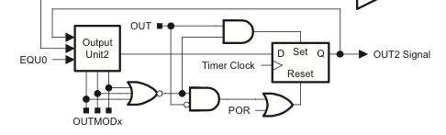
Transmission of Software UART
Use Capture/Compare Block 0 (TA0CCR0)
OUTMOD_0: OUT0 signal is defined by OUT bit
OUTMOD_2: OUT0 signal is reset when the timer counts to TA0CCR0
→ Use OUTMOD_0 to send a 1, OUTMOD_2 for 0
OUT0
Notes:
The OUTMODx determines how the signal changes when a CCR0 event happens.

Slide 23
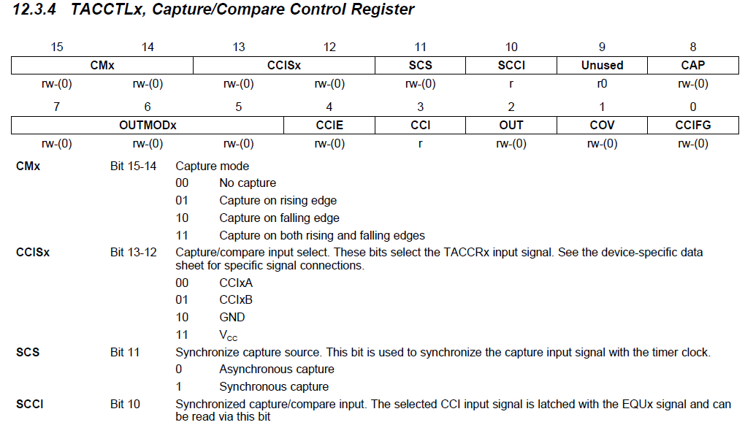
TA0CCTLx

Slide 24
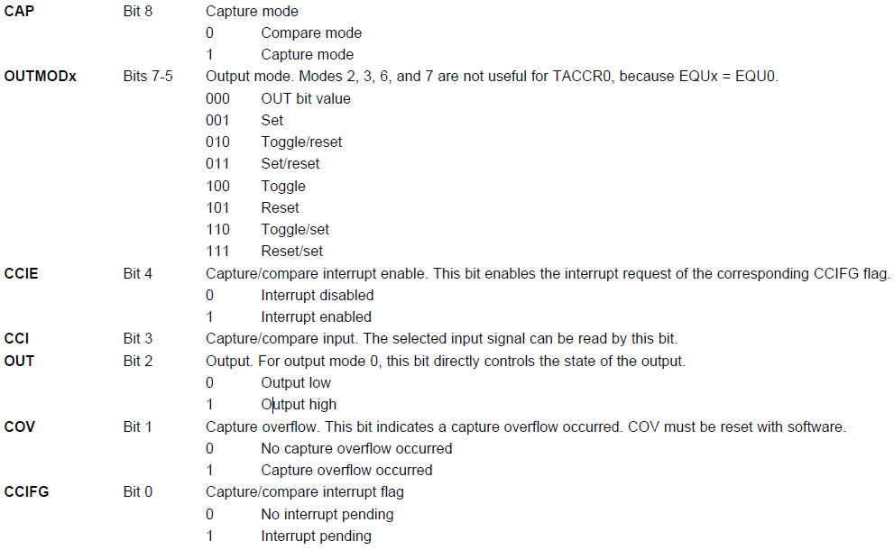
TA0CCTLx (cont’d)

Slide 25
Sample Code (msp430g2xx3_ta_uart9600)
Software UART, using Timer0_A, 9600 baud, echo, full duplex, SMCLK at 1MHz
  Main loop readies UART to receive one character and waits in LPM3 with all activity interrupt driven.
  TA0CCR0 and TA0CCR1 may interrupt at any time and in an interleaved way
  TA0R keeps an independent time reference, while CCR0 and CCR1 handle time intervals

Slide 26
Sample Code (msp430g2xx3_ta_uart9600)
#include "msp430g2553.h“ #define UART_TXD 0x02 // TXD on P1.1 (Timer0_A.OUT0) #define UART_RXD 0x04 // RXD on P1.2 (Timer0_A.CCI1A) #define UART_TBIT_DIV_2 (1000000 / (9600 * 2)) #define UART_TBIT (1000000 / 9600) unsigned int txData; // UART internal TX variable unsigned char rxBuffer; // Received UART character void TimerA_UART_init(void); void TimerA_UART_tx(unsigned char byte); void TimerA_UART_print(char *string);

Slide 27
Sample Code (msp430g2xx3_ta_uart9600)
void main(void) { WDTCTL = WDTPW + WDTHOLD; // Stop watchdog timer DCOCTL = 0x00; // Set DCOCLK to 1MHz BCSCTL1 = CALBC1_1MHZ; DCOCTL = CALDCO_1MHZ; P1OUT = 0x00; // Initialize all GPIO P1SEL = UART_TXD + UART_RXD; // Use TXD/RXD pins P1DIR = 0xFF & ~UART_RXD; // Set pins to output __enable_interrupt();

Slide 28
Sample Code (msp430g2xx3_ta_uart9600)
TimerA_UART_init(); // Start Timer_A UART TimerA_UART_print("G2xx3 TimerA UART\r\n"); TimerA_UART_print("READY.\r\n"); for (;;) { // Wait for incoming character __bis_SR_register(LPM0_bits); // Echo received character TimerA_UART_tx(rxBuffer); } } void TimerA_UART_print(char *string) { while (*string) TimerA_UART_tx(*string++); }
Waken up by
Timer_A1_ISR
Notes:
TimerA_UART_tx() sends one byte at a time
TimerA_UART_print(char *string) sends the whole string

Slide 29
Sample Code (msp430g2xx3_ta_uart9600)
void TimerA_UART_init(void) { TA0CCTL0 = OUT; // Set TXD idle as '1' TA0CCTL1 = SCS + CM1 + CAP + CCIE; // CCIS1 = 0 // Set RXD: sync, neg edge, capture, interrupt TA0CTL = TASSEL_2 + MC_2; // SMCLK, continuous mode } void TimerA_UART_tx(unsigned char byte) { while (TACCTL0 & CCIE); // Ensure last char TX'd TA0CCR0 = TAR; // Current state of TA counter TA0CCR0 += UART_TBIT; // One bit time till 1st bit TA0CCTL0 = OUTMOD0 + CCIE; // Set TXD on EQU0, Int txData = byte; // Load global variable txData |= 0x100; // Add stop bit to TXData txData <<= 1; // Add start bit }
Notes:
TACCTL1 = SCS + CM1 + CAP + CCIE;
// Sync, capture on rising edge, Capture mode, CCIS1 = 0 (default) → CCI1A, interrupt
SCS: Synchronize capture source. This bit is used to synchronize the capture input signal with the timer clock.
0 → Asynchronous capture; 1 → Synchronous capture
CMx: Capture mode
00 → No capture; 01 → Capture on rising edge; 10 → Capture on falling edge; 11 → Capture on both rising and falling edges
CCISx: Capture/compare input select. These bits select the TACCRx input signal.
00 → CCIxA; 01 → CCIxB; 10 → GND; 11 → VCC
Transmission starts from LSB
What happens if TACCR0 overflow? Synch with TAR’s overflow!

Slide 30
Sample Code (msp430g2xx3_ta_uart9600)
#pragma vector = TIMER0_A0_VECTOR __interrupt void Timer_A0_ISR(void) { static unsigned char txBitCnt = 10; TA0CCR0 += UART_TBIT; // Set TACCR0 for next intrpt if (txBitCnt == 0) { // All bits TXed? TA0CCTL0 &= ~CCIE; // Yes, disable intrpt txBitCnt = 10; // Re-load bit counter } else { if (txData & 0x01) {// Check next bit to TX TA0CCTL0 &= ~OUTMOD2; // TX '1’ using OUTMODE0 } else { TA0CCTL0 |= OUTMOD2;} // TX '0‘ txData >>= 1; txBitCnt--; } }

Slide 31
Sample Code (msp430g2xx3_ta_uart9600)
#pragma vector = TIMER0_A1_VECTOR __interrupt void Timer_A1_ISR(void) { static unsigned char rxBitCnt = 8; static unsigned char rxData = 0; switch (__even_in_range(TA0IV, TA0IV_TAIFG)) { case TA0IV_TACCR1: // TACCR1 CCIFG - UART RX TA0CCR1 += UART_TBIT;// Set TACCR1 for next int if (TA0CCTL1 & CAP) { // On start bit edge TA0CCTL1 &= ~CAP; // Switch to compare mode TA0CCR1 += UART_TBIT_DIV_2;// To middle of D0 } else { // Get next data bit rxData >>= 1;
Notes:
Timer_A interrupt vector register (TAIV): on an interrupt, TAIV contains a number indicating highest priority enabled interrupt for Timer_A0
TA0IV = 02h for TACCR1; = 04h for TACCR2; = 0ah for TAIFG
The __even_in_range(x,n) intrinsic tells the compiler that the expected argument is 1) always an even number and 2) in the range of x..n.
It allows the compiler to use a way more efficient method to branch to the different cases.
Instead of chained comparisons, the compiler just adds the argument to the program counter. And follows this instruction with a table of jump instructions (which take 2 bytes each). As a result of this add, the program counter directly lands on the jump instruction that jumps to the case code.
This intrinsic works best in conjunction with the IV registers, as these registers always return an even value in a known range. And, the highest priority interrupt has the largest value in the IV registers, so it is executed fastest.

Slide 32
Sample Code (msp430g2xx3_ta_uart9600)
if (TA0CCTL1 & SCCI) { // Get bit from latch rxData |= 0x80; } rxBitCnt--; if (rxBitCnt == 0) { // All bits RXed? rxBuffer = rxData; // Store in global rxBitCnt = 8; // Re-load bit counter TACCTL1 |= CAP; // Switch to capture __bic_SR_register_on_exit(LPM0_bits); // Clear LPM0 bits from 0(SR) } } break; } }
Wake up
main loop

Slide 33
Interrupt Source | Interrupt Flag | System Interrupt | Word Address | Priority
Power-up/external reset/Watchdog Timer+/flash key viol./PC out-of-range | PORIFG RSTIFG WDTIFG KEYV | Reset | 0FFFEh | 31 (highest)
NMI/Oscillator Fault/ Flash access viol. | NMIIFG/OFIFG/ ACCVIFG | Non-maskable | 0FFFCh | 30
Timer1_A3 | TA1CCR0 CCFIG | maskable | 0FFFAh | 29
Timer1_A3 | TA1CCR1/2 CCFIG, TAIFG | maskable | 0FFF8h | 28
Comparator_A+ | CAIFG | maskable | 0FFF6h | 27
Watchdog Timer+ | WDTIFG | maskable | 0FFF4h | 26
Timer0_A3 | TA0CCR0 CCIFG | maskable | 0FFF2h | 25
Timer0_A3 | TA0CCR1/2 CCIFG, TAIFG | maskable | 0FFF0h | 24
 |  |  | 0FFEEh | 23
 |  |  | 0FFECh | 22
ADC10 | ADC10IFG | maskable | 0FFEAh | 21
 |  |  | 0FFE8h | 20
I/O Port P2 (8) | P2IFG.0 to P2IFG.7 | maskable | 0FFE6h | 19
I/O Port P1 (8) | P1IFG.0 to P1IFG.7 | maskable | 0FFE4h | 18
 |  |  | 0FFE2h | 17
 |  |  | 0FFE0h | 16
Unused |  |  | 0FFDEh 0FFCDh | 15 - 0
Three sources of interrupts cause the same interrupt vector. Which one(s) cause the interrupt? → check TAIV register
Notes:
The MSP430 uses vectored interrupts, which means that the address of each ISR—its vector—is stored in a vector table at a deﬁned address in memory. In most cases each vector is associated with a unique interrupt but some sources share a vector. The ISR itself must locate the source of interrupts that share vectors. For example, TAIFG shares a vector with the capture/compare interrupts for all channels of Timer_A other than 0. Channel 0 has its own interrupt ﬂag TACCR0 CCIFG and separate vector.
32

Slide 34
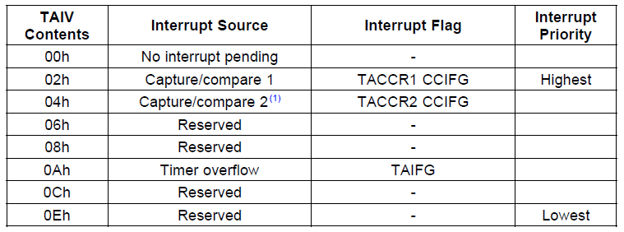
TAIV (Timer_A Interrupt Vector)
On an interrupt, TAIV contains a number indicating the highest priority enabled interrupt: TACCR1_CCIFG, TACCR2_CCIFG, TAIFG
  Any access of TAIV resets the highest pending interrupt flag. If another interrupt flag is set, another interrupt is immediately generated

