Slide 1
CS4101 嵌入式系統概論 Interrupts
Prof. Chung-Ta King
Department of Computer Science
National Tsing Hua University, Taiwan
Materials from MSP430 Microcontroller Basics, John H. Davies, Newnes, 2008

Slide 2
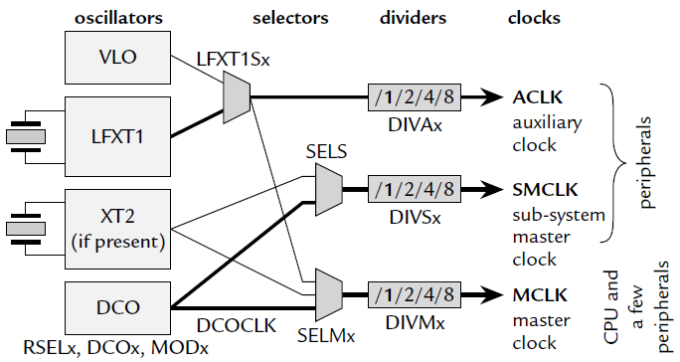
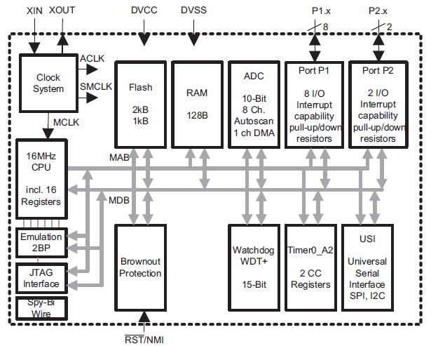
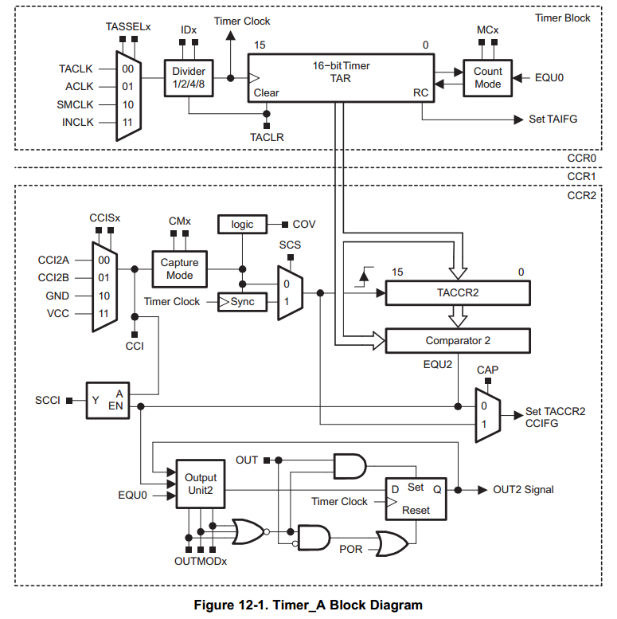
Inside MSP430 (MSP430G2551)

Slide 3
Introduction
When MSP430 processor executes the following code, it will loop forever
Question: How can it do other things, e.g. handling external events or falling into low-power modes?
StopWDT mov.w #WDTPW+WDTHOLD,&WDTCTL SetupP1 bis.b #001h,&P1DIR ; P1.0 output Mainloop xor.b #001h,&P1OUT ; Toggle P1.0 Wait mov.w #050000,R15 ; Delay to R15 L1 dec.w R15 ; Decrement R15 jnz L1 ; Delay over? jmp Mainloop ; Again
Notes:
2
2
2

Slide 4
Option 1
Put codes that handle external events in your main program → polling
StopWDT mov.w #WDTPW+WDTHOLD,&WDTCTL SetupP1 bis.b #001h,&P1DIR ; P1.0 output Mainloop xor.b #001h,&P1OUT ; Toggle P1.0 Wait mov.w #050000,R15 ; Delay to R15 L1 dec.w R15 ; Decrement R15 jnz L1 ; Delay over? bit.b #B1,&P2IN ; Test bit B1 jnz ButtonUp ; Jump if not zero ButtonUp:bis.b #LED1,&P2OUT ; Turn LED1 off jmp Mainloop ; Again
Notes:
Problem with polling: inexact timing

Slide 5
Sample Code 1 for Input from Lab 2
#include <msp430.h> #define LED1 BIT0 //P1.0 to red LED #define B1 BIT3 //P1.3 to button void main(void){ WDTCTL = WDTPW + WDTHOLD; //Stop watchdog timer P1OUT |= LED1 + B1; P1DIR = LED1; //Set pin with LED1 to output P1REN = B1; //Set pin to use pull-up resistor for(;;){ //Loop forever if((P1IN & B1) == 0){ //Is button down P1OUT &= ~LED1; } // Turn LED1 off else{ //Is button up P1OUT |= LED1; } // Turn LED1 on } }
Notes:
Whenever button is down, turn LED off. Whenever button is up, turn LED on.

Slide 6
Option 2
Keep your program unchanged and force the processor to jump to the code handling the external event when that event occurs
Requirements:
Must let the processor know when the event occurs
Must let the processor know where to jump to execute the handling code
Must not allow your program know!!
→ you program must execute as if nothing happens
→ must store and restore your program state
This is called interrupt!

Slide 7
Outline
Introduction to interrupt
The shared-data problem
Interrupts of MSP430

Slide 8
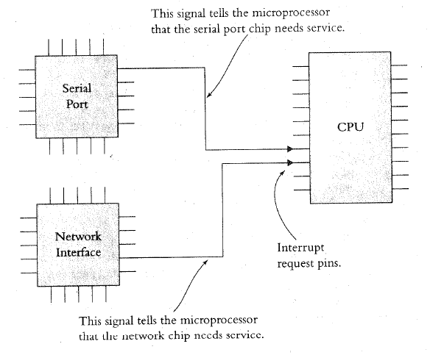
Interrupt: Processor’s Perspective
How does the processor know when there is an interrupt?
Usually when it receives a signal from one of the IRQ (interrupt request) pins

Slide 9
Interrupt: Processor’s Perspective
What does the processor do in handling an interrupt?
When receiving an interrupt signal, the processor stops at the next instruction and saves the address of the next instruction on the stack and jumps to a specific interrupt service routine (ISR)
ISR is basically a subroutine to perform operations to handle the interrupt with a RETURN at the end
How to be transparent to the running prog.?
The processor has to save the “state” of the program onto the stack and restoring them at the end of ISR

Slide 10
Interrupt Service Routine
The following shows an example of an ISR
Task Code ISR
...
MOVE R1, R7
MUL R1, 5 PUSH R1
ADD R1, R2 PUSH R2
DIV R1, 2 ...
JCOND ZERO, END ;ISR code comes here
SUBTRACT R1, R3 ...
... POP R2
... POP R1
END: MOVE R7, R1 RETURN
... ...

Slide 11
Interrupt: Program’s Perspective
To a running program, an ISR is like a subroutine, but is invoked by the hardware at an unpredictable time
Not by the control of the program’s logic
Subroutine:
Program has total control of when to call and jump to a subroutine

Slide 12
Disabling Interrupts
Programs may disable interrupts
In most cases the program can select which interrupts to disable during critical operations and which to keep enabled by writing corresponding values into a special register
Nonmaskable interrupts cannot be disabled and are used to indicate critical events, e.g. power failures
Certain processors assign priorities to interrupts, allowing programs to specify a threshold priority so that only interrupts having higher priorities than the threshold are enabled

Slide 13
Where to Put ISR Code?
Challenges:
Locations of ISRs should be fixed so that the processor can easily find them
But, different ISRs may have different lengths → hard to track their starting addresses
Worse yet, application programs may supply their own ISRs; thus ISR codes may change dynamically
Possible solutions:
ISR is at a fixed location, e.g., in 8051, the first interrupt pin always causes 8051 to jump to 0x0003
A table in memory contains addresses of ISR → the table is called interrupt vector table

Slide 14
How to Know Who Interrupts?
Simple answer: according to interrupt signal
One interrupt signal corresponds to one ISR
Difficult problem: same interrupt signal shared by several devices/events
Option 1: inside the corresponding ISR, poll and check these devices/events in turn → devices are passive
Option 2: devices/events provide the address of ISRs → devices are proactive → vectored interrupt

Slide 15
Some Common Questions
Can a processor be interrupted in the middle of an instruction?
Usually not
Exceptions: critical hardware failure, long-running instructions (e.g. moving data in memory)
If two interrupts occur at the same time, which ISR does the process do first?
Prioritize the interrupt signals
Can an interrupt signal interrupt another ISR?
Interrupt nesting is usually allowed according to priority
Some processor may require re-enabling by your ISR

Slide 16
Some Common Questions
What happens when an interrupt is signaled while the interrupt is disabled?
Processors usually remember the interrupt signals and jump to the ISR when the interrupt is enabled
What happens when we forget to re-enable disabled interrupts?
What happens if we disable a disabled interrupt?
Are interrupts enabled or disabled when the processor first starts up?

Slide 17
Interrupt Latency
Interrupt latency is the amount of time taken to respond to an interrupt. It depends on:
Longest period during which the interrupt is disabled
Time to execute ISRs of higher priority interrupts
Time for processor to stop current execution, do the necessary ‘bookkeeping’ and start executing the ISR
Time taken for the ISR to save context and start executing instructions that count as a ‘response’
Make ISRs short
Factors 4 and 2 are controlled by writing efficient code that are not too long
Factor 3 depends on HW, not under software control

Slide 18
Sources of Interrupt Overhead
Handler execution time
Interrupt mechanism overhead
Register save/restore
Pipeline-related penalties
Cache-related penalties

Slide 19
Outline
Introduction to interrupt
The shared-data problem
Interrupts of MSP430

Slide 20
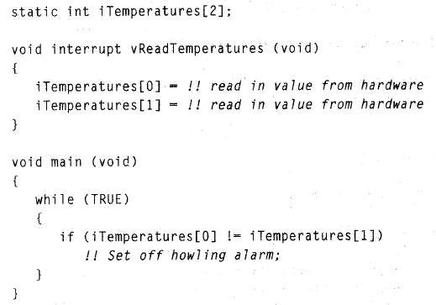
The Shared-Data Problem
In many cases the ISRs need to communicate with the task codes through shared variables.
Example:
Task code monitors 2 temperatures and alarm if they differ
An ISR reads temperatures, e.g. on time up

Slide 21
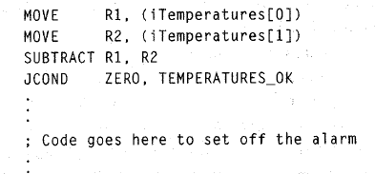
The Shared-Data Problem
Now, consider the assembly code:
When temperatures are 70 degrees and an interrupt occurs between the two MOVES to read temperatures
The temperatures now become 75 degrees
On returning from ISR, iTemp[1] will be assigned 75 and an alarm will be set off even though the temperatures were the same

Slide 22
The Shared-Data Problem
Problem is due to shared array iTemperatures
These bugs are very difficult to find as they occur only when the interrupt occurs in between the first 2 MOVE instructions, other than which the code works perfectly

Slide 23
Solving Shared-Data Problem
Disable interrupts during instructions that use the shared variable and re-enabling them later
while (TRUE)
{
disable(); // Disable interrupts
iTemp0 = iTemperatures[0];
iTemp1 = iTemperatures[1];
enable(); // Re-enable interrupts
...
}

Slide 24
Solving Shared-Data Problem
“Atomic” and “Critical Section”
A part of a program that cannot be interrupted
Example:
An ISR that updates iHours, iMinutes and iSeconds every second through a hardware timer interrupt:
long iSecondsSinceMidnight (void) {
long lReturnVal;
disable();
lReturnVal =
(((iHours*60)+iMinutes)*60)+iSeconds; enable();
return (lReturnVal);
}

Slide 25
Outline
Introduction to interrupt
The shared-data problem
Interrupts of MSP430

Slide 26
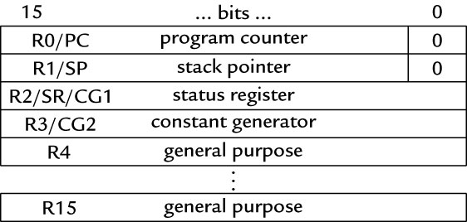
Know When an Interrupt Occurs
An interrupt will be detected and serviced if
The global interrupt-enable (GIE) bit in Status Register (SR) in CPU is set
A peripheral device enables interrupt → For Timer_A: TAIE bit in TACTL register, CCIE bit in TACCTLx register
The peripheral signals an interrupt → For Timer_A: TAIFG, CCIFG

Slide 27
Ex: Timer_A Interrupt Enabling
TACTL
TACCTL

Slide 28
When an Interrupt Is Requested
Any currently executing instruction is completed. MCLK is started if the CPU was off.
The PC, which points to the next instruction, is pushed onto the stack.
The SR is pushed onto the stack.
The interrupt with the highest priority is selected.
The interrupt request flag is cleared automatically for vectors that have a single source.
The SR is cleared, and maskable interrupts are disabled.
The interrupt vector is loaded into the PC and the CPU starts to execute the ISR at that address.
These operations take about 6 cycles

Slide 29
After an Interrupt Is Serviced
An interrupt service routine must always finish with the return from interrupt instruction reti:
The SR pops from the stack. All previous settings of GIE and the mode control bits are now in effect. → enable maskable interrupts and restores the previous low-power mode if there was one.
The PC pops from the stack and execution resumes at the point where it was interrupted. Alternatively, the CPU stops and the device reverts to its low-power mode before the interrupt.

Slide 30
Where to Find ISRs?
The MSP430 uses vectored interrupts.
Each ISR has its own vector, which is stored at a predefined address in a vector table at the end of the program memory (addresses 0xFFC0–0xFFFF).
The vector table is at a fixed location, but the ISRs themselves can be located anywhere in memory.

Slide 31
Interrupt Source | Interrupt Flag | System Interrupt | Word Address | Priority
Power-up/external reset/Watchdog Timer+/flash key viol./PC out-of-range | PORIFG RSTIFG WDTIFG KEYV | Reset | 0FFFEh | 31 (highest)
NMI/Oscillator Fault/ Flash access viol. | NMIIFG/OFIFG/ ACCVIFG | Non-maskable | 0FFFCh | 30
 |  |  | 0FFFAh | 29
 |  |  | 0FFF8h | 28
 |  |  | 0FFF6h | 27
Watchdog Timer+ | WDTIFG | maskable | 0FFF4h | 26
Timer_A2 | TACCR0 CCIFG | maskable | 0FFF2h | 25
Timer_A2 | TACCR1 CCIFG, TAIFG | maskable | 0FFF0h | 24
 |  |  | 0FFEEh | 23
 |  |  | 0FFECh | 22
ADC10 | ADC10IFG | maskable | 0FFEAh | 21
USI | USIIFG USISTTIFG | maskable | 0FFE8h | 20
I/O Port P2 (2) | P2IFG.6, P2IFG.7 | maskable | 0FFE6h | 19
I/O Port P1 (8) | P1IFG.0 to P1IFG.7 | maskable | 0FFE4h | 18
 |  |  | 0FFE2h | 17
 |  |  | 0FFE0h | 16
Unused |  |  | 0FFDEh 0FFCDh | 15 - 0
Notes:
The MSP430 uses vectored interrupts, which means that the address of each ISR—its vector—is stored in a vector table at a deﬁned address in memory. In most cases each vector is associated with a unique interrupt but some sources share a vector. The ISR itself must locate the source of interrupts that share vectors. For example, TAIFG shares a vector with the capture/compare interrupts for all channels of Timer_A other than 0. Channel 0 has its own interrupt ﬂag TACCR0 CCIFG and separate vector.
30

Slide 32
Sample Code
Toggle LEDs using interrupts from Timer_A in up mode
#include <io430x11x1.h> // Specific device #include <intrinsics.h> // Intrinsic functions #define LED1 BIT0 #define LED2 BIT4 void main (void) { WDTCTL = WDTPW|WDTHOLD; // Stop watchdog timer P1OUT = ˜LED1; P1DIR = LED1; TACCR0 = 49999; // Upper limit of count for TAR TACCTL0 = CCIE; // Enable interrupts TACTL = MC_1|ID_3|TASSEL_2|TACLR; // Up mode, divide clock by 8, clock from SMCLK, clear __enable _interrupt(); // Enable interrupts (intrinsic) for (;;) { // Loop forever doing nothing } } // Interrupt service routine for Timer_A #pragma vector = TIMERA0_VECTOR __interrupt void TA0_ISR (void){ P2OUT ˆ= LED1|LED2; // Toggle LEDs }
Notes:
31
31

Slide 33
Summary
Interrupts: a subroutine generated by the hardware at an unpredictable time
Issues to consider:
How to set up and know there is an interrupt?
How to know where is the interrupt service routine?
Must not interfere the original program
The shared-data problem
MSP430 interrupt mechanism

