Slide 1

CS4101 嵌入式系統概論
General Purpose IO
Prof. Chung-Ta King
Department of Computer Science
National Tsing Hua University, Taiwan
Materials from MSP430 Microcontroller Basics, John H. Davies, Newnes, 2008

Slide 2
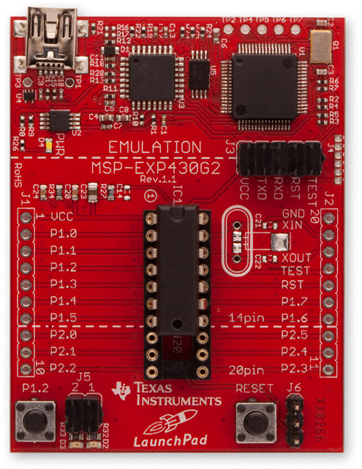
LaunchPad Development Board
USB Emulator
Connection
Embedded Emulation
6-pin eZ430 Connector
Crystal Pads
Chip Pinouts
Part and Socket
P1.3 Button
Power Connector
LEDs P1.0 & P1.6
Reset Button

Slide 3
Recall: Sample Code for Output
#include <msp430x2553.h> void main(void) { WDTCTL = WDTPW + WDTHOLD; // Stop watchdog P1DIR |= 0x41; // set P1.0 & 6 to outputs for(;;) { volatile unsigned int i; P1OUT ^= 0x41; // Toggle P1.0 & P1.6 i = 50000; // Delay do (i--); while (i != 0); } }

Slide 4
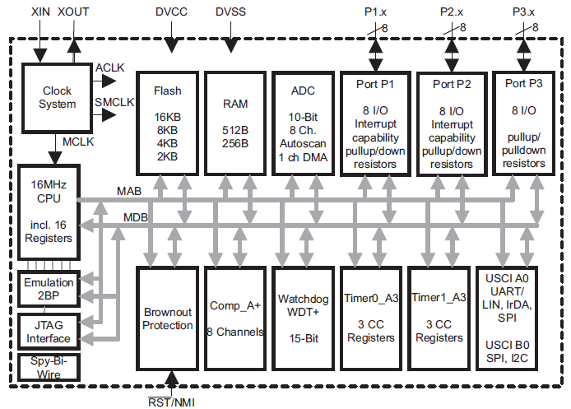
Recall: Memory-Mapped I/O
LED
P1OUT
X
No P3 for 20-pin devices
P1IN
…
P1REN
MOV.W #0x100,P1OUT
Notes:
Go through all the components once and explain their meanings

Slide 5
Configuring the I/O Ports
Registers (Mem Addr) | Functions | Descriptions
P1IN (0x0020) | Port 1 input | This is a read-only register that reflects the current state of the port's pins.
P1OUT (0x0021) | Port 1 output | The values written to this read/write register are driven out to corresponding pins when they are configured to output.
P1DIR (0x0022) | Port 1 data direction | Bits written as 1 (0) configure the corresponding pins for output (input).
P1SEL (0x0026) | Port 1 function select | Bits written as 1 (0) configure corresponding pins for use by the specialized peripheral (for general-purpose I/O).
P1REN (0x0027) | Port 1 resistor enable | Bits set in this register enable pull-up/down resistors on the corresponding I/O pins.

Slide 6
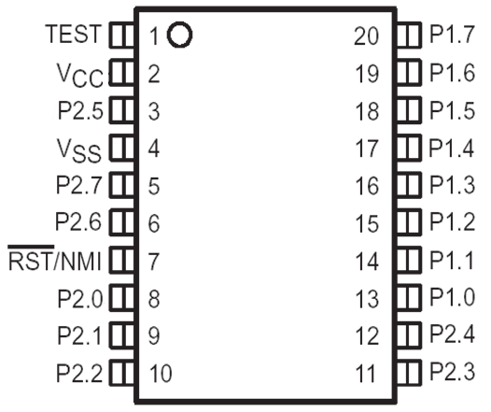
MSP430 GPIO
GPIO = General Purpose Bit Input/Output
8-bit I/O ports
Each pin is individually controllable
Controlled by memory-mapped registers
 | P1.7 | P1.6 | P1.5 | P1.4 | P1.3 | P1.2 | P1.1 | P1.0
I/O Port 1 | Bit 7 | Bit 6 | Bit 5 | Bit 4 | Bit 3 | Bit 2 | Bit 1 | Bit 0

Slide 7
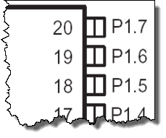
PxDIR (Pin Direction): Input or Output
PxDIR.y: 0 = input 1 = output
Register example: P1DIR &= 0x81;
P1IN.7
P1OUT.7
P1DIR.7
“1”
 | 7 | 6 | 5 | 4 | 3 | 2 | 1 | 0
P1IN
P1OUT
P1DIR | 1 |  |  |  |  |  |  | 1

Slide 8
GPIO Output
PxOUT.y: 0 = low 1 = high
Register example: P1OUT &= 0x80;
P1IN.7
P1OUT.7
P1DIR.7
“1”
“1”
“1”
 | 7 | 6 | 5 | 4 | 3 | 2 | 1 | 0
P1IN | X
P1OUT | 1
P1DIR | 1

Slide 9
Sample Code for Input (MSP430g2553)
#include <msp430g2553.h> #define LED1 BIT0 //P1.0 to red LED #define B1 BIT3 //P1.3 to button void main(void){ WDTCTL = WDTPW + WDTHOLD; //Stop watchdog timer P1OUT |= LED1 + B1; P1DIR = LED1; //Set pin with LED1 to output P1REN = B1; //Set pin to use pull-up resistor for(;;){ //Loop forever if((P1IN & B1) ==0){ //Is button down? P1OUT &= ~LED1; // Yes, turn LED1 off } else{ P1OUT |= LED1; // No, turn LED1 on } } }
Notes:
P1OUT is not initialized and must be written before configuring the pin for output.
Assume button is active low (0 → pressed; 1 → depressed)

Slide 10
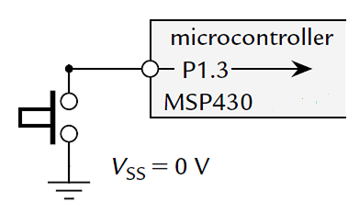
Problem with Input Using a Button
When the button is pressed down (closed), MSP430 will detect a 0 from the pin.
When the button is up (open), what will MSP430 detect?
Ans.: random value
→ Floating

Slide 11
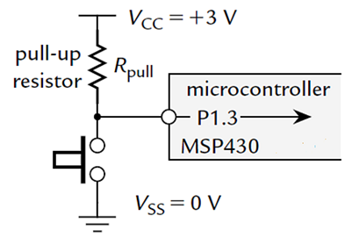
Typical Way of Connecting a Button
The pull-up resistor R_{pull} holds input at logic 1 (voltage V_{CC}) while button is up and logic 0 or V_{SS} when button is down → active low
  A wasted current flows through R_{pull} to ground when button is down
  This is reduced by making
  R_{pull} large enough,
  typically 33 kΩ

Slide 12
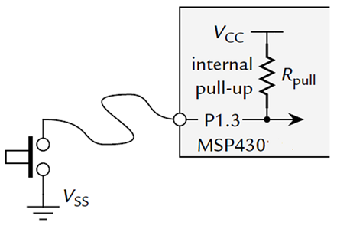
Typical Way of Connecting a Button
MSP430 offers internal pull-up/down
PxREN register selects whether this resistor is used (1 to enable, 0 to disable)
  When enabled, the corresponding bit of PxOUT register selects whether the resistor
  pulls the input up to V_{CC} (1)
  or down to V_{SS} (0)

Slide 13
GPIO Input
P1IN.7
P1OUT.7
P1DIR.7
P1REN.7
up/down
Enable resistor
Input pins are held in high-impedance (Hi-Z) state, so they can react to 0 or 1
When not driven, Hi-Z inputs may float up/down … prevent this with pullup/pulldown resistors
PxREN enables resistors
PxOUT selects pull-up (1) or -down (0)
Lower cost devices may not provide up/down resistors for all ports
 | 7 | 6 | 5 | 4 | 3 | 2 | 1 | 0
P1IN | x
P1OUT | 1
P1DIR | 0
P1REN | 1

