Slide 1
CS4101 Introduction to Embedded Systems
Course Overview
Prof. Chung-Ta King
Department of Computer Science
National Tsing Hua University, Taiwan

Slide 2


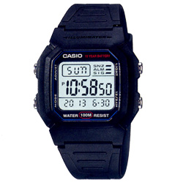
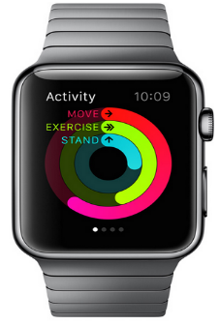
Consider the Evolution of Watches

Slide 3
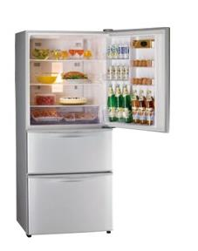
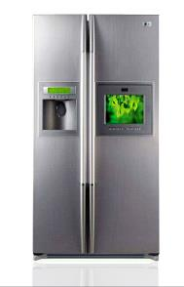
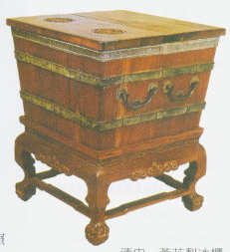
How about Refrigerators?

Slide 4

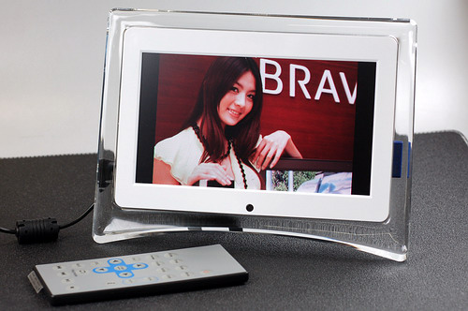
Picture Frames

Slide 5
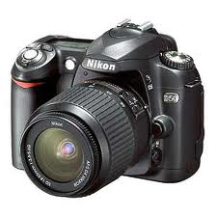
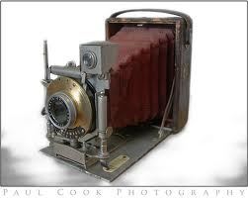
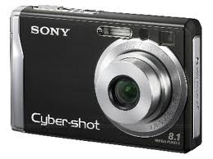
Cameras

Slide 6
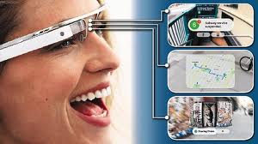
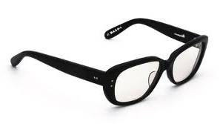
Glasses

Slide 7
What is the trend?
Notes:
Physical things are augmented with computing/communication capabilities, and become part of the cyber space
Virtual → real; real → virtual

Slide 8
Physical Things Augmented with Computing/Communication
OR
Computing/Communication “Embedded” into
Physical Things
Notes:
Physical things are augmented with computing/communication capabilities, and become part of the cyber space
Virtual → real; real → virtual

Slide 9
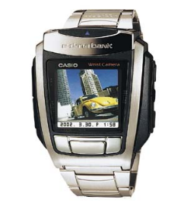
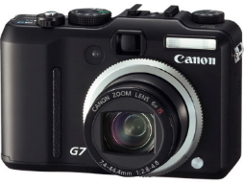
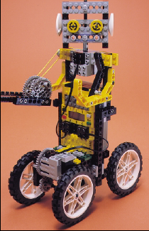
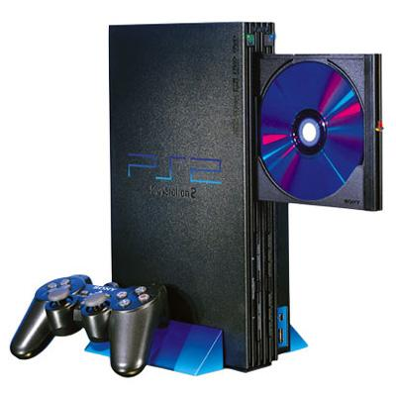
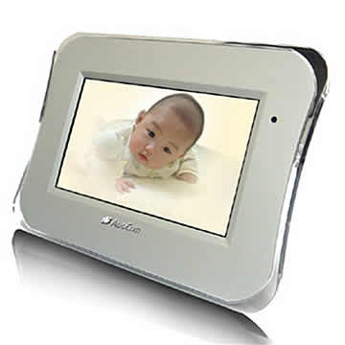
So, What Is Embedded System?
A computer, pretending not to be a computer
(Stephen A. Edwards)

Slide 10

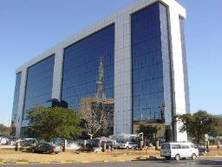
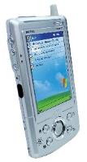
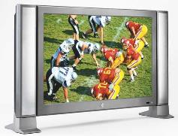

What Is Embedded System?
“An embedded system is an application that contains at least one programmable computer ... and which is used by individuals who are unaware that the system is computer-based.”
-- Michael J. Pont, Embedded C
  Programmable computers require programs
  → embedded software (嵌入式軟體)

Slide 11
What Is an Embedded System?
Information processing systems embedded into a larger product [Peter Marwedel]
  Main reason for buying is not information processing
Any device that includes a programmable processor but is not itself a general-purpose computer
➔Application-specific: take advantage of application characteristics to optimize the design:
  Do not need all general-purpose bells and whistles

Slide 12
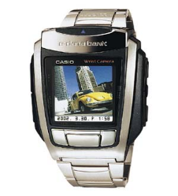
Same Basics Inside
I/O and control
are most important
output
analog
CPU
input
analog
mem
embedded
computer

Slide 13
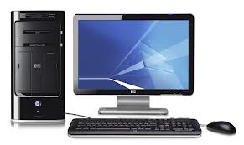
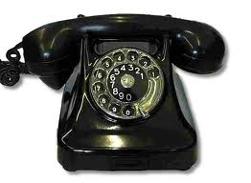
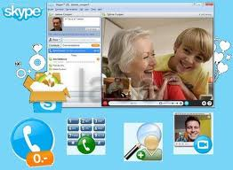
Why Embedded Systems?
After all, we can still make phone calls with
Why embed a computer into a phone?
or

Slide 14

Embedded vs Pure Hardware
Many electronic products are implemented in pure hardware (ASICs, boards)
  Lack of flexibility (changing standards, system
  revisions, bug fixes, extra functionalities)
  Costly for specialized application-specific
  integrated circuits (ASICs) (M$ range,
  technology-dependent)
Trend towards implementation in software running on embedded processors (or possibly FPGAs)
  Commodity microprocessors
(Peter Marwedel)

Slide 15
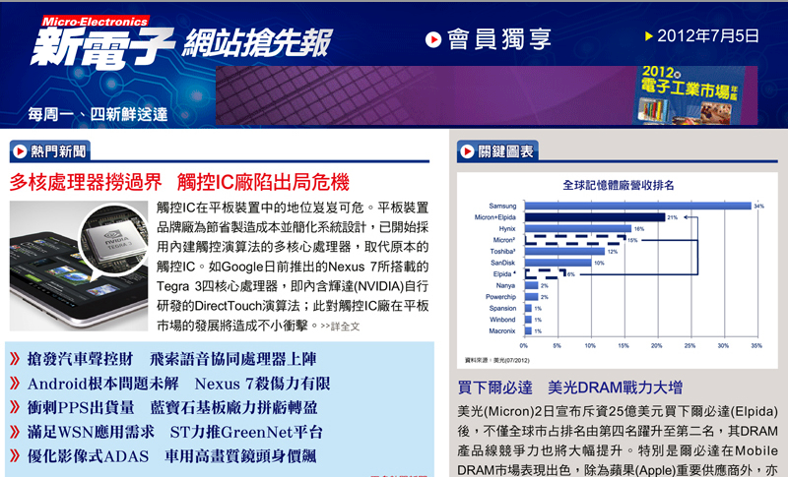
Trends towards Software

Slide 16
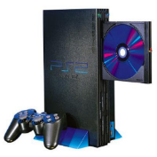
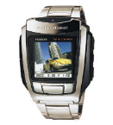
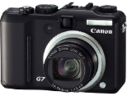
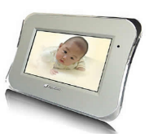
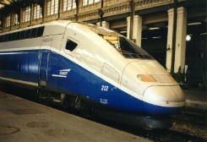
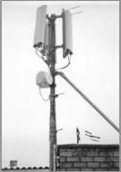

Some Concepts to Clarify
Embedded systems refer to not only small devices or gadgets
But also large, complex systems requiring strict reliability and real-time responses

Slide 17
Some Concepts to Clarify
A product, e.g., video decoder, may be implemented using pure hardware or microprocessor + embedded software
  A chip may be implemented using pure logic gates or a microprocessor + peripheral logic + software
An embedded system may or may not have OS
  Simple systems may be implemented by a single program that runs continuously
  Systems that need to control and respond to many activities may require an OS for management

Slide 18

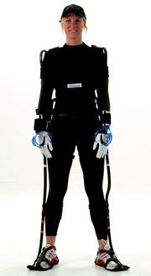
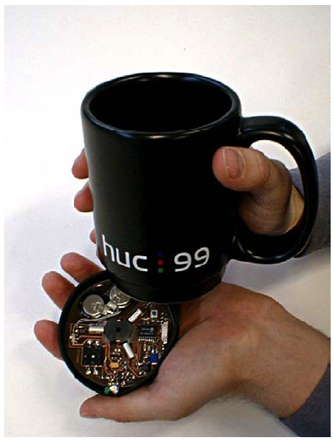
Embedded = Smart
Computers embedded into objects
  Augment objects with programmatic control,
  communication, sensing, and actuation
Let the world know you:
  Make physical objects/phenomena accessible to digital world
Let you know the world:
  Give intelligence/life to physical objects
  so that they can sense/react
  Put a “robot” inside everything!

Slide 19
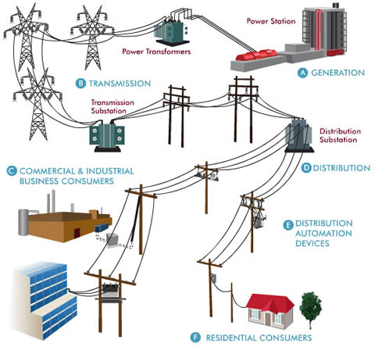
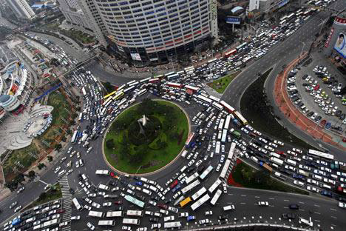
Future Embedded Systems
Smart Grid
Smart City
(Source: oncor.com, Prof. L.G. Chen)

Slide 20
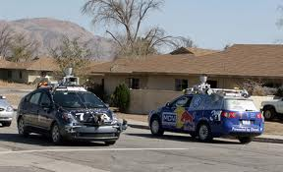
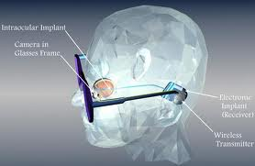
Future Embedded Systems
Smart Glasses
Unmanned Cars
Retinal Implant

Slide 21
Implications
Infinite opportunities and innovations
Integration: must know application domain, packaging, A/D, sensor/actuator, power, …
Innovation and execution
資工系的人有飯吃了!

Slide 22
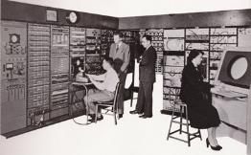
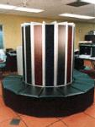
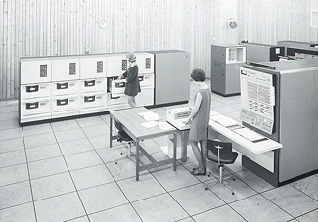
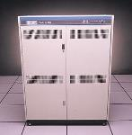
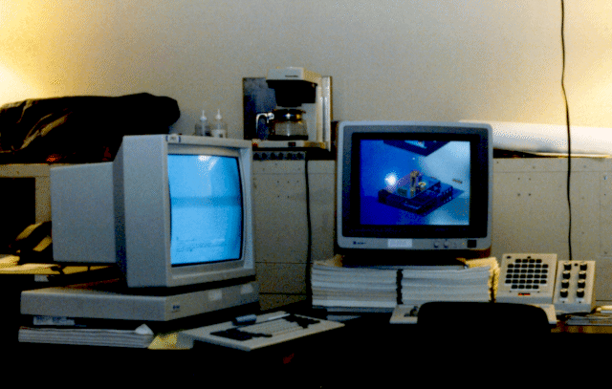


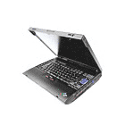


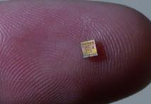
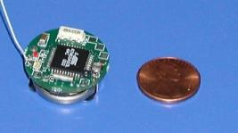
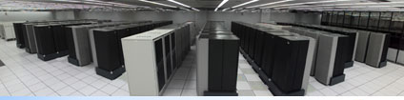
A New Paradigm of Computing
Number Crunching
Data Storage
Mainframe
log (people per computer)
Minicomputer
Productivity
Interactive
Workstation
PC
Streaming
information
to/from physical
world
Laptop
PDA
year
Notes:
So if we look at the computing spectrum today, each of the classes exist simultaneously. In a room we can put 100s of teraflops and many petabytes of computing.
Our productivity, document preparation, and personal information management fits in our pocket and a new class is emerging that will provide a means of streaming information to and from the physical world like we have never seen before.

Slide 23
About This Course
Principles behind the design of the course:
  Build the course around labs: Use labs to carry out the course contents. Labs are to develop a simple embedded system, from I/O device to system
  Cover basic concepts in embedded system development: interrupt, clocking, I/O, real-time system, OS service, development tools
  Term project development: innovation, development process, communication and team work, learning-by-doing

Slide 24
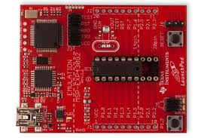
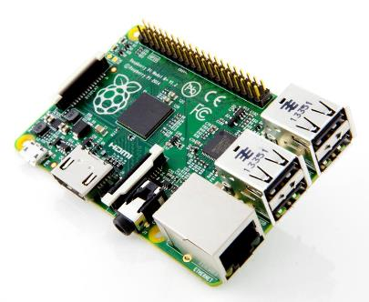
Lab Platforms
TI MSP430 LaunchPad
Raspberry Pi

Slide 25
Labs (subject to change)
LaunchPad:
  Registers/addressing mode/IO
  Stacks
  Timer and watchdog
  Serial communication interface, UART
Raspberry Pi:
  Environment and cross-compiler
  Bootloader
  Non-OS embedded application
  Real-time OS
  Device driver

Slide 26
Lectures
Discuss concepts related to the labs
  May lack of a systematic discussion of embedded systems and a comprehensive coverage of all important concepts

Slide 27
What Will and Will Not Learn?
Will learn:
  Basic concepts of embedded systems
  Hands-on development of a system and know what’s behind
  Innovation development, presentation, team work
Will not learn (but important):
  Software engineering for embedded systems
  System evaluation, optimization

Slide 28
Course Information
Instructor: Prof. Chung-Ta King (金仲達教授)
  Office: Delta 640 Phone: x42804
  email: king@cs.nthu.edu.tw
Teaching assistants: 張子逸、廖毓強、鄭又仁、何基愷、何冠霆、蘇柏元、蔡杰霖
  Office: CSEE 734 Phone: x33553
Class time:
  Tuesday 10:10 - 12:00
  Thursday 10:10 - 11:00
Classroom: Delta 105, EECS 326
http://www.cs.nthu.edu.tw/~king/courses/cs4101.html

Slide 29
Expected Workload
Labs:
  Run on Tuesday in EECS 326
  At least 2 basic assignments to be completed in class plus 1 advanced assignment for bonus
Term project:
  Final demonstration and competition, project report
Grade breakdown
  Assignments and Labs 70%
  Term project 30%

