Slide 1
CS4101 Introduction to Embedded Systems Lab 12: Device Drivers
Prof. Chung-Ta King
Department of Computer Science
National Tsing Hua University, Taiwan

Slide 2
Introduction
In this lab, we will learn
Basics of device drivers of MQX
To create and install a null IO driver
To develop a driver for the 3-axis accelerometer

Slide 3
Basics of I/O Device Drivers

Slide 4
I/O Device Drivers
Dynamically installed software packages that provide a direct interface to hardware
Driver installation:
Each device driver has a driver-specific installation function, io_device_install(), which is called in init_bsp.c under “mqx\source\bsp\” directory.
The installation function then calls _io_dev_install() to register the device with MQX.
To install a new device driver, the init_bsp.c needs to be modified and the BSP rebuilt

Slide 5
I/O Device Drivers
Device names
Device name must end with “:”, e.g. _io_mfs_install("mfs1:" ...)
Characters following “:” are information passed to device driver by fopen() call, e.g., fopen("mfs1:bob.txt") opens file bob.txt on device mfs1:
I/O device drivers must provide following services:
_io_device_open: required
_io_device_close: required
_io_device_read: optional
_io_device_write: optional
_io_device_ioctl: optional

Slide 6
Null Driver
The null device driver is an I/O device that functions as a device driver but does not perform any work.
Code at “mqx\source\io\io_null\”

Slide 7
Null Driver
_mqx_uint _io_my_null_install(char_ptr identifier) /* “idetifier” identifies the device for fopen */ { _mqx_uint result; result = _io_dev_install(identifier, _io_my_null_open, _io_my_null_close, _io_my_null_read, _io_my_null_write, _io_my_null_ioctl, NULL); return result; }
Notes:
6
6

Slide 8
Null Driver
/* This function is called when the user calls fopen. It prepares the driver for subsequent read, write, and ioctl operations.*/ _mqx_int _io_my_null_open(MQX_FILE_PTR fd_ptr, char_ptr open_name_ptr, char_ptr flags) { /* Nothing to do */ return(MQX_OK); }
Notes:
7
7

Slide 9
Null Driver
_mqx_int _io_my_null_read(MQX_FILE_PTR fd_ptr, char_ptr data_ptr, _mqx_int num) { /* Body */ return(0); } /* Endbody */ _mqx_int _io_my_null_ioctl(MQX_FILE_PTR fd_ptr, _mqx_uint cmd, pointer param_ptr) { /* Body */ return IO_ERROR_INVALID_IOCTL_CMD; } /* Endbody */ ...
Notes:
8
8

Slide 10
Using Null Driver
#include <my_null_io.h> #define MY_TASK 5 extern void my_task(uint_32); TASK_TEMPLATE_STRUCT MQX_template_list[] = { {MY_TASK, my_task, 1500, 9, "null_test", MQX_AUTO_START_TASK, 0, 0}, {0} }; void my_task(uint_32 initial_data) { FILE_PTR null_file; uint_8 data[10]; if (IO_OK != _io_my_null_install("null:")) { printf("Error opening Null\n"); }
Notes:
9
9

Slide 11
Using Null Driver
if (NULL == (null_file = fopen("null:", NULL ))) { printf("Opening NULL device driver failed.\n"); _mqx_exit(-1); } if (write(null_file, data, 4 ) != 4) { printf("Writing to NULL driver failed.\n"); _mqx_exit(-1); } fclose(null_file); printf ("NULL driver working\n"); _mqx_exit(0); }
Notes:
10
10

Slide 12
Installing a Null Device Driver
The Freescale MQX software solution includes several I/O device drivers that can be used as a reference to develop your own.
These drivers are located in your default installation folder (referred to in this document as “<MQX_folder>”) inside the following path:
<MQX_folder>\mqx\source\io

Slide 13
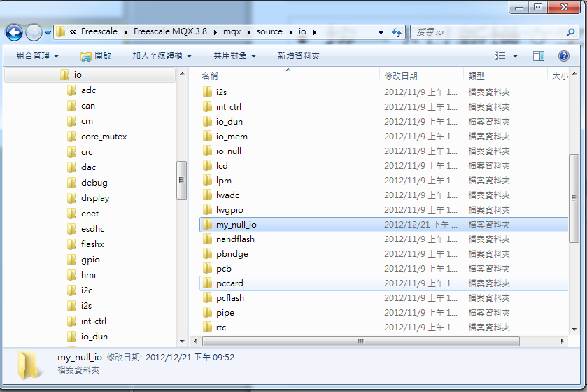
Under <mqx folder>/mqx/source/io, create a folder called “my_null_io” to contain your device driver.

Slide 14
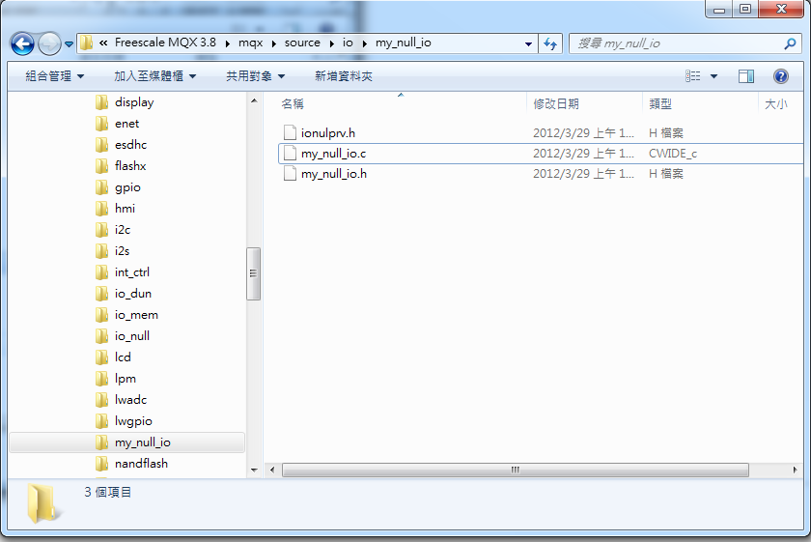
Under the “my_null_io” folder, put the following 3 files: ionulprv.h, my_null_io.c, my_null_io.h

Slide 15
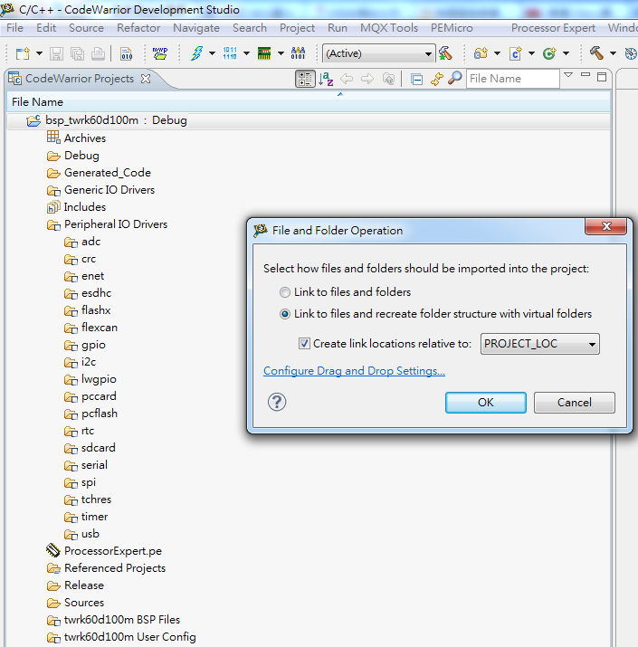
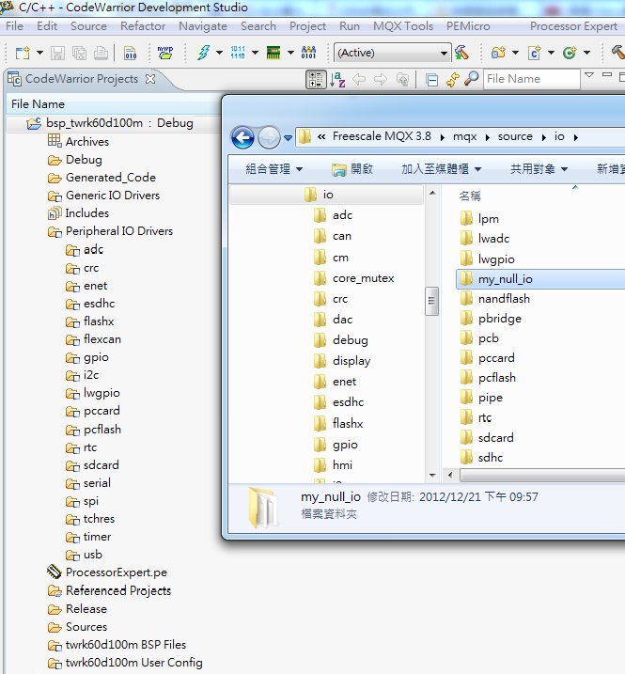
Drag-and-drop the whole my_null_io folder to your Codewarrior project inside the IO Drivers folder.
bsp_twrk60d100m/Peripheral IO Drivers
Drag-and-drop

Slide 16
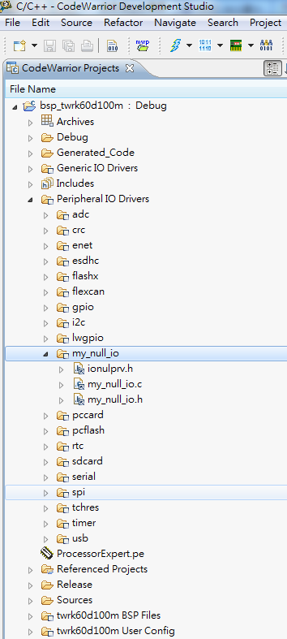
When you finish the drag-and-drop action, you will see the following.

Slide 17
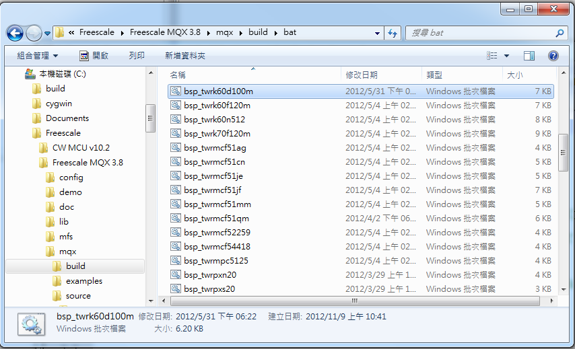
The projects will execute a .bat file, which, among other things, copies header files to the output directory. This file is located at: <mqx folder>\mqx\build\bat\bsp_twrk60d100m

Slide 18
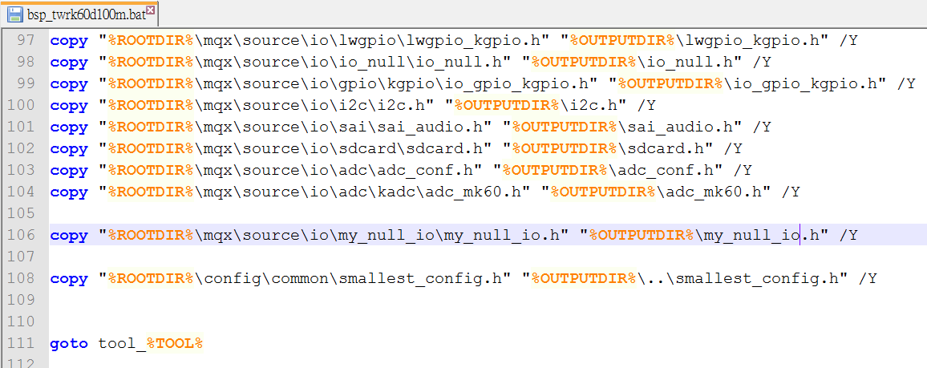
Add the following line to the file：
copy "%ROOTDIR%\mqx\source\io\my_null_io\my_null_io.h" "%OUTPUTDIR%\my_null_io.h" /Y

Slide 19
Basic Lab I
Test the Null Driver
This device driver can be used by adding the following header to your application:
#include <my_null_io.h>
New a mqx project and add #include <my_null_io.h> to see if it can be built successfully or not.

Slide 20
Basic Lab II
Create a driver for the 3-axis accelerometer by providing the five driver services.
The read service should return the 6 bytes of data
There is no need to provide the write service
The control service can set to catch 8-bit or 14-bit data from the 3-axis accelerometer
Create a new project to print the 3-axis value by calling the 3-axis accelerometer driver.

Slide 21
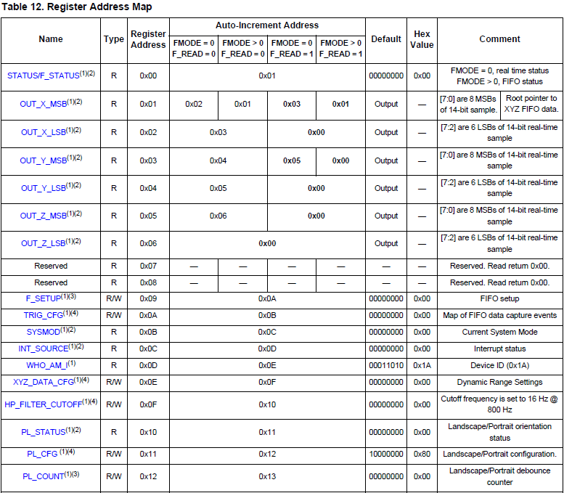

Slide 22
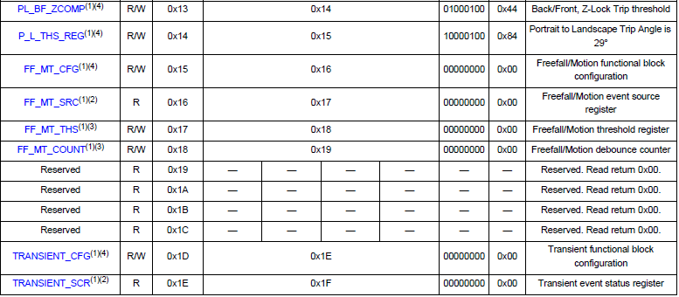
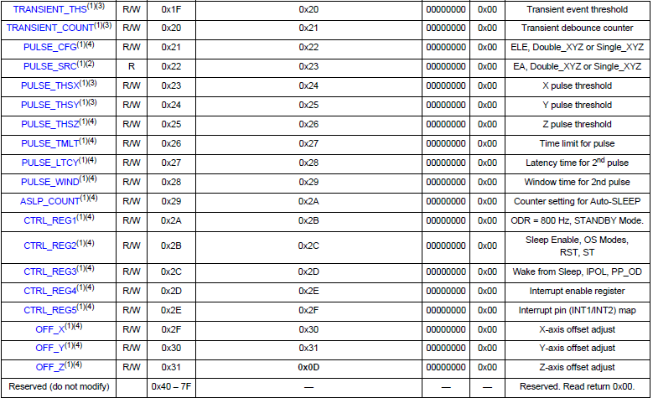

Slide 23
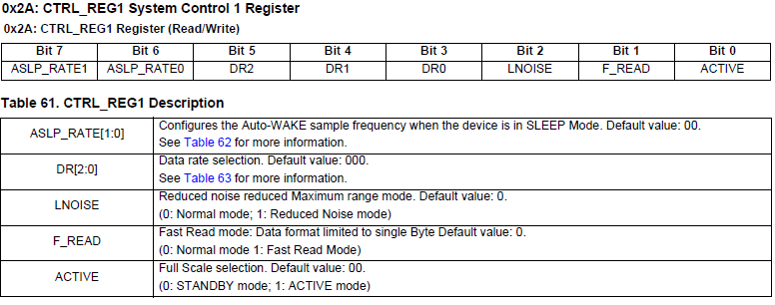
Write_I2C(I2C_ACCELEROMETER_ADDRESS,0x2A,0x03);
On 0x03 mode, the MSB value of 3-axis is meaningful.
So you need to catch the MSB data of 3-axis when reading the accelerometer.

Slide 24
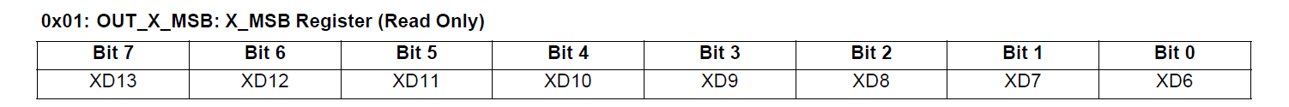
3-axis Original Value
The measured acceleration data are stored in the OUT_X_MSB, OUT_Y_MSB, OUT_Z_MSB registers as 2’s complement 8-bit numbers.
Data bit
0
0
0
0
0
0
0
0
Sign bit
Reference : http://en.wikipedia.org/wiki/Two%27s_complement

Slide 25
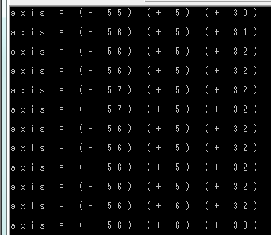
Bonus
Use a button to toggle a flag that selects the return value from _io_null_read().
If the flag is equal to 0, then return the value of the 3 axis- accelerometer as in Basic Lab.
If the flag is 1, then return additionally the inclination, e.g., right, left, front, back.
To do this, you have to add a control function using _io_null_ioctl(), which is called when the button is pushed.
X-axis
Y-axis
Z-axis
Regular gravity value will be between ±65

