Slide 1
CS4101 Introduction to Embedded Systems Lab 9: Task Scheduling
Prof. Chung-Ta King
Department of Computer Science
National Tsing Hua University, Taiwan

Slide 2
Introduction
In this lab, we will learn
Basic concepts of MQX tasks
Scheduling and management of tasks

Slide 3
MQX Tasks
Multiple tasks, created from same or different task template, can coexist
MQX maintains each instance by saving its context: program counter, registers, and stack.
Each task has an application-unique 32-bit task ID, which MQX and other tasks use to identify the task.
A task is defined by its task descriptor:
Task ID
Context: program counter, stack, registers
Priority
Resources and task-specific parameters

Slide 4
Task Environment

Slide 5
Priorities
Priorities run from 0 to N
Priority 0: interrupts disabled, 1 highest priority
N is set by the highest priority in MQX_Template_List
Idle task runs at N+1
MQX creates one ready queue for each priority up to lowest priority → priorities are consecutive
Can change priority during runtime _task_set_priority()
Any tasks at priority below 6 can mask certain levels of interrupts → user tasks should start at 7 or above

Slide 6
“Hello World 2” on MQX (1/2)
#include <mqx.h> #include <bsp.h> #include <fio.h> /* Task IDs */ #define HELLO_TASK 5 #define WORLD_TASK 6 extern void hello_task(uint_32); extern void world_task(uint_32); const TASK_TEMPLATE_STRUCT MQX_template_list[] = { /* Task Index, Function, Stack, Priority, Name, Attributes, Parameters, Time Slice */ {WORLD_TASK, world_task, 1000, 9, "world", MQX_AUTO_START_TASK, 0, 0}, {HELLO_TASK, hello_task, 1000, 8, "hello", 0,0,0}, { 0 } };
Notes:
5
5

Slide 7
“Hello World 2” on MQX (2/2)
/* world_task:create hello_task & print " World " */ void world_task(uint_32 initial_data) { _task_id hello_task_id; hello_task_id = _task_create(0, HELLO_TASK, 0); if (hello_task_id == MQX_NULL_TASK_ID) { printf ("\n Could not create hello_task\n"); } else { printf(" World \n"); } _mqx_exit(0); } void hello_task(uint_32 initial_data) { printf("\n Hello\n"); _task_block(); }
Notes:
6
6

Slide 8
“Hello World 2” Explained
When MQX starts, it creates world_task.
The world_task creates hello_task by calling _task_create() with hello_task as a parameter.
If _task_create() is successful, it returns the task ID of the new child task; otherwise, it returns MQX_NULL_TASK_ID.
The new hello_task task has a higher priority than world_task, it becomes active and prints “Hello”.
The world_task is then scheduled and prints “World”.
Notes:
If you change the priority of world_task to be of the same priority as hello_task, the output is World only.
The world_task runs before hello_task, because world_task has the same priority and does not relinquish
control with a blocking function. Since world_task calls _mqx_exit() after printing World, nothing else
can be printed, because hello_task does not have the opportunity to run again.

Slide 9
_task_create()
_task_id _task_create( _processor_number processor_number, _mqx_uint template_index, uint_32 create_parameter)
processor_number: # of the processor where the task is to be created or 0 if created on local
template_index: index of the task template in the processor’s task template list to use for the child task or 0 to use the template that create_parameter defines
create_parameter: if template_index is not 0, then pointer to the parameters that MQX passes to the child task; otherwise pointer to the task template

Slide 10
Task States
A task is in one of these logical states:
Blocked: the task is blocked and is not ready, waiting for a condition to be true
Active: the task is ready and is running because it is the highest-priority ready task
Ready: the task is ready, but not running because it is not the highest-priority ready task

Slide 11
Task States
Active
Task Finishes
Explicit Termination
Blocking Call
Higher-priority Task
becomes Ready
Time Slice Expires
Interrupt comes in
Terminated
Blocked
Context Switch
Task Starts
Object Available
Timeout Expires
Ready
Notes:
10
This diagram shows the visual representation of the different task states. Looking at the active task, it can go to the terminated state if the task finishes its work or becomes explicitly terminated.
If it calls a blocking call, then it goes into the blocked state. This means it is now waiting for some condition to become true.
Finally if a higher priority task becomes ready, its time slice expires, or an interrupt occurs, then the active tasks gets put into ready state. At that point a context switch occurs, and a task that was in the ready queue gets promoted to being the active task.
If a task becomes unblocked because that condition became true, then it gets put into the ready state and the schedule determines if it is the highest priority task that could be running, and does a context switch if that is the case. Also when a task is first created, it gets put into the ready state.

Slide 12
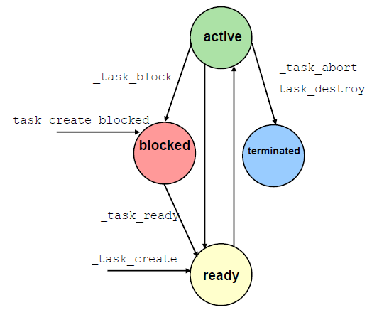
Transitions between Task States
Tasks can be automatically created when MQX starts; also, any task can create another task by calling _task_create() or _task_create_blocked()
_task_create() puts the new task in the ready state and the scheduler runs the highest priority task
If _task_create_blocked is used, the task is not ready until _task_ready() is called
Notes:
Now that we’ve covered the concept of tasks in an RTOS, lets link it with specific MQX calls. Tasks can be created when MQX starts, and also by calling the task_create function.
The active task can be put into the blocked state if it calls task_block on itself. Another task can then call task_ready on the blocked task to put it back into the ready state. And the active task can also end itself or any other task by calling task_abort or task_destory.
There are many other ways that a task can enter or leave these states. However this diagram shows some of the explicit commands that can be used to manipulate the task states directly.

Slide 13
Common Calls for Task Management
_task_abort | Terminates the task after running its task exit handler and releasing its resources.
_task_create | Allocates & starts (makes ready) a new task.
_task_create_blocked | Allocates a new task in the blocked state.
_task_destroy | Terminates task after freeing its resources.
_task_errno | Gets the task error code for the active task.
_task_get_id | Gets the task ID.
_task_get_processor | Gets processor # on which a task resides.
_task_restart | Restarts a task at top of its function; keeps same task descriptor, task ID, task stack

Slide 14
Task Creation Example
{INIT_TASK, init_task, 1500, 11, "init", MQX_AUTO_START_TASK, 0, 0},
void init_task(void) {
_task_create(0,TASK_A,0);
...
...
_task_ready(Task_B);
}
init_task is created when MQX starts
{TASK_A, Task_A, 1500, 10, “Task A", 0, 0, 0},
void Task_A(void)
{
...
_task_create_blocked(0,TASK_B,0);
...
_task_abort(TASK_A);
}
{TASK_B, Task_B, 1500, 9, “Task B", 0, 0, 0},
void Task_B(void)
{
...
_task_abort(TASK_B);
}
CPU Time
Notes:
Task flow example
Init_task starts first because of the MQX_AUTO_START_TASK configuration flag
It continues until it creates TaskA. Because Task A has a higher priority, it begins to run.
Inside Task A, it creates Task B, but puts it in a blocked state. Then Task A ends.
Control goes back to the init_task(). It continues until it makes Task B ready. Since Task B is a higher priority, it then begins to run. It goes until the task terminates itself.
Then control goes back once again to the init_task, until it also ends.

Slide 15
Task Scheduling

Slide 16
MQX Scheduling Policies
FIFO: (default policy)
Active task is the highest-priority task that has been ready for the longest
Round Robin:
Active task is the highest-priority task that has been ready for the longest without consuming its time slice
The scheduler is explicitly called after a specified period of time, a time slice.
Allows other tasks at same priority level to be active
Tasks in an application may have combinations of FIFO and round-robin with different time slice values.
Explicit: using task queues
Notes:
How does MQX determine which of the ready tasks gets to become the active task? By using a scheduler.
There are several scheduling policies that MQX supports. The most commonly used is First In-First Out. This means the task that becomes active is the highest priority task that has been ready the longest. A task will continue running as long as it is the highest priority ready task.
The next scheduling policy is called Round Robin. This behaves exactly the same as First In-First Out, except that the scheduler is explicitly called after a specified period of time, called a time slice. This allows other tasks at the same priority level to gain control of the processor. The length of the time slice can be set on a per-task basis, so not all tasks necessarily have to use round-robin, nor have the same time slice value.
Finally there is a way to explicitly schedule the tasks using task queues in MQX, but it is not used very often and will not be covered here

Slide 17
Priority-Based FIFO Scheduling
priority
high
low
FIFO
list of
ready
tasks
Ready
CPU
Scheduler active
processor time
Notes:
This diagram shows First In-First Out scheduling. Each priority has a queue associated with it, representing tasks was placed into the ready state at that priority level. The schedule first looks at the highest priority ready queue, and runs that task. That task will run as long as it needs until the task finishes.
Once the green task is finished, the scheduler is called and it looks at the highest priority queue. That queue is now empty, so it moves down to the next highest priority queue. The red task then runs until it is finished. The scheduler is called again, and it takes the next ready task that has been waiting the longest, which is the blue task. This continues on with the yellow task and so on until all the ready queues are empty.

Slide 18
Priority-Based FIFO Scheduling
priority
high
low
FIFO
list of
ready
tasks
Ready
CPU
Scheduler active
processor time
Notes:
FIFO (also called priority-based preemptive) scheduling is a core component — the active task is the highest-priority task that has been ready the longest. FIFO is the default scheduling in Freescale MQX.
The active task runs, until any of the
following occurs:
-The active task voluntarily relinquishes the processor, because it calls a blocking MQX function.
-An interrupt occurs that has higher priority than the active task.
-A task that has priority higher than the active task, becomes ready.

Slide 19
Priority-Based FIFO Scheduling
priority
high
low
FIFO
list of
ready
tasks
Ready
CPU
Scheduler active
processor time
Notes:
FIFO (also called priority-based preemptive) scheduling is a core component — the active task is the highest-priority task that has been ready the longest. FIFO is the default scheduling in Freescale MQX.
The active task runs, until any of the
following occurs:
-The active task voluntarily relinquishes the processor, because it calls a blocking MQX function.
-An interrupt occurs that has higher priority than the active task.
-A task that has priority higher than the active task, becomes ready.

Slide 20
Round-Robin Scheduling
Task 1
75ms
Same Priority
Task 2
50ms
Time Slice = 50ms
Task 3
60ms
time
Ready
Task1
Task2
Task3
Task1
Task3
T0
50ms
100ms
150ms
200ms
time
Notes:
Round Robin scheduling works similarly. We have 3 tasks all with the same priority, but each take different amounts of time to finish executing their code.
Task1 runs first, but because the timeslice is set to 50ms, the scheduler is called before Task1 can finish. Task 2 then gets to run, and is able to finish in the 50ms time slice. Then task 3 becomes the active task (as it has been waiting the longest) and also runs for 50ms before being interrupted by the scheduler. Now task1 gets to run again until it completes its work, and then the scheduler is called one last time to let task3 become the active task until it also finishes its work.

Slide 21
Context Switching
A task A will stop running and call scheduler if:
It calls a blocking function
Its time slice expires (Round Robin)
A higher priority task is made ready
An interrupt occurs
Then:
Context of task A is stored
Context of highest priority task in ready queue is restored
Task A is put at the end of ready or wait queue,
If called a blocking function, is put in wait queue
Else is put back in ready queue

Slide 22
Preemption
Preemption occurs when a higher-priority task becomes ready, and thus becomes active
The previously active task is still ready, but is no longer the active task
Occurs when:
An interrupt handler causes a higher-priority task to become ready
Active task makes a higher-priority task ready

Slide 23
Common Calls for Task Scheduling
_sched_yield | Moves active task to end of its ready queue, which yields the processor to the next ready task of equal priority.
_task_block | Blocks the task.
_task_get_priority | Gets a task's priority.
_task_ready | Makes a task ready.
_task_set_priority | Sets a task's priority.
_task_start_preemption | Re-enables preemption for the task.
_sched_set_policy | Sets the scheduling policy.
_sched_set_rr_interval | Sets the time slice in milliseconds.
_sched_set_rr_interval_ticks | Sets the time slice in tick time.

Slide 24
Board Support Package (BSP)

Slide 25
What is a Board Support Package?
Startup code for the processor
Initialize memory, clock, interrupt controller
All the drivers needed with the proper settings

Slide 26
MQX BSP
Initializes microprocessor and board
Clocks, memory interface, core registers
Defines board specific parameters
Clocks, memory parameters, interrupt usage, driver parameters/enabling, MQX limits, IO pin definitions, ...
Presents board-specific API to IO drivers and application
Timer ISR functions used by MQX scheduler, IO pin initializations
Installs and initializes device drivers (selected by user_config.h)

Slide 27
Use GPIO

Slide 28
Initialize LED
#if defined BSP_LED1 #define PIN_LED1 GPIO_PIN_STRUCT pin_led1[] = { BSP_LED1, GPIO_LIST_END }; #endif
PSP, BSP→twrk60d100m User Config→ user_config.h→#define BSPCFG_ENABLE_GPIODEV 1

Slide 29
Turn on the LED
/* open device for output */ port_file_led1 = fopen("gpio:write", (char *) NULL); /* add pins/signals to the existing file */ ioctl(port_file_led1, GPIO_IOCTL_ADD_PINS, &pin_led1 ); /* write logical 0 to all signals in the file (fast) */ ioctl(port_file_led1, GPIO_IOCTL_WRITE_LOG0, NULL );

Slide 30
Initialize Button
#if defined BSP_BUTTON1 #define PIN_BTN1 GPIO_PIN_STRUCT pin_btn1[] = { BSP_BUTTON1, GPIO_LIST_END }; #endif

Slide 31
Check Button Status
/* open device for input */
port_file_btn1 = fopen("gpio:read", (char *) &pin_btn1 ); /* read status from the input device
ioctl(port_file_btn1, GPIO_IOCTL_READ, (char *) &pin_btn1);

Slide 32
Create a New MQX Project

Slide 33
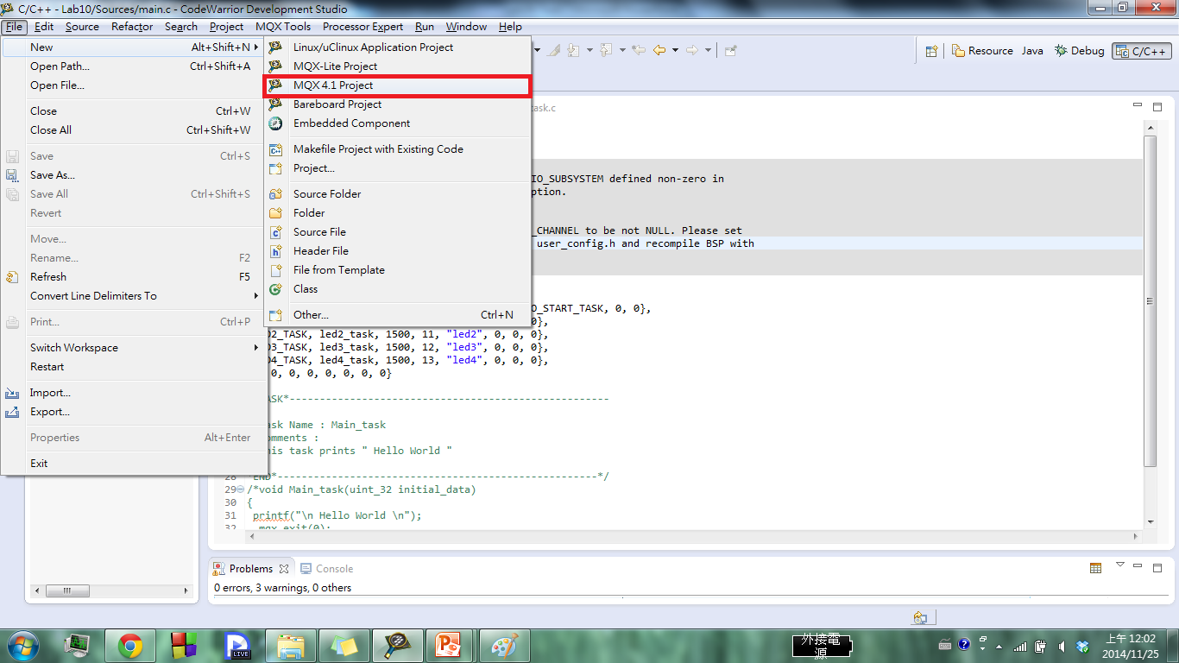
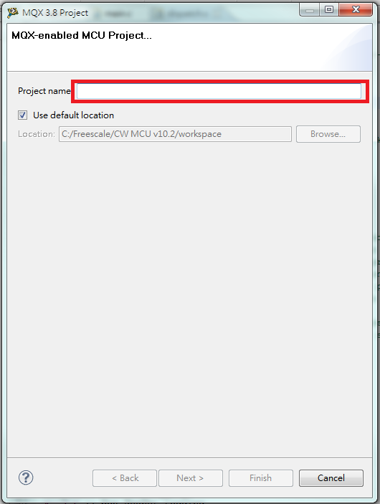

Slide 34
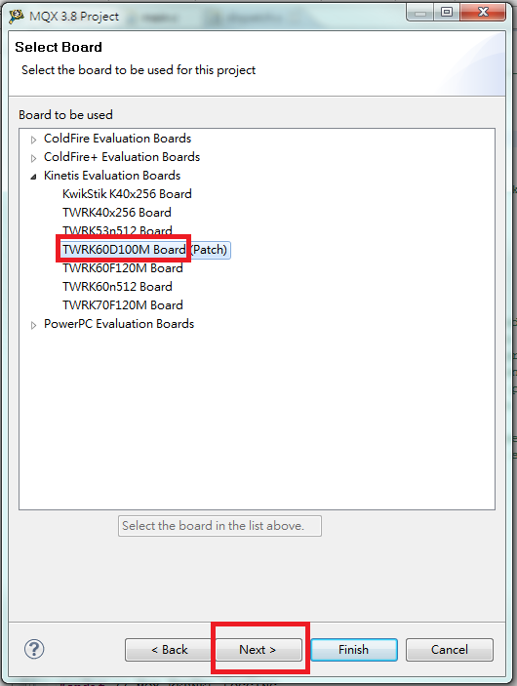
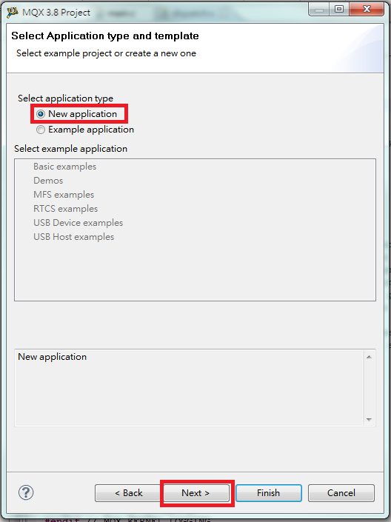
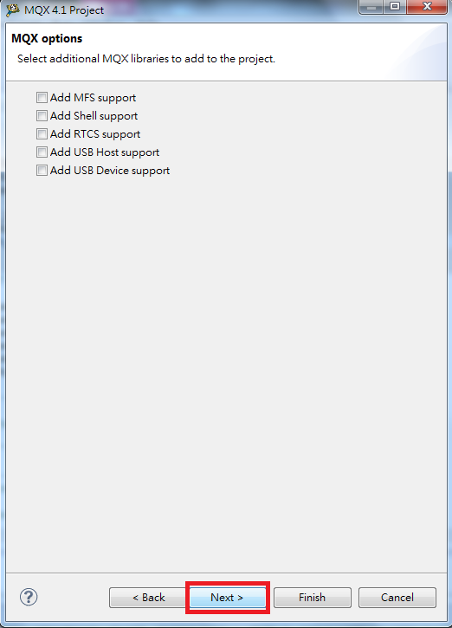

Slide 35
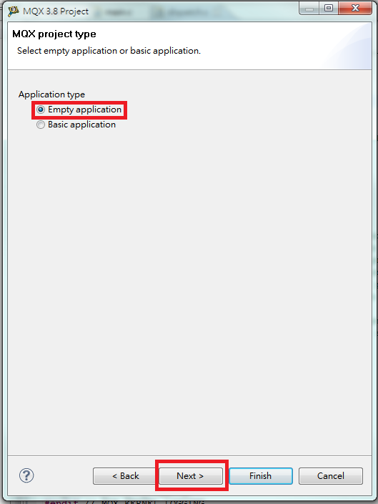
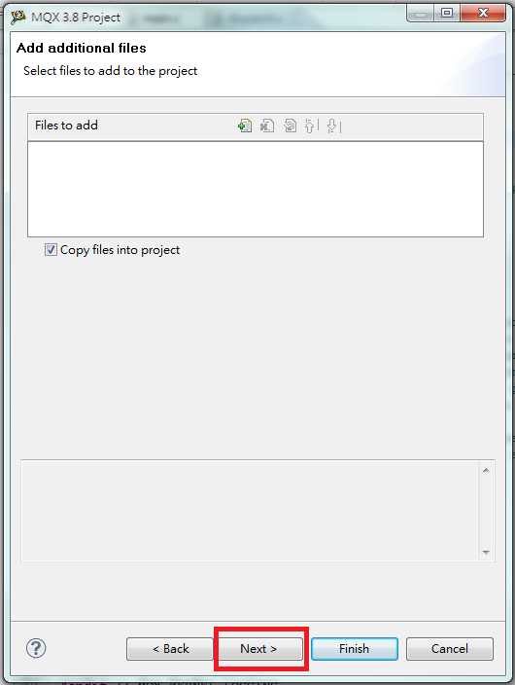
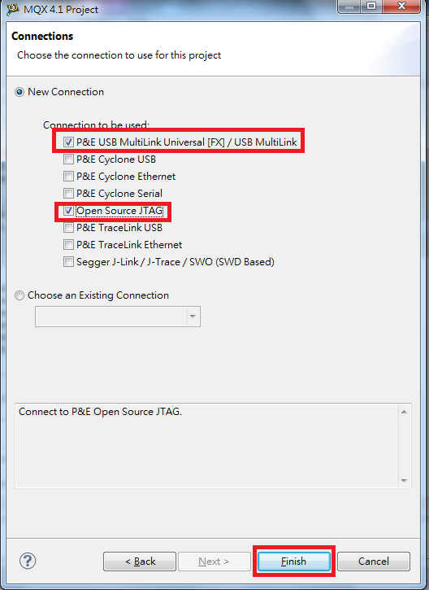

Slide 36
Basic Lab
Create four tasks: main, print, LED1, and LED2, where LED1 and LED2 use the same task template.
Main task initialized IO, creates print task, and yields CPU.
Print task prints “Hello, World!”, delays 500, yields CPU.
Main task checks whether button1 or button2 are pressed.
If button1 (button2) is pressed, main task creates LED1 (LED2) task to blink red (green) LED until button1 (button2) is released.
Hint:
You may like to use functions such as _sched_yield(), _task_block(), and _task_ready()
Set the priority of the tasks carefully

Slide 37
Bonus Lab
Modify Basic Lab to use the round robin scheduling and perform the same operations.
Use the main task to monitor whether button1 and button2 are pressed and released. Then create or destroy LED1 and LED2 tasks accordingly.
In other words, LED1 and LED2 only need to blink the LED periodically and do not need to check button status.
Hint: set their priority and time slices properly

