Slide 1
CS4101 Introduction to Embedded Systems Lab 8: Tower System
Prof. Chung-Ta King
Department of Computer Science
National Tsing Hua University, Taiwan

Slide 2
“Hello World” on MQX
#include <mqx.h> #include <bsp.h> #include <fio.h> #define HELLO_TASK 5 /* Task IDs */ extern void hello_task(uint_32); const TASK_TEMPLATE_STRUCT MQX_template_list[] = { /* Task Index, Function, Stack, Priority, Name, Attributes, Parameters, Time Slice */ {HELLO_TASK, hello_task, 1500, 8, "hello", MQX_AUTO_START_TASK, 0, 0 }, { 0 } }; void hello_task(uint_32 initial_data){ printf("Hello World\n"); _task_block(); // block the task }
Notes:
1
The hello_task is an autostart task. So, at initialization, MQX creates one instance of the task with a
creation parameter of zero. The application defines the task template index (HELLO_TASK). The task is of
priority 8. The function hello_task() is the code-entry point for the task. The stack size is 0x1500
single-addressable units.
1

Slide 3
“Hello World” Explained
There is no main() defined
main()in mqx\source\bsp\twrk60d100m\mqx_main.c
_mqx()starts MQX and initializes it according to the MQX initialization structure (with MQX_template_list as a member) defined in mqx_init.c
int main(void) { extern const MQX_INITIALIZATION_STRUCT MQX_init_struct; /* Start MQX */ _mqx( (MQX_INITIALIZATION_STRUCT_PTR) &MQX_init_struct ); return 0; }

Slide 4
“Hello World” Explained
A task is a unique instance of a task template
Can have multiple tasks from same template, and each has its own instance
Each task has a unique 32-bit task ID used by MQX
Automatic clean up of resources when terminates
Tasks are managed by MQX_template_list, an array of task templates for creating tasks
Terminated by a zero-filled task template

Slide 5
“Hello World” Explained
A task template contains these fields:
_mqx_uint TASK_TEMPLATE_INDEX
void (_CODE_PTR_)(uint_32) TASK_ADDRESS
_mem_size TASK_STACKSIZE
_mqx_uint TASK_PRIORITY
char _PTR_TASK_NAME
_mqx_uint TASK_ATTRIBUTES
uint_32 CREATION_PARAMETER
_mqx_uint DEFAULT_TIME_SLICE
TASK_TEMPLATE_STRUCT defined in mqx\source\include\mqx.h

Slide 6
MQX_template_list Examples
{ MAIN_TASK, world_task, 0x3000, 9, "world_task", MQX_AUTO_START_TASK, 0L, 0},
{ HELLO, hello_task, 0x1000, 8, "hello_task", MQX_TIME_SLICE_TASK, 0L, 100},
{ LED, float_task, 0x2000, 10, "Float_task", MQX_AUTO_START_TASK | MQX_FLOATING_POINT_TASK, 0L, 0},
Notes:
world_task
The world_task is an autostart task. So, at initialization, MQX creates one instance of the task with a
creation parameter of zero. The application defines the task template index (MAIN_TASK). The task is of
priority 9. The function world_task() is the code-entry point for the task. The stack size is 0x3000
single-addressable units.
hello_task
The hello_task task is a time-slice task with a time slice of 100, in milliseconds, if the default compile-time
configuration options are used.
Float_task
The Float_task task is both a floating-point task and an autostart task.

Slide 7
More on Task Attributes
Any combination of the following attributes can be assigned to a task:
Autostart: When MQX starts, it creates one instance of the task.
DSP: MQX saves the DSP co-processor registers as part of the task’s context.
Floating point: MQX saves floating-point registers as part of the task’s context.
Time slice: MQX uses round robin scheduling for the task (the default is FIFO scheduling).

Slide 8
Introduction to the Lab
In this lab, we will learn to set up the Freescale Tower System
To install the development environment and MQX
To set up Tower System and build MQX libraries
To develop and download programs to Tower

Slide 9
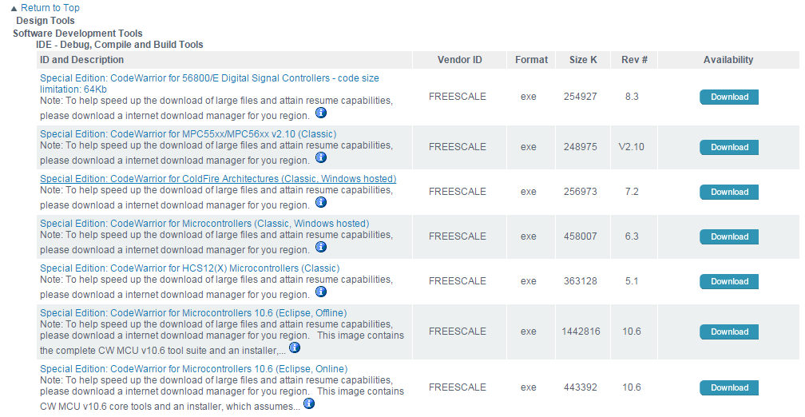
CodeWarrior Development Studio
Go to CodeWarrior for Microcontrollers10
(http://www.freescale.com/webapp/sps/site/overview.jsp?code=CW_SPECIALEDITIONS)
Select “ Special Edition: CodeWarrior for Microcontrollers 10.6 (Eclipse, Offline)” in Getting Started
You can download from the website or course ftp

Slide 10
MQX™ RTOS 4.1.1 TWR-K60D100M
Run the self-extracting K60D100M package installer and proceed according to instructions
The files will be installed directly into the specified folder in your PC

Slide 11
Setting up the Tower System
Use a PC (host) to control and develop programs for the Tower System (target), and load files to the Tower System
Connect one end of the USB cable to the PC and the other end to the power/OSJTAG mini-B connector on the TWR-K60D100M module.

Slide 12
Building the MQX Libraries
PSP (Processor Support Package) and BSP (Board Support Package) libraries must be built before building any application or changing kernel or I/O drivers

Slide 13
1. Import BSP and PSP files
Select menu File/Import/General/Existing Projects into Workspace and navigate to your MQX installation directory

Slide 14
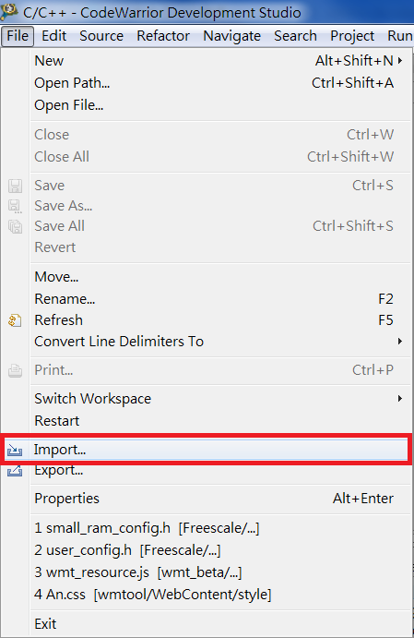
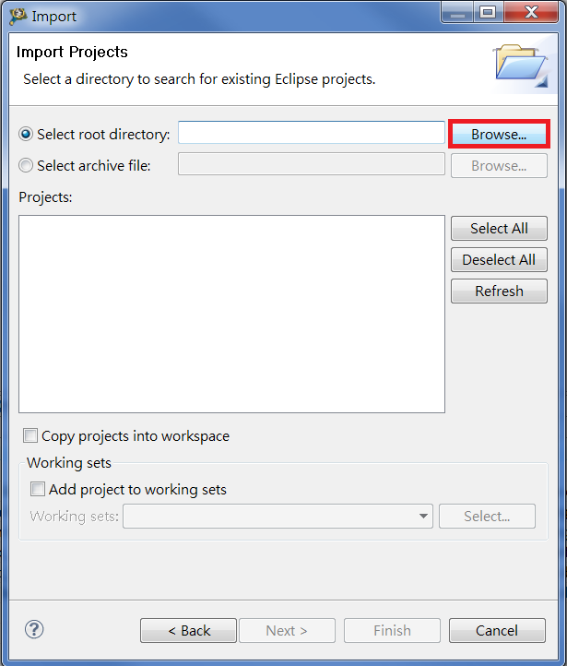
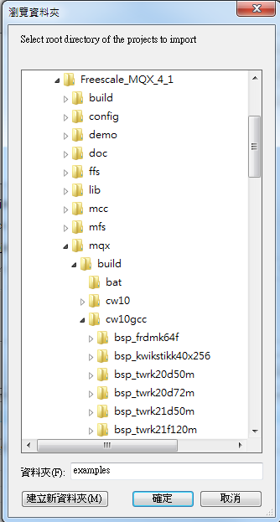
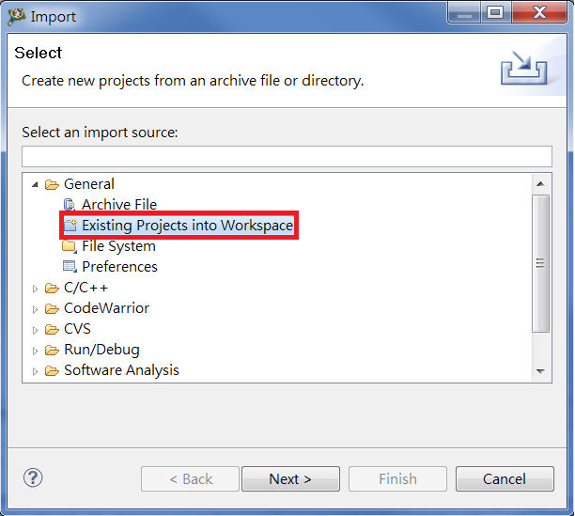
1. Import BSP and PSP Files
3
1
Freescale MQX 4.1
2
4
mqx/build/cw10gcc/
bsp_twrk60d100m
psp_twrk60d100m
Warning : The "Copy projects into workspace" check box in the file importer must be unchecked; otherwise, the project will be corrupted.

Slide 15
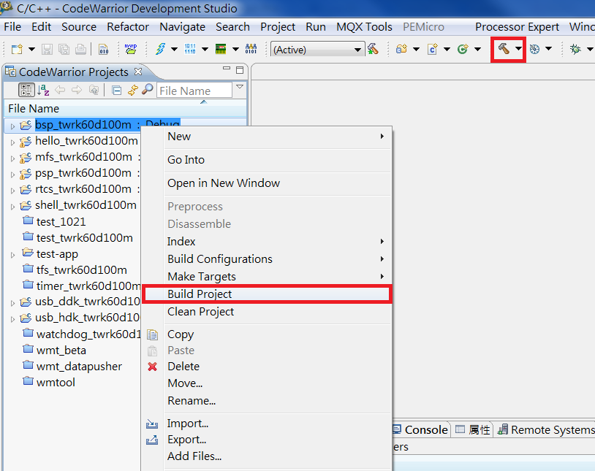
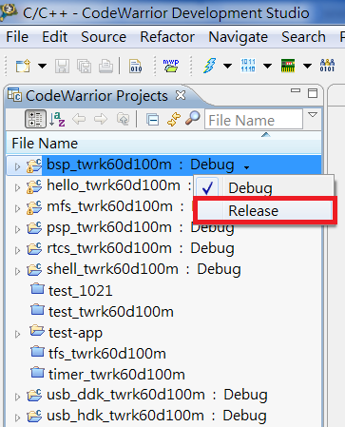
2. Use CodeWarrior to Compile Libraries
Build target (by default, the Debug build target is selected in all projects)
Switch all libraries to Release target and rebuild again
1
3
2
Build again ! (Release target)

Slide 16
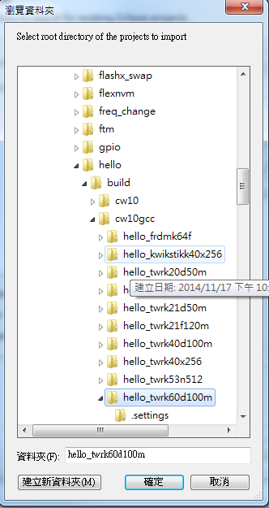
Basic Lab
Import example project hello and load to board
Select menu File/Import/General/Existing Projects into Workspace and search for example directory (Freescale MQX_4_1/mqx/examples/hello/cw10gcc/hello_twrk60d100m).
1
2
Build the project
hello_twrk60d100m
3
Debug the project
hello_twrk60d100m

Slide 17
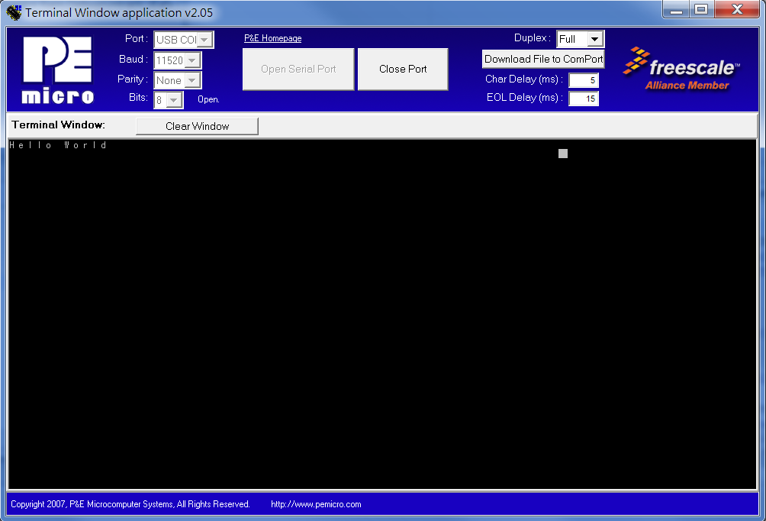
Basic Lab
Download and install P&E OSBDM OSJTAG Virtual Serial Toolkit
Open P&E OSBDM Toolkit → Utilities → Terminal Utility
Check following items: Port: USB COM Baud:115200 Parity:None Bits:8
Press “Open Serial Port”
Note : You can download toolkit from course FTP (final page)

Slide 18
Additional Explanations

Slide 19
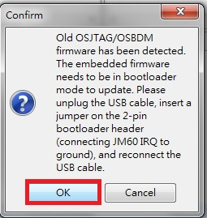
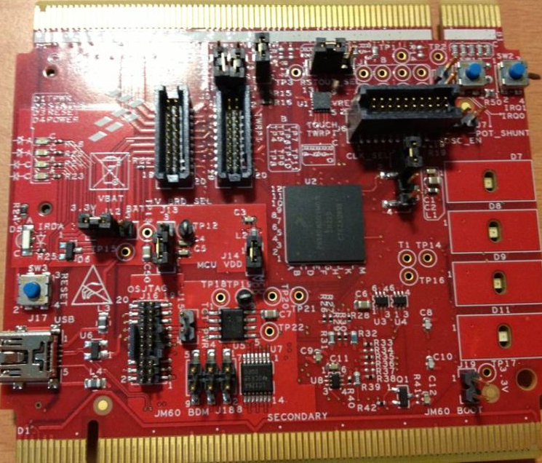
Update Firmware
When you first load a program to the Tower System, you need to update its firmware.
Press “Debug” button on CodeWarrior, and you will see
1
2
Unplug USB cable
Find an idle jumper and insert the 2-pin bootloader header
Reconnect USB cable
Press ”OK”
BOOT

Slide 20
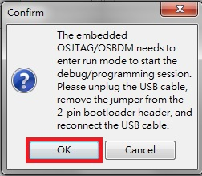
Update Firmware
2
Wait for the update of firmware
3
Unplug the USB cable
Remove the jumper from the 2-pin bootloader header
Reconnect the USB cable
Press “OK”

Slide 21
Download Software
Download from https://drive.google.com/folderview?id=0B4tCB87OXhqeRGJXb3p2eDdPZGs&usp=sharing
CW_MCU_v10.6_SE_Offline.exe
CodeWarrior v10.6
FSLMQXOS_4_1_1_GA.exe
FSLMQXOS_4_1_1_GA
pemicro_osbdm_osjtag_tower_toolkit.exe
P&E OSBDM OSJTAG Virtual Serial Toolkit

