Slide 1
CS4101 Introduction to Embedded Systems
Lab 7: Serial Communication
Prof. Chung-Ta King
Department of Computer Science
National Tsing Hua University, Taiwan

Slide 2
Introduction
In this lab, we will learn
  Communication peripherals of MSP430 LaunchPad
  Implementation of a software UART on MSP430 LaunchPad
  Communication between MSP430 LaunchPad and PC through RS232 interface

Slide 3
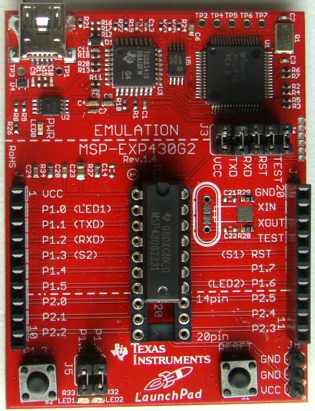
Recall
Pins for Comm
P1.1 → TXD
P1.2 → RXD

Slide 4
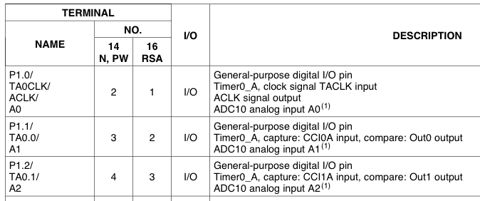
Pin Connections
Use TACCR0
TXD
Use TACCR1
RXD
#define TXD 0x02 // TXD on P1.1 (Timer0_A.OUT0) #define RXD 0x04 // RXD on P1.2 (Timer0_A.CCI1A) P1SEL |= TXD + RXD; // Enable TXD/RXD pins P1DIR = 0xFF & ~RXD; // Set pins to output P1OUT = 0x00; // Initialize all GPIO

Slide 5
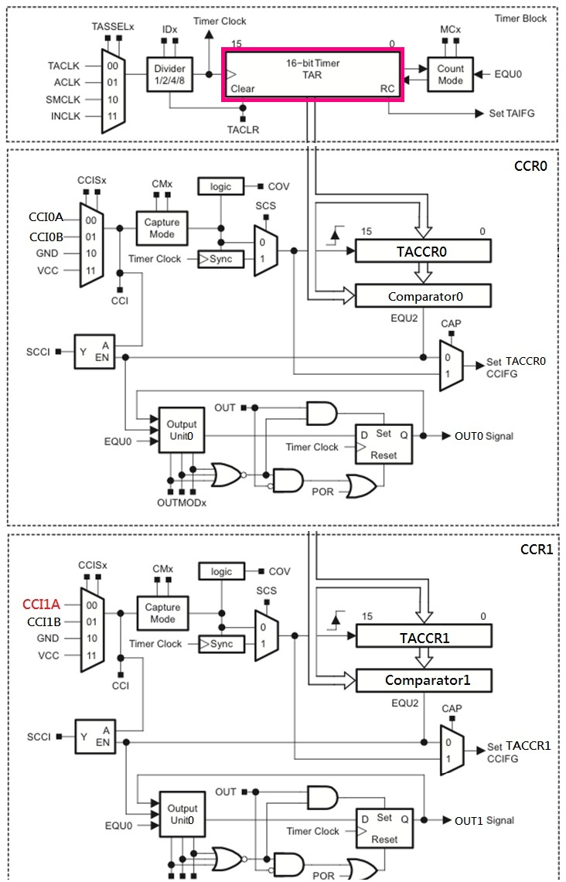
For
Transmission
TXD pin
For
Receive
Latch allows sampling
at precise time,
regardless of ISR
latency
RXD pin

Slide 6
Receive of Software UART by Timer_A
Between transmissions, CCR1 waits in Capture mode for a falling edge on its input.
When a falling edge is detected, TACCR1 captures the count in TAR and raises an interrupt. CCR1 is switched to Compare mode and TACCR1 is set to fire an interrupt after 1.5 of the bit period from now.
The next interrupt occurs and SCCI contains the value of LSB. ISR saves it. Next compare event is set up to occur after a further bit period.
The above procedure is repeated until all 8 bits of data have been received.

Slide 7
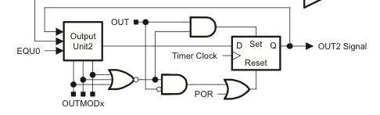
Transmission of Software UART
Use Capture/Compare Block 0 (TACCR0)
OUTMOD_0: OUT0 signal is defined by OUT bit
OUTMOD_2: OUT0 signal is reset when the timer counts to TACCR0
→ Use OUTMOD_0 to send a 1, OUTMOD_2 for 0
OUT0
Notes:
The OUTMODx determines how the signal changes when a CCR0 event happens.

Slide 8
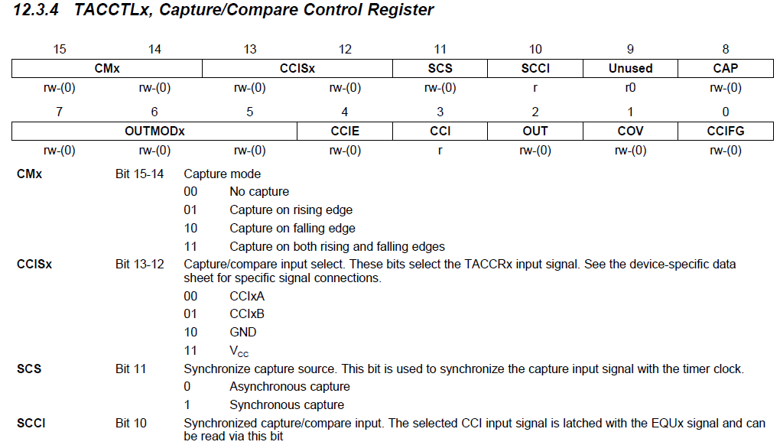
TACCTLx

Slide 9
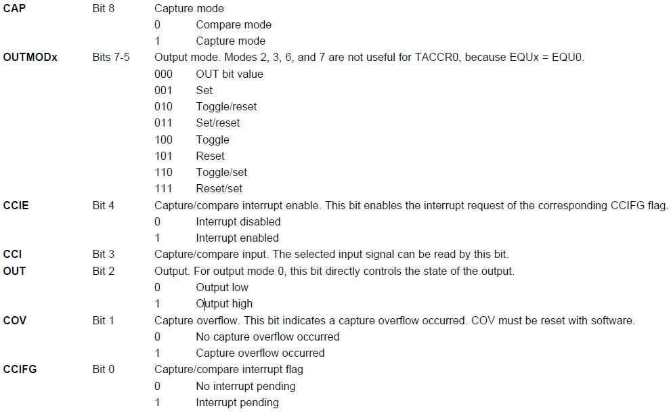
TACCTLx (cont’d)

Slide 10
Sample Code (msp430g2xx3_ta_uart9600)
Software UART, using Timer_A, 9600 baud, echo, full duplex, SMCLK at 1MHz
  Main loop readies UART to receive one character and waits in LPM3 with all activity interrupt driven.
  TACCR0 and TACCR1 may interrupt at any time and in an interleaved way
  TAR keeps an independent time reference, while CCR0 and CCR1 handle time intervals

Slide 11
Sample Code (msp430g2xx3_ta_uart9600)
#include "msp430g2553.h“ #define UART_TXD 0x02 // TXD on P1.1 (Timer0_A.OUT0) #define UART_RXD 0x04 // RXD on P1.2 (Timer0_A.CCI1A) #define UART_TBIT_DIV_2 (1000000 / (9600 * 2)) #define UART_TBIT (1000000 / 9600) unsigned int txData; // UART internal TX variable unsigned char rxBuffer; // Received UART character void TimerA_UART_init(void); void TimerA_UART_tx(unsigned char byte); void TimerA_UART_print(char *string);

Slide 12
Sample Code (msp430g2xx3_ta_uart9600)
void main(void) { WDTCTL = WDTPW + WDTHOLD; // Stop watchdog timer DCOCTL = 0x00; // Set DCOCLK to 1MHz BCSCTL1 = CALBC1_1MHZ; DCOCTL = CALDCO_1MHZ; P1OUT = 0x00; // Initialize all GPIO P1SEL = UART_TXD + UART_RXD; // Use TXD/RXD pins P1DIR = 0xFF & ~UART_RXD; // Set pins to output __enable_interrupt();

Slide 13
Sample Code (msp430g2xx3_ta_uart9600)
TimerA_UART_init(); // Start Timer_A UART TimerA_UART_print("G2xx3 TimerA UART\r\n"); TimerA_UART_print("READY.\r\n"); for (;;) { // Wait for incoming character __bis_SR_register(LPM0_bits); // Echo received character TimerA_UART_tx(rxBuffer); } } void TimerA_UART_print(char *string) { while (*string) TimerA_UART_tx(*string++); }
Waken up by
Timer_A1_ISR
Notes:
TimerA_UART_tx() sends one byte at a time
TimerA_UART_print(char *string) sends the whole string

Slide 14
Sample Code (msp430g2xx3_ta_uart9600)
void TimerA_UART_init(void) { TACCTL0 = OUT; // Set TXD idle as '1' TACCTL1 = SCS + CM1 + CAP + CCIE; // CCIS1 = 0 // Set RXD: sync, neg edge, capture, interrupt TACTL = TASSEL_2 + MC_2; // SMCLK, continuous mode } void TimerA_UART_tx(unsigned char byte) { while (TACCTL0 & CCIE); // Ensure last char TX'd TACCR0 = TAR; // Current state of TA counter TACCR0 += UART_TBIT; // One bit time till first bit TACCTL0 = OUTMOD0 + CCIE; // Set TXD on EQU0, Int txData = byte; // Load global variable txData |= 0x100; // Add stop bit to TXData txData <<= 1; // Add start bit }
Notes:
TACCTL1 = SCS + CM1 + CAP + CCIE;
// Sync, capture on rising edge, Capture mode, CCIS1 = 0 (default) → CCI1A, interrupt
SCS: Synchronize capture source. This bit is used to synchronize the capture input signal with the timer clock.
0 → Asynchronous capture; 1 → Synchronous capture
CMx: Capture mode
00 → No capture; 01 → Capture on rising edge; 10 → Capture on falling edge; 11 → Capture on both rising and falling edges
CCISx: Capture/compare input select. These bits select the TACCRx input signal.
00 → CCIxA; 01 → CCIxB; 10 → GND; 11 → VCC
Transmission starts from LSB
What happens if TACCR0 overflow? Synch with TAR’s overflow!

Slide 15
Sample Code (msp430g2xx3_ta_uart9600)
#pragma vector = TIMER0_A0_VECTOR __interrupt void Timer_A0_ISR(void) { static unsigned char txBitCnt = 10; TACCR0 += UART_TBIT; // Set TACCR0 for next intrpt if (txBitCnt == 0) { // All bits TXed? TACCTL0 &= ~CCIE; // Yes, disable intrpt txBitCnt = 10; // Re-load bit counter } else { if (txData & 0x01) {// Check next bit to TX TACCTL0 &= ~OUTMOD2; // TX '1’ using OUTMODE0 } else { TACCTL0 |= OUTMOD2;} // TX '0‘ txData >>= 1; txBitCnt--; } }

Slide 16
Sample Code (msp430g2xx3_ta_uart9600)
#pragma vector = TIMER0_A1_VECTOR __interrupt void Timer_A1_ISR(void) { static unsigned char rxBitCnt = 8; static unsigned char rxData = 0; switch (__even_in_range(TA0IV, TA0IV_TAIFG)) { case TA0IV_TACCR1: // TACCR1 CCIFG - UART RX TACCR1 += UART_TBIT; // Set TACCR1 for next int if (TACCTL1 & CAP) { // On start bit edge TACCTL1 &= ~CAP; // Switch to compare mode TACCR1 += UART_TBIT_DIV_2; // To middle of D0 } else { // Get next data bit rxData >>= 1;
Notes:
Timer_A interrupt vector register (TAIV): on an interrupt, TAIV contains a number indicating highest priority enabled interrupt for Timer_A0
TA0IV = 02h for TACCR1; = 04h for TACCR2; = 0ah for TAIFG
The __even_in_range(x,n) intrinsic tells the compiler that the expected argument is 1) always an even number and 2) in the range of x..n.
It allows the compiler to use a way more efficient method to branch to the different cases.
Instead of chained comparisons, the compiler just adds the argument to the program counter. And follows this instruction with a table of jump instructions (which take 2 bytes each). As a result of this add, the program counter directly lands on the jump instruction that jumps to the case code.
This intrinsic works best in conjunction with the IV registers, as these registers always return an even value in a known range. And, the highest priority interrupt has the largest value in the IV registers, so it is executed fastest.

Slide 17
Sample Code (msp430g2xx3_ta_uart9600)
if (TACCTL1 & SCCI) { // Get bit from latch rxData |= 0x80; } rxBitCnt--; if (rxBitCnt == 0) { // All bits RXed? rxBuffer = rxData; // Store in global rxBitCnt = 8; // Re-load bit counter TACCTL1 |= CAP; // Switch to capture __bic_SR_register_on_exit(LPM0_bits); // Clear LPM0 bits from 0(SR) } } break; } }
Wake up
main loop

Slide 18
Interrupt Source | Interrupt Flag | System Interrupt | Word Address | Priority
Power-up/external reset/Watchdog Timer+/flash key viol./PC out-of-range | PORIFG RSTIFG WDTIFG KEYV | Reset | 0FFFEh | 31 (highest)
NMI/Oscillator Fault/ Flash access viol. | NMIIFG/OFIFG/ ACCVIFG | Non-maskable | 0FFFCh | 30
Timer1_A3 | TA1CCR0 CCFIG | maskable | 0FFFAh | 29
Timer1_A3 | TA1CCR1/2 CCFIG, TAIFG | maskable | 0FFF8h | 28
Comparator_A+ | CAIFG | maskable | 0FFF6h | 27
Watchdog Timer+ | WDTIFG | maskable | 0FFF4h | 26
Timer0_A3 | TA0CCR0 CCIFG | maskable | 0FFF2h | 25
Timer0_A3 | TA0CCR1/2 CCIFG, TAIFG | maskable | 0FFF0h | 24
 |  |  | 0FFEEh | 23
 |  |  | 0FFECh | 22
ADC10 | ADC10IFG | maskable | 0FFEAh | 21
 |  |  | 0FFE8h | 20
I/O Port P2 (8) | P2IFG.0 to P2IFG.7 | maskable | 0FFE6h | 19
I/O Port P1 (8) | P1IFG.0 to P1IFG.7 | maskable | 0FFE4h | 18
 |  |  | 0FFE2h | 17
 |  |  | 0FFE0h | 16
Unused |  |  | 0FFDEh 0FFCDh | 15 - 0
Three sources of interrupts cause the same interrupt vector. Which one(s) cause the interrupt? → check TAIV register
Notes:
The MSP430 uses vectored interrupts, which means that the address of each ISR—its vector—is stored in a vector table at a deﬁned address in memory. In most cases each vector is associated with a unique interrupt but some sources share a vector. The ISR itself must locate the source of interrupts that share vectors. For example, TAIFG shares a vector with the capture/compare interrupts for all channels of Timer_A other than 0. Channel 0 has its own interrupt ﬂag TACCR0 CCIFG and separate vector.
17

Slide 19
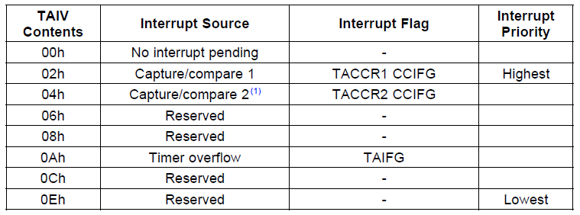
TAIV (Timer_A Interrupt Vector)
On an interrupt, TAIV contains a number indicating the highest priority enabled interrupt: TACCR1_CCIFG, TACCR2_CCIFG, TAIFG
  Any access of TAIV resets the highest pending interrupt flag. If another interrupt flag is set, another interrupt is immediately generated

Slide 20
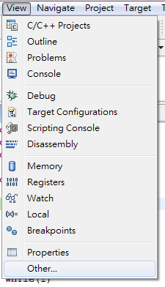
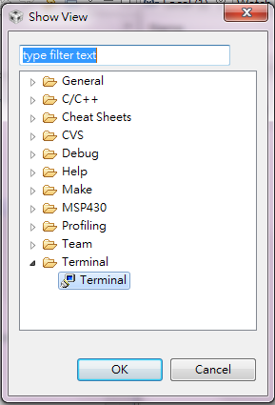
Setting PC for Serial Communication
In the Debug perspective of CCS IDE, click [View] -> [Other…] and, in the Show View window, click the + next to Terminal.
Select Terminal below that and click OK.

Slide 21
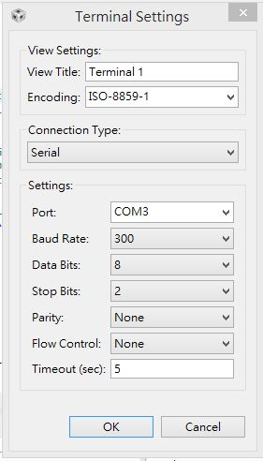
Setting PC for Serial Communication
A Terminal pane will appear on the screen. Click the Settings button in the Terminal pane and make the selections (set the serial communication setting)

Slide 22
Basic Lab
Temperature Sensing System
  MSP430 reads temperature from ADC every second.
  If the temperature is higher than 737, then flash the red LED at 5 Hz and send a string “Alarm!” to PC every second.
  Otherwise flash the green LED at 1 Hz and send a string “Normal” to PC every second.
Hint:
  Use Timer_A alternatively for timing 1 sec and UART

Slide 23
Bonus
Modify the basic lab so that when MSP430 receives the character ”0”, it stops temperature sensing.
While MSP430 is not sensing temperature, if it receives the character “R”, it turns on the red LED; if it receives the character “G”, turns on the green LED; and if it receives other characters, no LED is on.
When MSP430 receives the character ”1”, it goes back to basic lab.
Use 4800 baud, 8-bit of data, and 2 stop bits.

