Slide 1
CS4101 嵌入式系統概論
MQX Task Synchronization
Prof. Chung-Ta King
Department of Computer Science
National Tsing Hua University, Taiwan
(Materials from MQX User Guide)

Slide 2
Outline
Introduction to task synchronization
MQX events
MQX mutexs
MQX semaphores

Slide 3
Why Synchronization?
Synchronization may be used to solve:
  Mutual exclusion
  Control flow
  Data flow
Synchronization mechanisms include:
  Semaphores
  Events
  Mutexs
  Message queues
Correct synchronization mechanism depends
on the synchronization issue being addressed
EF
M

Slide 4
Mutual Exclusion
Problem: multiple tasks may “simultaneously” need to access the same resource
  Resource may be code, data, peripheral, etc.
  Need to allow the shared resource exclusively accessible to only one task at a time
How to do?
  Allowing only one task to lock the resource and the rest have to wait for the resource to be unlocked
  Common mechanisms: lock/unlock, mutex, semaphore

Slide 5
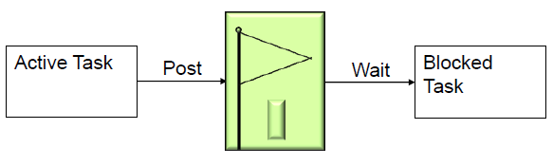
Control Flow Synchronization
Problem: a task or ISR may need to resume the execution of one or more other tasks, so that tasks execute in an application-controlled order
  Mutual exclusion is used to prevent another task from running, while control flow is used to allow another task to run, often specific tasks
How to do?
  Common mechanisms: post/wait, signal, event

Slide 6
Data Flow Synchronization
Problem: a task or ISR may need to pass some data to one or more other specific tasks, so that data may be processed in an application-specified order
How to do?
  May be accomplished indirectly through control flow synchronization
  Common mechanisms: messages, signal, post/wait

Slide 7
Outline
Introduction to task synchronization
MQX events
MQX mutexs
MQX semaphores

Slide 8
MQX Events
Can be used to synchronize a task with another task or ISR → control flow synchronization
An event component consists of event groups, which are groupings of event bits
  32 event bits per group (mqx_unit)
  Event groups can be identified by name (named event group) or an index (fast event group)
Tasks can wait for a combination of event bits to become set
A task can set or clear a combination of event bits

Slide 9
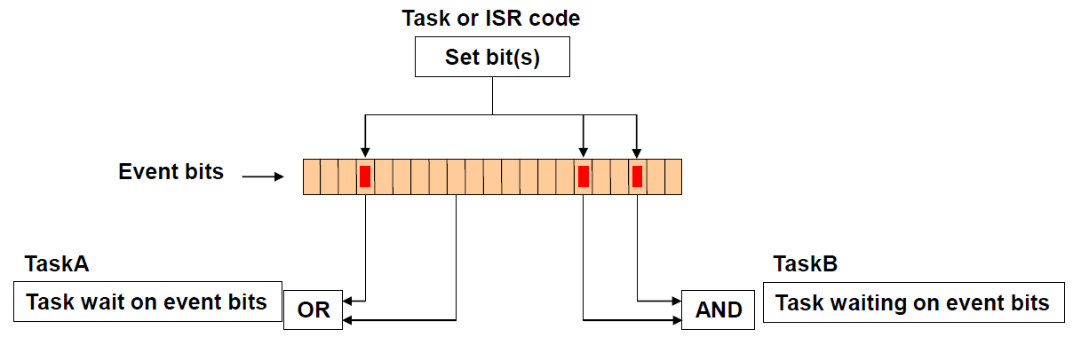
Event Bits
A task waits for a pattern of event bits (a mask) in an event group with _event_wait_all() or _event_wait_any()
  Wait for all bits in mask to be set or any of the bits
A task can set a mask with _event_set()

Slide 10
Operations on Events
When a task waits for an event group
  If the event bits are not set, the task blocks
When event bits are set, MQX puts all waiting tasks, whose waiting condition is met, into the task’s ready queue
  If the event group has autoclearing event bits, MQX clears the event bits as soon as they are set
Can use events across processors (not possible with lightweight events)

Slide 11
Example of Events

Slide 12
Example of Events (1/3)
#include <mqx.h> #include <bsp.h> #include <event.h> #define SERVICE_TASK 5 #define ISR_TASK 6 extern void simulated_ISR_task(uint_32); extern void service_task(uint_32); const TASK_TEMPLATE_STRUCT MQX_template_list[] = { /* Task Index, Function, Stack, Priority, Name, Attributes, Param, Time Slice */ {SERVICE_TASK, service_task, 2000, 8, "service", MQX_AUTO_START_TASK, 0, 0 }, {ISR_TASK, simulated_ISR_task, 2000, 8, "simulated_ISR", 0, 0, 0 }, { 0 } };
Notes:
11
11

Slide 13
Example of Events (2/3)
void service_task(uint_32 initial_data){ pointer event_ptr; _task_id second_task_id; /* Set up an event group */ if (_event_create("event.global") != MQX_OK) { printf("\nMake event failed"); _task_block(); } if(_event_open("event.global",&event_ptr)!=MQX_OK){ printf("\nOpen event failed"); _task_block(); } second_task_id = _task_create(0, ISR_TASK, 0); while (TRUE) { if(_event_wait_all(event_ptr,0x01,0)!=MQX_OK) { printf("\nEvent Wait failed"); _task_block(); } if (_event_clear(event_ptr,0x01) != MQX_OK) { printf("\nEvent Clear failed"); _task_block(); } printf(" Tick \n"); } }
Notes:
12
12

Slide 14
Example of Events (3/3)
void simulated_ISR_task (uint_32 initial_data) { pointer event_ptr; /* open event connection */ if (_event_open("event.global",&event_ptr)!=MQX_OK){ printf("\nOpen Event failed"); _task_block(); } while (TRUE) { _time_delay_ticks(1000); if (_event_set(event_ptr,0x01) != MQX_OK) { printf("\nSet Event failed"); _task_block(); } } }
Notes:
13
13

Slide 15
Common Calls for Events
_event_create | Creates a named event group.
_event_create_auto_clear | Creates a named event group with autoclearing event bits
_event_open | Opens a connection to a named event group.
_event_wait_all | Waits for all specified event bits in an event group for a specified number of milliseconds.
_event_wait_any | Waits for any of specified event bits in an event group for a specified number of ms.
_event_set | Sets the specified event bits in an event group on the local or a remote processor.
_event_clear | Clears specified event bits in an event group.
_event_close | Closes a connection to an event group.
_event_destroy | Destroys a named event group.

Slide 16
Outline
Introduction to task synchronization
MQX events
MQX mutex
MQX semaphores

Slide 17
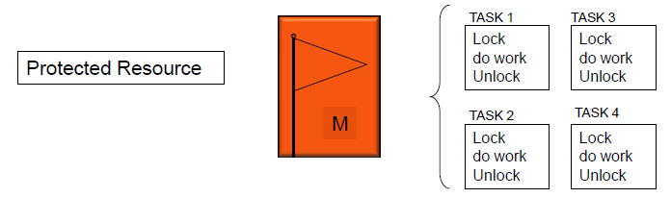
MQX Mutex
Mutexes are used for mutual exclusion, so that only one task at a time uses a shared resource, e.g., file, data, device, ...
  To access the shared resource, a task locks the mutex associated with the resource
  The task owns the mutex, until it unlocks the utex

Slide 18
MQX Mutex
A mutex is defined within a Mutex component
  Can be created with _mutex_create_component()
  If not explicitly created, MQX creates the component the first time an application initializes a mutex
Mutex attributes
  A mutex can have attributes with respect to its waiting and scheduling protocols

Slide 19
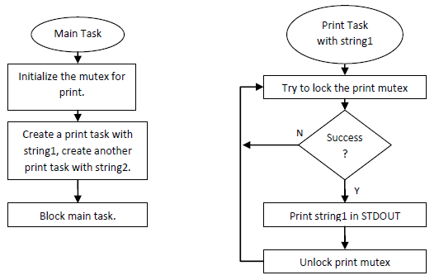
Example of Mutex
One main task and 2 printing tasks, which access STDOUT exclusively with mutex

Slide 20
Example of Mutex
#include <mqx.h> #include <bsp.h> #include <mutex.h> #define MAIN_TASK 5 #define PRINT_TASK 6 extern void main_task(uint_32 initial_data); extern void print_task(uint_32 initial_data); const TASK_TEMPLATE_STRUCT MQX_template_list[] = { /* Task Index, Function, Stack, Priority, Name, Attributes, Param, Time Slice */ { MAIN_TASK, main_task, 1000, 8, "main", MQX_AUTO_START_TASK, 0, 0 }, { PRINT_TASK, print_task, 1000, 9, "print", MQX_TIME_SLICE_TASK, 0, 3 }, { 0 } };
Notes:
19
19

Slide 21
Example of Mutex
MUTEX_STRUCT print_mutex; void main_task(uint_32 initial_data){ MUTEX_ATTR_STRUCT mutexattr; char* string1 = "Hello from Print task 1\n"; char* string2 = "Print task 2 is alive\n"; if (_mutatr_init(&mutexattr) != MQX_OK) { printf("Initialize mutex attributes failed.\n"); _task_block(); } if(_mutex_init(&print_mutex,&mutexattr)!= MQX_OK){ printf("Initialize print mutex failed.\n"); _task_block(); } _task_create(0, PRINT_TASK, (uint_32)string1); _task_create(0, PRINT_TASK, (uint_32)string2); _task_block(); }
Notes:
20
20

Slide 22
Example of Mutex
void print_task(uint_32 initial_data) { while(TRUE) { if (_mutex_lock(&print_mutex) != MQX_OK) { printf("Mutex lock failed.\n"); _task_block(); } _io_puts((char *)initial_data); _mutex_unlock(&print_mutex); } }
Notes:
21
21

Slide 23
Creating and Initializing a Mutex
Define a mutex variable of type MUTEX_STRUCT
Call _mutex_init() with a pointer to mutex variable and a NULL pointer to initialize mutex with default attributes
To initialize mutex with attributes other than default:
  Define a mutex attribute structure of type MUTEX_ATTR_STRUCT.
  Initialize the attributes structure with _mutatr_init()
  Call functions to set appropriate attributes of the mutex, e.g., _mutatr_set_wait_protocol()
  Initialize mutex by calling _mutex_init() with pointers to the mutex and to the attributes structure.
  Destroy mutex attributes structure with _mutatr_destroy()

Slide 24
Common Calls for Mutex
_mutex_destroy | Destroys a mutex
_mutex_get_wait_count | Gets the number of tasks that are waiting for a mutex
_mutex_init | Initializes a mutex
_mutex_lock | Locks a mutex
_mutex_try_lock | Tries to lock a mutex
_mutex_unlock | Unlocks a mutex

Slide 25
Mutex Attributes
Waiting protocols
  Queuing: (default) blocks until another task unlocks mutex
    Then, the first task (regardless of priority) that requested the lock locks the mutex
  Priority queuing: blocks until another task unlocks mutex
    Highest-priority task that requested the lock locks mutex
  Spin only: spins (timesliced) indefinitely until another task unlocks the mutex
    MQX saves the requesting task’s context and dispatches the next task in the same-priority ready queue. When all tasks in ready queue have run, the requesting task becomes active again. If mutex is still locked, spin repeats.
  Limited spin: spins for a specified number of times, or fewer if another task unlocks the mutex first

Slide 26
Mutex Attributes
Scheduling protocol
  Priority inheritance: If priority of the task that has locked the mutex (task_A) is not as high as the highest-priority task that is waiting to lock the mutex (task_B), MQX raises priority of task_A to be same as the priority of task_B, while task_A has the mutex.
  Priority protection: A mutex can have a priority. If the priority of a task that requests to lock the mutex (task_A) is not at least as high as the mutex priority, MQX raises the priority of task_A to the mutex priority for as long as task_A has the mutex locked.

Slide 27
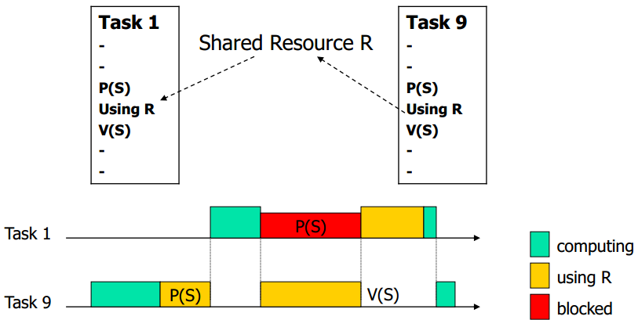
Priority Inversion
Assume priority of T₁ > priority of T₉
  If T₉ requests exclusive access first, T₁ has to wait until T₉ releases resource, thus inverting priority
T₁ has higher priority and preempts T₉
Critical section
(critical section)

Slide 28
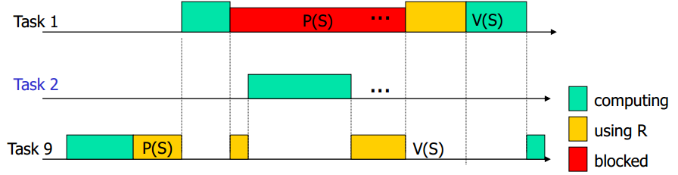
Priority Inversion
Three tasks with priorities T₁ > T₂ > T₉
T₁ and T₉ share mutex S
  T₉ runs first and locks S by P(S)
  T₁ runs next, preempts T₉, wants S by P(S), is blocked
  T₉ resumes execution
  T₂ runs the last, preempts T₉ again

Slide 29
Priority Inversion
Three tasks with priorities T₁ > T₂ > T₉
  Now T₂ can run for a very long period ...
  During this period, T₉ is blocked by T₂, and T₁ is blocked by T₉ → T₁ is blocked by T₂ → priority inversion
  After T₂ finishes execution, T₉ can resume to finish the critical section, and finally T₁ can enter the critical section to complete

Slide 30
Solution 1: Non Preemption Protocol
Basic strategy: make the task locking the mutex to run through the critical section as quickly as possible
Modify P(S) so that the ”caller” is assigned the highest priority if it succeeds in locking S
  Highest priority = non preemption!
Modify V(S) so that the ”caller” is assigned its own priority back when it releases S
Problem: allow low-priority tasks to block high-priority tasks including those that have no need for sharing the resources

Slide 31
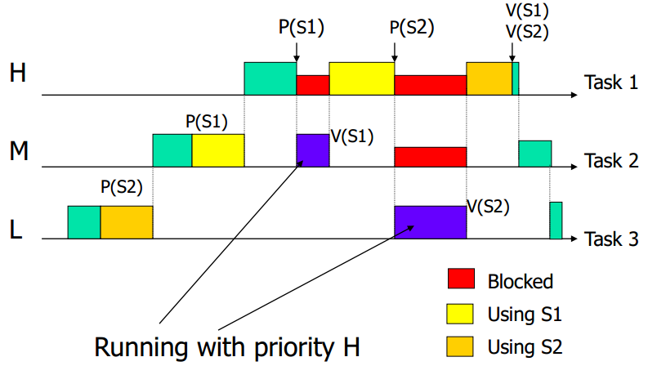
Solution 2: Priority Inheritance
T₂ gets mutex S1
T₁ tries to lock S1 and is blocked by S1
T₁ transfers its priority to T₂ (so T₂ is resumed and run with T₁’s
priority)
T₁ needing M resources may be blocked M times

Slide 32
Solution 3: Priority Protect Protocol
Also called Immediate Priority Ceiling Protocol
Each mutex S has a static ceiling value, which is the maximum priority of the tasks that may lock it
Whenever a task succeeds in holding S, its priority is changed dynamically to the maximum of its current priority and ceiling of S
  No other task that wants to lock the mutex has a higher priority that can block this task
More complex protocol if multiple resources are to be shared

Slide 33
Outline
Introduction to task synchronization
MQX events
MQX mutex
MQX semaphores

Slide 34

Semaphores
Semaphores are used to:
  Control access to a shared resource (mutual exclusion)
  Signal the occurrence of an event
  Allow two tasks to synchronize their activities
Basic idea
  A semaphore contains a number of tokens. Your code needs to acquire one in order to continue execution
  If all the tokens of the semaphore are used, the requesting task is suspended until some tokens are released by their current owners

Slide 35
How Semaphores Work?
A semaphore has:
  Counter: maximum number of concurrent accesses
  Queue: for tasks that wait for access
If a task requests (waits for) a semaphore
  if counter > 0, then (1) the counter is decremented by 1, and (2) task gets the semaphore and proceed to do work
  Else task is blocked and put in the queue
If a task releases (posts) a semaphore
  if there are tasks in the semaphore queue, then appropriate task is readied, according to queuing policy
  Else counter is incremented by 1
Notes:
34
This should be a quick review from the basic RTOS section earlier
Mutex is special case where the count =1 so only one task can hold it at a time

Slide 36
Example of Semaphores
Multiple tasks write to and read from a FIFO queue
  Mutual exclusion is required for updating the FIFO index
  Synchronization is required to block writing tasks when FIFO is full, and to block reading tasks when FIFO is empty
Three semaphores are used:
  Index: for mutual exclusion on FIFO read/write index
  Read: to notify readers for # of full entries
  Write: to notify writers for # of empty entries
Three tasks: Main, Read, Write
Read index
Writer
Reader
Writer
Reader
Write index

Slide 37
Example of Semaphores
#define MAIN_TASK 5 #define WRITE_TASK 6 #define READ_TASK 7 #define ARRAY_SIZE 5 #define NUM_WRITERS 2 // 2 writers, 1 reader typedef struct _task_id DATA[ARRAY_SIZE]; uint_32 READ_INDEX; uint_32 WRITE_INDEX; } SW_FIFO, _PTR_ SW_FIFO_PTR; /* Function prototypes */ extern void main_task(uint_32 initial_data); extern void write_task(uint_32 initial_data); extern void read_task(uint_32 initial_data);
Notes:
36
36

Slide 38
Example of Semaphores
const TASK_TEMPLATE_STRUCT MQX_template_list[] = { /* Task Index, Function, Stack, Priority, Name, Attributes, Param, Time Slice */ { MAIN_TASK, main_task, 2000, 8, "main", MQX_AUTO_START_TASK, 0, 0 }, { WRITE_TASK, write_task, 2000, 8, "write", 0, 0, 0 }, { READ_TASK, read_task, 2000, 8, "read", 0, 0, 0 }, { 0 } };
Notes:
37
37

Slide 39
Example of Semaphores: Main
SW_FIFO fifo; void main_task(uint_32 initial_data) { _task_id task_id; _mqx_uint i; fifo.READ_INDEX = 0; fifo.WRITE_INDEX = 0; /* Create the semaphores */ if (_sem_create_component(3,1,6) != MQX_OK) { printf("\nCreate semaphore component failed"); _task_block(); } if (_sem_create("sem.write",ARRAY_SIZE,0)!=MQX_OK){ printf("\nCreating write semaphore failed"); _task_block(); }
3: Initial number of semaphores that can be created
1: Number of semaphores to be added when the initial number have been created
6: Max. number of semaphores that can be created
Initial count of the semaphore and flags
Notes:
38
Create a write semaphore with 5 tokens
38

Slide 40
Example of Semaphores: Main
if (_sem_create("sem.read", 0, 0) != MQX_OK) { printf("\nCreating read semaphore failed"); _task_block(); } if (_sem_create("sem.index", 1, 0) != MQX_OK) { printf("\nCreating index semaphore failed"); _task_block(); } for (i = 0; i < NUM_WRITERS; i++) { task_id = _task_create(0, WRITE_TASK, (uint_32)i); printf("\nwrite_task created, id 0x%lx", task_id); } task_id = _task_create(0,READ_TASK, 0); printf("\nread_task created, id 0x%lX", task_id); _task_block(); }
Notes:
39
Create a read semaphore with 0 token and an index semaphore with 1 token
Create 2 writers and 1 reader
39

Slide 41
Attributes of Semaphores
When a task creates a semaphore, it specifies:
Count: initial value for the number of requests that can concurrently have the semaphore
Flag: specifying followings
  Priority queuing: if specified, the queue of tasks waiting for the semaphore is in priority order, and MQX puts the semaphore to the highest-priority waiting task. Otherwise, use FIFO queue
  Priority inheritance: if specified and a higher-priority task is waiting, MQX raises priority of the tasks that have the semaphore to that of the waiting task.
  Strictness: if specified, a task must wait for the semaphore, before it can post the semaphore

Slide 42
Example of Semaphores: Read
void read_task(uint_32 initial_data) { pointer write_sem, read_sem, index_sem; if (_sem_open("sem.write", &write_sem) != MQX_OK) { printf("\nOpening write semaphore failed."); _task_block(); } if (_sem_open("sem.index", &index_sem) != MQX_OK) { printf("\nOpening index semaphore failed."); _task_block(); } if (_sem_open("sem.read", &read_sem) != MQX_OK) { printf("\nOpening read semaphore failed."); _task_block(); }
Notes:
41
41

Slide 43
Example of Semaphores: Read
while (TRUE) { /* wait for the semaphores */ if (_sem_wait(read_sem, 0) != MQX_OK) { printf("\nWaiting for read semaphore failed."); _task_block(); } if (_sem_wait(index_sem,0) != MQX_OK) { printf("\nWaiting for index semaphore failed."); _task_block(); } printf("\n 0x%lx", fifo.DATA[fifo.READ_INDEX++]); if (fifo.READ_INDEX >= ARRAY_SIZE) { fifo.READ_INDEX = 0; } _sem_post(index_sem); _sem_post(write_sem); } }
FIFO queue is not empty
Safe to get data from FIFO
Notes:
42
_mqx_uint _sem_wait( pointer sem_handle, uint_32 ms_timeout)
ms_timeout [IN]
One of: • maximum number of milliseconds to wait
• 0 (unlimited wait)
42

Slide 44
Example of Semaphores: Write
void write_task(uint_32 initial_data) { pointer write_sem, read_sem, index_sem; if (_sem_open("sem.write", &write_sem) != MQX_OK) { printf("\nOpening write semaphore failed."); _task_block(); } if (_sem_open("sem.index", &index_sem) != MQX_OK) { printf("\nOpening index semaphore failed."); _task_block(); } if (_sem_open("sem.read", &read_sem) != MQX_OK) { printf("\nOpening read semaphore failed."); _task_block(); }
Notes:
43
43

Slide 45
Example of Semaphores: Write
Can be entered ARRAY_SIZE times w/o being blocked
while (TRUE) { if (_sem_wait(write_sem, 0) != MQX_OK) { printf("\nWwaiting for Write semaphore failed"); _task_block(); } if (_sem_wait(index_sem, 0) != MQX_OK) { printf("\nWaiting for index semaphore failed"); _task_block(); } fifo.DATA[fifo.WRITE_INDEX++] = _task_get_id(); if (fifo.WRITE_INDEX >= ARRAY_SIZE) { fifo.WRITE_INDEX = 0; } _sem_post(index_sem); _sem_post(read_sem); } }
Can be done outside of critical section
Notes:
44
44

Slide 46
Common Calls to Semaphores
_sem_close | Closes a connection to a semaphore.
_sem_create | Creates a semaphore.
_sem_create_component | Creates the semaphore component.
_sem_destroy | Destroys a named semaphore.
_sem_open | Opens a connection to a named semaphore
_sem_post | Posts (frees) a semaphore.
_sem_wait | Waits for a semaphore for a number of ms
_sem_wait_for | Waits for a semaphore for a tick-time period.
_sem_wait_ticks | Waits for a semaphore for a number of ticks.
_sem_wait_until | Waits for a semaphore until a time (in tick).

