Slide 1
CS4101 嵌入式系統概論 Device Drivers
Prof. Chung-Ta King
Department of Computer Science
National Tsing Hua University, Taiwan
(Materials from How to Develop I/O Drivers for MQX,
Freescale MQX I/O Drivers Users Guide)

Slide 2
Outline
Basics of MQX device drivers
Null driver

Slide 3
MQX Drivers
What is a device driver?
A software layer that interacts with and handle the HW
Dynamically installed software packages that provide a direct interface to hardware
MQX provides several device drivers that can be use by applications:
I2C, UART, SPI, RTC, Flash, GPIO, …
These drivers are included on the Board Support Package (BSP)
BSP is a software layer with all the initialization code, drivers, configuration needed to bring up a MCU/MPU

Slide 4
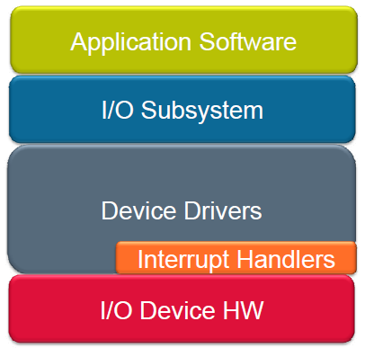
MQX I/O Subsystem
Uniform method to communicate with I/O device drivers
Hide specific driver functions

Slide 5
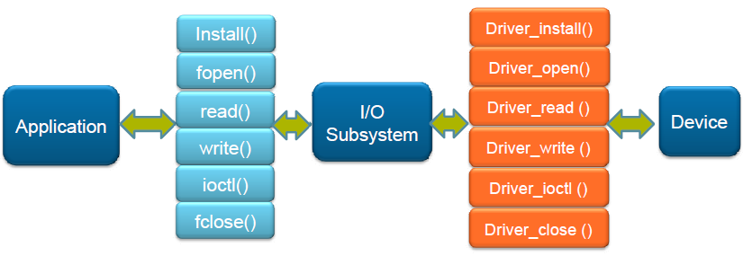
I/O Subsystem API
POSIX standard I/O

Slide 6
MQX Driver API
MQX device drive is installed by:
_io_device_install()
The installation function calls _io_dev_install() to register the device with MQX
To install a new device driver, the init_bsp.c needs to be modified and the BSP rebuilt
Device names
Device name must end with ‘:’, e.g., _io_mfs_install("mfs1:" ...)
Characters following ‘:’ are information passed to device driver by fopen() call, e.g., fopen("mfs1:bob.txt")

Slide 7
MQX Driver API
MQX device drive should contain following services:
_io_device_open(): required create a communication channel to the driver
_io_device_close(): required shut down the driver
_io_device_read(): optional
_io_device_write(): optional
_io_device_ioctl(): optional ask specific functionality to the driver
Note that “device” should be replaced with the name of the device family such as:
_io_null_xxx(), _io_ttya_xxx()

Slide 8
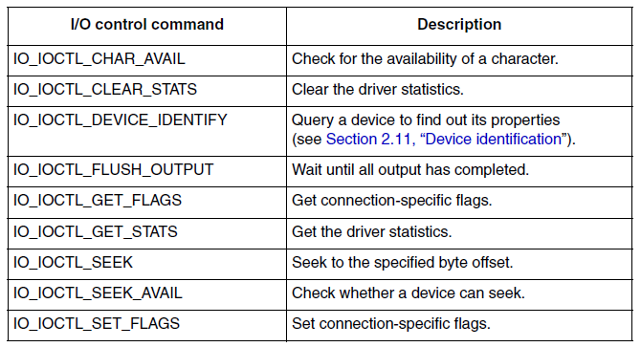
Common I/O Control Commands

Slide 9
Outline
Basics of MQX device drivers
Null driver

Slide 10
Null Driver
#include "mqx.h" // Structures & constants used by MQX #include "fio.h" // standard formatted I/O library #include "io.h" // I/O subsystem interface #include "my_null_io.h" // header for this driver /* function prototyping _mqx_int _io_my_null_open(FILE_PTR, char_ptr, char_ptr); _mqx_int _io_my_null_close(FILE_PTR); _mqx_int _io_my_null_read (FILE_PTR, char_ptr, _mqx_int); _mqx_int _io_my_null_write(FILE_PTR, char_ptr, _mqx_int); _mqx_int _io_my_null_ioctl(FILE_PTR, _mqx_uint, pointer);
Notes:
9
9
9

Slide 11
Null Driver
_mqx_uint _io_my_null_install(char_ptr identifier) { /* “idetifier” identifies the device for fopen */ _mqx_uint result; result = _io_dev_install(identifier, _io_my_null_open, _io_my_null_close, _io_my_null_read, _io_my_null_write, _io_my_null_ioctl, NULL); return result; } /* This function is called from fopen() to prepare driver for subsequent read, write, ioctl operations */ _mqx_int _io_my_null_open(FILE_PTR fd_ptr, char_ptr open_name_ptr, char_ptr flags) { /* Nothing to do */ return(MQX_OK); }
Notes:
10
10
10

Slide 12
Null Driver
_mqx_int _io_my_null_read(FILE_PTR fd_ptr, char_ptr data_ptr, _mqx_int num) { /* Body */ return(0); } /* Endbody */ _mqx_int _io_my_null_ioctl(FILE_PTR fd_ptr, _mqx_uint cmd, pointer param_ptr) { /* Body */ return IO_ERROR_INVALID_IOCTL_CMD; } /* Endbody */ ...
Notes:
11
11
11

Slide 13
Driver Code Installation in BSP
Create a folder inside the BSP to contain my_null device driver and save my_null program inside
Create a new text file to be used as the header file for the driver
Drag-and-drop the whole my_null_io folder to Codewarrior project inside the IO Drivers folder and add the files to all target boards
(Details next week)

Slide 14
Using Null Driver
#include <my_null_io.h> #define MY_TASK 5 extern void my_task(uint_32); TASK_TEMPLATE_STRUCT MQX_template_list[] = { {MY_TASK, my_task, 1500, 9, "null_test", MQX_AUTO_START_TASK, 0, 0}, {0} }; void my_task(uint_32 initial_data) { FILE_PTR null_file; uint_8 data[10]; if (IO_OK != _io_my_null_install("null:")) { printf("Error opening Null\n"); }
Notes:
13
13
13

Slide 15
Using Null Driver
if (NULL == (null_file = fopen("null:", NULL ))) { printf("Opening NULL device driver failed.\n"); _mqx_exit(-1); } if (write(null_file, data, 4 ) != 4) { printf("Writing to NULL driver failed.\n"); _mqx_exit(-1); } fclose(null_file); printf ("NULL driver working\n"); _mqx_exit(0); }
Notes:
14
14
14

