Slide 1
CS4101 嵌入式系統概論 Sensor Accessing in MQX
Prof. Chung-Ta King
Department of Computer Science
National Tsing Hua University, Taiwan
(Materials from www.freescale.com, Prof. P. Marwedel of Univ. Dortmund)

Slide 2
Recall Our TWR-K60D100M
Primary
Connector
SW1
SW2
MMA8451Q
Accelerometer
SW3(Reset)
LED/Touch Buttons
D7,D8,D9,
D11
Power/OSJTAG
Mini-B USB
Connector
PK60DN512VMD10
Kinetis MCU
Secondary
Connector

Slide 3
Outline
Introduction to sensors
Focusing on 3-axis accelerometer
Accessing sensors in MQX through I²C serial communication

Slide 4
What Are Sensors?
A sensor is a device that detects either an absolute value or a change in a physical or electrical quantity, and converts that change into a useful input signal (often analog signals) for a decision making center
Data Processing,
Control, Connectivity
Actuator
or
Output
Sensor
Input
Notes:
What is a Sensor?
A Sensor is a device that detects a physical or electrical quantity and converts this characteristic into a value for a decision making center such as an MCU. From this the MCU can decide on events, and trigger an additional output.
Some examples of physical quantities that our sensors measure include:
Temperature
Pressure
Flow rate
Acceleration
Vibration
Tilt
Touch

Slide 5
Sensors
For capturing physical data
Sensors can be designed for virtually every physical and chemical stimulus
Heat, light, sound, weight, velocity, acceleration, electrical current, voltage, pressure, …
chemical compounds
Many physical effects can be used for constructing sensors
Law of induction (generation of voltages in an electric field), light-electric effects. …

Slide 6
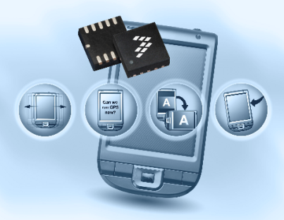
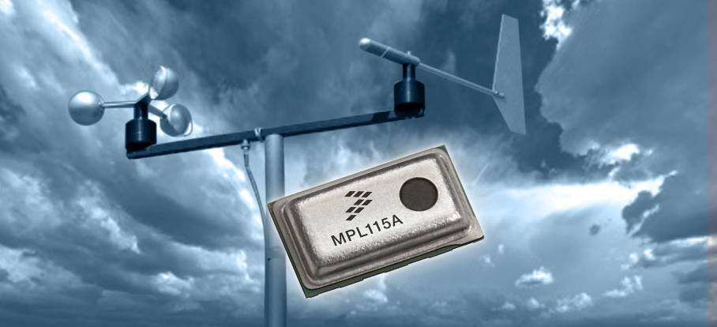
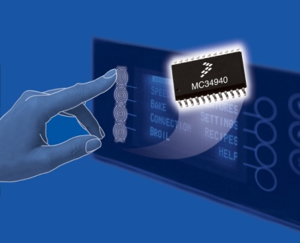

Sensor Applications
Acceleration
Gesture detection
Tilt to control
Tap detection
Position detection
Orientation
Gyroscopic
Magnetic
Ambient light sensing
Temperature/humidity
Motion detection
Pressure
Medical
Barometer/altimeter
Engine control/tire pressure
HVAC applications
Water level
Multiple sensors working together for next generation applications…
Touch
Touch detection
Appliance control panels
Touch panels
Notes:
Freescale has a diverse Sensor Portifolio . Traditionally we started in the Automotive field, and have branched into the Consumer and Industrial space. This includes some medical application space.
Freescale has many different sensors, including Inertial Accelerometers, Pressure Sensors and Touch Sensors.
Accelerometers include measurements of Gesture detection, Tilt, Tap and Orientation.
Pressure sensors measure Automotive engine control parameters, medical health monitoring, and have lots of industrial applications.
Touch sensors can be utilized in button replacement and be designed for custom applications.

Slide 7
Accelerometers
Devices that are used to measure acceleration
Common accelerometer types
Resistive: strain gauge, piezoresistive, thin-film
Capacitive, fiber optic, servo or force balance, vibrating quartz, piezoelectric
MEMS accelerometers:
MEMS (Micro ElectroMechanical Systems): small silicon devices that perform the same function as larger mechanical systems
There is always 1 g downward due to gravity

Slide 8
Accelerometer Types
Capacitive: utilizes frequency modulation technique through varying capacitor bridge
Power
Ground
Signal
Fixed Capacitors
~
Built-In Electronics
Insulator
Sensing Capacitor #1
Flexure
Mass
Sensing Capacitor #2
Insulator

Slide 9
Accelerometer Types
Signal/Power
Ground
F
Piezoelectric Material
+
+
+
+
+
+
+
-
-
-
-
-
-
Voltage or Charge Amplifier
-
Preload Ring
Mass
Piezoelectric Crystal
F
Base
8
Piezoelectric:
Force on self-generating crystal provides charge output proportional to acceleration
Notes:
壓電材料

Slide 10

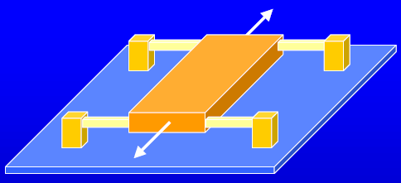
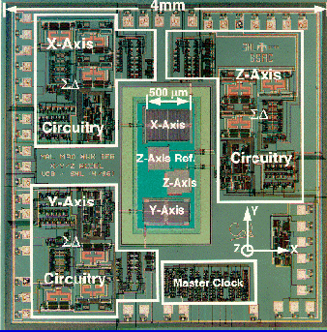
MEMS Accelerometer
Suspension arms
Proof mass
Substrate with circuitry
Axis of response
9

Slide 11
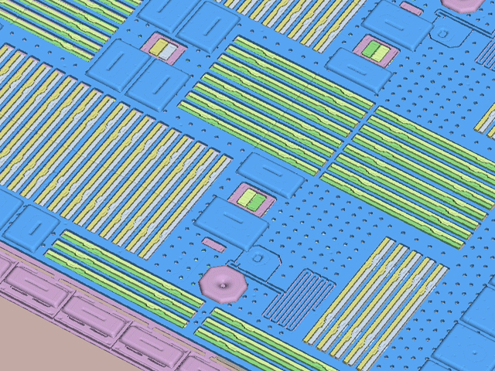
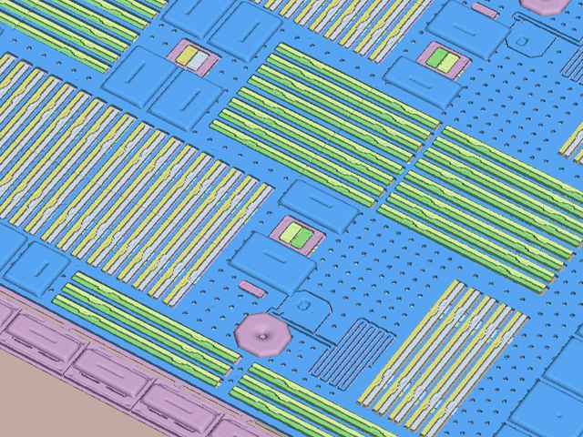
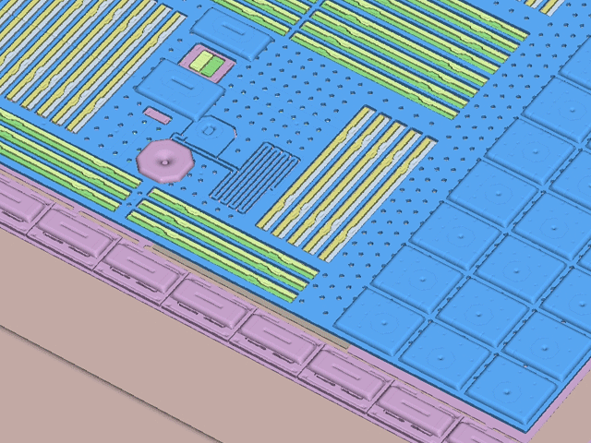
Accelerometer at Work: X, Y, Z Movement
X-axis
Y-axis
Z-axis
Notes:
Notice how the g-cell moves in X, Y and Z axes. The change in the distance between the plates or fingers determines the capacitance. This relates to the acceleration in each axis. Silicon has no fatigue, so can repetitively move back and forth for extended periods. Bump stops are used to control maximum movement.

Slide 12
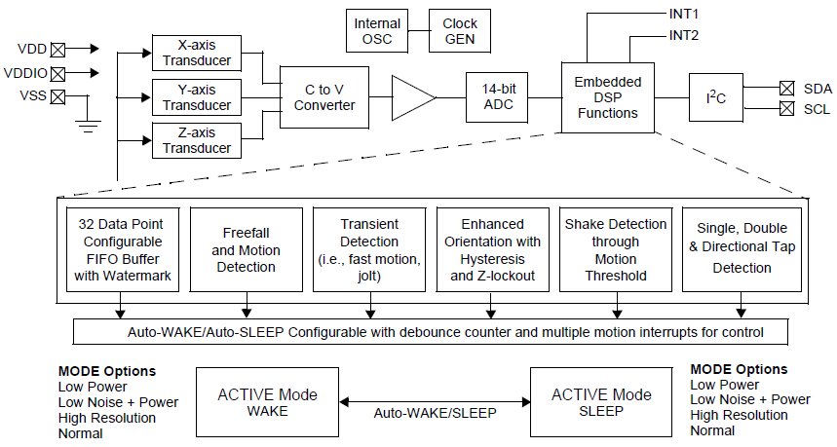
MMA8451Q Accelerometer
Low-power, 3-axis, capacitive micromachined accelerometer with 14 bits of resolution

Slide 13
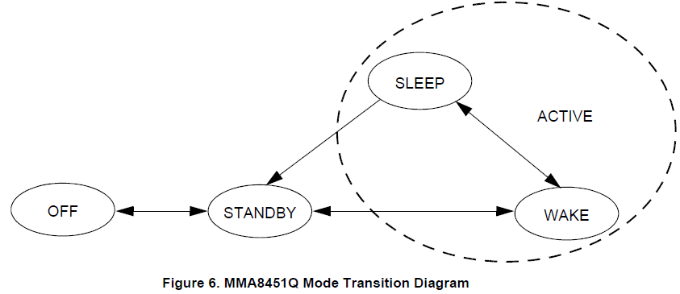
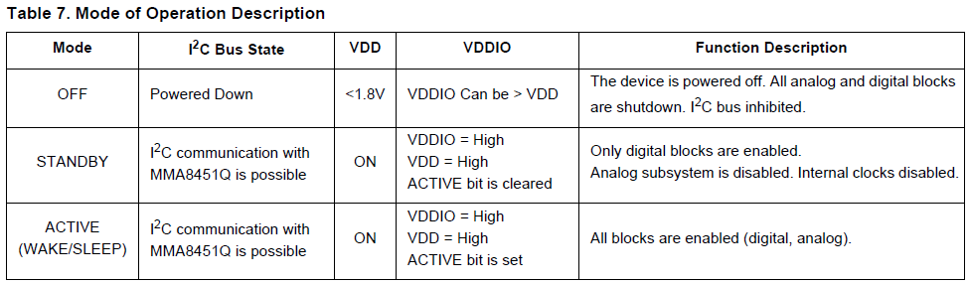
MMA8451Q Accelerometer
Operation modes

Slide 14
MMA8451Q Features
Measured acceleration data stored in OUT_X (Y, Z)_MSB, OUT_X (Y, Z)_LSB, registers as 2’s complement 14-bit numbers
If only 8-bit results needed, can use OUT_X (Y, Z)_MSB
Resolution
When the full-scale is set to 2g, the measurement range is -2g to +1.99975g, and each count corresponds to 1g/4096 (0.25 mg) at 14-bits resolution.
When 8g, range is -8g to +7.999g, and each count is 1g/1024 (0.98 mg) at 14-bits resolution.
Provide a large number of data and control registers, data buffer, interrupt, I²C communication

Slide 15
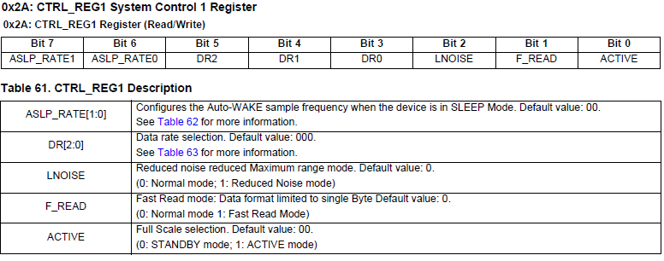
Control Register: CTRL_REG1
Configure MMA8451Q:
write_I2C(I2C_ACCELEROMETER_ADDRESS,0x2A,0x03);
Notes:
F_Read bit selects between normal and Fast Read mode. When selected, the auto increment counter will skip over the LSB data
bytes. Data read from the FIFO will skip over the LSB data, reducing the acquisition time. Note F_READ can only be changed
when FMODE = 00. The F_READ bit applies for both the output registers and the FIFO.

Slide 16
Outline
Introduction to sensors
With emphasis on 3-axis accelerometer
Accessing sensors through I²C serial communication

Slide 17
I²C Serial Communication
I²C: Inter Integrated Circuit Bus
Two-wire serial multimaster-slave bus protocol by Philips in the 1980s
Enables peripheral ICs to communicate using simple communication hardware
7-bit or 10-bit address space
Data transfer rate: 100 kbits/s (standard mode), 400 kbits/s (fast mode), 3.4M bits/s (high speed mode)
Common devices capable of interfacing to I²C bus:
EPROMS, Flash, and some RAM memory, real-time clocks, watchdog timers, and microcontrollers

Slide 18
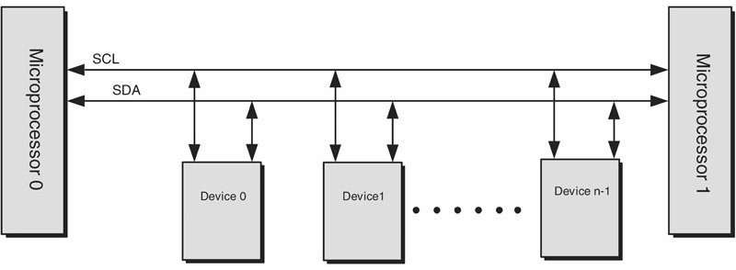
I²C Bus Structure
2 signal lines: SCL (serial clock), SDA (serial data)
Every device connected to the I²C bus has a unique address and can act as a receiver or a transmitter
I²C is a multi master bus.
Bus master is established at the time of communication

Slide 19
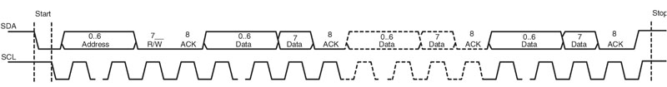
I²C Protocol
Transfers are byte oriented, MSB first
Quiescent state for SCL, SDA is HIGH
Start: Master sends SDA low while keeps SCL high
Master sends address of slave (7-bits) on next 7 clocks
Master sends read/write request bit
0 (write to slave), 1 (read from slave)
Slave ACKs by pulling SDA low on next clock

Slide 20
I²C Protocol
Master transfers one-byte of data to slave on next 8 clock pulses
Clock is controlled by master
Data receipt is ACKed by slave on 9th pulse by pulling SDA low
When slave releases, SDA master can send next byte
At the end of transmission, Master sets a Stop condition by making a low to high transition on SDA with SCL is high

Slide 21
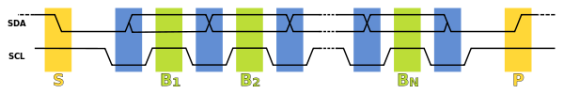
Timing Diagram of I²C Protocol
Data transfer initiated with a START bit (S) signaled by SDA being pulled low while SCL stays high.
SDA sets 1st data bit level, keeping SCL low (blue)
Data is sampled (received) when SCL rises (green)
This process repeats: SDA transitioning while SCL is low, and data being read while SCL is high
A STOP bit (P) is signaled when SDA is pulled high while SCL is high
(wikipedia)

Slide 22
I²C Transaction
Transmitter/receiver differs from master/slave
Master initiates transactions
Slave responds
Transmitter sets data on SDA line, slave acks
For a read, slave is transmitter and master acks
For a write, master is transmitter, and slave acks

Slide 23
Arbitration
Two transmitters may start transmission at about the same time → need arbitration
If one transmitter sets SDA to 1 (not driving a signal) and a second transmitter sets it to 0 (pull to ground), the result is that the line is low.
The first transmitter observes that the level of the line is different from that expected. It concludes that another node is transmitting and it loses arbitration
In the meantime, the other node has not noticed any difference between the expected and actual levels on SDA, and therefore continues transmission

Slide 24

Accessing MMA8451Q with I²C
The registers embedded inside the MMA8451Q are accessed through the I2C serial interface
Single byte read
MCU first addresses MMA8451Q ($1D) and then transmits the address of the register to read
MCU transmits a repeated start condition (SR) and then addresses MMA8451Q with R/W bit = 1 for a read
MMA8451Q acks and transmits data from requested register

Slide 25
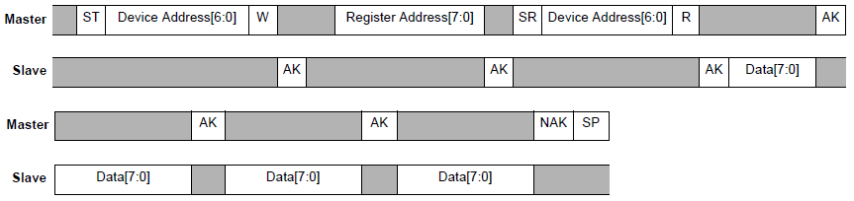
Accessing MMA8451Q with I²C
Multiple byte read
After following the steps of a single byte read, multiple bytes of data can be read from sequential registers after each MMA8451Q acknowledgment (AK) is received until a no acknowledge (NAK) occurs from the Master followed by a stop condition (SP) signaling an end of transmission.

Slide 26
Sample code next week

