Slide 1
CS4101 嵌入式系統概論 The Tower System
Prof. Chung-Ta King
Department of Computer Science
National Tsing Hua University, Taiwan
(Materials from www.freescale.com, Prof. P. Marwedel of Univ. Dortmund)

Slide 2
Recall Lab 7 on Software UART of MSP430
Basic lab: Temperature Sensing System
Read temperature from ADC every second. If temperature is higher than 737, then flash red LED at 5 Hz and send a string “Alarm!” to PC every sec. Otherwise flash green LED at 1 Hz and send a string “Normal” to PC every second.
How many “tasks” are there?
Transmit a byte: periodic for a duration
Receive a byte: periodic for a duration
Measure the temperature: periodic
Flash the LEDs: periodic for a duration
Do they have deadlines? Critical if deadline is missed?
How are they scheduled? Adjustable? Guarantee?

Slide 3
What about LaunchPad as a Whole?
Low level programming
Pros: direct control and efficiency
Cons: complexity and management, protection, reliability, program productivity
Limited flexibility
Modularity and composability, resource scheduling and management
For more complex embedded systems, need an operating system!

Slide 4
Outline
The Tower system and its major components
Introduction to MQX real-time operating system

Slide 5
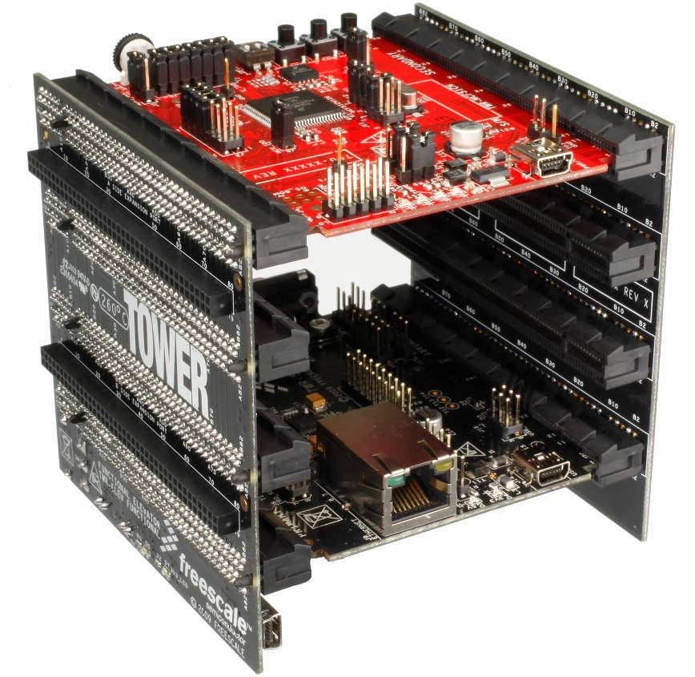
The Tower System
Processor Module:
Tower controller board
Works stand-alone or in Tower system
Open Source Background Debug Module (BDM) for easy programming and debugging via miniB USB cable
Board Connectors:
Four card-edge connectors
Uses PCI Express connectors
Functional Elevator:
Common serial and expansion bus signals
Two 2x80 connectors on backside for signal access and side-mounting board, e.g. LCD
Power regulation circuitry
Standardized signal assignments (e.g. UART, SPI, Timers, External Bus, I2C, CAN, GPIO, Ethernet, USB, etc.)
Dummy Elevator:
Future expansion for more serial interfaces and more complex MPU interfaces (e.g. RGB LCD, segment LCD, audio, enhanced Timer, etc.)
“Dummy” shown with only GND connectivity.
Peripheral Module:
Standard peripheral boards (e.g. Serial, Memory, etc.)
Notes:
4
4

Slide 6
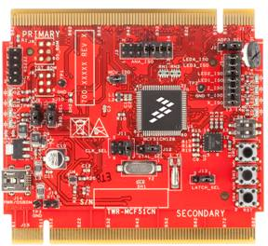
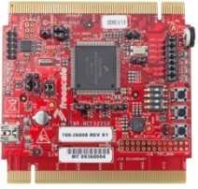


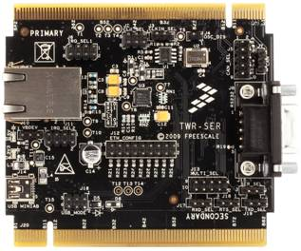
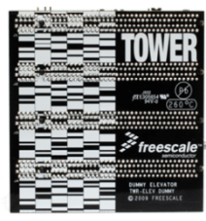
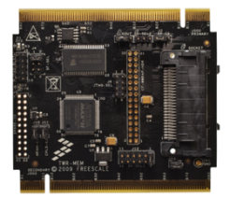

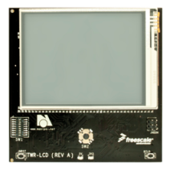
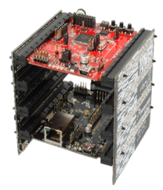
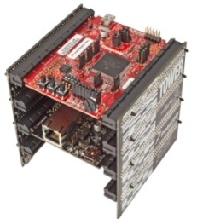
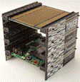
Typical Tower System Modules
Processor
Modules
($39-$69)
TWR-MCF51CN
TWR-MCF5225X
TWR-S08LL64
TWR-S08LL64
Peripheral
Modules
($15 – $149)
TWR-SER
TWR-ELEV
TWR-MEM
TWR-SENSOR-PAK
TWR-LCD
Complete
Kits
($99 - $149)
(www.freescale.com/tower for latest tools)
TWR-MCF51CN-KIT
TWR-MCF5225X-KIT
TWR-S08LL64-KIT
Notes:
5
5
The TWR-MCF5225X is a low-cost development tool for the MCF5225X V2 ColdFire® devices. Offered as a kit or as a standalone board, theTWR-MCF5225X comes complete with Freescale MQX software and an evaluation version of CodeWarrior Development Studio to ease application development and debug. The TWR-MCF5225X-KIT includes TWR-SER and TWR-ELEV modules.
The TWR-S08LL64 module is the first 8-bit module created for the Tower system. It is a low-cost development tool for the MC9S08LL64 family of devices. The TWR-S08LL64 provides a reusable, expandable development platform for 8-bit designs requiring segment LCD functionality. The TWR-S08LL64-KIT includes TWR-PROTO and TWR-ELEV modules.
The TWR-PROTO Prototyping module provides an easy way for designers to add custom circuitry to their Tower System designs. The TWR-PROTO module is a 9 x 8 cm board with card-edge connectors that allows it to be plugged directly into the Tower System. The perfboard area provides access to all of the signals as well as a generous 8.3 x 3.8cm prototyping area.
TWR-SER The Serial Module provides added connectivity solutions including USB, Ethernet, CAN and RS232 and RS485.
The TWR-MEM Memory Module provides added memory capacity to Tower System designs with Serial Flash, MRAM, SD Card and Compact Flash interfaces.
The TWR-LCD Graphical LCD module provides an easy way for designers to add an LCD interface to their Tower System designs. The TWR-LCD module features a 3.2" QVGA TFT LCD Display and attaches to the outer edge of the Tower System elevator modules by Side Expansion Port connectors.
The TWR-SENSOR-PAK is a module in the Tower System that features swappable sensor modules, or plug-ins. These swappable plug-ins allow you to rapidly evaluate and compare an expanding portfolio of sensors. Using real-time sensor data and interaction with your environment, it's easy to sense your world with the TWR-SENSOR-PAK.

Slide 7
What You Will Get -- TWR-K60D100M
Primary
Connector
SW1
SW2
MMA8451Q
Accelerometer
SW3(Reset)
LED/Touch Buttons
D7,D8,D9,
D11
Power/OSJTAG
Mini-B USB
Connector
PK60DN512VMD10
Kinetis MCU
Secondary
Connector

Slide 8
Back of TWR-K60D100M

Slide 9
Features of TWR-K60D100M
PK60DN512VMD10 MCU
ARM Cortex-M4 core, 100 MHz, 512 KB flash, Ethernet, USB FS OTG, encryption, 144 MAPBGA
Integrated open source JTAG (OSJTAG) circuit
MMA8451Q 3-axis accelerometer
Four user-controlled status LEDs
Four capacitive touch pads and two mechanical push buttons
General-purpose Tower plug-in TWRPI sockets
Potentiometer, SD card socket, coin-cell battery holder

Slide 10
TWR-K60D100M Block Diagram

Slide 11
ARM Cortex Series
The ARM Cortex family includes processors based on three distinct profiles of the ARMv7/v8 architecture
The A profile for sophisticated, high-end applications running open and complex operating systems (A5, A7, A8, A9, A15, A17, A53, A57)
The R profile for real-time systems (R4, R5, R7)
The M profile for cost-sensitive and microcontroller applications (M0, M1, M3, M4, M7)
Notes:
10

Slide 12
ARM Cortex-M4
Conceptually M4 is M3 + DSP instructions, with optional FPU. Key features include:
ARMv7 architecture with an instruction set of
Thumb, Thumb-2, 1-cycle 32-bit hardware multiply, 2-12 cycle 32-bit hardware divide, saturated math support, DSP extension (1-cycle MAC and SIMD arithmetic), FP extension (option)
3-stage pipeline with branch speculation
1~240 physical interrupts plus NMI, 12-cycle latency
Integrated sleep modes
8 region memory protection unit (MPU) (option)
Freescale Kinetis microcontroller based on M4

Slide 13
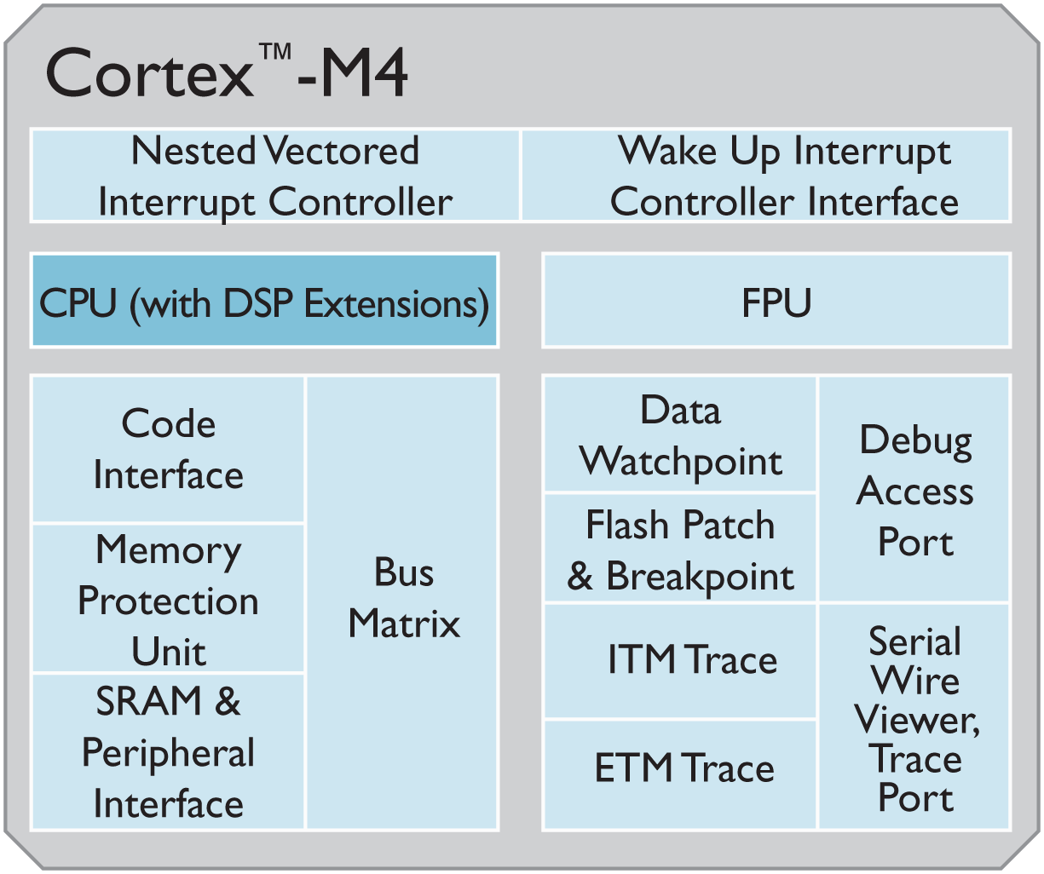
Freescale Kinetis MCU
Freescale IP:
On-chip cache for instructions and data
Crossbar switch for concurrent multi-master slave accessing
Memory protection unit
On-chip DMA for CPU off-load
Wake-up unit

Slide 14
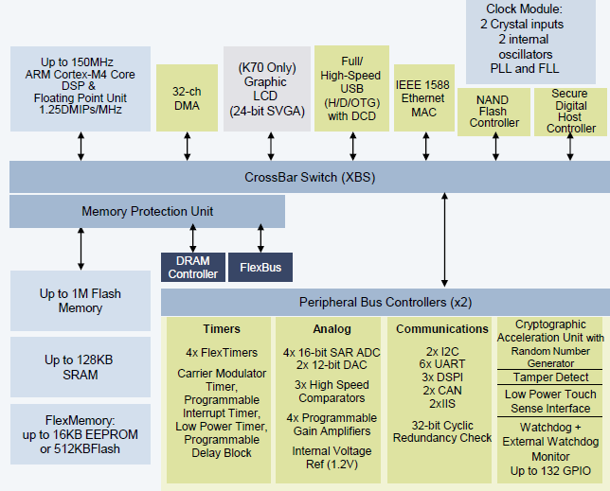
Kinetis K60/K70 Block Diagram

Slide 15
Outline
The Tower system and its major components
Introduction to MQX real-time operating system

Slide 16
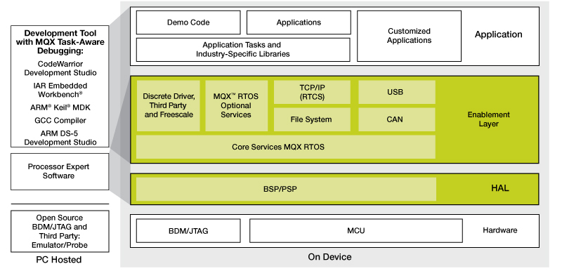
Software of the Tower System
MQX real-time operating system (RTOS)
CodeWorrier integrated development env. (IDE)

Slide 17
What is MQX?
Multi-threaded, priority-based RTOS provides
Task scheduling
Task management
Interrupt handling
Task synchronization: mutexes, semaphores, events, messages
Memory management
IO subsystems
Kernel logging
What are the differences among OS, embedded OS, and real-time OS?

Slide 18
General OS vs Embedded OS
General OS:
Applications are compiled separately from the OS
Embedded OS:
Application is compiled and linked together with the OS
Only part of OS (services or functions) that are needed to support the embedded system are linked in
(Dr Jimmy To, EIE, POLYU)

Slide 19
Characteristics of Embedded OS
Configurability
Device drivers often not integrated into kernel
Move device out of OS to tasks
For general OS, many devices are implicitly assumed to be presented, e.g., disk, network, audio, etc.
Protection is often optional
Embedded systems are typically designed for a single purpose, untested programs rarely loaded, and thus software is considered reliable
Privileged I/O instructions not necessary and tasks can do their own I/O instead of OS calls

Slide 20
Characteristics of Embedded OS
Interrupts not restricted to OS
As applications are considered trustworthy, allow more efficient control to let interrupts directly start or stop tasks, instead of going through OS services
Real-time capability (RTOS)
Allows multi-tasking
Scheduling of the tasks with priorities
Synchronization of the resource accesses
Inter-task communication
Time predictable
Fast interrupt handling

Slide 21
Requirements for RTOS
Predictability of timing
The timing behavior of the OS must be predictable
Execution time upper bound on all services of the OS
Scheduling policy must be deterministic
Period during which interrupts are disabled must be short to avoid unpredictable delays in processing critical events
OS should manage timing and scheduling
Should be aware of task deadlines
Should provide precise time services with high resolution
OS must be fast

Slide 22
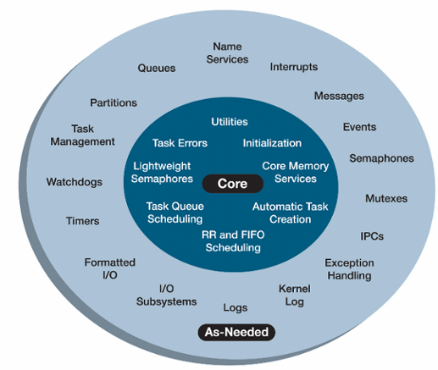
MQX Facilities
Required
Optional
MQX, RTCS, etc. are structured as a set of C files built by the user into a library that is linked into the same code space as the application. Libraries contain all functions but only called functions are included with the image.
Notes:
21
Note first that MQX is very configurable : referring to the diagram to the right, you can pick and choose the services from the outer ring as needed to fine tune the system. This component based architecture provides tunable scalability by choosing components and services required for your applications. Lightweight services also enable control of RAM and ROM utilization to balance code size with performance requirements. Also, selecting the services that fits your design will help reduce the overhead of the system.
The standard release from Freescale enables the majority of the features to showcase the capabilities of MQX as can been in the out of box labs. However, a user can edit configure files base on application needs creating a smaller footprint or faster solution.
This scalability is ideal for enabling an RTOS on a variety of processor classes, from 8-bit microcontrollers to microprocessors clocked at hundreds of megahertz.

Slide 23
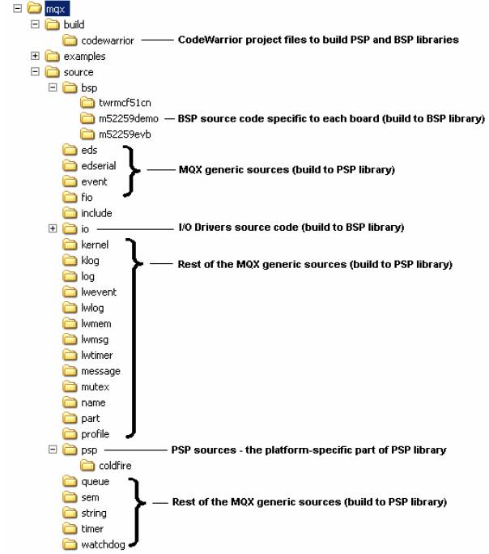
Getting MQX
Download from www.freescale.com/mqx
mqx directory:
build
examples
source
bsp
io
psp
MQX API

Slide 24
MQX Tasks
Applications running on MQX are built around tasks → a system consists of multiple tasks
Tasks are like threads and take turns running
Only one task is active (has the processor) at any given time
MQX manages how the tasks share the processor (scheduling and context switching)
Task context
Data structure stored for each task, including registers and a list of owned resources
Notes:
You have a software problem you’re trying to solve, and so you break it down into chunks, which are called tasks. An RTOS system consists of one or more tasks that work together to solve a larger problem.
The tasks takes turns running, as only one task, called the active task, has the processor at any one time. The RTOS then uses what is called a scheduler to determine how those tasks share the processor. And when a new task takes control of the processor, that’s called a context switch.
By performing many context switches quickly, you can create the illusion of concurrency. However only task is active at a time.

Slide 25
“Hello World” on MQX
#include <mqx.h> #include <bsp.h> #include <fio.h> #define HELLO_TASK 5 /* Task IDs */ extern void hello_task(uint_32); const TASK_TEMPLATE_STRUCT MQX_template_list[] = { /* Task Index, Function, Stack, Priority, Name, Attributes, Parameters, Time Slice */ {HELLO_TASK, hello_task, 1500, 8, "hello", MQX_AUTO_START_TASK, 0, 0 }, { 0 } }; void hello_task(uint_32 initial_data){ printf("Hello World\n"); _task_block(); // block the task }
Notes:
24
The hello_task is an autostart task. So, at initialization, MQX creates one instance of the task with a
creation parameter of zero. The application defines the task template index (HELLO_TASK). The task is of
priority 8. The function hello_task() is the code-entry point for the task. The stack size is 0x1500
single-addressable units.
24

Slide 26
“Hello World” Explained
There is no main() defined
main()in mqx\source\bsp\twrk60d100m\mqx_main.c
_mqx()starts MQX and initializes it according to the MQX initialization structure (with MQX_template_list as a member) defined in mqx_init.c
int main(void) { extern const MQX_INITIALIZATION_STRUCT MQX_init_struct; /* Start MQX */ _mqx( (MQX_INITIALIZATION_STRUCT_PTR) &MQX_init_struct ); return 0; }

Slide 27
“Hello World” Explained
A task is a unique instance of a task template
Can have multiple tasks from same template, and each has its own instance
Each task has a unique 32-bit task ID used by MQX
Automatic clean up of resources when terminates
Tasks are managed by MQX_template_list, an array of task templates for creating tasks
Terminated by a zero-filled task template

Slide 28
“Hello World” Explained
A task template contains these fields:
_mqx_uint TASK_TEMPLATE_INDEX
void (_CODE_PTR_)(uint_32) TASK_ADDRESS
_mem_size TASK_STACKSIZE
_mqx_uint TASK_PRIORITY
char _PTR_TASK_NAME
_mqx_uint TASK_ATTRIBUTES
uint_32 CREATION_PARAMETER
_mqx_uint DEFAULT_TIME_SLICE
TASK_TEMPLATE_STRUCT defined in mqx\source\include\mqx.h

Slide 29
MQX_template_list Examples
{ MAIN_TASK, world_task, 0x3000, 9, "world_task", MQX_AUTO_START_TASK, 0L, 0},
{ HELLO, hello_task, 0x1000, 8, "hello_task", MQX_TIME_SLICE_TASK, 0L, 100},
{ LED, float_task, 0x2000, 10, "Float_task", MQX_AUTO_START_TASK | MQX_FLOATING_POINT_TASK, 0L, 0},
Notes:
world_task
The world_task is an autostart task. So, at initialization, MQX creates one instance of the task with a
creation parameter of zero. The application defines the task template index (MAIN_TASK). The task is of
priority 9. The function world_task() is the code-entry point for the task. The stack size is 0x3000
single-addressable units.
hello_task
The hello_task task is a time-slice task with a time slice of 100, in milliseconds, if the default compile-time
configuration options are used.
Float_task
The Float_task task is both a floating-point task and an autostart task.

Slide 30
More on Task Attributes
Any combination of the following attributes can be assigned to a task:
Autostart: When MQX starts, it creates one instance of the task.
DSP: MQX saves the DSP co-processor registers as part of the task’s context.
Floating point: MQX saves floating-point registers as part of the task’s context.
Time slice: MQX uses round robin scheduling for the task (the default is FIFO scheduling).

Slide 31
Related URL
www.freescale.com/tower
community.freescale.com/community/tower
www.freescale.com/mqx
Notes:
30
30

