Slide 1
More Inheritance and LSP
CS340100, NTHU
Yoshi

Slide 2
More about Inheritance
Reuse?
Q1: 你有沒有程式”砍掉重練”的經驗?
Q2: 你有沒有”再造輪子”的經驗?
class Rectangle
Firstly, we only have this design, and the system was developed
class Square
Then, we have the requirement of Square, and we wrote a class Square
Square “IS A” kind of rectangle

Slide 3
Class Rectangle
class Rectangle { double width; double height; public double getHeight() { return height; } public void setHeight(double height) { this.height = height; } public double getWidth() { return width; } public void setWidth(double width) { this.width = width; } }

Slide 4
Class Square
class Square extends Rectangle { public void setHeight(double height) { super.setHeight(height); super.setWidth(height); } public void setWidth(double width) { super.setHeight(width); super.setWidth(width); } }

Slide 5
For Instance…
void g(Rectangle r) { r.setWidth(5); r.setHeight(4); if (r.getWidth() * r.getHeight() != 20) { throw new RuntimeException(); } }
//some other place
Rectangle square = new Square();
g(square);

Slide 6
Liskov Substitution Principle (LSP)
Functions that use pointers or references to base classes must be able to use objects of derived classes without knowing it
Very difficult problem!!
Further study: OOAD
Software design principals
Please google it if you are interested in it
One of the principals
Prefer Composition over inheritance
Why? Can you give an example?

Slide 7
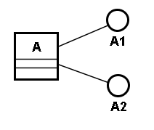
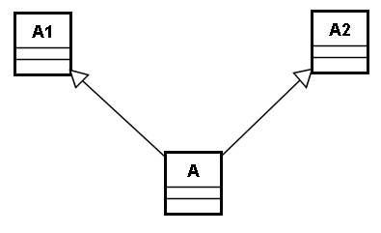
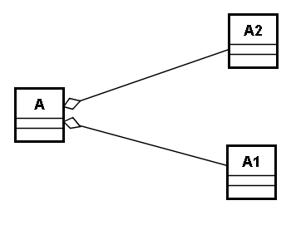
Delegation
Inheritance
Aggregation

