Slide 1
Before class…
下禮拜一交Proposal
  至多四人一組, 同組同分
  請勿超過一張A4
評分標準
創意
完整性
技術難度
User-defined
實用性

Slide 2
Swing
(Controller)
Yoshi

Slide 3
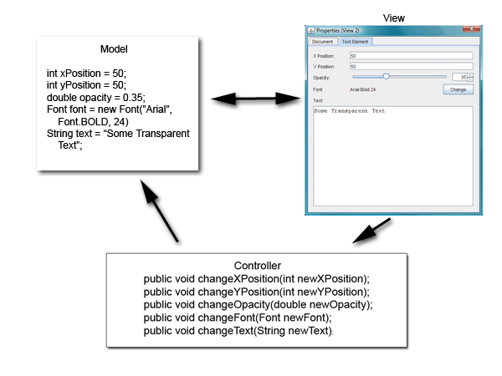
MVC

Slide 4
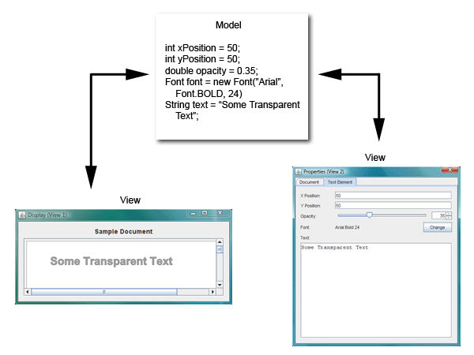
Multiple Views

Slide 5
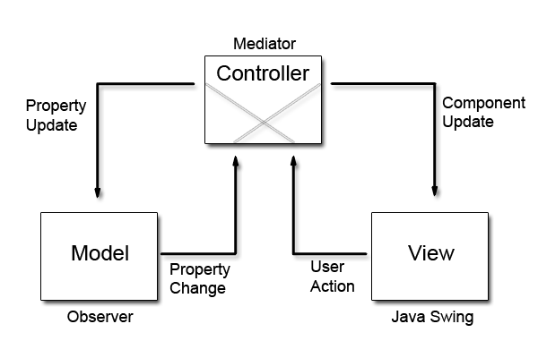
Another Perspective

Slide 6
Writing Event Handlers
Inner class
A separate controller

Slide 7
ActionListener
The listener interface for receiving action events
When the action event occurs, that object's actionPerformed method is invoked.
  Callback function
  jButton.addActionListener(listener);

Slide 8
Implementing ActionListener
View
View
View
Controller
Controller
Controller
Inner classes
Act as an ActionListener
Split view & controller

Slide 9
Threads in a Swing Program
Initial threads
  The threads that execute initial application code.
Event dispatch thread
  All event-handling code is executed. Most code that interacts with the Swing framework must also execute on this thread.
Worker threads
  Also known as background threads, where time-consuming background tasks are executed.

Slide 10
Event Dispatch Thread
It's useful to think of the code running on the event dispatch thread as a series of short tasks
  Most tasks are invocations of event-handling methods, such as ActionListener.actionPerformed.
Other tasks can be scheduled by application code, using invokeLater or invokeAndWait.
Tasks on the event dispatch thread must finish quickly
  If they don't, unhandled events back up and the user interface becomes unresponsive.

Slide 11
Responsiveness
Imaging that we have a GUI program, and we want to load a big image file on the screen
  If the graphic files are loaded from an initial thread, there may be a delay before the GUI appears
  If the graphic files are loaded from the event dispatch thread, the GUI may be temporarily unresponsive
So what can we do?

Slide 12
Solution
Thread
SwingWorker
  When a Swing program needs to execute a long-running task, it usually uses one of the worker threads, also known as the background threads.
    javax.swing.SwingWorker (abstract class)
    Since JDK 1.6

Slide 13
Thread-safe UI
Most code that invokes Swing methods also runs on event dispatch thread
Most Swing object methods are not "thread safe": invoking them from multiple threads risks thread interference or memory consistency errors.
Some Swing component methods "thread safe"
  Such as JTextArea
  Thread-safe UI can be safely invoked from any thread.
All other Swing component methods must be invoked from the event dispatch thread.
  Programs that ignore this rule may function correctly most of the time, but are subject to unpredictable errors that are difficult to reproduce.

Slide 14
Pitfalls
Place time-consuming tasks in ActionListener.actionPerformed
Queue updates for UI in ActionListener.actionPerformed
Update non-thread-safe components outside the event-dispatching thread

Slide 15
Let’s Write a Notepad
NOW!

