Slide 1
Java I/O and Java Networking (Client Side)
Yoshi

Slide 2
Outline
Basic concepts
InputStream/OutputStream
  Conversion and casting
IOException
Stream Redirection
Reader/Writer
Design in Reader/Writer
Socket

Slide 3
What is a Stream
Sequential, undetermined or undecided length of bits, such as
  System.in
  System.out
Stream redirection
  java MessageServer < data.txt

Slide 4
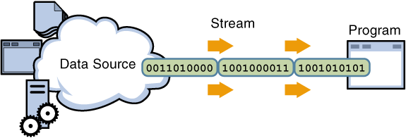
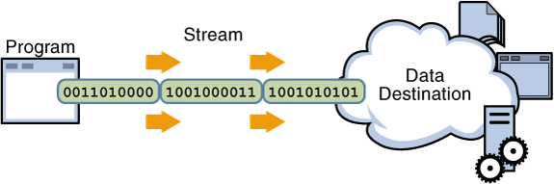
Stream Concept
Input Stream
Output Stream

Slide 5
java.io.InputStream/OutputStream
BufferedInputStream
ByteArrayInputStream
DataInputStream
FileInputStream
FilterInputStream
ObjectInputStream
PipedInputStream
PushbackInputStream
SequenceInputStream
StringBufferedInputStream
LineNumberInputStream
BufferedOutputStream
ByteArrayOutputStream
DataOutputStream
FileOutputStream
FilterOutputStream
ObjectOutputStream
PipedOutputStream
PrintStream

Slide 6
PrintStream
Deprecated in Java 1.1
  Expected to be replaced by PrintWriter
Come back in Java 2
  Note that System.out is an instance of PrintStream

Slide 7
Default Types
Integer number – int
  byte b = 42; //OK
  int i=42; byte = i; //wrong
  int i=42; byte = (byte) i; //OK
  byte = 1 + 2; //wrong
  byte b1=1, b2=2; byte b3 = b1+b2; //wrong
Floating number – double
  Similar as above

Slide 8
Conversion and Casting
For primitive types
  Conversion
    Narrow to wide
  Casting
    Wide to narrow, so information may be lost
    int i=128;
    byte b = (byte) i; //what is b?
Note that all the numeric types are signed

Slide 9
IOException
IOException is everywhere!
  Note that it is a checked exception
    We need to try/catch it
But in PrintStream/PrintWriter…
  Exceptions are hided
    public boolean checkError()

Slide 10
Something strange?
java.io.InputStream
  public abstract int read() throws IOException
java.io.OutputStream
  public abstract void write(int b) throws IOException

Slide 11
Something strange? (2)
byte
  -128 ~ +127
  -1 implies end of stream
http://gaznjang.blogspot.com/2007/06/java-io-stream-read-write.html
You can also find it in O’Reilly Java I/O

Slide 12
Stream Redirection
Recall that
    java MessageServer < data.txt
System.setOut
  System.setOut(new PrintStream(new FileOutputStream(“output.txt”)));
System.setIn
  System.setIn(new FileInputStream(“input.txt”));

Slide 13
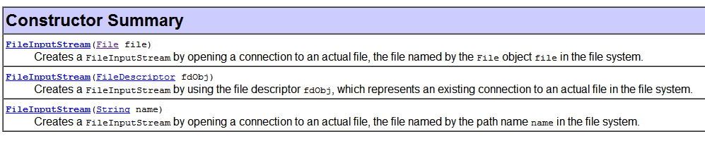
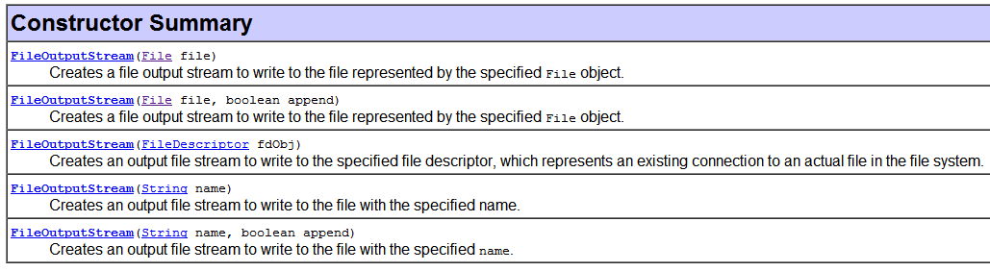
File Operations
FileInputStream
FileOutputStream

Slide 14
Stream with Unicode
int b1 = in.read();
int b2 = in.read();
char c = (char) (b1*256 + b2);
Difficult to handle
  That is why Java introduced Reader/Writer in Java 1.1

Slide 15
Character Stream
The Java platform stores character values using Unicode conventions
Character stream I/O automatically translates this internal format to and from the local character set.
Character streams are often wrappers for byte streams.
The character stream uses the byte stream to perform the physical I/O, while the character stream handles translation between characters and bytes.

Slide 16
Reader/Writer
BufferedReader
CharArrayReader
FileReader
FilterReader
InputStreamReader
PipedReader
StringReader
PushbackReader
LinedNumberReader
BufferedWriter
CharArrayWriter
FileWriter
FilterWriter
OutputStreamWriter
PipedWriter
StringWriter
PrintWriter

Slide 17
File Operations
InputStreamReader
  A bridge from byte streams to character streams: It reads bytes and decodes them into characters using a specified charset
    FileInputStream fin = new FileInputStream(“input.txt”);
    InputStreamReader isr = new InputStreamReader(fin, “Big5”);
OutputStreamWriter
  Similar as above
    FileOutputStream fos = new FileOutputStream(“output.txt”);
    OutputStreamWriter osw = new OutputStreamWriter(fos,”Big5”);

Slide 18
FileReader/FileWriter
FileWriter fw = new FIleWriter(“output.txt”);
FileReader fr = new FIleReader(“input.txt”);
Default charset
Just for convenience

Slide 19
Line-Oriented Reader/Writer
public class CopyLines {
public static void main(String[] args) throws IOException {
BufferedReader inputReader = null;
PrintWriter outputWriter = null;
inputReader = new BufferedReader(new FileReader(“input.txt"));
outputWriter = new PrintWriter(new FileWriter("output.txt"));
String line;
while ((line = inputReader.readLine()) != null) {
outputWriter.println(line);
}
inputReader.close();
outputWriter.close();
}
}

Slide 20
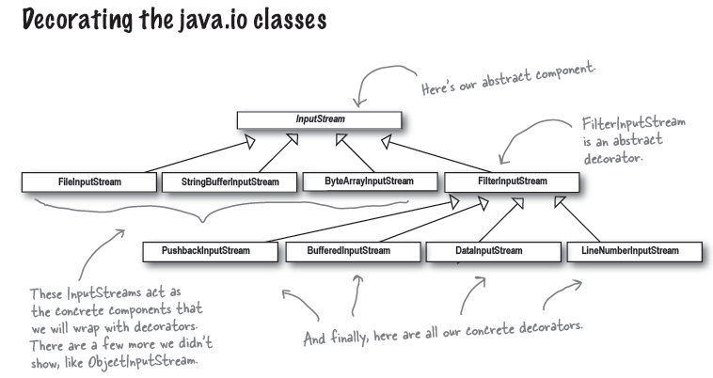
Recall that…

Slide 21
Recall that…and Questions?
Do Reader/Writer have the same design?
  java.io.FilterReader
  java.io.FilterWriter
Reader
InputStreamReader
BufferedReader
FilterReader

Slide 22
No Explanation
In Thinking in Java, Chapter 11
  It mentioned that BufferedReader is not a subclass of FilterReader, but no explanation
In O’Reilly Java I/O, no explanation
Anyone can answer me?

Slide 23
Let’s trace BufferedInputStream
http://www.docjar.com/html/api/java/io/BufferedInputStream.java.html

Slide 24
java.net.Socket
This class implements client sockets (also called just "sockets").
A socket is an endpoint for communication between two machines.
Very similar to local I/O operations

Slide 25
Retrieve Yahoo! Homepage
import java.io.*;
import java.net.*;
public class RetrieveWeb {
public RetrieveWeb(String host, int port) throws IOException {
Socket socket = new Socket(host, port);
InputStream in = socket.getInputStream();
BufferedReader reader = new BufferedReader(
new InputStreamReader(in, "UTF8"));
OutputStream out = socket.getOutputStream();
PrintWriter pw = new PrintWriter(new OutputStreamWriter(out));
pw.println("GET /");
pw.flush();
String line="";
while( (line=reader.readLine()) != null) {
System.out.println(line);

Slide 26
Retrieve Yahoo! Homepage
}
reader.close();
pw.close();
}
public static void main(String[] args) throws IOException {
//delete the following three lines to make this program general
args = new String[2];
args[0] = "tw.yahoo.com";
args[1] = "80";
int port = Integer.parseInt(args[1]);
RetrieveWeb obj = new RetrieveWeb(args[0], port);
}
}

Slide 27
Exercise
Trace java.io.BufferedReader
  http://www.docjar.com/html/api/java/io/BufferedReader.java.html
Write a program to connect to hulabear.twbbs.org:23

