Slide 1
Java Lab1

Slide 2
Preface
The goal of this lab is to calculate and compare the area of Circle, Rectangle and Square
In this lab, you need to write 5 classes: AreaCalculator, Shape, Circle, Rectangle and Square as the UML shows

Slide 3
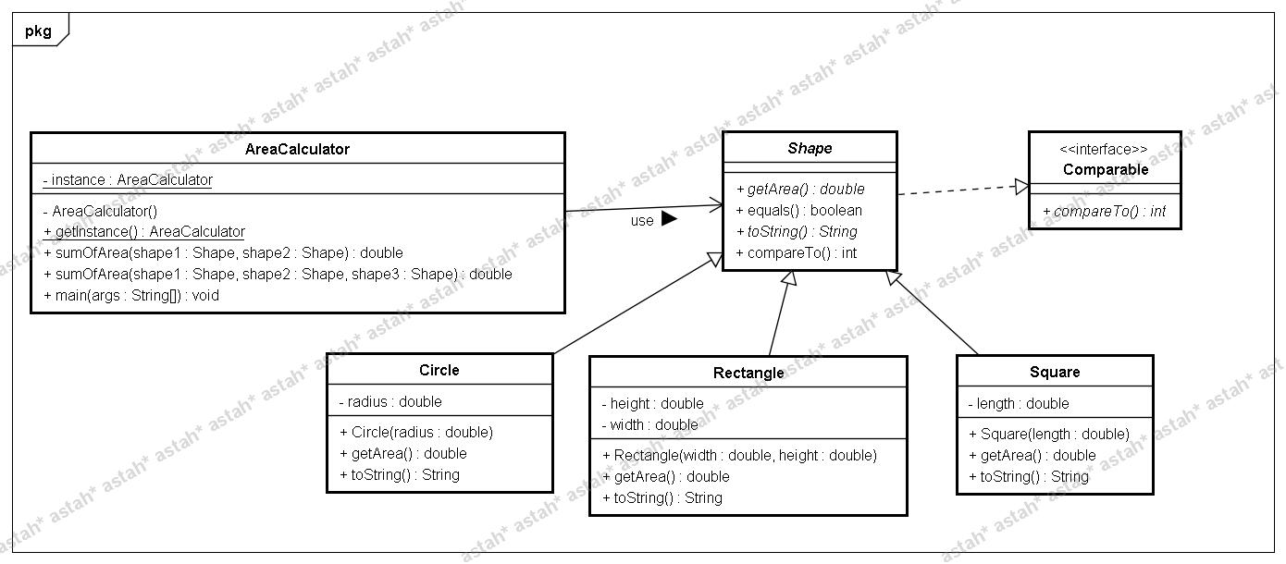
UML

Slide 4
Homework Requirements
Class Shape
  is an abstract class and implements interface Comparable.
  includes abstract methods getArea() and toString and overridden methods equals() and implement compareTo().
  equals()
    if the two shapes have the same area, they are equal
    use getArea() to identify whether the two shapes have the same area in equals().
  compareTo()
    if A’s area is large than B’s area, A is greater than B
    use getArea()

Slide 5
Homework Requirements
Circle, Rectangle & Square
  The three classes need to extend Shape and implement getArea() and toString().
  toString()
    return the string like “I am Square and the area is 100.”

Slide 6
Homework Requirements
AreaCalculator
  The goal of AreaCalculator is used to calculate and compare the area of shapes.
  overload methods sumOfArea() to add the area of two shapes and three shapes.
    sumOfArea(Shape s1,Shape s2),
    sumOfArea(Shape s1,Shape s2,Shape s3)
  sort shapes by the area
    use java.util.Arrays.sort(shapes) to sort the shapes
  use Singleton pattern
    Refer to attached file

Slide 7
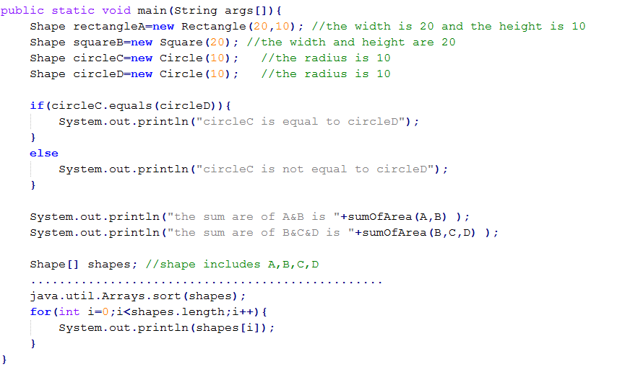
Homework Requirements
The partial content of main method, but it is not completed

Slide 8
Note
Please use package
  Package name is cs340100.lab1 (if you don’t use package, 20 points deduction)
Please pack all the files into a StudentID_lab1_version.zip
  Ex: 9862101_lab1_v1.zip
Deadline: 2010/04/08
Mail to CS340100@gmail.com

