Slide 1
Cloud Computing
Cloud Network
Che-Rung Lee

Slide 2
Outline
Ｎetwork overview
Data center network
Network virtualization

Slide 3
Protocol Stack
Layer 4: Transport layer
Flow control, reliability, connection
Ex: TCP, UDP
Layer 3: Network layer
Routing
Ex: IP
Layer 2: Data link layer
Media access control
Ex: Ethernet MAC, PPP

Slide 4
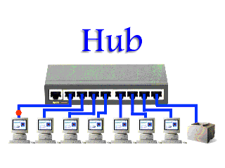
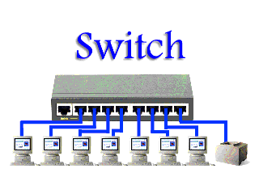
Ethernet
A computer networking technology for local area networks (LANs)
Introduced in 1980. (CSMA/CD)
Standardized in IEEE 802.3
Shared media protocol
Media: coaxial cable, twisted pair, and fiber optic
Equipment: repeater, hub, bridge and switch

Slide 5
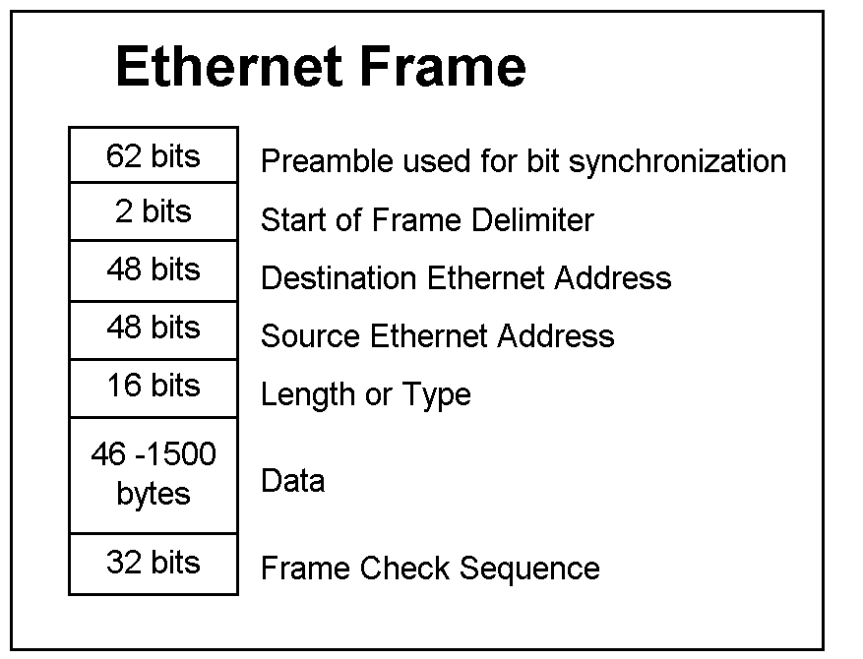
Ethernet Frame
Ethernet switches forward “Ethernet frames” based on the 6-byte MAC address
Ethernet Address
e.g., 0-0-0a-0b-de-3e
Assigned by Ethernet hardware vendors
No geographical or organizational association

Slide 6
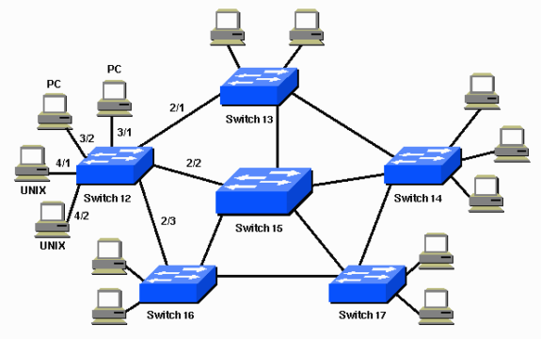
Switched Network
For a median or large LAN, multiple switches are connected as a graph
Problem: Broadcast Storm
Solution: spanning tree protocol

Slide 7
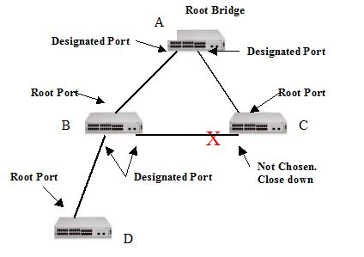
Spanning Tree Protocol
Select a root bridge (switch)
Each switch determines the least cost paths to the root bridge.
The port is called “root port”
Other non root ports are disabled

Slide 8
Link-state Routing Protocol
A routing protocol used in packet switching networks. Examples include OSPF and IS-IS.
Every node (switch) constructs a map of the connectivity to the network, in the form of a graph, showing which nodes are connected to which other nodes.
Each node (switch) independently calculates the next best logical path from it to every possible destination in the network.

Slide 9
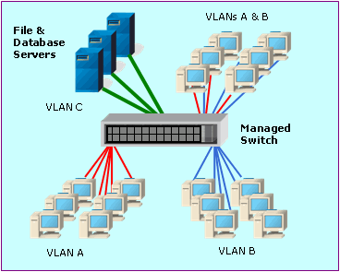
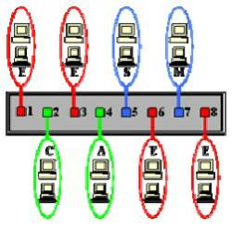
Virtual LAN (VLAN)
To reduce the amount of broadcast traffic, layer 2 switch can segment a LAN into Virtual LANs.
Members of a VLAN can only talk to other members of the same VLAN

Slide 10
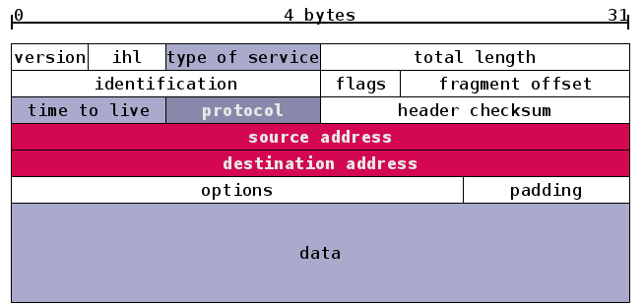
IP v4
IP routers forward “IP packets” based on the 4- byte IP address in the packet header
IP Address (e.g., 140.114.87.5)
Statically or dynamically assigned by ISPs
Geographical or organizational association
Use port number to distinct different applications (140.114.87.5:23)

Slide 11
Network Address Translation
32 bits IP address can only offer 4,294,967,296 unique addresses.
Network Address Translation (NAT) creates new private IP addresses within a LAN
Ex: Each computer on the private network is translated to the same IP address (213.18.123.100), but with a different port number assignment.

Slide 12
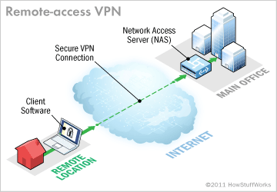
Virtual Private Network (VPN)
A private network that uses a public network to connect remote sites or users together.
Two major components
Network Access Server (NAS)
Client software
Tunneling: place a package within another package

Slide 13
Outline
Ｎetwork overview
Data center network
Network virtualization

Slide 14
Data Center Architecture

Slide 15
Conventional DC Network
Core
Aggregation
Edge

Slide 16
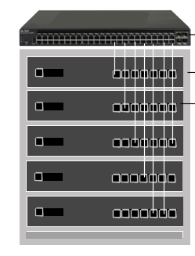
Rack Machines
General configurations
Each rack contains 40 machines interconnected by a top of rack (ToR) switch
A standard ToR switch contains 48 GigE ports and up to 4 available 10 GigE uplinks.
Links from ToRs: Typically 1:5 to 1:20 oversubscribed (i.e., 1 to 4 Gbpsof up-link for 20 servers)

Slide 17
Requirements of Cloud Network
Mult-tenancy
Multiple virtual data centers share a single physical data center
Any server can be assigned to any service with whatever IP address the service expects
Features like link-local broadcast, on which many legacy applications depend, should work.
Virtual machines should be able to migrate to any server while keeping the same IP address

Slide 18
Additional Requirements
Uniform high capacity:
The maximum rate of a server-to-server traffic flow should be independent of network topology.
Performance and fault isolation:
Traffic of one service should not be affected by the traffic of any other service, just as if each service was connected by a separate physical switch.
Using low cost commodity network equipment only

Slide 19
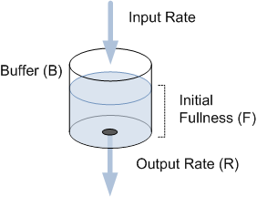
Traffic Shaping
The control of computer network traffic in order to optimize or guarantee performance
Average bandwidth
Peak bandwidth
Burst size
Load balancing policies
Ex: Leaky bucket
To check that data transmissions conform to defined limits on bandwidth and burstiness.

Slide 20
Problems of Existing Networks
LAN (layer-2 network) is not scalable and it does not allow multiple paths
IP-based network (layer 3) is scalable, but machines cannot be tied to IP addresses.
Any VM may migrate to any physical machine.
Migrating VMs should not have to change their IP addresses and all pre-existing TCP.

Slide 21
Multi-path
For (1) fault tolerance, (2) bandwidth, or (3) improved security.
Overlapped, edge-disjointed or node-disjointed
Within a layer-2 domain, the Spanning Tree Protocol causes only a single path to be used even multiple paths between switches exist.
In the layer-3 portion, Equal Cost Multipath can use multiple paths to a destination if paths of the same cost are available.

Slide 22
ECMP
Multipath routing is a per-hop decision which is limited to a single router.
Increase usable bandwidth
Performance is susceptible to changing latency, packet reordering, etc.
Equal-Cost Multi-Path routing is a routing strategy when multiple “best pathes” are available.
One way is using hashing function to selection the routing.

Slide 23
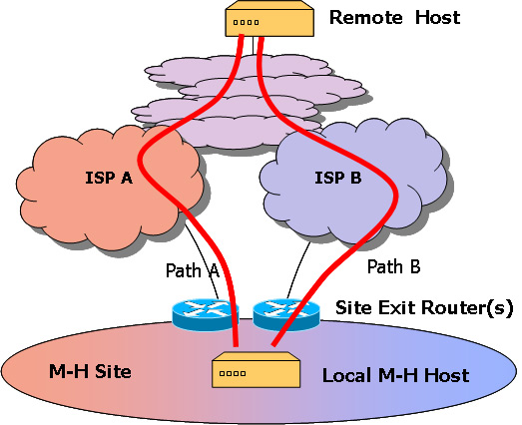
Multihoming
Multihoming: multipath provided by different ISPs
To increase the reliability of the Internet connection for an IP network.

Slide 24
Outline
Ｎetwork overview
Data center network
Network virtualization

Slide 25
What Are Not Virtualized Yet?
Current network protocol stack makes network virtualization easy.
However, some issues need be solved
Networks of VMs within a Hypervisor
Virtual network across WAN
Some network devices, such as Infiniband
In addition, for scalability and performance consideration, some virtualization techniques need be improved.

Slide 26
Scenario 1
Multiple LAN within a physical machine and/or across multiple physical machines.
PM 1
PM 2
VM1
LAN1
VM2
LAN1
VM3
LAN2
VM4
LAN1
VM5
LAN2
VM6
LAN2
Virtual switch 1
Virtual switch 2
Virtual switch 3
Physical switch

Slide 27
Scenario 2
Multiple VLAN within a switched based network.
LAN2
LAN2
LAN1
Switch 2
LAN1
LAN2
Switch 3
Switch 1
LAN1
LAN2
LAN1

Slide 28
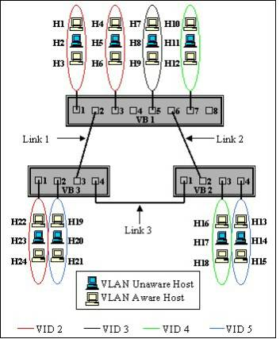
VLAN Tagging (IEEE 802.1Q)
The VLAN tag is of 2 bytes in length
The first 3 bits indicate user priority.
A canonical format indicator (CFI) bit indicates the MAC format.
The last 12 bits of the tag is for a VLAN identifier (VID), which means 4096 VLANs can coexist.

Slide 29
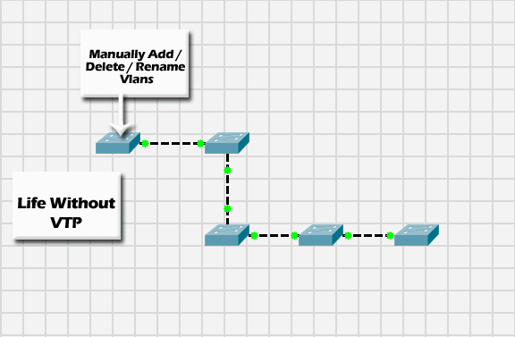
VLAN Trunking Protocol

Slide 30
Scenario 3
A VLAN across WAN
Why VPN is not enough?
How about VM migration?
Internet
Gateway
Gateway

Slide 31
References
Wikipedia
Multipath, VLAN tagging and trunking,
Photos are from the Internet
Dr Tzi-cker Chiueh‘s talk
Network Design Issues for Cloud Data Centers (2011-11-02 at NTHU)
Dr H. T. Hung’s talks
http://research.microsoft.com/apps/pubs/default.aspx?id=80693
http://ccr.sigcomm.org/online/?q=node/503
http://ccr.sigcomm.org/online/?q=node/501

