Slide 1
Cloud Computing
Network Virtualization
Che-Rung Lee

Slide 2
Outline
Virtual switch
IP v6 and Cloud

Slide 3
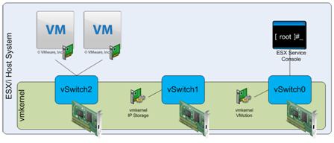
Virtual Switch
A Virtual Switch (vSwitch) is a layer 2 software that runs on hypervisor and is responsible for providing all network-based communications.
Networking components connect to vSwitches via Port Groups

Slide 4
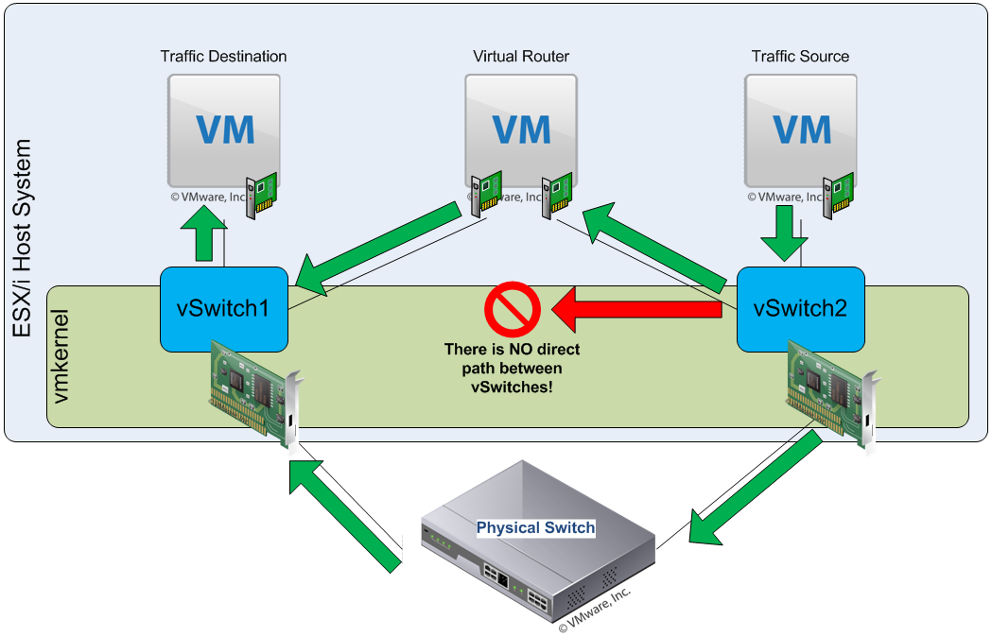
Communication between VMs
No Direct Connection between vSwitches

Slide 5
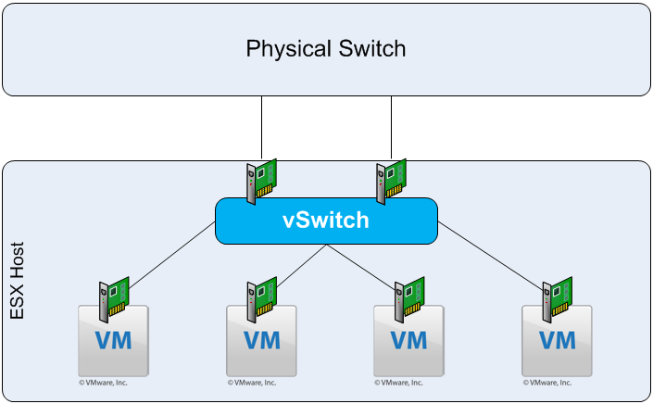
Fault Tolerance
Fault tolerance by vSwitch

Slide 6
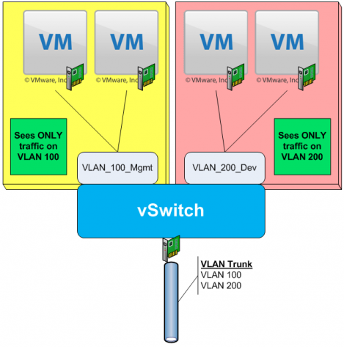
Traffic Isolation
vNICs share a port group on a vSwitch have the same network configurations, including security, traffic shaping, etc.
A vNIC can only see the traffic on vSwitch of the same port group.

Slide 7
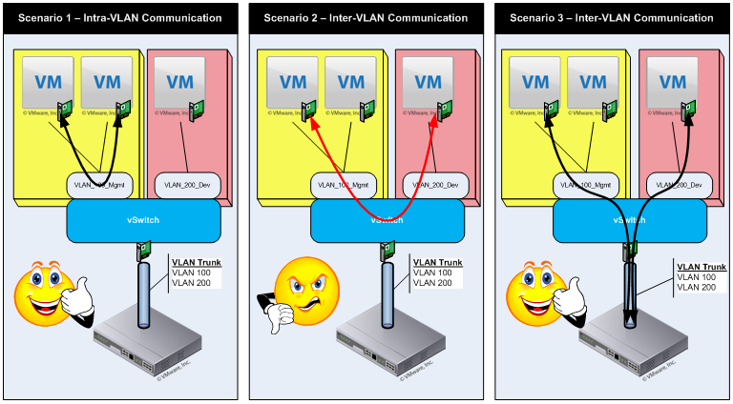
VM Communication

Slide 8
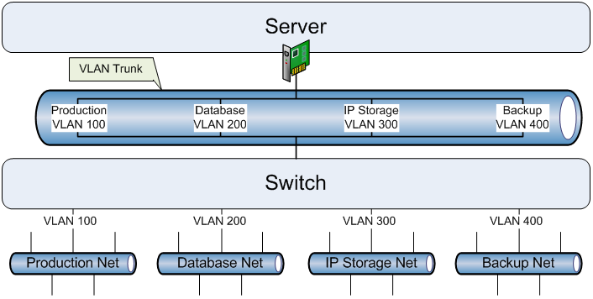
VLAN Trunking
A trunk is a single channel between two points
VLAN trunking = VLAN multiplexing

Slide 9
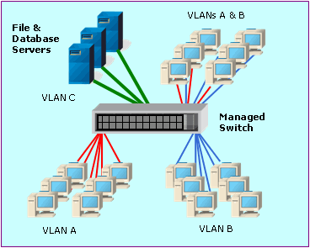
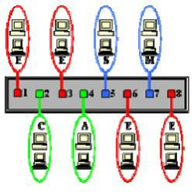
VLAN Tagging
To reduce the amount of broadcast traffic, layer 2 switch can segment a LAN into Virtual LANs.
Members of a VLAN can only talk to other members of the same VLAN

Slide 10
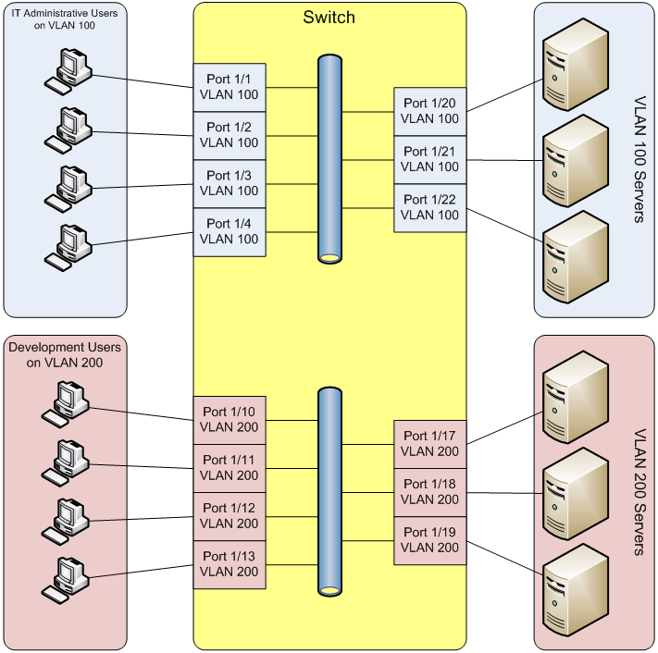
Example of VLAN Switch
Single physical switch, multiple logical netowrks.

Slide 11
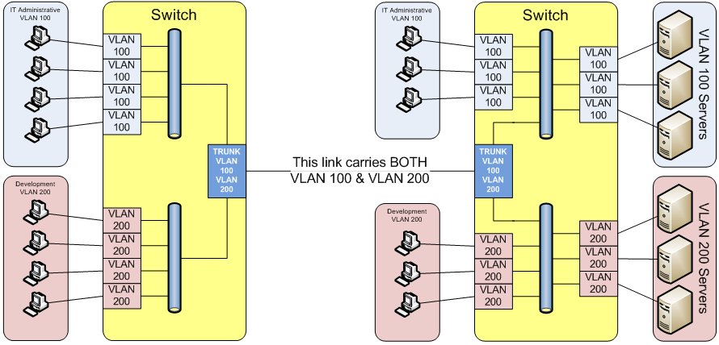
VLAN Trunking Example

Slide 12
VLAN Tagging in vSwitch
vSwitch has three modes to implement VLAN tagging
Virtual Guest Tagging (VGT) Mode – network packets are passed through the vSwitch to the guest OS.
External Switch Tagging (EST) Mode –VLAN tags are applied and removed on the physical switch port.
Virtual Switch Tagging (VST) Mode –VLAN tags are processed by the vSwitch.
EST and VST modes need physical switch support VLAN tagging processing.

Slide 13
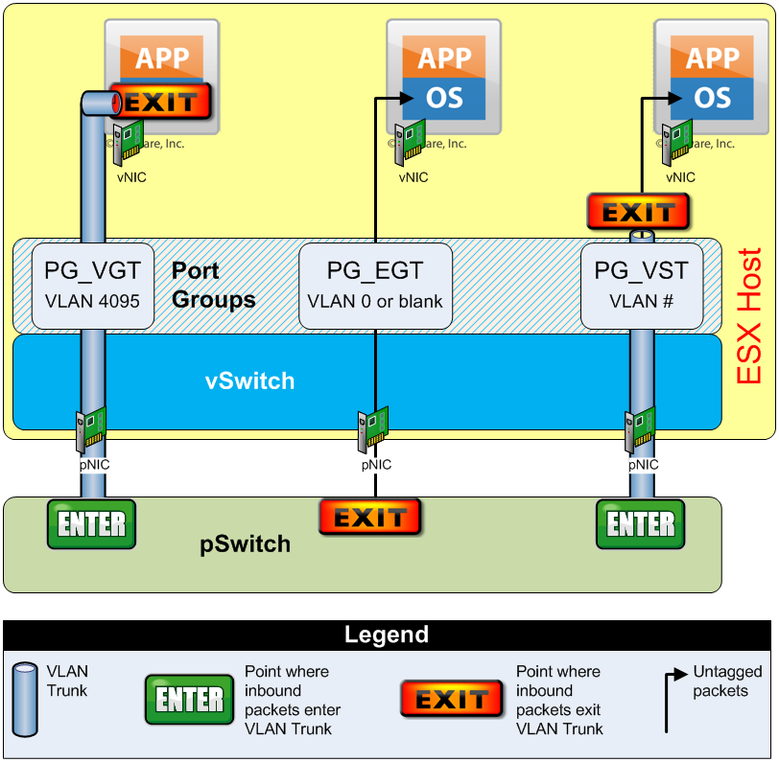
vSwitch Trunking Modes
Virtual Guest Tagging (VGT)
External Switch Tagging (EST)
Virtual Switch Tagging (VST)

Slide 14
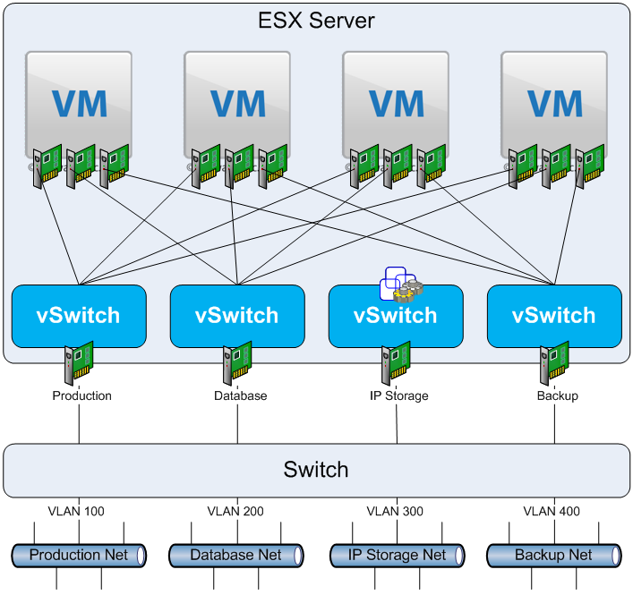
Multiple VMs, Multiple Networks

Slide 15
Traffic Shaping Configuration
Three parameters to control traffic shaping
Average Bandwidth: This is the “guaranteed” data rate that you want to set for data transmission.
Peak Bandwidth: This is the absolute ceiling data rate that the vSwitch will transmit data at.
Burst Size: The burst size is specified as the number of bytes that can be sent each time the vSwitch “bursts” above the Average Bandwidth.

Slide 16
Outline
Virtual switch
IPv6 and Cloud

Slide 17
IPv6
IPv6 is version 6 of the Internet Protocol (IP), which uses 128 bits for the address (3.4*10³⁸).
Advantages over IPv4
A lot more IP addresses
Can avoid NAT (more transparent P2P transmission)
Stateless address autoconfiguration (replace DHCP)
Fixed host identification (MAC address 64 bits)
Enhance the multicast ability (no explicit broadcast)
Support network mobility: allows entire subnets to move to a new router without renumbering.

Slide 18
NAT Problems
Overhead of unnecessary translation
Protocol incompatibilities (E.g. Ipsec)
Breaks peer-to-peer applications
Instant messaging, Interactive games, VoIP, …
Limits implementation of application servers
Web-services distribution
Grid computing

Slide 19
Mobile IP
Foreign Network
Data Flow
Mobile IP Tunnel
Reference [3]
Triangular routing
Binding Update
Home Agent
Home Network
Correspondent Node

Slide 20
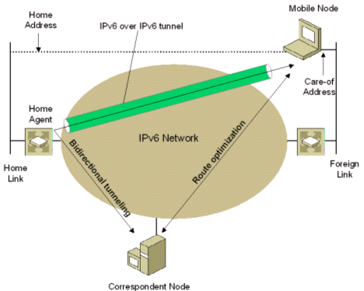
IPv6 Mobility Support
Binding: the association of a home address and a care-of address.
Two methods
Bidirectional Tunneling
Route Optimization
The communication between mobile node and correspondent node can be direct without going through the home agent.
Notes:
The home address is the IPv6 address within the home link prefix of a mobile node (MN).
Every node communicating with a mobile node is called a correspondent node (CN). Mobile nodes can also send registrations to the correspondent node directly (called a correspondent registration). A correspondent node can also be a mobile node.

Slide 21
Bidirectional Tunneling
Just like the mobile IPv4
Packets from the correspondent node are sent to the home agent, which encapsulates them in IPv6 and sends them to the foreign address of the mobile node.
Packets from the mobile node are sent through the reverse tunnel to the home agent that forwards them to the correspondent node through regular routing mechanisms.

Slide 22
Route Optimization
When moving to a new location, the mobile node will register its foreign address to home agent and correspondent node
The mobile node uses the Home Address option when sending packets to the correspondent node.
The correspondent node uses routing header type 2 when sending packets to the mobile node.
It contains both home address and care-of address.

Slide 23
Home Address Option
When a mobile node wants to use the care-of address as the source, it can add the home address option., which is carried by the destination options header.
Advantages:
No packets encapsulation and triangle tunneling
Movement are transparent to the transport layer
Multicast by mobile node is simpler.

Slide 24
References
The Great vSwitch Debate by Ken Cline http://kensvirtualreality.wordpress.com/2009/03/29/the-great-vswitch-debate-part-1/
Wikipedia and the Internet
Optimizing Cloud Computing with IPv6, http://www.slideshare.net/rhoton/optimizing-cloud-computing-with-ipv6-1606392
RFC 3963 http://tools.ietf.org/html/rfc3963
IPv6 Essentials http://flylib.com/books/en/1.88.1.96/6/

