Slide 1
Cloud Computing
Data Center Network
Che-Rung Lee

Slide 2
Outline
Network topologies
Fat tree and clos network
Hypercube and Mobius cube
Mesh and torus
Addressing and routing
Pseudo MAC

Slide 3
Network Topology
Properties of data center network
Flow control (load balance)
Fast failover
Scalability
Backward compatibility
Easy for virtualization
Solution
Level 2 network
Redundant links (multipath)
Use commodity switches

Slide 4
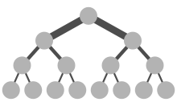
Fat Tree
The routing in a tree structure is single path static routing.
The traffic in the top links of a tree is heavier than that of the bottom links.
A fat tree is a tree structure network which has larger bandwidth for the top links and smaller bandwidth for the bottom links.

Slide 5
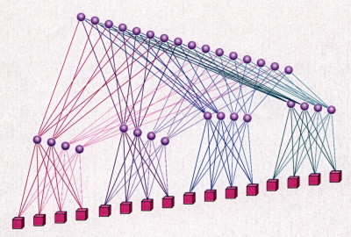
Fat Tree Implementation
Using heterogeneous networks
Using network of different bandwidth to construct a fat tree
Using homogeneous networks
Using same networks
Larger bandwidth can be interpreted as “more links”
An example is hypertree network.

Slide 6
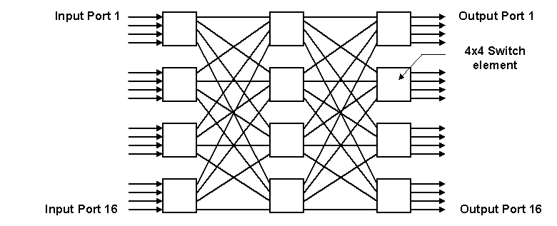
Clos Network
Clos is a multistage circuit switching network,
Formalized by Charles Clos in 1953
Example: 3 stage, 16 port Clos network
Each (input, output) has 4 paths

Slide 7
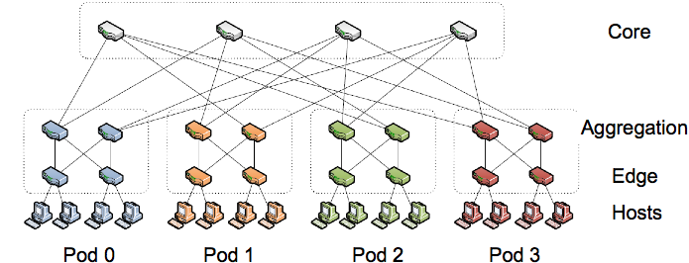
Fat Tree + Clos Network
Ex: 4-ary fat tree network
4 port switches: 2 for upper layer, 2 for lower layer
(4/2)² switches for core level

Slide 8
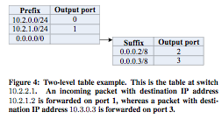
Addressing and Routing
Each physical node is assigned a fixed IP.
Since the routing table of commodity switches is small (64k), IPs are grouped in a hierarchical manor.
For load balance, the routing is also fixed
Two level routing table

Slide 9
Hypercube
1100
1110
1000
1010
0100
0110
0010
0000
0001
1101
1111
0101
0111
0011
1001
1011

Slide 10
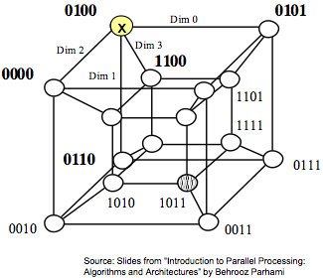
Neighbors of a Node in a Hypercube
Express a node by its binary representation x_{q-1}x_{q-2}…x₂x₁x₀.
Its neighbors are x_{q-1}x_{q-2}…x₂x₁x₀’
x_{q-1}x_{q-2}…x₂x₁’x₀
x_{q-1}x_{q-2}…x₂’x₁x₀
:
x_{q-1}’x_{q-2}…x₂x₁x₀

Slide 11
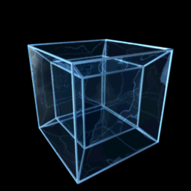
Routing on HyperCube
For a source A=a_{k}a_{k-1}…a₀ and a destination B=b_{k}b_{k-1}…b₀, a path can be constructed by alternating the a different bit.
The longest path is k+1.
Multipath
There are k+1 node-disjoint paths for given A and B.

Slide 12
B-Cube
Switch Based HyperCube
00
01
00
01
000
001
10
11
100
101
10
11
00
01
00
01
110
111
010
011
10
11
10
11

Slide 13
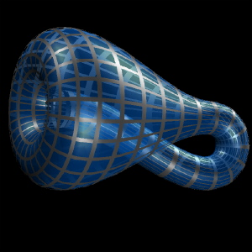
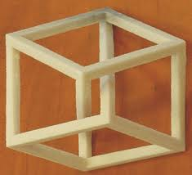
Mobius Cube
Mobius ring:
Mobius cube:

Slide 14
Mobius Cube as Network
The longest path can be half as that of hypercube
111
100
00
10
000
010
110
101
01
11
001
011

Slide 15
Definition of Mobius Cube
It has two types: type 0 and type 1.
For n=1, 0-M₁ and 1-M₁ are a complete 2 graph.
For n>=2, both types are constructed from one 0-M_{n-1} and one 1-M_{n-1}.
Let x = x_{n-1}x_{n-2}…x₁x₀ be a vertex of 0-M_{n-1}.
Let y = y_{n-1}y_{n-2}…y₁y₀ be a vertex of 1-M_{n-1}.
(x,y) is an edge of 0-M_{n} iff x_{i}=y_{i} for i=0,1,…,n-2.
(x,y) is an edge of 1-M_{n} iff x_{i}=y_{i}’ for i=0,1,…,n-2.

Slide 16
Mesh and Torus
A 4x4 mesh and a 4x4 torus

Slide 17
B-Cube as A Mesh
We can view B-cube as a mesh (or torus) too

Slide 18
Outline
Network topologies
Fat tree and clos network
Hypercube and Mobius cube
Mesh and torus
Addressing and routing
Pseudo MAC

Slide 19
Requirements of DC Network
Layer 2 protocol
R1: VM can be migrated to any physical machine without losing its TCP/IP connects
R2: Switches need not be configured
R3: All physical paths can be utilized
R4: No forwarding loop, but scalable
R5: Fault tolerance

Slide 20
PortLand
The goal of PortLand is to deliver scalable layer 2 routing, forwarding, and addressing for data center network environments.
Based on the fat tree-clos network topology
Components:
Fabric manager: A centralized user program is used to maintain network configuration.
Pseudo MAC address: a unique PMAC address to each end host.

Slide 21
Pseudo MAC
Each node is assigned a Pseudo MAC (PMAC) addresses, which encode it topological position.
To send message, the sender requests ARP to get the PMAC of the destination from the Fabric manager.
PMAC addresses is hierarchical (48bits)
Pod (16 bit) Position (8 bit) Port (8 bit) Vmid (16 bit)
Switch forwarding entries based on longest prefix match (like that in an IP router)
Switches need to perform deterministic PMAC⬅➔AMAC rewriting.

Slide 22
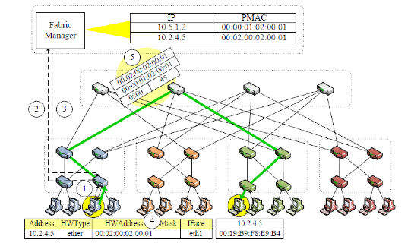
Routing and Forwarding

Slide 23
References
Al-Fares, Loukissas, Vahdat, A Scalable, Commodity Data Center Network Architecture, SIGCOMM, 2008.
Greenberg, Jain et al. VL2: A Scalable and Flexible Data Center Network, SIGCOMM 2009.
R.N. Mysore, A. Pamboris, et al, PortLand: A Scalable Fault-Tolerant Layer 2 Data Center Network Fabric, SIGCOMM 2009
Guo, Lu, et al, BCube: A High Performance, Server-centric Network Architecture for Modular Data Centers SIGCOMM 2009
Wikipedia, the Internet

