Slide 1

雲端計算
Cloud Computing
Storage System

Slide 2
Outline
Storage devices
Distributed storage systems
Storage virtualization
Distributed file systems
Distributed storage for structured data

Slide 3
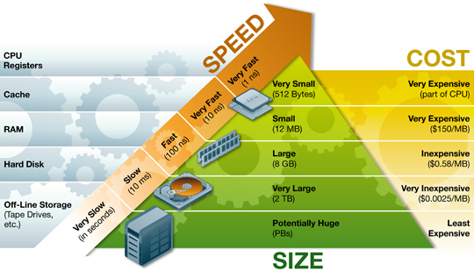
Storage Hierarchy
http://www.ts.avnet.com/uk/images/StorageHierarchy.jpg

Slide 4

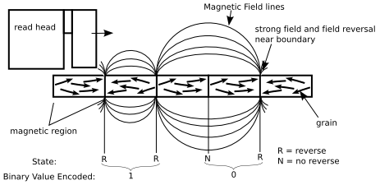
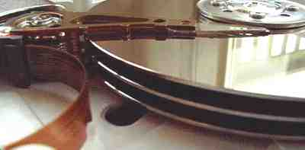
Hard Disk Driver (HDD)
A hard platter holds the magnetic medium
  Use magnetic field to represent 0/1

Slide 5
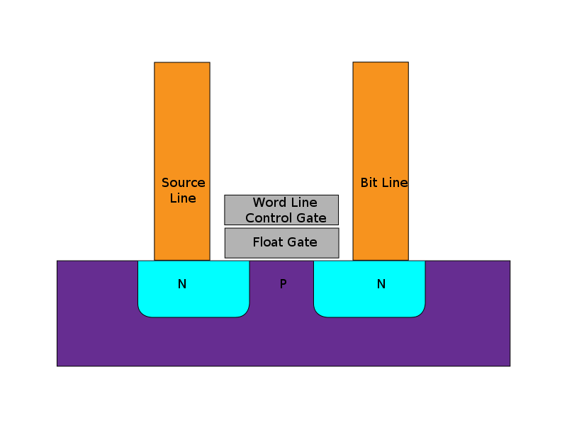
Solid-State Driver (Flash)
SSDs retain data in non-volatile memory chips and contain no moving parts.
  Most SSDs use NAND-based flash memory
Advantages comparing to traditional HDD
  Less susceptible to physical shock,
  Silent, lower access time, latency, and power
Disadvantages
  Expensive
  Limited access time

Slide 6
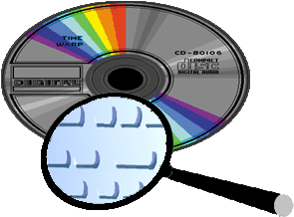
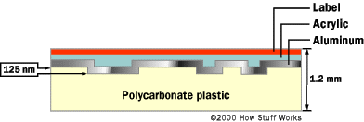
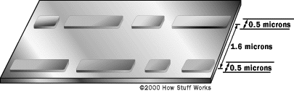
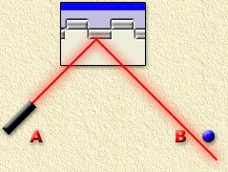
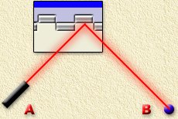
CD/DVD
CD: Compact Disk
DVD: Digital Video Disk
  Use bumps to represent 0/1

Slide 7
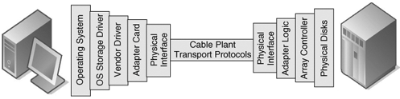
Storage Interconnection
The data path between servers and storage.
Composed of hardware and software component.
  OSs provide drivers for I/O to storage assets.
  Storage connectivity for hosts is provided by host bus adapters (HBAs) or network interface cards (NICs).

Slide 8
Interconnection Interfaces
 | Raw BW (Mbit/s) | Speed (MB/s) | Max. cable length (m) | Power | Devices/ channel
SATA 3.0 | 6,000 | 600 | 1 | N | 1
IEEE 1394 | 3,144 | 393 | 100 | Y | 63
USB3.0 | 5,000 | 400 | 3 | Y | 127
SCSI | 5,120 | 640 | 12 | N | 15
Fibri channel (optic cable) | 10,520 | 1,000 | 50,000 | N | 126
InfiniBand (optic cable) | 10,000 | 1,000 | 10,090 | N | 1
Thunderbolt | 10,000 | 1,250 | 3 | Y | 7
http://en.wikipedia.org/wiki/Serial_ATA

Slide 9
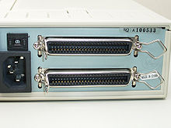
SCSI Interface
An intelligent, peripheral, buffered, peer to peer interface.
The SCSI protocol
  Host to host,
  Host to a peripheral device,
  Peripheral to peripheral device.
Logical Unit Number (LUN)
  A number used to identify a logical unit, which is a device addressed by the SCSI protocol
  Ex: RAID can share a LUN

Slide 10
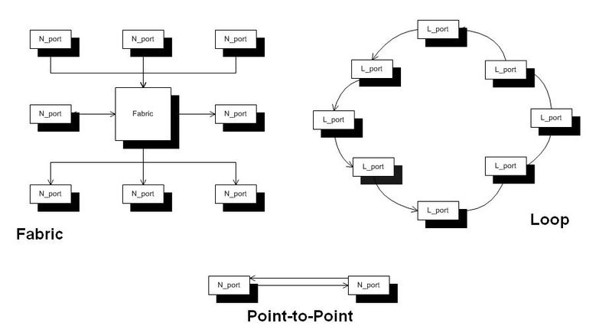
Fibre Channel
A gigabit-speed network technology primarily used for storage networking.
Fibre Channel Protocol (FCP)
  A transport
  protocol
  (similar to TCP)
  Predominantly
  transports SCSI
  commands

Slide 11
RAID
Redundant array of independent disks (RAID)
  Multiple disk drives are combined into a logical unit, where data are distributed across the drives.
Two key goals: data reliability & I/O performance
  Data striping: segment logically sequential data, such as a file, and place them to different physical devices.
  Disk mirroring: the replication of logical disk volumes on separate physical hard disks in real time.
  Parity check: error detection/correction code.

Slide 12
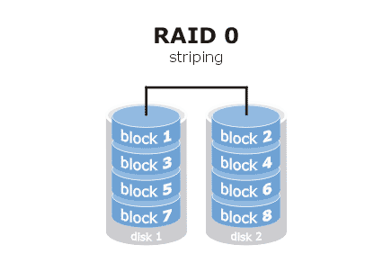
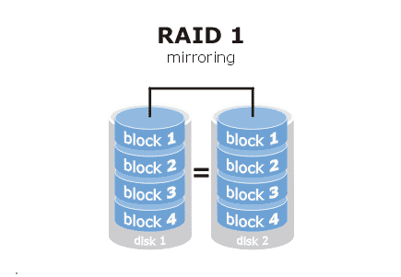
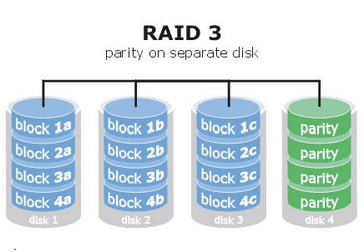
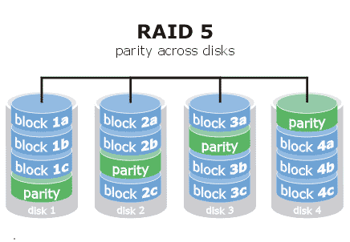
Different RAID Levels

Slide 13
Outline
Storage devices
Distributed storage systems
Storage virtualization
Distributed file systems
Distributed storage for structured data

Slide 14
Why Distributed Storage?
Multipath
Data sharing
Dependable
  Availability: readiness for correct service
  Reliability: continuity of correct service
  Safety - absence of catastrophic consequences on the user(s) and the environment
  Integrity - absence of improper system alteration
  Maintainability: ability for a process to undergo modifications and repairs

Slide 15
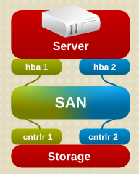
Multi-path
More than one physical path between the host and storage devices through the buses, controllers, switches, and bridge devices.

Slide 16
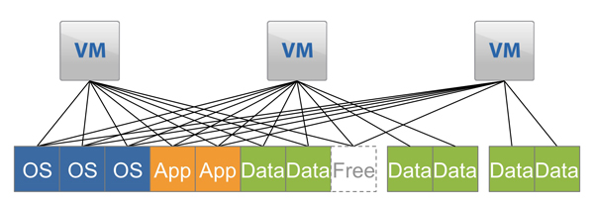
Data Sharing
Use data de-duplication technique to eliminate duplicated data.
Saving and improving the usage of storage space.

Slide 17
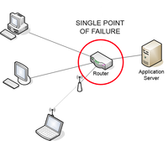
Single Point of Failure
A single point of failure (SPOF) is a part of a system that, if it fails, will stop the entire system from working.

Slide 18
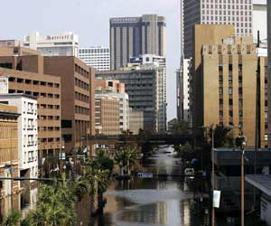
Reliability and Safety
The ability of a system to perform and maintain its functions in routine circumstances, as well as hostile or unexpected circumstances.
Data center 1
Data center 2

Slide 19
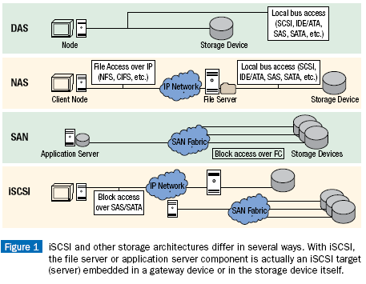
Distributed Storage Architectures

Slide 20
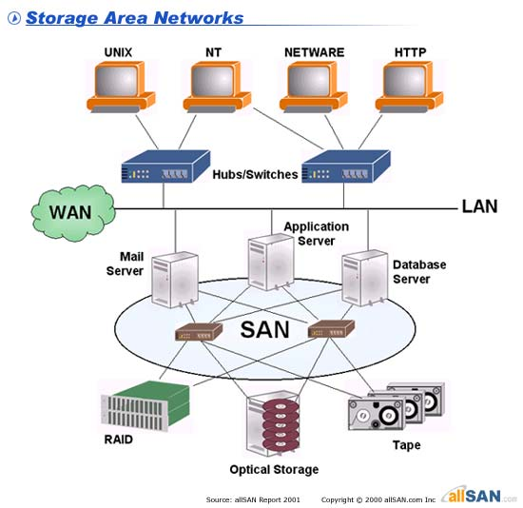
Storage Area Network (SAN)
A dedicated storage network that makes consolidated, block level storage accessible to servers so that the devices appear as locally attached to the OSs.
Usually connected via Fibre channel.

Slide 21
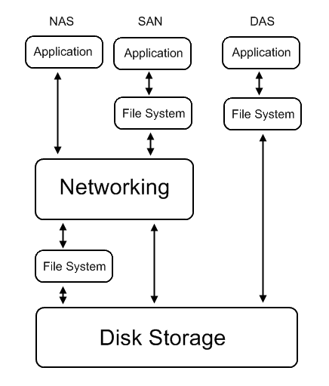
Network Attached Storage (NAS)
A file-level computer data storage system connected to a network, providing data access to heterogeneous clients.
  Using network file sharing protocols such as NFS, SMB/CIFS, or AFP (Apple Filing Protocol).

Slide 22
iSCSI
Internet Small Computer System Interface
  An Internet Protocol (IP)-based storage networking standard for linking data storage facilities.
  SCSI over IP
Unlike traditional Fibre Channel, iSCSI can be run over long distances using existing network infrastructure.
  Slower of course

Slide 23
Outline
Storage devices
Distributed storage systems
Storage virtualization
Distributed file systems
Distributed storage system for structured data

Slide 24
Storage Virtualization
In traditional storage system, a drive letter (volume ID) or a logical unit number (LUN, for SCSI deriver) is given on a partition of a disk.
Virtualized storage is abstracting data from a disk.
  This is usually a storage area network (SAN) connected via a fibre channel or iSCSI network.

Slide 25
Why Storage Virtualization?
Better utilization of resources
  Thin provisioning, pay what used, not allocated
Simpler data management and performance
  Tired Storage
  Sub-LUN Tiering
Higher availability and reliability
  RAID
Flexibility in introducing change
  With NAS or SAN

Slide 26
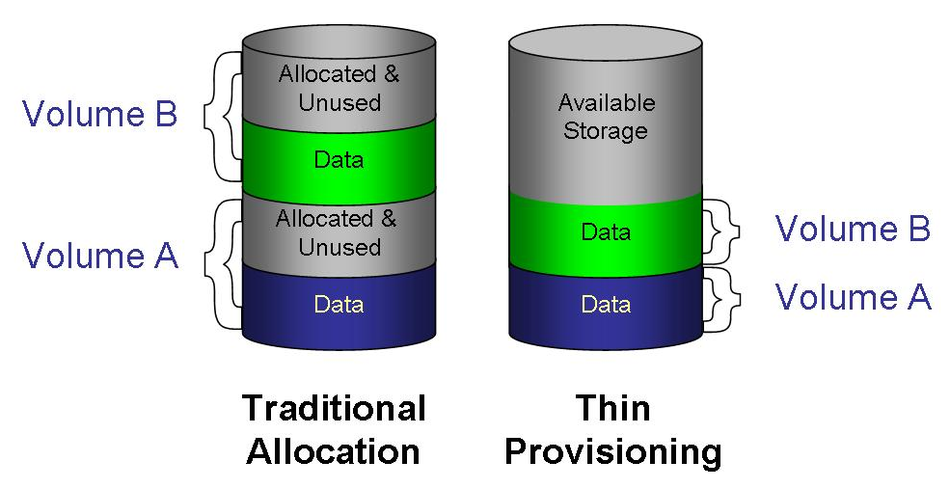
Thin Provisioning
Thin provisioning software allows higher storage utilization by eliminating the need to install physical disk capacity that goes unused.

Slide 27
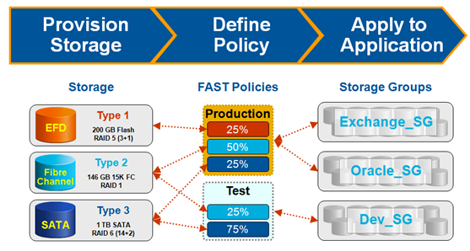
Tiered Storage System
A single system to manage multiple storage resources, so that data of different purposes and storage requirements can be located on the most appropriate storage resources.
Storage
Policies
Access Group

Slide 28
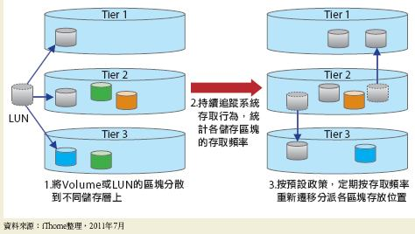
Sub-LUN Tiering System
Storage paging system (similar to virtual memory)
http://www.ithome.com.tw/itadm/article.php?c=68700&s=4

Slide 29
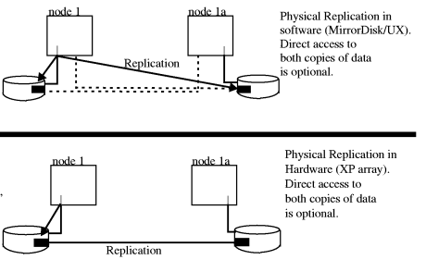
Data Replication
Maintain replicas to provide high availability.
RAID is a kind of storage virtualization.

Slide 30
What to Be Virtualized?
Storage virtualization can be done in either file level or block level
File system
  Provide compatible system
  call interface to user space
  applications.
Block device
  Provide compatible block
  device interface to file system.
User Space
Application
System call interface
Kernel Space
File System
Block interface
Device driver
Storage Device

Slide 31
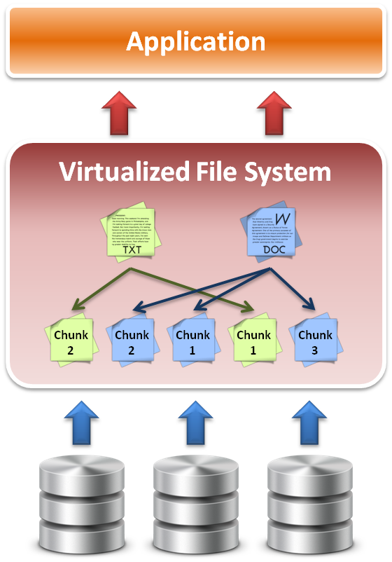
File Level Virtualization
File system maintains the information about where and how files are stored
File access requests are translated to the file system.
Sometime divides large file into small sub-files (chunks) for parallel access to improve the performance.
Will talk it later

Slide 32
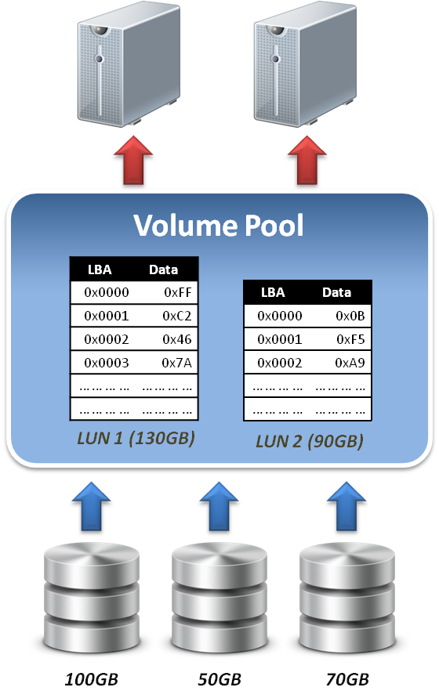
Block Level Virtualization
LUN & LBA
  A single block of information is addressed using a logical unit identifier (LUN) and an offset within that LUN, which known as a Logical Block Address (LBA).
Address space remapping
  The address space mapping is between a logical disk and a logical unit presented by one or more storage controllers.

Slide 33
Outline
Storage devices
Distributed storage systems
Storage virtualization
Distributed file systems
Distributed storage system for structured data

Slide 34
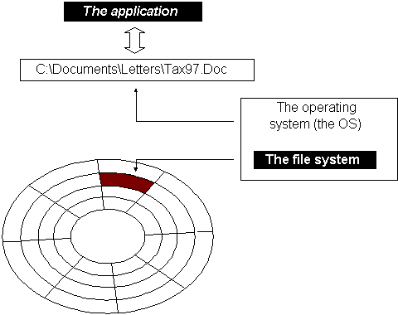
File System
File: the logical unit of stored data on disks and other media
File system: the system that manages files
  A file is a collection of
  disk blocks
  File System maps file
  names and offsets to
  disk blocks
  The set of valid paths
  form the “namespace”
  of the file system.

Slide 35
What Gets Stored
User data itself is the bulk of the file system's contents
  Also includes meta-data on a volume-wide and per-file basis:
Volume-wide
Per-file
Available space
Formatting info.
Character set
…
Name
Owner
Modification data
…

Slide 36
Design Considerations
Namespace
  Physical mapping
  Logical volume
Consistency
  Concurrent reads/writes on the same file.
Security
  Who can do what to a file?
  Authentication/Access Control List (ACL)
Reliability
  Power outage or other hardware failures

Slide 37
Local FS on Unix-like Systems
Namespace
  root directory “/”, followed by directories and files.
Consistency
  “sequential consistency”, newly written data are immediately visible to open reads
Security
  uid/gid, mode of files
  kerberos: tickets
Reliability
  journaling, snapshot

Slide 38
Distributed File Systems
Allows access to files from multiple hosts sharing via a computer network
Must support concurrency
  Make varying guarantees about locking, who “wins” with concurrent writes, etc...
  Must gracefully handle dropped connections
May include facilities for transparent replication and fault tolerance
Different implementations sit in different places on complexity/feature scale

Slide 39
When is DFS Useful
Multiple users want to share files
The data may be much larger than the storage space of a computer
A user want to access his/her data from different machines at different geographic locations
Users want a storage system
  Backup
  Management

Slide 40
Design Considerations of DFS
Interface
Security
Reliability (fault-tolerance)
Namespace (virtualization)
Consistency
Parallel
Scope

Slide 41
Distributed File Systems
NFS: network file system
Lustre: a POSIX-compliant high-performance filesystem
GFS: Google File System
  HDFS: free GFS clone produced by Apache.
Gluster: a scale-out NAS file system.

Slide 42
Outline
Storage devices
Distributed storage systems
Storage virtualization
Distributed file systems
Distributed storage for structured data

Slide 43
Structured Data
Row data
Structured data
Information
Ex: Row data (webpages)➔ Structured data (web crawling and indexing and ranking)
Structured data are usually stored in database
  Relational database management system (RDBMS)

Slide 44
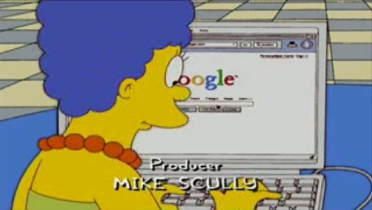
Common Operations
Read/query
  SQL command: SELECT student.name FROM student, class WHERE class.name=‘cloud computing’
  Google query: returns all the documents that contains the queried key words, and ranks them according relevance
Write/append
Write/update

Slide 45
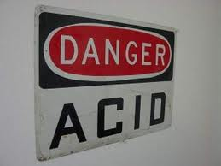
ACID Properties of Transactions
Atomicity: either all the operations of a transaction are executed or none of them are.
Consistency: the database is in a legal state before and after a transaction
Isolation: the effects of one
transaction are isolated from
other transactions.
Durability the effects of successfully completed transactions endure subsequent failures.

Slide 46


Problems of RDBMS
Modern RDBMS have shown poor performance on certain data-intensive applications,
  Indexing a large number of documents,
  Serving pages on high-traffic websites,
  Delivering streaming media.

Slide 47
NOSQL
NoSQL can service heavy read/write workloads.
  Not fixed table schemas,
  Usually avoid join operations, and
  Typically scale horizontally. (columns)
Examples
  GoogleBigTable, HBase, Hypertable
  AmazonDynamo, Voldemort, Cassendra, Riak
  Redis, CouchDB, MongoDB

Slide 48
References
Prof. Chung’s lecture notes
From Wikipedia, the free encyclopedia
http://horicky.blogspot.com/2009/11/nosql-patterns.html

