Slide 1
Cloud Computing
Storage for Structured Data
Che-Rung Lee

Slide 2
Outline
Database system
CAP theorem
NOSQL data storage
Google BigTable
Hadoop HBase
Apache Cassendra

Slide 3
Why File System Is Not Enough?
What we need is not only data, but also the relations among them.
The relations of data are also data
Also need data to describe data (metadata)
Common data operations are easier to perform using DataBase Management System (DBMS)
Search: retrieve data from the database
Update: update existing data
Insertion: insert new data
Deletion: remove existing data

Slide 4
Relational Database
In a relational database (the most commonly used one), records are organized using tables
Columns for attributes; rows for records
Primary key: one (or multiple) attributes that can be used to uniquely identify each row in a table
Name | StudentID | Status | Major | Grade | B-day | Gender | …
皮卡丘 | 123456 | 校 | 資工系 | 二年級 | 1-1-11 | M | …
可達鴨 | 789012 | 休 | 中文系 | 二年級 | 2-2-22 | F | …
… | … | … | … | … |  |  | …

Slide 5
Query
Using SQL (Structured Query Language)
Ex:
Ex: query all attributes
Indices for the attributes in conditions should be pre-built to speedup queries
Primary key is always indexed
Interested attributes
SELECT name, studentID FROM student
WHERE grade=2 AND gender=‘M’
Table name
Condition
SELECT * FROM student WHERE StudentID=123456

Slide 6
Indexing
B-tree
Hash

Slide 7
Relations
The relations among objects are described by the ER model (Entity-Relation model)
Relations are also organized as tables
What should be the primary key?
Student
Course
Teacher
Name,
StudentID,
Status, …
Year, CourseID,
CourseName
Schedule, …
Name,
Department, TeacherID, …
n
take
m
n
teach
1
CourseTaking
CourseTeaching
StudentID | CourseID | Grade | Status
123456 | 990110 | -1 | Normal
234567 | 990221 | -1 | Dropped
TeacherID | CourseID
888999 | 990110
777666 | 990221

Slide 8
Joint Query
Select data from different tables through relations
科目名稱 | 上課時間 | 授課老師
英文 | M3M4W3 | 小瑤
微積分 | T3T4H3H4 | 小剛，小智
體育 | F5F6 | 小智
… | … | …
SELECT Course.Name, Course.Schedule, Teacher.Name
FROM Course, CourseTaking, CourseTeaching, Student, Teacher
WHERE Student.StudentID=‘123456’ AND
Student.StudentID=CourseTaking.StudentID AND
CourseTaking.CourseID=Course.CourseID AND
CourseTeaching.CourseID=Course.CourseID AND
CourseTeaching.TeacherID=Teacher.TeacherID.
Usually will build a “view” to speedup common queries

Slide 9
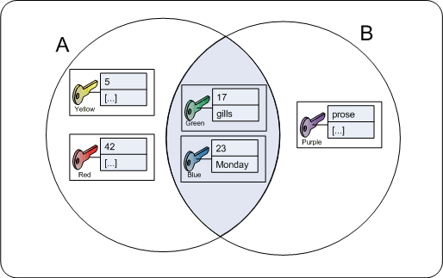
Join Operation
Where x =123 and y = ‘abc’
It’s a set join problem

Slide 10
Update, Insertion, Deletion
Suppose you want to add a course for next semester.
A transaction is more than just an insertion like that.
A sequence of operations must happen all together
Before insertion
The system needs to check if there is a schedule confliction
Also, the capacity of the class, the pre-requirement, …
After insertion
Suppose there is an attribute in Course, called “NoStudent”, that records the total number of students taking this course.
INSERT INTO CourseTaking VALUES (‘123456’,’990110’);
UPDATE Course SET NoStudent=ns+1 WHERE CourseID=‘990110’;

Slide 11
ACID Properties of Transactions
Atomicity: either all the operations of a transaction are executed or none of them are.
Consistency: the database is in a legal state before and after a transaction
Isolation: the effects of one transaction are isolated from other transactions.
Durability the effects of successfully completed transactions endure subsequent failures.

Slide 12
Database Integrity
DBMS need to maintain database integrity
Transaction log: non-volatile record of each transaction’s activities, built before the transaction is allowed to happen.
Locking: preventing others from accessing data being used by a transaction.
Roll-back: procedure to undo a failed, partially completed transaction.

Slide 13
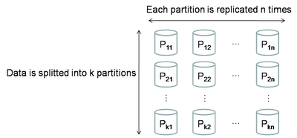
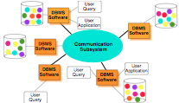
Distributed RDBMS
Distributed database management systems is a software for managing databases stored on multiple computers in a network.
A natural way to scale up the DBMS

Slide 14
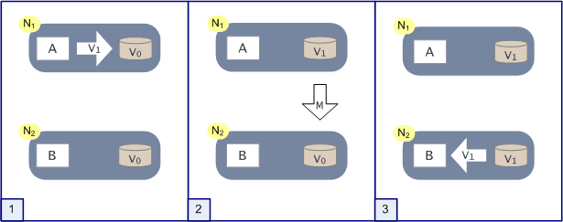
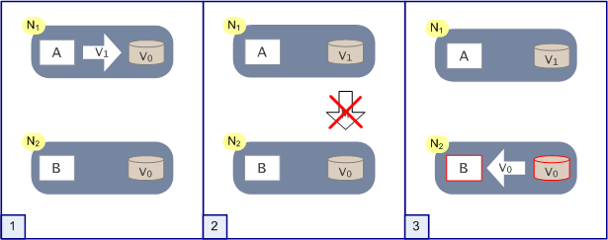
Consistency Problem
Ex: A writes v1 to DB and B reads the data

Slide 15
Brewer's CAP Theorem
It is impossible for a distributed computer system to provide all three of
Consistency: all nodes see the same data at the same time
Availability: a guarantee that every request receives a response about whether it was successful or failed
Partition tolerance: the system continues to operate despite arbitrary message loss

Slide 16
Outline
Database system
CAP theorem
NOSQL data storage
Google BigTable
Hadoop HBase
Apache Cassendra

Slide 17
Problems of RDBMS
Modern RDBMS have shown poor performance on certain data-intensive applications,
Indexing a large number of documents,
Serving pages on high-traffic websites,
Delivering streaming media.

Slide 18
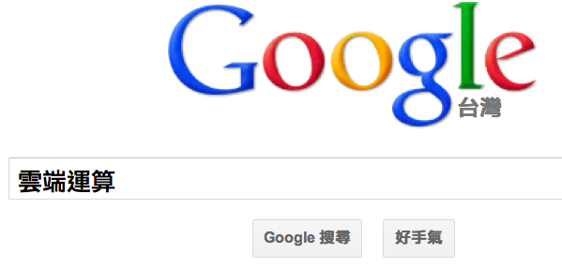
Example of Webpage DB
How to build tables for webpages for queries like
Schema 1:
Table 1: webpage
Table 2: terms
Table 3: contains
Join is slow
Schema 2:
Sparse
Webpage
Terms
URL,
Words from dictionary
n
contains
m
URL | cloud | 雲 | 端 | 學 | 清 | 華
www.nthu.edu.tw |  |  |  | 2 | 2 | 2
www.google.com | 1

Slide 19
NOSQL
Not Only SQL
Carlo Strozzi used the term NoSQL in 1998
Eric Evans, a Rackspace employee, reintroduced the term NoSQL in early 2009
Properties
May not require fixed table schemas,
Usually avoid join operations,
Typically scale horizontally,
Relax the data consistency requirement.

Slide 20
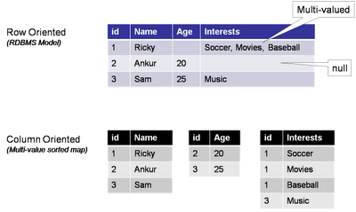
Column Oriented Layout
DBMS stores rows contiguously on disk
Column oriented layout is very effective to store very sparse data as well as multi-value cell.
Each “table” stores the key and value pair.
Each column can be stored in one file.

Slide 21
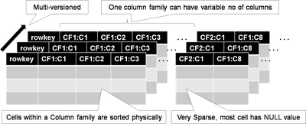
Google BigTable
The basic data storage unit is a cell,
Addressed by a particular row and column
Multiple timestamp version of data within a cell.
Bigtable allows users to specify how many versions can be stored within each cell
By count (how many) or by freshness (how old).

Slide 22
Sequential Write
BigTable is highly optimized for write operation with sequential write (no disk seek is needed).
Appending a transaction entry to a log file (the disk write is sequential with no disk seek),
Write the data into an in-memory Memtable.
In case of the machine crashes and all in-memory state is lost, the recovery step will bring the Memtable up to date by replaying the updates in the log file.

Slide 23
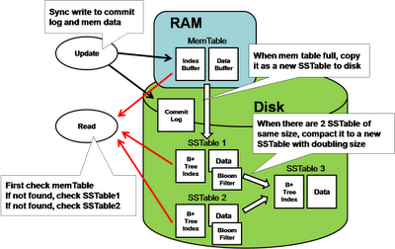
SSTable
All the latest update therefore will be stored at the Memtable, which will grow until reaching a size threshold, then it will flushed the Memtable to the disk as an SSTable. Over a period of time there will be multiple SSTables on the disk that store the data.

Slide 24
Merged Read
”Merged Read" means multiple places to lookup data when a read request is arrived.
It first looks at the Memtable by the row key of request. If not, it will look at the on-disk SSTables.
It is inefficient for read when there are too many SSTables scattering around.
To speed up the detection, SSTable has a companion Bloom filter such that it can rapidly detect the absence of the row-key.
The system periodically merge the SSTables.

Slide 25
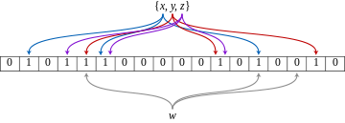
Bloom Filter
Conceived by Burton Howard Bloom in 1970
A probabilistic data structure that is used to test whether an element is a member of a set.
False positives are possible, but not false negatives. \
Ex: a set={x,y,x}, query=w
Elements are hashed to different bits
One of the hashed bit of w is 0, so it is not in the set.

Slide 26
Periodic Data Compaction
To merge the SSTables periodically.
Each SSTable is individually sorted by key,
A simple "merge sort" is sufficient to merge multiple SSTable into one.
Two SSTable of the same size will be merge into a single SSTable first, which doubles the size.
The number of SSTable is proportion to O(logN) where N is the number of rows.

Slide 27
BigTable Operation Summary
Full
V5.0
memtable
A new memtable
Frozen memtable
Read ops
Memory
GFS
Tablet log
V4.0
V3.0
V2.0
V1.0
Merging compaction
Major compaction
Write ops
Memtable + a few SSTables
-> A new SSTable
Memtable + all SSTables
-> to one SSTable
SSTable files
Periodically done.
Deleted data are still alive.
Minor compaction
Memtable -> a new SSTable
V6.0
Deleted data are removed
Storage can be re-used

Slide 28
Tablets in BigTable
Large tables broken into tablets at row boundaries
Tablet holds contiguous range of rows
Clients can often choose row keys to achieve locality
Aim for ~100MB to 200MB of data per tablet
Serving machine responsible for ~100 tablets
Fast recovery:
100 machines each pick up 1 tablet from failed machine
Fine-grained load balancing:
Migrate tablets away from overloaded machine
Master makes load-balancing decisions

Slide 29
Dynamic Fragmentation of Rows
Tablets split and merge
automatically based on size and load
or manually
Load balancing
Clients can choose row keys to achieve locality
Tablet
Start:aardvark
End:apple
64K block
64K block
64K block
SSTable
64K block
64K block
64K block
SSTable
Index
Index

Slide 30
Tablet Assignment
Master keeps track of the set of live tablet servers, and the current assignment of tablets to tablet servers, including which tablets are unassigned
Tablet servers
Cluster manager
Chubby
1) Start a server
8) Reassign unassigned tablets
2) Create a lock
7) Acquire and
Delete the lock
3) Acquire the lock
4) Monitor
Tablet Server
5) Assign tablets
Master Server
6) Check lock status

Slide 31
Tablet Serving
Memory
read
memtable
(random-access)
append-only log on GFS
write
SSTable
on GFS
SSTable
on GFS
Tablet
SSTable: Immutable on-disk ordered map from string->string
string keys: <row, column, timestamp> triples

Slide 32
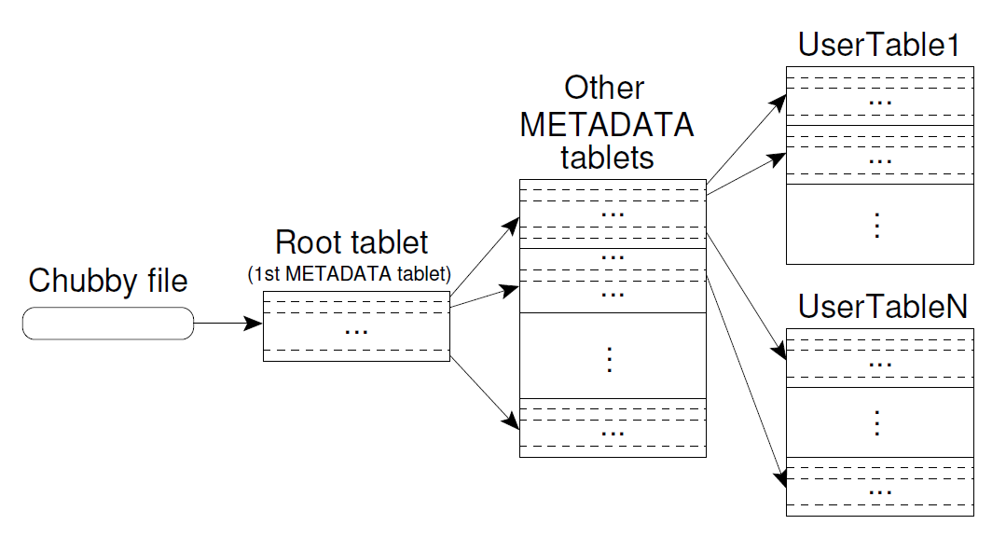
Locating Tablets
MD0

Slide 33
Chubby
Central service for distributed coordination
Store coordination information
Helps synchronization
Master election: many servers try to get the same lock, the one who gets it is the master
Used by many Google technologies like GFS and BigTable

Slide 34
Locating Tablets
Approach: 3-level B+-tree like scheme for tablets
1st level: Chubby, points to MD0 (root)
2nd level: MD0 data points to appropriate METADATA tablet
3rd level: METADATA tablets point to data tablets
METADATA tablets can be split when necessary
MD0 never splits so number of levels is fixed

Slide 35
Differences from RDBMS
Transaction protection is only guaranteed within a single row, not multiple rows
Inconsistency
While you are reading a row, other people may have modified the same row and update it before you. Your view is not current anymore but your later update can easily wipe off other people's change.
For the application Google interested, it’s few concurrent row updates.
Lack of surrounding tools

Slide 36
Differences from RDBMS (cont’)
No indexes
There is no index from the column value to its containing rowid.
If users require index in Bigtable, they need to build their own index at the application level.
No referential integrity enforcement
If users build artificial index at the application level, they need to maintain the integrity of index when the base data is inserted, modified or deleted.

Slide 37
HBase
Based on the BigTable, HBase uses the Hadoop Filesystem (HDFS) as its data storage engine.
HBase doesn't need to worry about data replication, data consistency and resiliency because HDFS has handled it already.
It is also constrained by the characteristics of HDFS, which is not optimized for random read access.
There will be an extra network latency between the DB server to the File server (which is the data node of Hadoop).

Slide 38
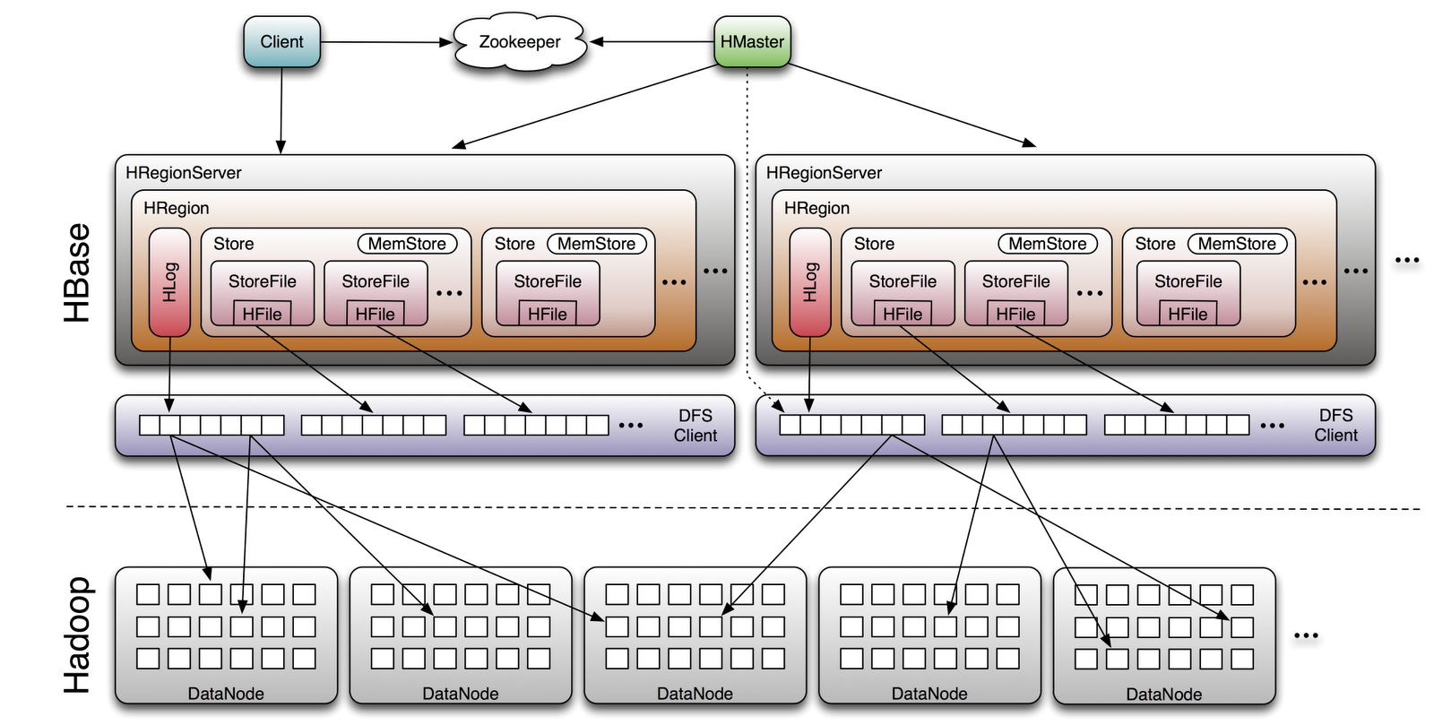
HBase Architecture

Slide 39
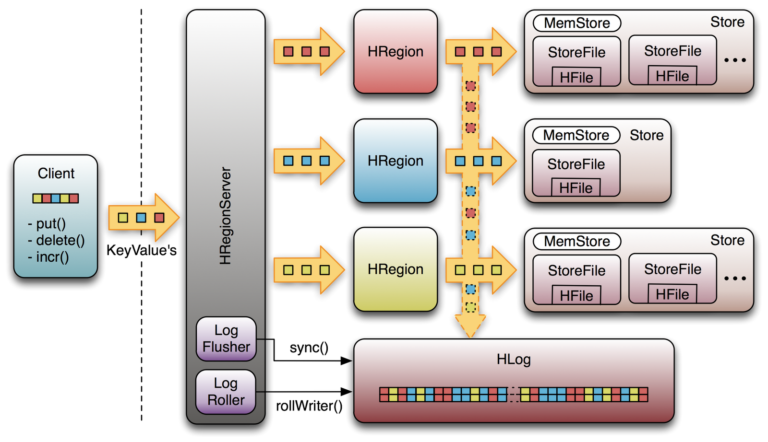
How Does HBase Work?

Slide 40
BigTable v.s. HBase
BigTable | HBase
Master | Master
Tablet server | Region server
Google file system | HDFS
SSTable | HFile
Chubby | Zookeeper
Memtable | Memcached

Slide 41
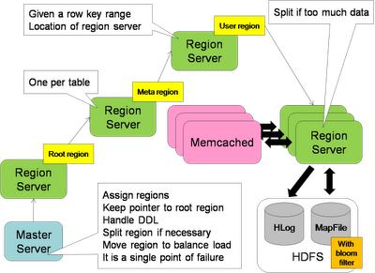
Key-to-Server Mapping
Master server
Root region server
Meta region server
User region server
Region server
Memcached

Slide 42
Differences from Bigtable
Number of Master
Hbase added support for multiple masters. These are on "hot" standby and monitor the master's ZooKeeper node
Storage System
Hbase has the option to use any file system as long as there is a proxy or driver class for it
HDFS, S3(Simple Storage Service), S3N(S3 Native FileSystem)
Memory Mapping
BigTable can memory map storage files directly into memory

Slide 43
Differences from Bigtable (cont.)
Lock Service
ZooKeeper is used to coordinate tasks in Hbase as opposed to provide locking services
ZooKeeper does for Hbase pretty much what Chubby does for BigTable with slightly different semantics
Locality Groups
Hbase does not have this option and handles each column family separately

Slide 44
Cassandra
Based on the BigTable model, Cassandra uses the distributed hash table to partition its data,
Based on the DHT in the Amazon Dynamo model.
Data is replicated across multiple servers.
Allows user to choose the consistency level that is suitable to application.

Slide 45
References
Prof. Chung’s slides
Wikipedia and Internet
http://www.julianbrowne.com/article/viewer/brewers-cap-theorem
http://horicky.blogspot.com/search?q=nosql

