Slide 1
Cloud Computing
Distributed File System
Che-Rung Lee

Slide 2
Outline
File system overview
Distributed file system
NFS
Lustre
Gluster
File systems for applications
GFS
HDFS

Slide 3
File System Overview
Physically, a file is a collection of disk blocks.
Logically, a file is a unit of data on disks or other media.
File system is a system that manages files
Maps file names and offsets to disk blocks
The set of valid paths form the “namespace” of the file system.
Manages file attributes, such as file size, date, types, owner, etc.
Manages volume properties, such free size etc.

Slide 4
FS Design Considerations
How to find files? (Namespace)
Logical volume and physical mapping
What to do when more than one user reads/writes on the same file? (Consistency)
Who can do what to a file? (Security)
Authentication/Access Control List (ACL)
How to avoid files damages at power outage or other hardware failures? (Reliability)

Slide 5
Local FS on Unix-like Systems
Namespace
root directory “/”, followed by directories and files.
Consistency
“sequential consistency”, newly written data are immediately visible to open reads
Security
uid/gid, mode of files
kerberos: tickets
Reliability
journaling, snapshot

Slide 6
Distributed File Systems
Allows access to files from multiple hosts sharing via networks
May include facilities for transparent replication and fault tolerance
Major problems
Concurrency
Dropped connections (reliability)

Slide 7
Why DFS?
Multiple users want to share files
The data may be much larger than the storage space of a computer
A user want to access his/her data from different machines at different geographic locations
Maintenance
Backup
Management

Slide 8
Outline
File system overview
Distributed file system
NFS
Lustre
Gluster
File systems for applications
GFS
HDFS

Slide 9
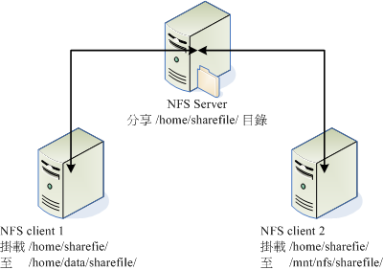
Network File System
Network drives are mounted into local directory
Ex: mount -t nfs 192.168.100.254:/home/sharefile /home/data/sharefile

Slide 10
NFS Namespace
NFS server instantiates NFS volume on top of local file system.
Local hard drives managed by local file systems
Access files in NFS is just like local files after NFS is mounted.

Slide 11
NFS Concurrency
NFS v4 supports stateful locking of files
Clients inform server of intent to lock
Server can notify clients of outstanding lock requests
Locking is lease-based: clients must continually renew locks before a timeout
Loss of contact with server abandons locks

Slide 12
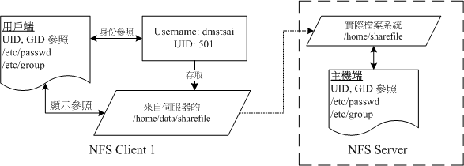
NFS Security
Authentication is at mounting NFS using account login in of NFS server
For non-registered users, it can use the account “nobody”

Slide 13
NFS Client Caching
NFS Clients are allowed to cache copies of remote files for subsequent accesses
Supports close-to-open cache consistency
When client A closes a file, its contents are synchronized with the master, and timestamp is changed
When client B opens the file, it checks that local timestamp agrees with server timestamp. If not, it discards local copy.
Concurrent reader/writers must use flags to disable caching

Slide 14
NFS: Tradeoffs
NFS Volume managed by single server
Higher load on central server
Simplifies coherency protocols
The performance is poor when large number of concurrent transmissions occur.
Full POSIX system means it “drops in” very easily, but isn’t “great” for any specific need.

Slide 15
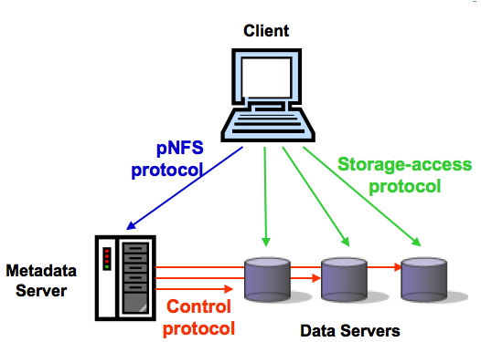
pNFS: Parallel NFS
pNFS protocol
standardized: NFSv4.1
Storage-access protocol
files (NFSv4.1)
blocks (FC, iSCSI, FCoE)
objects (OSD2)
Client
Outside of the pNFS standard

Slide 16
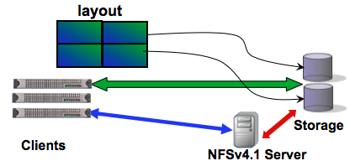
pNFS Layout
Client gets a layout from the NFSv4.1 server
Maps the file onto storage devices and addresses
Clients use the layout to perform direct I/O to storage
Client commits changes and returns the layout when it’s done

Slide 17
Lustre File System
Parallel shared POSIX file system
Developed 1999 by Peter Braam
2007, Sun included Lustre in its HPC hardware
Now maintained by Oracle
Fifteen of the top 30 supercomputers in the world use Lustre file systems, including the world's fastest supercomputer, K computer.

Slide 18
Features of Lustre
Scalable:
Tens of thousands clients
Hundreds of gigabytes per second of I/O throughput
Tens of petabytes (PBs) of storage
Coherent
Single namespace
Strict concurrency control
Heterogeneous networking
High availability (fault tolerance)

Slide 19
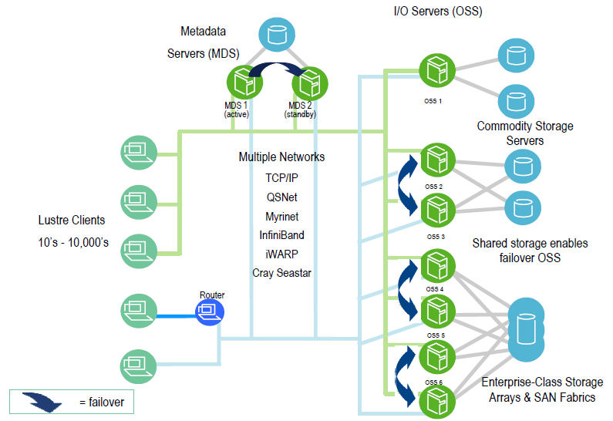
Lustre Architecture

Slide 20
Lustre Components
Metadata Server (MDS)
The MDS server makes metadata stored in one or more MDTs.
Metadata Target (MDT)
The MDT stores metadata of an MDS.
Object Storage Servers (OSS)
The OSS provides file I/O service, and network request handling for one or more local OSTs.
Object Storage Target (OST)
The OST stores file data as data objects on one or more OSSs.

Slide 21
Lustre Networks
Supports several network types
Infiniband, TCP/IP on Ethernet, Myrinet, …etc.
Take advantage of remote direct memory access (RDMA)
Improve throughput and reduce CPU usage

Slide 22
Gluster File System
Scale-out file storage software for
NetworkAttachedStorage(NAS)
Object
Big Data / Analytics
Scalable for large cloud systems
Used by Amazon
Now is maintained by Red-hat
User space file system (FUSE)

Slide 23
GlusterFS Design Goals
No centralized metadata
Unify files and objects
Elasticity: flexibility adapt to growth/reduction
Scale linearly
Multiple dimensions: Performance and Capacity
Aggregated resources
Simplicity: ease of management
No complex Kernel patches.
Run in user space

Slide 24
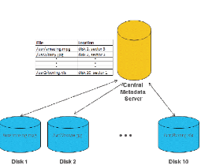
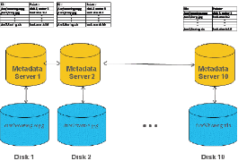
Traditional Metadata Servers
Centralized Distributed

Slide 25
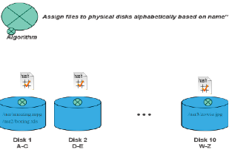
Elastic Hashing
An algorithm approach for namespace
Unique hash tag for each file stored
Tags stored within the file system
Rapid file read – low latency

Slide 26
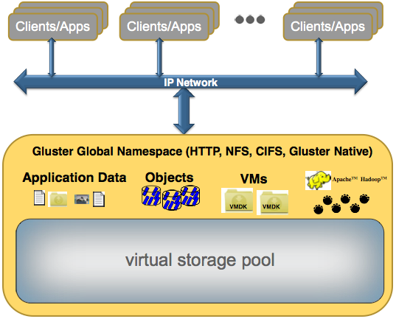
A Standard Gluster Deployment
Clients running standard apps
Over IP network
Access data in the global namespace
Stored in scale-out, virtualized, centrally managed pool of DAS,SAN, or NAS

Slide 27
Gluster Features
No metadata server
Built in replication
No block size restrictions
POSIX compliant file system
Expanded data access options
Reduces requirement for replicated files
Filesystem Runs in User Space

Slide 28
Outline
File system overview
Distributed file system
NFS
Lustre
Gluster
File systems for applications
GFS
HDFS

Slide 29
Motivations of GFS
Fault-tolerance and auto-recovery need to be built into the system.
Standard I/O assumptions (e.g. block size) have to be re-examined.
Record appends are the prevalent form of writing.
Google applications and GFS should be co-designed.

Slide 30
Assumptions of GFS
High component failure rates
Modest number (10⁶) of large files (>100MB)
The workloads primarily consist of large streaming reads and small random reads
The workloads also have many large, sequential writes that append data to files
Multiple clients concurrently append data to the same file
High sustained bandwidth is more important than low latency

Slide 31
GFS Design Decisions
Reliability through replication
Single master to coordinate access and to keep metadata
No data caching to simplify the system by eliminating cache coherence issues
Familiar interface, but customize the API
No POSIX: simplify the problem;
Focus on Google apps
Add snapshot and record append operations

Slide 32
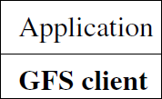
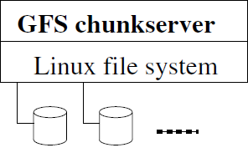
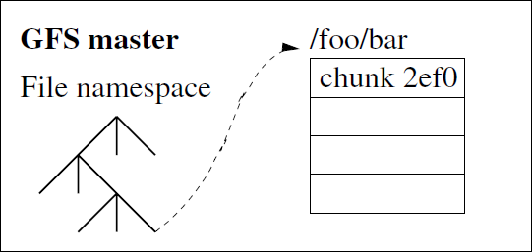
GFS Architecture
Master holds metadata
Chunk-servers hold data
Client produces/consumes data
Identified by
an immutable
and globally
unique 64 bit
chunk handle

Slide 33
Reading a File
Application
GFS Client
Master
Chunkserver
Open(name, read)
name
Open
handle
handle
Read(handle, offset,
length, buffer)
handle,
chunk_index
cache (handle,
chunk_index)
→
(chunk_handle,
locations),
select a replica
chunk_handle,
chunk_locations
Read
chunk_handle,
byte_range
Data
return code

Slide 34
Writing to a File
Application
GFS Client
Master
Chunkserver
Primary Chunkserver
Chunkserver
Chunkserver
Write(handle,
offset,length,
buffer)
* assign mutation order, write to disk
handle
grants a lease
(if not granted before)
chunk_handle, primary_id, replica address
Query
cache, select a replica
Data
Data
Data
Data Push
data received
received
write (ids)
m. order(*)
m. order(*)
Commit
return code
completed
complete
complete

Slide 35
Single Master
The master have global knowledge of chunks
Easy to make decisions on placement and replication
Single point of failure
Scalability bottleneck
GFS solutions:
Shadow masters
Minimize master involvement
Cache metadata at clients
Large chunk size
Master delegates authority to primary replicas in data mutations(chunk leases)

Slide 36
Chunkserver - Data
Data organized in files and directories
Manipulation through file handles
Files stored in chunks
A chunk is a Linux file on local disk of a chunkserver
Unique 64 bit chunk handles, assigned by master at creation time
Fixed chunk size of 64MB
Read/write by (chunk handle, byte range)
Each chunk is replicated across 3+ chunkservers

Slide 37
Metadata
Namespace and file-to-chunk mapping are kept persistent
Operation logs = historical record of mutations
Represents the timeline of changes to metadata in concurrent operations
Stored on master's local disk
Replicated remotely
A mutation is not done or visible until the operation log is stored locally and remotely
master may group operation logs for batch flush

Slide 38
Consistency Model
GFS has a relaxed consistency model
Namespace changes are atomic and consistent
Handled exclusively by the master using namespace lock, whose order is defined by the operation logs
File data changes is complicated (replicas)
“Consistent” = all replicas have the same data
“Defined” = consistent + replica reflects the change entirely
A relaxed consistency model: not always consistent, not always defined, either

Slide 39
Mutation
Mutation = write or append
must be done for all replicas
Goal: minimize master involvement
Lease mechanism for consistency
master picks one replica as primary; gives it a “lease” for mutations
a lease = a lock that has an expiration time
primary defines a serial order of mutations
all replicas follow this order
Data flow is decoupled from control flow

Slide 40
Write/Concurrent Write
Region inconsistent
Region consistent
Region consistent but undefined
Write X at region @ in C1
Write xyz at region @ in C1
xyzabc
xyzabc
xyzabc
X
X
X
Write abc at region @ in C1
C1
C1
C1

Slide 41
Append
Region defined interspersed with inconsistent
Region inconsistent and undefined
Retry
Append abc
abc
abc
abc
abc
abc
C1
C1
C1

Slide 42
Recovery
Recover the file system = replay the operation logs
“fsck” of GFS after, e.g., a master crash.
Use checkpoints to speed up
Memory-mappable, no parsing
Recovery = read in the latest checkpoint + replay logs taken after the checkpoint
Incomplete checkpoints are ignored
Old checkpoints and operation logs can be deleted.

Slide 43
Hadoop Distributed File System
Reference from Google File System
A scalable distributed file system for large data analysis
Based on commodity hardware with high fault-tolerant
The primary storage used by Hadoop applications
Cloud Applications
MapReduce
Hbase
Hadoop Distributed File System (HDFS)
A Cluster of Machines

Slide 44
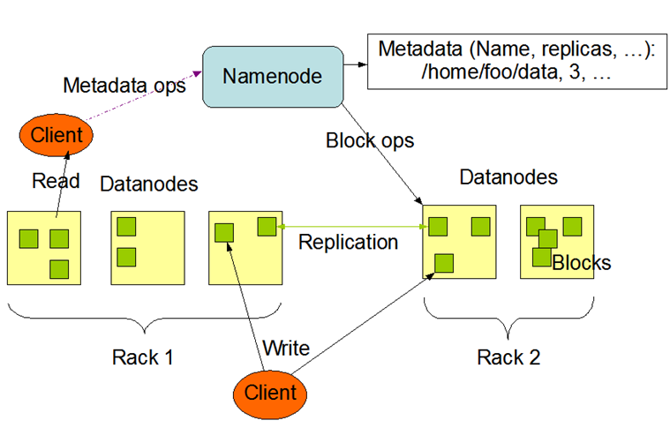
HDFS Architecture

Slide 45
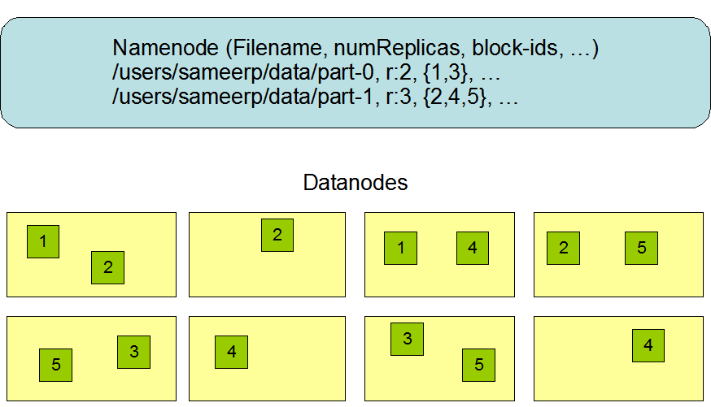
Block Replication

Slide 46
Coherency Model & Performance
Coherency model of files
Namenode handle the operation of write, read and delete.
Large Data Set and Performance
The default block size is 64MB
Bigger block size will enhance read performance
Single file stored on HDFS might be larger than single physical disk of Datanode
Fully distributed blocks increase throughput of reading

Slide 47
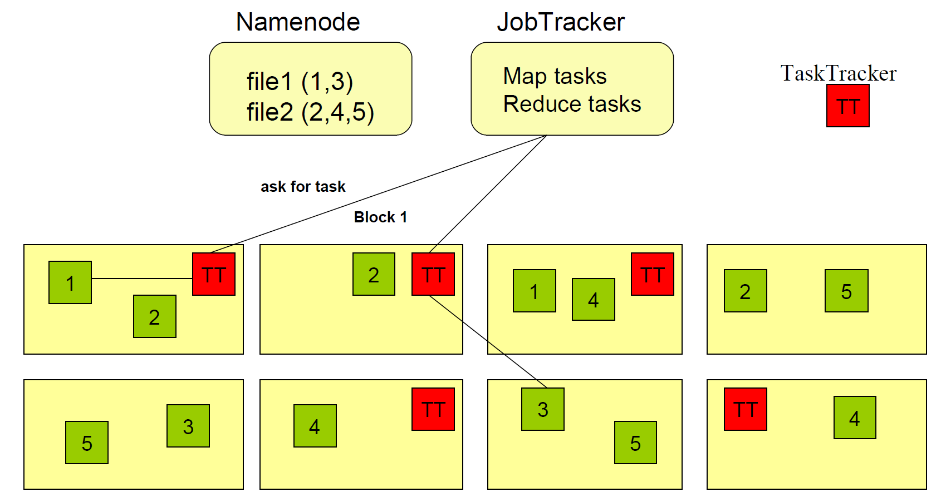
About Data Locality

Slide 48
Small File Problem
Inefficiency of resource utilization
Significantly smaller than the HDFS block size(64MB)
File, directory and block in HDFS is represented as an object in the namenode’s memory, each of which occupies 150 bytes
HDFS is not geared up to efficiently accessing small files
Designed for streaming access of large files

Slide 49
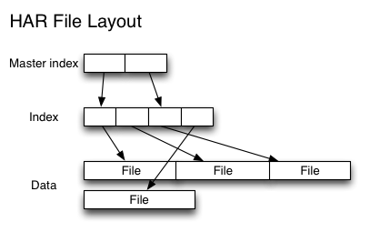
Small File Solution
Hadoop Archives (HAR)
Introduced to alleviate the problem of lots of files putting pressure on the namenode’s memory
Building a layered filesystem on top of HDFS

Slide 50
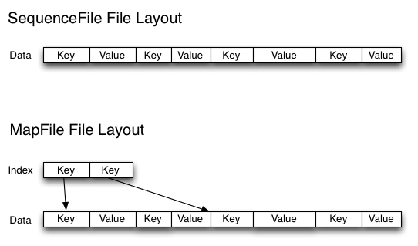
Small File Solution
Sequence Files
Use the filename as the key and the file contents as the value

Slide 51
References
S. GHEMAWAT, H. GOBIOFF, and S.-T. LEUNG, “The Google file system,” In Proc. of the 19th ACM SOSP (Dec. 2003)
鳥哥的 Linux 私房菜
Hadoop. http://hadoop.apache.org/
NCHC Cloud Computing Research Group.
http://trac.nchc.org.tw/cloud
NTU course- Cloud Computing and Mobile Platforms.
http://ntucsiecloud98.appspot.com/course_information

