Slide 1
Cloud Computing
Storage Virtualization
Che-Rung Lee

Slide 2
Outline
Storage management system
Where to virtualize?
Host-based virtualization
Network-based virtualization
Storage-based virtualization
How to virtualize?
In-band and out-band virtualization
Heterogeneous storage
Case study: LVM

Slide 3
Storage Metadata
Metadata is the data about data
Storage metadata describes storage information
Disk volume size
Data block mapping table
Location of the storage (for network storage device)

Slide 4
Disk Volume
A volume represents the storage capacity of one or more disk drives.
Volume management is responsible for creating and maintaining metadata about storage capacity.
Volume management is between the file system and the device drivers that control system I/O.
Logical volume(unit)
A logical volume can map to a fraction of a physical disk, or multiple disks.
Here we use SCSI convention to call a volume “unit”.

Slide 5
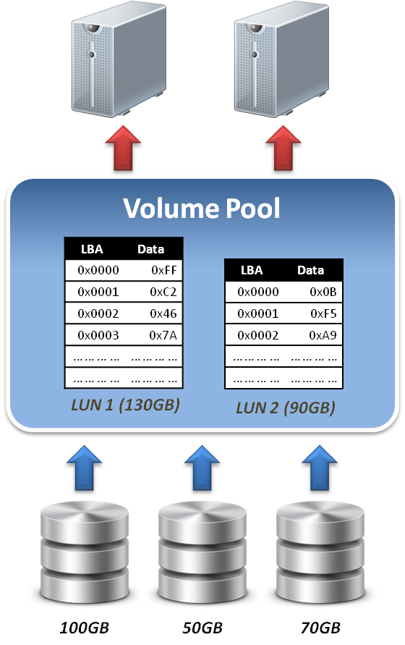
Data Block
A single block of information is addressed using a logical unit number (LUN) and an offset within LUN, known as a Logical Block Address (LBA).

Slide 6
Abstracting Physical Storage
Physical to virtual
The cylinder, head and sector geometry of individual disks is virtualized into logical block addresses (LBAs).
For storage networks, the physical storage system is identified by a network address / LUN pair.
Metadata integrity
Storage metadata integrity requires redundancy for failover or load balancing.
Virtualization intelligence may need to interface with upper layer applications to ensure data consistency.

Slide 7
Outline
Storage management system
Where to virtualize?
Host-based virtualization
Network-based virtualization
Storage-based virtualization
How to virtualize?
In-band virtualization
Out-band virtualization

Slide 8
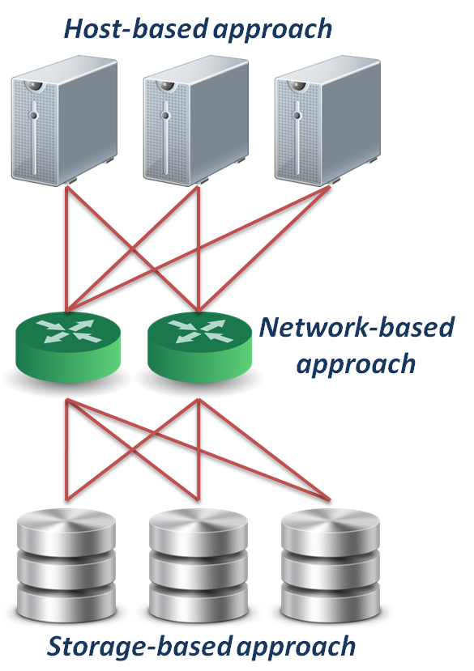
Where To Be Virtualized
Different approaches :
Host-based approach
Implemented as a software running on host systems.
Network-based approach
Implemented on network devices.
Storage-based approach
Implemented on storage target subsystem.

Slide 9
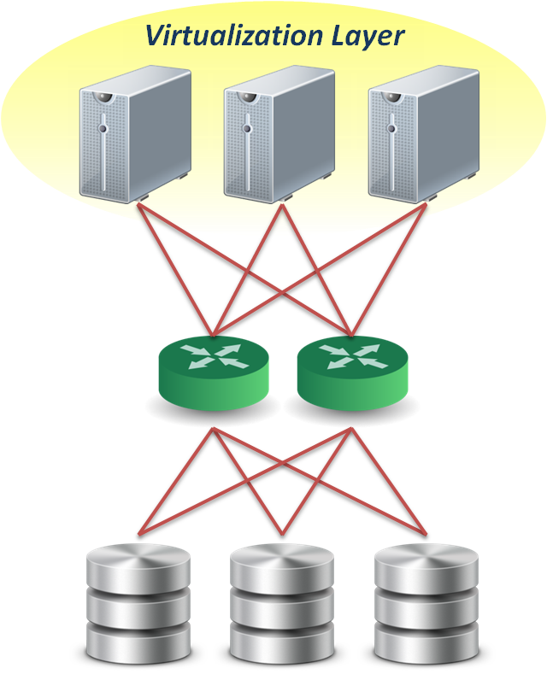
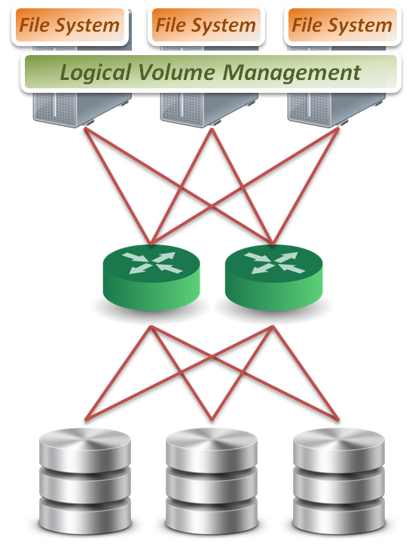
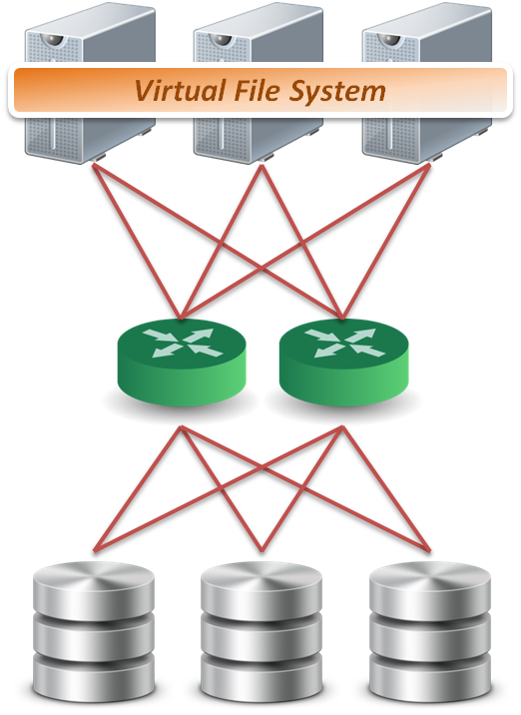
Host-based Virtualization
File level
Run virtualized file system on the host to map files into data blocks, which distributed among several storage devices.
Block level
Run logical volume management software on the host to intercept I/O requests and redirect them to storage devices.
Block 1
Block 2
Block 1
Block 2
Block 1
Sub-file 1
Sub-file 2
Sub-file 3

Slide 10
Storage Metadata Servers
Storage metadata may be shared by multiple servers.
Shared metadata enables a SAN file system view for multiple servers.
Provides virtual to real logical block address mapping for client.
A distributed SAN file system requires file locking mechanisms to preserve data integrity.

Slide 11
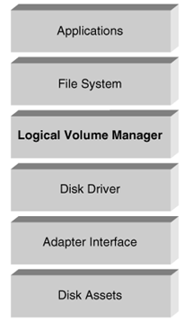
Host-based Virtualization
A typical example (LVM):
Software layer between the file system and the disk driver.
Executed by the host CPU.
Lack of hardware-assist functions.
Independence from vendor-specific storage architectures.
Dynamic capacity allocation to expand or shrink volumes.
Support alternate pathing for high availability.

Slide 12
Pros and Cons
Pros
No additional hardware or infrastructure requirements
Simple to design and implement
Improve storage utilization
Cons
Storage utilization optimized only on a per host base
Software implementation is depending on each operating system
Consume CPU clock cycle for virtualization

Slide 13
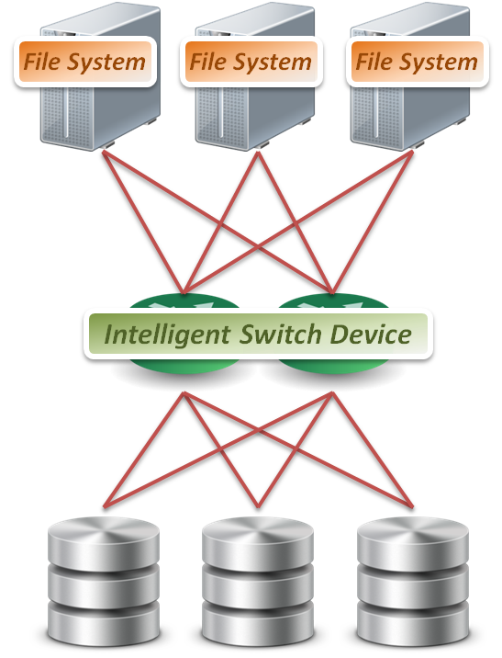
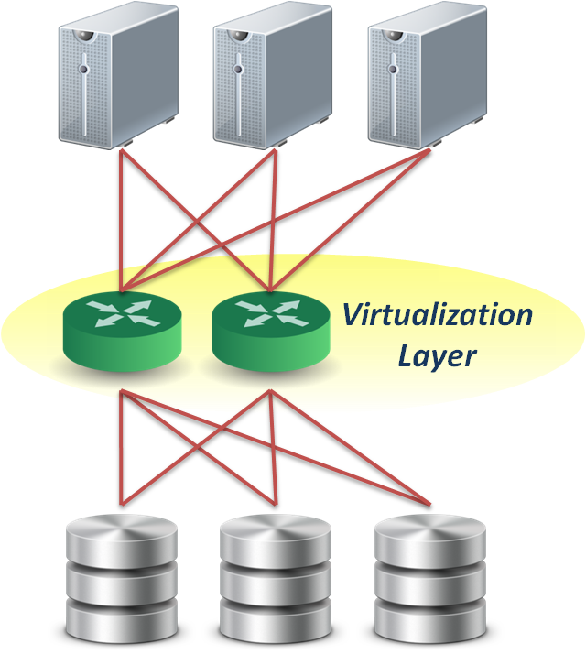
Network-based Virtualization
File level
Seldom implement file level virtualization on network device.
Block level
Run software on dedicated appliances or intelligent switches and routers.
Provide services
Multi-path
Storage pooling
Block 1
Block 2
Block 1
Block 2
Block 1

Slide 14
Requirements of Storage Network
Intelligent services
Logon services
Simple name server
Change notification
Network address assignment
Zoning
Fabric switch should provide
Connectivity for all storage transactions
Interoperability between disparate servers, operating systems, and target devices

Slide 15
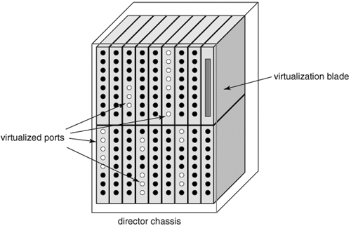
Fabric Switch Virtualization
A PC engine provisioned as an option blade.
Data center directors
Should be able to preserve the five nines availability characteristic of director-class switches.
Dedicated virtualization ASICs provide high-performance frame processing and block address mapping.

Slide 16
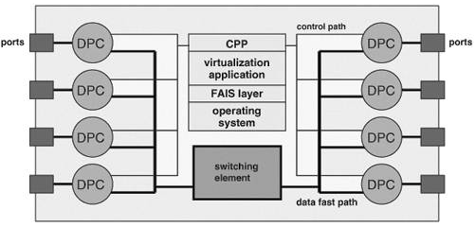
Fabric Application Interface
Fabric Application Interface Standard (FAIS): a set of APIs to integrate applications and switches.
The control path processor (CPP) supports the FAIS APIs and upper layer storage virtualization application.
The data path controller (DPC) executes the virtualized SCSI I/Os under the management of one or more CPPs

Slide 17
Pros and Cons
Pros
True heterogeneous storage virtualization
No need for modification of host or storage system
Multi-path technique improve the access performance
Cons
Complex interoperability matrices - limited by vendors support
Difficult to implement fast metadata updates in switch device
Usually require to build specific network equipments (e.g., Fibre Channel)

Slide 18
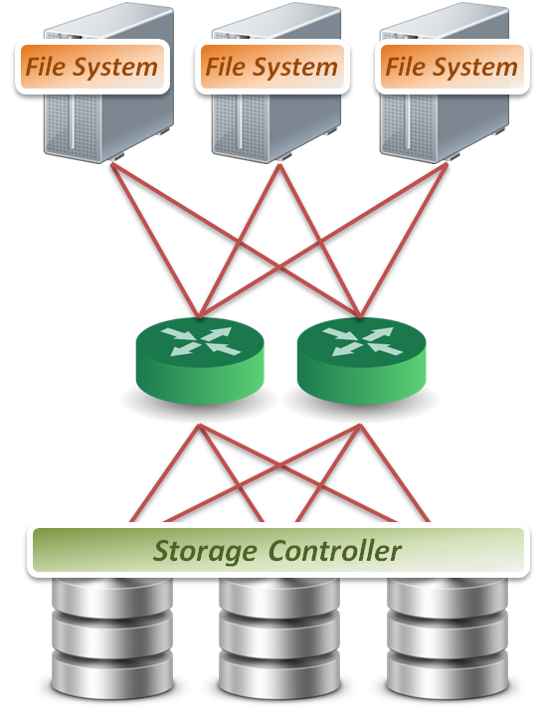
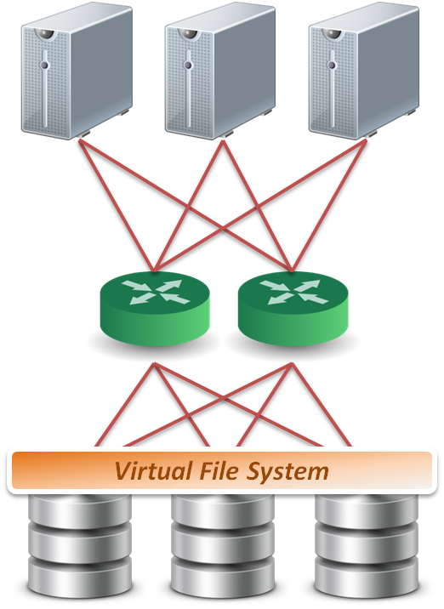
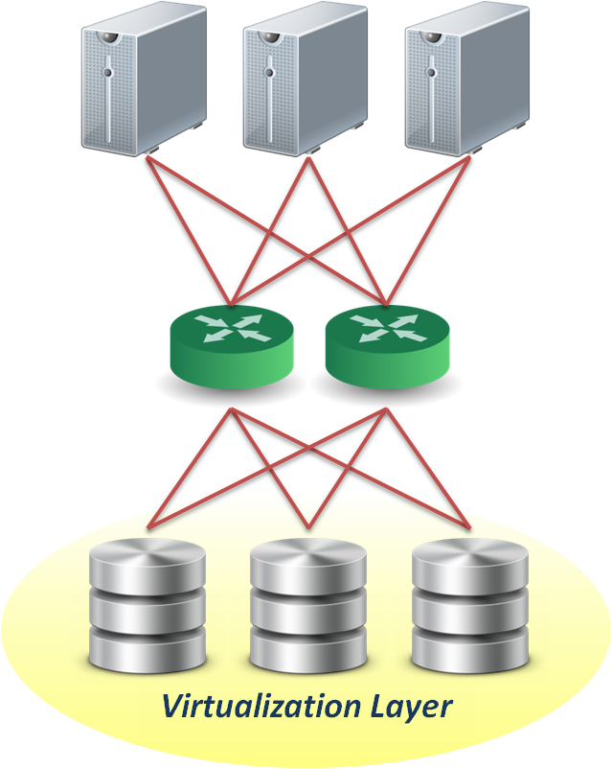
Storage-based Virtualization
File level
Run software on storage device to provide file based data storage services to host through network.
Block level
Embeds the technology in the target storage devices.
Provide services
Storage pooling
Replication and RAID
Data sharing and tiering
Block 1
Block 1
Block 1
Replica
Replica
Replica
Block 1
Block 1
Block 1
Sub-file 1
Sub-file 1.bak
Sub-file 2
Sub-file 2.bak
Sub-file 3

Slide 19
Array-based Virtualization
Storage controller
Provide basic disk virtualization in the form of RAID management, mirroring, and LUN mapping or masking.
Allocate a single LUN to multiple servers.
Cache memory
Enhance performance.
Storage assets coord.
Coordination between multiple storage system is necessary to ensure high availability.

Slide 20
Data Replication
Synchronous vs. Asynchronous
Synchronous data replication ensures that a write operation to a secondary disk array is completed before the primary array acknowledges task completion to the server.
Asynchronous data replication provides write completion by the primary array, although the transaction may still be pending to the secondary array.

Slide 21
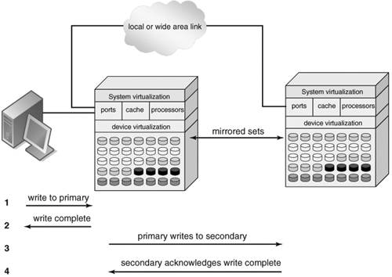
Data Replication
Synchronous
Asynchronous
To preserve performance, synchronous data replication is limited to metropolitan distances
Asynchronous data replication is largely immune to transmission latency

Slide 22
Other Features
Point-in-time copy ( snapshot )
Snapshot copies can be written to the secondary storage arrays.
Provide an efficient means to quickly recover.
Distributed modular virtualization
Decoupling storage controller logic from physical disk banks provides flexibility to support heterogeneous disk assets.
Accommodates class of storage services and data lifecycle management.

Slide 23
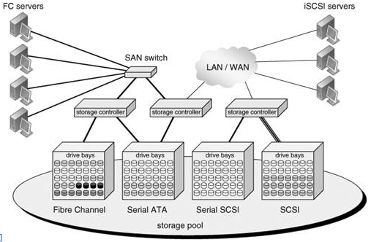
Distributed Modular Virtualization
Decoupling storage controller intelligence and virtualization engines from physical disk banks facilitates multi-protocol block data access and accommodation of a broad range of disk architectures.

Slide 24
Pros and Cons
Pros
Provide most of the benefits of storage virtualization
Reduce additional latency to individual IO
Cons
Storage utilization optimized only across the connected controllers
Replication and data migration only possible across the connected controllers and the same vendors devices

Slide 25
Outline
Storage management syste
Where to virtualize?
Host-based virtualization
Network-based virtualization
Storage-based virtualization
How to virtualize?
In-band and out-band virtualization
Heterogeneous storage
Case study: LVM

Slide 26
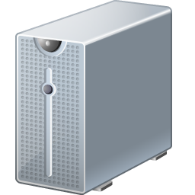
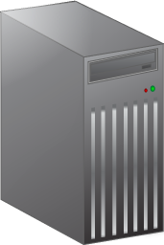
In-band Virtualization
Control Message
Control Message
Control Message
Devices sit in the data path between the host and storage.
Hosts perform IO to the virtualized device and never interact with the actual storage.
Pros
Easy to implement
Cons
Bad scalability & Bottle neck
Control Message
Control Message
Control Message
Data
Data
Data

Slide 27
Out-of-band Virtualization
Devices are sometimes called metadata servers.
Require additional software in the host which knows the first request location of the actual data.
Pros
Scalability & Performance
Cons
Hard to implement
Control Message
Control Message
Control Message
Control Message
Control Message
Control Message
Data
Data
Data

Slide 28
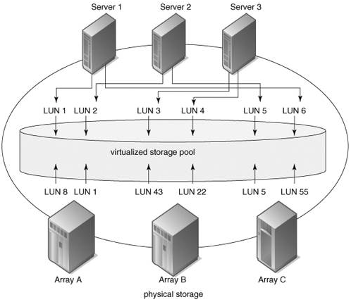
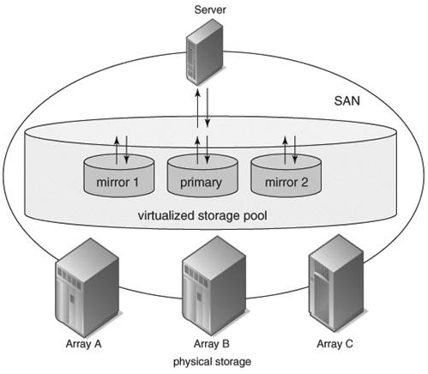
Heterogeneous Storage
Pooling Heterogeneous Storage Assets
Heterogeneous Mirroring

Slide 29
Heterogeneous Storage
Heterogeneous Data Replication

Slide 30
Outline
Storage management syste
Where to virtualize?
Host-based virtualization
Network-based virtualization
Storage-based virtualization
How to virtualize?
In-band and out-band virtualization
Heterogeneous storage
Case study: LVM

Slide 31
Logical Volume Management
Virtualized at block level
Host-based virtualization approach
In-band virtualization

Slide 32
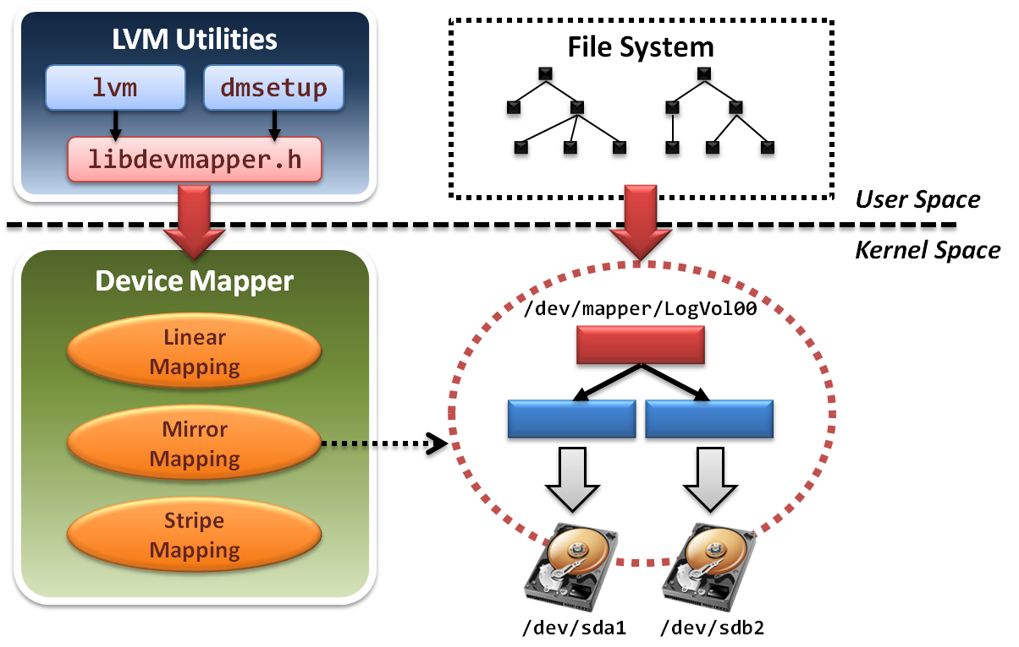
LVM Architecture

Slide 33
Two Components in LVM
In user space
Some management utilities and configuration tools Ex. lvm , dmsetup
Programming interface with a well-designed library Ex. libdevmapper.h
In kernel space
Implement device mapper framework
Provide different mapped device targets Ex. linear , stripe , mirror …etc.

Slide 34
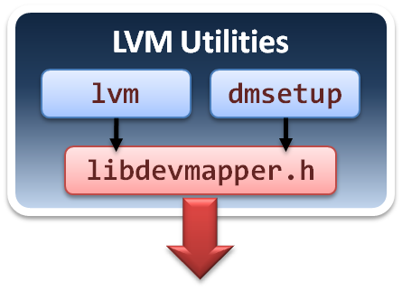
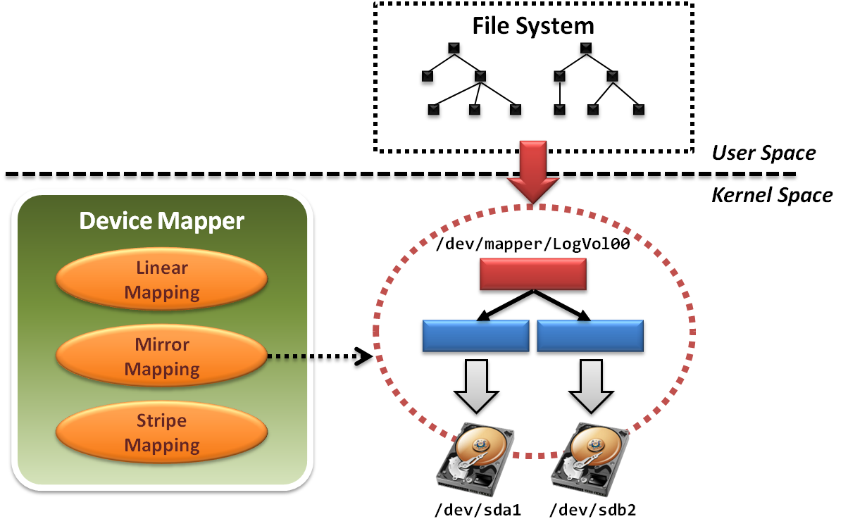
User Space
Tools and utilities are in user space.

Slide 35
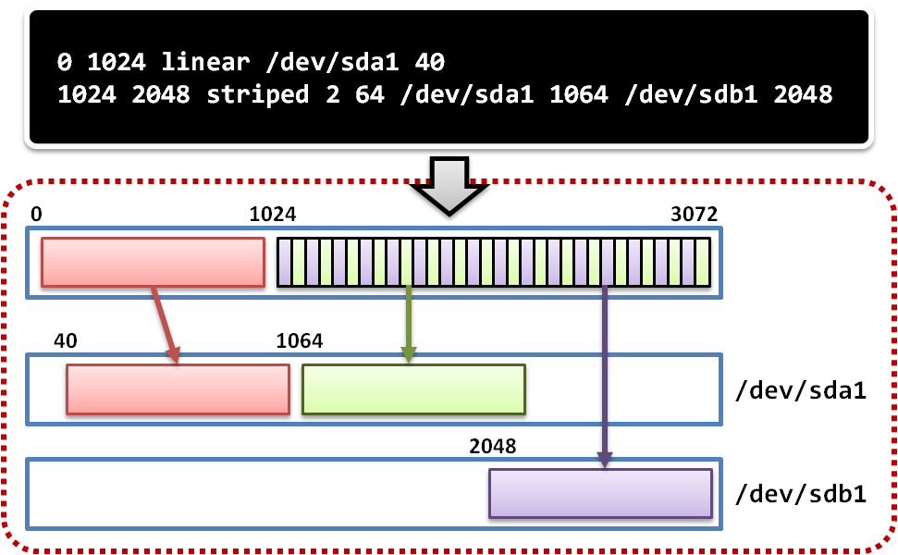
Example of LVM Partition

Slide 36
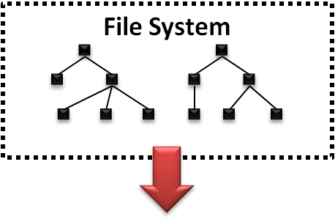
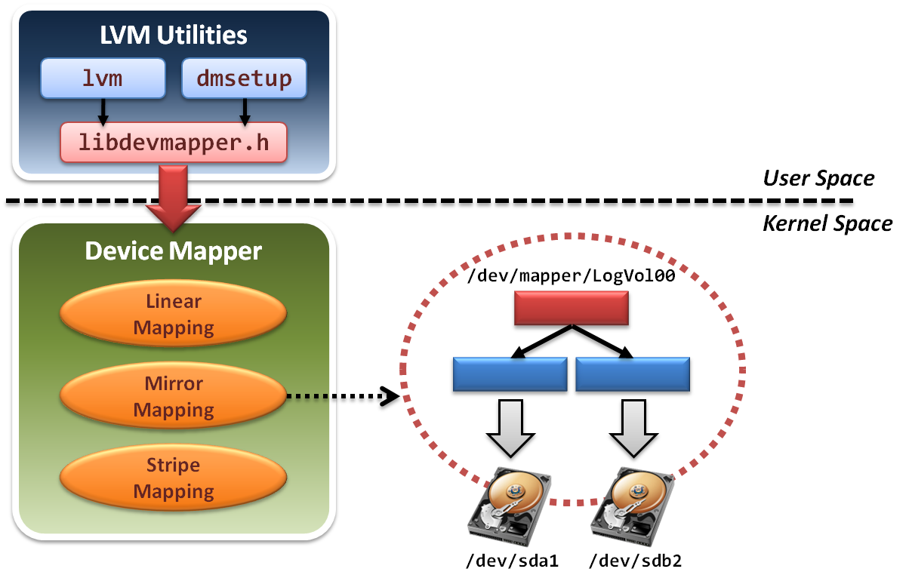
File System
File system will build upon device mapper framework by means of system calls.

Slide 37
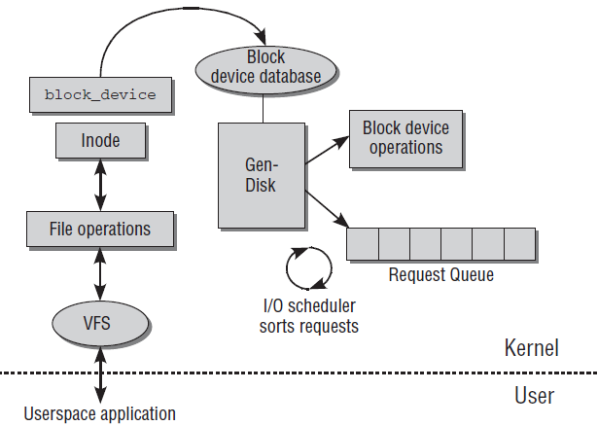
File System in Kernel Space
FS invokes a set of block device system calls.
Device Mapper framework reload operation functions

Slide 38
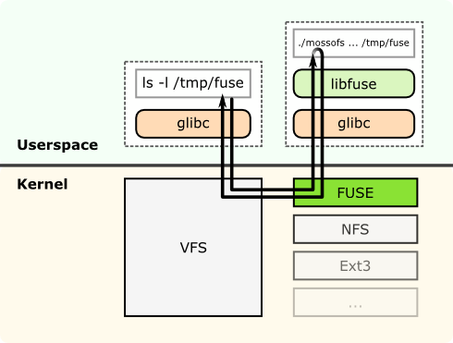
File System in User Space (FUSE)

Slide 39
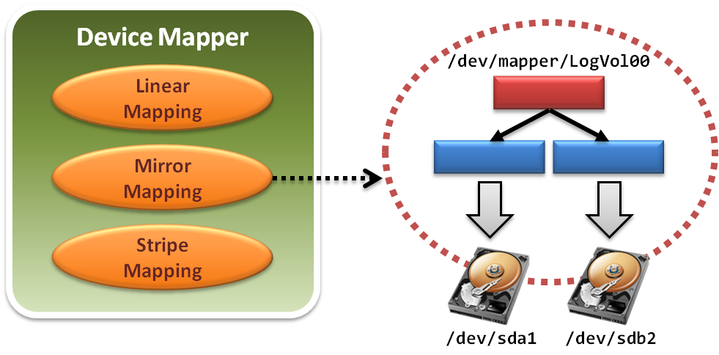
Device Mapper Framework
A Linux kernel driver for different mappings.

Slide 40
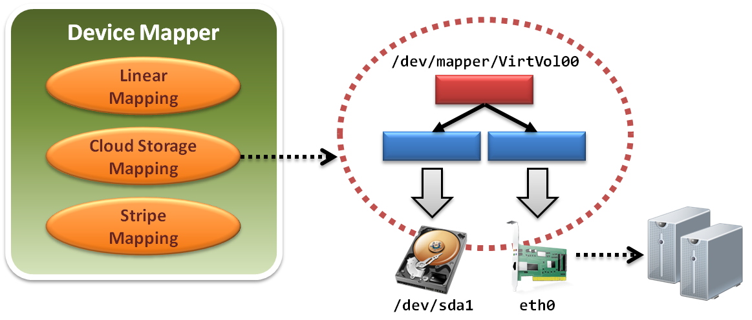
Integration with Network Storage

Slide 41
References
Lecture notes from Yeh-Ching Chung
Tom Clark, Storage Virtualization: Technologies for Simplifying Data Storage and Management, Addison Wesley Professional, 2005.
From Wikipedia, the free encyclopedia
Logical Volume Management (LVM). http://www.tldp.org/HOWTO/LVM-HOWTO/

