Slide 1
Cloud Computing
Cloud Management
Che-Rung Lee

Slide 2
Outline
VM provision
Scaling and load balancing
Energy-efficient provision

Slide 3
VM Provision Process
Select a server from a pool of available servers
Physical server with enough resources
With appropriate OS template (image)
Load the desired software
OS, device drivers, middleware, …
Customize and configure the machine
IP address, gateway, storage, …
Start the VM

Slide 4
Some Frameworks
Distributed Management Task Force (DMTF) is an industry organization that develops, maintains and promotes standards for systems management in enterprise IT environments.
The Open Cloud Computing Interface (OCCI) is a protocol and API for management tasks.

Slide 5
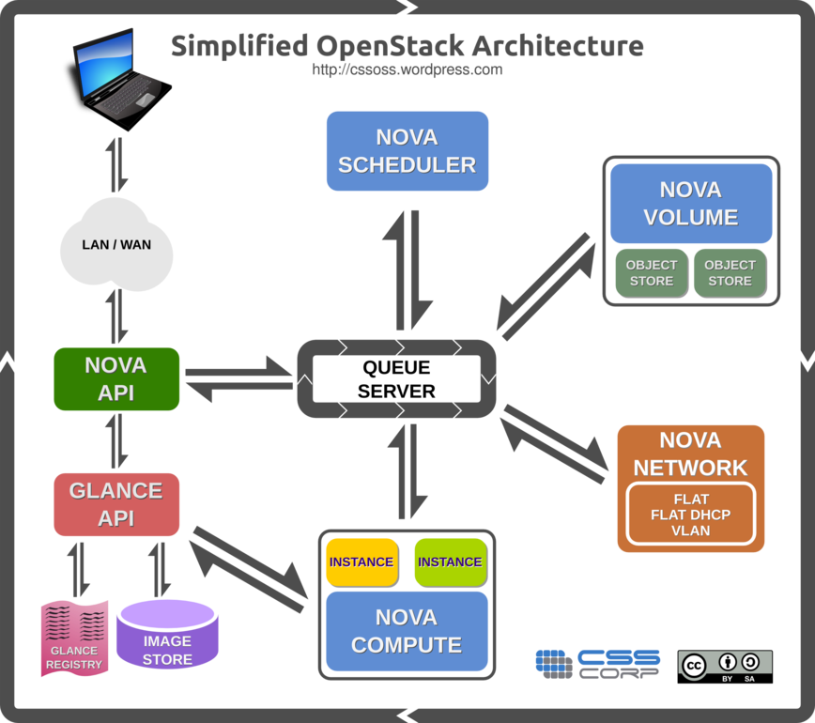
Ex: OpenStack

Slide 6
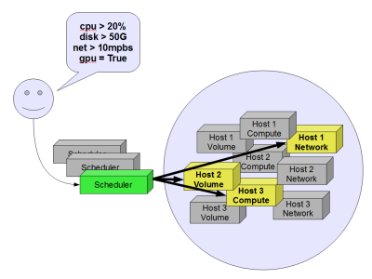
Scheduler
Scheduling is like a dating service, which matches requests and machines.

Slide 7
Allocation Methods
Random allocation: select an allocation randomly
Fastest fit allocation: select an allocation that has the best configuration
Best fit allocation: select an allocation that leaves smallest free machines in a cluster
Worst fit allocation: select an allocation that leaves largest free machines in a cluster
Cost-based allocation: select allocations based on some cost functions

Slide 8
Provision Models
Request Driven Provisioning
Users define their desired machine specification
SLA Driven Provisioning
Adaptively satisfy service level agreements (SLAs) for performance and availability statistical guarantees against load variations and software/hardware failures.
Capacity Driven Provisioning
Customers buy or bid on unused capacity of IaaS providers and run instances.
EC2 spot instance

Slide 9
Parameters Affecting Allocation
Network parameters
Bandwidth, throughput, session overhead, fetch time, session lifetime
Resource parameters
Number of CPU and memory, CPU speed
Data processing parameters
Job size, number of sessions, block size, total Time

Slide 10
Capacity Planning
Capacity planning is the process of determining the production capacity needed by an organization to meet changing demands for its products.
Ex: Capacity = (number of machines) × (utilization) × (efficiency).

Slide 11
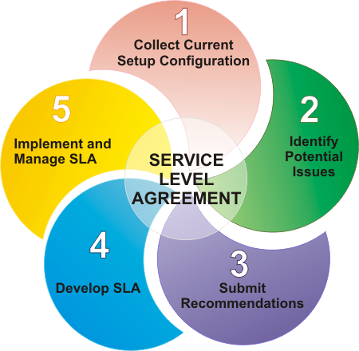
Service-Level Agreement
A service contract where the level of service is formally defined.
The contracted delivery time or performance.
MTBF: mean time between failures
MTTR: mean time to repair or mean time to recovery
Various data rates, throughput or jitter,…

Slide 12
Outline
VM provision
Scaling, load balancing, and fault tolerance
Energy-efficient provision

Slide 13
Auto Scaling & Load Balancing
Auto Scaling automatically adjusts the size of servers, which can add or remove servers to deal with load changes of applications.
Load Balancing automatically distributes incoming application traffic across multiple servers.

Slide 14
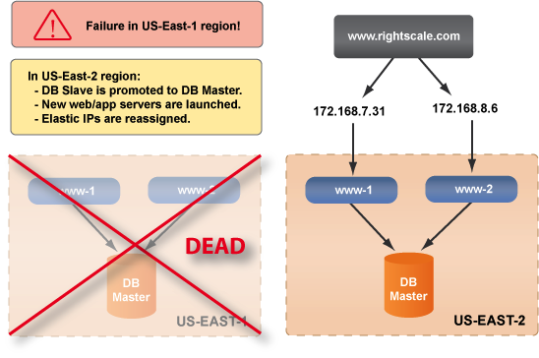
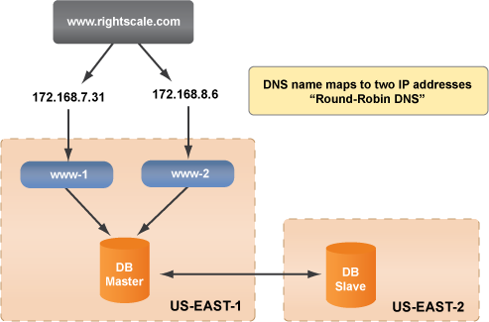
Fault Tolerance Design
Allocate additional VMs for fault tolerance
Failover

Slide 15
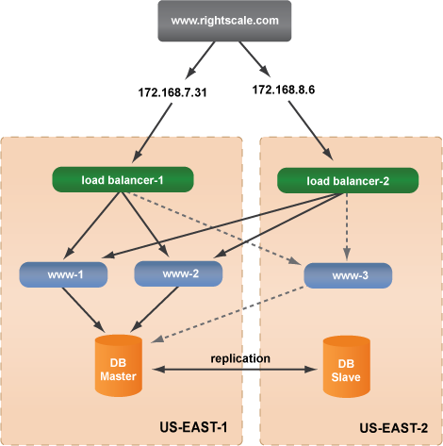
More Complicated Set-up

Slide 16
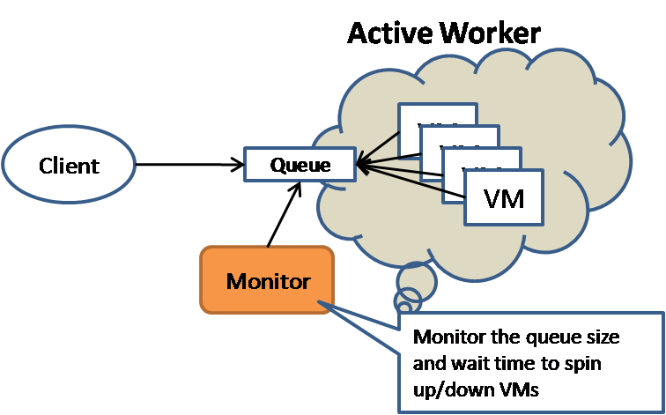
Active Worker Scaling Model
The client puts the request to a queue, which will be periodically polled by the server.
After queuing the request, the client will do other work and come back later to pickup the result.
The client can also provide a callback address where the server can push the result into after the processing is done.

Slide 17
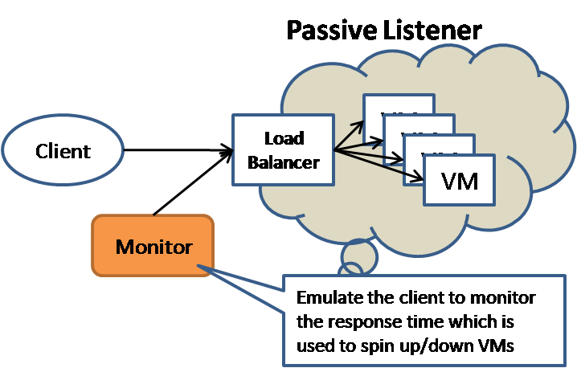
Passive Listener Scaling Model
The client pushes request to the server and synchronously wait for the processing result.
VMs are typically sit behind a load balancer.
To scale the resource according to the work load, a monitor service that sends NULL client request and use the measured response time to spin up and down the size of VMs.

Slide 18
EC2-Auto-Scaling Algorithm
Use traffic analyzer to keep track of the average time taken to process client requests.
If the time increases over a threshold, new application instance will be started up.
Join the same service group
If the time decreases under a threshold, unnecessary instances may be terminated after a grace period.
To avoid the fluctuation

Slide 19
Load-Balancer
In EC2, dynamic load balancing is handled by replicating instances of the specific middleware
It is achieved through a traffic analyser, which tracks the time taken to process a client request
New instances of the platform are started when the load increases beyond pre-defined thresholds
Distributed load balancer
Natural inspired global balancer
Biased random sampling
System restructured to optimise job assignment

Slide 20
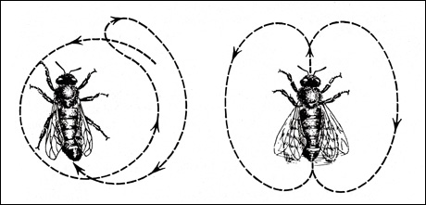
A. Inspiration from Honeybee
Behaviour of a colony of honeybees
Forager bees are sent to search for food;
When one is found, they return to the hive to advertise this using “waggle dance”.
The suitability of the food source may be derived from the quantity or quality of nectar the bee harvested, or its distance from the hive.

Slide 21
Analogy
Internet hosting center | Honey bee colonies
An ensemble of N servers | N nectar foragers
Host M services | M distinct flower patches
A group of servers serving requests from a specific service queue | A group of nectar foragers collecting nectar at a specific flower patch
Time to service a request will be dependent on the service application | Time to travel will be dependent on the location of the flower patch
Time taken by a server to find a request to serve | Time taken by a forager to collect nectar at a flower patch
Server switching to another service incurs downtime due to purging and installation of service application/data | Forager switching to another flower patch incurs switching cost due to time spent learning the location
A service application and its requests have a value-per-request | A flower patch has quality of nectar (sugar concentration)

Slide 22
Load-balancing Operation
Idle servers (waiting bees) follow one of two behaviour patterns randomly:
A server that reads the advert board (dance floor) will follow the chosen advert, then serve the request;
A server not reading the advert board reverts to forage behaviour; servicing a random virtual server’s queue request.
Servers after finishing a request will modify the advert board (waggle-dancing)

Slide 23
B. Biased Random Sampling
The load on a server is represented by its connectivity in a virtual graph
The initial network is constructed with server node. Each in-degree mapped to the server’s free resources, and is connected randomly to other nodes.
When executing a new job, a node removes an incoming edge to indicate available resources are reduced
When completing a job, a server creates a new inward edge to indicate available resources increased

Slide 24
Server Selection
The increment and decrement process is performed via random sampling.
The sampling walk starts at a specific node; at each step moving to a neighboring node chosen randomly.
The last node in the sampling walk is selected for the load allocation.
The effectiveness of load distribution is considered to increase with walk length, referred to herein as w.
An effective w threshold is around log(n) steps, where n is the network size.

Slide 25
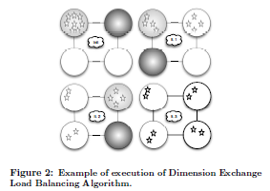
C: Active Clustering
Observation: many load balancing algorithms only work well where the nodes are aware of “like” nodes and can delegate workload to them
Active clustering is intended to group similar service type instances together

Slide 26
Outline
VM provision
Scaling, load balancing, and fault tolerance
Energy-efficient provision

Slide 27
Introduction
Energy consumption of IT equipment increase year by year
Estimated 61 billion kWh consumed by IT infrastructures in 2006, and it is expected to be doubled by 2011.

Slide 28
Power and Energy Models
Power P = W / T
W is the total work performed during T
T is a period of time
Energy E = PT
Dynamic power consumption P_{dynamic} = aCV²f
a, C: constants, V: supply voltage, f: clock frequency
Dynamic voltage and frequency scaling (DVFS)
A reduction of the power consumption does not always reduce the consumed energy

Slide 29
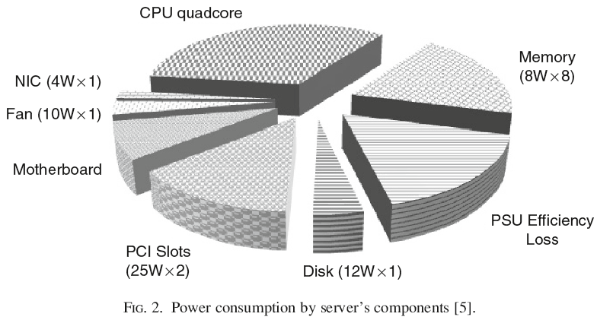
Source of Power Consumption
Dynamic power range
CPU 70%
Mem 50%
Disk 25%
Net. 15%
Ave 30%
Efficiency of power supplies depends on their load
Highest efficiency within the range of 50-75%

Slide 30
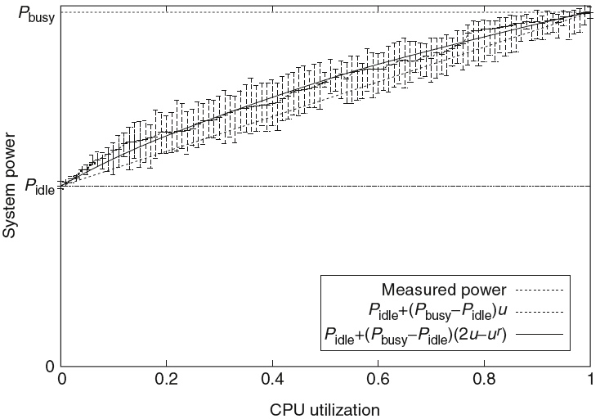
Modeling Power Consumption
Notes:
DVFS 可能再怎麼降可能也比不上 consolidation 加上關機省的電多，值得研究

Slide 31
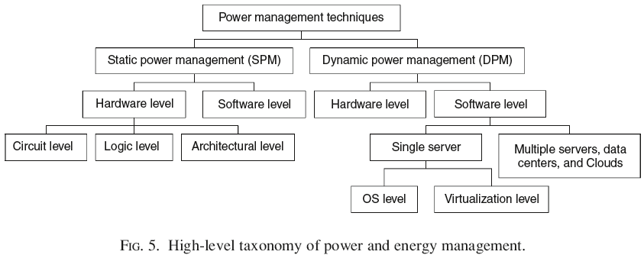
Power and Energy Management
Dynamic power management (DPM)
Dynamic voltage and frequency scaling (DVFS)
Dynamic component deactivation (DCD)
Advanced Configuration and Power Interface (ACPI)

Slide 32
Power Optimization
Power optimization in different levels
Hardware and Firmware Level
Operation System Level
Virtualization Level
Data Center Level

Slide 33
Hardware and Firmware Level
DCD: Dynamic Component Deactivation
Predictive: based on historical data
Stochastic: based on probabilistic model
DPS: Dynamic Performance Scaling
Resource throttling: limit the energy consumption?
Notes:
Static: 依造歷史資訊或固定時間，dynamic: runtime 動態調整threshold or parameter
Interval-based: 依前一段時間的CPU utilization來調整下一段時間的voltage，Intertask: 依工作所需CPU load分類並因此調整voltage，intratask: 單一工作內部做profile並視其隨時間的計算需求調整CPU load。

Slide 34
Virtualization Level
Virtualization vendors
Xen, Vmware, KVM, …
Energy management for VMM
Virtualization may cause problem for energy-aware OS since the allocated hardware resources is not dedicated
Example: two VMs on single server and one VM asks for lower CPU frequency while the other one ask for raising frequency.

Slide 35
Data Center Level
PUE: Power Usage Effectiveness
Computing power vs cooling and operational power
Cooling system design (container data center)
CPU, memory, harddisk, environment
Air cooling or close cooling
VM allocation and VM consolidation
Which VMs should be activated
The power overhead of consolidation

Slide 36
References
Lecture notes from Yeh-Ching Chung
Bonvin, Nicolas ; Papaioannou, Thanasis G. ; Aberer, Karl, “Autonomic SLA-driven Provisioning for Cloud Applications”, CCGrid 2011
Martin Randles, David Lamb, A. Taleb-Bendiab, „A Comparative Study into Distributed Load Balancing Algorithms for Cloud Computing “, 2010 IEEE 24th Intl. Conf. on Advanced Information Networking and Applications
K Hima Prasad et al., “Resource Allocation and SLA Determination for Large Data Processing Services Over Cloud,” In Proc. IEEE International Conference on Services Computing, pp. 522-529, 2010.
Anton Beloglazov, et. al, “A Taxonomy and Survey of Energy-Efficient Data Centers and Cloud Computing Systems”, Advances in Computers, Volume 82, 47-111pp

