Slide 1
Cloud Computing
VM Management
Che-Rung Lee

Slide 2
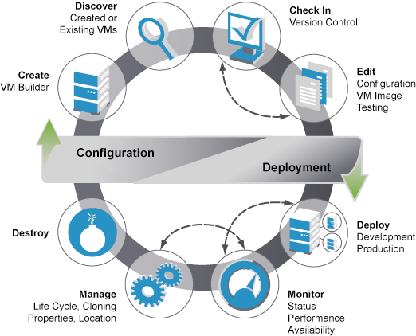
VM Life Cycle
http://www.novell.com/documentation/zen_orchestrator13

Slide 3
Outline
VM Life Cycle
VM consolidation
Memory overcommit
Intra VMM network
VM migration
Live migration

Slide 4
VM Consolidation
Increase system utilization
VM consolidation is the way to share power/hardware/...
Hardware is getting cheaper, electricity is not
Main challenge: memory system
Memory reclamation
Memory sharing
Memory compression

Slide 5
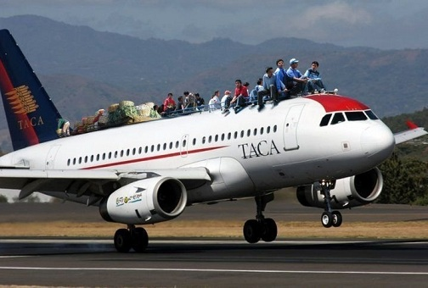
Memory Overcommit
Suppose each VM requests 4G RAM
But it usually uses 2.5 G RAM
Suppose host machine has 48 G RAM
It can only suppose 12 VMs (48/4=12)
With memory overcommit
it can suppose 19 VMs
The memory saved is 19*4-48 = 24G

Slide 6
Problems of Memory Overcommit
Memory is a non-renewable resource
Secondary storage is really slow.
Many millions of CPU cycles in one disk seek
Process in guest accesses non-resident memory
Memory reclaim
Which VM/process/page to reclamation?
Memory sharing
Which pages can be shared?

Slide 7
Memory Reclamation
Problem: when the physical memory is not enough, host machine (VMM) needs to reclaim memory from VMs
Which VM to reclaim?
Which pages to reclaim?
Double paging problem
Solutions
Asynchronized page fault
Ballooning technique

Slide 8
Asynchronized Page Fault
Host memory overcommit may cause guest memory to be swapped.
When guest vcpu access memory swapped out by a host its execution is suspended until memory is swapped back.
Asynchronous page fault is a way to try and use guest vcpu more efficiently by allowing it to execute other tasks while page is brought back into memory.

Slide 9
Ballooning
A balloon is a pseudo-device driver to guest OS
Memory reclamation steps
When host needs to reclaim memory from the guest OS, it inflates the balloon.
Balloon requests memory in guest OS
Guest OS needs to page out guest memory to satisfy the request.
The requested memory by the balloon is reclaimed by the host.

Slide 10
Performance of Ballooning
Experiments on VMware ESX

Slide 11
Problems of Ballooning
What if guest OS touches the memory of ballooning device?
VMM needs to allocate a new page to guest OS
In booting, the ballooning device may not be activated yet. Or the ballooning device fails or not efficient enough.
An alternative method is still needed to claim memory.

Slide 12
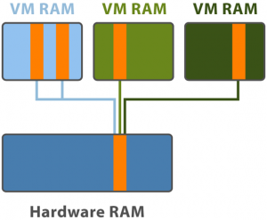
Transparent Page Sharing
Multiple VMs share the same page
The content of the page are the same to all the VMs
Many system (OS) memory are the same

Slide 13
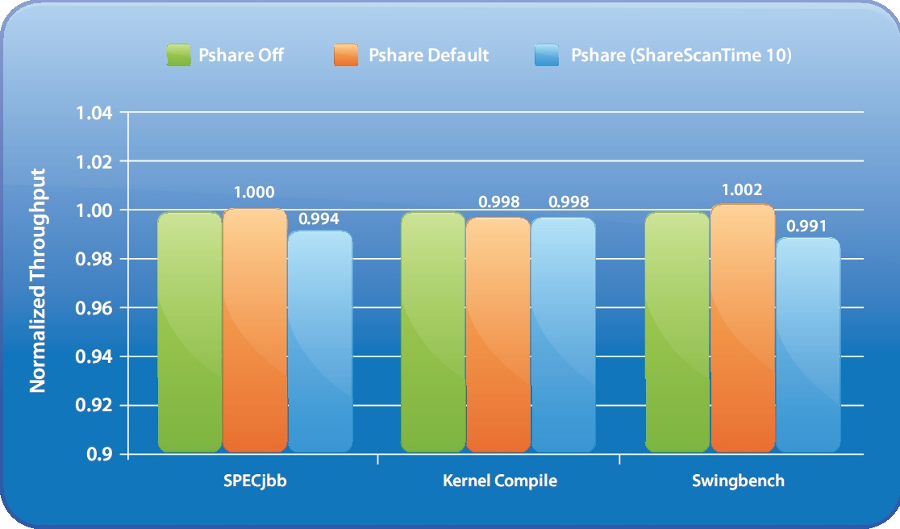
Performance of TPS
Experiments on VMware ESX

Slide 14
How to Decide Identical Pages?
If there are N pages per VM and there are k VMs, the number of comparison will be O(N²k².)
Memory comparison of two pages is expensive.
Binary string comparison of two size m data, where m is the page size.
Using hashing
Pages with the same hashcode may be identical.
Pages with different hashcodes must be different.
Reduce the unnecessary page comparisons.

Slide 15
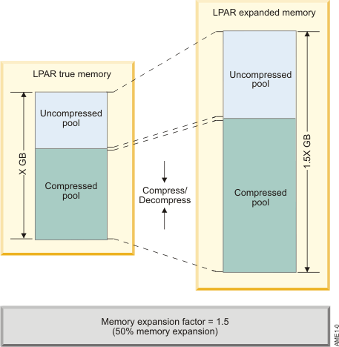
Memory Compression
Data are compressed in main memory, and decompressed when loaded to cache.
Special hardware are employed to performe the compression and decompression.
IBM MEXT

Slide 16
Outline
VM Life Cycle
VM consolidation
Memory overcommit
Intra VMM network
VM migration
Live migration

Slide 17
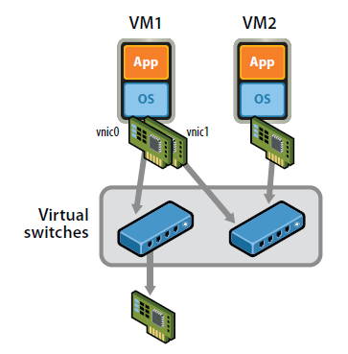
Network in A Box
VMs are connected logically to each other.
Each virtual network is serviced by a single virtual switch.
A virtual network can be connected to a physical network by associating one or more network adapters (uplink adapters) with the virtual switch.

Slide 18
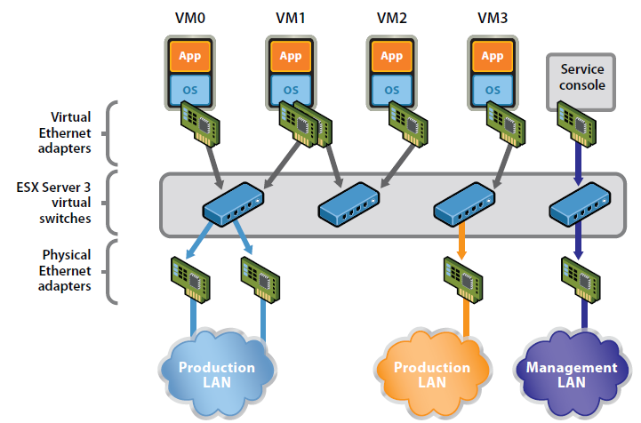
Example from VMware

Slide 19
Linux Solution
Linux provides two mechanisms for intra VMM communication: TUN/TAP and Bridge
TUN/TAP: Virtual machines connect to host by a virtual network adapter, which is implemented by TUN/TAP driver.
Linux Bridge :Virtual adapters will connect to Linux bridges, which play the role of virtual switch.

Slide 20
TUN/TAP Driver
TUN and TAP are virtual network kernel drivers :
TAP simulates an Ethernet device and it operates with layer 2 packets such as Ethernet frames.
TUN simulates a network layer device and it operates with layer 3 packets such as IP.
Data flow of TUN/TAP driver
Packets sent by a TUN/TAP device are delivered to a user-space program that attaches itself to the device.
A user-space program may pass packets into a TUN/TAP device, which delivers these packets to the network stack.

Slide 21
TUN/TAP Driver

Slide 22
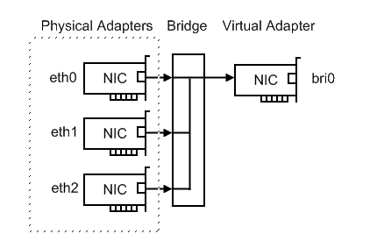
Linux Bridge
Bridging is a forwarding technique used in packet-switched computer networks.
Unlike routing, bridging makes no assumptions about where in a network a particular address is located.
Bridging depends on flooding and examination of source addresses in received packet headers to locate unknown devices.
Bridging connects multiple network segments at the data link layer (Layer 2).

Slide 23
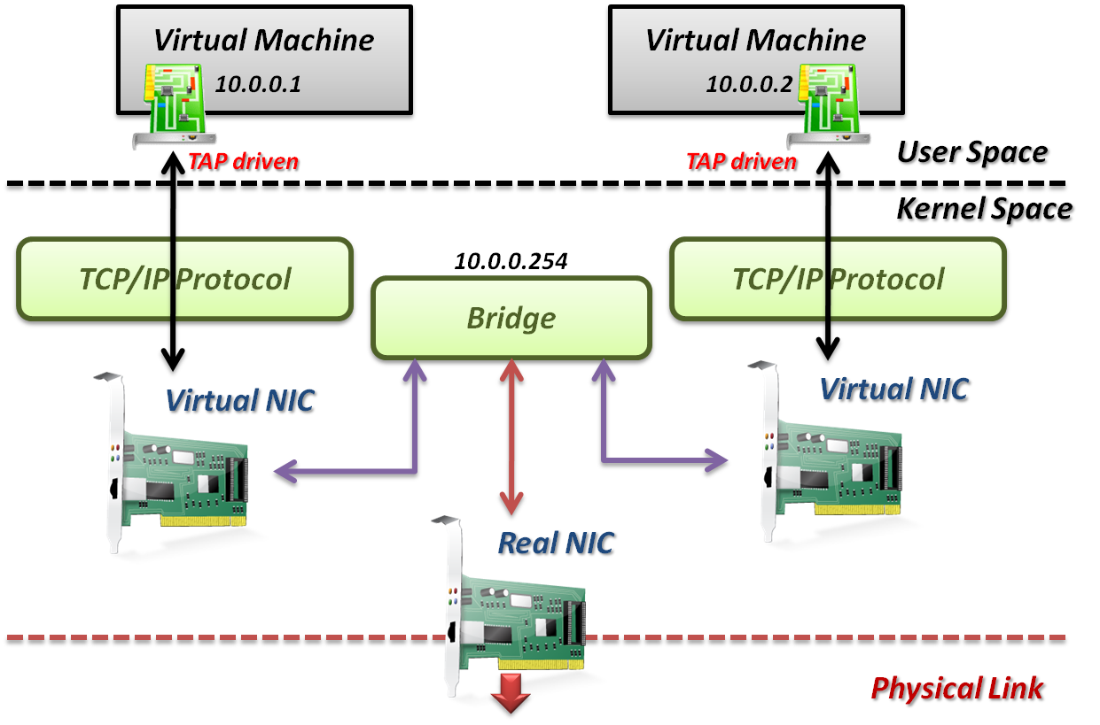
TAP/TUN Driver + Linux Bridge

Slide 24
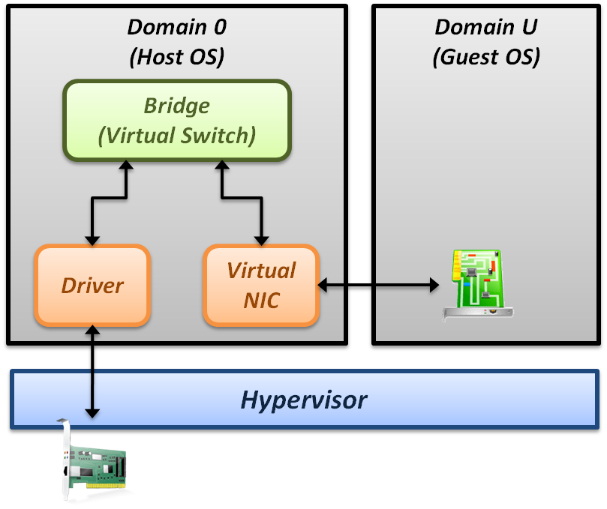
Implementation in Xen
Page remapping
Hypervisor remap memory page for MMIO.
Context switching
Whenever packets send, induce one context switch from guest to Domain 0 to drive real NIC.
Interrupt handling
Interrupt induces one context switch again.

Slide 25
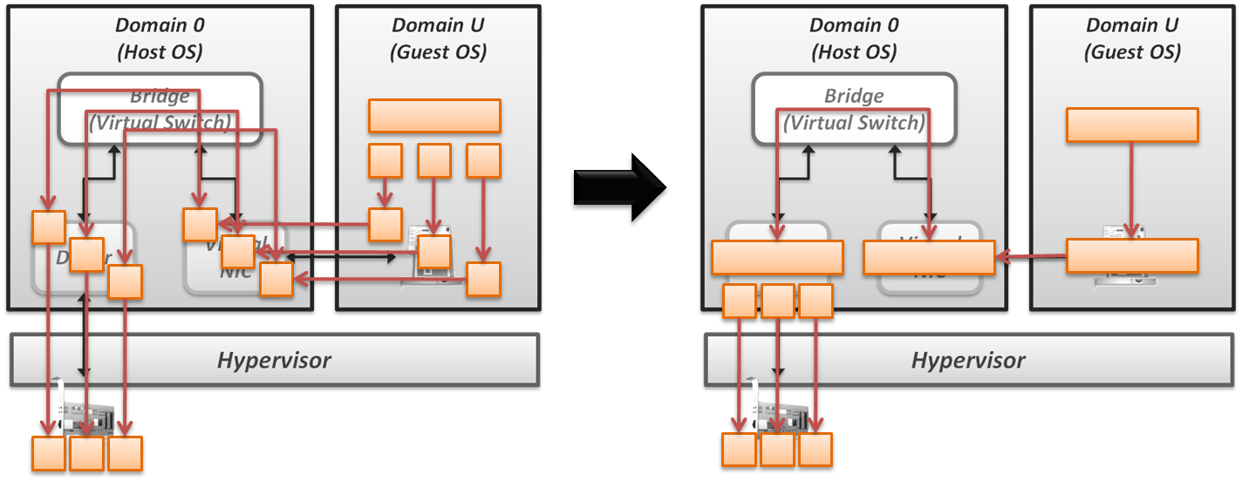
Performance Improvement
Improve Xen performance by software
Large effective MTU, fewer packets, and lower per-byte cost

Slide 26
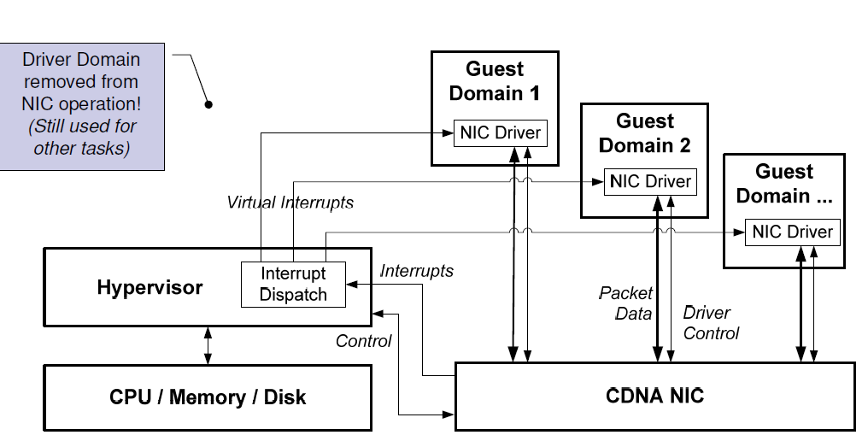
Performance Impv. By Hardware
CDNA (Concurrent Direct Network Access) hardware adapter.

Slide 27
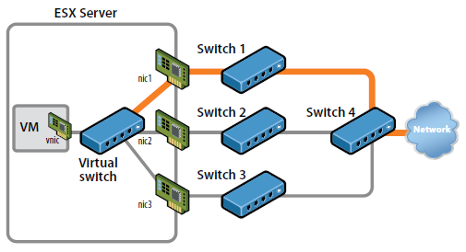
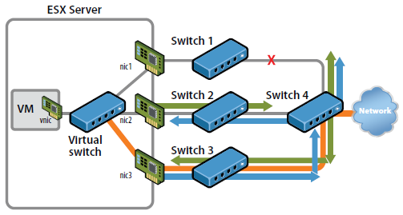
Redundant Links (VMware)
Use redundant links to provide high availability.
Virtual switch in host OS will automatically detect link failure and redirect packets to back-up links.

Slide 28
Outline
VM Life Cycle
VM consolidation
Memory overcommit
Intra VMM network
VM migration
Live migration

Slide 29
What is VM Migration?
Moving a VM from one physical machine to another one
Cold migration: VM stops to execute any currently working program and copy the current states to the machine where the VM migrates.
Live migration: During the migration process, the execution in VM might go on without stopping the execution of programs.
http://criterionglobal.wordpress.com/2008/10/

Slide 30
Why VM Migration?
Consolidate resources
Load balance
System maintenance
Performance improvement
User’s carte blanche of VM
Why live migration?
Avoid the problem of `residual dependencies’.
Avoid the stop of programs execution.

Slide 31
What to Migrate?
The VM status needs be moved to new physical machine
Register, memory, harddisk, …
Data in cache are usually flushed before migration
Data in harddisk may not be attached to the physical machine (we will talk about it later).
VM managing information.
Virtualized hardware info.

Slide 32
Problems of Migration
Performance of server migration
The system state includes memory, cache, register,…
The memory size can be very large
Minimize the downtime
The data/storage migration
Block device migration
NAS redirection
The network migration
Maintain the network connection
Maintain the LAN structure

Slide 33
Two Major Concerns
Downtime: the period during which the service is unavailable due to there being no currently executing instance of the VM
This period will be directly visible to clients of the VM as service interruption.
Total migration time: the duration between when migration is initiated and when the original VM may be finally discarded.
The source host may potentially be taken down for maintenance, upgrade or repair.

Slide 34
Migration Methods
Stop-and-copy (S-C)
Demand-migration (D-M)
Iterative precopy (I-P)

Slide 35
Stop and Copy
Procedure
Stop source VM
Copy all pages over the network
Start destination VM
Longest service downtime
Shortest migration duration

Slide 36
Demand Migration
Procedure
Copy over critical OS structures
Start destination VM
Page faults trigger network copy
Shortest Service Downtime
Longest Migration Duration

Slide 37
Iterative Precopy
Procedure
Iteratively copy pages over network
Keep copying dirtied pages until threshold
At threshold, stop source VM, copy remaining pages, start destination VM
Balances service downtime and migration duration
Method used by VMware/Xen

Slide 38
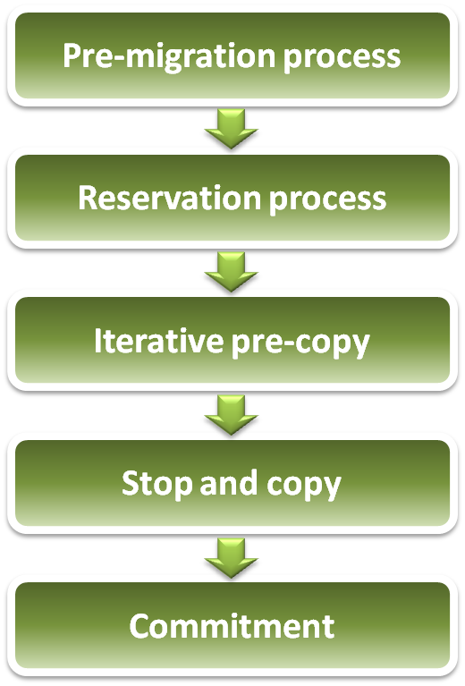
Live Migration Technique
Relocation strategy :
Pre-migration process
Reservation process
Iterative pre-copy
Stop and copy
Commitment

Slide 39
Live Migration Technique
Pre-migration process
Reservation process
VM active on host A
Destination host selected (Block devices mirrored)
Initialize container on target host
Copy dirty pages in successive rounds
Suspend VM on host A
Redirect network traffic
Synch remaining state
Activate on host B
VM state on host A released
Iterative pre-copy
Stop and copy
Commitment

Slide 40
Live Migration Technique
Live migration process :
Pre-copy migration : Round 1
Host A
Host B

Slide 41
Live Migration Technique
Live migration process :
Pre-copy migration : Round 2
Host A
Host B

Slide 42
Live Migration Technique
Live migration process :
Stop and copy : Final Round
Host A
Host B

Slide 43
Problems
Migration of block devices
Some harddisk is still attached on host
Massive data to migrate
Network forwarding/redirecting/tunneling
Ongoing network transmissions.
Migration over WAN
Hardware devices
Some data in hardware buffer need be migrated too.
Hardware assistant virtualization.

Slide 44
References
Lecture notes from Yeh-Ching Chung
Carl A. Waldspurger, ”Memory Resource Management in VMware ESX Server”, OSDI ’02, best paper award.
Gabe’s virtual world, http://www.gabesvirtualworld.com/
IBM Memory Expansion Technology (MXT)
Linux Bridge http://www.ibm.com/developerworks/cn/linux/l-tuntap/index.html
Xen networking http://wiki.xensource.com/xenwiki/XenNetworking
VMware Virtual Networking Concepts http://www.vmware.com/files/pdf/virtual_networking_concepts.pdf
TUN/TAP wiki http://en.wikipedia.org/wiki/TUN/TAP
Christopher Clark Keir, et. al, “Live migration of virtual machine.”, NSID 2005

