Slide 1

Cloud Computing
Server Virtualization
Che-Rung Lee

Slide 2
What is Virtualization?
Virtualization is to create an illusion of some actual things, such as servers, network,….
Often used in the partition of resources to satisfy multiple requests without the awareness of requesters.
  CPU virtualization: time sharing + context switch
  Memory virtualization: virtual memory
  Network cable virtualization: packet switch vs. circuit switch

Slide 3
Goals of Virtualization in Clouds
Hardware sharing
  On a physical resources, many virtual ones can share the same hardware as they owe it alone.
Performance
  The performance of virtualized resource can be close to the physical ones.
Migration
  Virtual machines can be migrated from one physical machine to another physical machine.
  Life migration: migration without interrupting the program executions on virtual machines.

Slide 4
What is a Virtual Machine?
A virtual machine (VM) is a software implementation of a machine (i.e., a computer) that executes programs like a physical machine.
Terminology :
  Host (Target) machine
  Guest (Source) machine
Host machine
Guest machine
Guest machine
Guest machine
Guest machine

Slide 5
Process Virtual Machine
Usually execute guest applications with an ISA different from host
Couple at ABI level via runtime system
Ex: Java virtual machine

Slide 6
System Virtual Machine
Provide the entire operating system on same or different host ISA
Constructed at ISA level

Slide 7
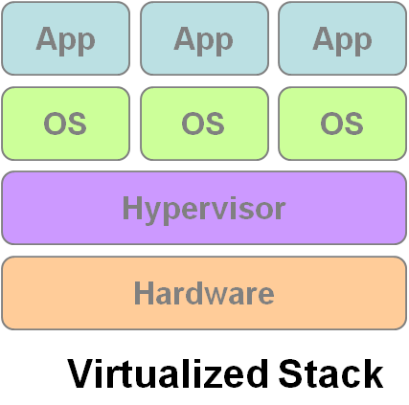
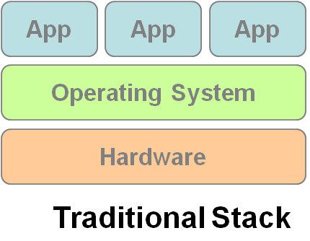
What’s a Virtual Machine Monitor?
A Virtual Machine Monitor (VMM) or Hypervisor is a software layer to support and manage the execution of VMs.
System architecture :
VM1
VM2
VM3

Slide 8
Types of VMMs
Classified by VMM’s role on host machines
  Type 1 – Bare metal
    VMMs run directly on the host's hardware as a hardware control.
    Ex: Xen
  Type 2 – Hosted
    VMMs are software applications running within a conventional operating system.
    Ex: KVM

Slide 9
Types of VMMs
Classified by virtualization methods
  Full-Virtualization
    VMM simulates enough hardware to allow an unmodified guest OS.
    Ex: KVM with QEMU
  Para-Virtualization
    Guest OS needs to modified to use special APIs provided by VMM
    Ex: KVM with virtio

Slide 10
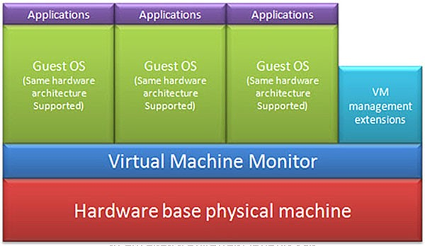
Full-Virtualization

Slide 11
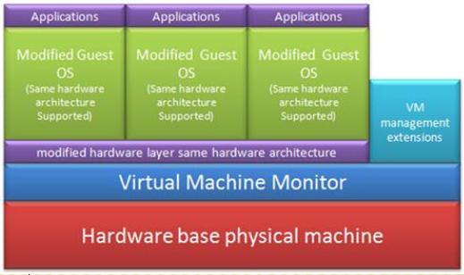
Para-Virtualization

Slide 12
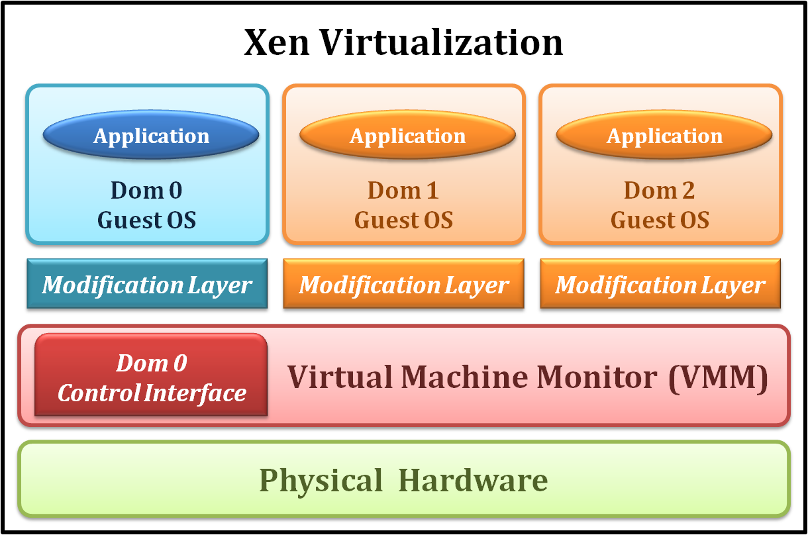
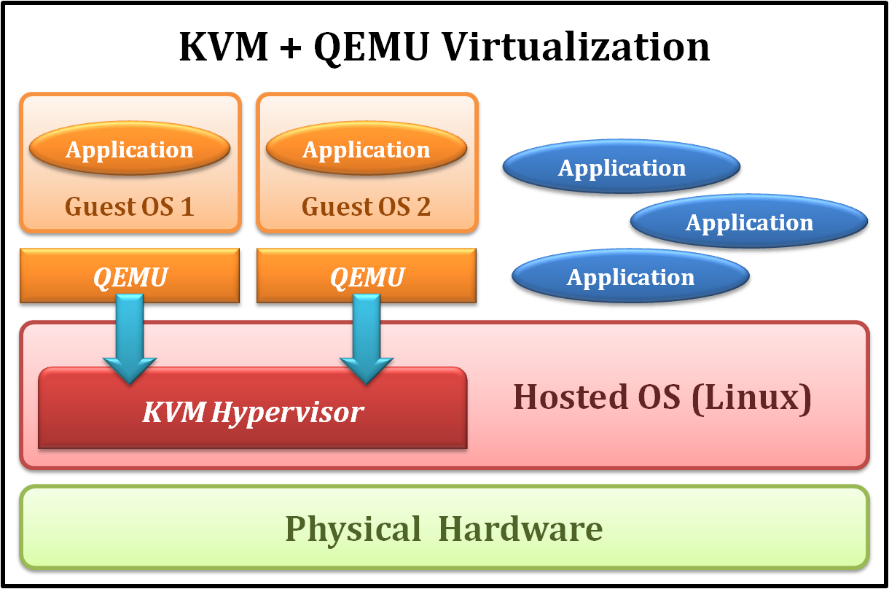
Examples
Xen
KVM
Type 1 Virtualization
Para-Virtualization
Type 2 Virtualization
Full-Virtualization

Slide 13
Outline
CPU Virtualization
  Emulation techniques
  Trap and emulate model
  Hardware assistance
Memory Virtualization
  Shadow page table
  Hardware assistance
IO Virtualization
  Device model
  Hardware assistance

Slide 14
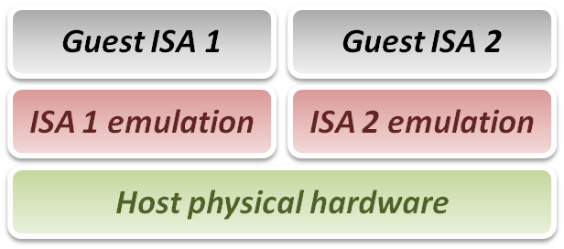
Emulation
Emulation: duplicates the functions of system 1 in system 2, so that the behavior of system 2 closely resembles the behavior of the system 1.
Relation between virtualization and emulation
  Virtualization can be treated as a special case of emulation technique.
  Many virtualization were
  developed in or inherited
  from emulation technique.

Slide 15
Three Emulation Implementations
Interpretation
  Emulator interprets only one instruction at a time.
Static binary translation
  Emulator translates a block of guest binary at a time and further optimizes for repeated instruction executions.
Dynamic binary translation
  This is a hybrid approach of emulation, which mixes two approaches above.

Slide 16
Interpretation
Execution flow :
  Fetch one guest instruction from guest memory image.
  Decode and dispatch to corresponding emulation unit.
  Execute the functionality of that instruction and modify some related system states, such as simulated register values.
  Increase the guest PC (Program Counter register) and then repeat this process again.

Slide 17
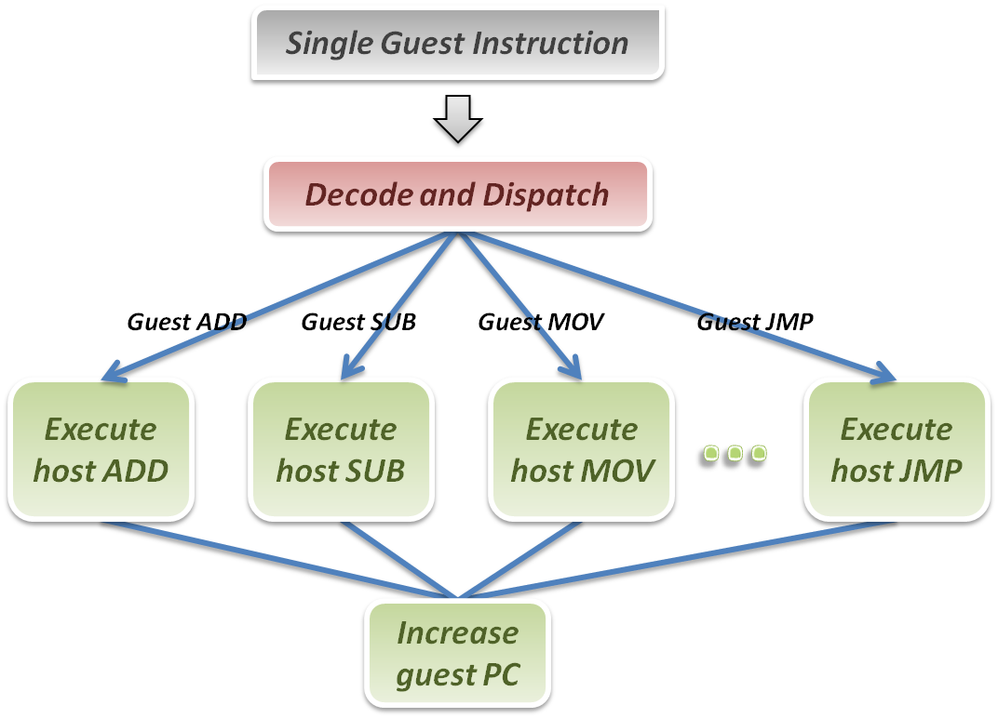
Interpretation
Interpreter

Slide 18
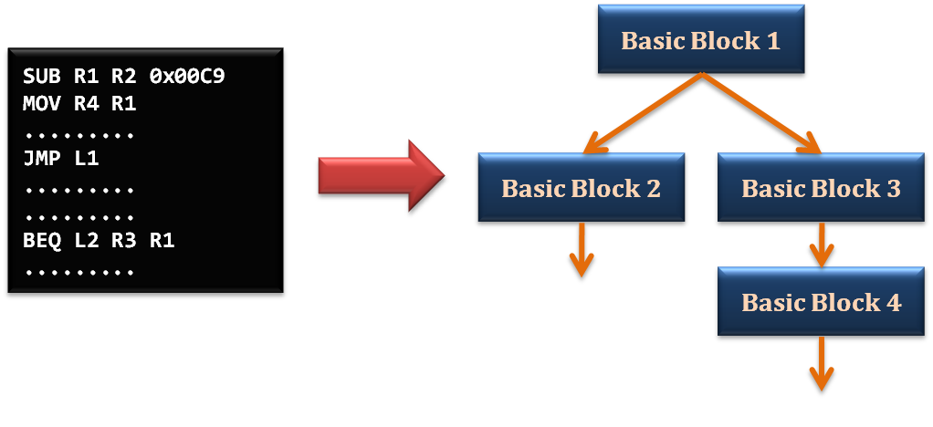
Static Binary Translation
Using the concept of basic block from compiler optimization technique.
  A basic block is a portion of the code within a program which only has one entry point and only one exit point.

Slide 19
Static Binary Translation
Static binary translation flow :
  Fetch one block of guest instructions from guest memory image.
  Decode and dispatch each instruction to the corresponding translation unit.
  Translate guest instruction to host instructions.
  Write the translated host instructions to code cache.
  Execute the translated host instruction block in code cache.

Slide 20
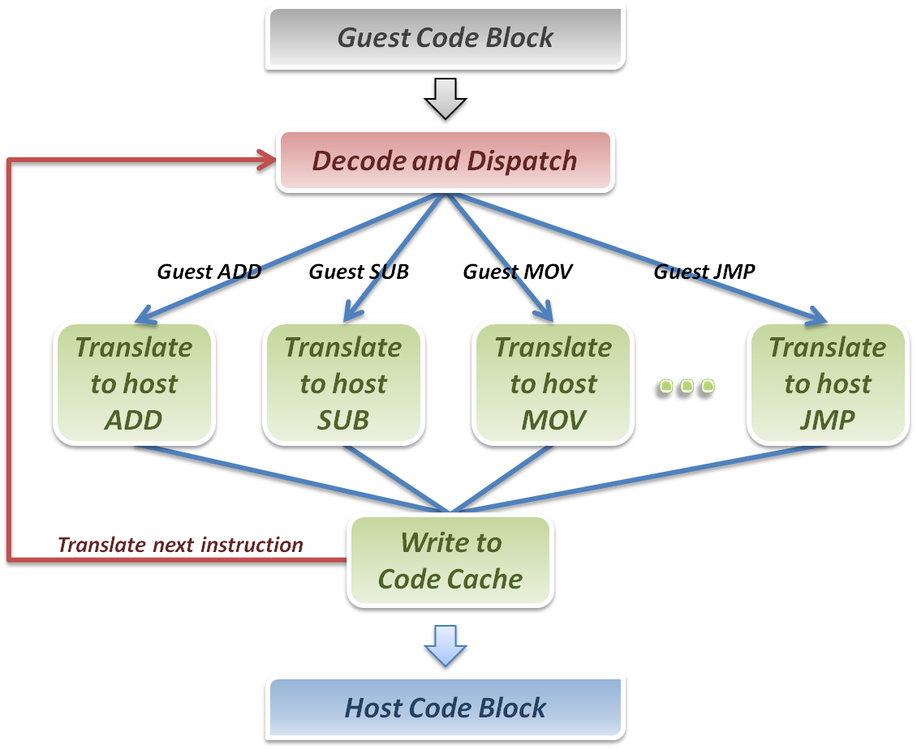
Binary Translation
Binary Translator

Slide 21
Dynamic Binary Translation
A hybrid implementation
  Perform static binary translation after the code is first executed by interpretation for future use.
Pros & Cons
  Pros: Transparently implement binary translation.
  Cons: Hard to implement.

Slide 22
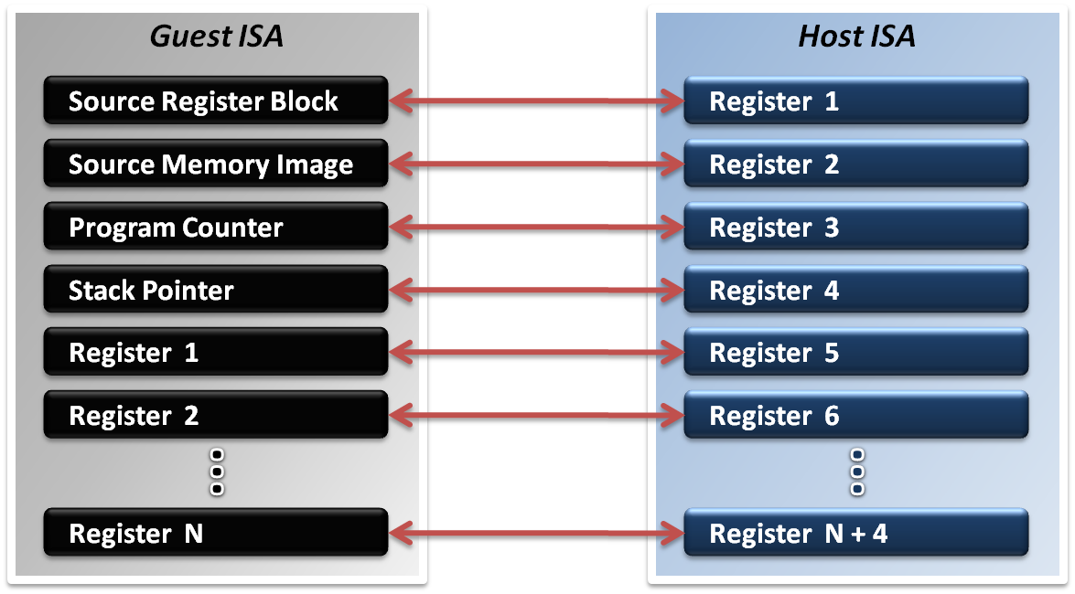
Register Mapping Problem
Different ISAs define different number of registers
Sometimes guest ISA even require some special purpose register which host ISA does not defined.

Slide 23
Register Mapping Problem
If number of host registers is larger the guest’s
  Directly map one register of guest to one of host, and make use of the rest registers for optimization.
  Example :Translating x86 binary to RISC
If number of host registers is not enough
  Emulator may only map some frequently used guest registers to host, and left the unmapped registers in memory.

Slide 24
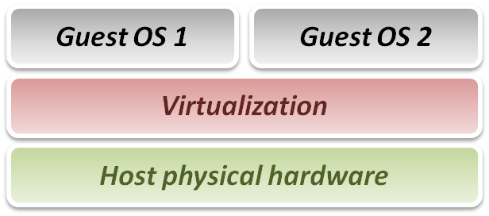
From Emulation to Virtualization
In virtualization techniques, guest and host have the same ISA.
  No binary translate.
  No unmatched special register mapping.
Goal of virtualization :Run or simulate all instructions of guest OS.

Slide 25
Virtualization Requirements
In Popek and Goldberg terminology, a VMM must present all three properties :
  Equivalence (Same as real machine)
  Resource control (Totally control)
  Efficiency (Native execution)
Problems: How to handle exceptions or privileged instructions?

Slide 26
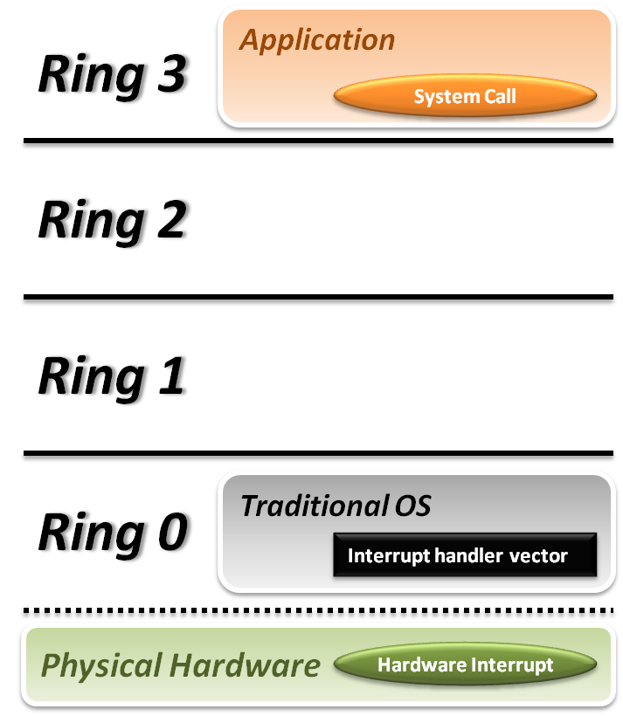


Handling Privilege Instructions
Traditional OS :
  When application invokes a system call, CPU will trap to the interrupt handler vector
  CPU switches to kernel mode (Ring 0 in x86) and executes OS instructions.
For guest OS, CPU will jump to the interrupt handler vector of the host OS.

Slide 27
Trap and Emulate Model
If the VMM is of Type-1, which can control the interrupt service routine, it can tell the exception is caused by a VM
Privilege instruction handling by trap and emulate
  When executing privileged instructions, hardware will make trap to the VMM.
  The VMM emulates the effect of the privileged instructions for the guest OS.

Slide 28
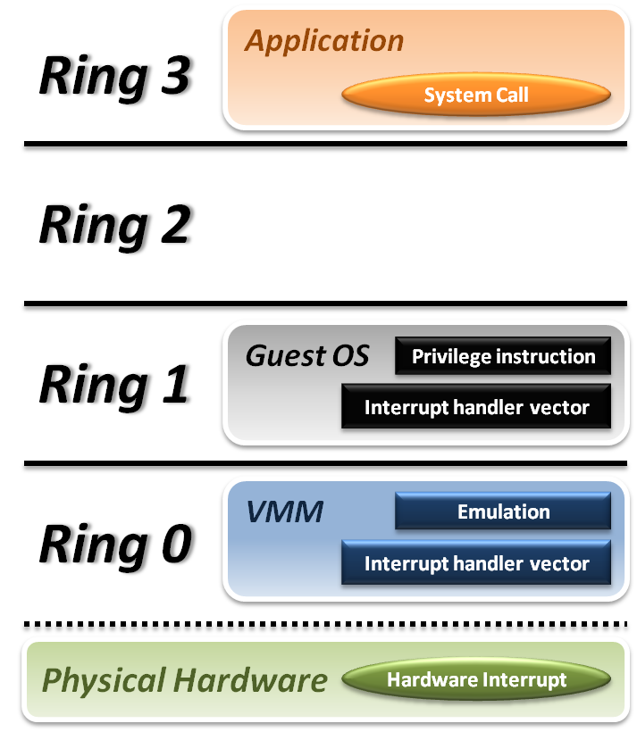






Ring Aliasing
Place guest OS in Ring 1
  System Call
    CPU traps to interrupt handler vector of VMM.
    VMM backs to guest OS.
  Hardware Interrupt
    Hardware traps to the interrupt handler of VMM.
    VMM jumps to interrupt handler of guest OS.
  Privilege Instruction

Slide 29
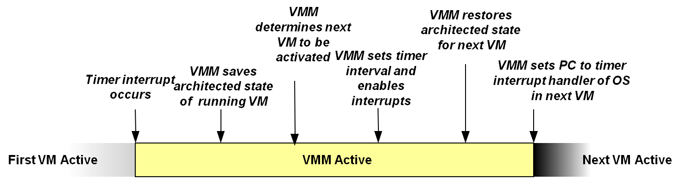
Context Switch of VMs
If VMM can handle interrupts properly, it can host multiple VMs by time sharing.
Steps of Type-1 VMM to switch different VMs
  VMM needs to tell those timer interrupts are not from VMs

Slide 30
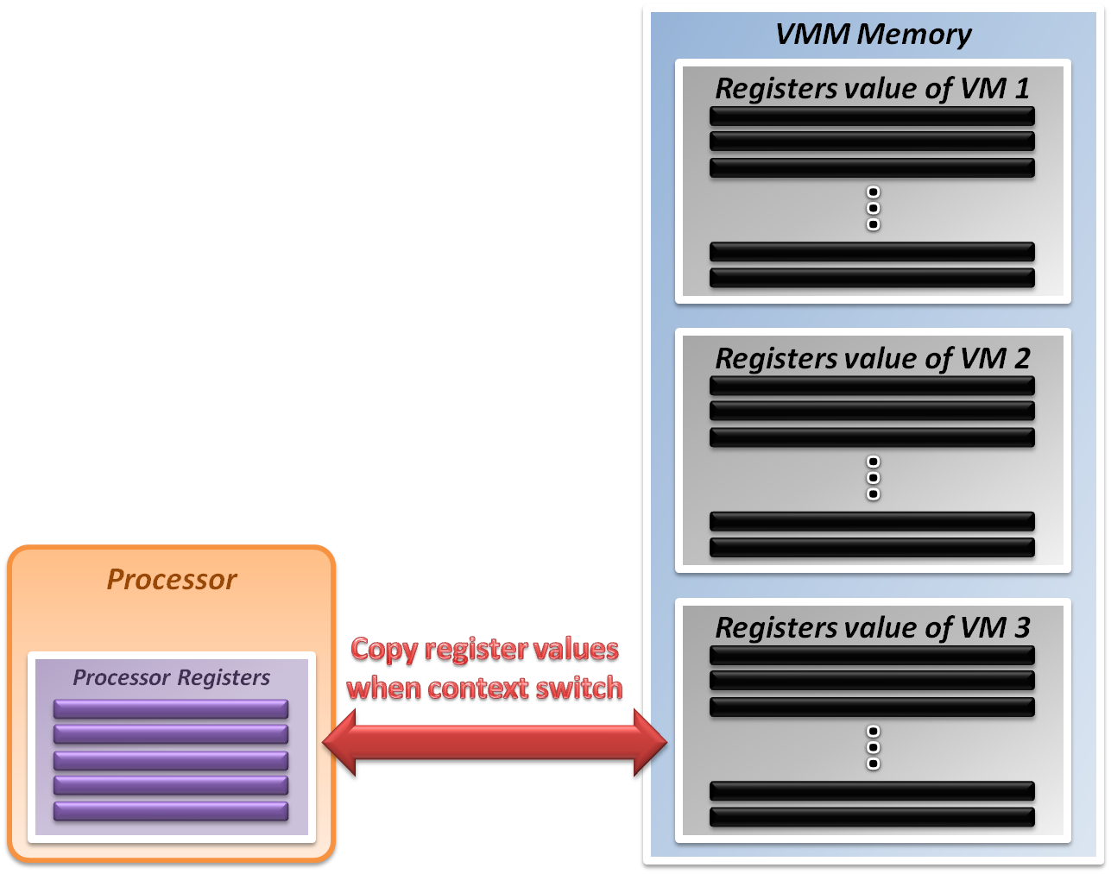
System State Management
VMM holds the system states of all VMs in memory.
When VMM context switches from
VM1 to VM2
  Write VM1’s system state to memory
  Recover the system state of VM 2

Slide 31
For Type-2 VMMs
Para-virtualization
  Modify guest OS to skip the critical instructions or to implement some hyper-calls to trap guest OS to VMM.
Binary translation
  Use emulation technique to skip the critical instructions by means of translations
Hardware assistance
  Modify or enhance ISA of hardware to provide virtualizable architecture.
  Reduce the complexity of VMM implementation.

Slide 32
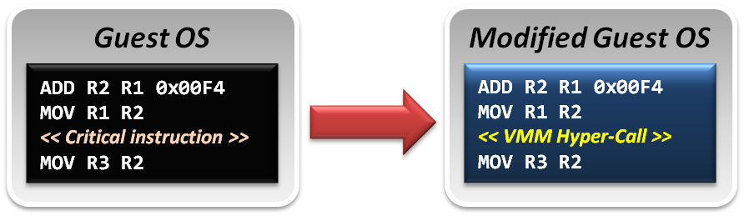
Para-Virtualization
Guest OS is modified to prevent invoking critical instructions.
VMM provides the hyper-call interfaces, which is a communication channel between guest and host.

Slide 33
Binary Translation
Binary translation is used to skip or to modify the guest OS binary code blocks which include critical instructions.
Translate those critical instructions into some privilege instructions which will trap to VMM for further emulation.

Slide 34
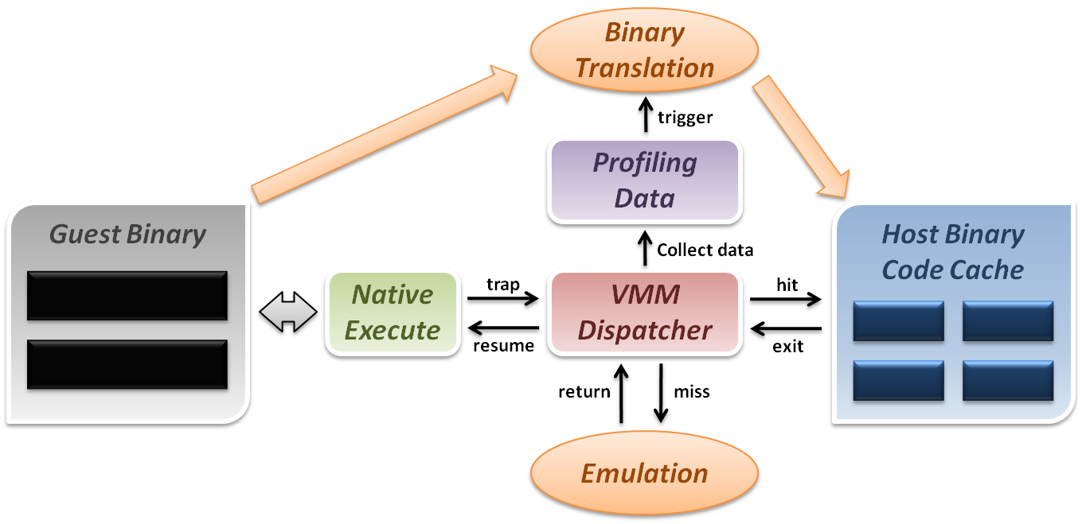
Binary Translation

Slide 35
Difficulties of Binary Translation
Self-modifying code
  If guest OS will modify its own binary code in runtime, binary translation needs to flush the responding code cache and retranslate the code block.
Self-reference code
  If guest OS needs to read its own binary code in runtime, VMM needs to make it referring back to original guest binaries location.
Real-time system
  For some timing critical guest OS, emulation will lose precise timing.

Slide 36
Hardware Solution
Major problem of type-2 VMM: critical instructions do not trap in user mode.
  Even if we make those critical instructions trap, their semantic may be changed, which is not acceptable.
Not all exceptions or privilege instructions need VMM’s involvement.
  Ex: OpenFile in the applications of guest OS
Latest CPU does redefine the privilege structure and provide instructions to assist the virtualization

Slide 37
Intel VT-x
VMX Root Operation (Root Mode)
  All instruction behaviors in this mode are no different than traditional ones.
  All legacy software can run in this mode correctly.
  VMM runs in this mode to control all system resources.
VMX Non-Root Operation (Non-Root Mode)
  All sensitive instruction in this mode are redefined.
  The sensitive instructions will trap to Root Mode.
  Guest OS should run in this mode and be fully virtualized through typical “trap and emulation model”.

Slide 38
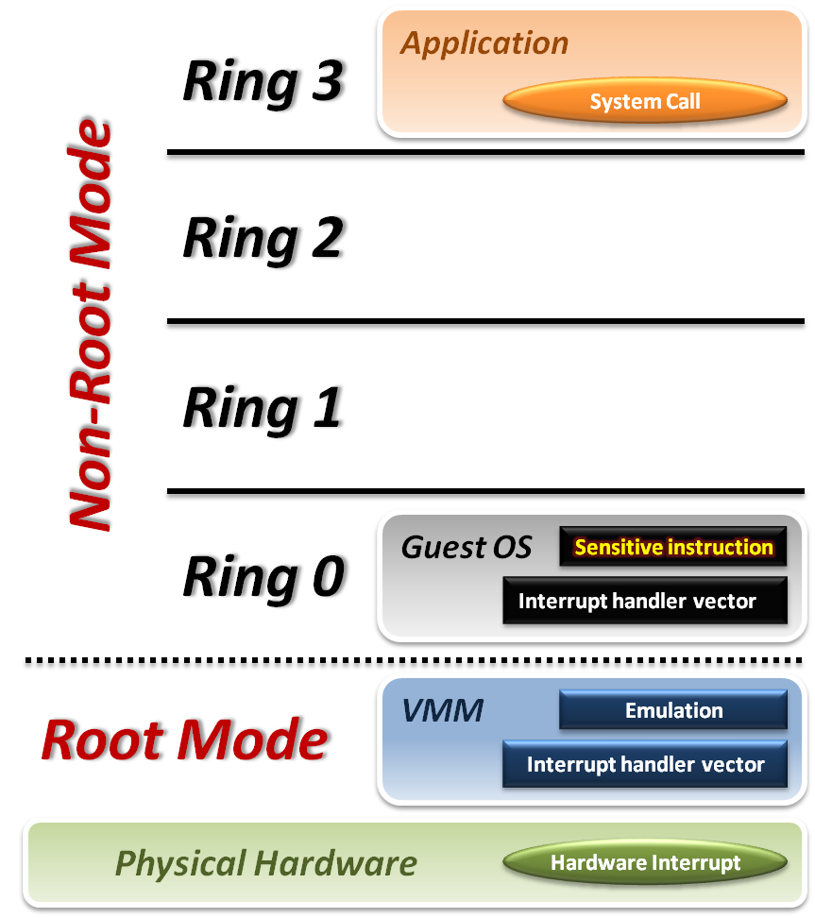





Intel VT-x
System Call
  CPU directly traps to the interrupt handler vector of guest OS.
Hardware Interrupt
  Hardware events are handled by VMM.
Sensitive Instruction
  Running guest OS in
  Non-root mode will
  trap sensitive instruction only.

Slide 39
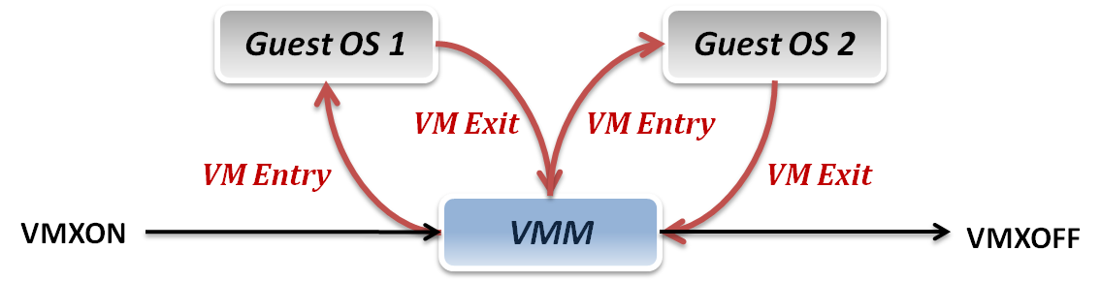
Context Switch
VMM can switch different VMs with Intel VT-x :
  VMXON/VMXOFF: to turn on/off CPU Root Mode.
  VM Entry: caused by the execution of VMLAUNCH/VMRESUME instructions, which switches CPU from Root Mode to Non-Root Mode.
  VM Exit: caused by many reasons, such as hardware interrupts or sensitive instruction executions, which switch CPU mode from Non-Root Mode to Root Mode.

Slide 40
System State Management
Virtual Machine Control Structure (VMCS): Control Structures for register switching,
  Only one VMCS active per virtual processor at any given time
VMCS Payload:
  VM execution, VM exit, and VM entry controls
  Guest and host state
  VM-exit information fields

Slide 41
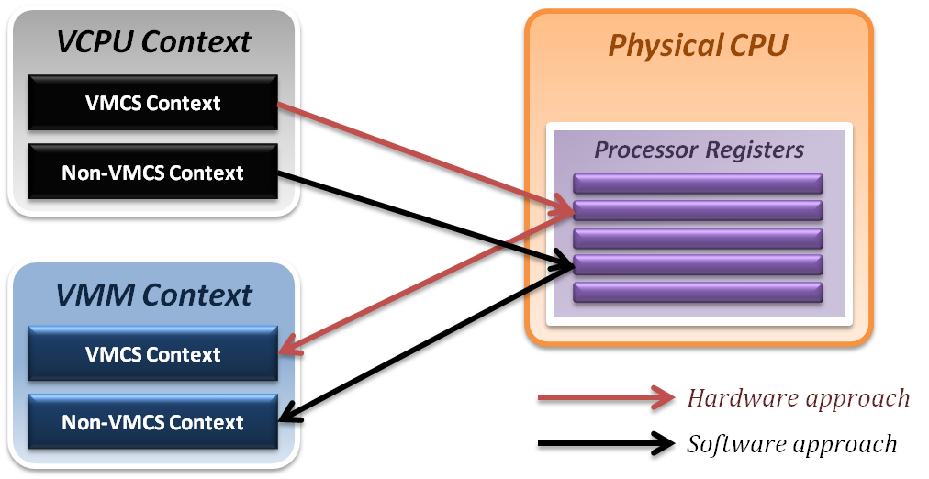
Binding Virtual CPU to VM
VCPU (Virtual CPU) contains two parts
  VMCS maintains system states, operated by HW
  Non-VMCS maintains other non-essential system information, maintained by software.
VMM needs to handle Non-VMCS part.

Slide 42
Outline
CPU Virtualization
  Emulation techniques
  Trap and emulate model
  Hardware assistance
Memory Virtualization
  Shadow page table
  Hardware assistance
IO Virtualization
  Device model
  Hardware assistance

Slide 43
Memory Virtualization
Goals of memory virtualization :
  Address translation
    Control table-walking hardware that accesses translation tables in main memory.
  Memory protection
    Define access permission which uses the Access Control Hardware.
  Access attribute
    Define attribute and type of memory region to direct how memory operation to be handled.

Slide 44
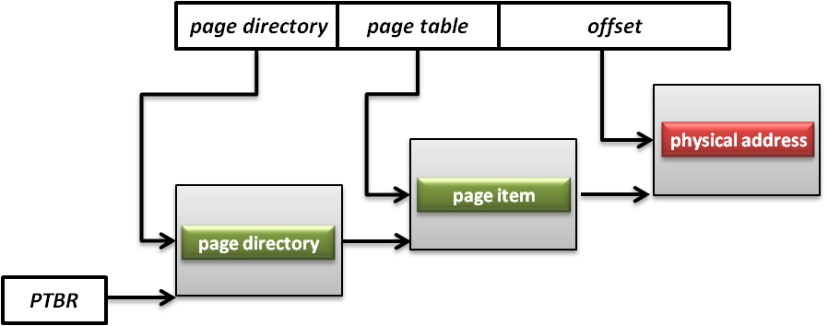
Memory Management Unit (MMU)
A hardware to handle CPU’s memory requested
  Translation virtual addresses to physical addresses, memory protection, cache control, bus arbitration, etc.
  Page Table Base Register (PTBR) is a register point to the base of page table for MMU.

Slide 45
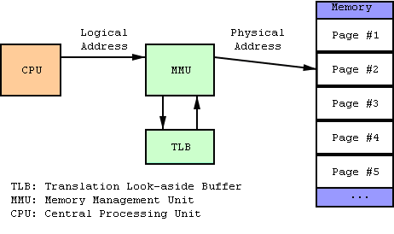
Translation Lookaside Buffer (TLB)
A CPU cache to speedup the virtual address translation.

Slide 46
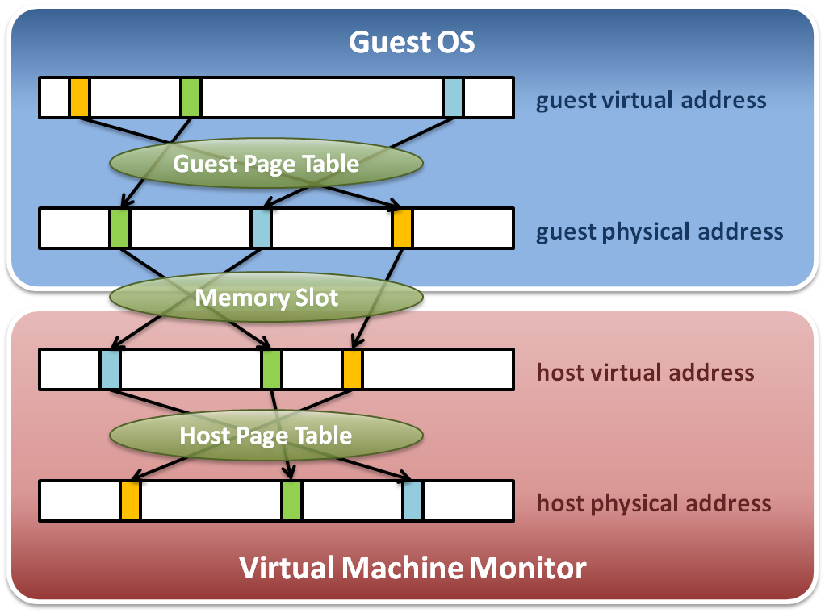
Memory Virtualization Architecture

Slide 47
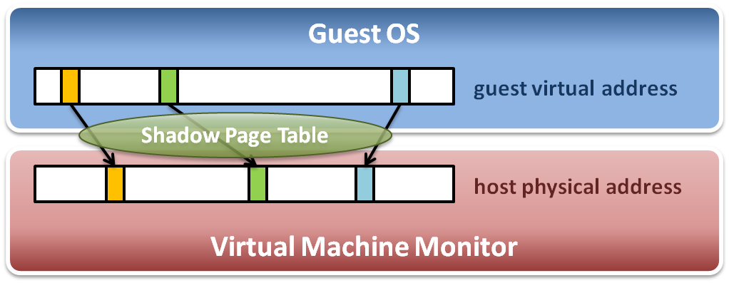
Memory Virtualization
The performance drop of memory access is usually unbearable.
VMM maintains a shadow page table for each VM
  Direct virtual-to-physical address mapping
  Use hardware TLB for address translation

Slide 48
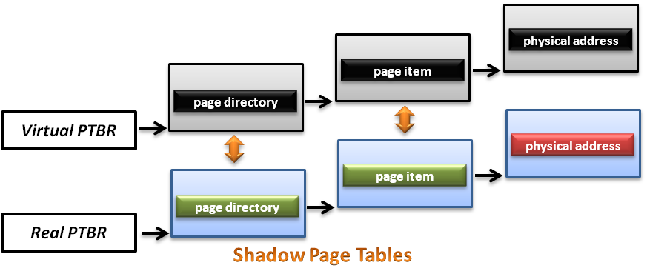
Shadow Page Table
Maps the virtual address of the guest OS to the physical address of the host OS directly

Slide 49
Virtualized MMU
To make shadow page work, VMM needs to virtualize MMU.
  VMM manages the real PTBR and a virtual PTBR for each VM
  When guest OS is activated, the real PTBR points to a shadow page table
  When guest OS attempts to modify the PTBR, it will be interrupted by VMM for further emulation.

Slide 50
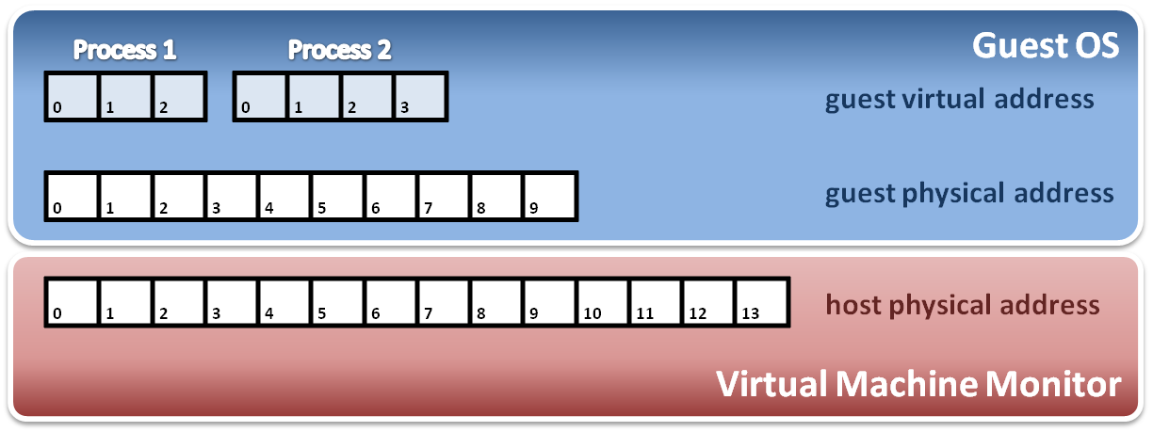
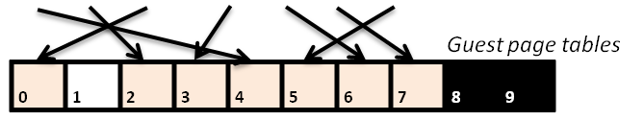
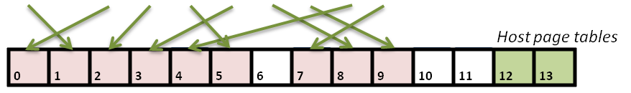
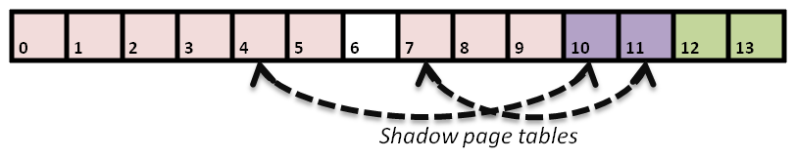
Construct Shadow Page Table
Write protection
Notes:
1. Guest OS will maintain its own page table for each process.
2. VMM maps each guest physical page to host physical page.
3. Create shadow page tables for each guest page table.
4. VMM should protect host frame which contains guest page table.

Slide 51
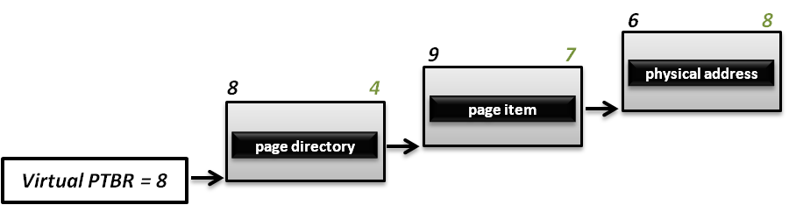
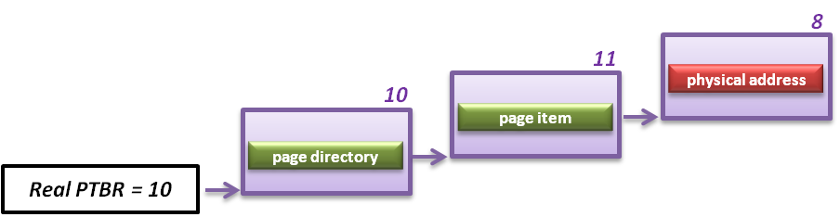
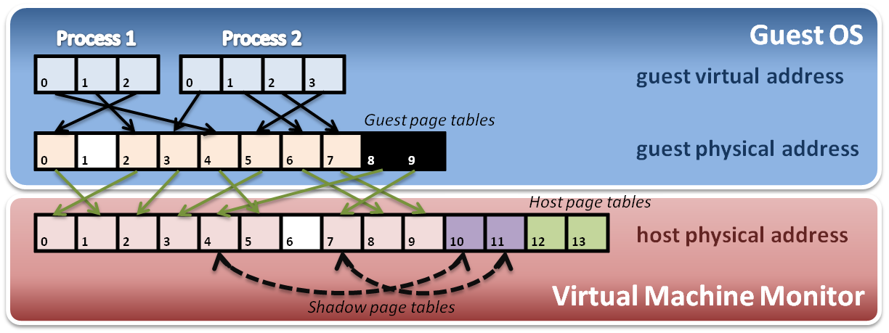
Implementation with PTBR
  For example, process 2 in guest OS wants to access its memory whose (virtual) page number is 1.

Slide 52
Shadow Page Table Operations
Context switch
New process
Access
Process
Page Table
Process
Page Table
Process
Page Table
Virtual PTPR
Guest OS
Real PTPR
VMM
Page fault !
Shadow
Page Table
Shadow
Page Table
Shadow
Page Table
Load !
Corresponding mapping table
Switch the pointer to new location
Create new shadow page table mapping to new process

Slide 53
Page Fault
When a physical page fault occurs, should VMM inject this exception to guest OS?
  If the page entry in the page table of guest OS is still valid, VMM should prepare the corresponding page and not inject any exception to guest OS.
  If the page entry in the page table of guest Os is invalid either, then VMM should directly inject the virtual page fault to guest OS.

Slide 54
Page Protection
When guest OS wants to modify its page tables, VMM needs to intercept this operation.
  When guest OS reloads PTBR, CPU will trap to VMM due to the Ring Compression nature.
  VMM will walk the page table of guest OS and modify the related shadow page table to make MMU get host physical address.

Slide 55
Difficulties of Shadow Page Table
Shadow page table implementation is extremely complex.
Page fault mechanism and synchronization issues are critical.
Host memory space overhead is considerable.
Hardware Solution for MMU

Slide 56
Extended Page Table (EPT)
EPT implements one more page table hierarchy.
  One page table is maintained by guest OS, which is used to generate guest physical address.
  The other page table is maintained by VMM, which is used to map guest physical address to host physical address.
  For each memory access operation, EPT MMU will directly get guest physical address from guest page table, and then get host physical address by the VMM mapping table automatically.

Slide 57
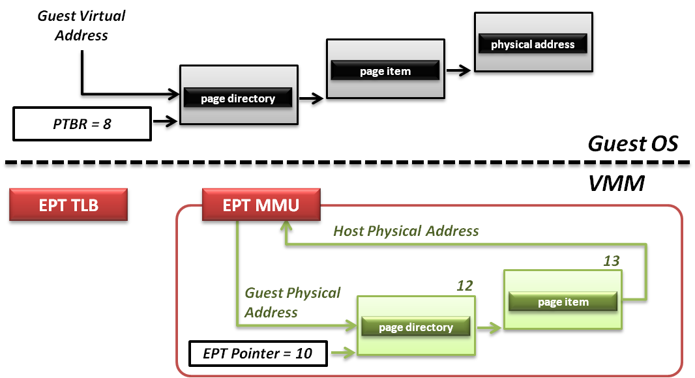
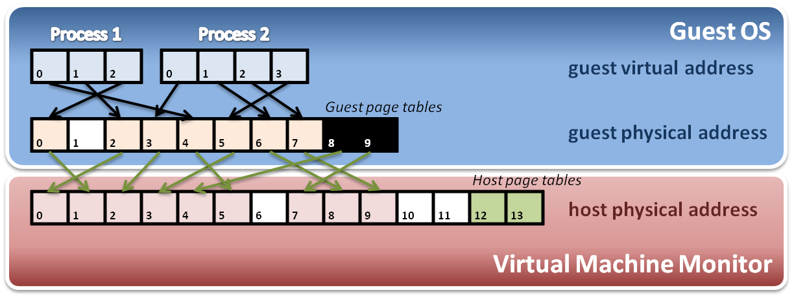
Example of EPT
Memory operation :
6
8
9
7
8
4
Data

Slide 58
Outline
CPU Virtualization
  Emulation techniques
  Trap and emulate model
  Hardware assistance
Memory Virtualization
  Shadow page table
  Hardware assistance
IO Virtualization
  Device model
  Hardware assistance

Slide 59
IO Virtualization
Goal :
  Share or create IO devices for virtual machines.
Traditional IO techniques :
  Direct memory Access (DMA)
  PCI / PCI Express

Slide 60
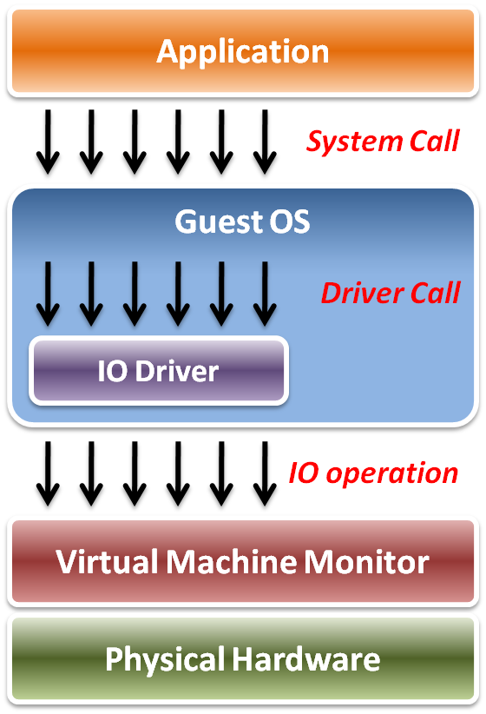
IO Virtualization
Implementation Layers :
  System call
    The interface between applications and guest OS.
  Driver call
    The interface between guest OS and IO device drivers.
  IO operation
    The interface between IO device driver of guest OS and virtualized hardware ( in VMM ).

Slide 61
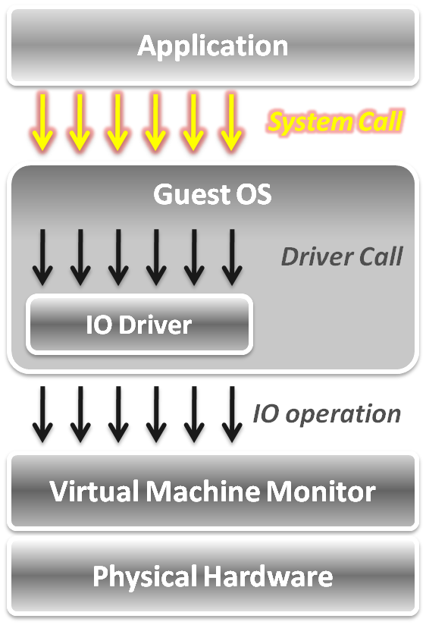
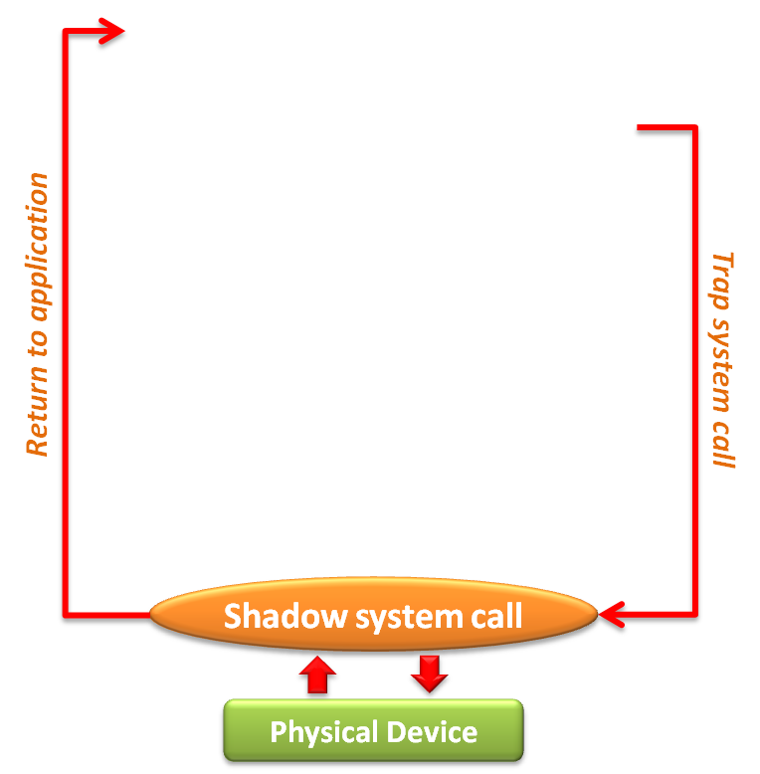
System Call Level Implementation
When an application invokes a system call, CPU traps to VMM.
VMM maintains shadowed IO system call routines to simulate system calls.
After simulation, VMM directly returns to application in gust OS.

Slide 62
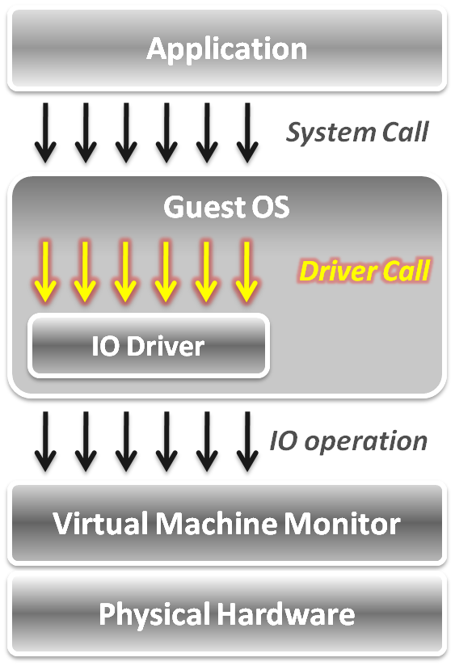
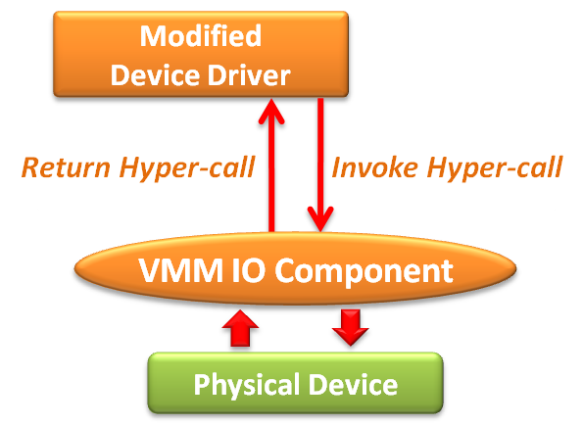
Device Driver Level Implementation
Utilize para-virtualization technique, which means IO device drivers in guest OS need be modified.
The IO operation is invoked by means of hyper-call between the modified device driver and VMM IO component.

Slide 63
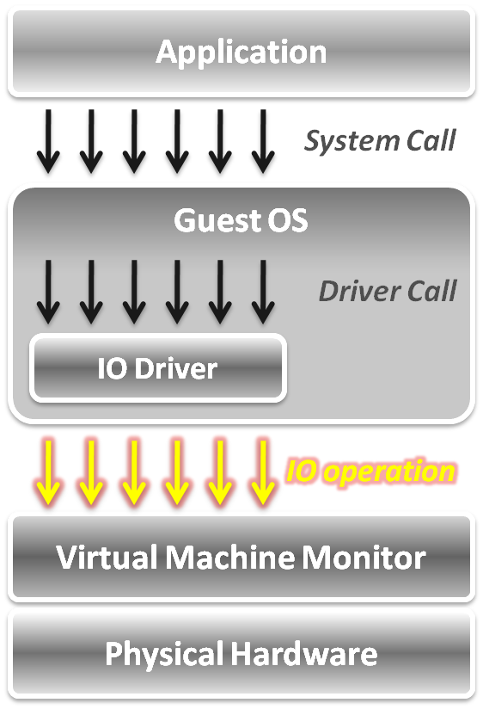
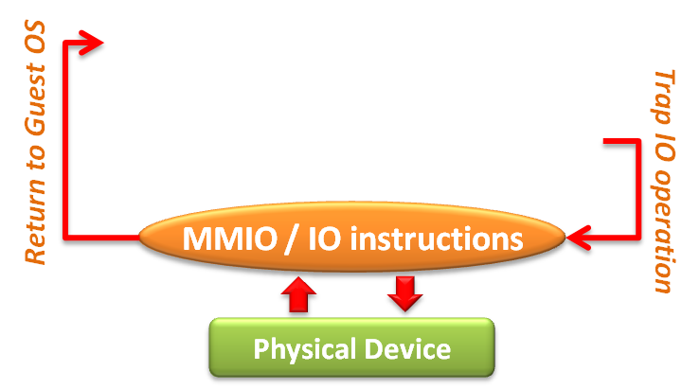
IO Operation Level Implementation
Two approaches
  Memory mapped IO
    Loads/stores to specific region of real memory
    The memory mapped IO region is protected.
  Port mapped IO
    Special input/output instructions with special addresses.
    The IO instructions are privileged.

Slide 64
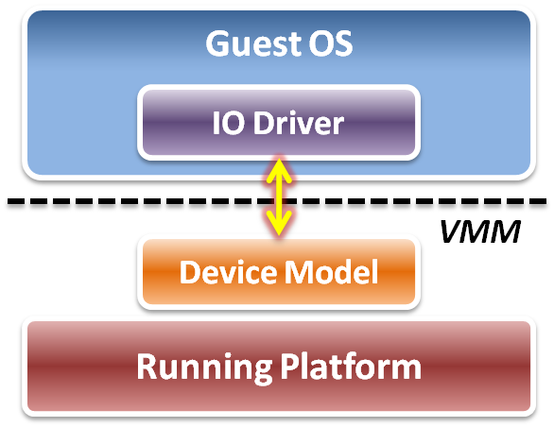
Device Model
IO operation level implementation is of full virtualization.
Logic relation between guest OS and VMM :
  VMM intercepts IO operations from guest OS, and passes them to device model on a running platform.
  A Device model needs to emulate the IO operation
    Port mapped IO
    Memory mapped IO
    DMA mapped IO
    ... etc.

Slide 65
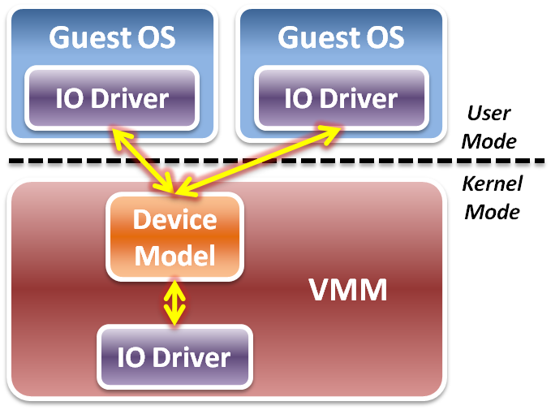
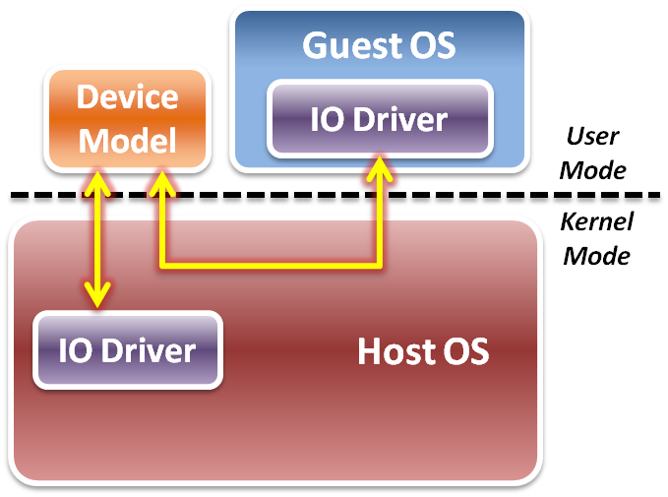
Two Kinds of Implementations
Device model is implemented as a part of VMM.
Device model is running in user space as a stand alone service.
Type 1 Virtualization
Type 2 Virtualization

Slide 66
Device Model Operations
Initialization – device discovery
  VMM lets guest OS discover the virtualized IO devices. Then guest OS will load the device driver.
Operation – access interception
  When guest OS requests IO operations, VMM will intercept those accesses. After virtual device operations, VMM returns the control to guest OS.
Virtualization – device virtualization
  Device model emulates the real electronic logic to satisfy all device interface definition and its effects.

Slide 67
Device Discovery
Non-enumerable device: ex PS/2 keyboard
  These devices have their own hard-coded numbers.
  VMM setups status of the virtual device ports.
Enumerable physical device: ex: PCI, PCIe
  They have a complete device discover method.
  VMM has to emulate the device and the bus behavior.
Virtualize non-exist devices
  VMM must define and emulate all functions of these devices. Guest OS needs to load some new drivers of these virtual devices.

Slide 68
Access Interception
For port mapped IO operation
  Direct device assignment:
    VMM should turn ON the physical IO bitmap.
    All the IO instructions (IN/OUT) from guest OS will be directly performed onto hardware without VMM intervention.
  Indirect device assignment
    VMM should turn OFF the physical IO bitmap.
    All the IO instructions from guest OS will be intercepted by VMM and forward to physical hardware.

Slide 69
Access Interception
Memory mapped IO operation
  Direct device assignment
    VMM uses the shadow page table to map IO device addressing space of guest OS to the space of host.
    All IO operations from guest OS won’t be intercepted.
  Indirect device assignment
    VMM makes all entries of the IO device addressing space in the shadow page table to be invalid.
    When guest OS accesses those addressing space, it will introduce the page fault which trap CPU to VMM for device emulation.

Slide 70
Performance Issues
How to make guest OS directly access IO addresses?
  Other than software approaches discussed above, we can make use of the hardware assistance
How to make DMA directly access memory space in guest OS?
  For the synchronous DMA, guest OS can assign the correct host physical memory address.
  For the asynchronous DMA, hardware must access memory from host OS which involves the VMM.

Slide 71
Hardware Solutions
Tow hardware solutions
  Implement DMA remapping in hardware
    Remap DMA operations automatically by hardware.
    For example, Intel VT-d .
  Specify IO virtualization standards of PCI Express devices
    Implement virtualizable device with PCI Express interface.
    For example, SR-IOV or MR-IOV.

Slide 72
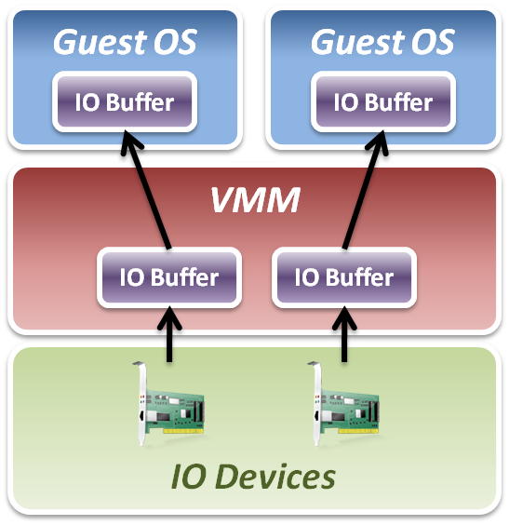
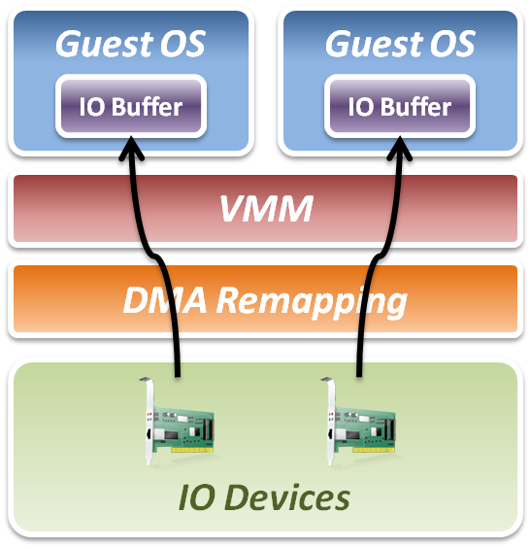
Intel VT-d
Add DMA remapping hardware component.
Software Approach
Hardware Approach

Slide 73
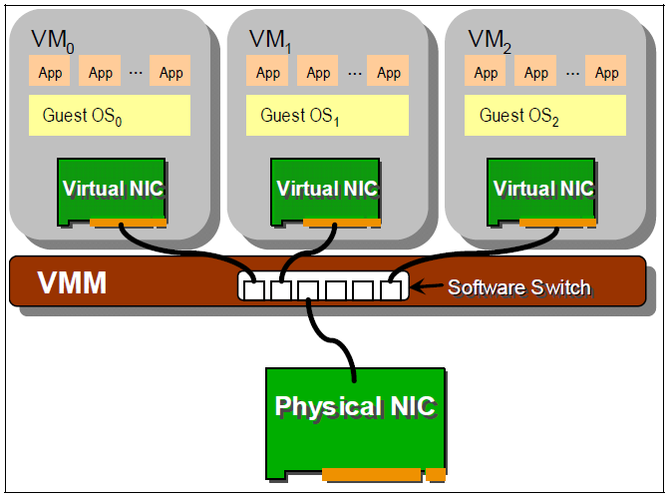
Software Based Device Sharing

Slide 74
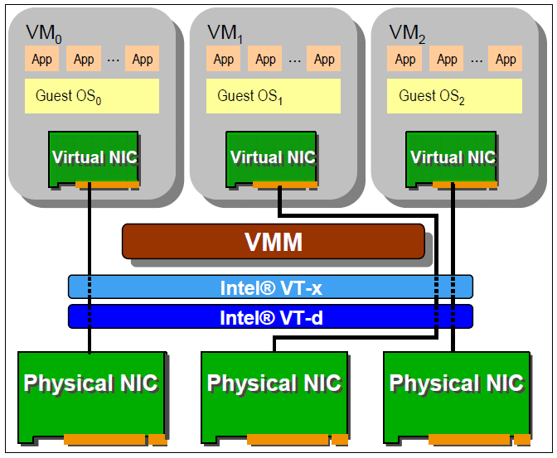
Hardware Direct Assignment

Slide 75
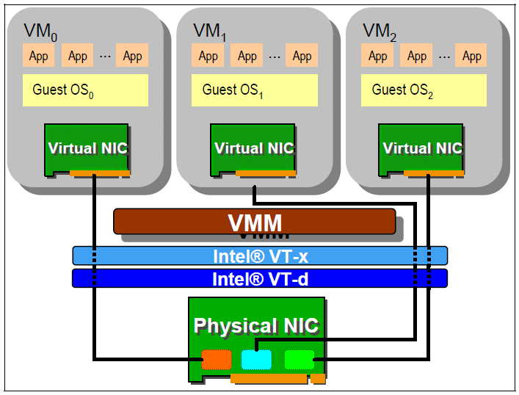
Hardware Based Sharing

Slide 76
Single Root IO Virtualization (SRIOV)
A standard for natively shared PCIe devices.
Basic components :
  Physical Functions (PFs):
    These are full PCIe functions that include the SR-IOV Extended Capability. Used to configure and manage the SR-IOV functionality.
  Virtual Functions (VFs):
    These are “lightweight” PCIe functions that contain the resources necessary for data movement but have a carefully minimized set of configuration resources.

Slide 77

SRIOV

Slide 78
References
Books :
  James E. Smith & Ravi Nair, Virtual Machines, Elsevier Inc., 2005
  英特爾開源軟件技術中心 & 復旦大學並行處理研究所, 系統虛擬化 – 原理與實現, 北京 : 清華大學出版社, 2009.03
Web resources :
  Xen project http://www.xen.org
  KVM project http://www.linux-kvm.org/page/Main_Page
  IBM VirtIO survey https://www.ibm.com/developerworks/linux/library/l-virtio
  PCI-SIG IO virtualization specification http://www.pcisig.com/specifications/iov

Slide 79
References
Other resources :
  Lecture slides of “Virtual Machine” course (5200) in NCTU
  Vmware Overview Openline presentation slides http://www.openline.nl
  Xen presentation http://www.cl.cam.ac.uk/research/srg/netos/papers/2006-xen-fosdem.ppt
  Lecture notes from Yeh-Ching Chung

