Slide 1
Cloud Computing
Real-Machine
Che-Rung Lee

Slide 2
Outline
Computer System
Computer System Hardware
Instruction Set Architecture (ISA)
Operating System Organization
Program execution
Memory management
Input / Output control

Slide 3
A Computer System
Application Programs
Libraries
Software
Operating System
Drivers
Memory
Manager
Scheduler
Instruction Set Architecture
Execution Hardware (CPU)
System Interconnect
(Bus)
Memory
Translation
Hardware
Controllers
Controllers
I/O Devices
Networking
Main
Memory
Notes:
Change

Slide 4
Computer Hardware Organization
High-Speed I/O Bus
Local Bus
Monitor
Frame Buffer
Processor
Expansion
Low-Speed I/O Bus
Floppy
Interface
Interface
Controller
Memory
CD ROM
Hard Drives
Controller
Controller

Slide 5
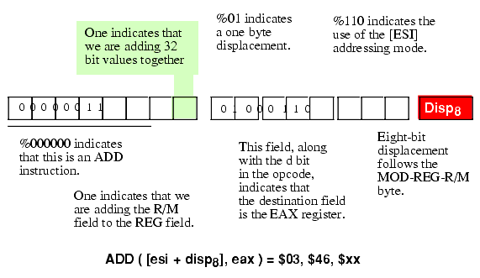
Instruction Set Architecture (ISA)
The part of the computer architecture related to programming, including the native data types, instructions, registers, addressing modes, memory architecture, interrupt and exception handling, and external I/O.
For computers, it’s the control interface.
For OS, it’s a set of assembly instructions.

Slide 6
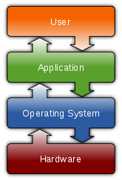
Operating System
An operating system (OS) is software, consisting of programs and data, that runs on computers, manages computer hardware resources, and provides common services for execution of various application software.

Slide 7
A Computer System
A computer system is an integration of computer hardware, ISA, and OS. Many functions/activities are achieved from the combinative efforts from those three.
We will see three major functions/activities of a computer system
Program execution
Memory access
Input / output control

Slide 8
Outline
Computer System
Computer System Hardware
Instruction Set Architecture (ISA)
Operating System Organization
Program execution
Memory management
Input / Output control

Slide 9
OS: Program Execution
The operating system time-multiplexes a computer system's processor(s) among several processes that may be active in the system.
0ms 50ms 150ms 250ms 350ms
Interrupt
Interrupt
Interrupt
Interrupt
Process A
contextswitch
Process B
context switch
Process A
context switch
Process B
context switch
Process B ready
Process A ready
Process B ready

Slide 10
Interrupt
The interrupt is triggered by a timer (hardware), which is set to a fixed time-slice.
When an interrupt is triggered, CPU hardware
Stops the execution of the current program,
Saves the context of the current program,
Jumps to the subroutine that handles the interrupt.
The subroutine that handles the interrupt is called interrupt service routine (ISR), which is numbered to an interrupt handle vector
OS defines those ISRs, and loads them to fixed addresses when booting

Slide 11
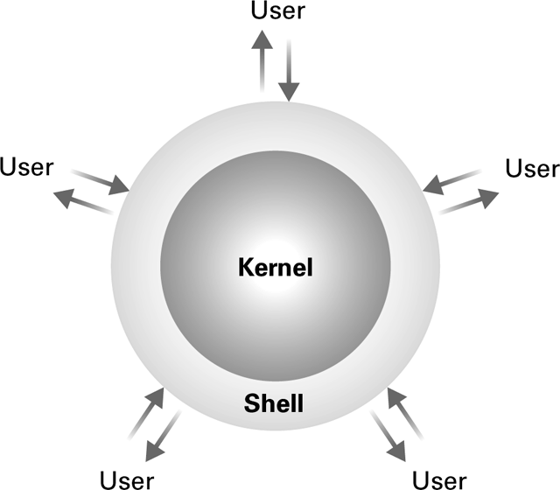
Privilege Levels
To manage the execution of processes and system resources, OS (software) needs more power than general processes (software also).
OS is called the kernel
But how can we prevent other processes to perform forbidden instructions
Such as change the code of ISRs

Slide 12
Privilege Levels
Usually an ISA specifies at least two modes of operation
System mode (supervised, kernel, privileged mode) : all resources are accessible to software.
User mode : only certain restricted resources are accessible.
 | Two privilege levels | IA-32 ISA Four levels
OS | UNIX | Windows, Linux
Modification bit(s) | Just one bit | Two bits

Slide 13
User Mode vs. Kernel Mode
Applications (user level)
Least privileged
System Mode
User Mode
Extensions
Kernel
Mode
System services
Kernel
Ring 0
Ring1
Ring 2
Ring 3
Most privileged
Simple systems have two levels of privilege.
Intel IA-32 has four rings, use only the innermost level for the OS and level 3 for user applications.

Slide 14
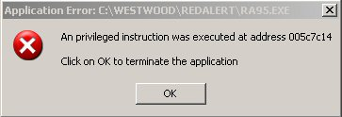
Classification of Instructions
Normal instruction: Both executable in user mode and kernel mode.
Ex: Add, And, jump
Privileged instruction: Only executable in kernel mode, but not in user mode
Ex: Access memory in kernel space
Executing privilege instructions in user mode will cause a trap.

Slide 15
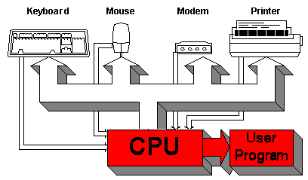
Trap, Exception, and Interrupt
A trap is a software-invoked interrupt.
User program can invoke a trap, such as by “int”.
An exception is also a trap, which is triggered by an exceptional condition, not by programs.
Ex: stack overflow, divide by zero, illegal memory access, etc
An interrupt, or hardware interrupt, occurs due to events of external hardware.

Slide 16
Change of Privilege Modes
Either via a trap or via a system call
System call
Invoked by applications in user mode to ask services from OS, for example, file IO.
After a system call, the control is given to OS.
#include<syscall.h>
Extern int syscall(int,…);
int file_close( int filedescriptor){
return syscall(SYS_close , filedescriptor);
}

Slide 17
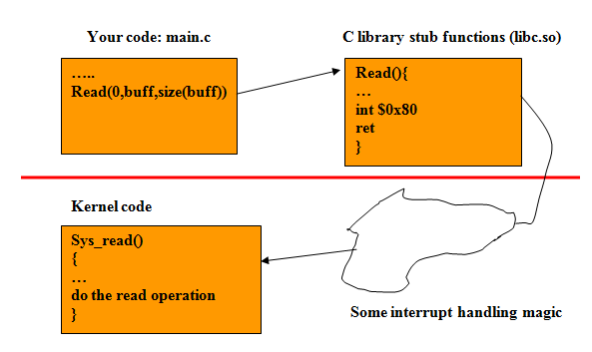
System Call in x86
A system call is accomplished in Linux on x86 processors by calling the “int 0x80” together with the register values (system call number).

Slide 18
Outline
Computer System
Computer System Hardware
Instruction Set Architecture (ISA)
Operating System Organization
Program execution
Memory management
Input / Output control

Slide 19
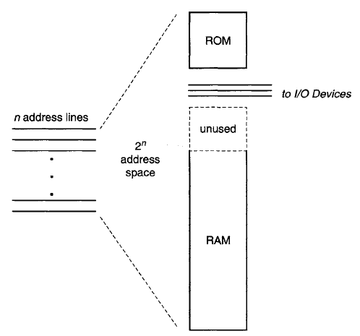
Main Memory
Memory system are built primarily from RAM.
All locations in the real address space do not necessarily correspond to RAM.

Slide 20
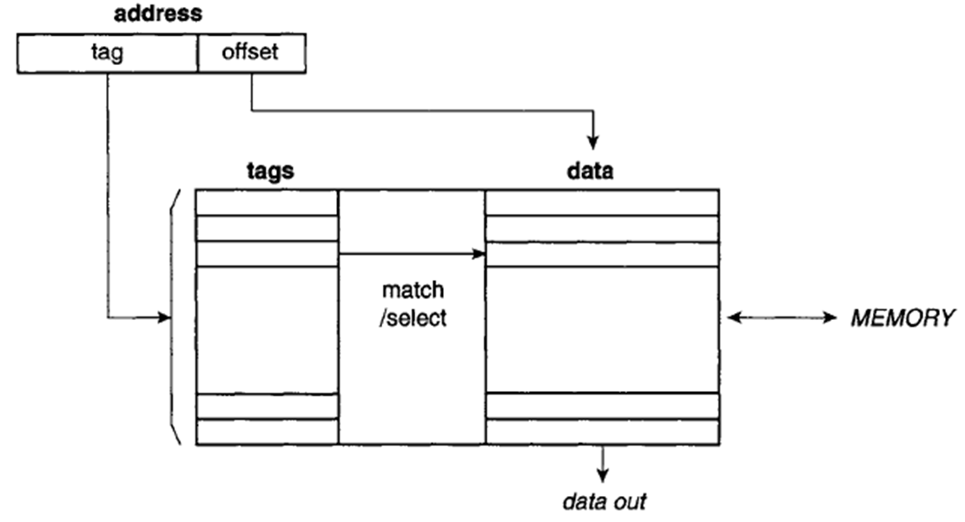
Cache Memory
In order to determine which main memory lines are located in a cache, the cache is designed to be associatively accessed.
Figure belong is a fully associative cache.

Slide 21
Memory Management
Virtual memory
With logical-to-real memory mapping, program memory has become a virtualized resource. The logical address space represents only a virtual view of memory.
For protecting the in used memory, the ISA can limit the access of a program to parts of memory.
By setting the permission of read, write, and execute instructions.

Slide 22
Virtual Memory
Logical Memory of Program 1
Real Memory
unused memory
Logical Memory of Program 2
Backing Store

Slide 23
Page Table
To support logical-to-real memory mapping, a data structure known as the page table is used.
Page Table
v | PB | real page no.
v | PB | real page no.
v | PB | real page no.
⁞
v | PB | real page no.
v | PB | real page no.
⁞
virtual address
real address
Real page no.
offset
offset
Virtual page no.

Slide 24
Page Table Structure
The page table itself usually resides in memory.
The page table pointer register indicates the base of the page table.
The real page number contains information about the real memory location of an accessed virtual page.
Valid bit indicates whether or not the page is mapped.
Protection bits (PB)
Three types of common control are read, write, and execute.
Which may be determined by a program’s privilege level

Slide 25
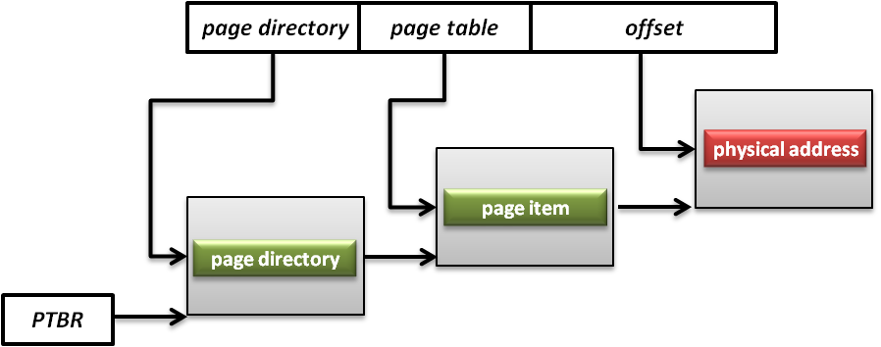
Memory Management Unit (MMU)
A hardware to handle the memory requested
Translate virtual addresses to physical addresses, memory protection, cache control, bus arbitration, etc.
Page Table Base Register (PTBR) is a register point to the base of page table for MMU.

Slide 26
Translation Lookaside Buffer
To make memory accesses much faster, a small associative memory structure called a translation lookaside buffer (TLB) is used for caching recent address translations.
Three possibilities
TLB hit
Entry is match, but protection bit does not allow
TLB miss

Slide 27
TLB to Page Table
TLB
Page Table
v | virtual page no. | PB | real page no.
v | virtual page no. | PB | real page no.
v | virtual page no. | PB | real page no.
v | virtual page no. | PB | real page no.
v | PB | real page no.
v | PB | real page no.
v | PB | real page no.
⁞
v | PB | real page no.
v | PB | real page no.
v | PB | real page no.
Notes:
NOT sure about the valid bit case

Slide 28
OS: Virtual Memory Process
When a process generates a page or TLB fault, the OS takes over
Updates the TLB from the page table if the TLB is architected.
Or handles the fault by scheduling a disk I/O operation to the backing store (hard disk) to retrieve the page.

Slide 29
Outline
Computer System
Computer System Hardware
Instruction Set Architecture (ISA)
Operating System Organization
Program execution
Memory management
Input / Output control

Slide 30
Input/Output Systems
An I/O system consists of a number of buses that connect the processor and memory to the I/O devices.
The bus serves as a highway, through which
devices are addressed and given commands
data is transferred between the processor or memory and the I/O devices.
There are four ways in which I/O is organized.

Slide 31
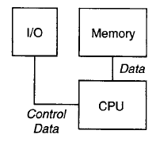
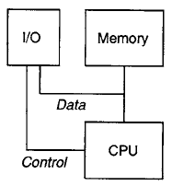
Input/Output Systems
Programmed I/O:
The I/O request is issued over the bus and the device controller is polled until the request is satisfied.
Interrupt-driven I/O:
The CPU continues with some other tasks after issuing an I/O request. An interrupt from the I/O controller informs the OS about the status of the request.

Slide 32
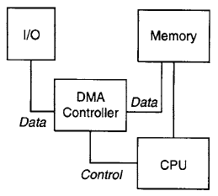
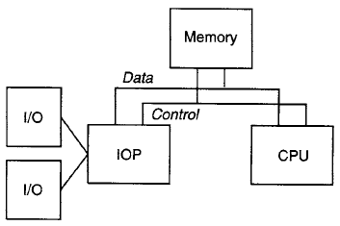
Input/Output Systems
DMA-managed I/O:
The I/O controller uses a series of bus transactions to move large blocks of data to or from an I/O device and to interrupt the CPU when it completes the entire task.
IOP-based I/O:
IOP (I/O processor) is a special processor that can manage complex I/O transactions. The IOP can buffer transactions for various devices and bundle them to make the best utilization of the available I/O resource.

Slide 33
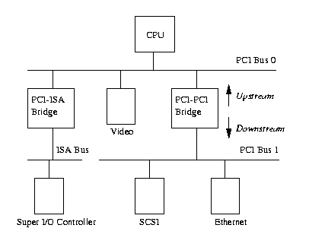
PCI Architecture
PCI based system builds in a tree topology
PCI bus
Parallel connect devices and bridges
PCI-PCI Bridge
Connect two PCI buses
Become the root of lower bus
PCI-ISA Bridge
Connect to conventional ISA device

Slide 34
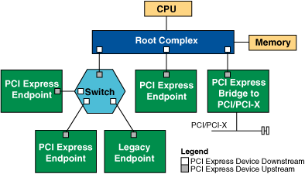
PCI Express Architecture
PCIe is in a point to point architecture
Root Complex: generate transaction requests on behalf of CPU, interconnected through a local bus.
Switch: connect endpoint devices or other switches
Endpoint Device:
Physical PCIe devices
Legacy PCI devices
PCI Express Bridge
Connect to other legacy subsystems

Slide 35
Input/Output Resources
It is more appropriate to deal with the specifics of I/O in software, particularly in the OS software.
The ISA needs to provide only a mechanism for addressing I/O devices and to transfer information to and from the devices.
Two types of addressing mechanisms
Specific I/O instructions
Memory mapped I/O

Slide 36
Input/Output Instructions
I/O Instructions
The addresses are completely separate from main memory addresses.
The execution needs signals to activated the corresponding I/O instruction.
Instructions are usually privileged and can only be invoked by the operating system.

Slide 37
Memory Mapped I / O
Memory Mapped I/O
A specific region of the real memory address space is reserved for accessing I/O devices.
Loads and stores directed to these addresses are interpreted by the memory controller as commands sent to an I/O device.
The real memory addresses used for I/O are never mapped to user-accessible pages, so only the OS has access to them.

Slide 38
Input/Output Management
OS abstracts most of the details of devices and makes I/O devices accessible through well-defined system calls.
Processes invoke I/O by using system calls, which transfers control to the OS.
The OS uses an interface to a set of software routines that convert generic hardware requests into specific commands to hardware devices.
Notes:
There are two types of device drivers in Linux, character device drivers
and block device drivers.
Character device drivers communicate directly with
the user program, with no buffering in between. A terminal is an example of
a character device driver; communication between the device driver and the
hardware is performed a character at a time.
In contrast, the communication
between the driver and the hardware is at a much higher granularity in the case
of block device drivers, like those for disks. In this case, user programs access
information through an area reserved for the transfer of a block of data.

Slide 39
Input/Output Management
Applications
OS
Hardware
Virtual Mem mgr
Virtual memory and I/O operations
System calls
Driver calls
I/O Drivers

Slide 40
Input/Output System Calls
Program makes a device-independent request such as open() or read() through a system-call.
User Program
System calls
fd_open(“dev/abc”,O_RDWR,0);
read(fd,out_data,8);
write(fd,out_data,8);
close(fd);
Virtual Filesystem Switch
Linux Kernel
device driver routines
abc_open()
abc_read()
abc_write()
abc_close()
Hardware

Slide 41
References
Appendix A of “Virtual Machines: Versatile Platforms for Systems and Processes”, by Jim Smith and Ravi Nair
Many figures are from Internet

