Slide 1
Cloud Computing
Overview
Che-Rung Lee

Slide 2
Outline
History and Trend of Computing
What is Cloud Computing?
Cloud Enabling Technologies

Slide 3
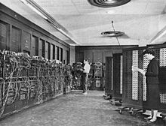
First-generation Machines
1946 ENIAC: first electronic general purpose computer
In 1954, IBM 650
Main body 900 kg,
Power supply 1350 kg
Size: 1.5m*0.9m*1.8 m
Memory: 2,000 ten-digit word

Slide 4
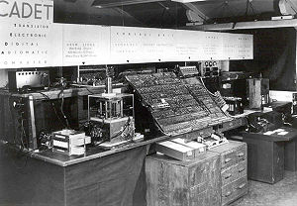
Second-generation Machines
1955 Harwell CADET: first fully transistorised computer
200 transistors and 1,300 solid-state diodes and had a power consumption of 150 watts.

Slide 5
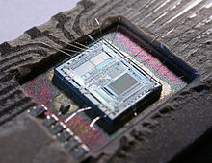
Third-generation Machines
Making use of Jack St. Clair Kilby’s and Robert Noyce’s independent invention of the integrated circuit (or microchip).
In 1966, Hewlett-Packard entered the general purpose computer business with its HP-2116
Intel 8742 eight-bit microcontroller IC

Slide 6
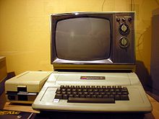
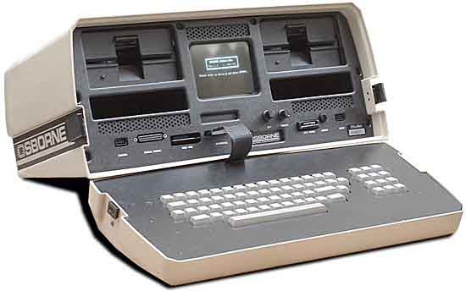
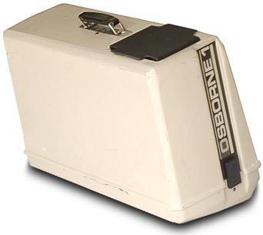
Fourth-generation Machines
Microprocessor based computers
In 1975, Apple I, first personal computer
1981, IBM-PC announced
1981, Osborne 1, the first laptop

Slide 7
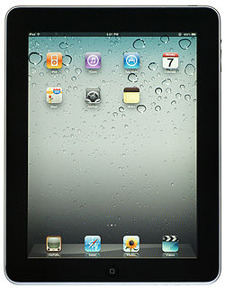
Past Decade
2003 IBM sold its PC department to Lenovo
2007: Apple released the first iPhone
2010: Apple released the first iPad,
Sold 3 million of the devices in 80 days.
2011 HP separated its PC department

Slide 8
Traditional Food Chain

Slide 9
Food Chain of Computer
PC
Mobile devices
PC
Mobile device
Workstation
Workstation
Mainframe
Mainframe

Slide 10
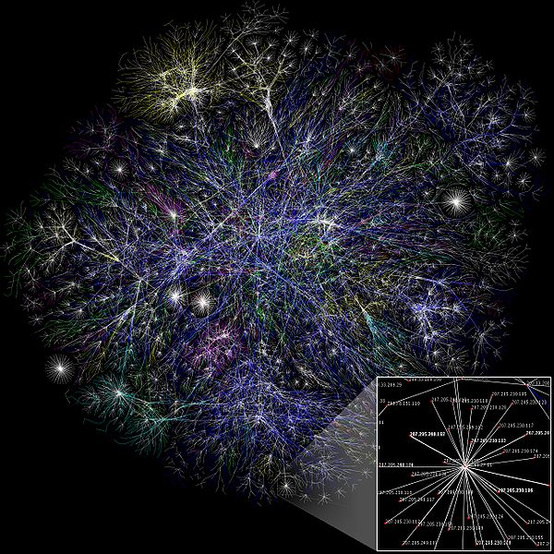
The Story of the Internet
First message sent over Arpanet, 1969
First email over Arpanet, 1971
The name Internet, 1974
World Wide Web, 1989
Wireless App Protocol, 1997
Google launched, 1998
DotCom bubble bursts, 2000
Wikipedia launched, 2001
Facebook 2004

Slide 11
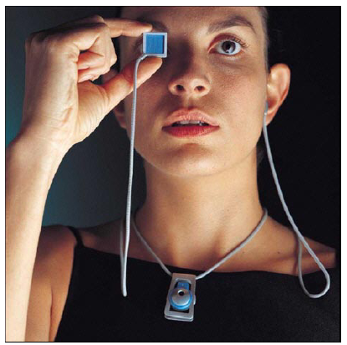
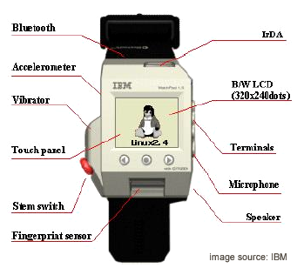
What’s Next?
Computing devices are smaller and smaller
Ubiquitous networking

Slide 12
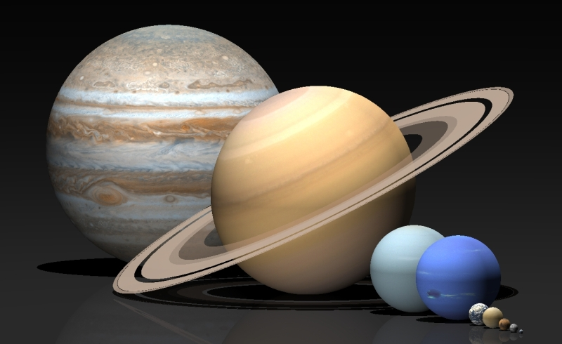
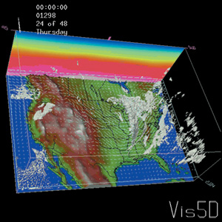
But…
The demands of computing power are increasing.
Scientific application
Computer animation
Computer games
Image processing
Data mining
… etc
Where to get the desired computing power?

Slide 13
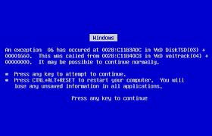
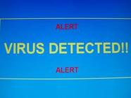
Things Annoy Computer Users
Computer crashes
Hard-disk crashes
Computer is slower and slower
Booting is slower and slower
Cannot run new programs
Cannot run old programs
Check the versions of data
Keep a lot of garbage in computer
Virus, worm, Trajan horse, malware, spyware, …
Anti virus software, firewall, …

Slide 14
It Would Be Wonderful IF
A computer is powerful but portable
My computer won’t crash
If it crashes, my data are still there, and the system can recover in no time.
Can run desired programs at any time any where
Even using different OSs or different platform
Need not worry about virus and other attaches
Since I only use the computer 6 hours a day, can I buy the computer using 1/4 of price.

Slide 15
For the IT Industry
If you think maintaining a computer is a lot of work, think about people need to manage a bunch of computers.
Hardware/software upgrade, downgrade
Network facility and management
Heat problem, power consumption
Place to host the machines
User account management
Technician, technical support
Trouble shooting

Slide 16
Story That Happens Every Time
離譜 台鐵網路票 第１分鐘就塞爆
2010年 01月28日
【李姿慧╱台北報導】台鐵昨早六時開賣春節東部車票，才一開放網路系統就塞爆，不少民眾瘋狂按網頁卻都連不上，第一分鐘僅五十二人透過網路訂到票，與往年平均有八成透過網路訂票相比可說史上最慘烈，民眾狂罵不斷，台鐵表示，中華電信控管出問題，今開賣西部幹線車票將增加伺服器改善。
台鐵訂票系統昨一開放就狂塞一個半小時，民眾林先生不滿的說，他訂一個多小時不是進不去就是掛掉，每次網路當掉台鐵就說瞬間流量大，「重大節日量大不是事先料想到的嗎？還以瞬間量大當藉口，到底要不要臉！」
住花蓮的民眾陳正修也無奈的說，想買花蓮到高雄的車票，試整天都買不到，政府講講蘇花替代道路都沒用，還不如想辦法讓花蓮人買到車票。網路上昨也民怨不斷，有網友說訂不到票打到台鐵客服抱怨，客服人員還毫無歉意的說：「現在都塞爆了啊！」讓人氣炸。
台鐵表示，初步調查發現昨清晨六時一開放訂票就發現網路系統異常，每秒瞬間流量達八萬八千多筆，比去年六萬筆多出近五成，且第一分鐘僅有一千四百二十八人成功訂票，遠低於去年第一分鐘有七千多人成功訂票，「最離奇的是，第一分鐘僅有百分之三點七、約五十二人是用網路買到票，但正常比率應是八成，今年是網路凸槌最嚴重的一次，但中華電聲稱是流量太大導致。」

Slide 17
Under Provision
Loss Revenue
Resources
Capacity
Resources
Demand
Capacity
1
2
3
Demand
Loss Users
Resources
Capacity
1
2
3
Time (days)
Demand
1
2
3

Slide 18
Low Utilization
Capacity
Resources
Unused resources
Demand
Time

Slide 19
Enterprises to Initiate IT
Steps:
Survey and analysis the industry and market
Estimate the quantity of supply and demand
Purchase and deploy IT infrastructure
Install and test the software system
Design and develop enterprise specific business service
Announce the business service to clients
What if market changes or analysis is incorrect?

Slide 20
Capital Expenditure of IT
Each enterprise establishes its IT department
IT department handles the listing jobs
Manage and administrate hardware and software
Apply regular data backup and check point process
Purchase new infrastructure and eliminate outdated one
Always standby for any unexpected IT problems
Enterprise pays for IT investment which is not its business focus

Slide 21
Next Big Thing
Google search trends – all years

Slide 22
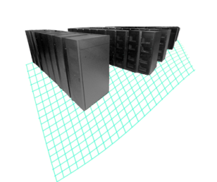
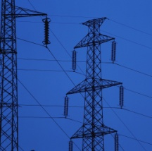
Cloud Computing
An IT service delivered to users that provides:
A simple user interface that automatically provisions IT resources
Capacity on demand with massive scalability
Innovative service delivery models for applications
2009
Cloud Computing
1990
Software as a Service
Anytime, anywhere access to resources delivered dynamically as a service
Utility Computing
Network-based subscriptions to applications
Grid Computing
Offering computing resources as a metered service
Solving large problems with parallel computing

Slide 23
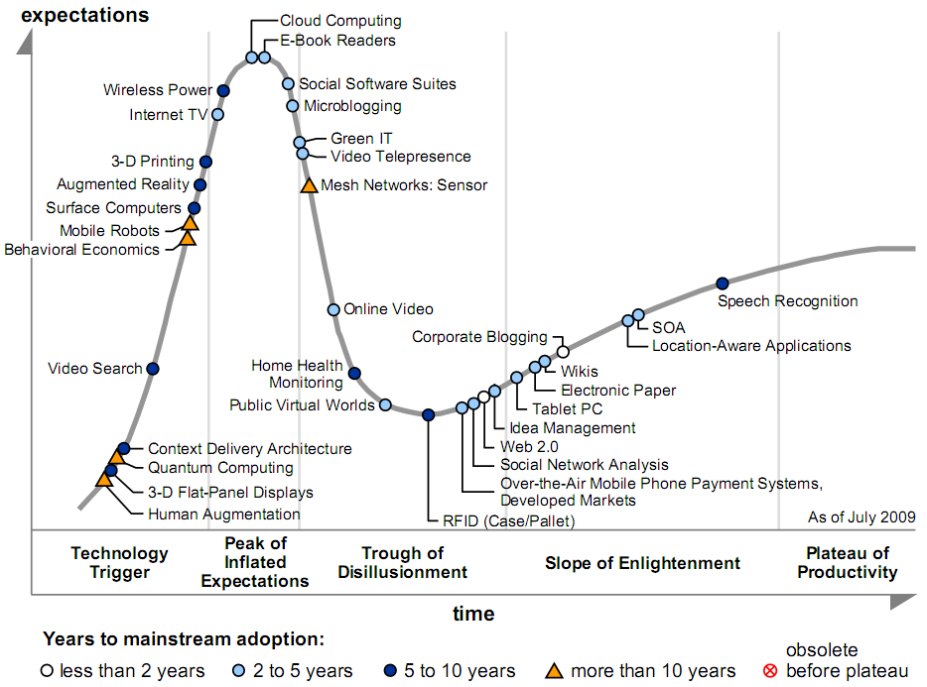
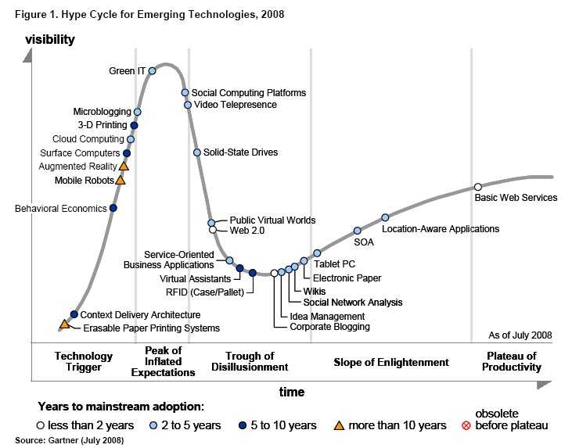
Emerging Technologies Cycle
Gartner 2009

Slide 24
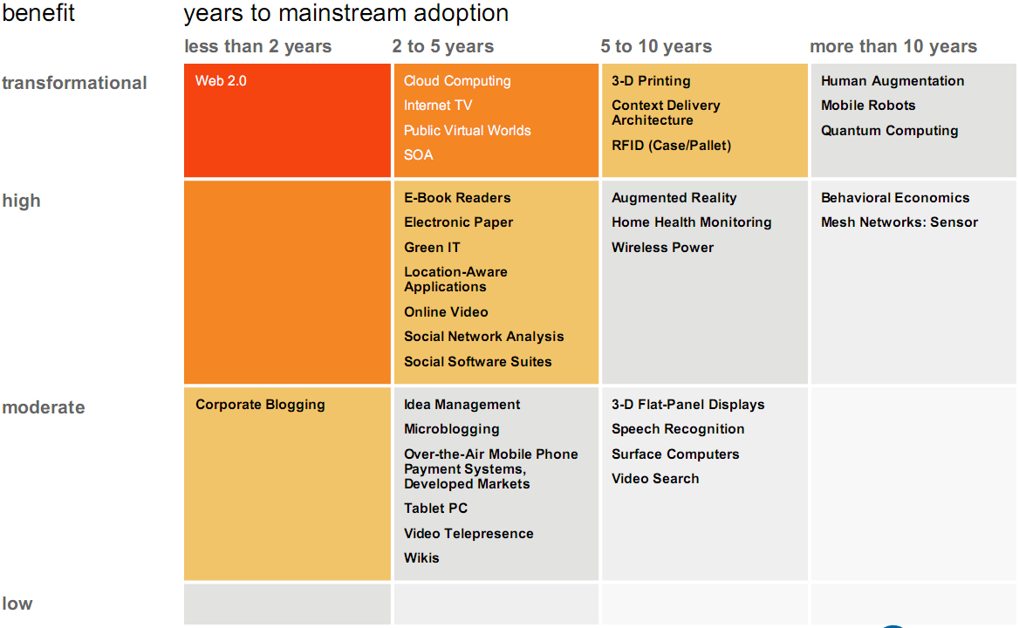
Technologies Priority Matrix
Gartner 2009

Slide 25
Benefits from Cloud Computing
Q: Rate the benefits commonly ascribed to the 'cloud'/on-demand model
Source: IDC Enterprise Panel, 3Q09, n = 263, September 2009
Pay only for what you use
77.9%
Easy/fast to deploy to end-users
77.7%
Monthly payments
75.3%
Encourages standard systems
68.5%
Requires less in-house IT staff, costs
67.0%
Always offers latest functionality
64.6%
Sharing systems with partners simpler
63.9%
Seems like the way of the future
54.0%
0%
10%
20%
30%
40%
50%
60%
70%
80%
90%

Slide 26
Adoption of Cloud Computing
Q: Rate your likelihood to pursue the cloud model for the following
Source: IDC Enterprise Panel, 3Q09, n = 263, September 2009
Collaboration applications
67.3%
Web applications/Web serving
66.9%
Data Back-up or Archive services
59.4%
Business apps (CRM, HR, ERP)
55.6%
Personal productivity apps
55.1%
Data/Content Distribution services
54.8%
Storage capacity on demand
52.9%
IT Management software
51.3%
Server capacity on demand
50.6%
Business Intelligence/Analytics
49.8%
Application dev/test/deploy platform
49.1%
IT/Information Security
48.6%
0%
10%
20%
30%
40%
50%
60%
70%
80%

Slide 27
Compared with Traditional IT
 | Traditional IT | Cloud
Servers | Large capacities Multi-year leases | On demand, pay-as-you-go
Software | Software licenses by seat | Pay by the month
Infrastructure capacity | Large increments with up-front capital costs | Allow capacity to be obtained on just what is needed
Rapid provision | 2 to 3 weeks | In minutes to hours

Slide 28
Reduce IT Investment
 | Traditional | Cloud Computing
Investment Risk | Enterprise take the risk | Cloud reduces the risk
Infrastructure | Enterprise own the infrastructure | Cloud provider own the infrastructure
Business focus | Need to own its IT department | Cloud provider take care everything
Payment | Investment and human resource | Enterprise pay as the service used
Time duration | Long establish time | Fast to business ready

Slide 29
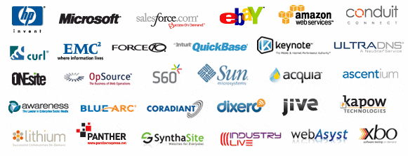
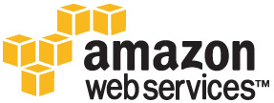
Cloud Computing Players

Slide 30
Outline
History and Trend of Computing
What is Cloud Computing?
Cloud Enabling Technologies

Slide 31
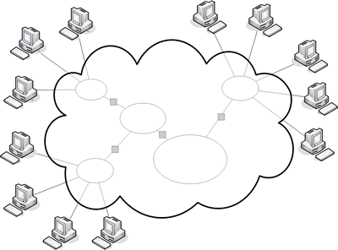
The “Cloud”
The term “cloud” is often used as a metaphor for the Internet.

Slide 32
History of Cloud
1983 Sun Microsystems founded: Theme: The Network is the Computer
1993 Sun Microsystems CTO Eric Schmidt: When the network becomes as fast as the processor, the computer hollows out and spreads across the network
August 2006: Eric Schmidt coined “Cloud Computing” for server clusters

Slide 33
Cloud Industry
October 2004: Google offered Gmail service
March 2006: Amazon offered Amazon S3 (Simple Storage Service) service
June 2006 Microsoft Ray Ozzie: Software + Service
December 2006: Amazon offered Amazon EC2 (Elastic Compute Cloud) service
January 2008: Saleforce offered Force.com
April 2008: Google offered Google App Engine
October 2008: Microsoft offered Window Azure

Slide 34
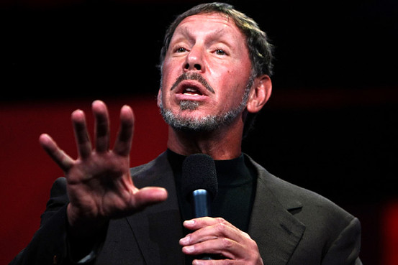
Cloud Disclaimers
Oracle CEO Larry Ellison
We’ve redefined Cloud Computing to include everything that we already do. I don’t understand what we would do differently other than change the wording of some of our ads.

Slide 35
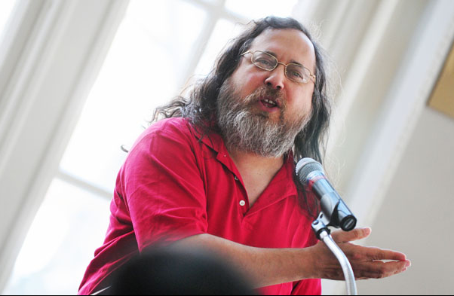
Cloud Disclaimers
Rich Stallman
Founder of Free Software Foundation.
It's stupidity. It's worse than stupidity: it's a marketing hype campaign. Somebody is saying this is inevitable – and whenever you hear somebody saying that, it's very likely to be a set of businesses campaigning to make it true.

Slide 36
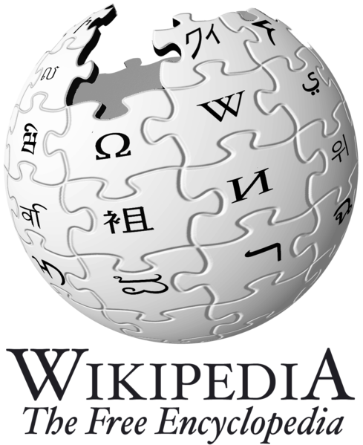
Definition from Wikipedia
Cloud computing is Internet-based computing, whereby shared resources, software, and information are provided to computers and other devices on demand, like the electricity grid.
Cloud computing is a style of computing in which dynamically scalable and often virtualized resources are provided as a service over the Internet.

Slide 37
Definition from NIST
Cloud computing is a model for enabling convenient, on-demand network access to a shared pool of configurable computing resources (e.g., networks, servers, storage, applications, and services) that can be rapidly provisioned and released with minimal management effort or service provider interaction.

Slide 38
More Specifically
Five characteristics
On-demand self-service.
Broad network access.
Resource pooling.
Rapid elasticity.
Measured Service.
Four deployment models
Private cloud
Commodity cloud
Public cloud
Hybrid cloud
Three service models
Cloud Infrastructure as a Service (IaaS).
Cloud Platform as a Service (PaaS).
Cloud Software as a Service (SaaS).

Slide 39
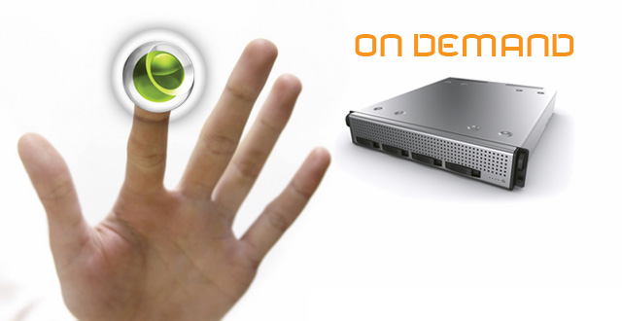
1. On-demand Self-service
A consumer can unilaterally provision computing capabilities, such as server time and network storage, as needed automatically without requiring human interaction with each service’s provider.

Slide 40
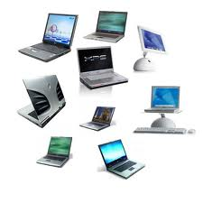
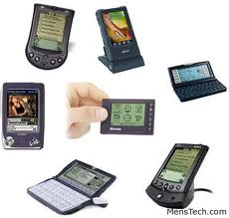
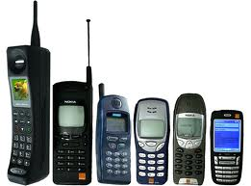
2. Broad Network Access
Capabilities are available over the network and accessed through standard mechanisms that promote use by heterogeneous thin or thick client platforms (e.g., mobile phones, laptops, and PDAs).

Slide 41
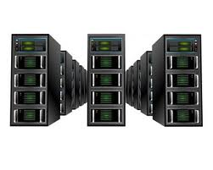
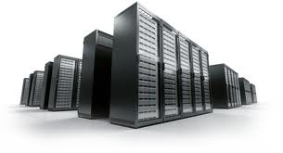
3. Resource Pooling
The provider’s computing resources are pooled to serve multiple consumers using a multi-tenant model, with different physical and virtual resources dynamically assigned and reassigned according to consumer demand.

Slide 42
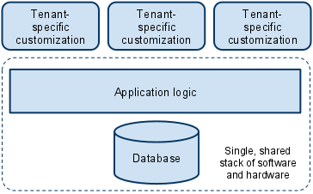
Multi-tenancy
In a multi-tenant environment a single application can be used and customized by different organization as if they each have a separate instance.

Slide 43
4. Rapid Elasticity
Capabilities can be rapidly and elastically provisioned, in some cases automatically, to quickly scale out, and rapidly released to quickly scale in.
To the consumer, the capabilities available for provisioning often appear to be unlimited and can be purchased in any quantity at any time.

Slide 44
Dynamic Provisioning
Meet seasonal demand variations
Meet burst demand for some extraordinary events
Resources
Capacity
Resources
Capacity
Demand
Demand
Time
Time

Slide 45
5. Measured Service
Cloud systems automatically control and optimize resource use by leveraging a metering capability at some level of abstraction appropriate to the type of service (e.g., storage, processing, bandwidth, and active user accounts).
Typically through a pay-per-use business model
Resource usage can be monitored, controlled, and reported, providing transparency for both the provider and consumer of the utilized service.

Slide 46
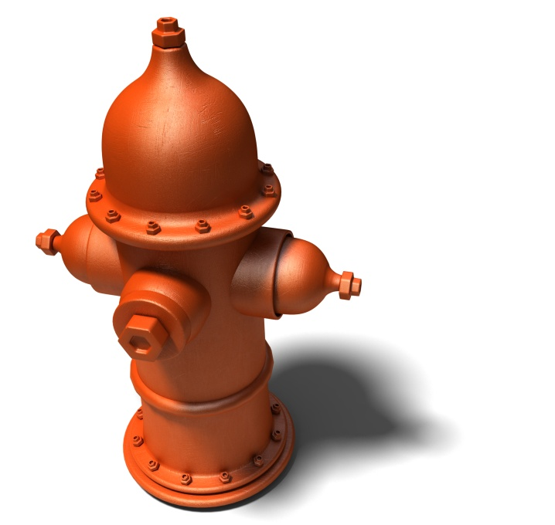
Utility Computing
One service provisioning model
Service provider makes computing resources and infrastructure management available to the customer as needed, and charges them for specific usage rather than a flat rate.

Slide 47
Four Deployment Models
Private cloud.
The cloud infrastructure (CI) is operated solely for an organization.
Community cloud.
The CI is shared by several organizations and supports a specific community that has shared concerns
Public cloud.
The CI is made available to the general public
Hybrid cloud.
The CI is a composition of two or more clouds.

Slide 48
Different Deployment Types

Slide 49
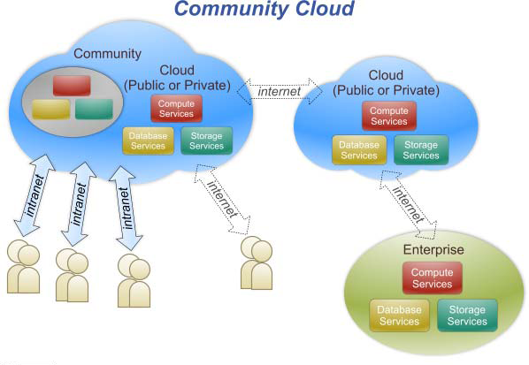
Community Cloud

Slide 50
Public vs. Private
 | Public Cloud | Private Cloud
Infrastructure | Homogeneous | Heterogeneous
Policy Model | Common defined | Customized & Tailored
Resource Model | Shared & Multi-tenant | Dedicated
Cost Model | Operational expenditure | Capital expenditure
Economy Model | Large economy of scale | End-to-end control

Slide 51
Three Service Models
Cloud Infrastructure as a Service (IaaS).
To provision processing, storage, networks, and other fundamental computing resources where the consumer is able to deploy and run arbitrary software, including OSs and applications.
Cloud Platform as a Service (PaaS).
To deploy onto the cloud infrastructure consumer-created or acquired applications.
Cloud Software as a Service (SaaS).
To use the provider’s applications running on a cloud infrastructure.

Slide 52
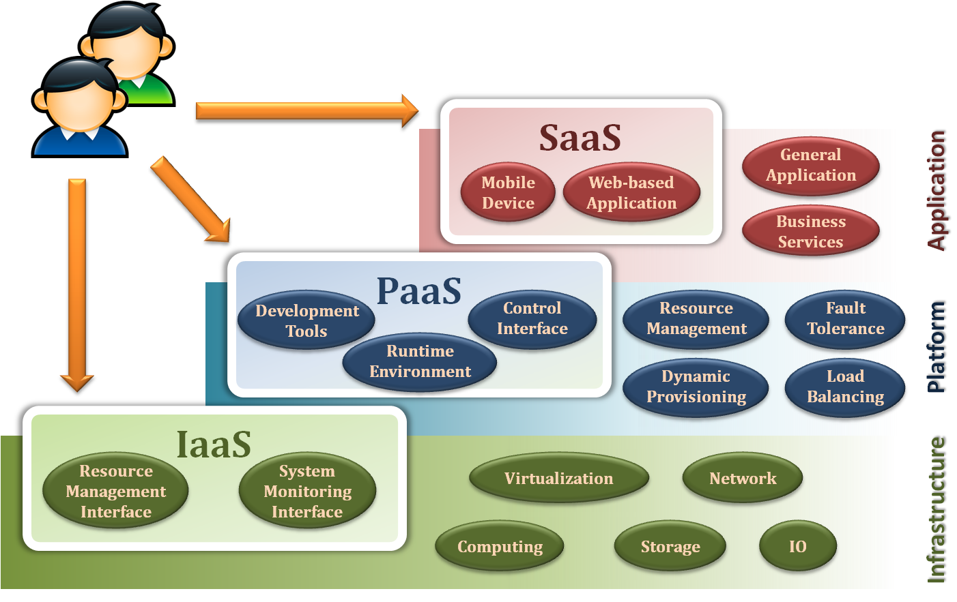
Three Service Models

Slide 53
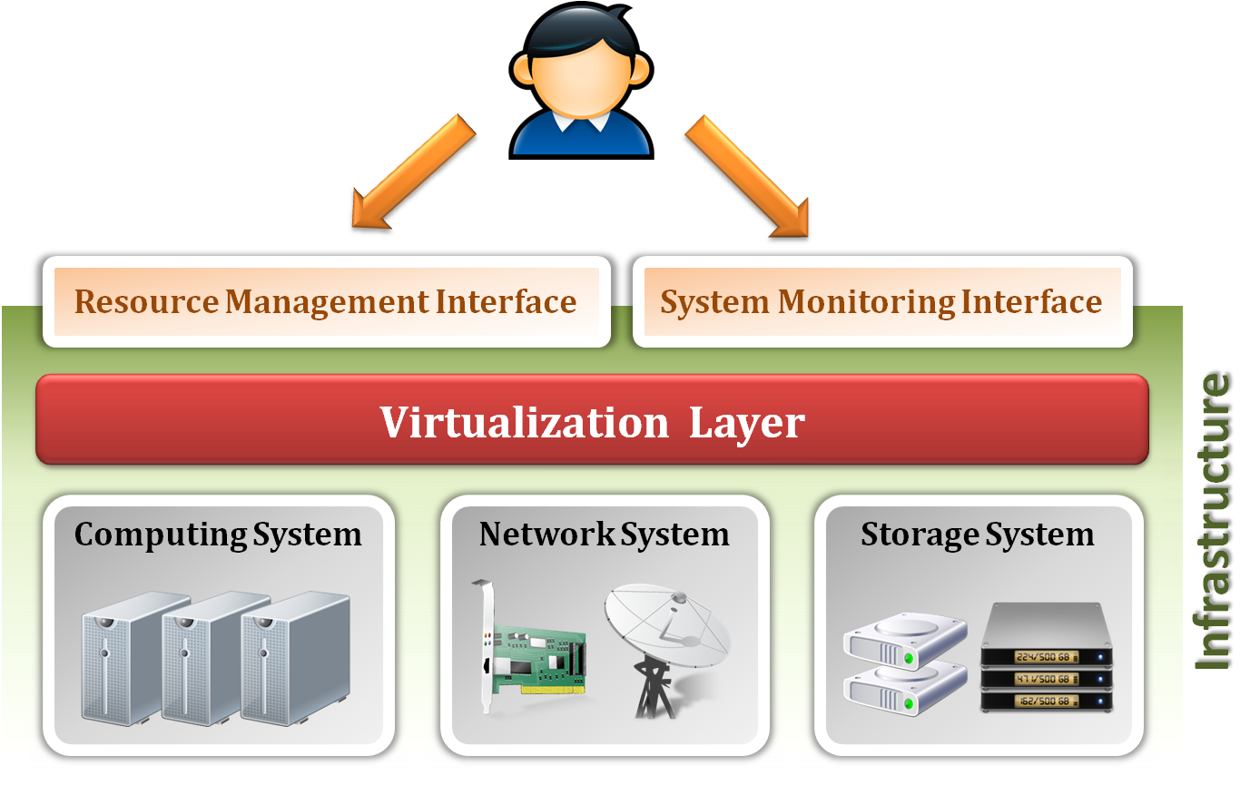
Infrastructure as a Service

Slide 54
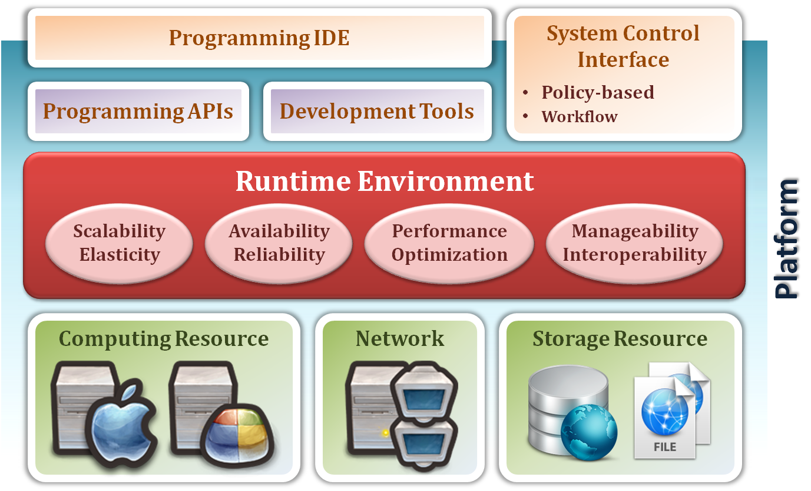
Platform as a Service

Slide 55
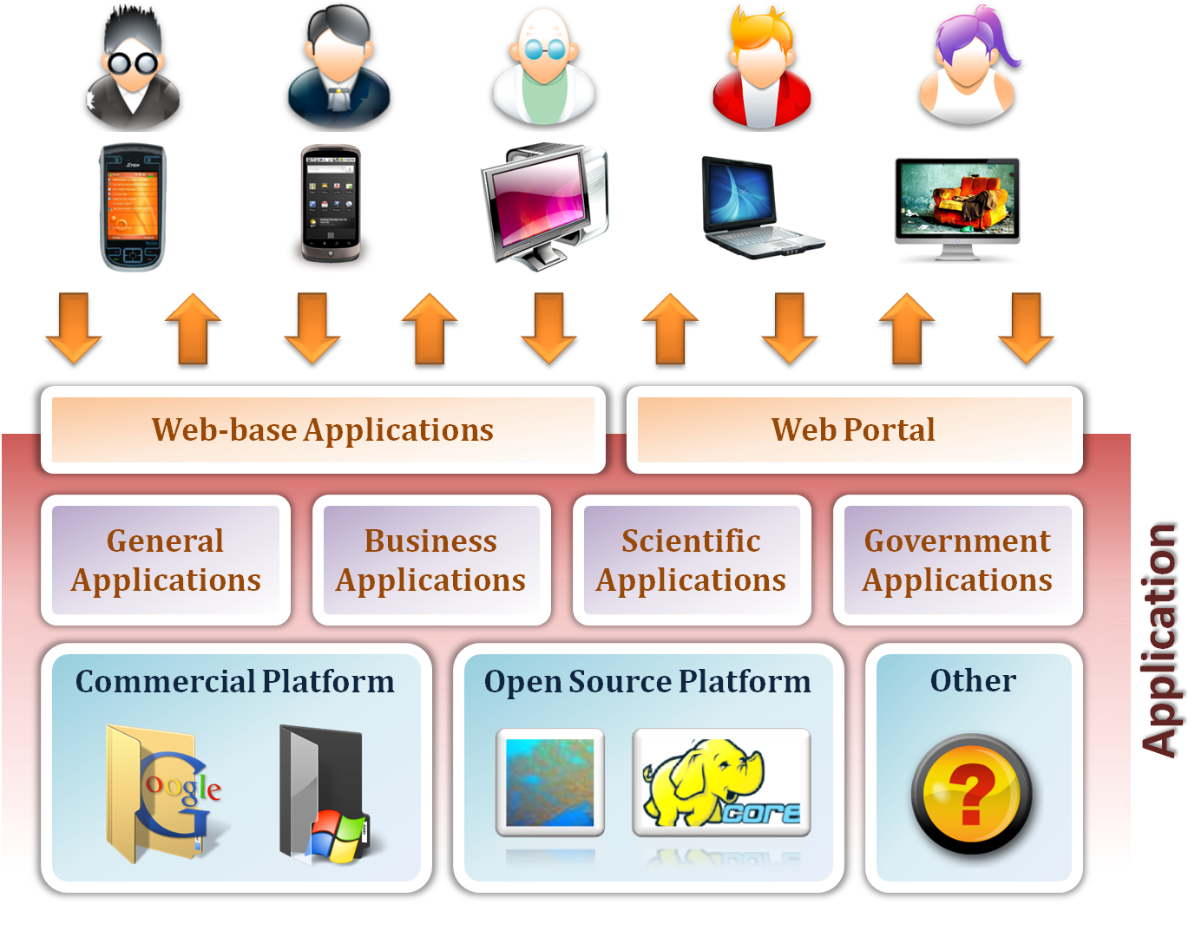
Software as a Service

Slide 56
Outline
History and Trend of Computing
What is Cloud Computing?
Cloud Enabling Technologies

Slide 57
Cloud Enabling Technologies
Virtualization technology
Data center and its network
Distributed file systems
MapReduce
Web services
Cloud management system
SaaS
Enabling Technologies
Web Services
PaaS
IaaS
Web Services
Cloud Infrastructure Mangers
VIM
VMM
VMs
MapReduce
DFS
Hardware Technologies

Slide 58
Virtualization Technology
Cloud Infrastructure Manager (CIM)
Web based VM management on top of IaaS providers.
Virtual Infrastructure Manager (VIM)
Deploying , control and monitoring of VMs on a distributed pool of resources.
Virtual Machine Manager (VMM)
Manage the lifecycle of VMs on a single node.
Virtual Machines (VMs)
Have two main layers, the operating system and a software package that is partially or fully configured to perform a specific task.

Slide 59
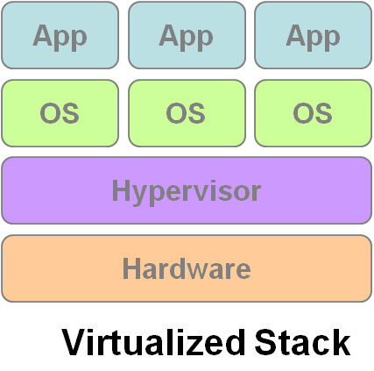
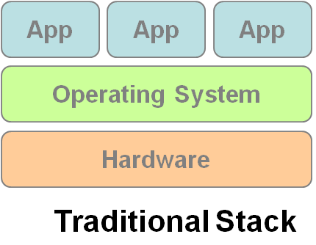
Virtual Machines
Multiple OS share the physical hardware and provide different services.
VM1
VM2
VM3

Slide 60
Why Virtualization?
Server and application consolidation:
Allow multiple applications on the same server
Configurability:
Allows dynamic configuration and bundling of resources for a wider variety of applications
Increased application availability:
Allow quick failure recovery from unplanned outages with no interruption in service.
Improved responsiveness:
Resource provisioning, monitoring, and maintenance can be automated.

Slide 61
Distributed Computing
A computer system in which several interconnected computers share the computing tasks assigned to the system
Workstation
Workstation
Mainframe
PC
Mainframe
PC
Mini Computer
Mini Computer

Slide 62
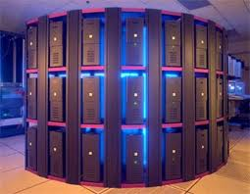
Cluster Computing
A cluster is a type of parallel and distributed system, which consists of a collection of inter-connected stand-alone computers working together as a single integrated computing resource

Slide 63
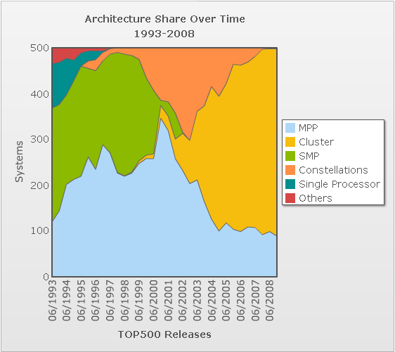
Cluster Applications
Cluster had become the mainstream computing system
Apply parallel program to
Computing intensive
Data intensive
Timing critical system
… any time you are pleased

Slide 64
Grid Computing
To coordinate resource sharing and problem solving in dynamic, multi-institutional virtual organization (VO)

Slide 65
The Grid
Grid
An analogy with the electric power grid around 1910
In the mid-1990s, this term is coined to denote a proposed distributed computing infrastructure for advanced science and engineering

Slide 66
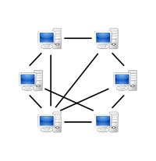
Peer-to-peer Computing
Peer-to-peer (P2P) computing or networking is a distributed application architecture that partitions tasks or workloads between peers.
Peers make a portion of their resources, such as processing power, disk storage or network bandwidth, directly available to other network participants, without the need for central coordination by servers or stable hosts.

Slide 67
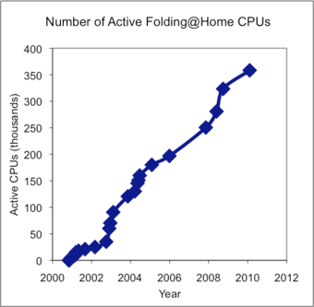
Volunteer Computing
Computer owners donate their computing resources through the Internet to one or more "projects".
Ex: SETI@home and Folding@home

Slide 68
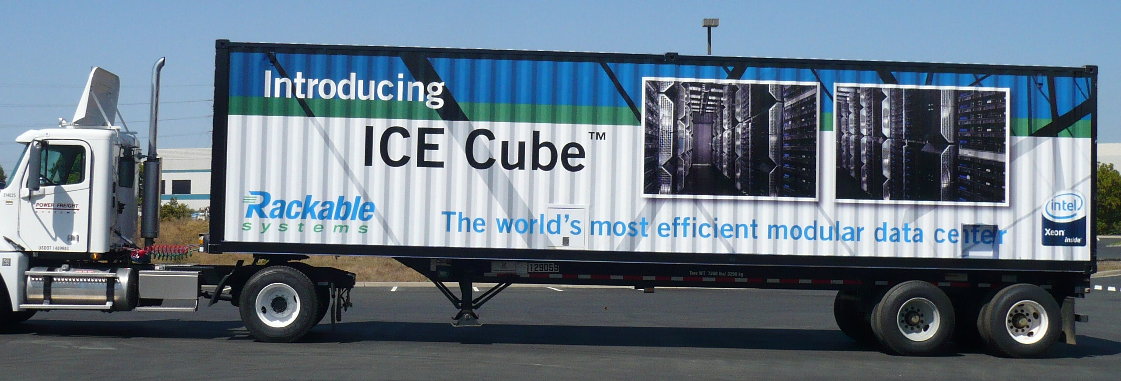
Data Center and Its Network
Manage and maintain a pool of resources is a big problem
Container data center
Modular data center
Connect them and let them work together is an even bigger problem
Massive machines in a large scale LAN
Compatibility problem with existing protocols (TCP/IP)

Slide 69
Distributed File Systems
Support access to files on remote servers
Can offer support for replication and local caching
Network file system (NFS)
Network drives are mounted into local directory hierarchy
Google file system (GFS)
Design for redundant storage of massive amounts of data on cheap and unreliable computers

Slide 70
Parallel Programming Models
Has a wide spectrum, depending on the underlying hardware architecture
MPI, PVM, OpenMP, TBB, MapReduce, …
MapReduce is a programming model to process massive data
Because of the huge amount of data stored by a cloud, efficient processing and analysis of data has become a challenging issue.
Google uses its MapReduce framework to process 20 petabytes of data per day.

Slide 71
Flynn's Taxonomy
Programs and computers are classified by
whether they were operating using a single set or multiple sets of instructions
whether or not those instructions were using a single or multiple sets of data
 | Single Instruction | Multiple Instructions
Single Data | SISD | MISD
Multiple Data | SIMD | MIMD

Slide 72
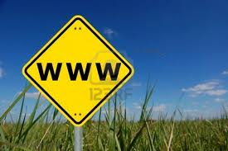
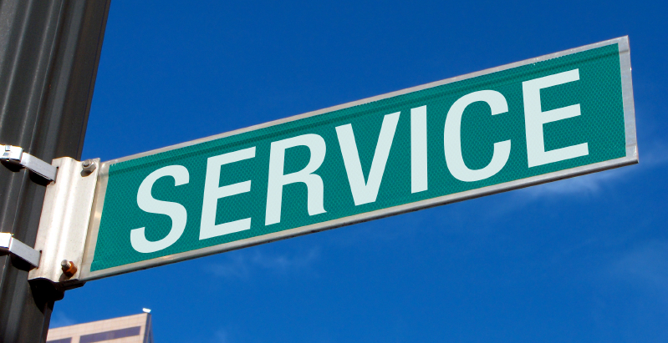
Web Services
Definition :
Web service is self-describing and stateless modules that perform discrete units of work and are available over the network
Web service providers offer APIs that enable developers to exploit functionality over the Internet, rather than delivering full-blown applications

Slide 73
Web Services
RPC (Remote Procedure Call)
SOA (Service-Oriented Architecture)
REST (Representative State Transfer)
WSDL (Web Services Description Language)
Expressed in XML, both data type and messages

Slide 74
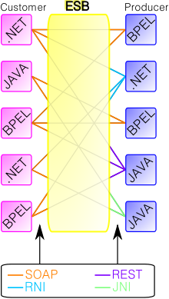
Enterprise Service Bus
An enterprise service bus (ESB) is a software architecture model used for designing and implementing the interaction and communication between mutually interacting software applications in Service Oriented Architecture (SOA).

Slide 75
References
Chap 1 of . “Cloud Computing: Principles, Systems and Applications,” L. Gillam et al. (eds.) Springer, 2010.
Lecture notes from Yeh-Ching Chung
http://csrc.nist.gov/publications/drafts/800-145/Draft-SP-800-145_cloud-definition.pdf
http://www.theenterprisearchitect.eu/archive/2010/04/27/multi-tenancy-and-model-driven-engineering-necessary-assets-of-a-platform-as-a-servic

