Slide 1
Image Sharing Based on Chinese Remainder Theorem
Institute of Information Systems and Applications
Department of Computer Science
National Tsing Hua University
Hsinchu, Taiwan 30013
http://www.cs.nthu.edu.tw/~cchen

Slide 2
Illustration

Slide 3
Outline
Introduction
Background Review
Proposed Method
Experimental Results
Conclusion

Slide 4
Introduction
To avoid the information is carried by only a single individual
Data are partitioned into n shadows and are distributed to n participants
By collecting at least k out of n shadows, we can completely recover the original data (information)
A (k,n)-threshold technique based on CRT is introduced

Slide 5
Background Review for (k,n)-threshold Techniques
The secret value S is used to generate n shadows
Any k or more shadows can recover the secret value S
Fewer than k shadows cannot reveal the secret value S
Commonly used (k,n)-threshold schemes for sharing
Shamir [Sham1979]
Blakley [Blak1979]
Asmuth and Bloom [Asmu1983]

Slide 6
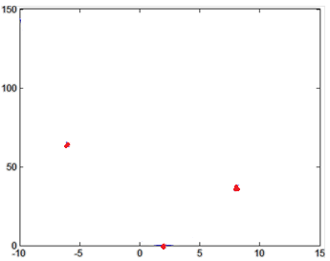
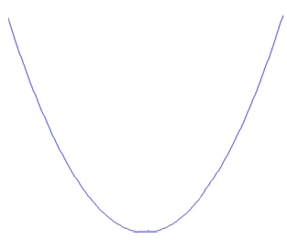
Shamir (1979)
Based on polynomial interpolation
Sharing
Given k distinct points in the 2-d plane, determine a unique polynomial of degree k-1
Put the secret message to the constant term, generate n shadow messages which are distributed to n participants
Recovering
Polynomial interpolation to find the secret message

Slide 7
Blakley (1979)
Uses the characteristic of geometry
Sharing
Chooses a point Q which contains the secret value S in the k-dimensional space
Select n hyper-planes passing through the point Q as n shadows
Recovering
Collect at least k hyper-planes
Solving a linear system of equations
L2
L3
L1
Q

Slide 8
Asmuth and Bloom (1983)
Requirements
A sequence of pairwise relatively prime positive integers
Sharing
Modular arithmetic
Random integer α
Recovering
Based on Chinese Remainder Theorem to solve Congruence Eqs.

Slide 9
Background Review-Thien and Lin (2002)
1. Suppress all pixels whose gray values are larger than 250 to 250.
2. Permute the pixels
3.
k pixels
q(x)≡a₀+a₁x+…+a_{k-1}x^{k-1} (mod 251)
a₀ | a₁ | … | a_{k-１} | …
q(r₁)
q(r_{n})
．．．
Permuted Image
Shadow Images

Slide 10
Background Review-Thien and Lin
1. Collect any k shadow images.
2.
Polynomial interpolation
q(r₁)
q(r_{k})
．．．
q(x)≡a₀+a₁x+…+a_{k-1}x^{k-1} (mod 251)
Shadow Images
3. Permute the pixels inversely.
a₀ | a₁ | … | a_{k-１} | …
Permuted Image

Slide 11
Background Review-Thien and Lin
Distortion
Suppress pixels whose gray values are larger than 250 to 250.
a₀ | a₁ | … | a_{k-１} | …
If p<250→store p
If p$≥$250→store 250 and p-250
250 | a₀-250 | … | a_{k-2} | a_{k-１}
Permuted Image
Array E

Slide 12
Chinese Remainder Theorem
Let m₁, m₂,…, m_{k} be integers with gcd(m_{i}, m_{j})=1 whenever i $≠$ j. There exists a unique solution x for the following simultaneous congruence equations in [0, m₁m₂$⋯$m_{k})

Slide 13
Solution for Chinese Remainder Theorem

Slide 14
Background Review- Mignotte’s Scheme vs. Asmuth’s Scheme
Mignotte’s Scheme | Asmuth’s Scheme
gcd(m_{i}, m_{j})=1, for | gcd(m_{i}, m_{j})=1, for
CRT | CRT

Slide 15
Background Review-Ulutas (Sharing)
1. Select a set {m₀<m₁<…<m_{n}} which satisfies
(i) gcd(m_{i}, m_{j}) = 1, for 1$≤$i$<$j$≤$n (ii) M = $\prod_{i=1}^{k}{m_{i}}$＞ m₀ * $\prod_{i=1}^{k−1}{m_{n−i+1}}$
2.
p₀ | p₁ | …
 |  | …
 |  | … |  | p_{n}
If p $≥$m₀ If p < m₀
y =p-m₀+$α×$m₀ y = p+$α×$m₀
0$≤α≤$t t+1 $≤α$ <m₁*…*m_{k}
$t∈[0,m_{0})$
Secret Image
y_{i} ≡ y mod m_{i} for i=1,2,…n
y₁
y₂
y_{n}
．．．
Shadow Images

Slide 16
Background Review-Ulutas (Revealing)
y₁
If $α≤t$
p = m₀+y mod m₀
y₂
CRT→y
．．．
Else
p = y mod m₀
y_{k}
If p $≥$m₀ If p < m₀
y =p-m₀+$α×$m₀ y = p+$α×$m₀
0$≤α≤$t t+1 $≤α$ <m₁*…*m_{k}
$t∈[0,m_{0}]$
Shadow Images

Slide 17
Proposed Method
https://lh4.ggpht.com/T7Qsp9L8qYLtaLk4-4Zgt8Nwy_FfvnDdxSL8c3BSF2Lk5X-CKjfxGjhbfbyHy5iHsB3YRA=s151

Slide 18
Proposed Method
Based on Ulutas scheme [Ulut2009], we proposed a method which uses the color image as the secret image.
There are three values R, G, and B in each pixel of the color image, we need to compute these three values respectively.
To strengthen the robustness and the reliability of our method, we encrypt the secret values using the simple exclusive-or (XOR) cipher with a 24-bit long key.
1 | 0 | 1 | 0 | 1 | 1 | 0 | 1
Last significant bit
+random integer→shares

Slide 19
The Proposed Sharing Method
Original Secret image
Encryption with XOR
Sharing scheme
Shadow image 1
Shadow image 2
………………
Shadow image n

Slide 20
The Proposed Revealing Method
$$Shadow image i_{1}$$
$$Shadow image i_{2}$$
.…………
$$Shadow image i_{k}$$
Chinese Remainder Theorem
Revealing scheme
Decryption with XOR
Revealed image

Slide 21
The Proposed Sharing Method
R
G
B
ＲＲＲＲＲＲＲＲＧＧＧＧＧＧＧＧＢＢＢＢＢＢＢＢ
♁１００１０１０１１００１０１０００１１０１０１１
Encrypted R, G, B values
XOR
Pixel
1. Do the XOR operation on each R,G,B values
2. Determine a set of integers {m₀, m₁, m₂, …, m_{n}} which satisfies
(i) m₀=128<m₁<…<m_{n}<256; (ii) gcd(m_{i}, m_{j}) = 1, for 0$≤$i$<$j$≤$n;
(iii) M = $\prod_{i=1}^{k}{m_{i}}$＞ m₀ * $\prod_{i=1}^{k−1}{m_{n−i+1}}$
3.
$y_{h}=(p_{h}>>1)+α×m_{0},$
h=r, g, b, $0≤α≤\left\lfloor \frac{M}{m_{0}}−1\right\rfloor$
4.
y_{r}
$r_{i}^{(p)}$\
mod m_{i}
y_{g}
$$g_{i}^{(p)}$$
y_{b}
$$b_{i}^{(p)}$$
Shadow pixel

Slide 22
The Proposed Revealing Method
y₁
$y_{i}=(p_{h}>>1)+α×m_{0},$
h=r, g, b, $0≤α≤\left\lfloor \frac{M}{m_{0}}−1\right\rfloor$
$r_{i}^{(p)}$\
y₂
$$g_{i}^{(p)}$$
CRT→y_{r}、y_{g} 、y_{b}
$P_{h}=((y_{h} mod{ m}_{0})<<1),$ h=r, g, b
$$b_{i}^{(p)}$$
Without using $α$
．．．
XOR
1 | 0 | 1 | 0 | 1 | 1 | 0 | 0 or 1
y_{k}
p_{r}
Last significant bit
Shadow images
p_{g}
p_{b}
Revealed pixel

Slide 23
Experimental Results
http://blog.toggl.com/wp-content/uploads/sites/5/2014/10/programmer-at-work.jpg

Slide 24
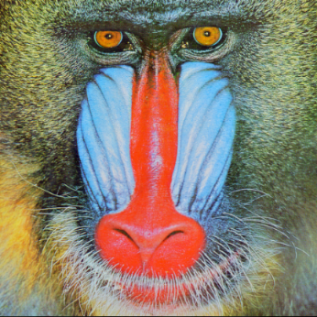
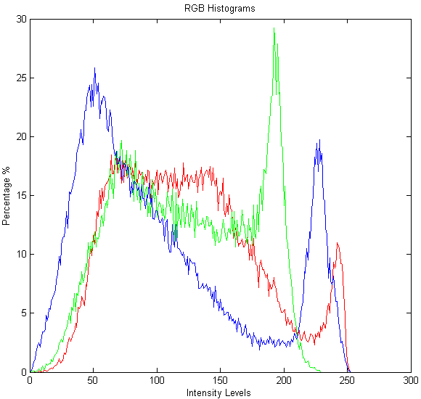
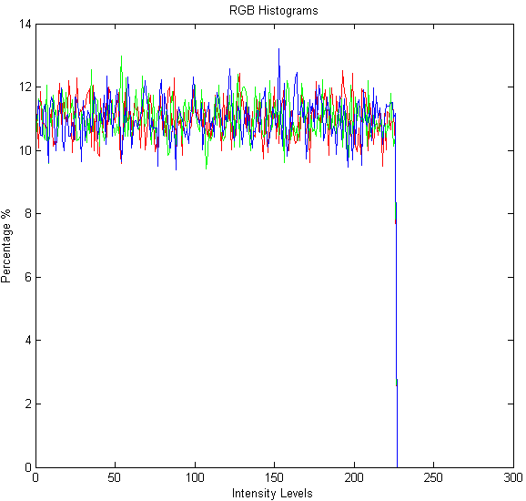
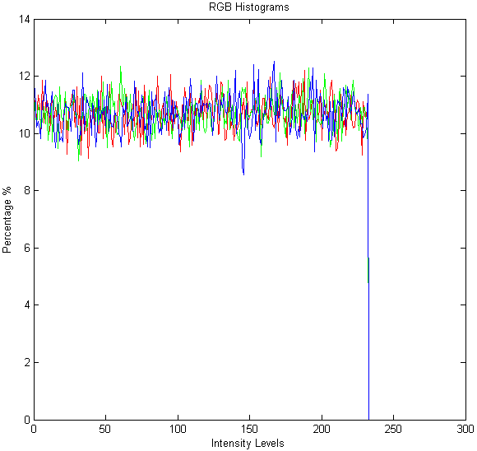
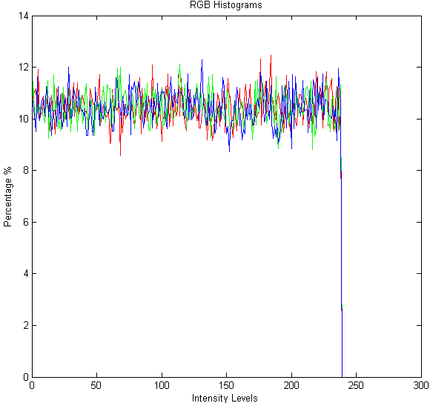
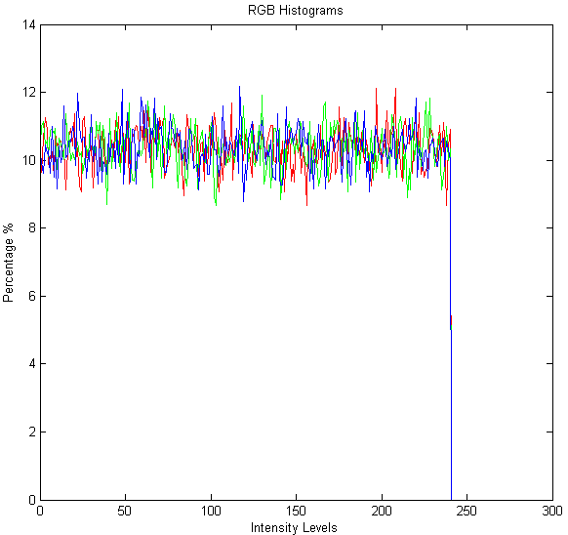
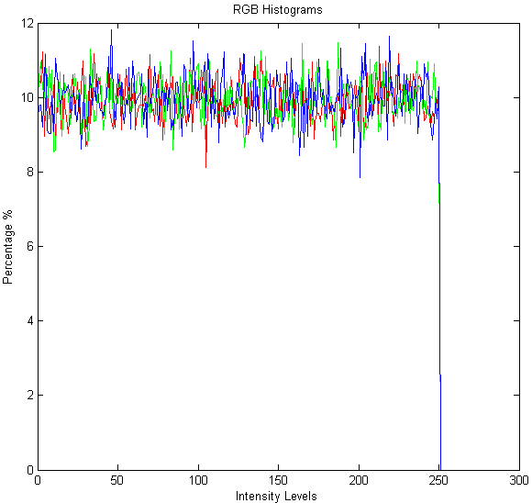
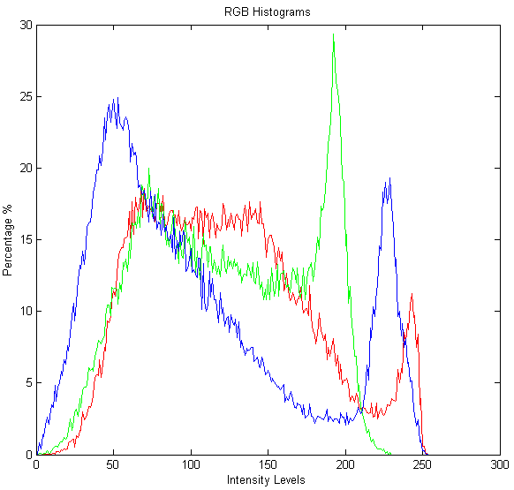
Experimental Results - Mandrill
Original image
Shadow image1
Shadow image2
Shadow image3
Shadow image4
Shadow image5
Revealed image

Slide 25
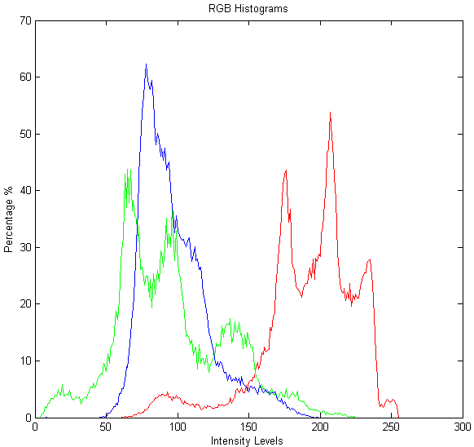
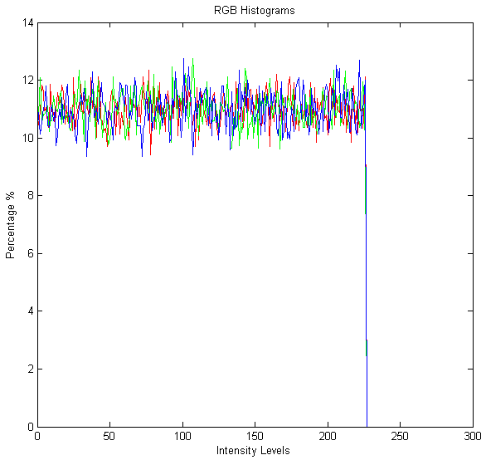
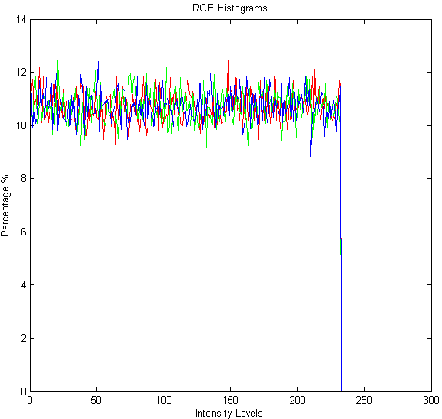
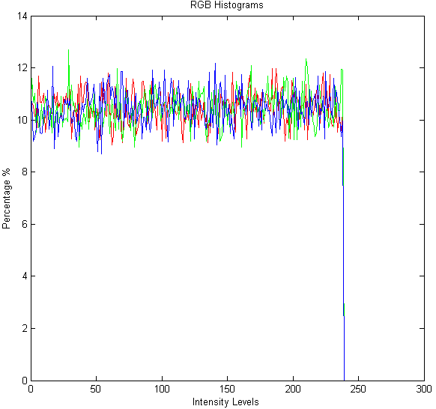
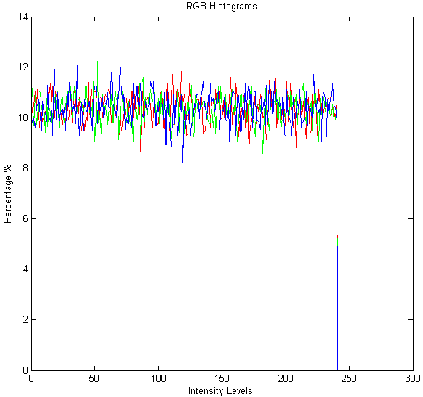
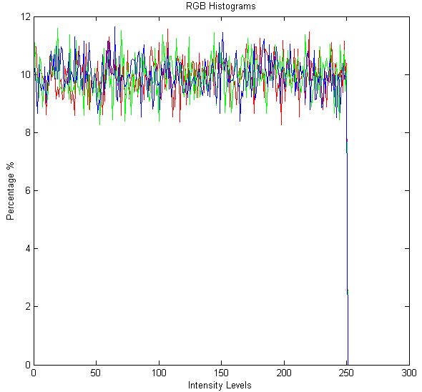
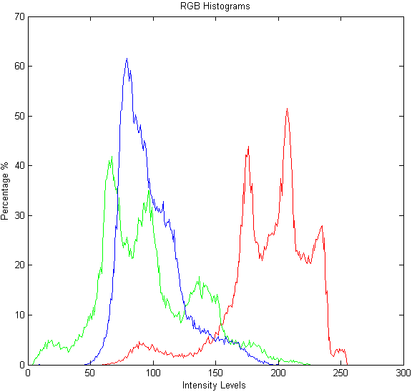
Experimental Results - Lenna
Original image
Shadow image1
Shadow image2
Shadow image3
Shadow image4
Shadow image5
Revealed image

Slide 26
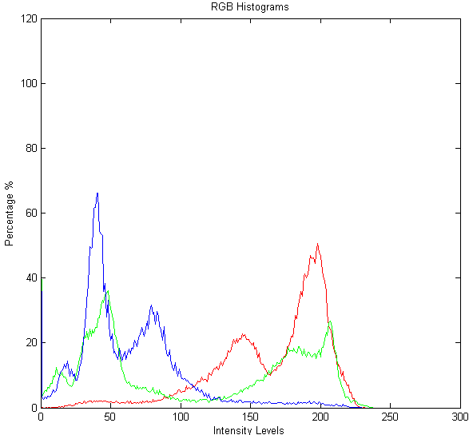
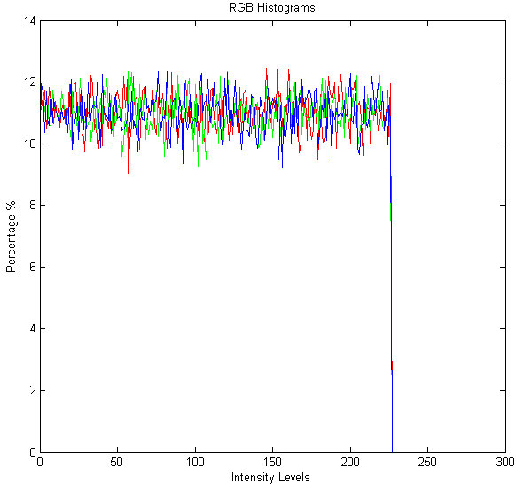
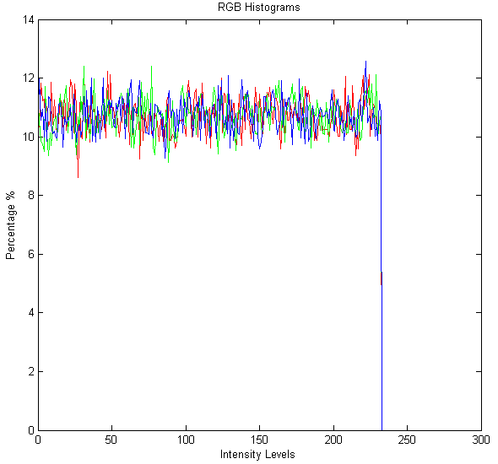
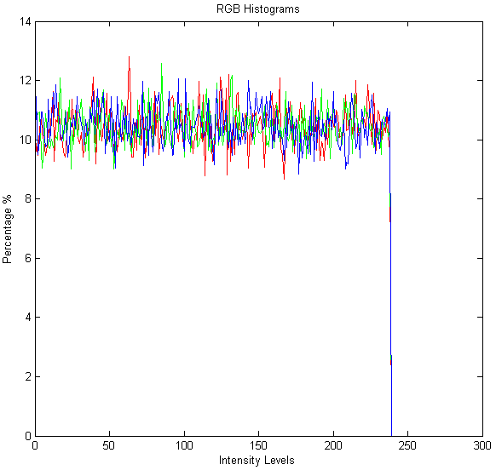
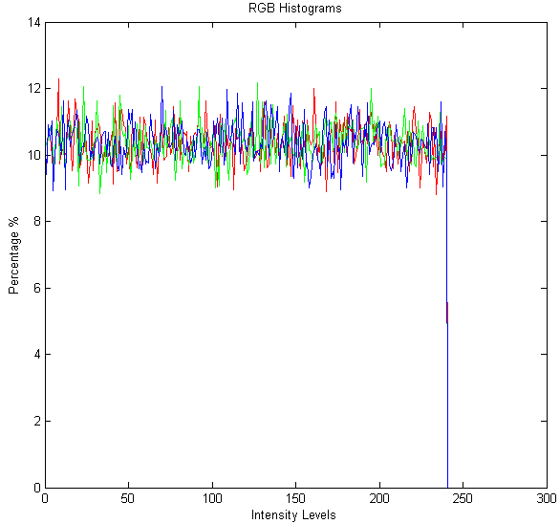
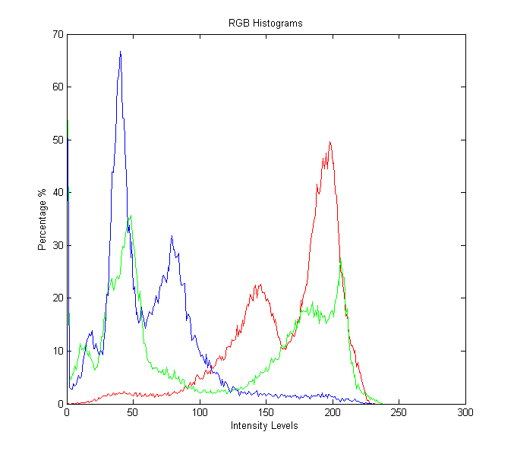
Experimental Results - Peppers
Original image
Shadow image1
Shadow image2
Shadow image3
Shadow image4
Shadow image5
Revealed image

Slide 27
Experimental Results
Sharing time and revealing time of three secret images
 | Sharing time (sec.) | Revealing time (sec.)
Baboon | 6.37 | 4.10
Lenna | 6.57 | 4.13
Peppers | 6.31 | 3.93

Slide 28
Conclusion
http://www.oldinsuranceguy.com/wp-content/uploads/2013/12/conclusion-diagram-in-blank.jpg

Slide 29
Conclusion
Based on Ulutas’s scheme, we proposed a secret image sharing method which uses color image as secret image and Chinese remainder theorem to reveal the secret image.
In our method, we can only reveal a distortion image. Generally speaking, naked eyes cannot distinguish the difference between the secret image and distortion image with only the difference of the least significant bit.

