Slide 1
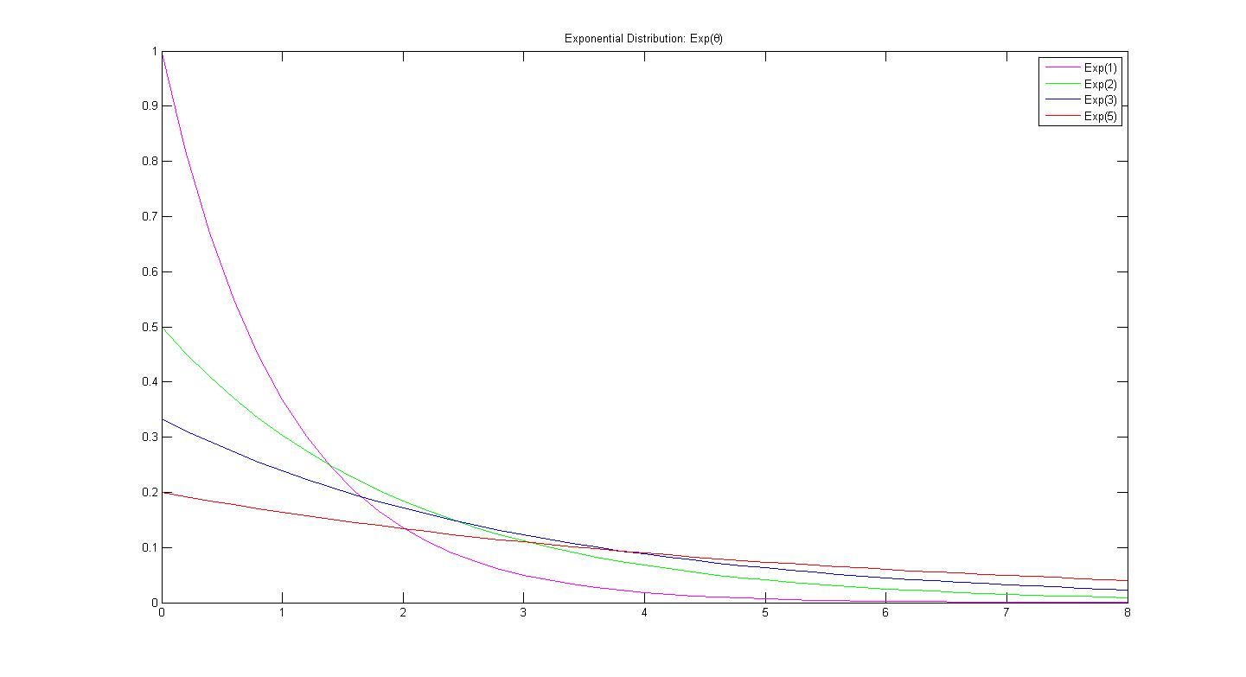
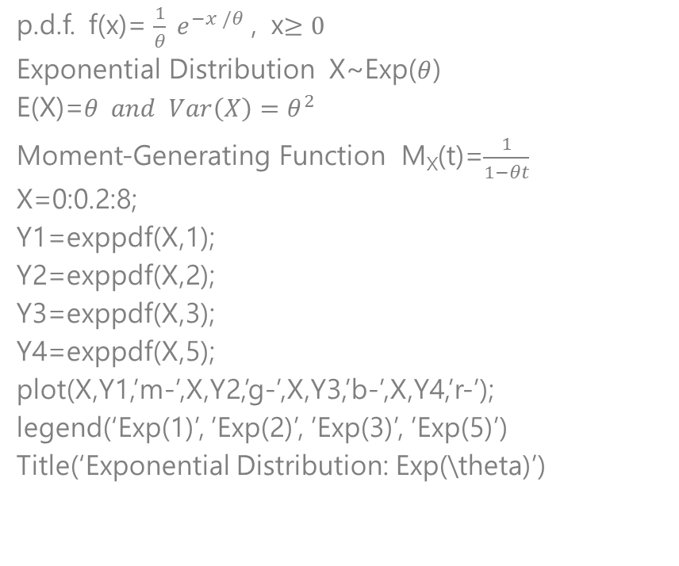
Exponential Distribution
p.d.f. f(x)= $\frac{1}{θ} e^{−x /θ}$ , x$≥0$
Exponential Distribution X~Exp($θ$)
E(X)=$θ and Var\left(X\right)=θ^{2}$
Moment-Generating Function M_{X}(t)=$\frac{1}{1−θt}$
X=0:0.2:8;
Y1=exppdf(X,1);
Y2=exppdf(X,2);
Y3=exppdf(X,3);
Y4=exppdf(X,5);
plot(X,Y1,’m-’,X,Y2,’g-’,X,Y3,’b-’,X,Y4,’r-’);
legend(‘Exp(1)’, ’Exp(2)’, ’Exp(3)’, ’Exp(5)’)
Title(‘Exponential Distribution: Exp(\theta)’)

Slide 2
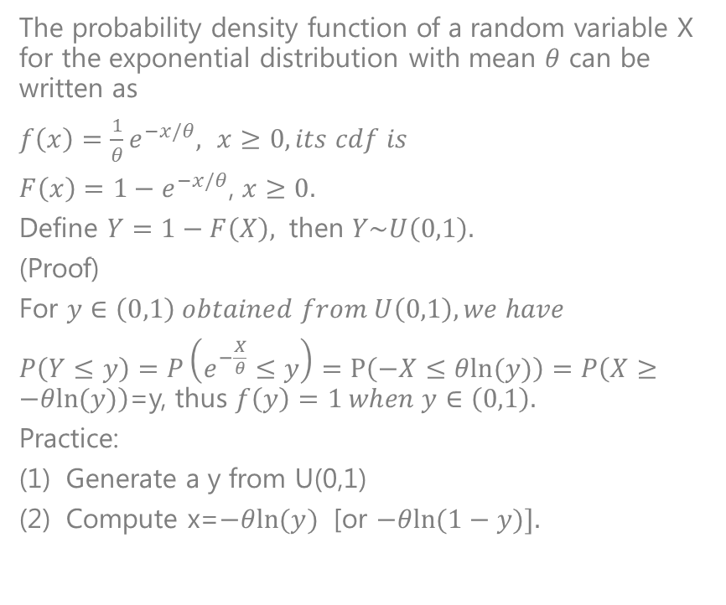

Simulate an exponential distribution with mean $θ$: Exp($θ$)
The probability density function of a random variable X for the exponential distribution with mean $θ$ can be written as
$f\left(x\right)=\frac{1}{θ}e^{−x/θ},$ $x≥0, its cdf is$
$F\left(x\right)=1−e^{−x/θ}$, $x≥0.$
Define $Y=1−F\left(X\right),$ then $Y\sim U\left(0,1\right).$
(Proof)
For $y∈\left(0,1\right) obtained from U\left(0,1\right), we have$
$P\left(Y≤y\right)=P\left(e^{−\frac{X}{θ}}≤y\right)=P\left(−X≤θln⁡(y)\right)=P\left(X≥−θln⁡(y)\right)$=y, thus $f\left(y\right)=1 when y∈\left(0,1\right).$
Practice:
Generate a y from U(0,1)
Compute x=$−θln⁡(y)$ [or $−θln⁡(1−y)].$
The probability density function of a random variable X for the exponential distribution with mean $θ$ can be written as
$f\left(x\right)=\frac{1}{θ}e^{−x/θ},$ $x≥0, its cdf is$
$F\left(x\right)=1−e^{−x/θ}$, $x≥0.$
Define $Y=1−F\left(X\right),$ then $Y\sim U\left(0,1\right).$
(Proof)
For $y∈\left(0,1\right) obtained from U\left(0,1\right), we have$
$P\left(Y≤y\right)=P\left(e^{−\frac{X}{θ}}≤y\right)=P\left(−X≤θln⁡(y)\right)=P\left(X≥−θln⁡(y)\right)$=y, thus $f\left(y\right)=1 when y∈\left(0,1\right).$
Practice:
Generate a y from U(0,1)
Compute x=$−θln⁡(y)$ [or $−θln⁡(1−y)].$

